Slide 1
Computer Organization and Assembly Languages
with slides by Kip Irvine

Slide 2
Prerequisites
Programming experience with some high-level language such C, C ++,Java …

Slide 3
Books
Textbook
Assembly Language for Intel-Based Computers, 4th, 5th, 6th Edition, Kip Irvine
Reference
The Art of Assembly Language, Randy Hyde

Slide 4
Grading (subject to change)
Assignments/Quizzes (20%)
Class participation (10%)
Midterm exam (30%)
Final Exam (40%)

Slide 5
Why learning assembly?
It is required.
It is foundation for computer architecture and compilers.
At times, you do need to write assembly code.
“I really don’t think that you can write a book for serious computer programmers unless you are able to discuss low-level details.”
Donald Knuth

Slide 6
Why programming in assembly?
It is all about lack of smart compilers
Faster code, compiler is not good enough
Smaller code , compiler is not good enough, e.g. mobile devices, embedded devices, also Smaller code → better cache performance → faster code
Unusual architecture , there isn’t even a compiler or compiler quality is bad, eg GPU, DSP chips, even MMX.

Slide 7
Syllabus (topics we might cover)
IA-32 Processor Architecture
Assembly Language Fundamentals
Data Transfers, Addressing, and Arithmetic
Procedures
Conditional Processing
Integer Arithmetic
Advanced Procedures
Strings and Arrays
Structures and Macros

Slide 8
What you will learn
Basic principle of computer architecture
IA-32 modes and memory management
Assembly basics
How high-level language is translated to assembly
How to communicate with OS

Slide 9
Chapter.1 Overview
Virtual Machine Concept
Data Representation
Boolean Operations

Slide 10
Assembly programming
mov eax, Y
add eax, 4
mov ebx, 3
imul ebx
mov X, eax
editor
.asm
assembler
debugger
.obj
linker
.exe
loader

Slide 11
Virtual machines
Abstractions for computers

Slide 12
High-Level Language
Level 5
Application-oriented languages
Programs compile into assembly language (Level 4)
X:=(Y+4)*3

Slide 13
Assembly Language
Level 4
Instruction mnemonics that have a one-to-one correspondence to machine language
Calls functions written at the operating system level (Level 3)
Programs are translated into machine language (Level 2)
mov eax, Y
add eax, 4
mov ebx, 3
imul ebx
mov X, eax

Slide 14
Operating System
Level 3
Provides services
Programs translated and run at the instruction set architecture level (Level 2)

Slide 15
Instruction Set Architecture
Level 2
Also known as conventional machine language
Executed by Level 1 program (microarchitecture, Level 1)

Slide 16
Microarchitecture
Level 1
Interprets conventional machine instructions (Level 2)
Executed by digital hardware (Level 0)

Slide 17
Digital Logic
Level 0
CPU, constructed from digital logic gates
System bus
Memory

Slide 18
Data representation
Computer is a construction of digital circuits with two states: on and off
You need to have the ability to translate between different representations to examine the content of the machine
Common number systems: binary, octal, decimal and hexadecimal

Slide 19
Binary numbers
Digits are 1 and 0
(a binary digit is called a bit)
1 = true
0 = false
MSB –most significant bit
LSB –least significant bit
Bit numbering:
A bit string could have different interpretations

Slide 20
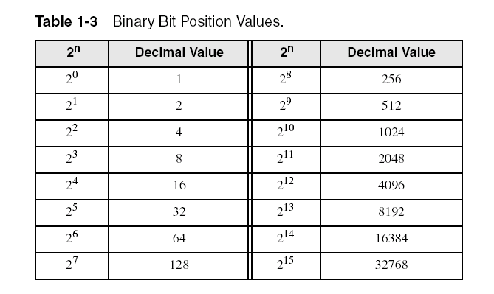
Unsigned binary integers
Each digit (bit) is either 1 or 0
Each bit represents a power of 2:
Every binary number is a sum of powers of 2

Slide 21
Translating Binary to Decimal
Weighted positional notation shows how to calculate the decimal value of each binary bit:
dec = (D_{n-1} × 2^{n-1}) + (D_{n-2} × 2^{n-2}) + ... + (D₁ × 2¹) + (D₀ × 2⁰)
D = binary digit
binary 00001001 = decimal 9:
(1 × 2³) + (1 × 2⁰) = 9

Slide 22
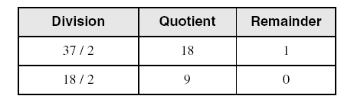
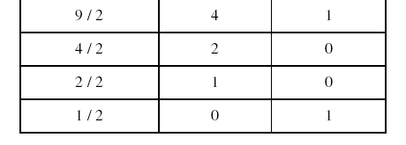
Translating Unsigned Decimal to Binary
Repeatedly divide the decimal integer by 2. Each remainder is a binary digit in the translated value:
37 = 100101

Slide 23
Binary addition
Starting with the LSB, add each pair of digits, include the carry if present.

Slide 24
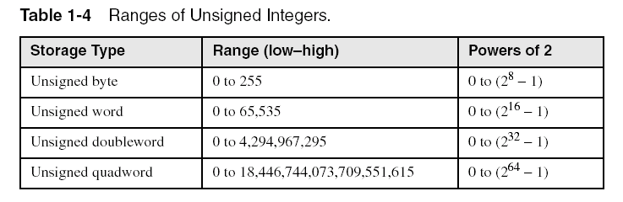
Integer storage sizes
Standard sizes:
Practice: What is the largest unsigned integer that may be stored in 20 bits?

Slide 25
Large measurements
Kilobyte (KB), 2¹⁰ bytes
Megabyte (MB), 2²⁰ bytes
Gigabyte (GB), 2³⁰ bytes
Terabyte (TB), 2⁴⁰ bytes
Petabyte
Exabyte
Zettabyte
Yottabyte

Slide 26
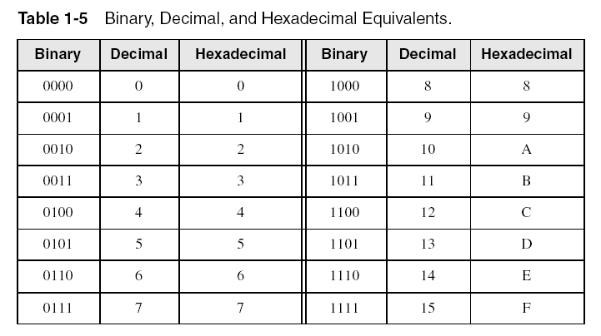
Hexadecimal integers
All values in memory are stored in binary. Because long binary numbers are hard to read, we use hexadecimal representation.

Slide 27

Translating binary to hexadecimal
Each hexadecimal digit corresponds to 4 binary bits.
Example: Translate the binary integer 000101101010011110010100 to hexadecimal:

Slide 28
Converting hexadecimal to decimal
Multiply each digit by its corresponding power of 16:
dec = (D₃ × 16³) + (D₂ × 16²) + (D₁ × 16¹) + (D₀ × 16⁰)
Hex 1234 equals (1 × 16³) + (2 × 16²) + (3 × 16¹) + (4 × 16⁰), or decimal 4,660.
Hex 3BA4 equals (3 × 16³) + (11 * 16²) + (10 × 16¹) + (4 × 16⁰), or decimal 15,268.

Slide 29
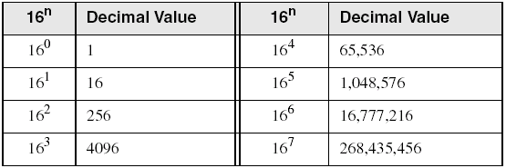
Powers of 16
Used when calculating hexadecimal values up to 8 digits long:

Slide 30
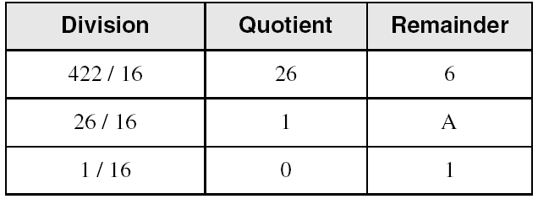
Converting decimal to hexadecimal
decimal 422 = 1A6 hexadecimal

Slide 31
Hexadecimal addition
Divide the sum of two digits by the number base (16). The quotient becomes the carry value, and the remainder is the sum digit.
1
1
36 28 28 6A
42 45 58 4B
78 6D 80 B5
Important skill: Programmers frequently add and subtract the addresses of variables and instructions.

Slide 32
Hexadecimal subtraction
When a borrow is required from the digit to the left, add 10h to the current digit's value:
−1
C6 75
A2 47
24 2E
Practice: The address of var1 is 00400020. The address of the next variable after var1 is 0040006A. How many bytes are used by var1?

Slide 33
Signed integers
The highest bit indicates the sign. 1 = negative, 0 = positive
If the highest digit of a hexadecmal integer is > 7, the value is negative. Examples: 8A, C5, A2, 9D

Slide 34
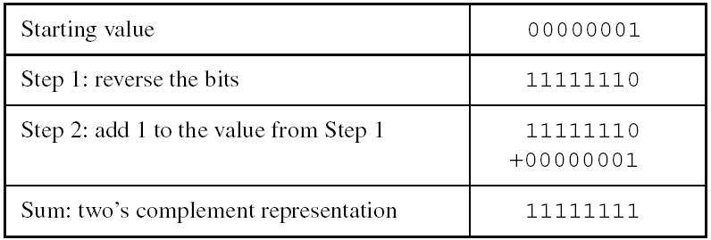
Two's complement notation
Steps:
Complement (reverse) each bit
Add 1
Note that 00000001 + 11111111 = 00000000

Slide 35
Binary subtraction
When subtracting A – B, convert B to its two's complement
Add A to (–B)
1 1 0 0 1 1 0 0
– 0 0 1 1 1 1 0 1
1 0 0 1
Advantages for 2’s complement:
No two 0’s
Sign bit
Remove the need for separate circuits for add and sub

Slide 36
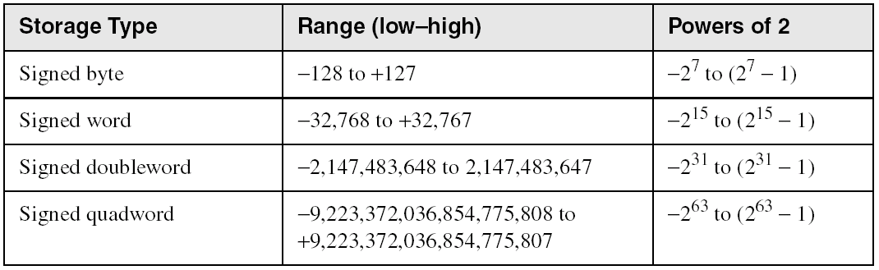
Ranges of signed integers
The highest bit is reserved for the sign. This limits the range:

Slide 37
Character
Character sets
Standard ASCII (0 – 127)
Extended ASCII (0 – 255)
ANSI (0 – 255)
Unicode (0 – 65,535)
Null-terminated String
Array of characters followed by a null byte
Using the ASCII table
back inside cover of book

Slide 38
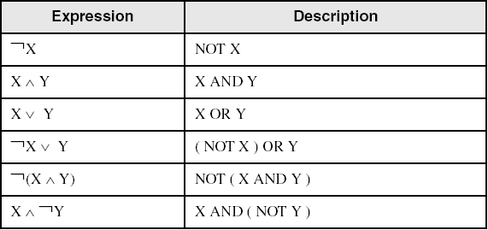
Boolean algebra
Boolean expressions created from:
NOT, AND, OR

Slide 39
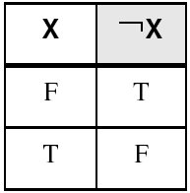
NOT
Inverts (reverses) a boolean value
Truth table for Boolean NOT operator:
Digital gate diagram for NOT:

Slide 40
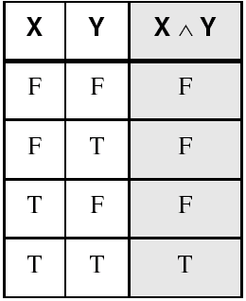
AND
Truth if both are true
Truth table for Boolean AND operator:
Digital gate diagram for AND:

Slide 41
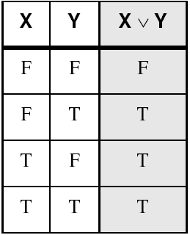
OR
True if either is true
Truth table for Boolean OR operator:
Digital gate diagram for OR:

Slide 42
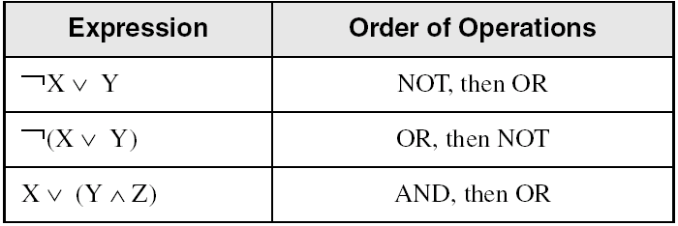
Operator precedence
NOT > AND > OR
Examples showing the order of operations:
Use parentheses to avoid ambiguity

Slide 43
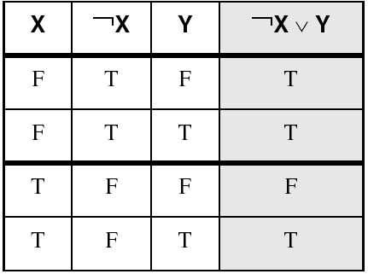
Truth Tables (1 of 3)
A Boolean function has one or more Boolean inputs, and returns a single Boolean output.
A truth table shows all the inputs and outputs of a Boolean function
Example: ¬X ∨ Y

Slide 44
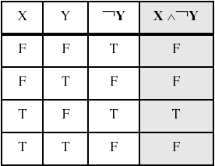
Truth Tables (2 of 3)
Example: X ∧ ¬Y

Slide 45
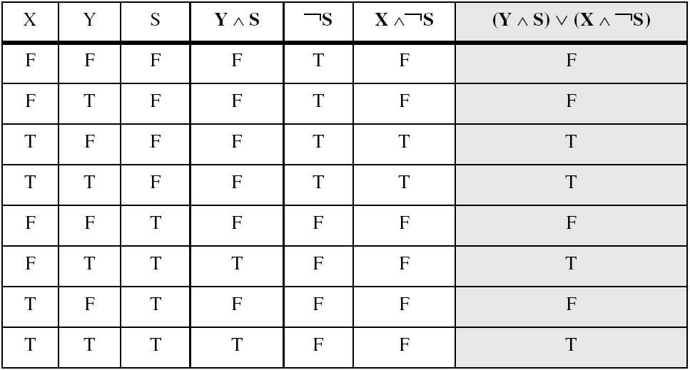
Truth Tables (3 of 3)
Example: (Y ∧ S) ∨ (X ∧ ¬S)
Two-input multiplexer

