Slide 1
IA-32 Architecture
Computer Organization and Assembly Languages
with slides by Kip Irvine and Keith Van Rhein

Slide 2
Virtual machines
Abstractions for computers

Slide 3
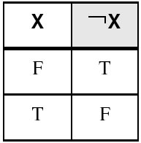
NOT
Inverts (reverses) a boolean value
Truth table for Boolean NOT operator:
Digital gate diagram for NOT:

Slide 4
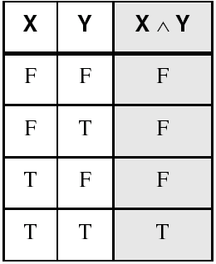
AND
Truth if both are true
Truth table for Boolean AND operator:
Digital gate diagram for AND:

Slide 5
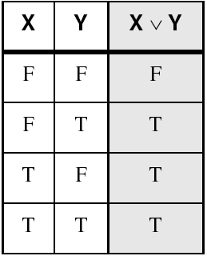
OR
True if either is true
Truth table for Boolean OR operator:
Digital gate diagram for OR:

Slide 6
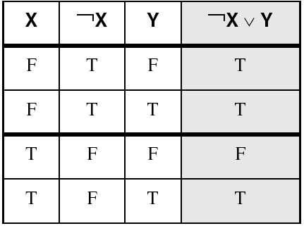
Truth tables
A Boolean function has one or more Boolean inputs, and returns a single Boolean output.
A truth table shows all the inputs and outputs of a Boolean function
Example: ¬X ∨ Y

Slide 7
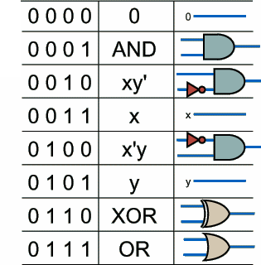
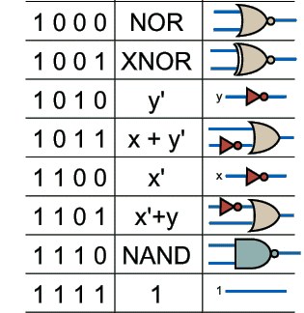
All possible 2-input Boolean functions

Slide 8
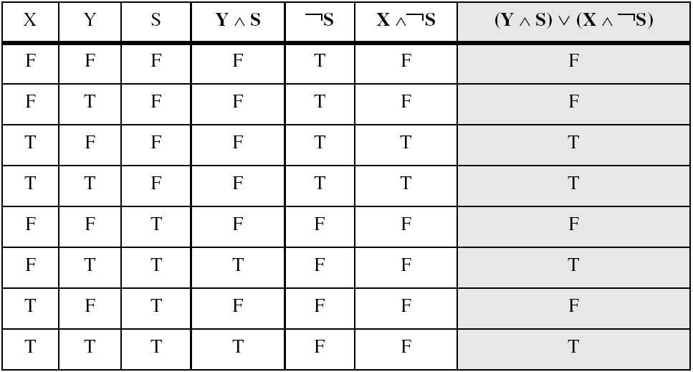
Truth tables
Example: (Y ∧ S) ∨ (X ∧ ¬S)
Two-input multiplexer

Slide 9
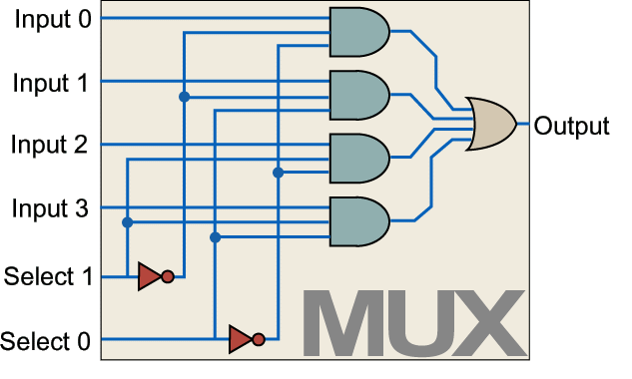
4-multiplexer
x₀
4MUX
x₁
z
x₂
x₃
s₀
s₁

Slide 10
4-multiplexer
x₀
2MUX
x₀
4MUX
x₁
x₁
z
2MUX
x₂
z
x₃
x₂
2MUX
x₃
s₀
s₁
s₀
s₁

Slide 11
Comparator
CMP
x>y
x=y
x<y
x
y
x
y
x>y
x=y
x<y

Slide 12
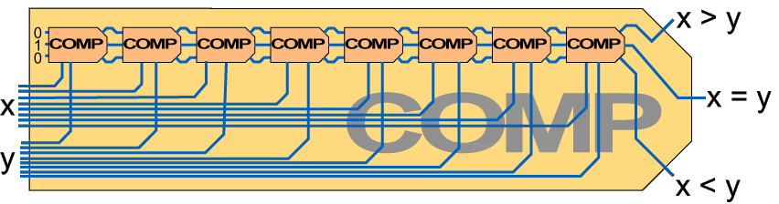
8-bit comparator
x_{n}>yn
CMP
x>y
xn=yn
x=y
xn<yn
x<y
x
y

Slide 13
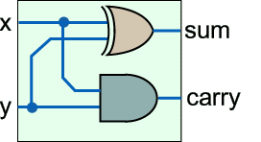
1-bit half adder
x
ADD
c
y
s
x
y
s
c

Slide 14
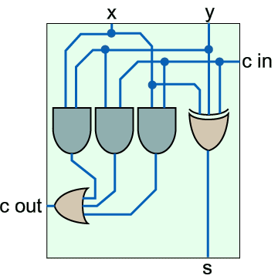
1-bit full adder
x
y
x
y
C_{in}
C_{out}
s
ADD
C_{in}
C_{out}
s

Slide 15
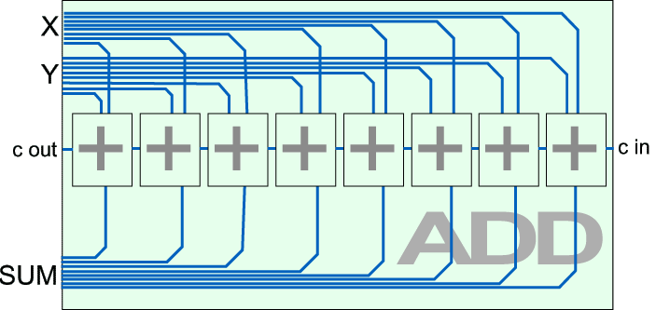
8-bit adder

Slide 16
Registers and counters
EN(RD)
EN(RD)
REG
IN
COUNTER
IN
OUT
OUT
SET
SET
INC
DEC
z₀
s₀
z₁
s₁
z₂
z₃

Slide 17
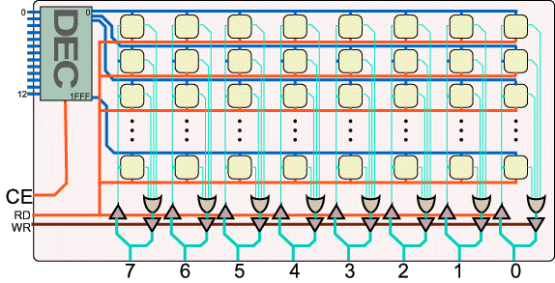
Memory
8K 8-bit memory

Slide 18
Microcomputer concept

Slide 19
Basic microcomputer design
clock synchronizes CPU operations
control unit (CU) coordinates sequence of execution steps
ALU performs arithmetic and logic operations

Slide 20
Basic microcomputer design
The memory storage unit holds instructions and data for a running program
A bus is a group of wires that transfer data from one part to another (data, address, control)

Slide 21
Clock
synchronizes all CPU and BUS operations
machine (clock) cycle measures time of a single operation
clock is used to trigger events
Basic unit of time, 1GHz→clock cycle=1ns
A instruction could take multiple cycles to complete, e.g. multiply in 8088 takes 50 cycles

Slide 22
Instruction execution cycle
program counter
instruction queue
Fetch
Decode
Fetch operands
Execute
Store output

Slide 23
A simple microcomputer
DATA BUS
IR
ACC
B
I/O
PORT
MEMORY
I/O
DEVICE
DECODE
PC
ALU
I/O
DEVICE
FLAG
CONTROL
AND
SEQUENCING
ADDRESS BUS
CONTROL BUS
CLOCK

Slide 24
Instruction set
OPCODE MNEMONIC OPCODE MNEMONIC
0 NOP A CMP
1 LDA B JG
2 STA C JE
3 ADD D JL
4 SUB
5 IN
6 OUT
7 JMP
8 JN
9 HLT
OPCODE
OPERAND
4
12

Slide 25
Control bus
A series of control signals to control all components such as registers and ALU
Control signal for load ACC:
SET_{ACC}=1, others=0

Slide 26
Control and sequencing unit
MEMORY
from decoder
PC_{RD}
MEM_{RD}
SET_{ACC}
μPC
…
CLOCK

Slide 27
Control and sequencing unit
PC_{RD}
MEM_{RD}
MEM_{WT}
IR_{SET}
….
0000
1
0
0
0
0….
fetch
0001
0
1
0
0
0002
0
0
0
1
decode
0003
4-bit IR RD
0004
DECODER RD, μPC SET
exec
0005
fetch
decode
000B

Slide 28
Decoder
4-bit opcode
0
5
1
B
μcode

