Slide 1
IA-32 Architecture
Computer Organization and Assembly Languages
with slides by Kip Irvine and Keith Van Rhein

Slide 2
Virtual machines
Abstractions for computers

Slide 3
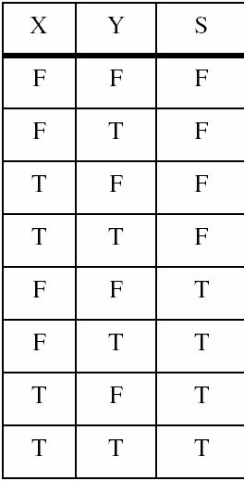
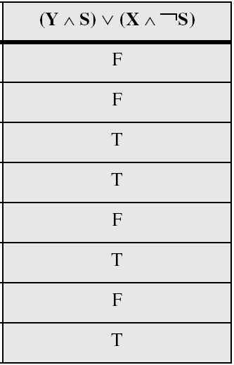
Truth tables
Example: (Y ∧ S) ∨ (X ∧ ¬S)
Two-input multiplexer

Slide 4
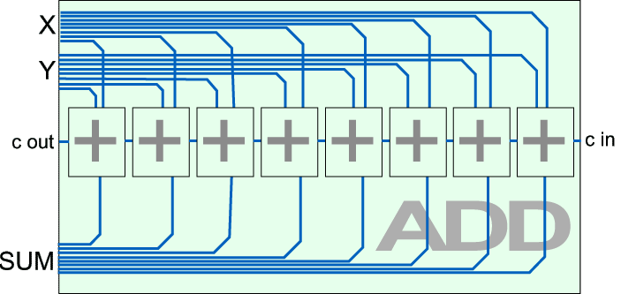
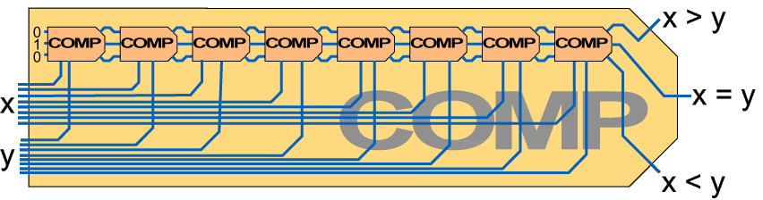
Combinational logic

Slide 5
Sequential logic
EN(RD)
EN(RD)
REG
COUNTER
IN
OUT
IN
OUT
WR
WR
INC
register
counter

Slide 6
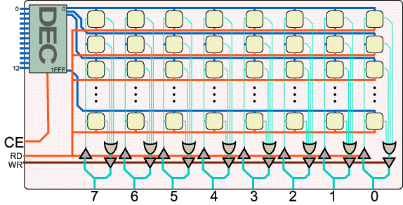
Memory
8K 8-bit memory

Slide 7
Virtual machines
Abstractions for computers

Slide 8
Instruction set
OPCODE MNEMONIC OPCODE MNEMONIC
0 NOP A CMP addr
1 LDA addr B JG addr
2 STA addr C JE addr
3 ADD addr D JL addr
4 SUB addr
5 IN port
6 OUT port
7 JMP addr
8 JN addr
9 HLT
OPCODE
OPERAND
4
12

Slide 9
Virtual machines
Abstractions for computers

Slide 10
Basic microcomputer design
clock synchronizes CPU operations
control unit (CU) coordinates sequence of execution steps
ALU performs arithmetic and logic operations

Slide 11
Basic microcomputer design
The memory storage unit holds instructions and data for a running program
A bus is a group of wires that transfer data from one part to another (data, address, control)

Slide 12
Clock
synchronizes all CPU and BUS operations
machine (clock) cycle measures time of a single operation
clock is used to trigger events
Basic unit of time, 1GHz→clock cycle=1ns
A instruction could take multiple cycles to complete, e.g. multiply in 8088 takes 50 cycles

Slide 13
Instruction execution cycle
program counter
instruction queue
Fetch
Decode
Fetch operands
Execute
Store output

Slide 14
A simple microcomputer
DATA BUS
IR
ACC
B
I/O
PORT
MEMORY
I/O
DEVICE
DECODE
PC
ALU
I/O
DEVICE
FLAG
CONTROL
AND
SEQUENCING
ADDRESS BUS
CONTROL BUS
CLOCK

Slide 15
ALU and Flag
X
Y
X
Y
X
Y
16
16
16
16
16
16
16-bit subtractor
16-bit adder
16-bit comparator
16
16
Z-
Z₊
C_{out}
X>Y
X=Y
X<Y
ALU_{OP}
0
2-MUX
1
00 NOP
01 CMP
10 ADD
11 SUB
ALU
16
Z₁₅
N
C
G
E
L
Flag
Z

Slide 16
Flags
FLAG_{RD}
N
C
G
E
L
0 1 2 3
4-MUX
FLAG_{OP}
PC_{WR}
WR
PC_{RD}
RD
PC
ADDRESS BUS
PC_{INC}
INC

Slide 17
Control signals (20 in total)
WR
RD
WR
RD
DATA BUS
RD
I/O
PORT
IR
ACC
B
MEMORY
WR
WR
INC
RD
RD
I/O
DEVICE
DECODE
PC
ALU
OP
RD
I/O
DEVICE
FLAG
CONTROL
AND
SEQUENCING
OP
WR
ADDRESS BUS
WR
RD
WR
RD
CONTROL BUS
CLOCK

Slide 18
LDA (execution cycle 1): IR_{RD}
DATA BUS
RD
I/O
PORT
IR
ACC
B
MEMORY
I/O
DEVICE
DECODE
PC
ALU
I/O
DEVICE
FLAG
CONTROL
AND
SEQUENCING
ADDRESS BUS
CONTROL BUS
CLOCK

Slide 19
LDA (execution cycle 2): MEM_{RD}
DATA BUS
IR
ACC
B
I/O
PORT
MEMORY
I/O
DEVICE
DECODE
PC
ALU
I/O
DEVICE
FLAG
CONTROL
AND
SEQUENCING
ADDRESS BUS
RD
CONTROL BUS
CLOCK

Slide 20
LDA (execution cycle 3): ACC_{WR}
WR
DATA BUS
IR
ACC
B
I/O
PORT
MEMORY
I/O
DEVICE
DECODE
PC
ALU
I/O
DEVICE
FLAG
CONTROL
AND
SEQUENCING
ADDRESS BUS
CONTROL BUS
CLOCK

Slide 21
ALU and Flag
X
Y
X
Y
X
Y
16
16
16
16
16
16
16-bit subtractor
16-bit adder
16-bit comparator
16
16
Z-
Z₊
C_{out}
X>Y
X=Y
X<Y
ALU_{OP}
0
2-MUX
1
00 NOP
01 CMP
10 ADD
11 SUB
ALU
16
Z₁₅
N
C
G
E
L
Flag
Z

Slide 22
ADD (execution cycle 1): IR_{RD}
DATA BUS
RD
I/O
PORT
IR
ACC
B
MEMORY
I/O
DEVICE
DECODE
PC
ALU
I/O
DEVICE
FLAG
CONTROL
AND
SEQUENCING
ADDRESS BUS
CONTROL BUS
CLOCK

Slide 23
ADD (execution cycle 2): MEM_{RD}
DATA BUS
IR
ACC
B
I/O
PORT
MEMORY
I/O
DEVICE
DECODE
PC
ALU
I/O
DEVICE
FLAG
CONTROL
AND
SEQUENCING
ADDRESS BUS
RD
CONTROL BUS
CLOCK

Slide 24
ADD (execution cycle 3): B_{WR}
WR
DATA BUS
IR
ACC
B
I/O
PORT
MEMORY
I/O
DEVICE
DECODE
PC
ALU
I/O
DEVICE
FLAG
CONTROL
AND
SEQUENCING
ADDRESS BUS
RD
CONTROL BUS
CLOCK

Slide 25
ADD (execution cycle 4): ALU₁₀,ACC_{WR}
WR
DATA BUS
IR
ACC
B
I/O
PORT
MEMORY
I/O
DEVICE
DECODE
PC
ALU
I/O
DEVICE
FLAG
CONTROL
AND
SEQUENCING
ADDRESS BUS
RD
CONTROL BUS
CLOCK

Slide 26
Flags
FLAG_{RD}
N
C
G
E
L
0 1 2 3
4-MUX
FLAG_{OP}
PC_{WR}
WR
PC_{RD}
RD
PC
ADDRESS BUS
PC_{INC}
INC

Slide 27
JMP (execution cycle 1): IR_{RD}
DATA BUS
RD
I/O
PORT
IR
ACC
B
MEMORY
I/O
DEVICE
DECODE
PC
ALU
I/O
DEVICE
FLAG
CONTROL
AND
SEQUENCING
ADDRESS BUS
CONTROL BUS
CLOCK

Slide 28
JMP (execution cycle 2): PC_{WR}
DATA BUS
IR
ACC
B
I/O
PORT
MEMORY
WR
I/O
DEVICE
DECODE
PC
ALU
I/O
DEVICE
FLAG
CONTROL
AND
SEQUENCING
ADDRESS BUS
CONTROL BUS
CLOCK

Slide 29
JG (execution cycle 1): IR_{RD},FLAG_{RD}
DATA BUS
RD
I/O
PORT
IR
ACC
B
MEMORY
I/O
DEVICE
DECODE
PC
ALU
RD
I/O
DEVICE
FLAG
CONTROL
AND
SEQUENCING
ADDRESS BUS
CONTROL BUS
CLOCK

Slide 30
JG (execution cycle 2): FLAG₀₁
DATA BUS
IR
ACC
B
I/O
PORT
MEMORY
I/O
DEVICE
DECODE
PC
ALU
I/O
DEVICE
FLAG
CONTROL
AND
SEQUENCING
OP
ADDRESS BUS
CONTROL BUS
CLOCK

Slide 31
Microcode sequence
LDA 510 PC_{RD}
MEM_{RD}
IR_{WR} PC_{INC}
IR_{RD}
DECODER_{RD}
μPC_{WR}
IR_{RD}
MEM_{RD}
ACC_{WR}
JMP 10 PC_{RD}
MEM_{RD}
IR_{WR} PC_{INC}
IR_{RD}
DECODER_{RD}
μPC_{WR}
IR_{RD}
PC_{WR}

Slide 32
Decoder
4-bit opcode
NOP
0
0000
μcode for LDA
LDA
1
0006
STA
2
000F
JMP
7
μcode for JMP

Slide 33
Control and sequencing unit
CONTROL
from decoder
PC_{RD}
MEM_{RD}
SET_{ACC}
WR
μPC
…
CLOCK

Slide 34
Control and sequencing unit
PC_{RD}
MEM_{RD}
MEM_{WR}
IR_{WR}
PC_{INC}
….
NOP
0000
1
0
0
0
0
0….
fetch
0001
0
1
0
0
0
0002
0
0
0
1
1
decode
0003
IR_{RD}
0004
DECODER_{RD}
0005
μPC_{WR}
LDA
fetch
decode
exec
0006
IR_{RD}
0007
MEM_{RD}
0008
ACC_{WR}
000F

Slide 35
Virtual machines
Abstractions for computers

Slide 36
X=min of X,Y,Z
int X=7; Y=2; Z=9;
if (X>Y) then
if (Y>Z) then
X=Z;
else
X=Y;
end
else
if (X<Z) then
X=Z;
end
end
.DATA
X 007
Y 002
Z 009
.CODE
LDA X
CMP Y
JG L1
CMP Z
JL L0
JMP END
L0 LDA Z
STA X
L1 LDA Y
CMP Z
JG L2
STA X
JMP END
L2 LDA Z
STA X
END HLT
compiler
else?

Slide 37
Virtual machines
Abstractions for computers

Slide 38
Memory layout
code segment
1K
data segment
3K

Slide 39
X=min of X,Y,Z
.DATA
X 007
Y 002
Z 009
.CODE
LDA X
CMP Y
JL L1
LDA Y
L1 CMP Z
JL L2
LDA Z
L2 STA X
HLT
.DATA
X 007
Y 002
Z 009
.CODE
LDA Y
CMP Z
JL L1
LDA Z
L1 CMP X
JG END
STA X
END HLT

Slide 40
X=min of X,Y,Z
.DATA
X 007
Y 002
Z 009
.CODE
LDA Y
CMP Z
JL L1
LDA Z
L1 CMP X
JG END
STA X
END HLT
X
400
Y
401
Z
402
1401
A402
D004
1402
A400
B007
2400
9000
0
1
2
L1
4
3
END
7
4
5
6
7

Slide 41
DATA BUS
IR
ACC
B
MEMORY
000
1401
LDA 401
CMP 402
JL 004
LDA 402
CMP 400
JG 007
STA 400
HLT
001
A402
002
D004
DECODE
003
1402
PC
ALU
004
A400
005
B007
006
2400
007
9000
FLAG
400
0007
CONTROL
AND
SEQUENCING
401
0002
402
0009
ADDRESS BUS
CONTROL BUS

Slide 42
Advanced architecture

Slide 43
Multi-stage pipeline
Pipelining makes it possible for processor to execute instructions in parallel
Instruction execution divided into discrete stages
Example of a non-pipelined processor. For example, 80386. Many wasted cycles.

Slide 44
Pipelined execution
More efficient use of cycles, greater throughput of instructions: (80486 started to use pipelining)
For k stages and n instructions, the number of required cycles is:
k + (n – 1)
compared to k*n

Slide 45
Wasted cycles (pipelined)
When one of the stages requires two or more clock cycles, clock cycles are again wasted.
For k stages and n instructions, the number of required cycles is:
k + (2n – 1)

Slide 46
Superscalar
A superscalar processor has multiple execution pipelines. In the following, note that Stage S4 has left and right pipelines (u and v).
For k states and n instructions, the number of required cycles is:
k + n
Pentium: 2 pipelines
Pentium Pro: 3

Slide 47
Reading from memory
Multiple machine cycles are required when reading from memory, because it responds much more slowly than the CPU. The four steps are:
address placed on address bus
Read Line (RD) set low
CPU waits one cycle for memory to respond
Read Line (RD) goes to 1, indicating that the data is on the data bus

Slide 48
Cache memory
High-speed expensive static RAM both inside and outside the CPU.
Level-1 cache: inside the CPU
Level-2 cache: outside the CPU
Cache hit: when data to be read is already in cache memory
Cache miss: when data to be read is not in cache memory. When? compulsory, capacity and conflict.
Cache design: cache size, n-way, block size, replacement policy

Slide 49
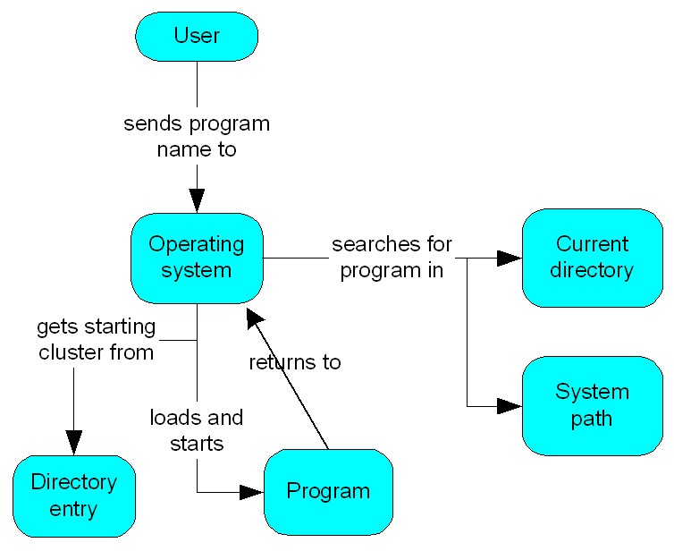
How a program runs

Slide 50
Multitasking
OS can run multiple programs at the same time.
Multiple threads of execution within the same program.
Scheduler utility assigns a given amount of CPU time to each running program.
Rapid switching of tasks
gives illusion that all programs are running at once
the processor must support task switching
scheduling policy, round-robin, priority

Slide 51
IA-32 Architecture

Slide 52
IA-32 architecture
From 386 to the latest 32-bit processor, P4
From programmer’s point of view, IA-32 has not changed substantially except the introduction of a set of high-performance instructions

Slide 53
Modes of operation
Protected mode
native mode (Windows, Linux), full features, separate memory
Real-address mode
native MS-DOS
System management mode
power management, system security, diagnostics
Virtual-8086 mode
hybrid of Protected
each program has its own 8086 computer

Slide 54
Addressable memory
Protected mode
4 GB
32-bit address
Real-address and Virtual-8086 modes
1 MB space
20-bit address

Slide 55
General-purpose registers
Named storage locations inside the CPU, optimized for speed.

Slide 56
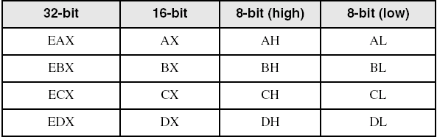
Accessing parts of registers
Use 8-bit name, 16-bit name, or 32-bit name
Applies to EAX, EBX, ECX, and EDX

Slide 57
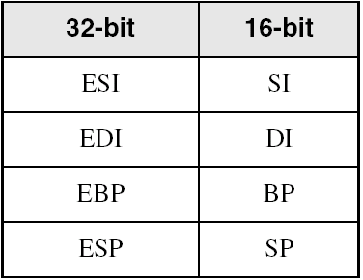
Index and base registers
Some registers have only a 16-bit name for their lower half. The 16-bit registers are usually used only in real-address mode.

Slide 58
Some specialized register uses (1 of 2)
General-Purpose
EAX – accumulator (automatically used by division and multiplication)
ECX – loop counter
ESP – stack pointer (should never be used for arithmetic or data transfer)
ESI, EDI – index registers (used for high-speed memory transfer instructions)
EBP – extended frame pointer (stack)

Slide 59
Some specialized register uses (2 of 2)
Segment
CS – code segment
DS – data segment
SS – stack segment
ES, FS, GS - additional segments
EIP – instruction pointer
EFLAGS
status and control flags
each flag is a single binary bit (set or clear)

Slide 60
Status flags
Carry
unsigned arithmetic out of range
Overflow
signed arithmetic out of range
Sign
result is negative
Zero
result is zero
Auxiliary Carry
carry from bit 3 to bit 4
Parity
sum of 1 bits is an even number

Slide 61
Floating-point, MMX, XMM registers
Eight 80-bit floating-point data registers
ST(0), ST(1), . . . , ST(7)
arranged in a stack
used for all floating-point arithmetic
Eight 64-bit MMX registers
Eight 128-bit XMM registers for single-instruction multiple-data (SIMD) operations

Slide 62
IA-32 Memory Management

Slide 63
Real-address mode
1 MB RAM maximum addressable (20-bit address)
Application programs can access any area of memory
Single tasking
Supported by MS-DOS operating system

Slide 64
Segmented memory
Segmented memory addressing: absolute (linear) address is a combination of a 16-bit segment value added to a 16-bit offset
one segment
linear addresses

Slide 65
Calculating linear addresses
Given a segment address, multiply it by 16 (add a hexadecimal zero), and add it to the offset
Example: convert 08F1:0100 to a linear address
Adjusted Segment value: 0 8 F 1 0
Add the offset: 0 1 0 0
Linear address: 0 9 0 1 0
A typical program has three segments: code, data and stack. Segment registers CS, DS and SS are used to store them separately.

Slide 66
Example
What linear address corresponds to the segment/offset address 028F:0030?
028F0 + 0030 = 02920
Always use hexadecimal notation for addresses.

Slide 67
Example
What segment addresses correspond to the linear address 28F30h?
Many different segment-offset addresses can produce the linear address 28F30h. For example:
28F0:0030, 28F3:0000, 28B0:0430, . . .

Slide 68
Protected mode (1 of 2)
4 GB addressable RAM (32-bit address)
(00000000 to FFFFFFFFh)
Each program assigned a memory partition which is protected from other programs
Designed for multitasking
Supported by Linux & MS-Windows

Slide 69
Protected mode (2 of 2)
Segment descriptor tables
Program structure
code, data, and stack areas
CS, DS, SS segment descriptors
global descriptor table (GDT)
MASM Programs use the Microsoft flat memory model

Slide 70
Multi-segment model
Each program has a local descriptor table (LDT)
holds descriptor for each segment used by the program
multiplied by
1000h

Slide 71
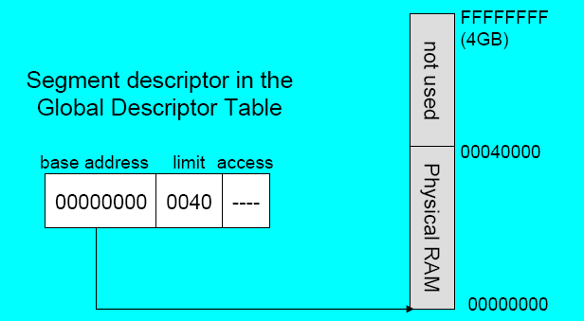
Flat segmentation model
All segments are mpped to the entire 32-bit physical address space, at least two, one for data and one for code
global descriptor table (GDT)

Slide 72
Paging
Virtual memory uses disk as part of the memory, thus allowing sum of all programs can be larger than physical memory
Divides each segment into 4096-byte blocks called pages
Page fault (supported directly by the CPU) – issued by CPU when a page must be loaded from disk
Virtual memory manager (VMM) – OS utility that manages the loading and unloading of pages

Slide 73
Components of an IA-32 microcomputer

Slide 74
Components of an IA-32 Microcomputer
Motherboard
Video output
Memory
Input-output ports

Slide 75
Motherboard
CPU socket
External cache memory slots
Main memory slots
BIOS chips
Sound synthesizer chip (optional)
Video controller chip (optional)
IDE, parallel, serial, USB, video, keyboard, joystick, network, and mouse connectors
PCI bus connectors (expansion cards)

Slide 76
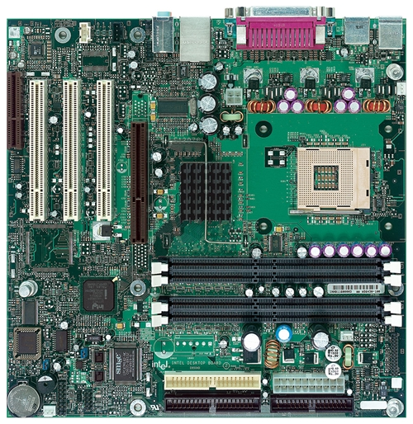
Intel D850MD motherboard
Video
mouse, keyboard, parallel, serial, and USB connectors
Audio chip
PCI slots
memory controller hub
Intel 486 socket
AGP slot
dynamic RAM
Firmware hub
I/O Controller
Speaker
Power connector
Battery
Diskette connector
Source: Intel® Desktop Board D850MD/D850MV Technical Product Specification
IDE drive connectors

Slide 77
Video Output
Video controller
on motherboard, or on expansion card
AGP (accelerated graphics port)
Video memory (VRAM)
Video CRT Display
uses raster scanning
horizontal retrace
vertical retrace
Direct digital LCD monitors
no raster scanning required

Slide 78
Memory
ROM
read-only memory
EPROM
erasable programmable read-only memory
Dynamic RAM (DRAM)
inexpensive; must be refreshed constantly
Static RAM (SRAM)
expensive; used for cache memory; no refresh required
Video RAM (VRAM)
dual ported; optimized for constant video refresh
CMOS RAM
refreshed by a battery
system setup information

Slide 79
Input-output ports
USB (universal serial bus)
intelligent high-speed connection to devices
up to 12 megabits/second
USB hub connects multiple devices
enumeration: computer queries devices
supports hot connections
Parallel
short cable, high speed
common for printers
bidirectional, parallel data transfer
Intel 8255 controller chip

Slide 80
Input-output ports (cont)
Serial
RS-232 serial port
one bit at a time
used for long cables and modems
16550 UART (universal asynchronous receiver transmitter)
programmable in assembly language

Slide 81
Intel microprocessor history

Slide 82
Early Intel microprocessors
Intel 8080
64K addressable RAM
8-bit registers
CP/M operating system
5,6,8,10 MHz
29K transistros
Intel 8086/8088 (1978)
IBM-PC used 8088
1 MB addressable RAM
16-bit registers
16-bit data bus (8-bit for 8088)
separate floating-point unit (8087)
used in low-cost microcontrollers now

Slide 83
The IBM-AT
Intel 80286 (1982)
16 MB addressable RAM
Protected memory
several times faster than 8086
introduced IDE bus architecture
80287 floating point unit
Up to 20MHz
134K transistors

Slide 84
Intel IA-32 Family
Intel386 (1985)
4 GB addressable RAM
32-bit registers
paging (virtual memory)
Up to 33MHz
Intel486 (1989)
instruction pipelining
Integrated FPU
8K cache
Pentium (1993)
Superscalar (two parallel pipelines)

Slide 85
Intel P6 Family
Pentium Pro (1995)
advanced optimization techniques in microcode
More pipeline stages
On-board L2 cache
Pentium II (1997)
MMX (multimedia) instruction set
Up to 450MHz
Pentium III (1999)
SIMD (streaming extensions) instructions (SSE)
Up to 1+GHz
Pentium 4 (2000)
NetBurst micro-architecture, tuned for multimedia
3.8+GHz
Pentium D (Dual core)

Slide 86
CISC and RISC
CISC – complex instruction set
large instruction set
high-level operations (simpler for compiler?)
requires microcode interpreter (could take a long time)
examples: Intel 80x86 family
RISC – reduced instruction set
small instruction set
simple, atomic instructions
directly executed by hardware very quickly
easier to incorporate advanced architecture design
examples:
ARM (Advanced RISC Machines)
DEC Alpha (now Compaq)

