Slide 1



Discrete Mathematics for
Computer Science
Department of Computer Science
Instructor: Dr. Ayesha Altaf
Reference Book: Discrete Mathematics and its applications BY Kenneth H. Rosen – 8th edition

Slide 2



Lecture 10
.
Chapter 2. Basic Structures
2.3 Functions

Slide 3


2.3 Functions
.
 From calculus, you are familiar with the concept of a real-valued function f,
which assigns to each number x∈R a value
y = f(x), where y∈R.
 But the notion of a function can also be naturally generalized to the concept of assigning elements of any set to elements of any set. (Also known as a map.)

Slide 4

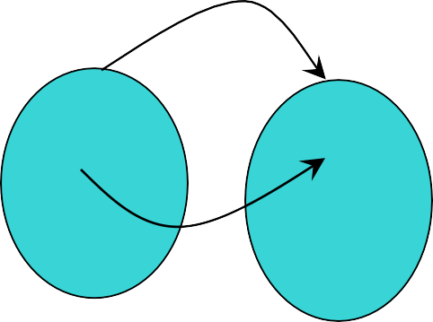
Function: Formal Definition
.
 For any sets A and B, we say that a function (or “mapping”) f from A to B (f : A → B) is a particular assignment of exactly one element f(x)∈B to each element x∈A.
 Functions can be represented graphically in several ways:
f
A
•
•
•
•
•
B
•
•
•
•
•
•
y
a
b
f
A
B
x
Plot
Like Venn diagrams
Bipartite Graph

Slide 5

Some Function Terminology .
 If it is written that f : A → B, and f(a) = b
(where a∈A and b∈B), then we say:
 A is the domain of f
 B is the codomain of f
 b is the image of a under f
 a can not have more than 1 image
 a is a pre-image of b under f
 b may have more than 1 pre-image
 The range R⊆B of f is R = {b | ∃a f(a) = b }

Slide 6
Range versus Codomain
.
 The range of a function might not be its whole codomain.
 The codomain is the set that the function is
declared to map all domain values into.
 The range is the particular set of values in the codomain that the function actually maps elements of the domain to.

Slide 7
Range vs. Codomain: Example
 Suppose I declare that: “f is a function mapping students in this class to the set of grades {A, B, C, D, F}.”
 At this point, you know f ’s codomain is:
_^{{A,}_^{B, C, D}_,_^{F}_}_, and its range is _unknown!
 Suppose the grades turn out all As and Bs.
 Then the range of f is _^{{A,}_^{B}} , but its codomain is _still {A,_B, C, D_, _F_}_!

Slide 8
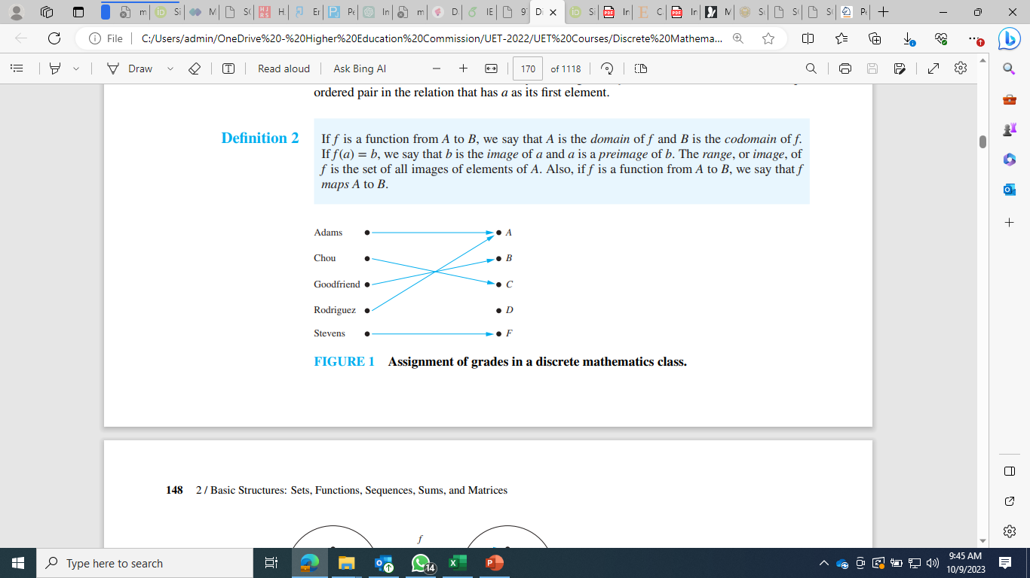

Slide 9
Function Operators
.
 + , × (“plus”,“times”) are binary operators over R. (Normal addition & multiplication.)
 Therefore, we can also add and multiply two
real-valued functions f,g: R → R:
 (f + g): R → R, where (f + g)(x) = f(x) + g(x)
 (fg): R → R, where (fg)(x) = f(x)g(x)
 Example 6:
Let f and g be functions from R to R such that f(x) = x² and g(x) = x – x². What are the functions f + g and fg?

Slide 10

Function Composition Operator
Note the match here. It’s necessary!
 For functions g: A → B and f : B → C, there is a special operator called compose (“◦”).
 It composes (creates) a new function from f and
g by applying f to the result of applying g.
 We say (f ◦ g): A → C, where (f ◦ g)(a) = f(g(a)).
 Note: f ◦ g cannot be defined unless range of g
is a subset of the domain of f.
 Note g(a)∈B, so f(g(a)) is defined and ∈C.
 Generally, f ◦ g ≠ g ◦ f.

Slide 11
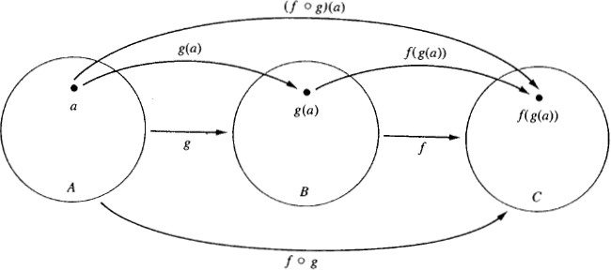
Function Composition
Illustration
 g: A → B, f : B → C
.

Slide 12

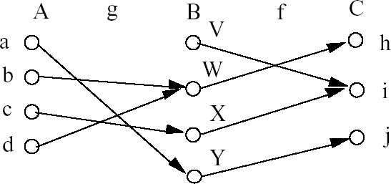
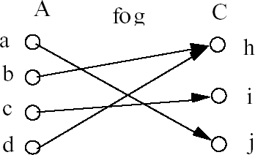
Function Composition:
Example
 g: A → B, f : B → C
.

Slide 13
Function Composition:
Example
.
 Example 20: Let g: {a, b, c} → {a, b, c} such that
g(a) = b, g(b) = c, g(c) = a.
Let f : {a, b, c} → {1, 2, 3} such that
f(a) = 3, f(b) = 2, f(c) = 1.
What is the composition of f and g, and what is the composition of g and f ?
 f◦g: {a, b, c} → {1, 2, 3} such that (f◦g)(a) = 2, (f◦g)(b) = 1, (f◦g)(c) = 3.
(f◦g)(a) = f(g(a)) = f(b) = 2
(f◦g)(b) = f(g(b)) = f(c) = 1
(f◦g)(c) = f(g(c)) = f(a) = 3
 g◦f is not defined (why?)

Slide 14

Function Composition:
Example
 If f(x) = x² and g(x) = 2x + 1, then what is the composition of f and g, and what is the composition of g and f ?
 (f◦g)(x) = f(g(x))
= f(2x+1)
= (2x+1)²
 (g◦f)(x) = g(f(x))
= g(x²)
= 2x² + 1
Note that f◦g ≠ g◦f. (4x²+4x+1 ≠ 2x²+1)
.

Slide 15
Images of Sets under Functions
 Given f : A → B, and S⊆A,
 The image of S under f is simply the set of all images (under f) of the elements of S.
f(S) = {f(t) | t∈S}
= {b | ∃t∈S: f(t) = b}.
 Note the range of f can be defined as simply the image (under f) of f ’s domain.
 Let A = {a, b, c, d, e} and B = {1, 2, 3, 4} with f (a) = 2, f (b) = 1, f (c) = 4, f (d) = 1, and f (e) = 1. The image of the subset S = {b, c, d} is the set f (S) = {1, 4}.

Slide 16

One-to-One Functions
.
 A function f is one-to-one (1–1), or injective, or an injection, iff f(a) = f(b) implies that a = b for all a and b in the domain of f (i.e. every element of its range has only 1 pre-image).
 Formally, given f : A→B,
“f is injective”: ∀a,b (f(a) = f(b) → a = b) or equivalently ∀a,b (a ≠ b → f(a) ≠ f(b))
 Only one element of the domain is mapped to any given one element of the range.
 Domain & range have the same cardinality.
What about codomain?

Slide 17

One-to-One Illustration
.
 Bipartite (2-part) graph representations of functions that are (or not) one-to-one:
•
•
•
•
•
•
•
•
•
•
•
•
•
•
•
•
•
•
•
•
•
•
•
•
•
•
•
One-to-one Not one-to-one Not even a function!
 Example 8:
Is the function f : {a, b, c, d} → {1, 2, 3, 4, 5} with
f(a) = 4, f(b) = 5, f(c) = 1, and f(d) = 3 one-to-one?
 Example 9:
Let f : Z → Z such that f(x) = x². Is f one-to-one?
NO

Slide 18
Sufficient Conditions for
1–1ness
 For functions f over numbers, we say:
 f is strictly (or monotonically) increasing
iff x > y → f(x) > f(y) for all x, y in domain;
 f is strictly (or monotonically) decreasing
iff x > y → f(x) < f(y) for all x, y in domain;
 If f is either strictly increasing or strictly decreasing, then f is one-to-one.
 E.g. x³
.

Slide 19
Onto (Surjective) Functions
.
 A function f : A → B is onto or surjective or a surjection iff for every element b∈B there is an element a∈A with f(a) = b (∀b∈B, ∃a∈A: f
(a) = b) (i.e. its range is equal to its codomain).
 Think: An onto function maps the set A onto (over, covering) the entirety of the set B, not just over a piece of it.

Slide 20
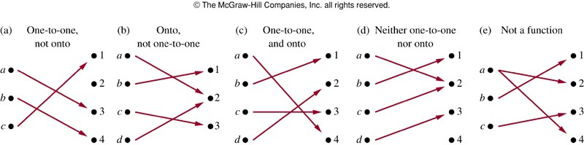
Illustration of Onto
.
 Some functions that are, or are not, onto their codomains:
 Example13: Is the function f(x) = x + 1 from the set of integers to the set of integers onto?

Slide 21
Bijections and Inverse Function
 A function f is said to be a one-to-one correspondence, or a bijection, or reversible, or invertible, iff it is both one-to-one and onto.
 Let f : A → B be a bijection.
The inverse function of f is the function that assigns to an element b∈B the unique element
a∈A such that f(a) = b.
The inverse function of f is denoted by f ⁻¹: B → A. Hence, f ⁻¹(b) = a when f(a) = b.

Slide 22
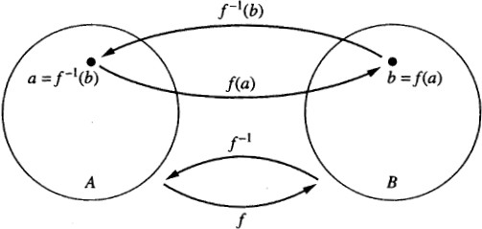
Inverse Function Illustration
.
 Let f: A → B be a bijection
 Example 16: Let f : {a, b, c} → {1, 2, 3} such that
f(a) = 2, f(b) = 3, f(c) = 1. Is f invertible, and if it is,
what is its inverse? Yes. f^{–1}(1) = c, f^{–1}(2) = a, f^{–1}(3) = b
 Example 18: Let f be the function from R to R with
f(x) = x². Is f invertible?
No. f is not a one-to-one function. So it’s not invertible.

Slide 23

The Identity Function
.
 For any domain A, the identity function I: A → A (also written as I_{A}, 1, 1_{A}) is the unique function such that ∀a∈A: I(a) = a.
 Note that the identity function is always both one-to-one and onto (i.e., bijective).
 For a bijection f : A → B and its inverse function f ⁻¹: B → A,
f ⁻¹ □ f = I
A
 Some identity functions you’ve seen:
 + 0, × 1, ∧ T, ∨ F, ∪ ∅, ∩ U.

Slide 24

Identity Function Illustrations.
 The identity function:
•
•
•
•
•
y
y = I(x) = x
•
•
•
•
Domain and range
x

Slide 25

Graphs of Functions
.
 We can represent a function f : A → B as a set of
ordered pairs {(a, f(a)) | a∈A}.
← The function’s graph.
 Note that ∀a∈A, there is only 1 pair (a, b).
 Later (ch.9): relations loosen this restriction.
 For functions over numbers, we can represent an ordered pair (x, y) as a point on a plane.
 A function is then drawn as a curve (set of points), with only one y for each x.

Slide 26
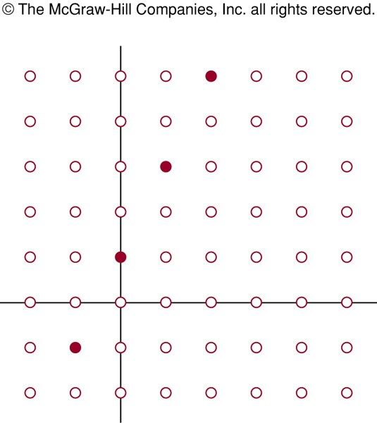
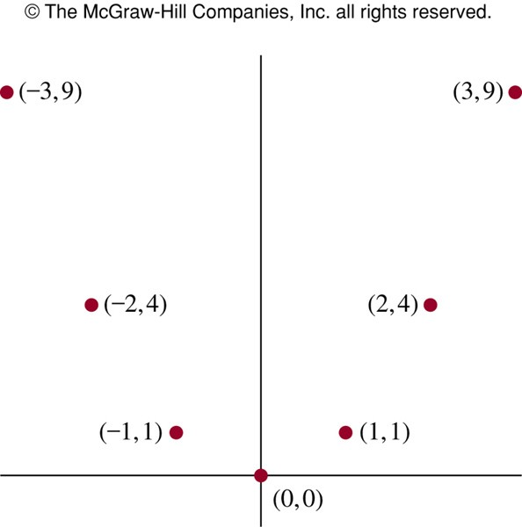
Graphs of Functions: Example s
The graph of f(n) = 2n + 1 from Z to Z
The graph of f(x) = x²
from Z to Z

Slide 27
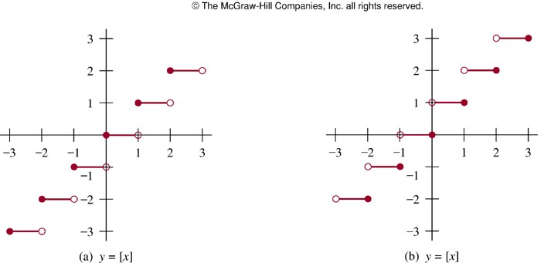
Plots with Floor/Ceiling:
Example
.
y = ⎣⎣ x⎦ ⎦
y = ⎡⎡x⎤⎤

Slide 28
Applications of Floor/Ceiling:
 Data stored on a computer disk or transmitted over a data network are usually represented as a string of bytes. Each byte is made up of 8 bits. How many bytes are required to encode 100 bits of data?
Solution: To determine the number of bytes needed, we determine the smallest integer that is at least as large as the quotient when 100 is divided by 8, the number of bits in a byte. Consequently, 100/8 = 12.5 = 13 bytes are required.
.

Slide 29
QUIZ
 For each of these arguments, explain which rules of inference are used for each step.
“Each of five roommates, Melissa, Aaron, Ralph, Veneesha, and Keeshawn, has taken a course in discrete mathematics. Every student who has taken a course in discrete mathematics can take a course in algorithms. Therefore, all five roommates can take a course in algorithms next year.”
 What rule of inference is used in each of these arguments?
Sir Nazeef is teaching DM. So it concludes that either sir Nazeef is teaching DM or he is from computer science department.
If it is Monday today, then there department will close . The department is not closed today. Therefore, it’s not Monday today.
.

