Slide 1
Breast Cancer Detection Using Decision Trees
Prepared by:
Abdul Haseeb
Nouman Zahid

Slide 2
Project Overview
Evaluation:
Accuracy comparison across different feature engineering approaches

Slide 3
Dataset Information
Feature Categories:
• Mean values (10 features): radius, texture, perimeter, area, etc.
• Standard error values (10 features)
• Worst values (10 features)

Slide 4
Methodology
Three-Approach Comparison:
1. Full Feature Set (30 features)
  - Train decision tree on all original features
2. Reduced Feature Set (correlated features removed)
  - Remove highly correlated features (>0.35 correlation)
  - Reduce dimensionality while maintaining information
3. PCA Features (10 principal components)
  - Apply PCA to reduce from 30 to 10 dimensions
  - Capture maximum variance in fewer components

Slide 5
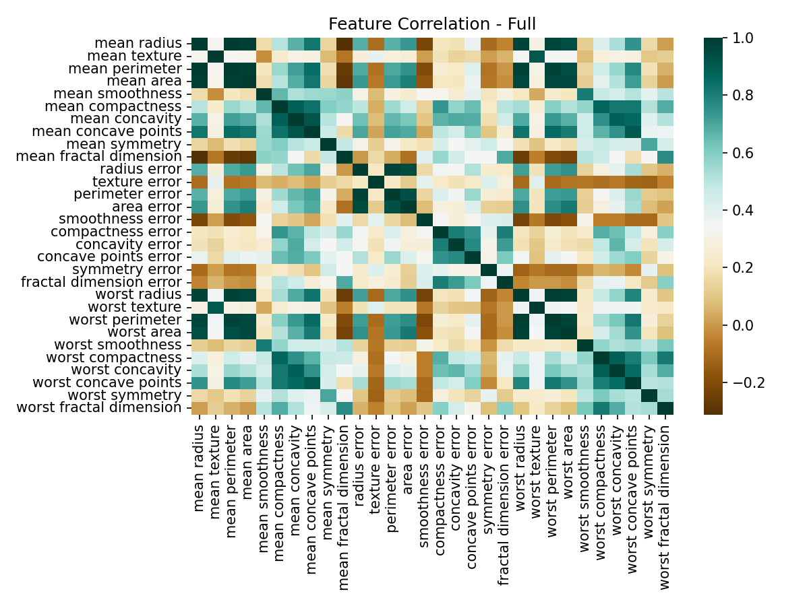
Feature Correlation Analysis
Benefits:
• Reduces model complexity and training time
• Prevents overfitting due to redundant features
• Improves model interpretability

Slide 6
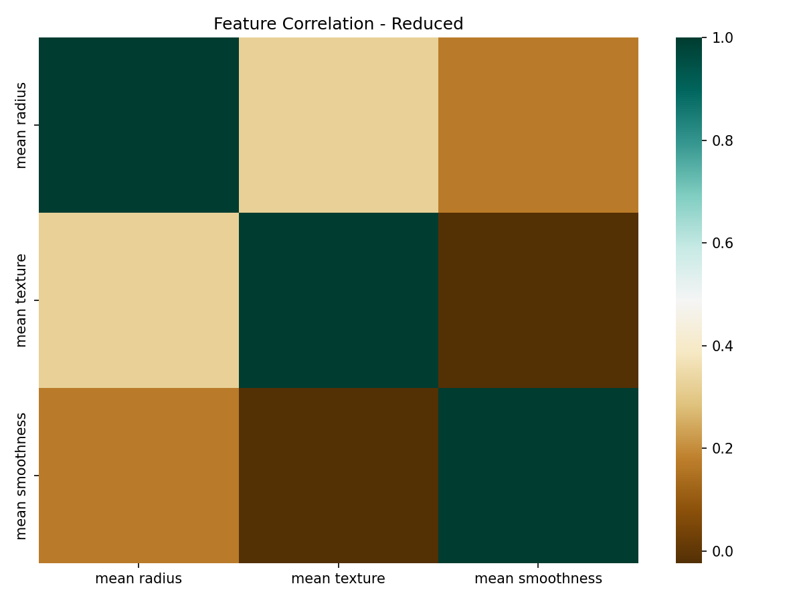
Feature Reduction Results
Feature Reduction Impact:
• Original dataset: 30 features
• Features removed: Highly correlated pairs (>0.35)
• Reduced dataset: Variable size (maintains most information)
• Goal: Balance between dimensionality reduction and information retention

Slide 7
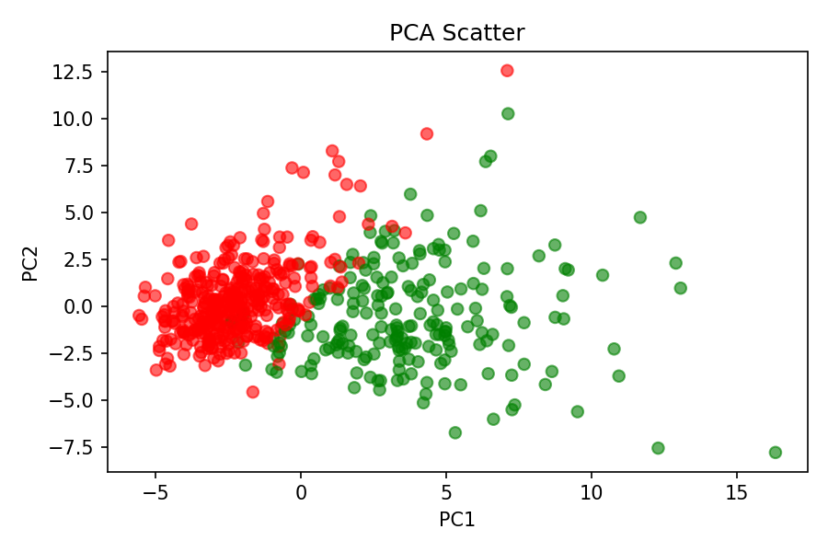
Principal Component Analysis (PCA)
PCA Benefits:
• Significant dimensionality reduction (30 → 10 features)
• Captures maximum variance in fewer dimensions
• Removes noise and redundant information

Slide 8
Model Training
Training Approaches:
1. Full Features: All 30 original features
2. Reduced Features: Correlated features removed
3. PCA Features: 10 principal components

Slide 9
Performance Comparison
Key Findings:
• All approaches achieve high accuracy (>90%)
• Full feature set performs slightly better
• Reduced features maintain good performance with fewer dimensions
• PCA provides good dimensionality reduction with minimal accuracy loss

Slide 10
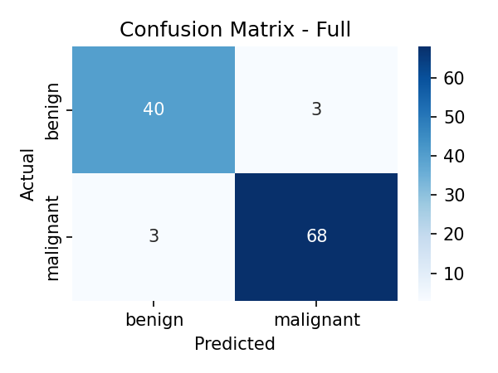
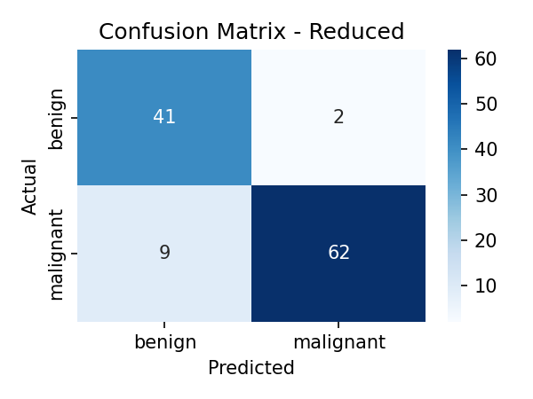
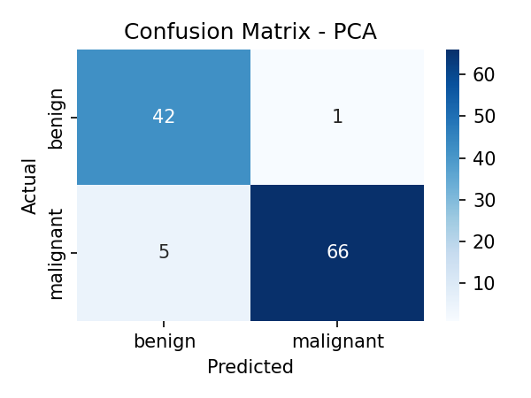
Detailed Results & Visualizations
Confusion Matrix Analysis:
• Full Features: High true positive and true negative rates
• Reduced Features: Minimal performance degradation
• PCA Features: Good performance with significant dimensionality reduction

Slide 11
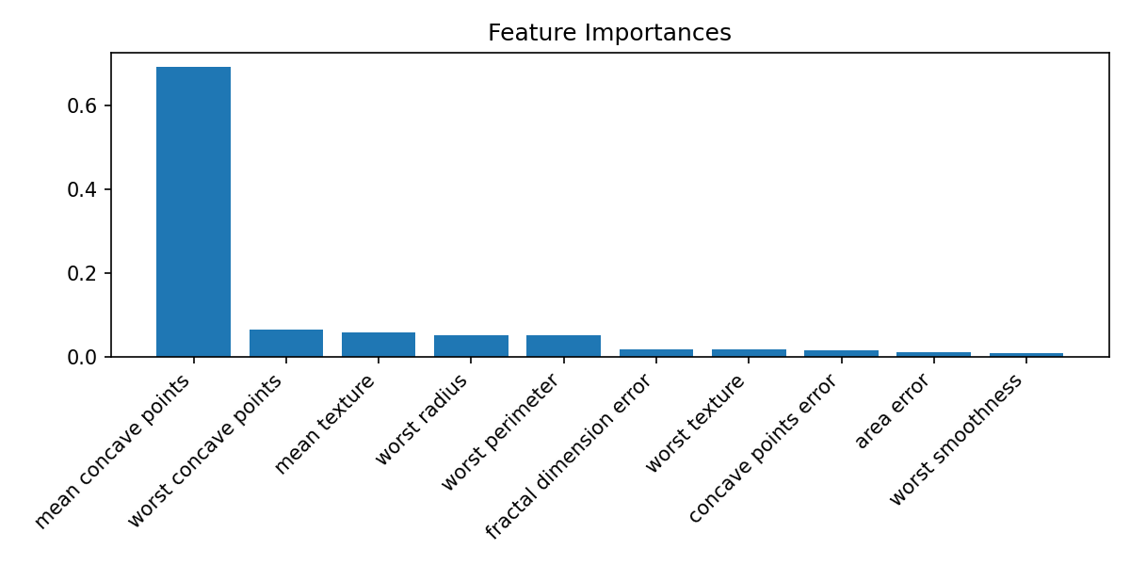
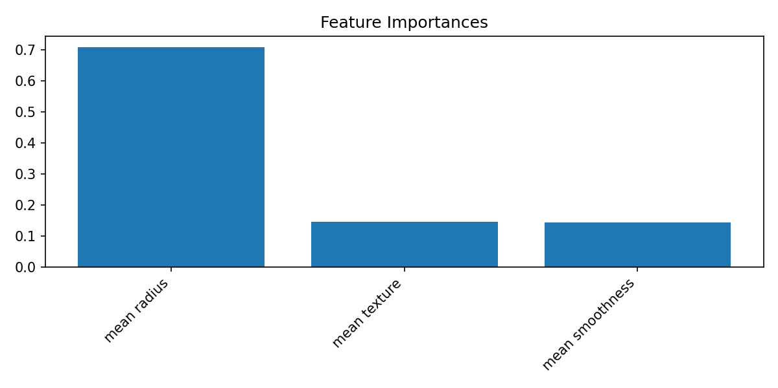
Feature Importance Analysis
Feature Importance Insights:
• Most important features vary across different approaches
• Full features: Original feature importance ranking
• Reduced features: Remaining features show clear importance
• PCA: Components show distributed importance across original features

Slide 12
Conclusion
Future Work:
• Explore ensemble methods (Random Forest, Gradient Boosting)
• Implement cross-validation for more robust evaluation
• Consider deep learning approaches for comparison

