Slide 1
KNN Classification on Diabetes Dataset
Submitted BY
Abdul Haseeb
Nouman Zahid

Slide 2
Problem Statement
Predict diabetes presence using physiological measurements
Binary classification task with 8 features
Evaluate KNN performance across different k values
Identify optimal neighborhood size for best accuracy

Slide 3
Dataset Overview
Total samples: 768
Features: 8
Target classes: 2
No Diabetes: 500
Diabetes: 268
Features include glucose, blood pressure, BMI, age, etc.

Slide 4
Dataset Schema
Feature | Type | Min | Max
Pregnancies | int64 | 0 | 17
Glucose | int64 | 0 | 199
BloodPressure | int64 | 0 | 122
SkinThickness | int64 | 0 | 99
Insulin | int64 | 0 | 846
BMI | float64 | 0.0 | 67.1
DiabetesPedigreeFunction | float64 | 0.078 | 2.42
Age | int64 | 21 | 81
Feature types and value ranges in the diabetes dataset

Slide 5
Methodology
Data split: 80% training, 20% testing (random_state=42)
Feature standardization using StandardScaler
KNN classifier with k values from 1 to 20
Model selection based on highest test accuracy
Performance evaluation using accuracy, precision, recall, F1-score

Slide 6
K-Nearest Neighbors Algorithm
Distance metric: Euclidean distance
d(p, q) = √[(p₁ - q₁)² + (p₂ - q₂)² + ... + (pₙ - qₙ)²]
Prediction: Majority vote from k nearest neighbors
ŷ = argmax_c ∑_{i=1}^k [yᵢ = c]

Slide 7
Accuracy vs K Value
K | Accuracy
1 | 0.6233766233766234
2 | 0.6558441558441559
3 | 0.7077922077922078
4 | 0.7012987012987013
5 | 0.6948051948051948
6 | 0.7012987012987013
7 | 0.6818181818181818
8 | 0.7077922077922078
9 | 0.6818181818181818
10 | 0.6883116883116883
11 | 0.7077922077922078
12 | 0.7207792207792207
13 | 0.7077922077922078
14 | 0.7272727272727273
15 | 0.7207792207792207
16 | 0.7467532467532467
17 | 0.7532467532467533
18 | 0.7597402597402597
19 | 0.7597402597402597
20 | 0.7597402597402597
Test accuracy for different k values (best k=18, accuracy=0.760)

Slide 8
Best Model Results
Optimal k value: 18
Best test accuracy: 0.760
Final test accuracy: 0.760
Confusion Matrix and Classification Report available
Performance improves with moderate k values (avoiding overfitting)

Slide 9
Classification Report Summary
Macro Average Precision: 0.748
Macro Average Recall: 0.708
Macro Average F1-Score: 0.718
Weighted Average F1-Score: 0.749
Balanced performance across both classes

Slide 10
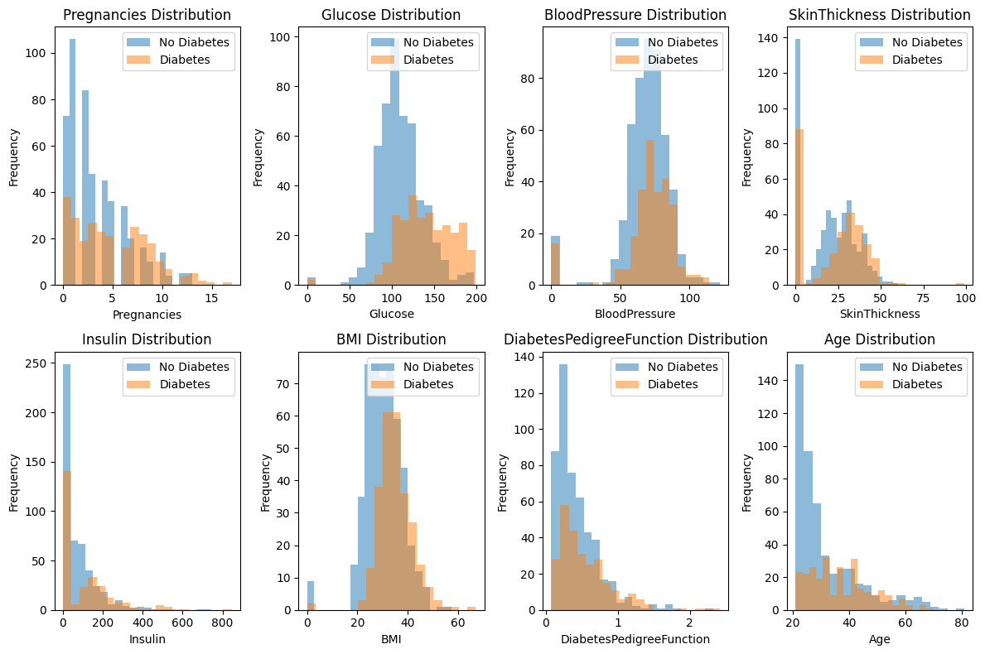
Visualization 1: {column} Distribution
{column} Distribution

Slide 11
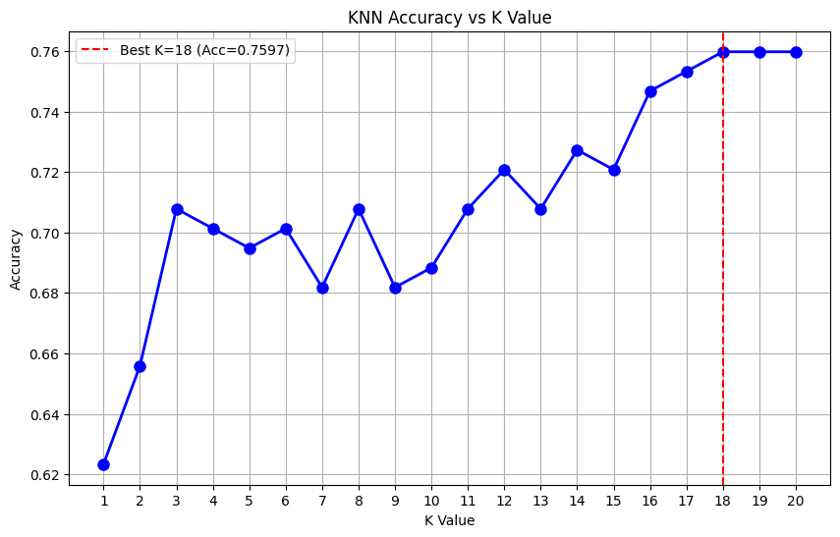
Visualization 2: KNN Accuracy vs K Value
KNN Accuracy vs K Value

Slide 12
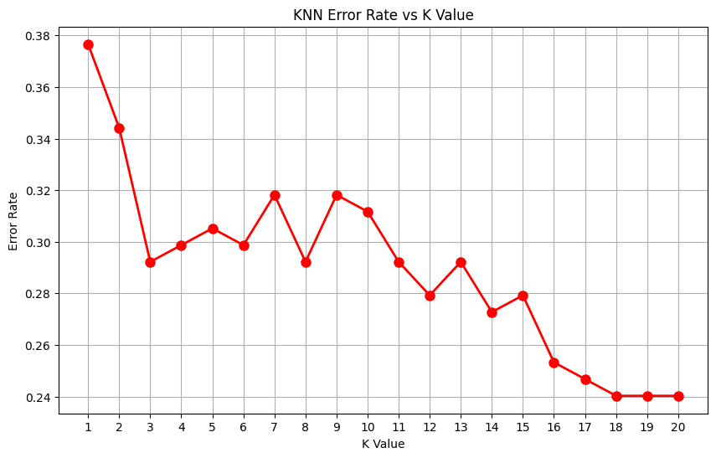
Visualization 3: KNN Error Rate vs K Value
KNN Error Rate vs K Value

Slide 13
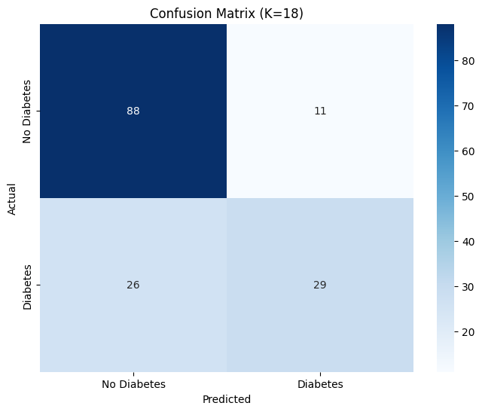
Visualization 4: Confusion Matrix (K={best_k})
Confusion Matrix (K={best_k})

Slide 14
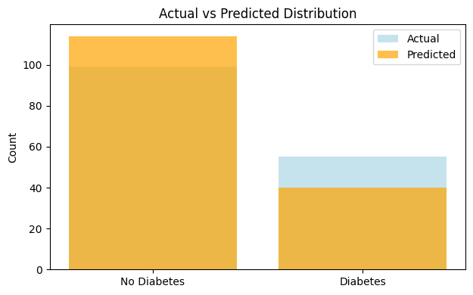
Visualization 5: Actual vs Predicted Distribution
Actual vs Predicted Distribution

Slide 15
Discussion and Insights
Best performance at k=18 with 76.0% accuracy
Moderate k values provide good balance between bias and variance
Feature standardization crucial for distance-based algorithm
Class imbalance may affect sensitivity to minority class
Further optimization could include feature selection or ensemble methods

Slide 16
References
scikit-learn: KNeighborsClassifier documentation
scikit-learn: StandardScaler documentation
Pima Indians Diabetes Database - Kaggle
Machine Learning fundamentals and evaluation metrics

