Slide 1
K-Means Clustering Analysis of Facebook Live Video Engagement
A Machine Learning Approach to Understanding Social Media Engagement Patterns
Prepared by: Abdul Haseeb & Nouman Zahid
Date: September 28, 2025

Slide 2
Introduction
Problem Statement:
Social media platforms generate massive engagement data daily
Understanding user engagement patterns is crucial for content creators
Need to identify natural groupings in Facebook Live video metrics
Objectives:
Apply K-means clustering to identify engagement patterns
Determine optimal number of clusters using quantitative methods
Analyze cluster characteristics for content strategy insights

Slide 3
Dataset Description
Data Source:
Facebook Live video engagement metrics
7,052 records from various Facebook pages
Engagement metrics: reactions, comments,
shares, likes
Data Structure:
status_id: Unique video identifier
status_type: Content type (video/photo)
num_reactions: Total reaction count
num_comments: Total comment count
num_shares: Total share count
num_likes: Like reaction count
Preprocessing:
Removed missing values
Selected 4 key engagement features
Applied feature standardization
Feature | Description
num_reactions | Total reactions
num_comments | Total comments
num_shares | Total shares
num_likes | Total likes
status_type | Content type

Slide 4
Methodology
K-Means Clustering Algorithm:
Unsupervised machine learning algorithm
Partitions observations into k clusters
Minimizes within-cluster sum of squares
Iterative process: assign → update centers → repeat
Feature Selection:
Selected 4 engagement metrics
Standardized using StandardScaler
Ensures equal contribution to distance calculations
Elbow Method:
Determines optimal number of clusters
Plots inertia vs. number of clusters (k)
Identifies "elbow" point where improvement diminishes

Slide 5
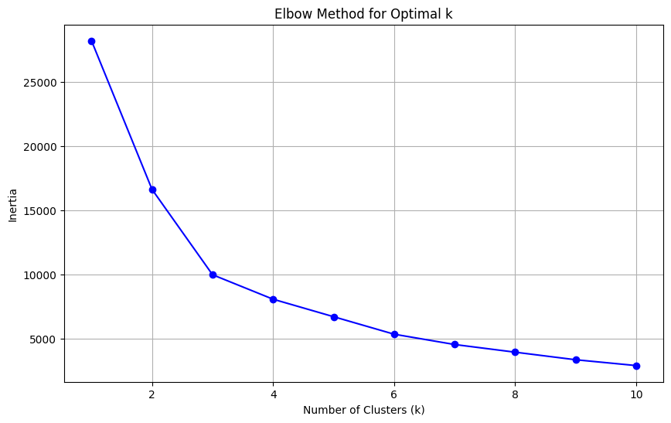
Results - Elbow Method
Elbow Method Analysis:
Tested k values from 1 to 10
Optimal k = 4 identified
Clear elbow at k=4
Beyond k=4, improvement diminishes
Cluster Distribution:
Cluster 0: 6,130 samples (87.0%)
Cluster 1: 395 samples (5.6%)
Cluster 2: 71 samples (1.0%)
Cluster 3: 454 samples (6.4%)

Slide 6
Results - Cluster Analysis
Cluster Characteristics:
Cluster 0 (Low Engagement):
• Average reactions: 106
• Average comments: 54
• Average shares: 11
• Average likes: 100
Cluster 1 (High Likes):
• Average reactions: 1,784
• Average comments: 75
• Average shares: 16
• Average likes: 1,774
Cluster 2 (High Comments & Shares):
• Average reactions: 789
• Average comments: 6,565
• Average shares: 754
• Average likes: 596
Cluster | Reactions | Comments | Shares | Likes
Cluster 0
Cluster 1
Cluster 2
Cluster 3

Slide 7
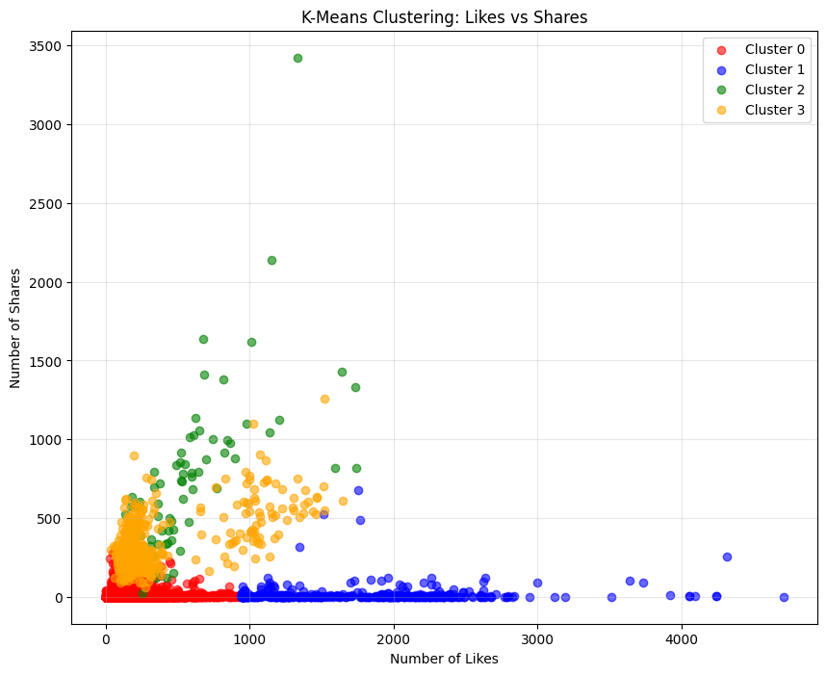
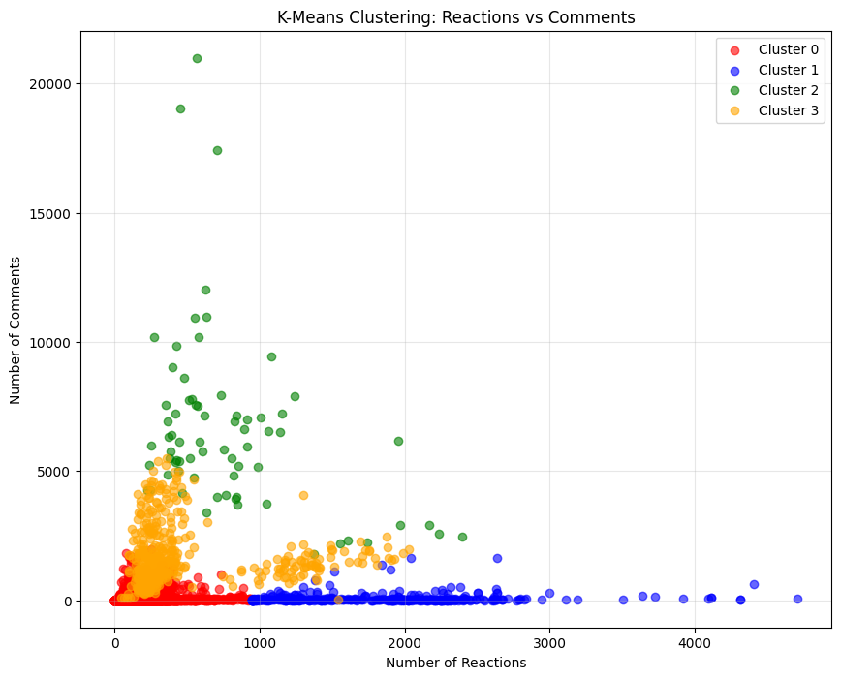
Results - Visualizations
Reactions vs Comments:
Clear separation between clusters
High-engagement cluster shows distinct pattern
Low-engagement cluster forms main group
Likes vs Shares:
Similar clustering patterns observed
Different engagement types visible
Cluster 2 shows high comments/shares correlation

Slide 8
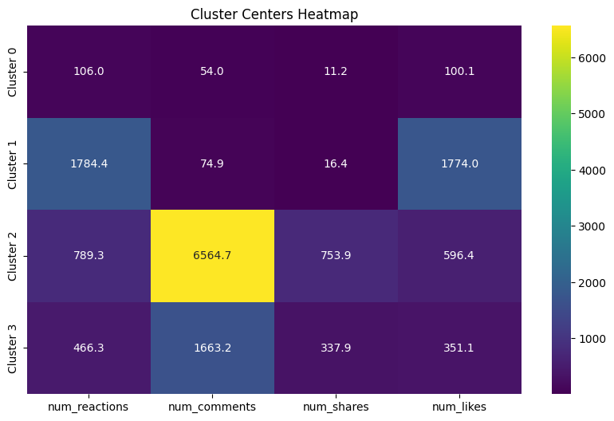
Results - continued
Heatmap Insights:
• Visual representation of cluster centers
• Easy interpretation of engagement patterns
• Color-coded intensity shows relative values

Slide 9
Conclusion and Future Work
Key Findings:
Successfully identified 4 distinct engagement patterns
Cluster 0: Low engagement (87% of data)
Cluster 1: High likes-focused engagement
Cluster 2: High comments and shares
Cluster 3: Very high overall engagement
Business Insights:
Content creators can target specific engagement types
Different strategies needed for different audience segments
High-engagement content identified for optimization
Future Work:
Incorporate temporal features (time, duration)
Text analysis of video description
Real-time clustering for live recommendations

Slide 10
References
[1] MacQueen, J. (1967). Some methods for classification and analysis of multivariate observations.
Proceedings of the fifth Berkeley symposium on mathematical statistics and probability.
[2] Syakur, M. A., et al. (2018). Integration k-means clustering method and elbow method for
identification of the best customer profile cluster.
IOP Conference Series: Materials Science and Engineering.
[3] Prashant111. (2021). K-Means Clustering with Python. Kaggle.
https://www.kaggle.com/code/prashant111/k-means-clustering-with-python/notebook
[4] Facebook Live Video Dataset. Retrieved from various sources.
Contains engagement metrics for social media analysis.

Slide 11
Thank You
Questions?
Contact Information:
Data Science Student
This presentation demonstrates the application of K-means clustering
for analyzing Facebook Live video engagement patterns.
Key takeaway: Data-driven insights can optimize content strategy
and improve audience engagement.

