Slide 1
Linear and Multiple Linear Regression: Implementation and Evaluation
Course: Fundamentals of Machine Learning
Instructor: Umar Nauman
Authors:
Nouman Zahid — FA23-BCS-085
Abdul Haseeb — FA23-BCS-120
Date: 10/3/25

Slide 2
Problem & Objectives
Problem
SLR: Model per-capita income (Canada) as a function of year
MLR: Predict salary from experience, test score, interview score
Objectives
Build SLR and MLR using scikit-learn LinearRegression
Preprocess and validate with appropriate metrics
Report results, insights, and limitations

Slide 3
Datasets & Preprocessing
Datasets
canada_per_capita_income.csv: Year, Per capita income ($)
hiring.csv: experience, test_score(0–10), interview_score(0–10), salary($)
Preprocessing
SLR: Numeric columns; 80/20 train/test split (random_state=0)
MLR: Map text experience → numbers; cast to numeric; fill missing as 0
Assumptions
Score ranges valid; no scaling required for OLS baseline

Slide 4
Methodology
Models
Ordinary Least Squares via scikit-learn LinearRegression (fit_intercept=True)
Evaluation
SLR: R² on held-out test set
MLR: Point estimates for requested inputs
Rationale
Baseline regressors with interpretability and low variance on small data
Transparent coefficients and simple training pipeline

Slide 5
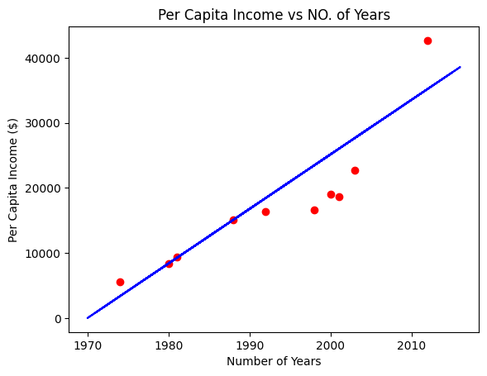
SLR Results (Income vs. Year)
Metric
Test R²: 76.22% (strong linear trend, residual variance expected)
Sample Predictions (USD)
Example pairs: (23487.89, 16622.67), (27680.30, 22739.43), (25164.85, 18987.38)
Takeaway
Linear trend captured well; some under/over-shoot on specific years

Slide 6
MLR Results (Salary Prediction)
Inputs → Predicted Salary ($)
(2, 9, 6) → 52783.41
(10, 8, 7) → 76983.83
Interpretation
Higher experience and strong scores align with higher predicted salaries
Notes
Small dataset; predictions mainly illustrative

Slide 7
Discussion & Limitations
Discussion
SLR: Strong temporal signal; simple model suffices
MLR: Reasonable estimates; interpretable effects
Limitations
Small MLR dataset limits generalization
OLS ignores nonlinearities without feature engineering
Economic shocks not modeled in SLR
Improvements
Larger datasets, cross-validation
Regularization (Ridge/Lasso), richer features

Slide 8
Conclusion & References
Conclusion
SLR achieved 76.22% test R², indicating strong year–income link
MLR produced plausible salary predictions

