Slide 1
Naive Bayes Classifier Study
Implementation, Evaluation, and Comparative Analysis
Done By:
Nouman Zahid
Abdul Haseeb

Slide 2
1. Introduction
Problem:
Train a Naive Bayes (NB) classifier to predict class labels.
Objectives:
• Implement and compare NB variants: Gaussian, Multinomial, Bernoulli.
• Design preprocessing pipeline for continuous/discrete/binary data.
• Evaluate models with standard metrics.
Contributions:
• Reproducible NB pipeline.
• Comparative study of NB variants and smoothing.
• Analysis using confusion matrix and ROC curves.

Slide 3
2. Background
Bayes’ Theorem:
P(C|x) = (P(x|C)P(C)) / P(x)
Decision Rule (MAP):
Choose class with highest posterior.
Naive Independence Assumption:
Features are conditionally independent given the class.
Variants:
• GaussianNB: continuous data
• MultinomialNB: counts/frequencies
• BernoulliNB: binary features

Slide 4
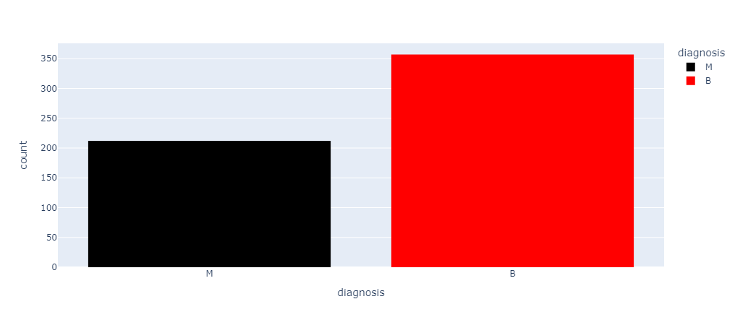
3. Dataset & Preprocessing
Dataset:
Description of dataset
Preprocessing Steps:
Handle missing values (impute/drop)
Encode categorical features
For text: tokenization + vectorization (Count/TF-IDF)
Analyze correlations to choose suitable features

Slide 5
4. Methodology
Hyperparameters:
GaussianNB: var_smoothing ∈ {1e-9, 1e-8, 1e-7}
MultinomialNB: alpha ∈ {0.1, 0.5, 1.0}
BernoulliNB: alpha ∈ {0.1, 0.5, 1.0} + binarization
Training:
Train/validate models, final evaluation on test set.
Metrics:
Accuracy, Precision, Recall, F1, ROC-AUC, Confusion matrix

Slide 6
5. Experimental Results
Results:
Accuracy comparison of GaussianNB, MultinomialNB, BernoulliNB
ROC Curves for model performance
Confusion Matrices for detailed error analysis

Slide 7
6. Conclusion
Naive Bayes is a simple yet powerful baseline.
With proper preprocessing and smoothing, it provides robust results.
Future Work:
Use richer features
Explore ensemble approaches
Extend analysis on larger datasets

