Slide 1
DataMining

Slide 2
Objecttives
1. Understanding the fundamentals of Data Mining
2. Learn how to use SQL in data mining
3. Learn how to implement mining concepts

Slide 3
Data Used
Online retail
500000+ Rows (Before cleaning)
9 Columns

Slide 4
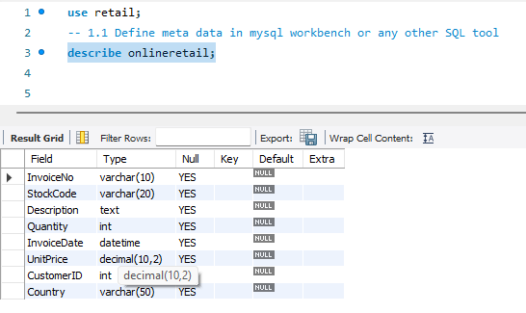
Define meta data in mysql workbench or any other SQL tool
Describe OnlineReatil
Result:

Slide 5

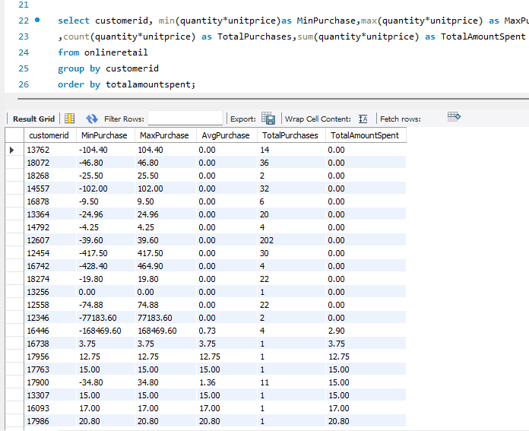
What is the distribution of order values across all customers in the dataset?
select customerid, min(quantity*unitprice)as MinPurchase,max(quantity*unitprice) as MaxPurchase,round(avg(quantity*unitprice),2) as AvgPurchase,count(quantity*unitprice) as TotalPurchases,sum(quantity*unitprice) as TotalAmountSpentfrom onlineretailgroup by customeridorder by totalamountspent;

Slide 6
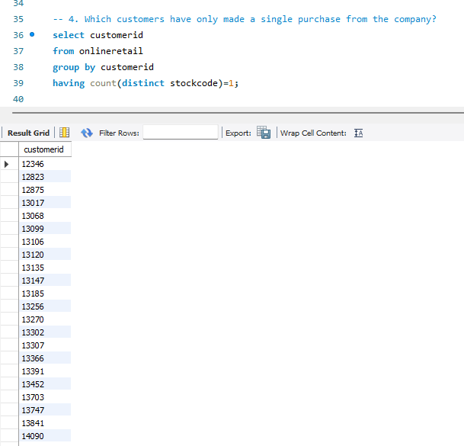
Which customers have only made a single purchase from the company?
Query
select customerid
from onlineretail
group by customerid
having count(distinct stockcode)=1;

Slide 7
Some Advance queries

Slide 8
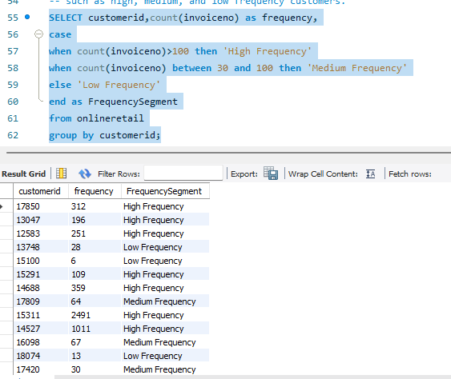
Group customers into segments based on their purchase frequency.
Query
SELECT customerid,count(invoiceno) as frequency,
casewhen count(invoiceno)>100 then 'High Frequency’
when count(invoiceno) between 30 and 100 then 'Medium Frequency’
else 'Low Frequency'end as FrequencySegment
from onlineretail
group by customerid;

Slide 9
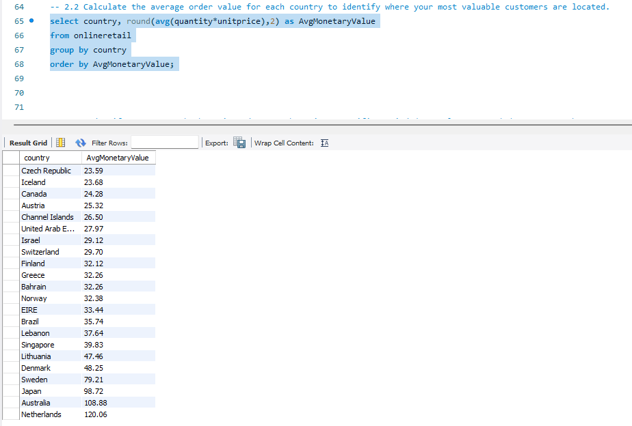
Calculate the average order value for each
Query
select country, round(avg(quantity*unitprice),2) as AvgMonetaryValue
Fromonlineretail
group by country
order by AvgMonetaryValue;

Slide 10
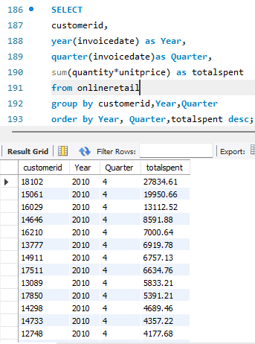
Explore trends in customer behavior over time, such as monthly or quarterly sales patterns.
Query
SELECT customerid,year(invoicedate) as Year,
quarter(invoicedate)as Quarter,
sum(quantity*unitprice) as totalspent
from onlineretail
group by customerid,Year,Quarter
order by Year, Quarter,totalspent desc;

Slide 11
Any Questions?

