Slide 1

Expression Classification from Facial Images
By Nouman ALi

Slide 2

Outline
Data Set
Data Preprocessing
Model Architecture
Hyperparameters
Model performance

Slide 3
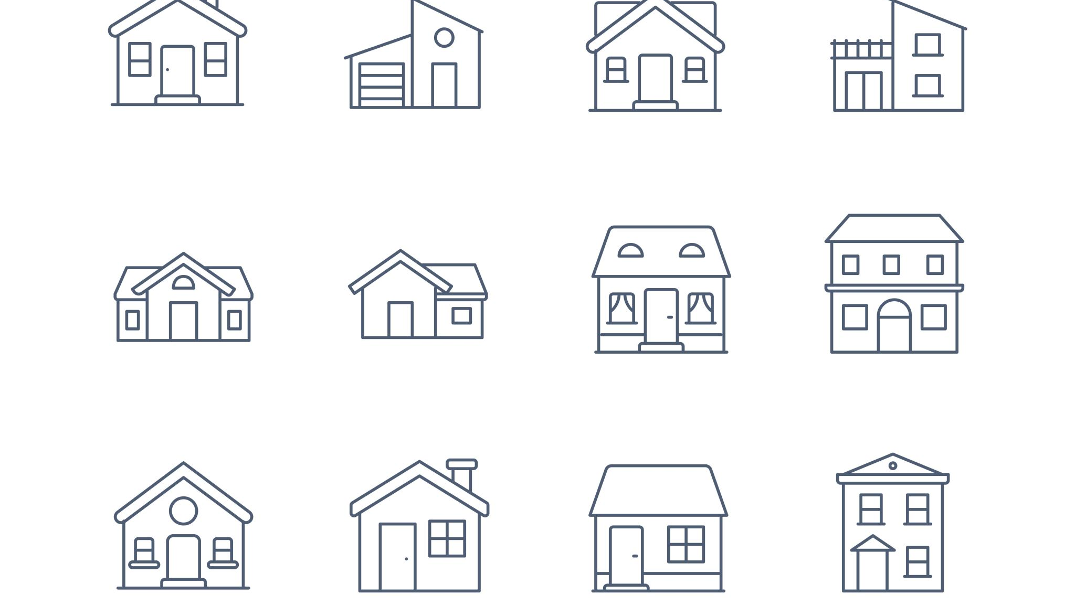
Data Set
Expressions in the wild
Total Images = 91793
Total Images(after CI) = 44,452
Total labels =7
Image size =(224*224*3)

Slide 4

Data Preprocessing
Loading
Loading Data
Splitting
Splitting Training and Testing Data

Slide 5
Data Preprocessing
Normalization
train_images=train_images/255
test_images=test_images/255
One Hot Encoding
train_labels=to_categorical(train_labels,7)
test_labels=to_categorical(test_labels,7)
Data Splitting
70% Training
15% Validation
15% Testing

Slide 6
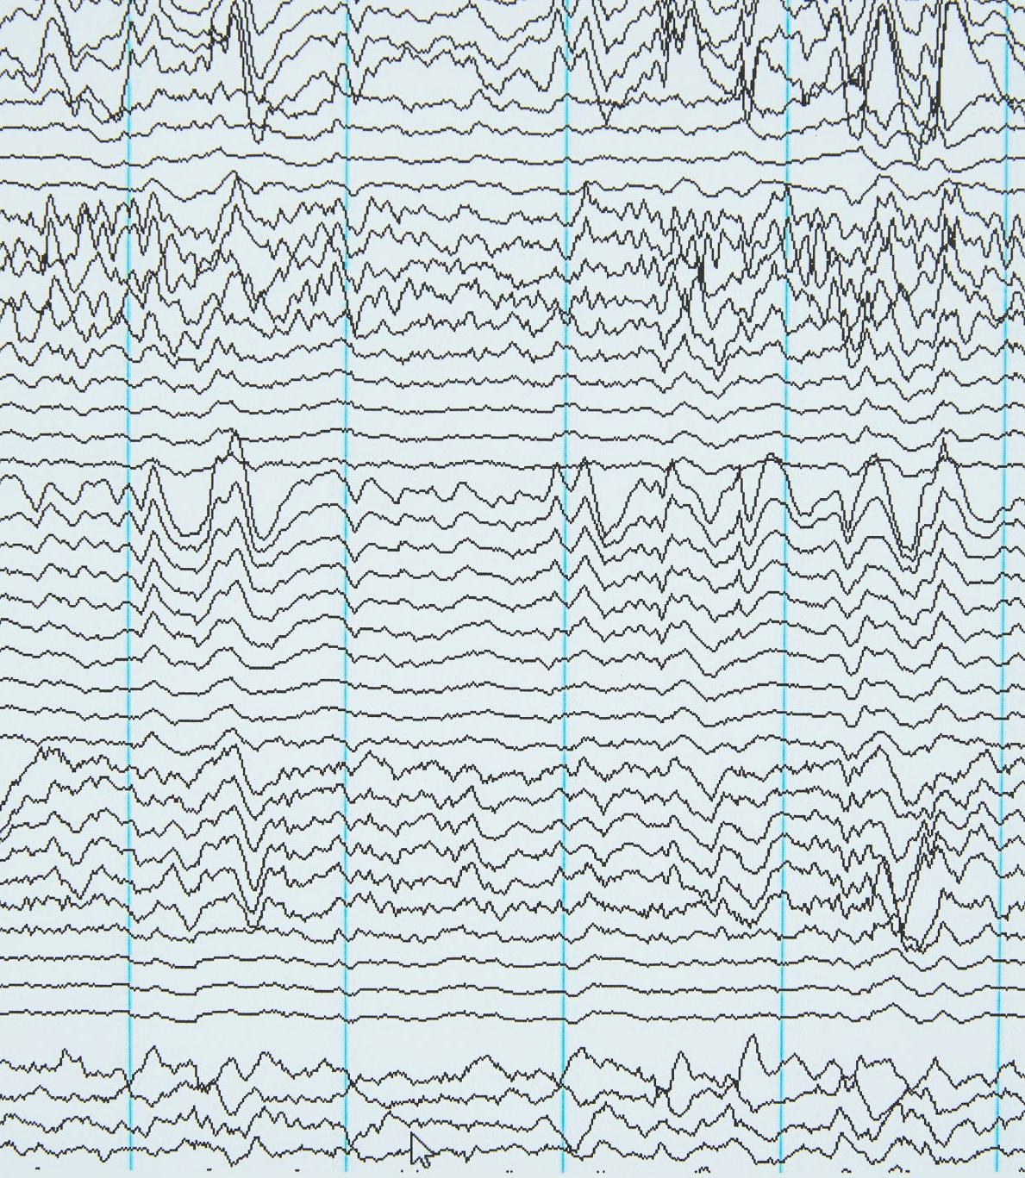
Data Preprocessing
Data Augmentation
rotation_range=10
width_shift_range=0.05
height_shift_range=0.05
shear_range=0.05
zoom_range=0.05

Slide 7
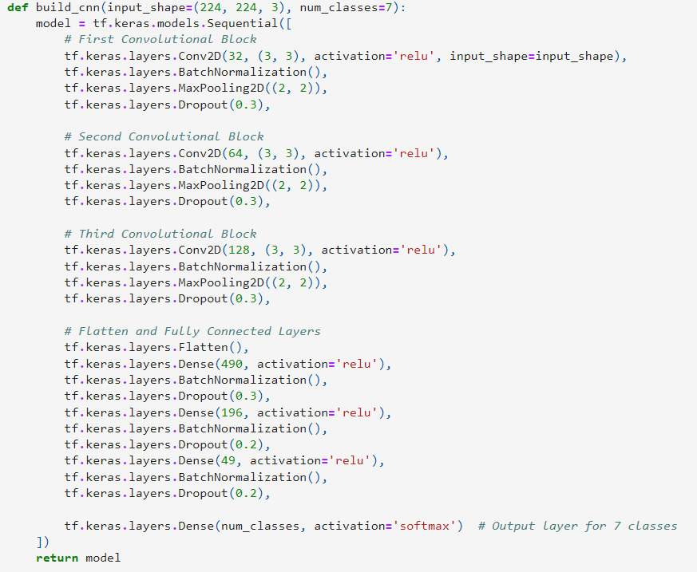
Model Building

Slide 8

Hyperparameters
Convolutional Layer Hyperparameters
Pooling Layer Hyperparameters
Dense Layer Hyperparameters
Dropout Layer Hyperparameters
Optimizer and Learning Rate
Batch Size
Number of Epochs

Slide 9
Model Performance
Accuracy=64.38%
Precision = 61%
Recall = 64%
F1 score 60%

Slide 10
Conclusion
The Model Performance was Satisfactory
Room for Improvements

