Slide 1
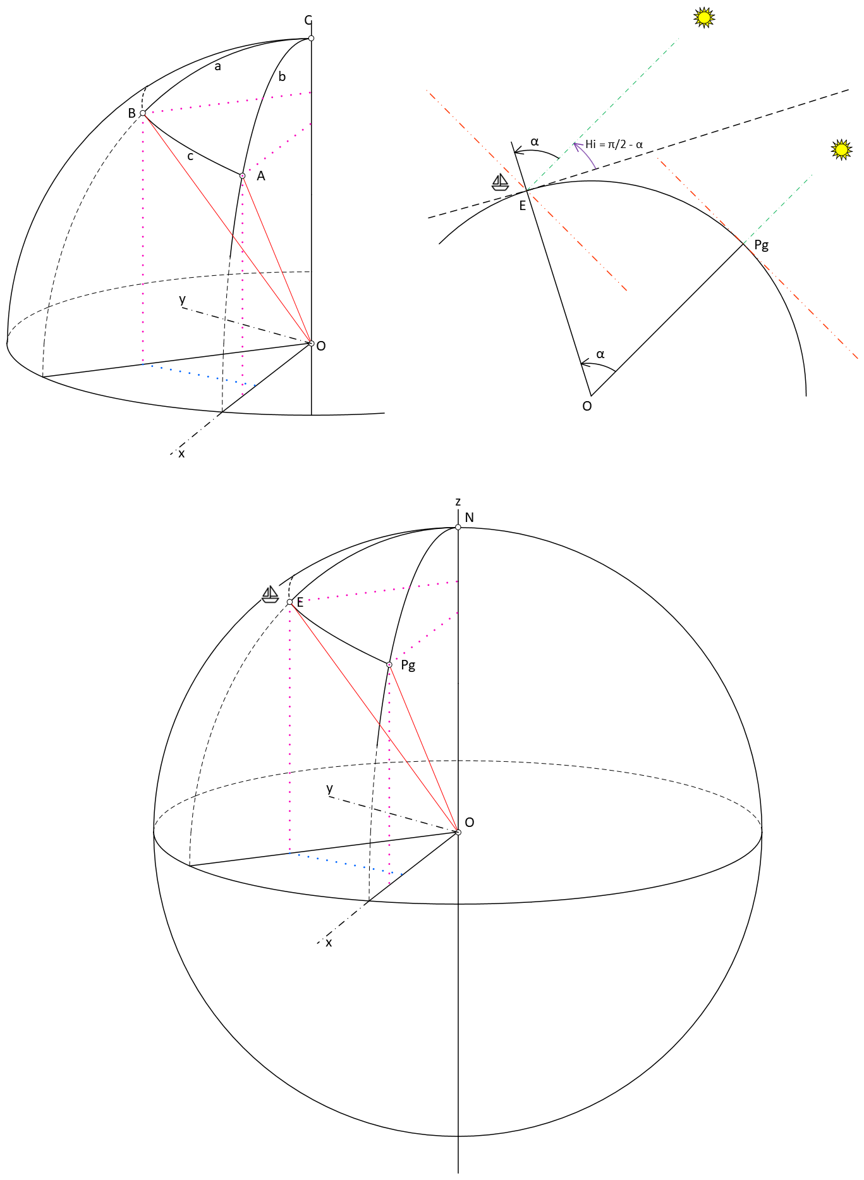

Hc = Sin⁻¹(Sin(Latitude_{E}) x Sin(Declination) + Cos(Latitude_{E}) x Cos(Declination) x Cos(LHA)
c
c
c
$$\vec{OA} ∗\vec{OB}= …$$
Z = Cos⁻¹((Sin(Declination) - Sin(Latitude_{E}) x Sin (H_{c})) / (Cos(Latitude_{E}) x Cos(H_{c}))

