Slide 1
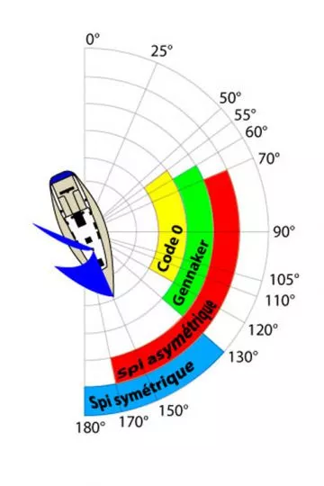
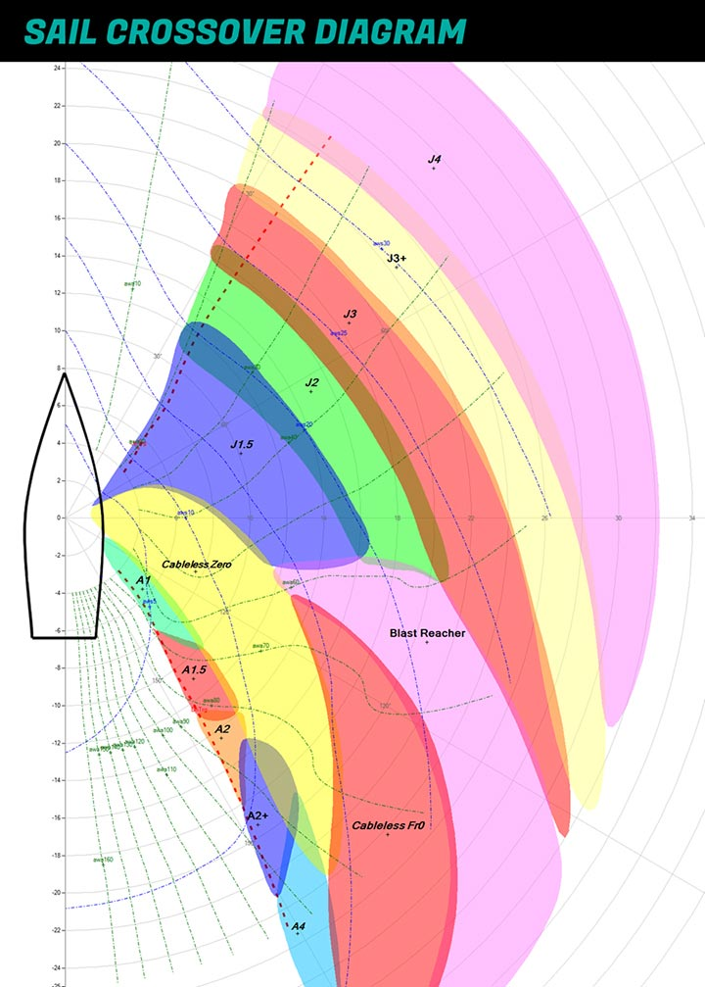


Slide 2
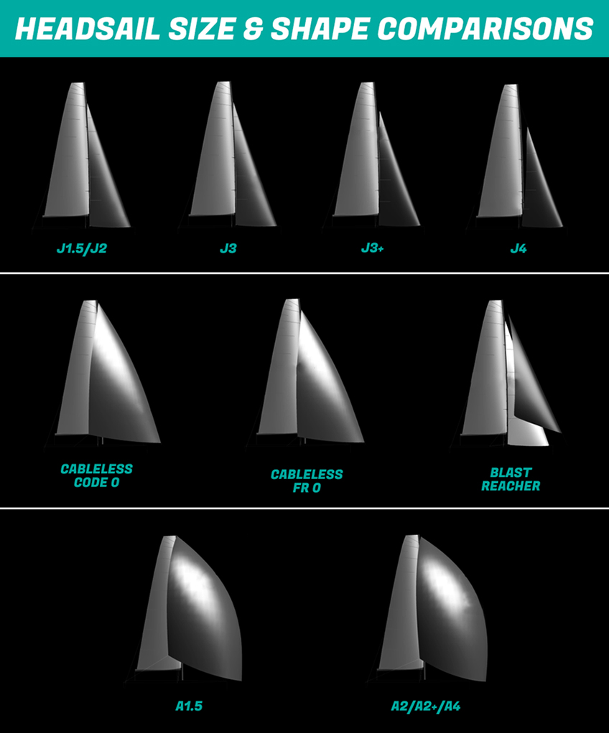

Slide 3
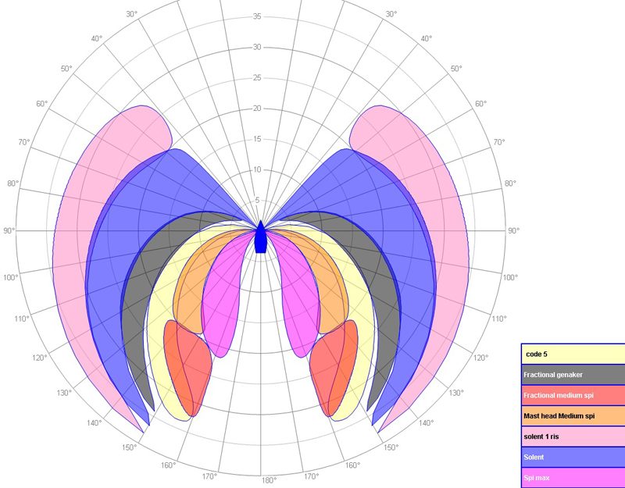

Slide 4
Genois
Spi sym
40°
Spi asym
Reacher
50°
Code 0
55°
Code D
60°
Genaker
(code H)
70°
80°
90°
100°
110°
120°
130°
140°
150°
160°
180°
170°

Slide 5
40°
50°
55°
60°
70°
120°
130°
140°
150°
160°
180°
170°

Slide 6
Genois
Spi sym
Spi asym
Reacher
Code 0

