Slide 1


N
Nm
Nc
W
D
d
②
Cv
Cc
①
③
Rs
Derive °
Loch / STW
$$\overset{→}{Courant}$$
④
⑤

Rf
SOG

Slide 2

N
Rs
④
Rf
⑥
Cv

⑤
- Derive °
Cc = Cv - W
Objectif
③
SOG
②
①
$$\overset{→}{Courant}$$
Loch / STW

Slide 3
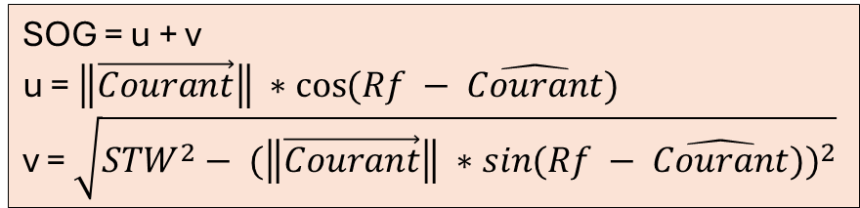

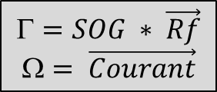
N
SOG = u + v
u = $\left\|\vec{Courant}\right\| ∗\cos{(Rf − \hat{Courant})}$
v = $\sqrt{{STW}^{2}− {(\left\|\vec{Courant}\right\| ∗\sin{(Rf − \hat{Courant})})}^{2}}$
Rs
Γ
Rf
SOG
v
$$=SOG ∗ \vec{Rf}$$
$$= \vec{Courant}$$
$$\overset{→}{Courant}$$
u
Β
Loch / STW
Ω

Slide 4
RS – B₂
N
I

③
B₂ (t₁)
②
B₂ (t₀)
RS – B₁
α
B₁ (t₁)
⑤
①
④
β
α
B₁ (t₀)

