Slide 1

FINANCIAL REPORT
Made By: Nour El-Deen Khaled

Slide 2
Agenda:
Background
Project Goals
Questions to Answer
Methodology
Tools
Implement
Process
Conclusion
Business Impact
Result
Analysis
Data

Slide 3
Background
Project Goals
Questions to answer
methodology
Data
Analysis
Business Impact
Conclusion
Background
- In today’s data-driven world, understanding the story behind numbers is key to making smart business decisions. This project will dive into the world of business performance where numbers reflect effort, strategy, customer sentiment, and market outcomes.
- We’re looking at data that captures how a company invested in marketing, how customers responded, and how revenue evolved over time.
- This isn’t just about spreadsheets or dashboards. It’s about uncovering patterns, drawing meaningful conclusions, and turning data into actionable insights.
- Through this project, we’ll explore the relationship between marketing efforts and business results, aiming to bring clarity to performance trends and help guide future strategies.

Slide 4
Background
Project Goals
Questions to answer
methodology
Data
Analysis
Business Impact
Conclusion
Background: Terms Used in the project
Equity = Total Assets - Total liabilities a
Net Cash Flow = Cash Coming in – cash going out a
ESG (Environmental, Social, Governance) a
EBITDA (Earnings Before Interest, Taxes, Depreciation, Amortization) a
CLTV(Customer LifeTime Value) a
Revenue = Price * Quantity Sold a
Gross Profit = Revenue – COGS(Cost of Goods Sold) a
Net Profit = Gross Profit – Operating expenses – Taxes – Interest a
Market Share = (Company’s Revenue / Total Industry Revenue) * 100

Slide 5
Background
Project Goals
Questions to answer
methodology
Data
Analysis
Business Impact
Conclusion
The primary goal of this project is to analyze the company's performance using historical data to provide clear, data-driven insights that support strategic business decisions. Specifically, the project aims to:
Summarize financial performance (revenue, expenses, net profit, and cash flow) and highlight any irregularities or risks
Project Goals
Break down revenue by segment, region, and customer type, and compare it with industry benchmarks.
Assess financial risks, including tax obligations and loans (pending), and evaluate risk exposure.
Analyze employee performance and supplier costs to identify optimization opportunities.
Forecast company growth and evaluate the ROI of capital investments.
Measure the financial impact of ESG initiatives and recommend ways to align sustainability with profitability.

Slide 6
Background
Project Goals
Questions to answer
methodology
Data
Analysis
Business Impact
Conclusion
How have our revenue, expenses, net profit, and cash flow evolved over the past year?
Are there any irregularities in our cash flow or outstanding accounts that could pose financial risks?
Which business segments, regions, and customer types are driving the most revenue—and which are underperforming?
How do our financial results compare to industry benchmarks and key competitors?
What are our current outstanding loans, tax obligations, and overall financial risk exposure?
How does employee performance correlate with financial outcomes? Are we allocating talent effectively?
Where can we reduce supplier costs without affecting operational efficiency?
What is our growth forecast for the next quarter and year based on historical trends?
Which investments and capital expenditures are delivering strong returns—and which may need to be reconsidered?
How are our sustainability (ESG) initiatives impacting financial performance, and how can we optimize their balance with profitability?
Questions to answer

Slide 7
Background
Project Goals
Questions to answer
methodology
Data
Analysis
Business Impact
Conclusion
Methodology
Tools
Process
Implementation
To carry out this project, a combination of data analysis and visualization tools was used:
Microsoft Power BI for building interactive dashboards and visual reports.
Power Query for data transformation, cleansing, and merging.
DAX (Data Analysis Expressions) for creating custom measures, KPIs, and time intelligence metrics.
- Data Collection: Got the data from an Excel file with multiple sheets, including financial records, HR data, ESG reports, and investment records. n
- Data Cleaning & Preparation: Performed extensive cleaning, handled missing values, corrected calculation errors, and ensured consistency across tables. y
- Data Modeling: Built a relational model linking financial, operational, and HR tables to enable cross-analysis and drill-down capabilities. y
- Requirement Mapping: Mapped stakeholder questions to specific metrics and created calculated columns and measures to address them.
Designed an interactive Power BI dashboard to visualize key metrics, track performance trends, and highlight risks.
Implemented dynamic filters (by time, region, customer type, etc.) for tailored insights.
Identified gaps (such as Low Customer Satisfaction) for further investigation.

Slide 8
Background
Project Goals
Questions to answer
methodology
Data
Analysis
Business Impact
Conclusion
Data
The project leveraged a rich and diverse dataset composed of multiple interrelated tables covering the company’s financial, operational, and strategic domains. The key tables included:
Financial Data: Captured core financial metrics such as revenue, expenses, net profit, total assets, total liabilities, cash flow, and equity over time.
Revenue Breakdown: Detailed revenue segmented by region, customer type, and product category.
Growth Forecast: Included historical and projected financial figures used for forecasting future growth.
Customer Data: Contained customer profiles, types, satisfaction scores, and transactional history for analyzing retention and segmentation.
Employee Information: Included roles, departments, tenure, and performance indicators, used to evaluate talent investment and performance correlation.
Supplier Costs: Tracked cost and spending across suppliers to identify optimization opportunities.
Investment Portfolio: Held data on capital expenditures and ROI, used for evaluating investment performance.
ESG Table: Environmental, Social, and Governance-related data with financial impact metrics.
Outstanding Loans and Tax Obligations: Captured liabilities and financial commitments to assess risks and financial health.

Slide 9
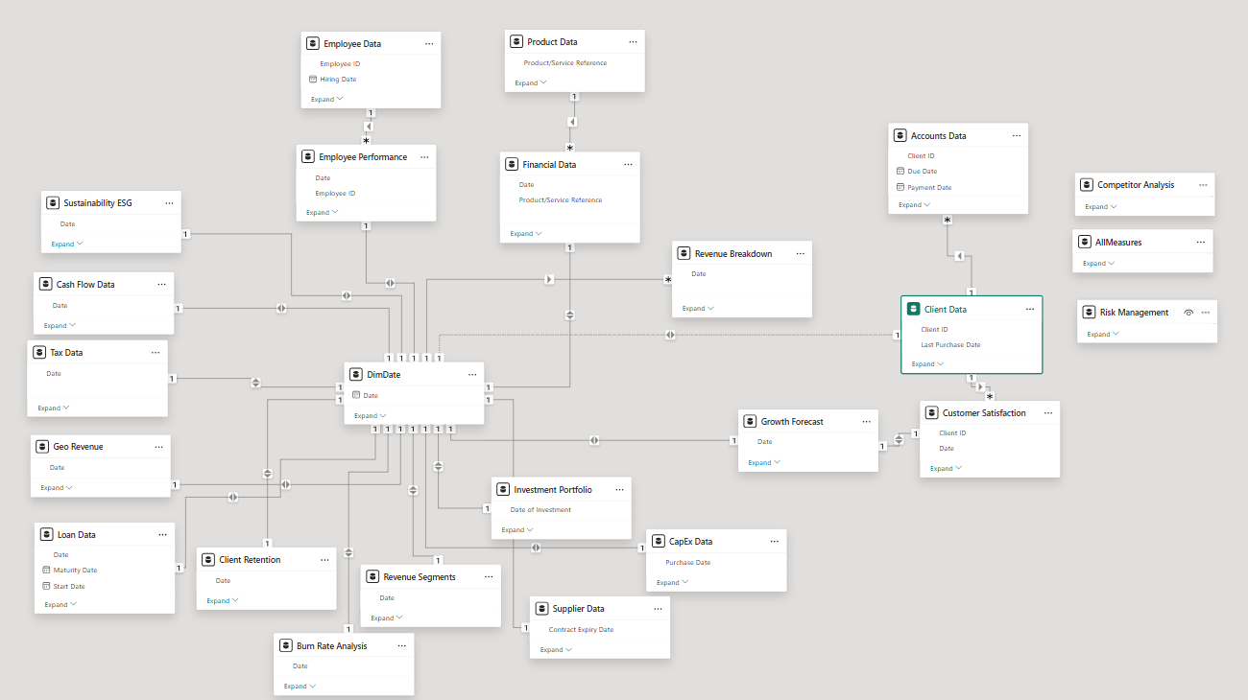
Background
Project Goals
Questions to answer
methodology
Data
Analysis
Business Impact
Conclusion
Schema

Slide 10
Background
Project Goals
Questions to answer
methodology
Data
Analysis
Business Impact
Conclusion
Data Preparation
After getting the data from the Excel file I followed an ETL process and used power Query for:
1- Cleaning the data if it needed any cleaning
2- Re-Checking for data Types
3- Recalculating some columns because it was calculated wrong and here are some of the columns I recalculated and the way I calculated it with:
1. GrossProfit = Revenue – COGS
2. NetProfit = GrossProfit – Operating expenses
3. equity = Total Assets – Total Liabilities
4- Re-Validating the Date columns and checking if there is any non-valid dates

Slide 11
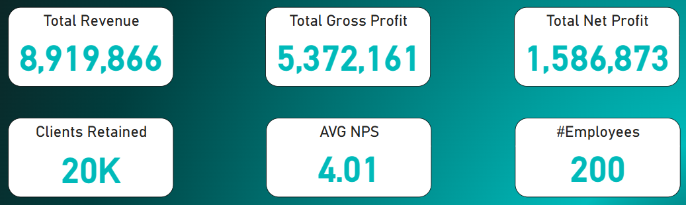
Background
Project Goals
Questions to answer
methodology
Data
Analysis
Business Impact
Conclusion
1. Overview Analysis & Findings
Revenue vs. Profit
The company generated 8.9 millions in revenue ,but netprofit was only 1.59M (17.8% margin), indicating significant operating costs or tax burdens.

Slide 12
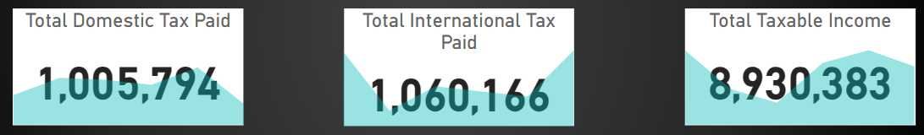
Background
Project Goals
Questions to answer
methodology
Data
Analysis
Business Impact
Conclusion
2. Tax Analysis & Findings
Tax Efficiency
Total tax paid was $2.07M (23% of taxable income), with domestic taxes (33.68% rate in Q1 2024) being higher than international (26.74%).

Slide 13
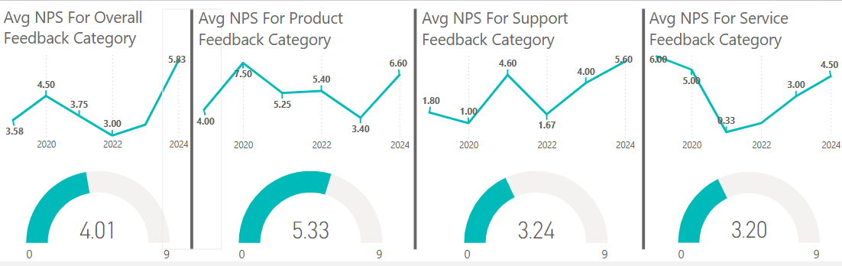
Background
Project Goals
Questions to answer
methodology
Data
Analysis
Business Impact
Conclusion
3.1. Customer Analysis & Findings
We see that the overall average NPS was 4.01 that is really low
the lowest NPS Feedback category that the customers gave us was 3.2 in Service Category

Slide 14
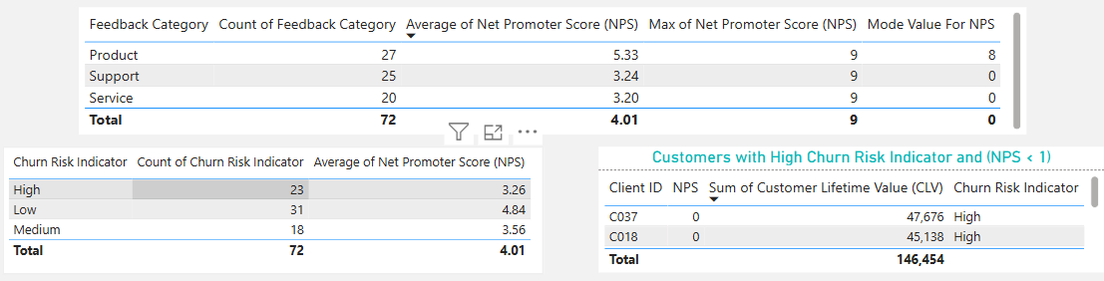
Background
Project Goals
Questions to answer
methodology
Data
Analysis
Business Impact
Conclusion
3.2. Customer Analysis & Findings
We see here that out #customers that has high churn risk indicatior is high
we can see that there are customers with high CLTV and also have high churn risk indicator

Slide 15
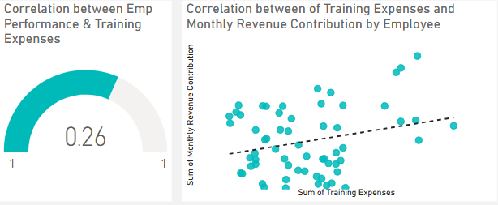
Background
Project Goals
Questions to answer
methodology
Data
Analysis
Business Impact
Conclusion
4.1. Employee Analysis & Findings
We see that there is a weak positive correlation between the Employee performance and the Training expenses which shows that there is minimal impact of training on employee performance
We will see also that it doesn’t necessarily mean when the employee cost us high training expenses that he/she will have higher monthly revenue contribution

Slide 16
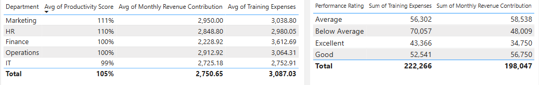
Background
Project Goals
Questions to answer
methodology
Data
Analysis
Business Impact
Conclusion
4.2. Employee Analysis & Findings
We see that there is a weak positive correlation between the Employee performance and the Training expenses which shows that there is minimal impact of training on employee performance
We will see also that it doesn’t necessarily mean when the employee cost us high training expenses that he/she will have higher monthly revenue contribution

Slide 17
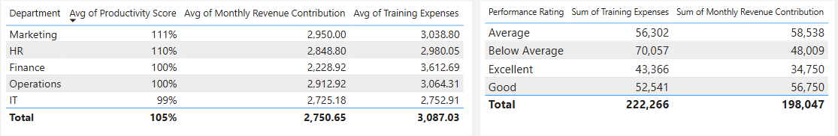
Background
Project Goals
Questions to answer
methodology
Data
Analysis
Business Impact
Conclusion
4.3. Employee Analysis & Findings
We see that the Marketing and the HR departments have the highest productivity score
We see that the Finance department takes the most training expenses in average while they are performing nearly 10% less on average compared to the HR and Marketing Departments

Slide 18
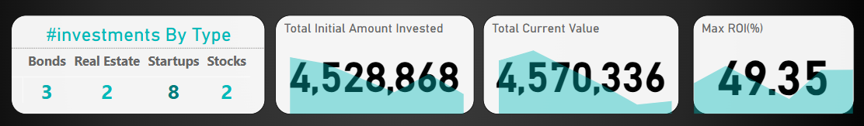
Background
Project Goals
Questions to answer
methodology
Data
Analysis
Business Impact
Conclusion
5.1. Investment Portfolio Analysis & Findings
We invest in a total of 15 entities with most of our investments going for Startups with 8 investments

Slide 19
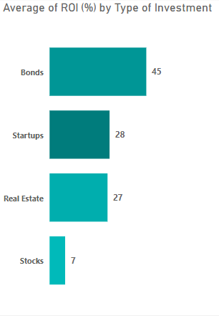
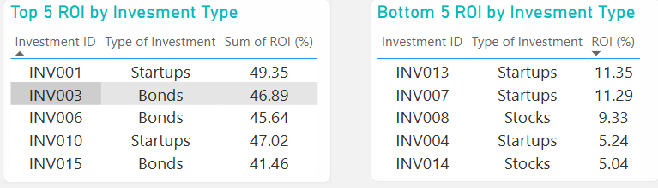
Background
Project Goals
Questions to answer
methodology
Data
Analysis
Business Impact
Conclusion
5.2. Investment Portfolio Analysis & Findings
The Startups generated the highest ROI but on average Bonds generate the highest ROI and is considered more steady than Startups.

Slide 20
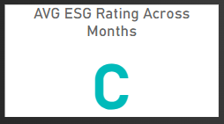
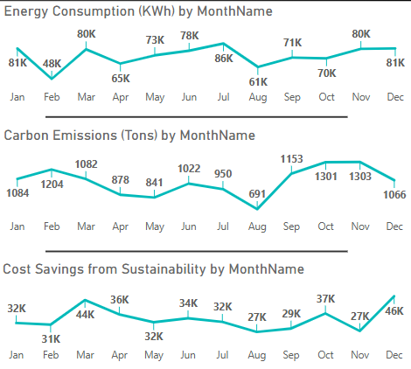
Background
Project Goals
Questions to answer
methodology
Data
Analysis
Business Impact
Conclusion
6. ESG Analysis & Findings
This is what I made for the ESG Rating:
- A Corresponds 4
- B Corresponds 3
- C Corresponds 2
- D Corresponds 1
We see here that Nov is considered one of the highest months on both carbon emissions and energy consumption so we need to investigate further why is this happening

Slide 21
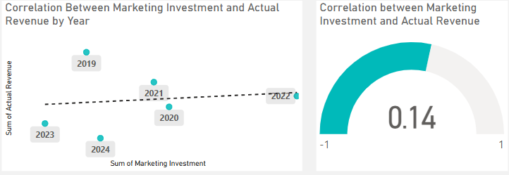
Background
Project Goals
Questions to answer
methodology
Data
Analysis
Business Impact
Conclusion
7. Growth Forecast Analysis & Findings
There is a positive weak correlation between Marketing Investment and Actual Revenue so we need to investigate further on this matter because we can be marketing to wrong audience or the marketing effect will have an impact later

Slide 22
Background
Project Goals
Questions to answer
methodology
Data
Analysis
Business Impact
Conclusion
7. Growth Forecast Analysis & Findings
There is a positive weak correlation between Marketing Investment and Actual Revenue so we need to investigate further on this matter because we can be marketing to wrong audience or the marketing effect will have an impact later

Slide 23

Background
Project Goals
Questions to answer
methodology
Data
Analysis
Business Impact
Conclusion
Business Impact
We need to investigate in our Support center and see why it has the lowest NPS among the different feedback categories because we have the highest average NPS in our Product which means customers love our product but our support is the lowest which means that the customers may not buy from us again and it will have bad return on our sales.
We need to further investigate on the IT department and why it had the lowest AVG in the productivity Score .
We need to keep investing in Bonds because it is considered a safe and steady investment and it provided us with the highest AVG of ROI.
We see that investing in Stocks wasn’t the Right decision until now because the only 2 investments that we made in stocks scores at out least 3 investments by ROI in the company.
We need to see why the month November is considered one of the highest months in Energy Consumption and carbon emissions over Years.
There is a Weak positive correlation between Marketing investment and actual revenue, so we need to further investigate and see if there is any pending campaigns that its results will impact soon because as we saw earlier

Slide 24
Background
Project Goals
Questions to answer
methodology
Data
Analysis
Business Impact
Conclusion
Contact Me
Thank
You for reading this far
Linkedin Profile : Click Here
Email : nourk1497@gmail.com

