Slide 1
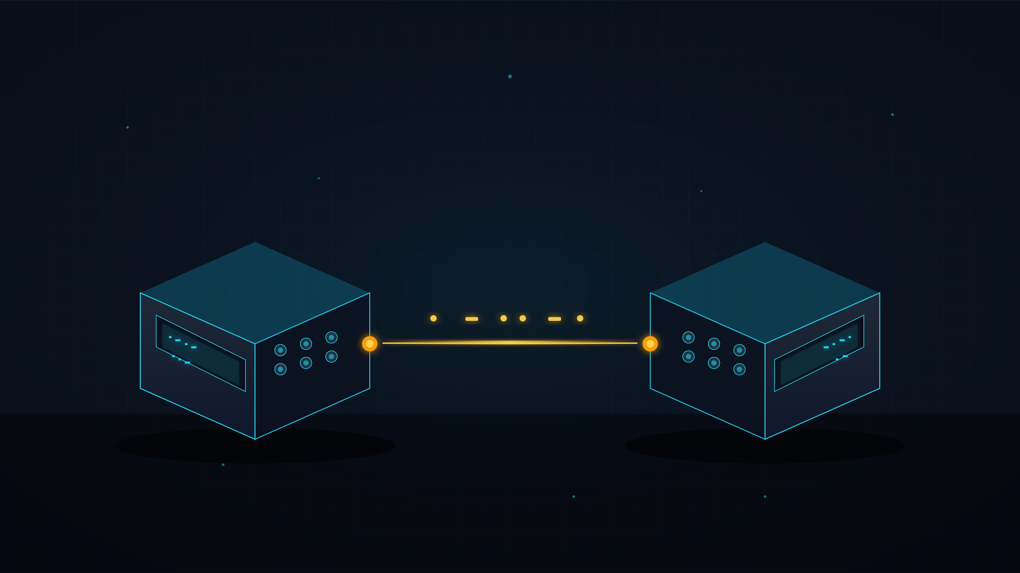
EMBEDDED SYSTEMS · PROJECT BRIEF · 2026
MORSE
COMMUNICATOR
Bidirectional Infrared Morse Messaging Terminal
PREPARED BY
Nour Waleed · Hagar Ali
INSTRUCTOR
Dr. Alaa Hamdi
> SYSTEM ONLINE · AWAITING SIGNAL

Slide 2
00 · TABLE OF CONTENTS
What we'll cover.
Eight chapters from concept to working prototype.
01
Overview
02
Objectives
What the system does
What we set out to build
03
Hardware
04
Button Layer
Components & pin map
Input mechanics
05
Software
06
Pipeline
Code architecture
End-to-end data flow
07
Sim vs HW
08
Issues Fixed
Where they diverge
Real-world debugging
● INDEX · 08 CHAPTERS
02 / 12

Slide 3
01 · PROJECT OVERVIEW
Two-way Morse, over light.
01 THE SETUP
Two identical Arduino terminals. Each can send and receive Morse-encoded text through an infrared link.
02 THE INTERACTION
Six dedicated buttons compose letters. The system decodes Morse locally, transmits the message, and shows the chat on a 16×2 LCD.
2
6
36
STATIONS
BUTTONS / SIDE
MORSE GLYPHS
▸ CLICK TO REVEAL
03 / 12

Slide 4
02 · OBJECTIVES
Five goals.
Every objective is verifiable on the hardware.
01
BUILD
Bidirectional embedded comms with two identical stations.
02
CONVERT
Morse button input → readable English text before transmission.
03
TRANSMIT
Send data over IR; reconstruct it accurately on the receiver.
04
RESPOND
Same firmware handles both send and reply on either side.
05
DISPLAY
Show latest chat history on the LCD for live demo + validation.
● OBJECTIVES · 5 VERIFIED
▸ CLICK TO REVEAL
04 / 12

Slide 5
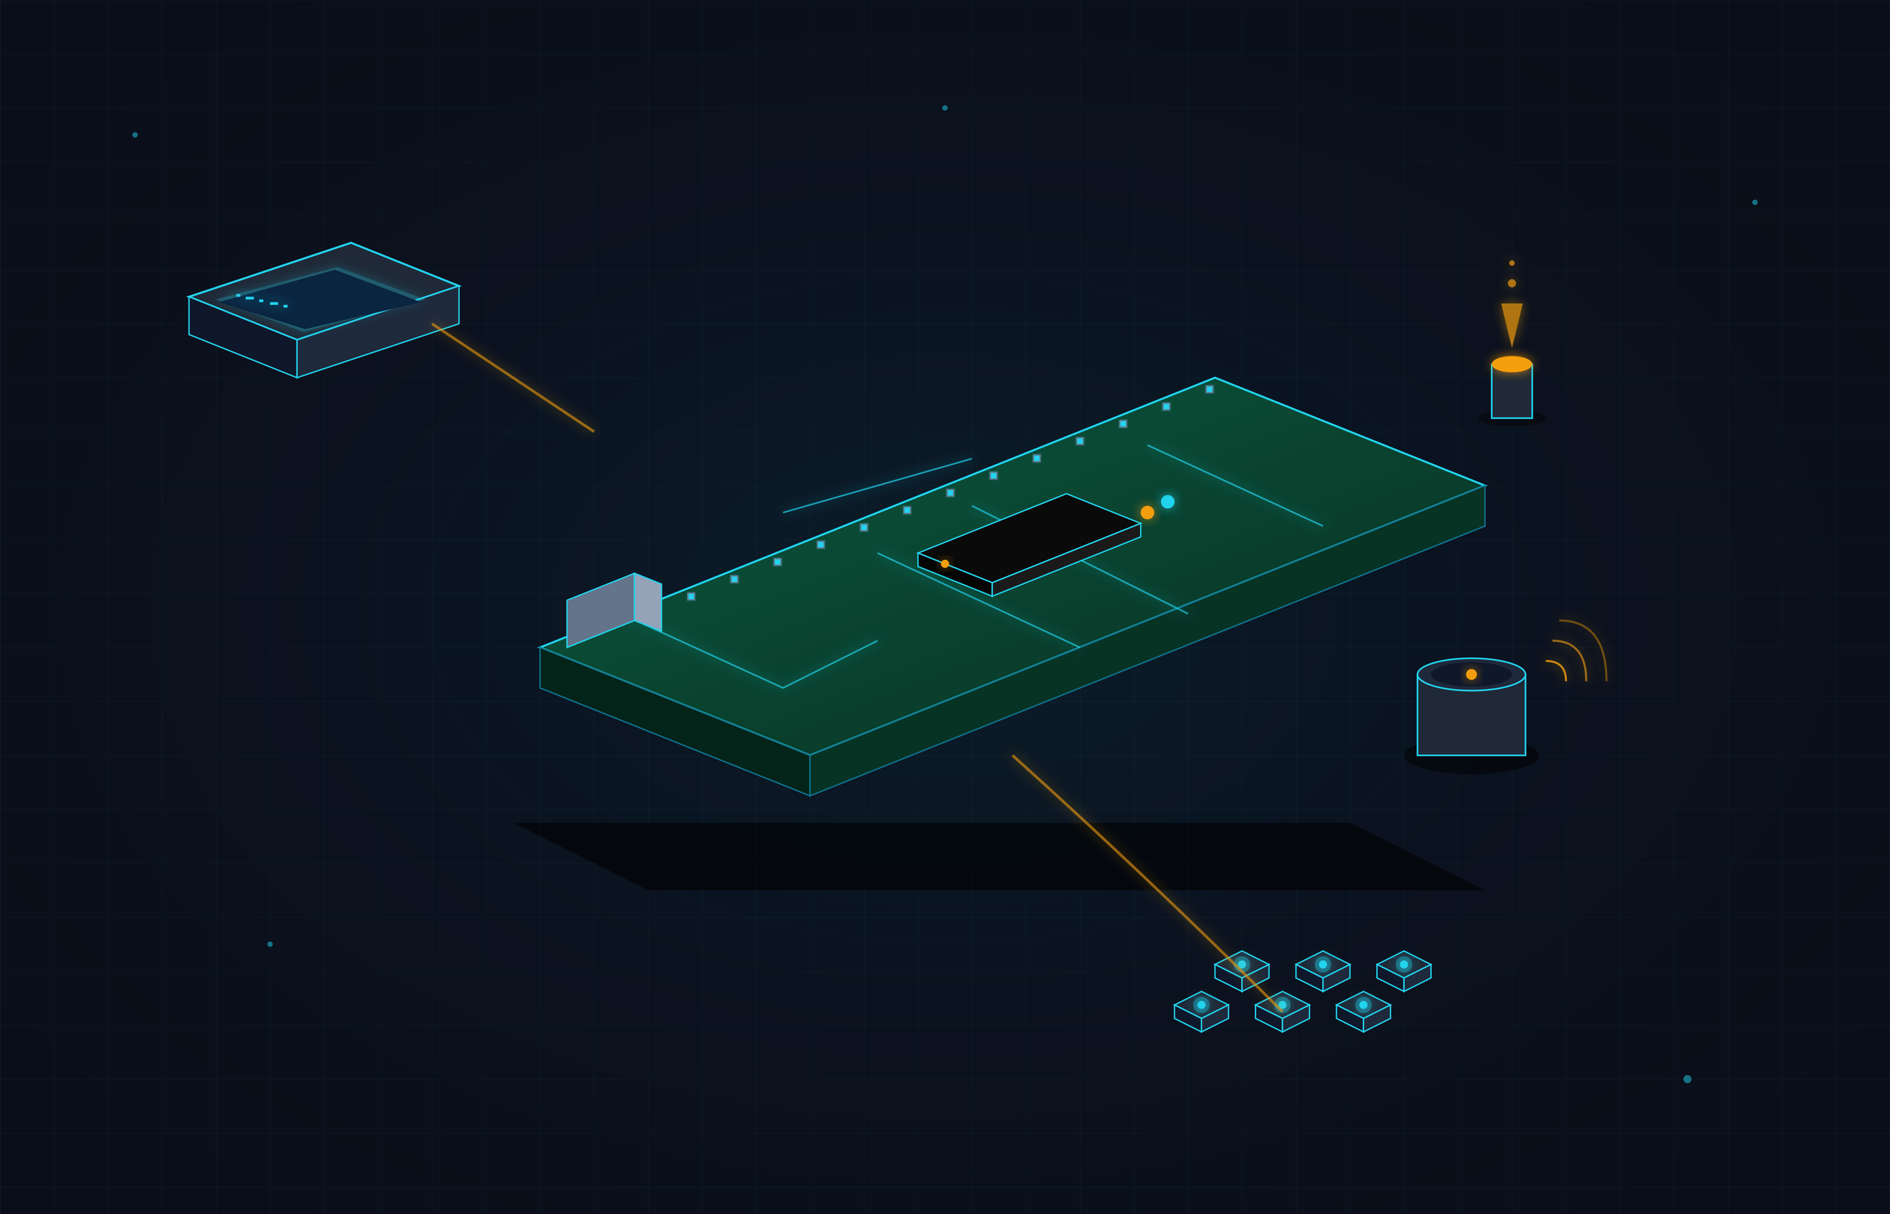
03 · HARDWARE
Bill of materials.
2×
Arduino Uno
2×
VS1838B
Main controllers
IR receiver
2×
IR LED
2×
16×2 LCD
Emitter + resistor
I²C @ 0x27
2×
Buzzer
12×
Push Button
Tone feedback
6 per station
PIN MAP
DOT
D4
DASH
D5
END
D6
BACK
D7
SPACE
D8
SEND
D9
BUZZ
D10
IR TX
D3
IR RX
D11
SDA
A4
SCL
A5
▸ CLICK TO REVEAL
05 / 12

Slide 6
04 · BUTTON LAYER
Six buttons. One language.
No keyboard. No screen typing. Pure Morse composition.
.
DOT
—
DASH
↵
END
Append a dot
Append a dash
Decode → letter
PIN D4
PIN D5
PIN D6
⌫
BACK
␣
SPACE
▶
SEND
Edit current
Word gap
Transmit via IR
PIN D7
PIN D8
PIN D9
● INPUT INTERFACE · 6 BTN
▸ CLICK TO REVEAL
06 / 12

Slide 7
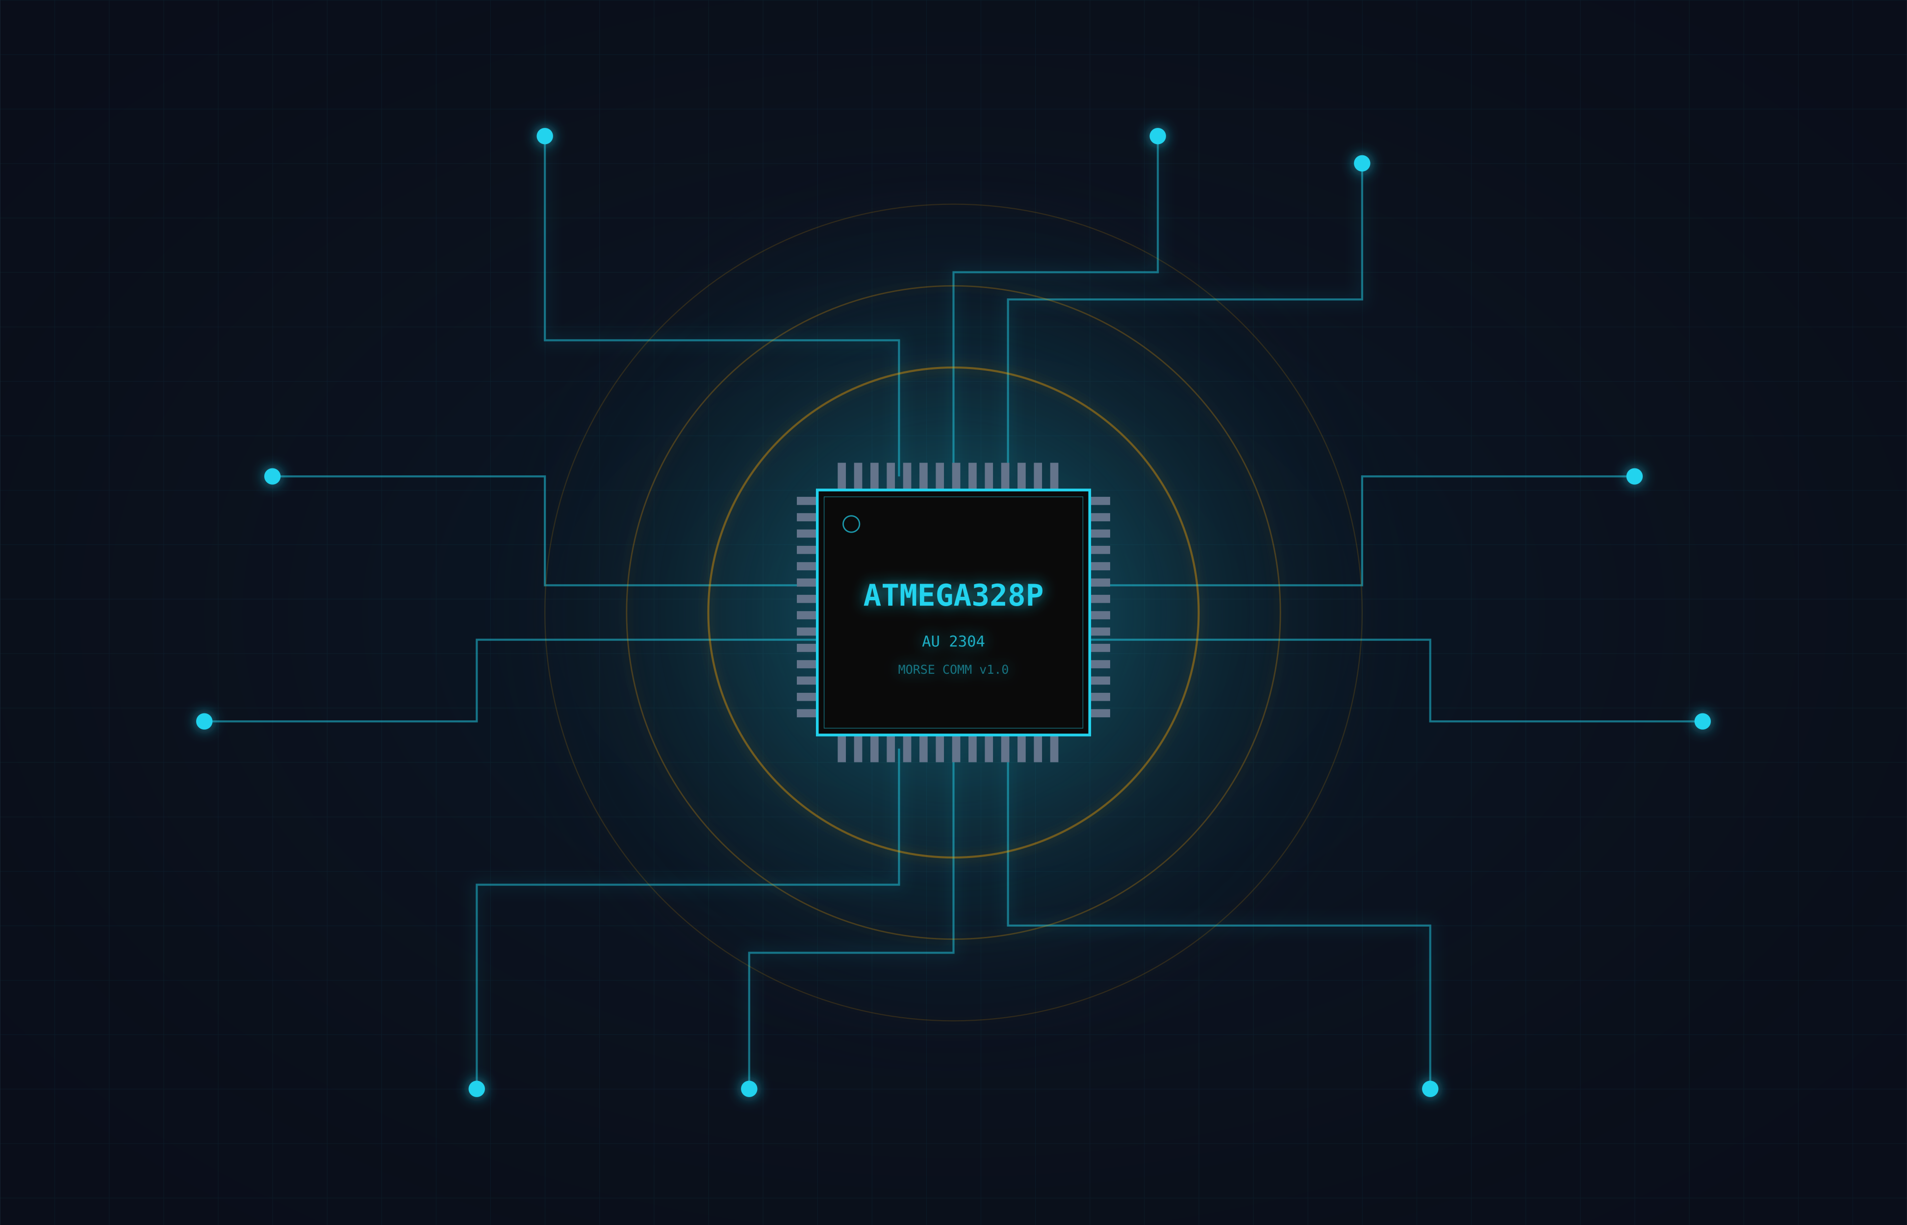
05 · SOFTWARE ARCHITECTURE
Modular firmware.
One sketch runs on both stations — symmetric design.
setup()
Init pins, LCD, buzzer, IR.
loop()
Continuous: buttons + receive.
checkButtons()
Debounced, one-shot detection.
handleButton(i)
Action dispatch by button.
decodeMorse()
Code → English char (or null).
sendMessageIR()
Char-by-char NEC transmission.
checkReceive()
Rebuild incoming → end marker.
updateLCD()
Render send mode or chat log.
▸ CLICK TO REVEAL
07 / 12

Slide 8
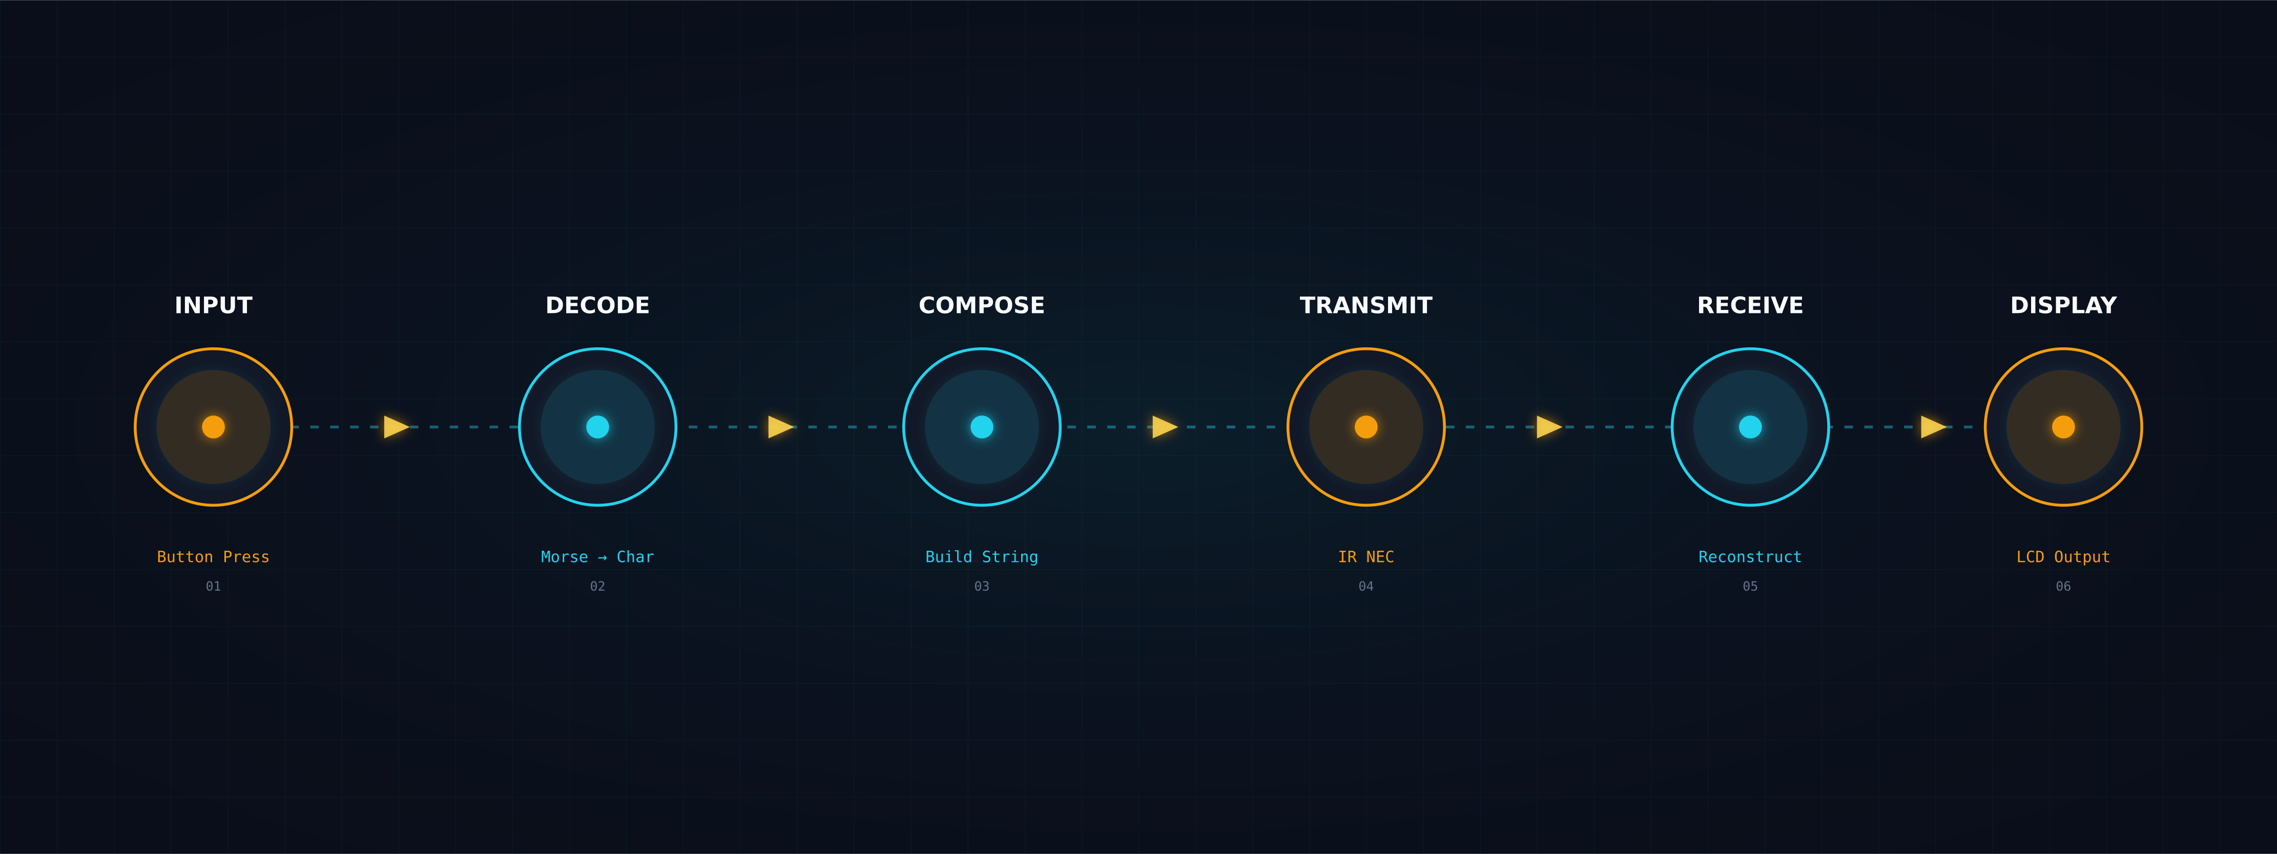
06 · EXECUTION PIPELINE
Eight stages, one beat.
From button press to chat history — the message journey.
01
02
03
04
05
06
setup()
loop()
handleButton()
sendMessageIR()
checkReceive()
addToLog()
Boot peripherals
Poll buttons + IR
Compose / send
Transmit + EOM
Rebuild chars
Store in history
● DATA FLOW · 6 STAGES
▸ CLICK TO REVEAL
08 / 12

Slide 9
07 · SIMULATION vs HARDWARE
Two worlds. Same logic.
What works in Tikercad doesn't always survive the breadboard.
ASPECT
SIMULATION
HARDWARE
ENVIRONMENT
Tinkercad
Two real Arduino boards
MEDIUM
UART
Physical IR LED + receiver
DEBUGGING
Fast iteration, easy rewiring
Wiring checks + alignment
TIMING
Predictable, controlled
Affected by ambient light + blocking code
FAULTS
Only what's modeled
Polarity, weak TX, saturation
VALUE
Verifies logic & UI flow
Proves the full embedded system
▸ CLICK TO REVEAL
09 / 12

Slide 10
08 · ISSUES & FIXES
What broke. What we did.
Real debugging — every fix is wired into the final code.
BUTTON CONFUSION
→
APPLIED FIX
Triggered wrong actions, stayed active.
Rebuilt button area, aligned signal paths.
BUZZER GHOST FIRES
→
APPLIED FIX
Activated without input — short or wrong row.
Isolated buzzer to clean two-row connection.
IR PROTOCOL MISMATCH
→
APPLIED FIX
TX sent but RX couldn't rebuild chars.
Unified to NEC command-byte workflow.
REPLY PATH INSTABLE
→
APPLIED FIX
First exchange worked, later replies failed.
Reduced blocking; re-armed receiver after TX.
HISTORY TOO SHALLOW
→
APPLIED FIX
Only minimal chat state visible.
Larger log; both sent + received tracked.
● 5 ISSUES · 5 RESOLVED
▸ CLICK TO REVEAL
10 / 12

Slide 11
09 · TESTING · VALIDATION · LIMITS
It works. Here's how we know.
✓ VERIFIED ON HARDWARE
△ KNOWN LIMITATIONS
✓
All six controls respond correctly
△
16×2 LCD shows only two lines at once
✓
Buzzer feedback + LCD updates
△
IR depends on distance + alignment
✓
One-way IR transmission
△
History depth bounded by Arduino RAM
✓
Reply transmission (reverse direction)
✓
Repeated exchanges after fixes
△
Letters + digits only (limited punctuation)
✓
Chat history logs both sides
▸ CLICK TO REVEAL
11 / 12

Slide 12
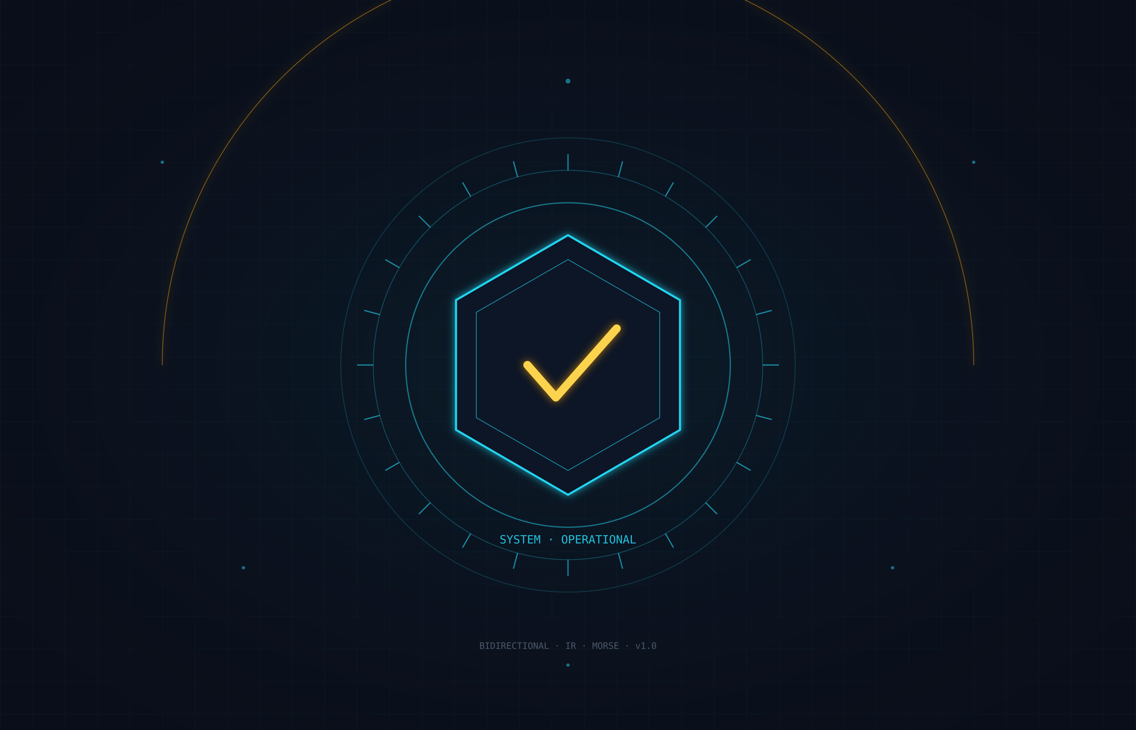
▸ CONCLUSION · PROJECT COMPLETE
Signal sent.
Signal received.
The Morse Communicator delivers a complete embedded workflow: button-based Morse input, local English decoding, infrared transmission, reception, reply, and chat-style history — symmetric across two stations.
100%
OBJECTIVES MET
5/5
ISSUES RESOLVED
2
STATIONS · 1 PROTOCOL
// MORSE COMMUNICATOR · v1.0 · EMBEDDED SYSTEMS · 2026

Slide 13
EMBEDDED SYSTEMS · PROJECT BRIEF · Bidirectional Infrared Morse Messaging Terminal
Thank
YOU
> SYSTEM OFFLINE · THAT’S IT

