Slide 1
CivicPulse
Turning NYC 311 data into decisions for city managers
Executive presentation · PostgreSQL, SQL and Power BI · 2024 data
SID2 · 2026/2027

Slide 2
Our team
Project team and supervisor
Elheddi Ilham
Khiter Nour Elimene
Bedjbedj Soundous
Meliani Amina
Supervised by
Mrs. Benkrid Soumia
SID2 · 2026/2027

Slide 3
Problem definition, objectives, and decisions to support
311 complaints pile up faster than NYC can fix them
The problem
Objectives
Decisions supported
Thousands of 311 complaints every day (parking, noise, heat, potholes, garbage)
The city cannot fix everything at once
Useful information is hidden in raw data
Turn raw 311 data into a clear 3-page Power BI dashboard
Answer 4 questions: what is common and growing, where, when, how fast
Users: city managers and agency heads
What to fix first
Where to send teams
When more staff are needed
Which agencies need support

Slide 4
Data sources and analytical data model
From 45,750 raw records to a clean 4-table database
Data source
service_request
45,750 rows
request_id (PK)
created / closed date
status, channel
3 foreign keys
agency
14 rows
NYC Open Data, 311 Service Requests (erm2-nwe9), public API
All of 2024: 45,750 rows, 15 columns kept
Reproducible 2% sample (request numbers ending in 07 or 57, fixed seed)
Raw file loaded into staging_311, then 4 tables; 0 rows lost
complaint_type
709 rows
location
222 rows (ZIP + borough)

Slide 5
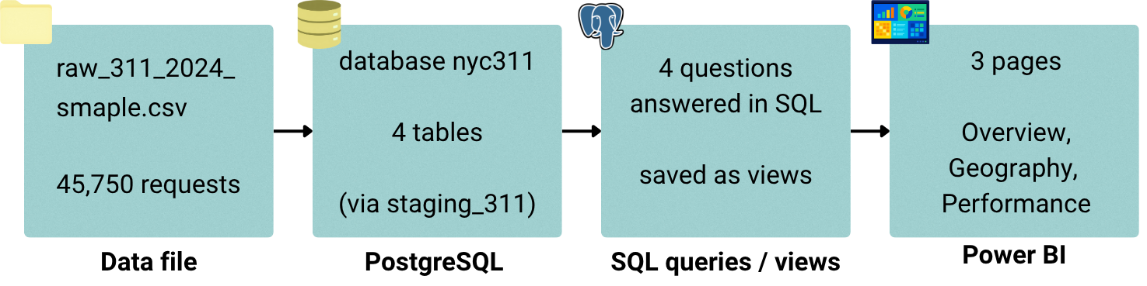
Proposed architecture and data flow
Our architecture diagram: from raw file to dashboard
Data file → PostgreSQL (staging_311, 4 tables) → 17 SQL views → Power BI (3 pages)
Everything is rebuilt from the CSV by 6 scripts, so the results are reproducible.

Slide 6
Proposed architecture and data flow
Four steps, six scripts, one set of rules
Data file
raw_311_2024_sample.csv
45,750 requests
PostgreSQL
database nyc311
staging_311 → 4 tables
SQL views
4 questions answered
17 views
Power BI
3 pages: Overview, Geography, Performance
6 scripts, run in order
Shared rules for every query
download, check, load into staging
schema.sql: tables; views.sql: 17 views
data_quality_checks.sql: counts problems
Open request = status <> 'Closed'
Solving time = closed − created, valid dates only
Typical time = median; Power BI reads the views

Slide 7
SQL analytical approach and results
Our SQL answers the four questions managers ask
Approach
Topic | Key result
Boroughs | Brooklyn leads: 13,738 requests (30.03%)
Top problems | Illegal Parking 6,700; Noise - Residential 4,977
Months | Low 3,150 (Feb), high 4,179 (Dec)
Hours and days | Peak 11:00 (6.0%); Monday busiest (15.7%)
Open requests | 490 (1.1%); Queens 187, open rate 1.71%
Speed | NYPD median 1.1 h; TLC 71.8 days
Joins on ids to get names
CTEs, LAG, DENSE_RANK
COUNT FILTER + ROLLUP pivot
Median time, % solved in 24 h and 7 days
Data-quality checks; every query saved as a view

Slide 8
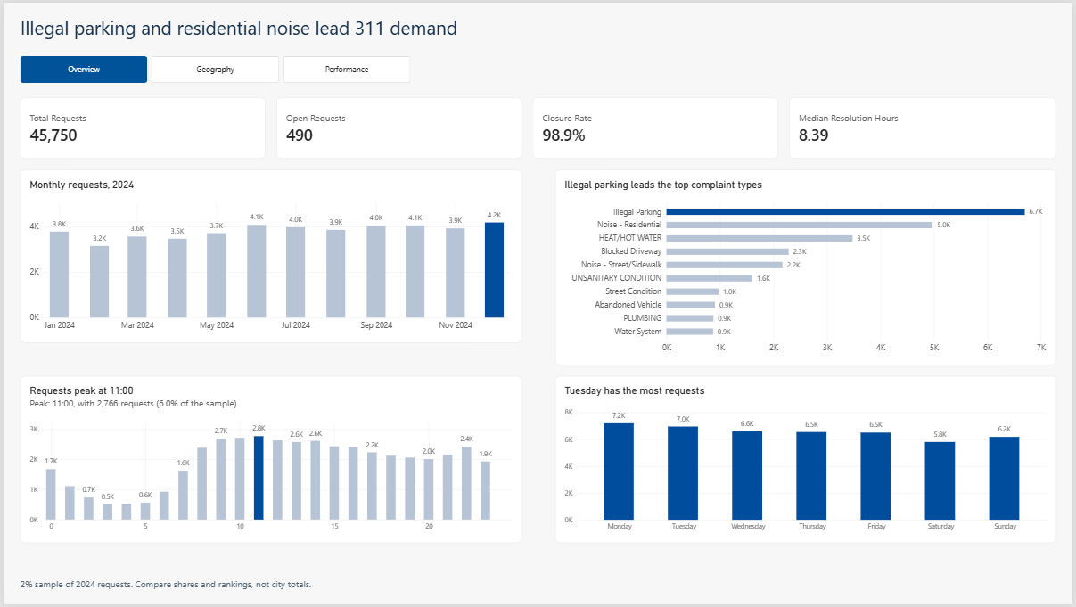
Reports and dashboard demonstration
Overview: parking and noise lead demand all year
Our dashboard
45,750 requests; 490 open (98.9% closed)
Illegal Parking 6,700; Noise - Residential 4,977
Peak at 11:00; Monday busiest (7,194); December is the peak month

Slide 9
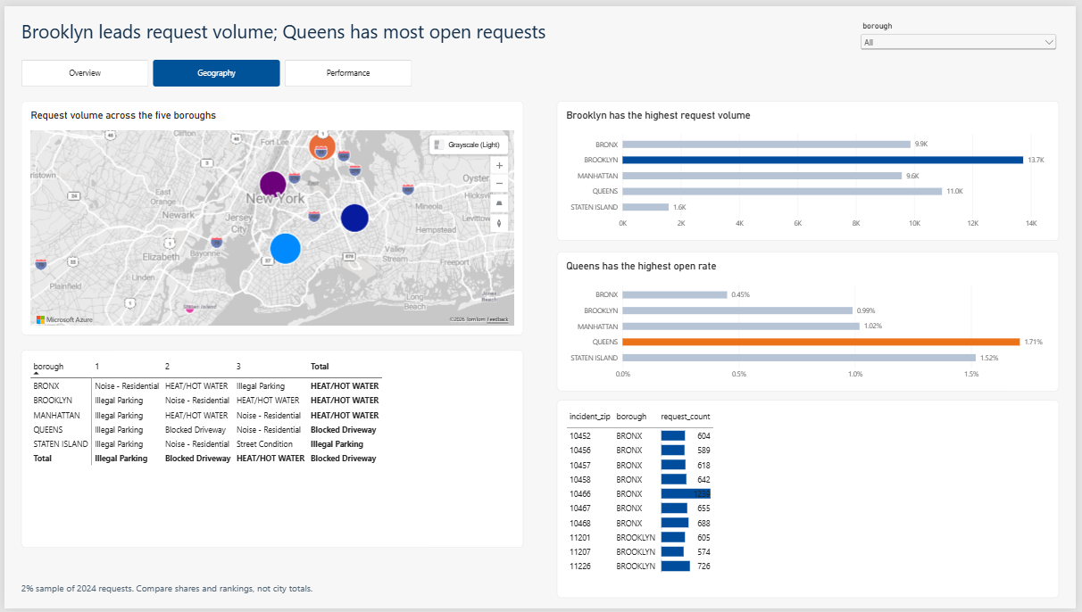
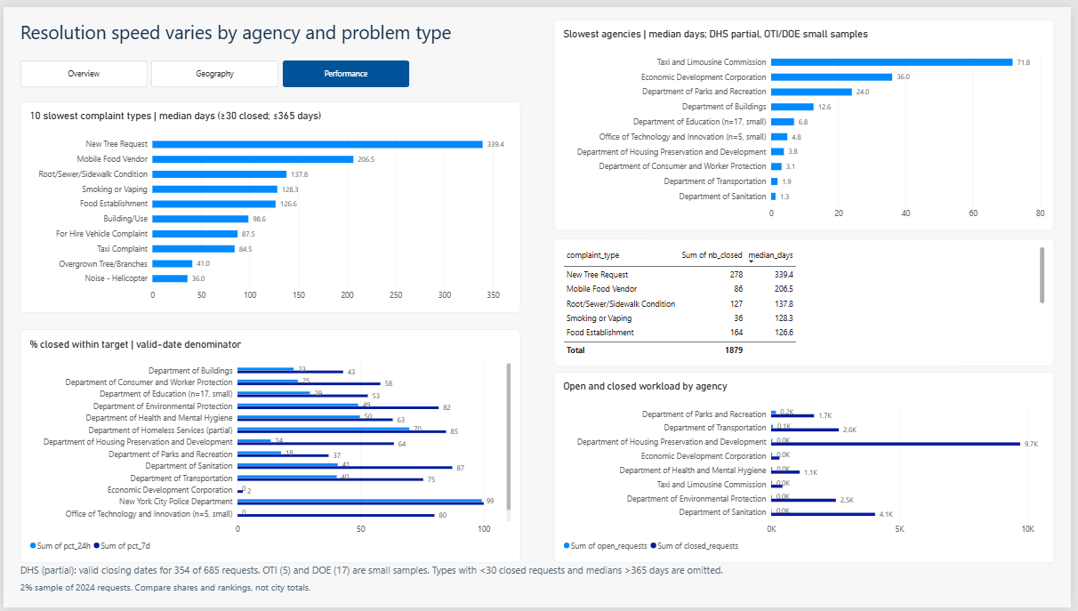
Reports and dashboard demonstration
Geography and Performance: where requests pile up, who is slow
Brooklyn: 13,738 requests (30.03%)
Queens: highest open rate, 1.71% (Bronx 0.45%)
ZIP 10466 (Bronx): 1,239 requests
NYPD median 1.1 h; TLC 71.8 days
New Tree Request slowest: about 340 days
DHS covers only 354 of 685 requests

Slide 10
Three key findings and corresponding recommendations
Three findings that tell managers where to act
1. Queens has the most open requests
Finding
Queens: 187 open, rate 1.71%. Bronx: 0.45%, though it has high demand.
Recommendation
Review Queens queue age and routing; track the open rate over time.
2. Noise pushes demand to evenings
Finding
Noise peaks at 22:00. Sunday evening is the busiest (1,957). Parking peaks at 8:00.
Recommendation
Evening and night noise teams Friday to Sunday; morning teams for parking.
3. Agency speed varies widely
Finding
HPD: 21% of volume, 13.5% solved in 24 h. TLC and EDC slowest. DPR has 186 open; tree requests ~340 days.
Recommendation
Set service targets, starting with HPD and DPR trees; review TLC and EDC.

Slide 11
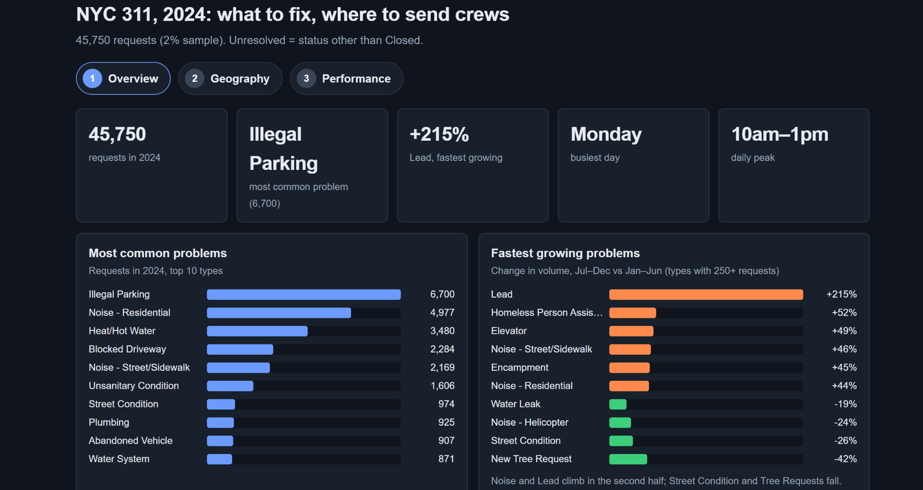
AI-generated dashboard
What an AI-generated dashboard is, and what Claude built
The concept
A tool builds a dashboard from the raw data and a prompt, in minutes
We gave Claude the CSV, our problem statement and the 4 questions, with no hints
Result: a 3-tab dashboard (Overview, Geography, Performance) and 3 findings
Dashboard generated by Claude (Overview tab)

Slide 12
AI-generated dashboard
We checked it against our SQL: fast, but it needs a human check
Criterion | Our dashboard | AI tool (Claude)
Numbers | All match the SQL | Match on all checked values; 1 wrong claim (Bronx has the most requests, but Brooklyn does)
Data problems | DHS dates, bad dates, empty due_date, missing ZIP and borough | Only bad dates and the sample size
Recommendations | Based on all 4 questions, with caveats | Specific, but some unsupported
Extras | % solved in 24 h and 7 days | Dot map, slowest-10% marker
It missed the 331 DHS requests marked Closed without a closing date: AI is a fast first draft, a human must verify.

Slide 13
Open issues and proposed improvements
What we would fix next
Open issues
Proposed improvements
331 DHS requests Closed without a closing date: DHS times are partial
due_date 99.45% empty: no deadline compliance
2% sample and one year only
Open requests have no solving time yet
OTI (5) and DOE (17) too small to compare
Get correct DHS closing dates or flag them in Power BI
Use the full dataset and several years
Add backlog age and trend views
Add deadline data to measure compliance
Re-run the Queens and ZIP watch list on a full year

