Slide 1
AI-Controlled Wastewater Aeration
DQN • PER-DQN • Rule-based Auto DO • Fixed Manual
Simulation evaluation, explainability, and research limitations
24-hour runs | 96 control steps | BSM1-derived dry influent
WASTEWATER AERATION | RESEARCH RESULTS

Slide 2
Problem & objective
• Maintain dissolved oxygen (DO) while avoiding excessive aeration.
• Compare fixed control, rule-based Auto DO, DQN and PER-DQN.
• Assess reward, DO violations, energy proxy and switching.
• Explain learned decisions with SHAP and decision-tree surrogates.
WASTEWATER AERATION | RESEARCH RESULTS

Slide 3
Experiment design
• One complete 24-hour interactive simulation per controller.
• 96 decisions per run (15-minute intervals).
• All four exports labeled BSM1-derived dry.
• Metrics use simplified DO/BOD-proxy simulator; energy is not kWh.
• Single-run results are descriptive, not statistical validation.
WASTEWATER AERATION | RESEARCH RESULTS

Slide 4
Four-controller results
Controller
Reward
DO < 2%
Energy
Switches
Manual
-197.22
68.75%
24.00
0
Auto DO
-75.81
5.21%
38.81
20
DQN
-69.56
15.62%
33.31
33
PER-DQN
-71.85
26.04%
34.00
45
Higher reward is better; lower DO violations and energy proxy are generally preferred.
WASTEWATER AERATION | RESEARCH RESULTS

Slide 5
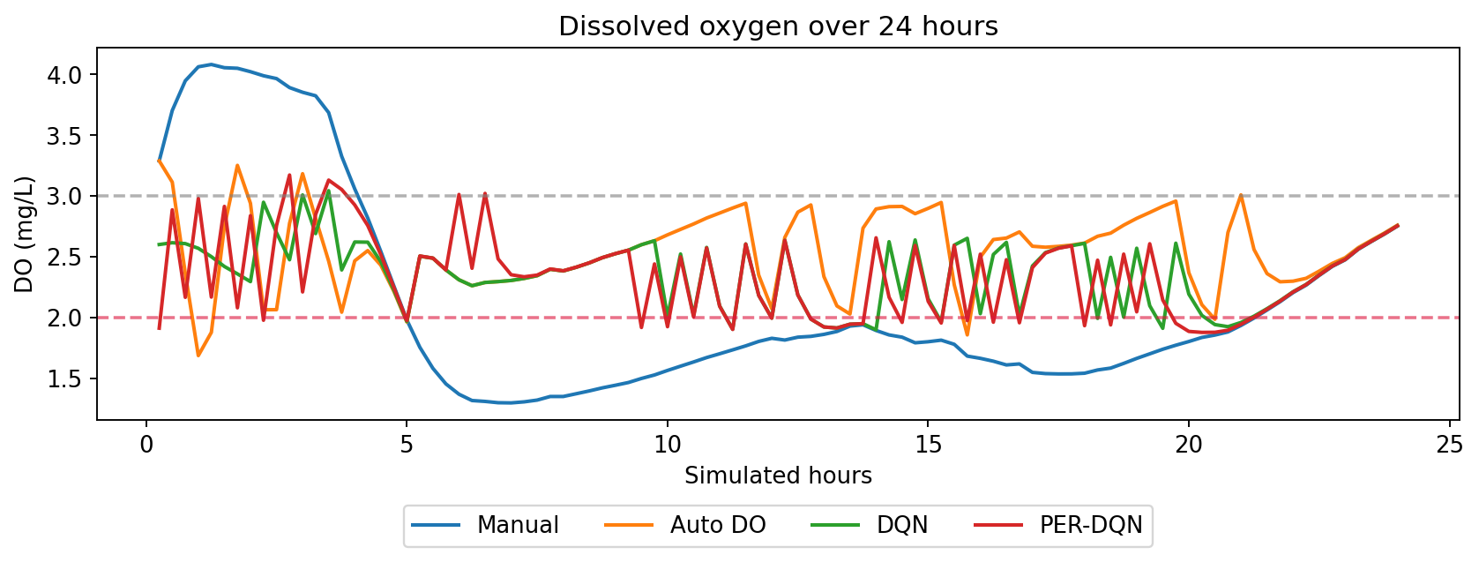
Dissolved oxygen across 24 hours
WASTEWATER AERATION | RESEARCH RESULTS

Slide 6
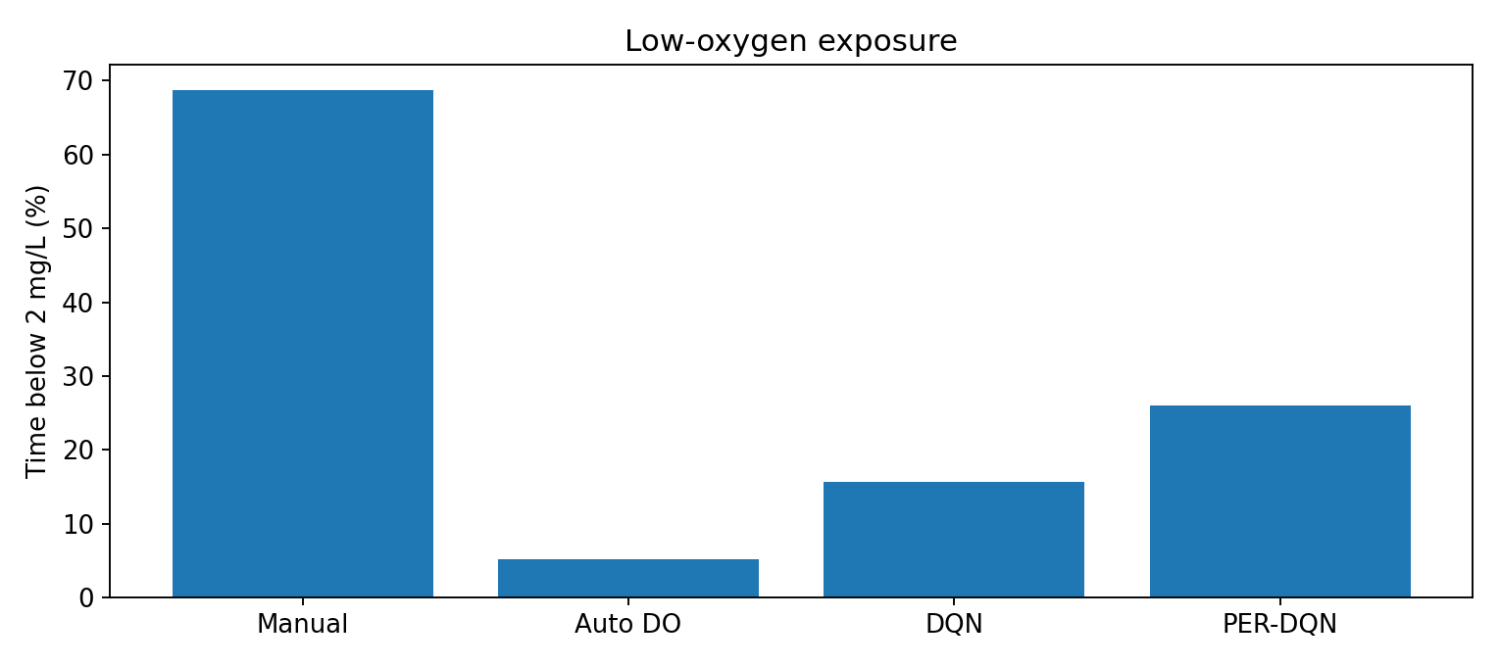
Safety trade-off
Auto DO: 5.21% below 2 mg/L
DQN: 15.63%
PER-DQN: 26.04%
Best reward ≠ best oxygen protection
WASTEWATER AERATION | RESEARCH RESULTS

Slide 7
Explainable AI: preliminary findings
• Previously reported DQN surrogate fidelity: 85.2%.
• Previously reported PER-DQN surrogate fidelity: 93.5%.
• Majority-class baselines: 82.4% and 89.8%, respectively.
• Balanced fidelity: 56.9% (DQN) and 61.8% (PER-DQN).
• SHAP images and extracted rule text are needed to verify feature-level claims.
WASTEWATER AERATION | RESEARCH RESULTS

Slide 8
Conclusions
• DQN achieved highest reward (−69.56) in the four recorded runs.
• Auto DO minimized low-DO exposure (5.21%).
• PER-DQN did not outperform DQN on reward or energy in this run.
• More switching may increase actuator wear (not modeled).
• No claim of statistical superiority or real-plant deployment readiness.
WASTEWATER AERATION | RESEARCH RESULTS

Slide 9
Next validation milestones
• Train DQN and PER-DQN with ≥3 independent seeds.
• Evaluate every trained model on identical held-out dry scenarios.
• Create independent rain/storm test events (avoid train/test leakage).
• Report mean ± standard deviation and DO safety metrics.
• Attach SHAP plots, extracted rules and feature definitions.
WASTEWATER AERATION | RESEARCH RESULTS

