Slide 1
Wastewater Aeration Control
• DQN and Prioritized Experience Replay DQN (PER-DQN)
• Simulated aeration control with interpretable decision support
• Final experimental results • three training seeds
Wastewater Aeration | DQN vs PER-DQN | 2026

Slide 2
Problem and objective
• Control dissolved oxygen (DO) while limiting aeration energy proxy.
• Compare fixed-blower, rule-based, DQN and PER-DQN policies.
• Explain learned decisions using SHAP and decision-tree surrogates.
Wastewater Aeration | DQN vs PER-DQN | 2026

Slide 3
Simulation and data
• BSM1-derived influent scenarios: dry, rain and storm.
• Simplified DO and BOD-proxy dynamics; discrete blower settings 0, 25, 50, 75, 100%.
• State: DO, BOD proxy, previous blower, influent BOD proxy and flow.
• Energy is a normalized proxy, not measured kWh.
Wastewater Aeration | DQN vs PER-DQN | 2026

Slide 4
Experimental design
• 600 training episodes per model; training seeds 42, 43 and 44.
• Held-out chronological dry test; 20 evaluation episodes per seed.
• Fixed evaluation seed 123 for matched testing.
• Report mean ± sample standard deviation across three trained seeds.
Wastewater Aeration | DQN vs PER-DQN | 2026

Slide 5
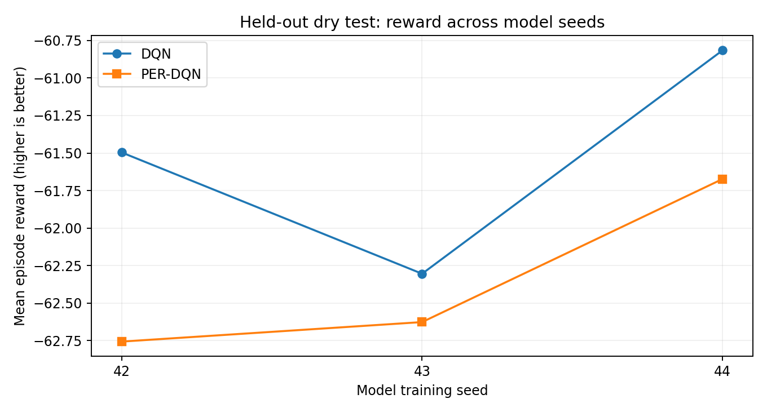
Main result: held-out reward
• DQN: −61.54 ± 0.75
• PER-DQN: −62.35 ± 0.59
• DQN achieved higher reward in all three seeds.
Wastewater Aeration | DQN vs PER-DQN | 2026

Slide 6
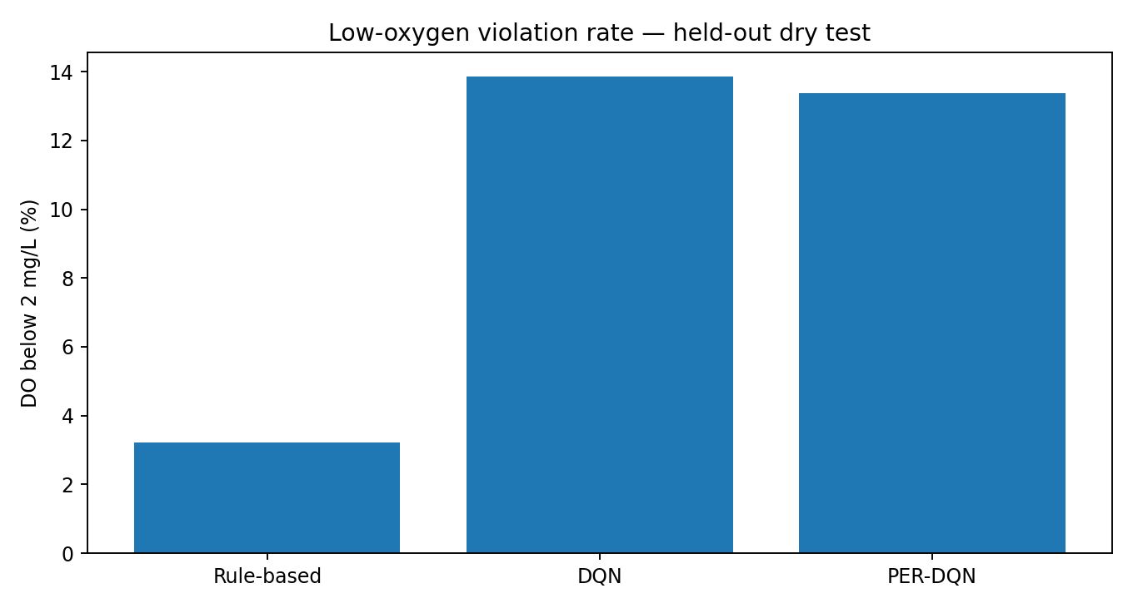
Energy and DO outcomes
• DQN energy proxy: 22.56 ± 0.34
• PER-DQN energy proxy: 23.38 ± 0.48
• Rule-based control had only 3.23% low-DO violations.
• Learned controllers trade reward/energy against DO safety.
Wastewater Aeration | DQN vs PER-DQN | 2026

Slide 7
What PER-DQN did and did not improve
• PER-DQN had slightly fewer low-DO violations on average: 13.37% vs 13.85%.
• DQN had fewer high-DO violations: 2.12% vs 5.28%.
• Three seeds are useful for robustness checks, not conclusive statistical superiority.
Wastewater Aeration | DQN vs PER-DQN | 2026

Slide 8
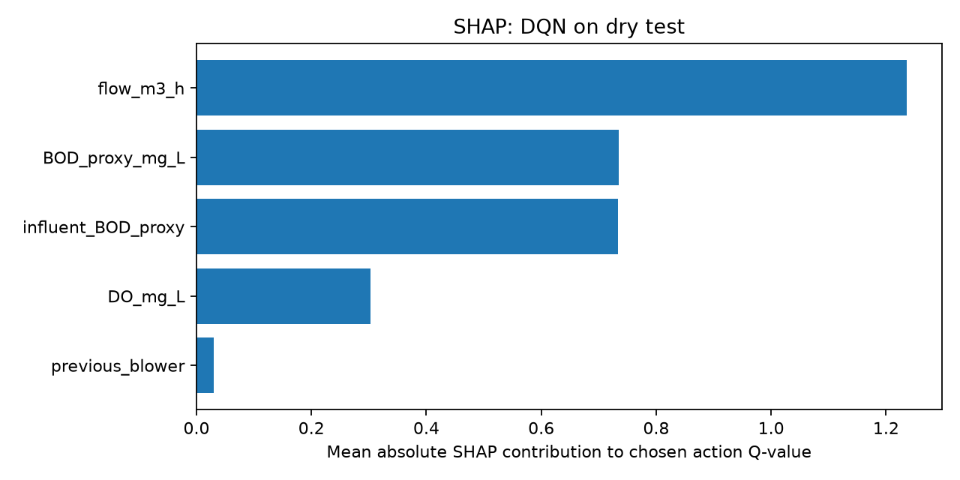
SHAP: DQN feature contributions
• Flow had the largest mean absolute SHAP contribution to selected-action Q-values.
• BOD proxy and influent BOD proxy followed.
• These are model explanations, not causal physical findings.
Wastewater Aeration | DQN vs PER-DQN | 2026

Slide 9
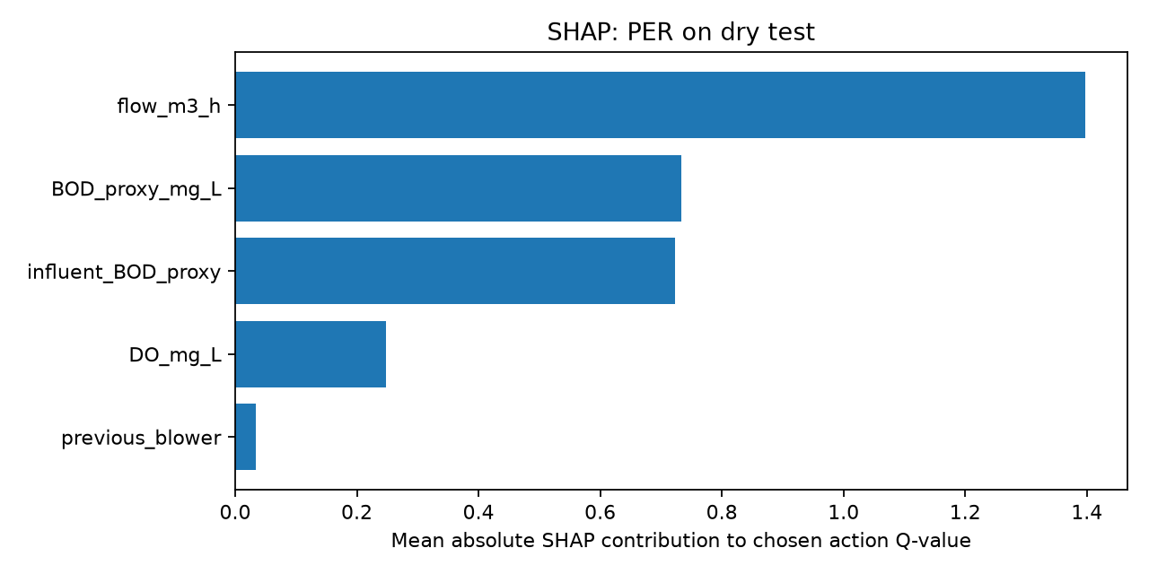
SHAP: PER-DQN feature contributions
• Flow ranked first, followed by BOD proxy and influent BOD proxy.
• DO and previous blower had smaller contributions in this explanation sample.
• SHAP outputs were available for seed 42 only.
Wastewater Aeration | DQN vs PER-DQN | 2026

Slide 10
Decision-tree surrogate
• DQN fidelity: 85.24%; balanced fidelity: 56.87%.
• PER-DQN fidelity: 93.49%; balanced fidelity: 61.76%.
• Majority-action baselines: 82.38% and 89.84%, respectively.
• Rules approximate network decisions; they are not validated safety logic.
Wastewater Aeration | DQN vs PER-DQN | 2026

Slide 11
Interactive demonstration
• Pygame supports Manual, Auto DO, DQN and PER-DQN modes.
• 24-hour CSV exports confirmed changing blower actions.
• These demonstrations are distinct from the held-out multi-seed evaluation.
Wastewater Aeration | DQN vs PER-DQN | 2026

Slide 12
Conclusions and limitations
• DQN gave the best mean reward and lower energy proxy in this experiment.
• Rule-based control protected against low DO more consistently.
• No demonstrated PER-DQN superiority on the dry held-out test.
• Simplified simulator; limited seeds; no real-plant validation or kWh calibration.
Wastewater Aeration | DQN vs PER-DQN | 2026

Slide 13
Submission checklist
• Include dataset provenance, preprocessing and code.
• Include six checkpoints and three seed-specific evaluation CSVs.
• Include SHAP/rules, graphs, presentation and report.
• Document assumptions and separate held-out tests from event diagnostics.
Wastewater Aeration | DQN vs PER-DQN | 2026

