Slide 1
DO ≈ 2–3 mg/L
Wastewater Treatment Aeration Tank Control Using Prioritized Experience Replay DQN (PER-DQN) and Rule Extraction
SELECTED TOPICS IN ARTIFICIAL INTELLIGENCE
Selected Topics in Artificial Intelligence | 7th Project
Team: Mariam Eladawy 231000469 – Zeyna Nader 231000000 –
Nourallah Ghonim 231003800 – Jaslim Elmassry 231012500
github.com/Nour158/Wastewater-Aeration-PER-DQN
Notes:
SAY: Introduce the project in one sentence: we trained Deep Q-Network controllers (standard DQN and PER-DQN) to set the blower power of a simulated aeration tank, compared them with fixed and rule-based controllers, and explained the learned policy with SHAP and a decision tree.
CONFIRM BEFORE PRESENTING: team names, student IDs, university, college, instructor, academic year (placeholders in amber; the repository does not contain them).
Q: Is this a real plant? A: No. It is a simplified single-tank simulator driven by BSM1-derived influent data; results are simulation findings only.
Q: What is the one-line result? A: DQN had the best reward/energy; the rule-based controller had the fewest low-DO steps; PER-DQN did not beat DQN overall.

Slide 2
Project overview: what the controller is controlling
PROJECT IDEA
Blower u ∈ {0, 25, 50, 75, 100}%
DO sensor
Aeration tank
Air lets microbes consume organic pollutants.
Dissolved oxygen (DO)
O₂ in the water, mg/L. Too low harms treatment.
Influent (flow Q, BOD in)
Effluent
BOD (proxy here)
Oxygen demand of the organic load, mg/L.
Our AI controller
Chooses blower power every 15 min to hold DO in band with less energy.
Notes:
SAY: An aeration tank is where bacteria remove organic pollution. They need dissolved oxygen (DO), measured in mg/L, supplied by blowers. BOD (biochemical oxygen demand) is the oxygen the microbes need to degrade organic matter, so it measures pollution load. Our AI picks the blower setting every 15 minutes.
TERMS: In this project BOD is a COD-derived PROXY: 0.6 x (Ss + Xs) from BSM1 influent files, not a lab-measured BOD. Energy is the normalized proxy u^2, not kWh.
LINK: Next slide turns this into objectives and the oxygen–energy trade-off.
Q: Why 2–3 mg/L? A: Our config uses min DO 2.0, max 3.0, target 2.5 (config.py). They are illustrative design values, not regulatory limits.
Q: Why must DO not be too high? A: Extra air wastes energy; in the reward high DO is also penalized.

Slide 3
Main objectives and the oxygen–energy trade-off
PROJECT IDEA
1 Maintain adequate dissolved oxygen
Oxygen availability
DO in 2–3 mg/L band
2 Reduce excess aeration energy
more air →
more DO
more air →
more energy
3 Handle changing wastewater conditions
4 Compare intelligent vs conventional control
Treatment performance
BOD removal (proxy)
Energy
blower power u²
5 Explain AI decisions with XAI
AI must balance all three
Notes:
SAY: Five goals: keep DO adequate, cut aeration energy, cope with changing influent, compare intelligent vs conventional control, and explain AI decisions. The triangle shows why it is a trade-off: more air raises DO and treatment capacity but costs energy; less air saves energy but lets DO collapse.
MATH: In the reward these goals become penalties: low DO (weight 12), high DO (5), energy u^2 (1), switching (0.1), capped BOD term (0.1).
LINK: Slide 4 shows why this is hard.
Q: Is "treatment performance" measured? A: Only through the simulated BOD proxy and DO band, not real effluent quality.
Q: Are objectives weighted equally? A: No; weights are in config.py and are a design choice (see slide 12/25).

Slide 4
Why aeration control is hard
PROBLEM STATEMENT
Too little O₂
DO < 2 mg/L: biological treatment suffers
Too much air
Wasted blower energy; DO > 3 mg/L
Varying load
Flow and organic load change over the day and by weather
Fixed settings
Cannot track changing conditions
Notes:
SAY: Four difficulties: (1) too little oxygen harms biological treatment, (2) too much wastes energy, (3) influent flow and load vary — the chart shows the BSM1-derived dry, rain and storm flows over 14 days (dry 417–1,341 m3/h; storm up to 2,500), (4) a fixed blower setting cannot adapt.
TERMS: Aeration is widely reported as one of the most energy-intensive parts of a plant (see Water 2025 in references); we do not claim a plant-specific share.
LINK: Slide 5 compares the control families.
Q: Why does fixed 50% fail? A: It leaves DO below 2 mg/L in 20.7% of test steps and above 3 mg/L in 24.1% (evaluate.py, seed 123).
Q: Why use flow as a state? A: Higher flow increases dilution/load and shifts DO and BOD dynamics.

Slide 5
Why traditional control is not enough — and why AI is not automatically better
PROBLEM STATEMENT
 | Fixed aeration | Rule-based feedback | RL (DQN / PER-DQN)
Idea | Constant blower (50% or 75%) | u ← u + 0.30·(2.5 − DO) | Learn a policy from reward
Strength | Simple, predictable | Transparent, no training, reacts to DO | Can trade DO vs energy automatically
Weakness | Cannot adapt to load | Fixed gain; not cost-aware | Needs simulator, reward design, no safety guarantee
Our result | Fixed 50%: −88.2 reward, 20.7% low DO Fixed 75%: −420.8, 89.2% high DO | Reward −64.2, low DO 3.2%, energy 25.9 | DQN −61.5 / PER-DQN −62.4; low DO 13.9% / 13.4%
Take-away: RL gave the best reward and energy, but the simple rule-based controller was clearly better at keeping DO ≥ 2 mg/L.
Notes:
SAY: Three families. Fixed aeration is simple but cannot adapt. Our rule-based controller is a proportional feedback law, u(t+1)=clip(u(t)+0.30(2.5-DO),0,1), rounded to the nearest of 5 levels (controllers.py). RL learns from reward but needs a simulator and gives no guarantees.
KEY HONESTY POINT: On the held-out dry test the rule-based controller had only 3.2% low-DO steps vs 13.9% (DQN) and 13.4% (PER-DQN); RL won only on reward and energy.
Q: Why not claim RL is better? A: Our data do not support it on DO compliance.
Q: Is the rule controller tuned? A: Gain 0.30 and target 2.5 are fixed by us; not optimized.

Slide 6
Related research 1/2: reinforcement learning for wastewater control
LITERATURE REVIEW
Croll, Ikuma, Ong, Sarkar (2023) – Environ. Sci. Technol.
Klawikowska & Grochowski (2024) – IEEE Access
Method: Compared DQN, PPO, A2C, TD3 on BSM1-type control.
Finding: TD3 cut aeration+pumping energy 14.3% vs BSM1 control; DQN, PPO, A2C generally performed poorly.
Limit: Robustness of RL needs work.
Our link: Shows RL is not automatically better; motivates honest baselines.
Method: TD3 sets oxygen transfer in 3 aerated tanks; BSM1, 4 weather scenarios, 16 metrics.
Finding: Better aeration-energy efficiency and cost index.
Limit: Single algorithm; simulation only.
Our link: Same dry/rain/storm idea, far richer plant model.
Zhu et al. (2025) – Bioresour. Technol.
Zhang, Meng, Ma (2026) – Processes 14(11):1800
Method: Bayesian optimization + RL for multi-objective control of activated sludge (A2O).
Finding: 46% lower operating cost, 12% lower energy, compliance kept.
Limit: Details beyond abstract not reviewed.
Our link: Suggests tuning rewards/hyperparameters (our future work).
Method: Model-based RL (SAC, TD3, PPO) for chemical dosing using an MLP surrogate of a plant.
Finding: All RL agents beat proportional control (≈70 vs 61 reward).
Limit: 227 records, single plant; surrogate R² ≈ 0.34.
Our link: Same simulator-fidelity limits; they add statistical tests.
Notes:
SAY: Four verified studies. Croll et al. (2023) compared DQN, PPO, A2C and TD3 and found TD3 best (14.3% lower aeration+pumping energy vs BSM1 benchmark); DQN generally performed poorly. Klawikowska & Grochowski (2024) used TD3 on BSM1 over four weather scenarios. Zhu et al. (2025) combined Bayesian optimization with RL (46% lower cost, 12% less energy). Zhang et al. (2026) used model-based RL (SAC/TD3/PPO) on a surrogate of a real plant.
CAUTION: Summaries come from abstracts/papers we retrieved; results are not comparable across papers (different plants and metrics).
Q: Why DQN if Croll found it weak? A: Our task is small and discrete (5 blower levels), which suits DQN, and we report DQN honestly as a baseline.
Q: Why no continuous control? A: Out of scope; listed as future work.

Slide 7
Related research 2/2: comparison and our contribution
LITERATURE REVIEW
Study | Algorithm(s) | Environment | Target | XAI
Chen et al. 2021 | MADDPG (multi-agent) | WWTP model | DO + chemical dosing | n/r
Croll et al. 2023 | DQN, PPO, A2C, TD3 | BSM1 via process-model interface | Aeration + pumping energy | n/r
Klawikowska 2024 | TD3 | BSM1, 4 weather scenarios | KLa in 3 tanks | n/r
Zhu et al. 2025 | Bayesian opt. + RL | Activated sludge (A2O) | Cost, energy, compliance | n/r
Zhang et al. 2026 | SAC, TD3, PPO | MLP surrogate (real plant) | Chemical dosing | Diagnostics
This project | DQN, PER-DQN (Double-DQN target) | Simplified tank + BSM1-derived influent | Blower (5 levels): DO band + energy proxy | SHAP + tree rules
n/r = not reported in the abstract we reviewed. Foundations: Mnih 2015 (DQN) · van Hasselt 2016 (Double DQN) · Schaul 2016 (PER) · Lundberg & Lee 2017 (SHAP) · Bastani 2018 (tree extraction).
Contribution: a transparent testbed that isolates PER vs uniform replay with matched seeds, benchmarks against fixed/rule baselines, adds SHAP + IF–THEN rules, and reports a neutral result honestly.
Notes:
SAY: The table positions our work. We are far simpler than BSM1/ASM1 studies, but we add something small and transparent: a matched-seed DQN vs PER-DQN test, fixed and rule-based baselines, and explainability (SHAP + extracted rules). Foundations: DQN (Mnih 2015), Double DQN (van Hasselt 2016), PER (Schaul 2016), SHAP (Lundberg & Lee 2017), policy extraction with trees (Bastani 2018).
GAP: We did not find a verified 2025–2026 paper applying PER-DQN to wastewater aeration; we do not claim none exists.
Q: What is your novelty? A: Not a better controller; a reproducible, honest comparison plus interpretability on a transparent testbed.
Q: Why compare with chemical dosing papers? A: They share the sequential-decision, reward-design and surrogate-fidelity issues.

Slide 8
Complete system architecture
PROPOSED APPROACH
BSM1-derived
influent data
Inf_dry/rain/strm
Data
preprocessing
prepare_dataset.py
data_split.py
Simplified
simulator
wastewater_env.py
RL controller
DQN / PER-DQN
rl_core.py
Blower
action
u ∈ {0…100%}
state s′ and reward r return to the agent
Tank
response
DO, BOD proxy
update (15 min)
Reward
DO band, energy,
switching, BOD cap
Learning &
evaluation
train.py
evaluate.py
Explainable AI
SHAP + tree rules
explain.py
Real data
Simulation
Learning
Analysis
Notes:
SAY: Read left to right then back along the bottom. BSM1-derived influent files are converted to flow and a BOD proxy, split chronologically, and fed to the simulator row by row. The RL agent observes the tank state, chooses one of five blower levels, the simulator updates DO and BOD and returns a reward. After training, evaluate.py compares controllers and explain.py produces SHAP and tree rules.
FILES: prepare_dataset.py, data_split.py, wastewater_env.py, rl_core.py + train.py, evaluate.py, explain.py.
Q: What is real and what is simulated? A: Influent flow/BOD-proxy are BSM1-derived data; DO, BOD proxy and blower response are simulated.
Q: Is training online on a plant? A: No, only in the simulator.

Slide 9
Dataset: BSM1-derived influent scenarios
PROPOSED APPROACH
Scenario | Rows | Flow mean / max (m³/h) | BOD proxy mean / max (mg/L)
Dry | 1,345 | 769 / 1,341 | 155 / 222
Rain | 1,345 | 888 / 2,172 | 143 / 222
Storm | 1,345 | 823 / 2,500 | 152 / 267
Real influent data
flow Q, BOD proxy 0.6·(Ss+Xs)
Simulated tank states
DO, BOD proxy, previous blower
Train 70%
Val 15%
Test 15%
941 rows (≈ days 0–9.8)
202
202 (≈ last 2.1 d)
All three test CSVs are identical (dry weather). Rain/storm “test” ≠ new weather event.
Chronological split — no shuffling, no overlap
Preprocessing: parse text → drop invalid rows (Q ≤ 0) → proxy + m³/h → split. Simulator reads one row per 15-min step.
Notes:
SAY: Source: IWA Benchmark Simulation Model No.1 influent files (dry, rain, storm; 14 days, 15-minute samples = 1,345 rows each). prepare_dataset.py keeps flow Q (m3/day -> m3/h) and builds bod_in_proxy = 0.6 x (Ss + Xs). data_split.py splits chronologically 70/15/15: train 941, validation 202, test 202 rows (~2.1 days).
IMPORTANT: the three test CSVs are byte-identical (same MD5) — the last 15% is dry weather in all three files, so "rain test" and "storm test" are not distinct held-out events. Event-window runs (rows 708–1096 rain, 750–1203 storm) overlap training/validation and are only diagnostics.
DISTINCTION: influent = real BSM1-derived data; DO, BOD and blower response = simulated.
Q: Why a chronological split? A: Avoids leakage from neighbouring time steps.
Q: Is validation used? A: Not for model selection in the code (final checkpoint is used) — state this if asked.
CONFIRM: license/citation of the BSM1 data (README asks to verify).

Slide 10
Wastewater simulation environment (wastewater_env.py)
PROPOSED APPROACH
D = Q / V
dilution rate (1/h); Q flow m³/h, V = 1000 m³
r_{bio} = k_{b} · BOD · DO/(K_{O}+DO)
degradation; k_b 0.08/h, K_O 0.5 mg/L
dBOD/dt = D(BOD_{in} − BOD) − r_{bio}
inflow dilution minus degradation
dDO/dt = K_{La}·u·(DO_{sat} − DO) − Y_{O}·r_{bio} + D(DO_{in} − DO)
aeration, consumption (Y_O 0.5), inflow; K_La 2/h, DO_sat 8
x_{t+1} = clip(x_{t} + Δt · dx/dt), Δt = 0.25 h
DO ∈ [0,8], BOD ∈ [0,1000]
Simplified simulation — not a calibrated BSM1/ASM1 plant model.
Notes:
SAY: One well-mixed tank. D=Q/V is the dilution rate. Biodegradation r = k_b·BOD·DO/(K_O+DO) is Monod-style oxygen limitation. BOD changes by inflow dilution minus degradation. DO changes by aeration K_La·u·(DO_sat−DO), minus oxygen consumed (0.5 per unit BOD degraded), plus inflow dilution. Euler step with dt=0.25 h; states clipped (DO 0–8, BOD 0–1000). Episode = 96 steps = 24 h; start DO 2.5, BOD 40, u 0.5, random start row.
PARAMETERS (TankConfig): V=1000 m3, k_b=0.08/h, K_O=0.5 mg/L, K_La,max=2/h, DO_sat=8, DO_in=0.5.
CHART: real env, constant blower from DO 2.5: 0% drives DO to 0; 50% stays ~2–3; 100% sits above 4 mg/L.
NOT a calibrated BSM1/ASM1 model.
Q: Is the BOD ever near 30 mg/L? A: No; it stays ≈ 130 mg/L in tests, so the 30 mg/L limit is illustrative and the capped BOD term is a constant offset.
Q: Why Euler? A: Simplicity; dt=15 min is small relative to the dynamics.

Slide 11
Markov decision process (MDP)
PROPOSED APPROACH
Agent
Q-network 5→128→128→5
ε-greedy / greedy
Action a_t ∈ {0, 25, 50, 75, 100}% blower
Environment
wastewater_env.py
BSM1-derived influent
γ = 0.99
96 steps / episode
Δt = 15 min
Reward r_t and next state s_{t+1}
S state
A action
R reward
S′ next state
DO, BOD, prev. blower, influent BOD proxy, flow
5 discrete blower settings
−(low-DO + high-DO + BOD cap + energy + switching)
Euler update + next 15-min influent row
Notes:
SAY: State s_t=[DO, BOD, previous blower, influent BOD proxy, flow] (5 numbers, normalized by fixed scales [8,200,1,200,1000], clipped to [0,5] inside rl_core). Action a_t = one of 5 blower levels. Reward r_t from the penalties on slide 12. Next state s_{t+1} comes from the simulator and the next data row. Discount gamma=0.99. There are no terminal states: episodes end by time-limit truncation after 96 steps and the code bootstraps through the truncation (done=False).
Q: Is it Markov? A: Approximately; the influent time series is only observed at the current step (no forecast), so some hidden dynamics exist.
Q: Why include previous blower? A: It enters the switching penalty and the rule baseline; SHAP found it nearly irrelevant to Q-values (≈0.03).

Slide 12
Reward function: exact implemented form
PROPOSED APPROACH
r_{t} = −[ 12·max(0, 2 − DO′)² + 5·max(0, DO′ − 3)² + 0.1·min(4, (max(0, BOD′ − 30)/30)²) + 1.0·u² + 0.1·|u − u_{prev}| ]
Term | Weight | Threshold | Purpose
Low DO | 12 | DO < 2.0 mg/L | protect treatment (quadratic)
High DO | 5 | DO > 3.0 mg/L | avoid over-aeration
BOD (capped) | 0.1 | 30 mg/L, cap 4 | illustrative effluent limit
Energy u² | 1.0 | — | normalized energy proxy
Switching | 0.1 | |u − u_prev| | smooth blower use
Case (start DO) | Blower | DO′ | Low | High | Energy | r
too low (0%) (2.1) | 0% | 0.673 | -21.115 | 0 | 0 | -21.565
Appropriate (50%) (2.1) | 50% | 2.149 | 0 | 0 | -0.25 | -0.65
Too high (100%) (2.9) | 100% | 3.776 | 0 | -3.014 | -1 | -4.464
BOD′ ≈ 129 mg/L in all runs, so the BOD term is a constant −0.4 per step (≈ −37 per episode) — it does not distinguish controllers.
Examples computed with the real environment, BOD = 130, previous blower 50%, first test row.
Notes:
SAY: r = −(12·max(0,2−DO')² + 5·max(0,DO'−3)² + 0.1·min(4,(max(0,BOD'−30)/30)²) + 1.0·u² + 0.1·|u−u_prev|), where primes denote the next state. Low DO is penalized hardest and quadratically; high DO and energy discourage over-aeration; switching discourages chattering; the BOD term is capped so it cannot dominate.
EXAMPLES (computed with the real env): DO 2.1 and blower 0% → DO falls to 0.67 and reward −21.6; blower 50% → DO 2.15, reward −0.65; DO 2.9 with blower 100% → DO 3.78, reward −4.46.
CRITICAL INSIGHT: BOD' ≈ 129 mg/L, so the capped BOD term is always −0.4/step (≈ −37 per episode) for every controller — an uncontrollable offset (≈ 60% of a −61 reward).
Q: Why quadratic? A: Larger violations hurt more; shallow dips are cheap, which helps explain the learned policies' many shallow low-DO steps.
Q: How were weights chosen? A: Design choice in config.py; no sensitivity study — a limitation.

Slide 13
Deep Q-Network (DQN) as implemented in rl_core.py
PROPOSED APPROACH
Q(s,a) ← Q(s,a) + α [ r + γ max_{a′} Q(s′,a′) − Q(s,a) ]
Input
5 state
Hidden
128 ReLU
Hidden
128 ReLU
Output
5 Q-values
y = r + γ (1 − d) · Q_{θ⁻}( s′, argmax_{a′} Q_{θ}(s′,a′) )
L(θ) = E[ w · Huber( y − Q_{θ}(s,a) ) ] (w = 1 for DQN)
ε_{k} = max(0.05, 1 − 0.95 k / (0.8 E)), E = 600
Hyperparameter | Value
Optimizer / lr | Adam, 5e-4
γ / batch / buffer | 0.99 / 64 / 50,000
Target sync | every 250 updates
Grad clip / loss | 10 / Huber
Greedy action = argmax of the 5 Q-values (blower 0–100%)
Notes:
SAY: Q-learning learns Q(s,a), the expected discounted return. A neural network Q_theta (5→128→128→5, ReLU) approximates it. Experience replay breaks correlation; epsilon-greedy explores (epsilon from 1.0 to 0.05 by 80% of training); a target network (copied every 250 updates) stabilizes the bootstrap. Our code uses the Double-DQN target: the online net picks the next action, the target net evaluates it. Loss is Huber (smooth L1) times importance weights (all 1 for plain DQN); Adam lr 5e-4; gradient clip 10; batch 64; buffer 50,000; gamma 0.99.
Q: Is this vanilla DQN? A: It is DQN with a Double-DQN target and Huber loss — say so explicitly.
Q: Why a target network? A: A moving target makes bootstrapped regression unstable.
Q: Does 'done' matter? A: Always 0, since episodes end only by time limit.

Slide 14
Prioritized Experience Replay (PER)
PROPOSED APPROACH
δ_{i} = y_{i} − Q_{θ}(s_{i}, a_{i}) p_{i} = |δ_{i}| + 10⁻⁵
Schematic (not experimental data)
Uniform sampling probability
P(i) = p_{i}^{α} / Σ_{k} p_{k}^{α}, α = 0.6
w_{i} = (N · P(i))^{−β} / max_{j} w_{j}, β: 0.4 → 1.0
L(θ) = mean_{i}[ w_{i} · Huber(δ_{i}) ]
 | Uniform replay (DQN) | Prioritized replay (PER-DQN)
Sampling | equal probability | ∝ |TD error|^0.6
Loss weights | all 1 | importance weights w_i
New data | stored | max priority
Cost | O(1) sampling | O(N) list sampling here
Prioritized sampling probability
Notes:
SAY: Uniform replay treats every stored transition as equally useful. PER samples transitions with large temporal-difference (TD) error more often because the network has more to learn from them. delta = y − Q(s,a); priority p = |delta| + 1e-5; probability P(i) = p^alpha / sum p^alpha with alpha = 0.6; to correct the bias, each sample gets an importance-sampling weight w = (N·P(i))^(−beta), normalized by the max weight in the batch; beta anneals 0.4 → 1.0. New transitions receive the current maximum priority; priorities are updated after every gradient step.
IMPLEMENTATION NOTE: priorities live in a Python list, so sampling is O(N) (no sum-tree); sampling is without replacement.
Q: Why might PER not help here? A: Hypotheses (untested): small 5-D state space, stationary simulator, noisy TD errors, untuned alpha/beta, only 3 seeds.
Q: What does beta do? A: Controls how fully the sampling bias is corrected; reaches 1 at the end.

Slide 15
DQN vs PER-DQN: one change, tested as a hypothesis
PROPOSED APPROACH
Shared by both
Only PER-DQN
Network 5→128→128→5 (ReLU)
Double-DQN target, Huber loss, Adam 5e-4
γ 0.99, batch 64, buffer 50,000, target sync 250
ε schedule, 600 episodes, seeds 42/43/44
Same environment and evaluation seeds
Priorities p = |δ| + 1e-5, α = 0.6
Probability-proportional sampling
Importance weights, β: 0.4 → 1.0
Priority update after each step
Extra O(N) sampling cost
Hypothesis H: prioritizing high-TD-error transitions improves learning. Evidence in our runs: not supported overall (slide 22). PER-DQN is not guaranteed to be better.
Notes:
SAY: Everything is identical except replay sampling and loss weighting: same network, Double-DQN target, optimizer, schedules, seeds and evaluation. This isolates the effect of PER. PER adds alpha and beta hyperparameters and extra computation. The hypothesis was that prioritizing surprising transitions would speed learning or improve the final policy; our experiment does not support an overall improvement.
Q: Could PER be mis-tuned? A: Yes — alpha=0.6, beta 0.4→1 are the standard PER values and were not tuned for this task.
Q: Why same hyperparameters for both? A: To keep the comparison controlled; tuning each separately is future work.
Q: Is the difference significant? A: With 3 seeds we make no significance claim; reward gaps were same-sign in 3/3 seeds (exploratory only).

Slide 16
Training process (train.py)
PROPOSED APPROACH
Initialize environment
Initialize agent + replay
1
2
Select blower action (ε-greedy)
Simulate next tank state
3
4
Compute reward
Store transition
5
6
Sample batch (uniform / PER)
Update network
7
8
Update priorities (PER)
Save final model + logs
9
10
600 episodes · seeds 42/43/44 · 96 steps (24 h) · 57,600 transitions/model
Notes:
SAY: For each of 600 episodes: reset the environment (random start row in the dry TRAIN split, seed = model seed + episode), then 96 steps: choose action (ε-greedy), step the simulator, store the transition, sample a batch of 64 and update the network; PER also updates priorities. Targets sync every 250 updates. We log per-episode reward, epsilon, loss, % steps below 2 mg/L, mean blower and action counts to CSV; only the FINAL model is saved (no intermediate checkpoints).
FACTS: 600 episodes x 96 = 57,600 transitions; buffer 50,000 fills around episode 521 and then overwrites oldest. Seeds 42, 43, 44 for each algorithm = 6 models. README examples mention 300 episodes, but logs and report use 600.
CHART: mean training reward over 3 seeds (includes exploration, so not the test score): about −714 at the start to about −100 at the end; curves for DQN and PER nearly coincide.
Q: Is training reward comparable to test reward? A: No; training includes ε-random actions and the training split.
Q: Early stopping? A: None.

Slide 17
Our implemented solution
PROPOSED SOLUTION
Simplified aeration simulator
wastewater_env.py · config.py
Baselines: fixed & rule-based
controllers.py
DQN controller
rl_core.py · train.py
PER-DQN controller
rl_core.py · train.py
Evaluation pipeline
evaluate.py · plot_training.py
Explainable AI
explain.py (SHAP + tree)
Interactive Pygame lab
pygame_aeration_lab.py
Implemented ✓
Simulated findings → slides 21–25
Future → slide 26
Re-run check: all six checkpoints reproduce the multi-seed table exactly (evaluation seed 123, 20 episodes).
Notes:
SAY: Seven components, all in 02_Python_Code: simulator (wastewater_env.py + config.py), baselines (controllers.py: Fixed and RuleBased), DQN and PER-DQN (rl_core.py, train.py), evaluation (evaluate.py, saves CSVs and figures), explainability (explain.py), and the interactive Pygame lab. Trained checkpoints for 3 seeds x 2 algorithms are in 03_Results/models.
STATUS: Implemented = all of the above. Experimental finding = slides 21–25. Future = slide 26.
VERIFIED: we re-ran all six checkpoints and reproduced the multi-seed table exactly (e.g., DQN seed 42 reward −61.496), and re-built the surrogate trees (fidelity 0.8524 / 0.9349).
Q: What is not implemented? A: Continuous actions, real-plant calibration, safety constraints, intermediate checkpoints.
Q: Where are results stored? A: 03_Results/metrics and /figures; final summary in 04_Final_Submission.

Slide 18
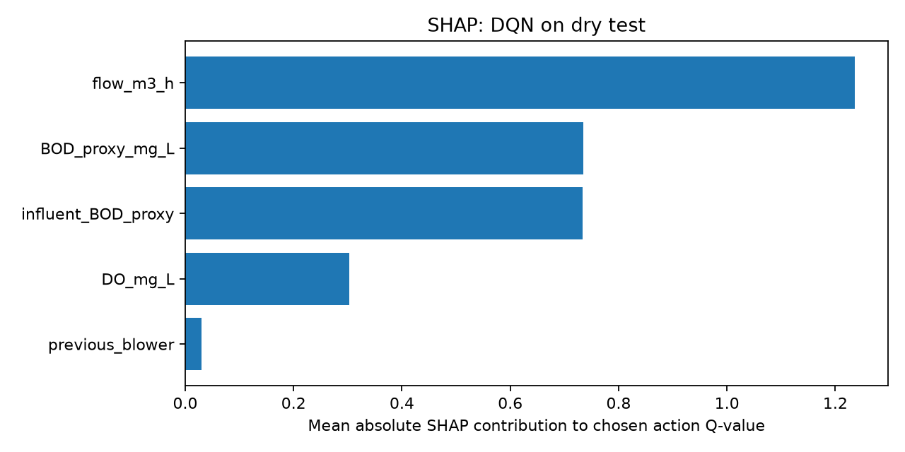
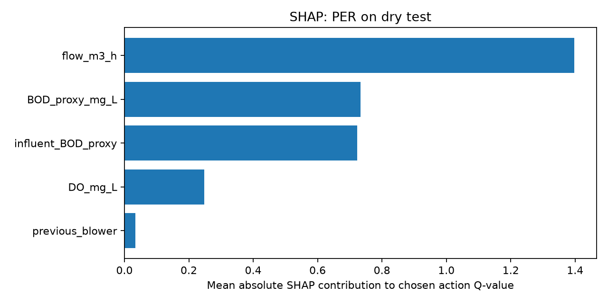
Explainable AI: SHAP attributions of Q-values
PROPOSED SOLUTION
DQN (seed 42)
PER-DQN (seed 42)
Flow ranks first, then BOD proxy and influent BOD proxy; DO is 4th; previous blower ≈ 0.
Attribution of predicted Q-values for the chosen action — not proof of causality.
Seed 42 only; 30 explained samples.
Notes:
SAY: SHAP assigns each input feature a Shapley-value contribution to the model output. We use KernelExplainer on the Q-network's Q-values for the greedy action: background 40 states, 30 explained states, 100 samples, seed-42 models, dry test rollouts. Importance = mean |SHAP|.
RESULTS: flow 1.24 (DQN) / 1.40 (PER); BOD proxy 0.73 / 0.73; influent BOD proxy 0.73 / 0.72; DO 0.30 / 0.25; previous blower 0.03 / 0.03.
CAUTION: SHAP explains what drives the predicted VALUE, not why an action is physically right, and is not causal. DO is only 4th even though it triggers the penalties — Q-values depend on future load too. Only seed 42, 30 samples: low statistical stability.
Q: Why KernelSHAP? A: Model-agnostic; works on any network.
Q: Why does flow dominate? A: Flow sets dilution and load; it varies most across states (hypothesis).
Q: Does high SHAP mean causal? A: No.

Slide 19
Rule extraction: a decision tree approximates the policy
PROPOSED SOLUTION
Trained
DQN / PER-DQN
State → action
rollouts
Decision tree
(depth 4)
IF–THEN
rules
Fidelity
evaluation
Extracted PER-DQN rules (seed 42, dry)
Fidelity (held-out rollouts)
IF BOD ≤ 168.6 AND DO ≤ 3.14 AND BOD ≤ 74.6 → 25% blower
DQN 85.2%
majority 82.4% · balanced 56.9%
PER-DQN 93.5%
majority 89.8% · balanced 61.8%
Rules describe the network, not safe control.
IF BOD ≤ 168.6 AND DO ≤ 3.14 AND BOD > 74.6 → 50%
IF BOD ≤ 168.6 AND DO > 3.14 AND influent BOD ≤ 94.7 → 0%
IF BOD ≤ 168.6 AND DO > 3.14 AND influent BOD > 94.7 → 50%
IF BOD > 168.6 AND DO ≤ 2.47 → 75%
IF BOD > 168.6 AND DO > 2.47 AND influent BOD ≤ 193.4 → 50%
IF BOD > 168.6 AND DO > 2.47 AND influent BOD > 193.4 → 75%
Notes:
SAY: We roll out the trained greedy policy on the dry train/test splits, record (state, action) pairs, and fit a depth-4 decision tree (min 20 samples per leaf) to imitate the network. Rules below are read directly from rules_per_trained_dry_explained_dry_seed42.txt (classes: 25%, 50%, 75%, 0% blower).
FIDELITY = agreement with the network on held-out rollouts: DQN 85.2%, PER 93.5%; but the majority-action baselines are 82.4% and 89.8%, and balanced fidelity is 56.9% / 61.8%.
Q: Are these safety rules? A: No; they approximate the network, not the physical process.
Q: Why depth 4? A: Readability; deeper trees would raise fidelity but reduce interpretability.
Q: Why PER fidelity higher? A: Mostly because its policy is more concentrated on 50% (baseline 89.8%).

Slide 20
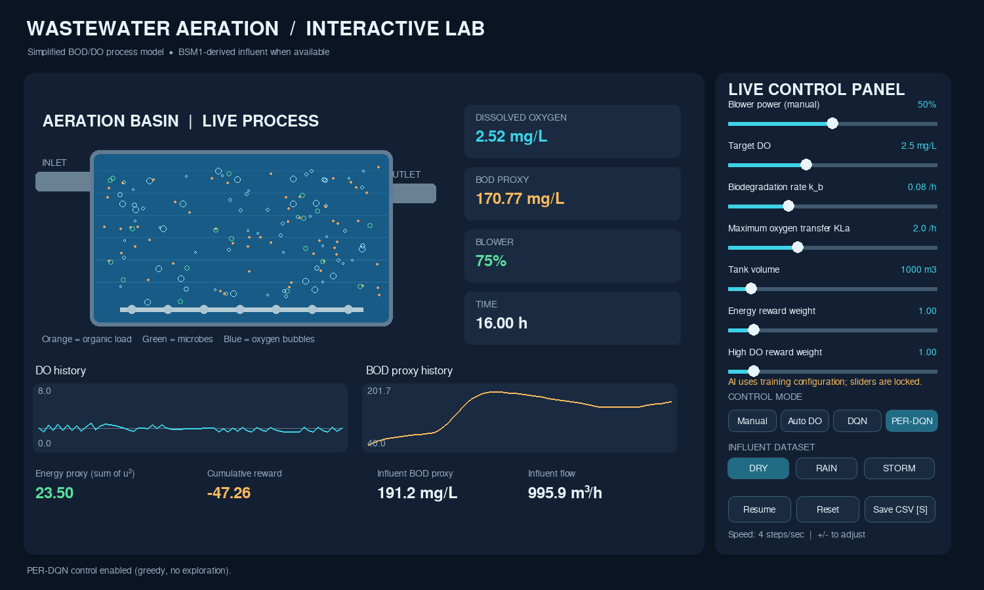
Interactive simulation: Pygame aeration lab
PROPOSED SOLUTION
Tank visualization
bubbles ∝ blower, organic load, microbes
Controls
Manual · Auto DO · DQN · PER-DQN
Live metrics
DO, BOD proxy, blower, reward, energy
Experiments
dry/rain/storm, sliders, CSV export
Real screenshot of the lab (PER-DQN mode, dry influent, 16 h into an episode).
Notes:
SAY: pygame_aeration_lab.py lets the audience see the tank. Left: animated basin (bubbles scale with blower, orange = organic load). Right: sliders for blower, target DO, k_b, K_La, tank volume and reward weights; four control modes (Manual, Auto DO, DQN, PER-DQN); dry/rain/storm influent. AI modes lock sliders to the training configuration. A 24-hour (96-step) episode is auto-saved as CSV in 03_Results/simulation_exports.
SCREENSHOT: rendered headless from your repository code with the real PER-DQN seed-42 checkpoint (Python/Pygame, no display). Replace it with a live screenshot if you prefer.
CAUTION: Demo runs are single episodes with different settings (e.g., PER-DQN −71.9, DQN −69.6, Auto DO −75.8, Manual −93.2 / −197.2 reward) — not controlled experiments.
Q: Is the demo the evaluation? A: No; evaluation is evaluate.py on the held-out split.
Q: Why locked sliders for AI? A: The agents were trained with default dynamics; changing them is out of distribution.

Slide 21
Experimental setup
RESULTS AND DISCUSSION
Item | Setting
Training data | Dry train split, 941 rows
Test data | Dry chronological test, 202 rows (last ≈ 2.1 days)
Models | DQN and PER-DQN × seeds 42, 43, 44 (600 episodes)
Evaluation | 20 episodes / model, greedy, evaluation seed 123
Baselines | Fixed 50%, Fixed 75%, rule-based (gain 0.30, target 2.5)
Metrics | Reward, % DO < 2, % DO > 3, energy proxy Σu², blower switches
Reporting | Mean ± sample SD over model seeds; descriptive only
Protocol
Same start rows for every controller
No exploration at test time
No tuning on the test split
Weather-event windows (rain rows 708–1096, storm 750–1203) overlap training data: diagnostics only, not held-out.
Notes:
SAY: Train on the dry TRAIN split; test on the chronological dry TEST split (202 rows). Three model seeds (42, 43, 44) per algorithm, 600 episodes each. Evaluation: 20 episodes per model, greedy (epsilon=0), evaluation seed 123 so every controller sees identical start rows. We report mean ± sample SD across the three model seeds (not confidence intervals).
VERIFIED: re-running evaluate-style code with seed 123 reproduced fixed_50 −88.222, fixed_75 −420.776, rule-based −64.164 and all six DQN/PER rows.
CONFIRM: evaluate.py default seed is 900 (it reproduces the “rain/storm tested” CSVs, which are the same dry test split); the final report states seed 123. Say which you used.
Q: Why only dry? A: Time and clean held-out data; rain/storm event windows overlap training.
Q: Why 20 episodes? A: Reduces start-state noise; per-model reward SD ≈ 1.1–1.3.
Q: Where is the statistics test? A: None; n = 3 seeds.

Slide 22
DQN vs PER-DQN: multi-seed held-out results
RESULTS AND DISCUSSION
Metric (mean ± SD, 3 seeds) | DQN | PER-DQN
Mean reward | −61.54 ± 0.74 | −62.35 ± 0.59
Energy proxy | 22.56 ± 0.34 | 23.38 ± 0.48
Low-DO steps | 13.85% ± 2.71 | 13.37% ± 2.99
High-DO steps | 2.12% ± 1.51 | 5.28% ± 2.49
Blower switches | 25.4 ± 2.1 | 23.7 ± 5.3
DQN: better reward & energy (3/3 seeds). PER-DQN: slightly fewer low-DO steps (2/3 seeds) but more high-DO. No overall PER-DQN win.
Reward by seed — DQN: −61.50, −62.30, −60.82 · PER-DQN: −62.76, −62.63, −61.67
Notes:
SAY: Verified against multiseed_summary.csv AND by re-running all six checkpoints. DQN: reward −61.54 ± 0.74, energy 22.56 ± 0.34, low-DO 13.85 ± 2.71%, high-DO 2.12 ± 1.51%. PER-DQN: −62.35 ± 0.59, 23.38 ± 0.48, 13.37 ± 2.99%, 5.28 ± 2.49%.
INTERPRETATION: DQN had better reward and energy in 3/3 seeds; PER-DQN had slightly fewer low-DO steps on average (2/3 seeds), a difference far smaller than the seed SD; PER-DQN had more high-DO steps. We do NOT claim PER-DQN outperformed DQN.
Exploratory paired differences (PER−DQN reward): −1.26, −0.32, −0.86; with n=3 any p-value is fragile.
Q: Is DQN significantly better? A: Consistent in sign for reward/energy, but n=3; we call it descriptive.
Q: Is 13.37 vs 13.85 meaningful? A: No; it is well inside the seed SD.

Slide 23
Baseline comparison on the dry held-out test
RESULTS AND DISCUSSION
Controller | Reward | Low DO (%) | High DO (%) | Energy | Switches
Fixed 50% | −88.22 | 20.68 | 24.12 | 24.00 | 0
Fixed 75% | −420.78 | 0.00 | 89.17 | 54.00 | 0
Rule-based | −64.16 | 3.23 | 4.38 | 25.91 | 17.9
DQN | −61.54 | 13.85 | 2.12 | 22.56 | 25.4
PER-DQN | −62.35 | 13.37 | 5.28 | 23.38 | 23.7
Best reward/energy: DQN. Best DO compliance among adaptive controllers: rule-based. Fixed 75% is the cost of “always safe”.
Mean over 20 episodes; DQN/PER = mean of 3 model seeds; baselines identical across seeds.
Notes:
SAY: Fixed 75% never goes below 2 mg/L (0%) but is above 3 mg/L in 89.2% of steps and uses 54.0 energy units. Fixed 50% is cheap (24.0) but under-aerates 20.7% of the time. The rule-based controller has the best DO compliance among adaptive controllers (3.2% low, 4.4% high) at energy 25.9. DQN/PER-DQN lower energy to 22.6/23.4 and achieve the best rewards, but at 13–14% low-DO steps.
WHY: with a quadratic penalty, many shallow dips below 2 mg/L cost little relative to energy savings (see slide 25).
Baselines are deterministic, so they have no seed variation.
Q: Which controller would you deploy? A: None directly; rule-based looks safest here, and RL would need constraints and real validation.
Q: Why does RL beat rule on reward? A: Lower energy — reward differences are mostly energy.

Slide 24
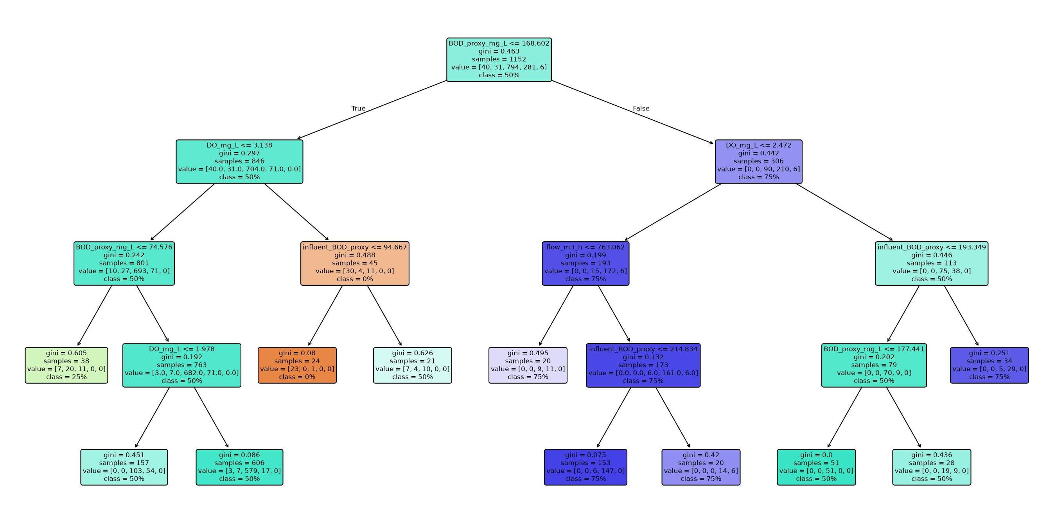
Explainability results: tree, fidelity and limits
RESULTS AND DISCUSSION
PER-DQN surrogate tree (seed 42)
Fidelity ≠ safety: rare but important actions (75%, 25%) are poorly recovered; the rules describe the network, not the plant.
Notes:
SAY: Left: the depth-4 surrogate tree for PER-DQN (seed 42, from the repository). Right: fidelity vs the majority-action baseline. Fidelity 93.5% looks high but the always-predict-50% baseline is 89.8%. The tree captures the dominant 50% action well (1,020/1,035) but misses most rare actions: PER tree recovers only 5/39 of the 75% actions; DQN tree 17/36 of 75% and 44/167 of 25%.
TREE IMPORTANCE: BOD proxy 0.54–0.63, DO 0.22–0.33; SHAP ranked flow first — the two methods answer different questions (surrogate splits vs Q-value attribution).
LIMITS: fidelity measures agreement, not correctness or safety; tree trained on rollouts of one seed.
Q: Why disagree with SHAP? A: Tree splits reflect action boundaries; SHAP reflects value contributions.
Q: Would you trust these rules? A: As an explanation aid only.

Slide 25
Discussion and limitations
RESULTS AND DISCUSSION
What the evidence says
BOD term ≈ 37 per episode for every controller (constant).
Gaps between DQN, PER and rule are mostly energy.
Quadratic low-DO penalty makes shallow dips cheap → 13–14% low-DO steps.
PER-DQN not better: untested hypotheses (small state, stationary simulator, untuned α/β, 3 seeds).
Limitations
Simplified dynamics; BOD is a COD-derived proxy, not effluent BOD.
Energy proxy u², not kWh; reward weights not tuned or sensitivity-tested.
Only 3 seeds, one dry held-out window; no real-plant data.
No safety constraints; weak generalization evidence.
Notes:
SAY: Why PER-DQN did not consistently win (HYPOTHESES, not tested): low-dimensional state, stationary simulator and a 50k buffer leave little to prioritize; TD errors are noisy; alpha/beta untuned; only 3 seeds.
REWARD EVIDENCE (chart, computed from the real env): the capped BOD term is ≈ 37 per episode for every controller; energy is 22–26; DO terms are tiny for adaptive controllers (0.1–1.2). So reward gaps between DQN, PER and rule-based are driven mostly by energy, and quadratic low-DO penalties make shallow dips cheap — hence 13–14% low-DO steps despite good reward.
LIMITS: simplified dynamics; BOD is a COD-derived proxy and not effluent BOD; energy u^2 is not kWh; 3 seeds, one held-out dry window; unknown generalization to real plants; no safety constraints.
Q: How would you fix low-DO? A: Higher/constraint-based low-DO penalty, or safe RL, then re-test.
Q: Does the simulator mislead? A: It can; no calibration against measured DO or energy.

Slide 26
Future improvements
FUTURE WORK
Near term
Mid term
Long term
Better reward design and hyperparameter optimization
Larger multi-seed experiments with statistics
More advanced process models (BSM1/ASM1)
Disturbance and robustness tests
Rigorous surrogate-policy validation
Safer constrained reinforcement learning
Testing with calibrated real-plant data
Deployment research with supervisory safety controls
All items above are proposals — none were implemented or tested in this project.
Notes:
SAY: These are proposals, not results. Near term: tune the reward (constraint-like low-DO handling), hyperparameters (including PER alpha/beta), and run many more seeds with statistical tests. Mid term: richer process models (BSM1/ASM1), disturbance and robustness tests, and rigorous validation of surrogate rules (e.g., rule rollouts in the simulator, not only agreement). Long term: safe/constrained RL, calibration with measured plant data, and deployment research with supervisory safety controllers (e.g., Durkin et al. 2025 on safety layers).
Q: What first? A: More seeds + reward redesign, because current conclusions are limited by n=3 and a weak reward signal.
Q: Why not deploy now? A: Simulated, uncalibrated, no safety guarantees.

Slide 27
References
REFERENCES
[1] J. Alex, L. Benedetti, J. Copp, K. V. Gernaey, J.-P. Steyer, "Benchmark Simulation Model No. 1 (BSM1)," Lund Univ., Sweden, 2008 (IWA Task Group on Benchmarking).
[2] V. Mnih et al., "Human-level control through deep reinforcement learning," Nature, vol. 518, pp. 529–533, 2015.
[3] H. van Hasselt, A. Guez, D. Silver, "Deep reinforcement learning with double Q-learning," in Proc. AAAI, 2016, pp. 2094–2100.
[4] T. Schaul, J. Quan, I. Antonoglou, D. Silver, "Prioritized experience replay," in Proc. ICLR, 2016, arXiv:1511.05952.
[5] S. M. Lundberg, S.-I. Lee, "A unified approach to interpreting model predictions," in Proc. NeurIPS, 2017, pp. 4765–4774.
[6] O. Bastani, Y. Pu, A. Solar-Lezama, "Verifiable reinforcement learning via policy extraction," in Proc. NeurIPS, 2018.
[7] D. P. Kingma, J. Ba, "Adam: A method for stochastic optimization," in Proc. ICLR, 2015, arXiv:1412.6980.
[8] H. C. Croll, K. Ikuma, S. K. Ong, S. Sarkar, "Systematic performance evaluation of reinforcement learning algorithms applied to wastewater treatment control optimization," Environ. Sci. Technol., vol. 57, no. 46, pp. 18382–18390, 2023.
[9] Z. Klawikowska, M. Grochowski, "Optimizing control of wastewater treatment plant with reinforcement learning: Technical evaluation of twin-delayed deep deterministic policy gradient agent," IEEE Access, vol. 12, pp. 130318–130333, 2024.
[10] Z. Zhu et al., "Bayesian optimization-enhanced reinforcement learning for self-adaptive and multi-objective control of wastewater treatment," Bioresour. Technol., vol. 421, Art. 132210, 2025.
[11] Y. Zhang, D. Meng, W. Ma, "Model-based reinforcement learning for chemical dosing optimization in a municipal wastewater treatment plant: A comparative study of three actor–critic algorithms," Processes, vol. 14, no. 11, Art. 1800, 2026, doi: 10.3390/pr14111800.
[12] K. Chen et al., "Optimal control towards sustainable wastewater treatment plants based on multi-agent reinforcement learning," Chemosphere, 2021, doi: 10.1016/j.chemosphere.2021.130498.
[13] T. Liu, H. Zhang, J. Wu, W. Liu, Y. Fang, "Wastewater treatment process enhancement based on multi-objective optimization and interpretable machine learning," J. Environ. Manage., vol. 364, Art. 121430, 2024.
[14] A. Durkin et al., "Safe deployment of offline reinforcement learning via input convex action correction," arXiv:2507.22640, 2025 (preprint).
[15] "Hybrid explainable AI framework for predictive maintenance of aeration systems in wastewater treatment plants," Water, vol. 17, no. 17, Art. 2636, 2025 [add authors].
[16] M. Henze, W. Gujer, T. Mino, M. van Loosdrecht, Activated Sludge Models ASM1, ASM2, ASM2d and ASM3, IWA Sci. Tech. Rep. No. 9, 2000.
[17] C. J. C. H. Watkins, P. Dayan, "Q-learning," Mach. Learn., vol. 8, pp. 279–292, 1992.
Notes:
SAY: Do not read the list; point to it. Entries [8]–[15] were verified by retrieving the paper, abstract or publisher page during preparation: Croll 2023, Klawikowska & Grochowski 2024, Zhu 2025, Zhang 2026 (doi 10.3390/pr14111800), Chen 2021 (doi 10.1016/j.chemosphere.2021.130498), Liu 2024, Durkin 2025 (arXiv preprint), Water 2025 17(17) 2636. [1]–[7], [16], [17] are standard references cited from knowledge: double-check page numbers before submission. [15] needs its author list added.
Q: Why no 2025–2026 PER paper? A: We did not find a verified one; PER is cited from Schaul et al. 2016.
Q: BSM1 license? A: Confirm the data terms at iwa-mia.org/benchmarking before redistribution.

Slide 28
Thank you — Questions?
SELECTED TOPICS IN ARTIFICIAL INTELLIGENCE
Wastewater Treatment Aeration Tank Control Using PER-DQN and Rule Extraction
Team: Mariam Eladawy 231000469 – Zeyna Nader 231000000 –
Nourallah Ghonim 231003800 – Jaslim Elmassry 231012500
github.com/Nour158/Wastewater-Aeration-PER-DQN
Notes:
SAY: Close with the three honest take-aways: (1) we built a transparent simulated testbed and trained DQN and PER-DQN controllers; (2) DQN gave the best reward and energy, the rule-based controller the best DO compliance, and PER-DQN did not outperform DQN overall; (3) SHAP and extracted rules help explain the policies but do not prove safety. Invite questions.
CONFIRM before the defense: team names/IDs, university, instructor, year; BSM1 data license; evaluation seed (123 vs default 900); author list for reference [15].
QUICK ANSWERS: Real plant? No. PER better? Not in our runs. Ready to deploy? No.

