Slide 1

1- Label propagation
Fraud detection task
Attributes: credit card number
Engineering feature is hard
Label propagation/ message passing/ iterations/ hops
Graph structure, some fraud labels => new risk scores for unlabeled nodes
How to simultaneously use attributes and graph structure in a single learning task?
Next topic: Neural network helps us achieve this

Slide 2
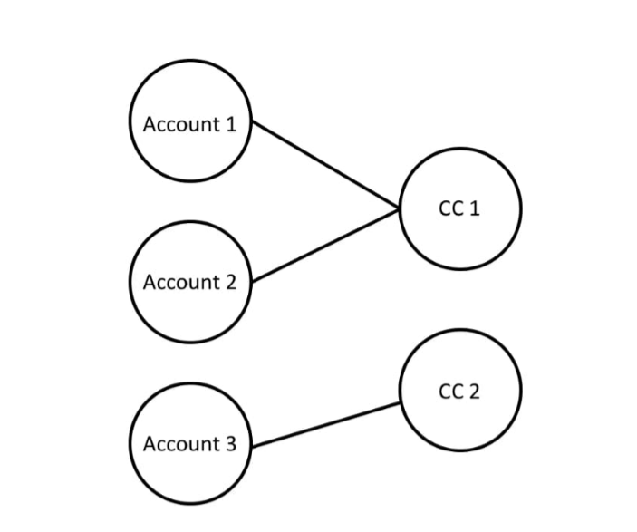
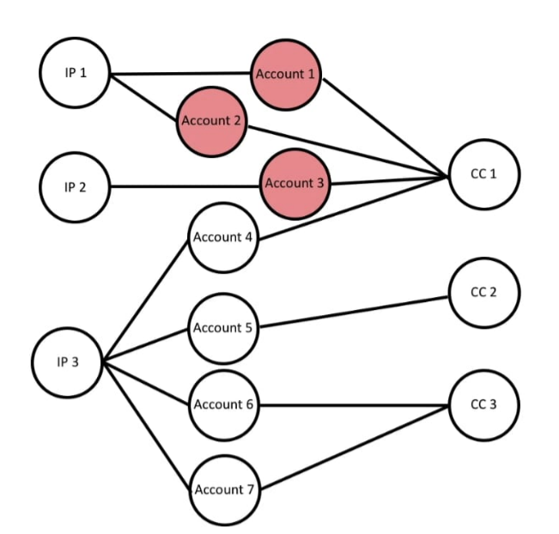
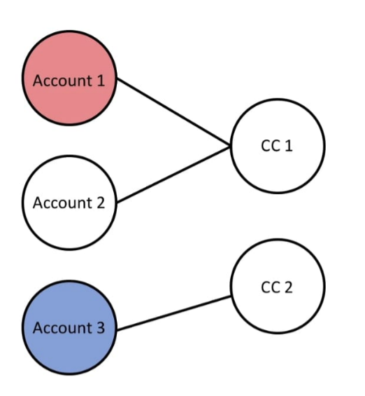
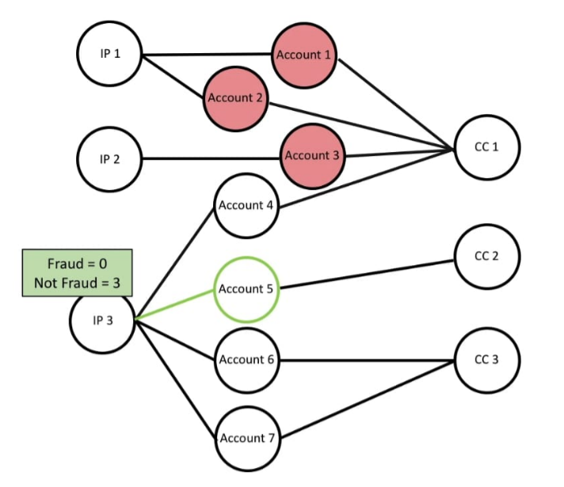
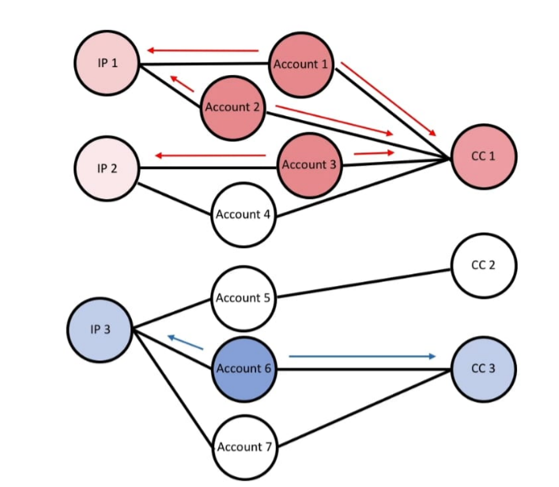
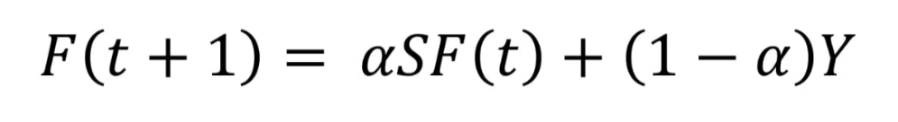

Slide 3
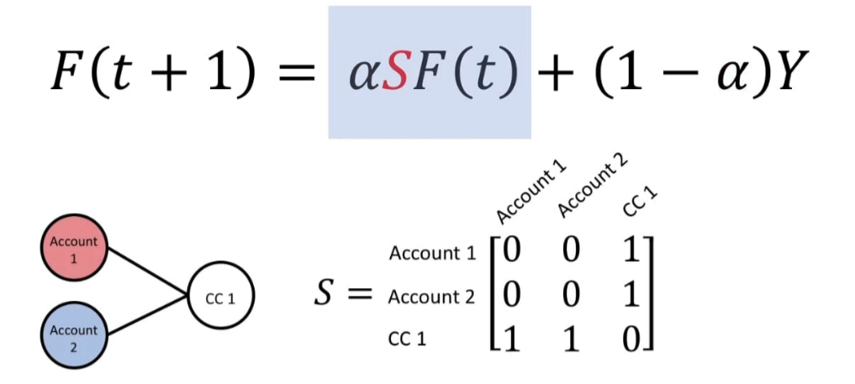
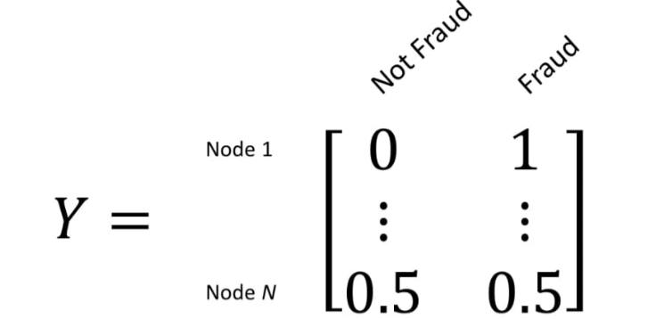
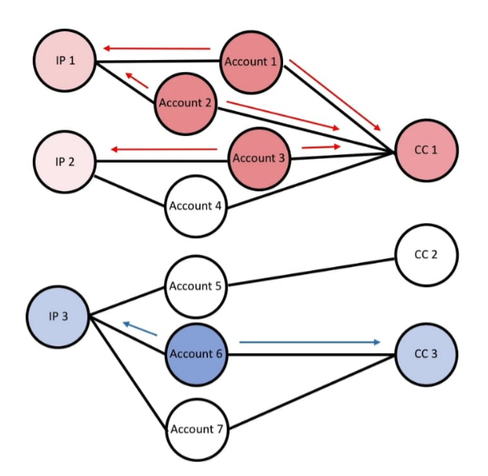
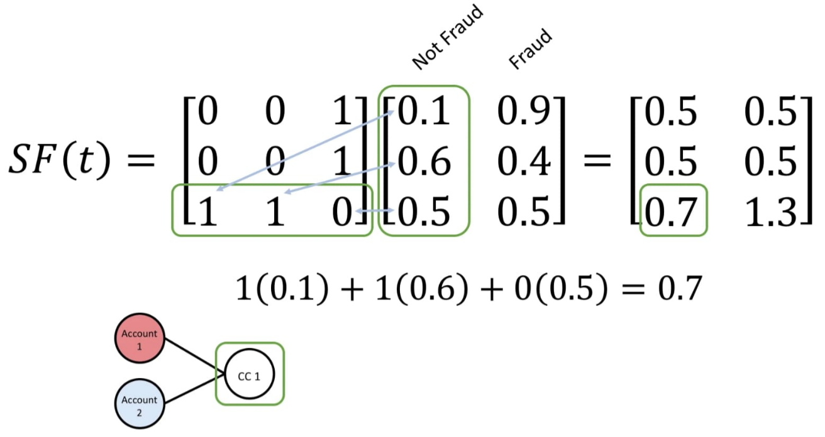

Slide 4
2- Graph Convolutional network
Message passing in graphs: each nodes sends and receives messages from neighbors
GCN is feature smoothing Vs Label propagation is label smoothing
Collect messages, aggregate (like average, the representation is the same size regardless of the number of labels), pass through a dense neural network (multiply by a matrix and apply an activation function), the output of this is a new representation of the node, this is one layer that needs to be applied to all nodes
If we use a second layer, the input vector is the output of the previous embedding
The difference with neural network is that it preprocesses data by averaging data from each node (think of CNN for images)
The number of GCN layers put an upper bound on how far the message could pass through the graph

Slide 5
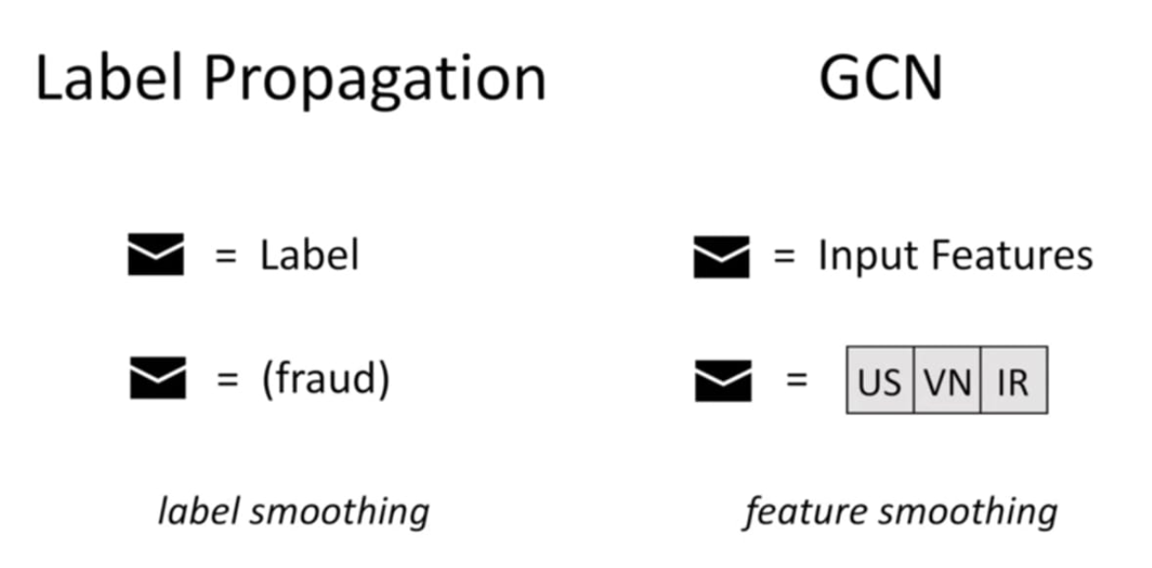
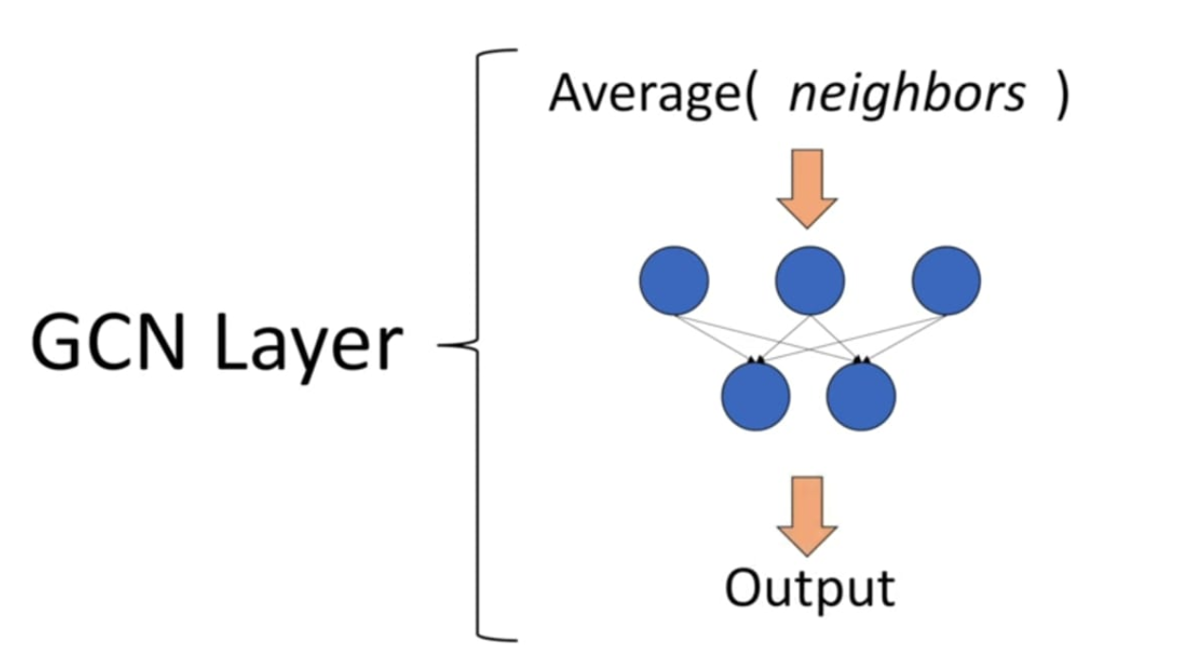
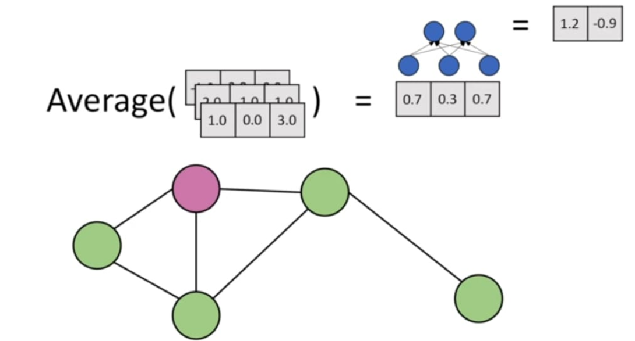
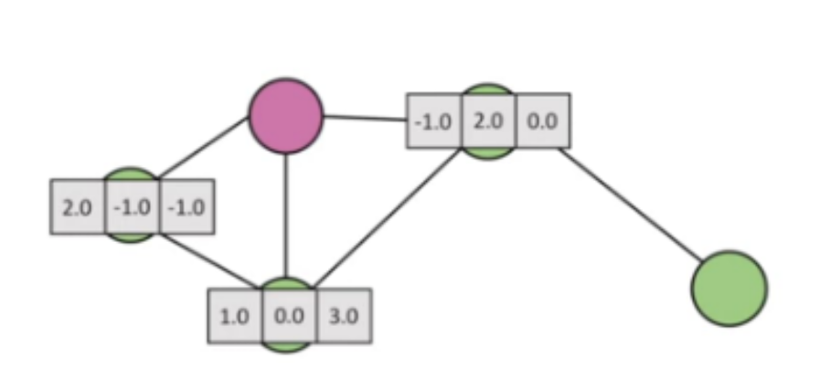
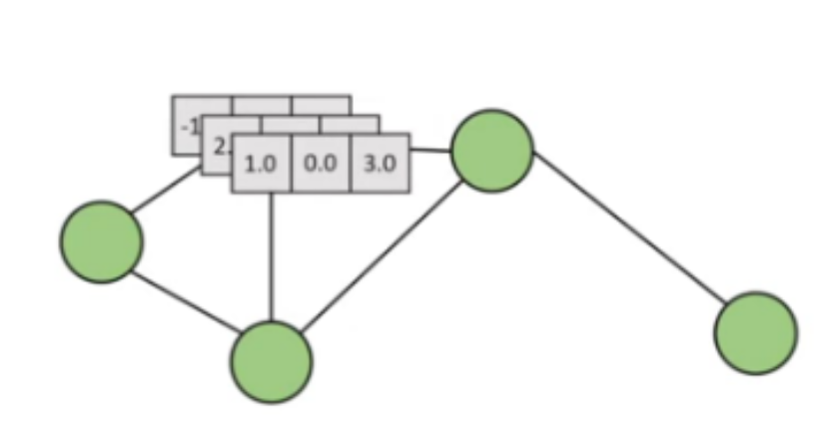

Slide 6
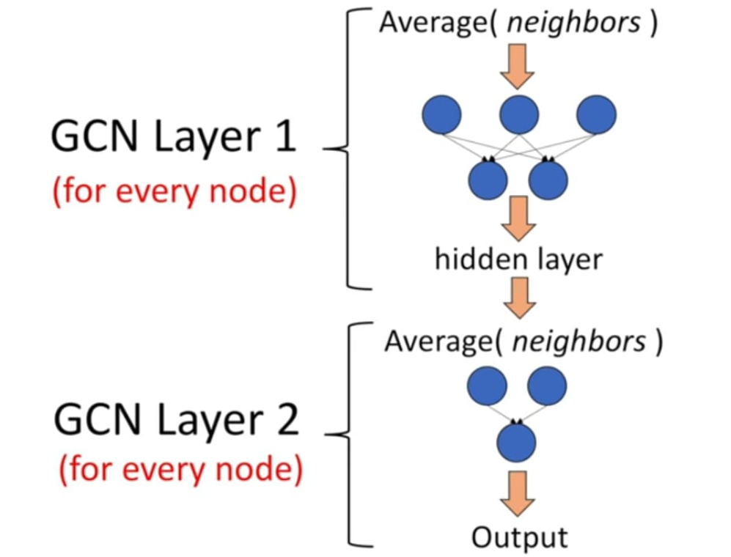
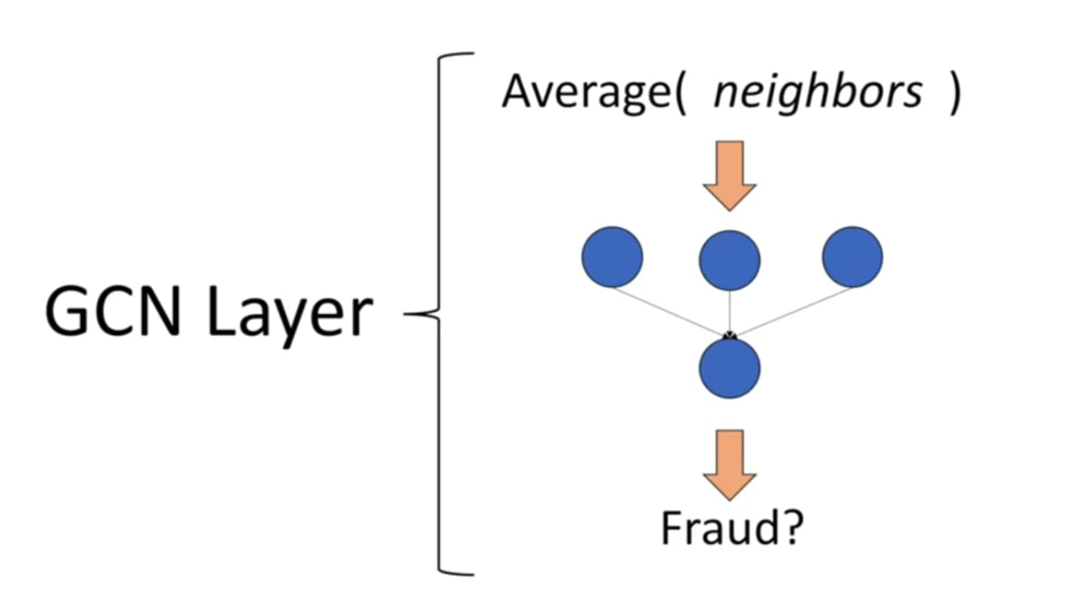

Slide 7
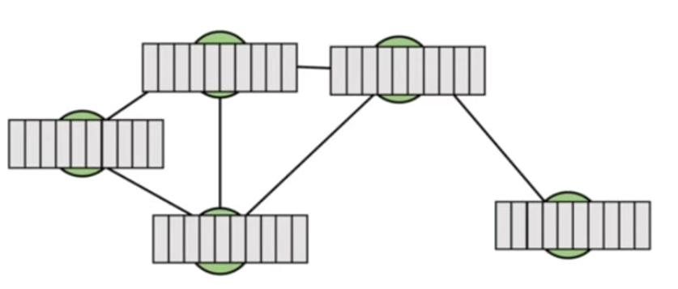
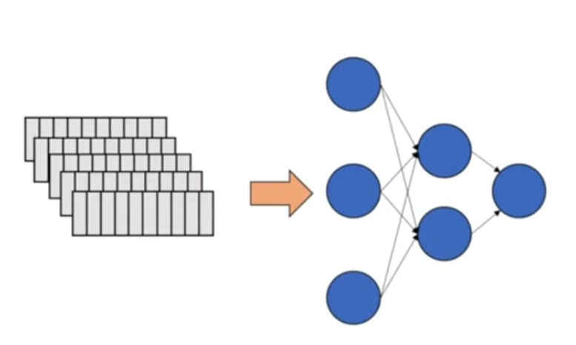
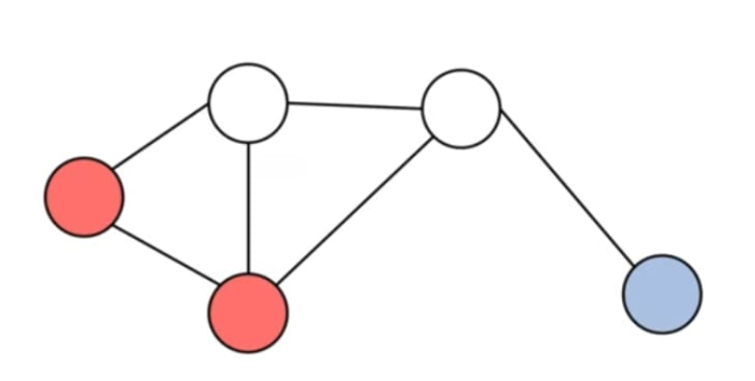
Not aggregating messages misses the graph structure
Label prop lacks features

Slide 8
Credits:
(26336) YouTube

