Slide 1
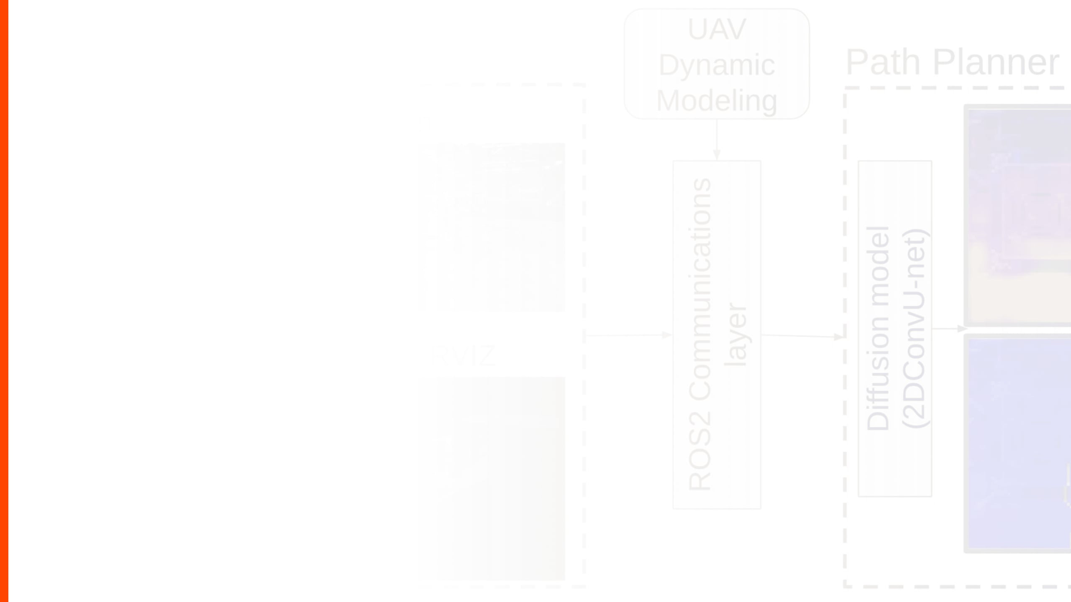
AUTONOMOUS VIRTUAL ROBOT SIMULATION PROJECT
Robotics Programming - Final Project

Slide 2

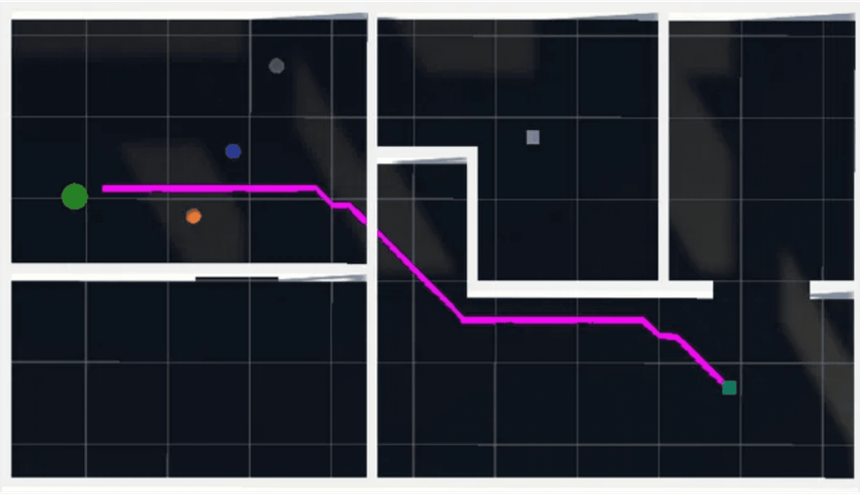
PROJECT OVERVIEW & OBJECTIVES
PRIMARY GOAL
TECHNICAL FOCUS
AUTONOMY
TOOLS USED
Design and implement an autonomous virtual robot in a 2D simulated environment, focusing on algorithmic independence.
Application of algorithmic thinking, Object-Oriented Programming (OOP), and realistic robotic behavior simulation.
The robot makes independent decisions based on virtual sensor inputs and environmental state to reach a target.
Python with Pygame for the graphical user interface, emphasizing custom logic over external AI libraries.

Slide 3

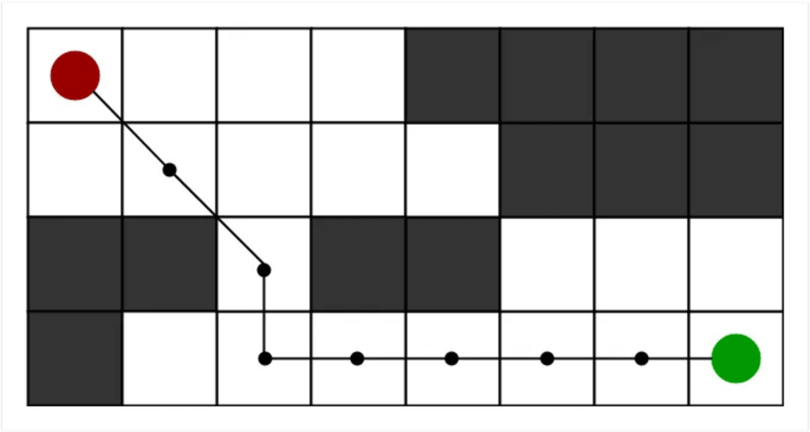
SYSTEM ARCHITECTURE & ENVIRONMENT
GRID-BASED MAP
CELL TYPES
BOUNDARIES & SAFETY
IMPLEMENTATION
A structured 15x12 grid environment representing the robot's world, allowing for precise coordinate-based navigation.
Defined using Python Enums to represent EMPTY, OBSTACLE, and GOAL states, ensuring type safety and clear logic.
Integrated collision prevention system that validates every movement against grid boundaries and obstacles.
The Environment class manages the grid state and provides spatial validation for the robot's sensors and movement.

Slide 4

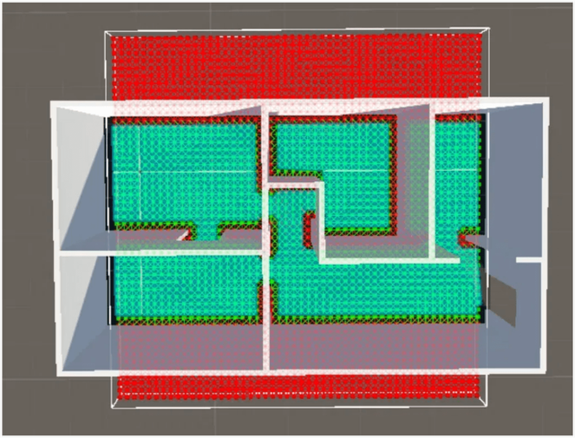
ROBOT MODEL & MOVEMENT
ATTRIBUTES
MOVEMENT COMMANDS
VIRTUAL SENSORS
INTEGRATION
The robot maintains its position (x, y) and orientation (Direction) across four cardinal points: North, East, South, and West.
The robot "senses" adjacent cells to identify obstacles or the goal before executing a move, preventing collisions.
Seamlessly connects high-level decision-making with low-level movement execution for autonomous navigation.
Custom functions for turning towards targets and moving forward, ensuring precise execution of the planned path.

Slide 5
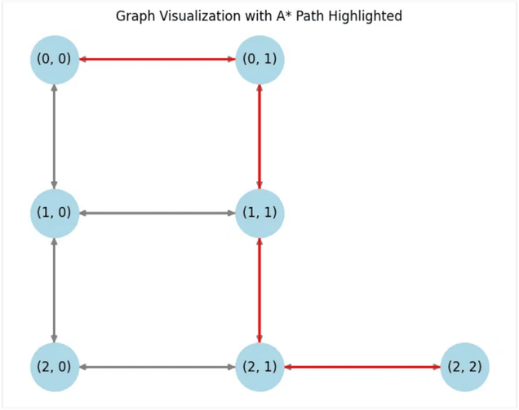
EXTENSION TRACK 1: A* PATHFINDING
WHY A*?
HEURISTIC FUNCTION
MECHANISM
RESULT
Chosen for its optimal balance between Dijkstra's efficiency and heuristic-driven intelligence in grid environments.
Utilizes "Manhattan Distance" to estimate the remaining cost to the goal, ensuring efficient search direction.
Calculates the shortest path upon initialization, navigating around complex obstacle configurations with ease.
Intelligent, direct pathfinding that ensures the robot reaches its destination with minimal steps and no collisions.

Slide 6
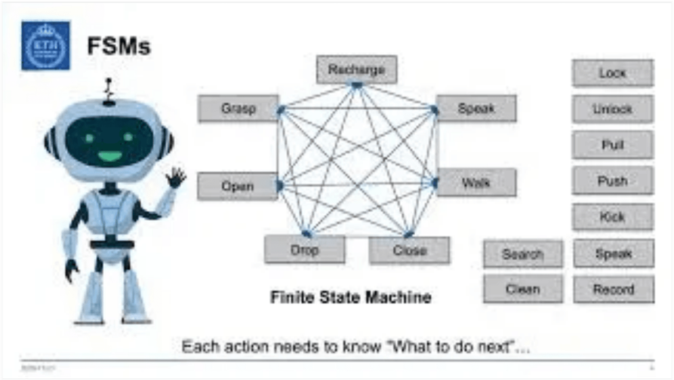
FINITE STATE MACHINE (FSM)
PLANNING
EXECUTING
FINISHED
STUCK
The initial state where the robot calculates the optimal path to the goal using the A* algorithm based on current environment data.
The active movement state where the robot follows the pre-calculated path, managing orientation and step-by-step progression.
The terminal success state reached when the robot's coordinates match the goal position, signaling mission completion.
An emergency state triggered if no valid path exists or if the robot exceeds the maximum allowed simulation steps.

Slide 7

EXTENSION: PYGAME GRAPHICAL UI
VISUAL REPRESENTATION
GRAPHICAL COMPONENTS
REAL-TIME INFO PANEL
PERFORMANCE
Features a dedicated dashboard that displays the robot's current state, step count, and mission progress in real-time.
Optimized at 30 FPS to ensure smooth movement transitions and immediate visual feedback for every decision step.
Transforms the simulation from a text-based console to an interactive 2D graphical interface for better observation.
Utilizes custom assets for the robot, obstacles, and goal, providing a clear and intuitive simulation environment.

Slide 8

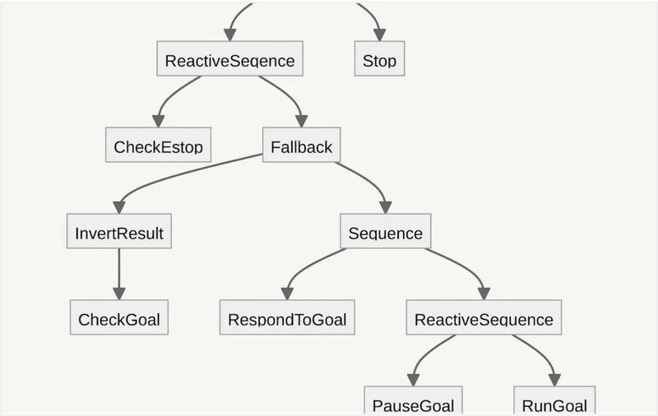
CONCLUSION & KEY TAKEAWAYS
OBJECTIVES MET
LESSONS LEARNED
FUTURE WORK
FINAL OUTCOME
Successfully implemented core requirements plus three extension tracks: Path Planning, FSM, and Graphical UI.
The importance of decoupling logic from presentation and using OOP for scalable and maintainable code.
Potential for dynamic obstacles, multi-robot cooperation, or learning-based behaviors for adaptive navigation.
A comprehensive simulation system demonstrating fundamental principles of autonomous robotics and algorithmic design.

