Slide 1

DepWay
Presenter: Nour Elden Hany
Date: 30/11/2025

Slide 2
Project Idea
Problem Being Solved
  Developers spend a lot of time manually creating Dockerfiles and configuring projects for containerization.
  Managing multi-language projects (Node.js, Python, Java, PHP, Ruby, static HTML) requires different Docker setups.
  Deployment pipelines become error-prone and inconsistent without standardization.
Proposed Solution (High-Level Idea)
An automated platform that:
  Detects the project’s language and framework from GitHub repositories.
  Generates the appropriate Dockerfile and optionally docker-compose.yml.
  Builds Docker images and pushes them to user’s Docker Hub.
  Provides API endpoints to manage images and containers.
Unique Value Proposition
Time-saving: Developers can dockerize projects in minutes.
Multi-language support: Works with JavaScript (Node.js/React/Vue), Python, Java, PHP, Ruby, and static HTML.
Automation: No manual Docker setup needed.
Flexibility: Supports both single-service and multi-service projects.
Developer-friendly: Can integrate with existing CI/CD pipelines and simplifies deployment.

Slide 3
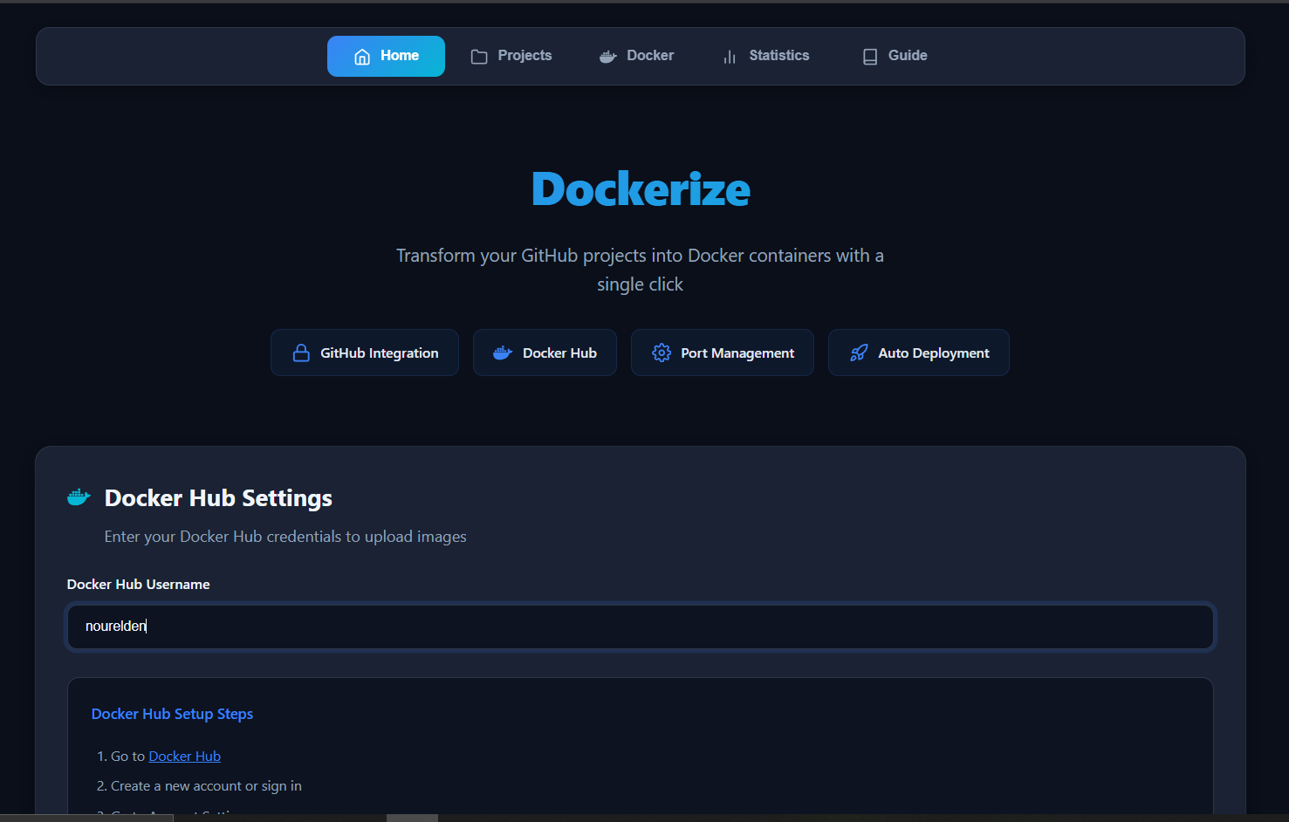
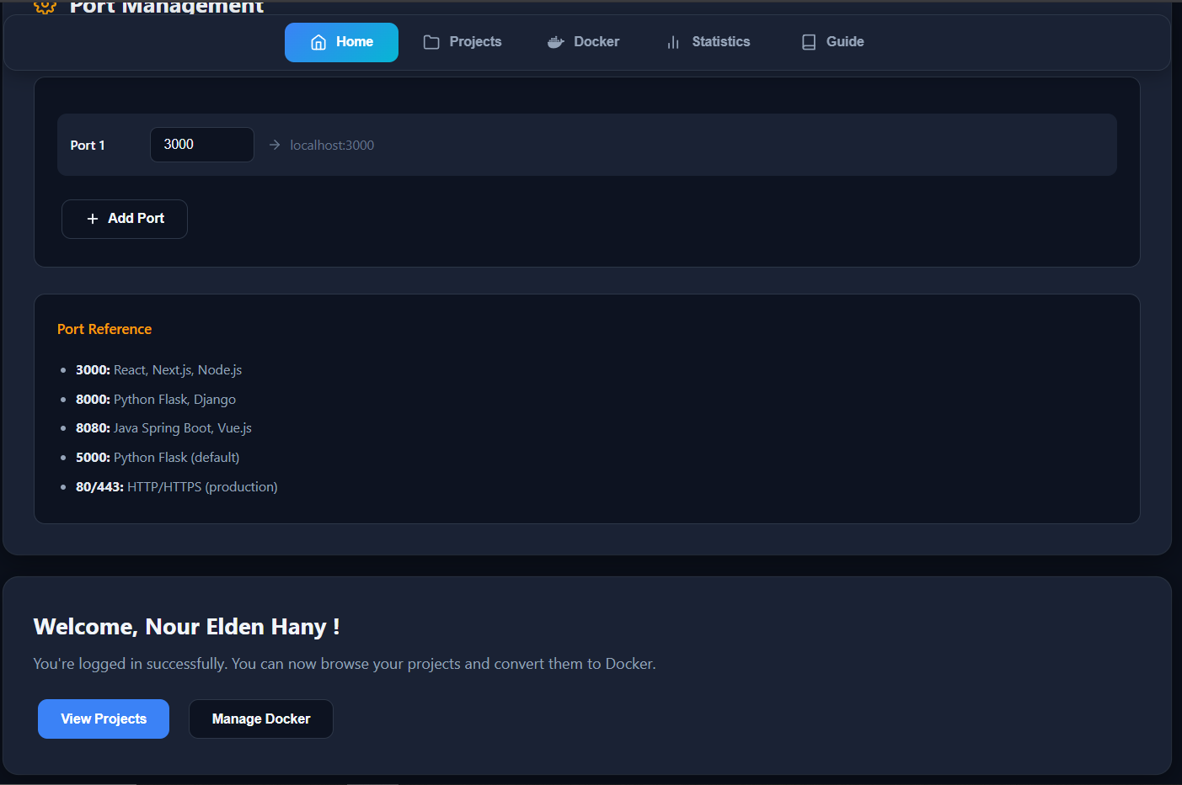
Project Wireframe

Slide 4
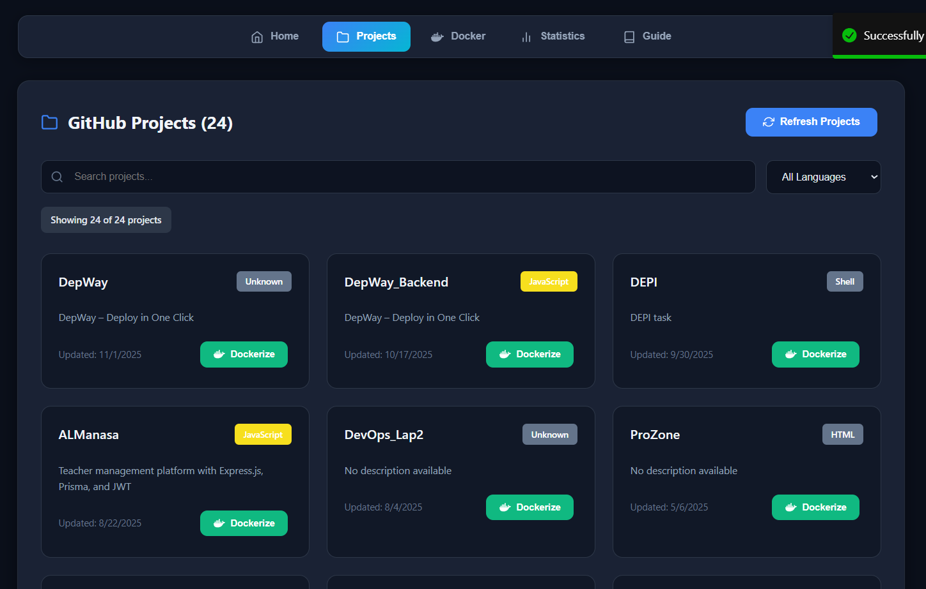
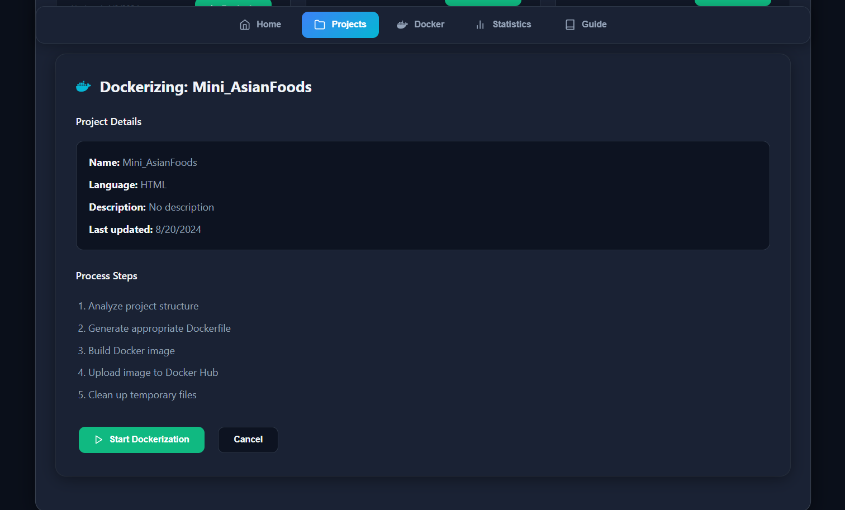
Project Wireframe

Slide 5
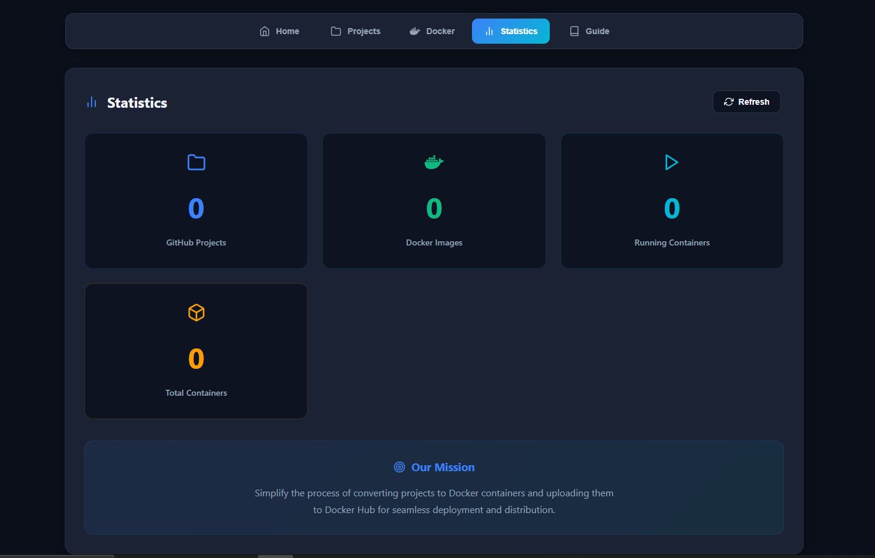
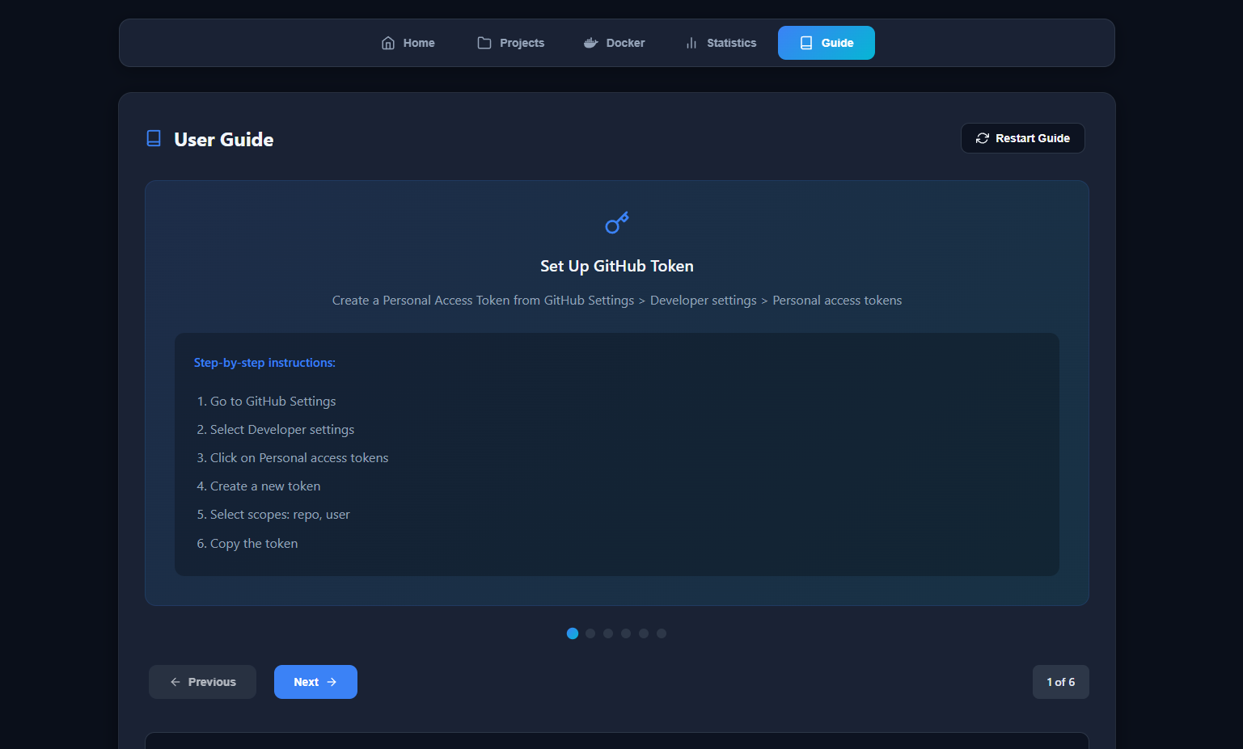
Project Wireframe

Slide 6
End Users + Features
Primary User Personas
Individual Developers
  Freelancers or hobbyists building projects in multiple languages.
Software Teams & Businesses
  Small to medium-sized teams needing standardized containerization.
  DevOps engineers looking for quick deployment pipelines.
Key Features
Automated Project Analysis: Detects language, framework, and dependencies automatically.
Dockerfile Generation: Creates ready-to-use Dockerfiles for various tech stacks.
Docker-Compose Support: Handles multi-service applications with ease.
Docker Image Build & Push: Builds images and optionally pushes to Docker Hub automatically.
Container Management API: Start, stop, and list Docker containers programmatically.
Multi-Language & Static HTML Support: Works for Node.js, React, Vue, Python, Java, PHP, Ruby, and HTML projects

Slide 7
End Users + Features
How Features Solve User Problems
Saves time & reduces errors: Developers no longer write Dockerfiles manually.
Standardizes deployment: Teams get consistent container setups across projects.
Simplifies multi-language projects: One platform handles multiple tech stacks.
Speeds up DevOps workflows: Quick build and deployment through automation.

Slide 8
Data Structure
Database Architecture
Type: Relational (SQL-based)
Purpose: Store user credentials, GitHub repository info, Docker images, and container states.
Entity | Description | Key Attributes | Relationships
User | Platform users | id (PK), name, email, GitHub token | One-to-Many with Repositories
Repository | GitHub repositories linked to users | id (PK), user_id (FK), name, clone_url, language, framework, last_updated | Belongs to User
DockerImages | Docker images created from repositories | id (PK), repo_id (FK), image_name, ports, status, created_at | Belongs to Repository
Container | Running/stopped containers | id (PK), image_id (FK), container_id, status, started_at | Belongs to DockerImage

Slide 9
Data Structure
Data Flow
Collection
    Users provide a GitHub token → API fetches repositories via GitHub API.
Storage
Repositories and generated Docker images are stored in the database.
  Container statuses are updated in real-time using the Dockerode API.
Access
  Users query repositories, build images, or manage containers via API endpoints.
Additional Notes
  Static HTML projects are detected from file existence (index.html) instead of database metadata.
  The system can be extended to store multi-service configurations in a JSON column for flexibility.

Slide 10
Programming Languages + Frameworks
Main Programming Languages
JavaScript – Core language for server (Node.js/Express) and client (React)
Frameworks & Tools
React – Frontend interface of the platform
Express.js – Backend API server
Docker / Docker Compose – Containerization and orchestration
Axios – API requests (GitHub integration)
simple-git – Git repository cloning and management
fs-extra – File system operations
Supporting Technologies
  GitHub API – Fetch repository data and metadata
  Docker Hub – Push and store Docker images
  CORS & JSON middleware – Secure and structured API communication
  Cloud Platforms – Can deploy on AWS, Azure, or GCP

Slide 11
Deliverables (Reports, etc.)
1. Reports & Documentation
Technical Documentation: Detailed description of the system architecture, database design, API endpoints, and deployment process.
User Manual: Step-by-step guide for end-users explaining how to use the application.
2. Timeline for Deliverables
Week 1: Requirements analysis, system design, and architecture planning.
Week 2-3: Development of main features (frontend + backend).
Week 4: Testing, bug fixes, and final adjustments.
Week 5: Final documentation, deployment, and project handover.
3. Final Products
Fully working web application (deployed or locally runnable via Docker).
Complete source code repository (GitHub/GitLab).

Slide 12
Project Team + Roles
Core Team (roles & short responsibilities)
Nour Elden Hany — Backend, Presenter & Documentation
  Implement backend APIs (project analysis, dockerize endpoints, Dockerode integration)
  Prepare and deliver the presentation; produce technical docs, user & developer guides
  Assisted in dockerization flow
Zeyad Hossam — Dockerization, Frontend Support
  Design & implement Dockerfile generation logic and build/push pipeline
  Integrate docker-compose and host/docker-socket handling
  Helped with frontend troubleshooting and build integration
Ali Essam — Frontend Developer
  Build React UI for repository selection, dockerize form, and status pages
  Implement API consumption, routing and UX elements (toasts, loaders)
Mohamed Foad — Cloud & Deployment (AWS)
  Design deployment strategy and environment on AWS
  Prepare deployment scripts, registry setup and production runbooks
Omar — Team Member
  Member of the team (no contributions recorded yet)

Slide 13
Thank You

