Slide 1
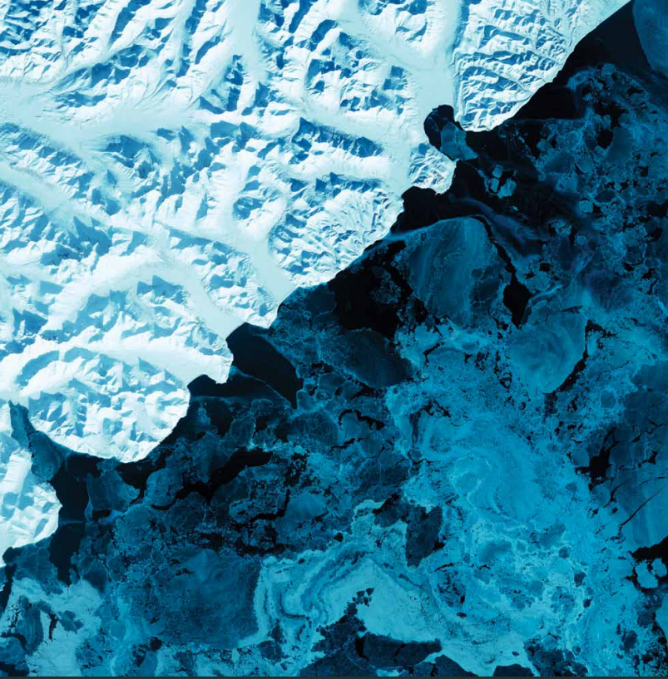
THE ART IN OUR
WORLDS

Slide 2
Problem

Slide 3
Document-to-document similarity
Creatively manipulating images
Creating text representation for images
Text-to-speech transcription
solution
phases
Speech-to-text Transcription
Web application

Slide 4

solution
phases
Speech-to-text Transcription

Slide 5



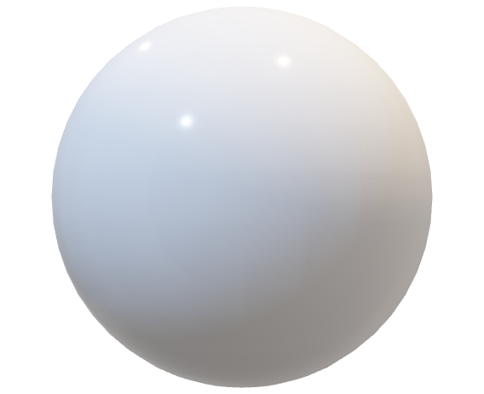
Speech-to-text Transcription

Slide 6
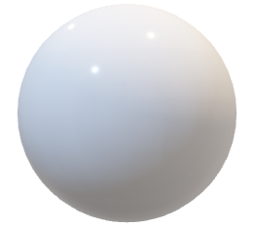
solution
phases

Slide 7
Creating text representation for images
solution
phases

Slide 8



Creating text representation for images

Slide 9
solution
phases

Slide 10
Document-to-document similarity
solution
phases

Slide 11
Document-to-document similarity

Slide 12
solution
phases

Slide 13
Creatively manipulating images
solution
phases

Slide 14
Creatively manipulating images

Slide 15
solution
phases

Slide 16
Text-to-speech transcription
solution
phases

Slide 17
Text-to-speech transcription

Slide 18
solution
phases

Slide 19
solution
phases
Web application

Slide 20
Web application

Slide 21
solution
phases

