Slide 1
AMAZON’S
Shopping Algorithm
BY :NOURA ALBABTAIN

Slide 2

Bills itself most customer-centric company in the earth
Puts Customers First
250 bestselling products
summer 2016
pricing
shipping costs for products
multiple vendors
Amazon and sellers in the "Fulfilled by Amazon [FBA] program

Slide 3
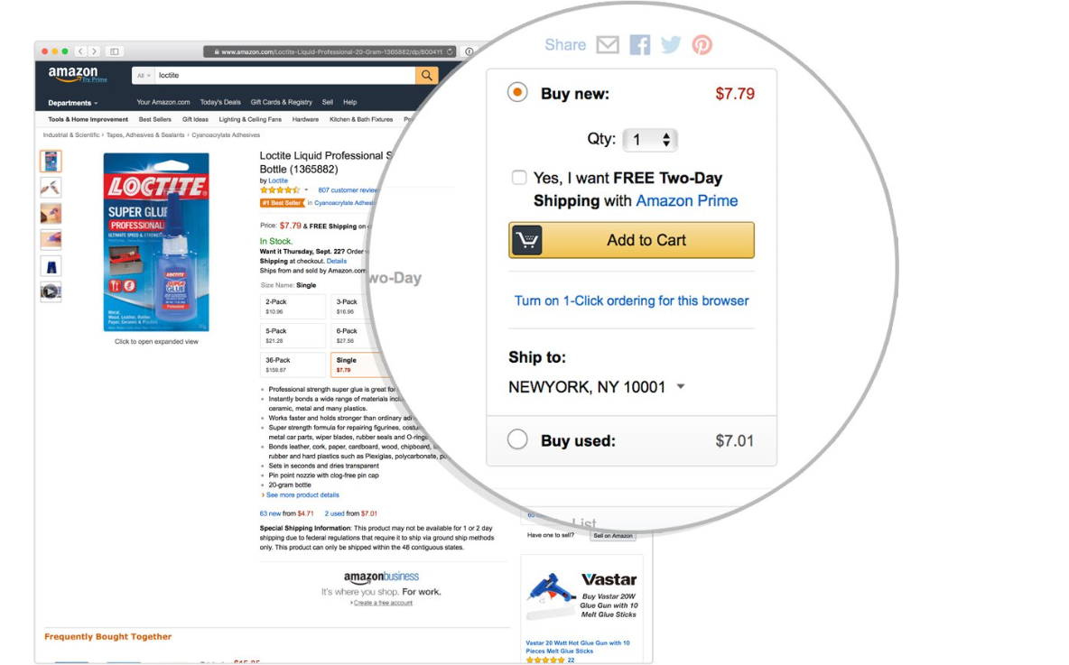
Buy Box = Items were selected for the most prominent placement on Amazon’s virtual shelves that pops up first as a suggested purchase.

Slide 4

vendor 1 = $6.75 with free shipping
vendor 2= $7.27 with free shipping
vendor 3= $7.80 + shipping $6.51 =$14.31
Ranking Items In buy box is real?
Is all product have same Procedure?

Slide 5
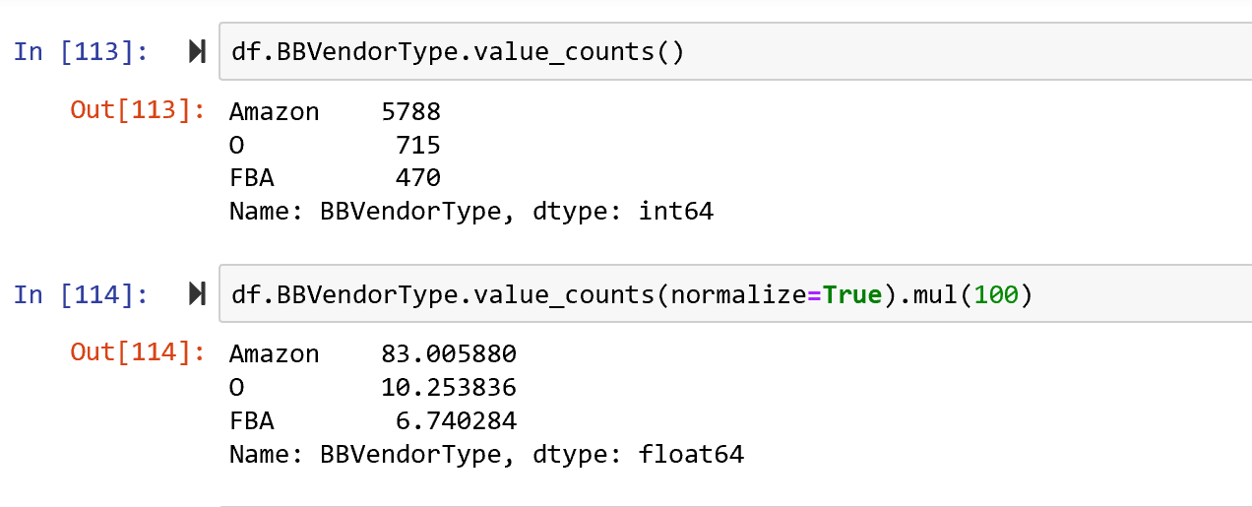
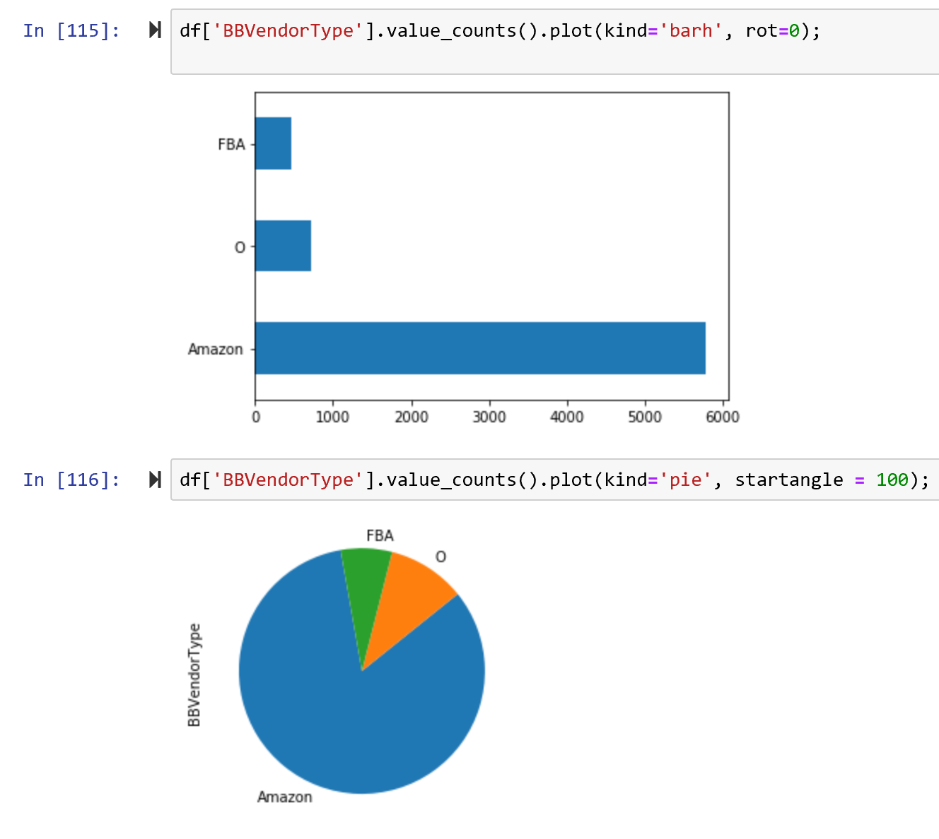

Slide 6
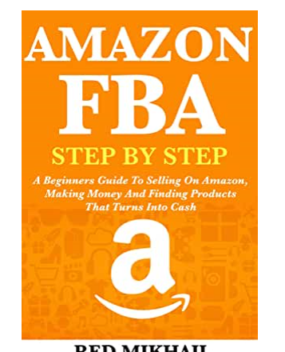

FACT
1
Amazon placed his own products in BB even when there were substantially cheaper offers available from others.

Slide 7

FACT
2
Amazon does give customers a chance to comparison
Some how, Amazon gives itself an advantage. Its rankings without shipping costs only for his own products and those in FBA program.

Slide 8
Appearing in Buy Box
80%
We found that the practice earned Amazon-linked products higher rankings in more than 80 percent of cases

Slide 9
Amazon Strategy
Costumer
Prime
Vendor
FBA

Slide 10

Solution
Evaluation and Impact
Recomm and next
work
Be Smart
Predict
Vendor type
Rank
Accuracy
To have real Rank and price
Use different website
Predict Date BBVendor

Slide 11
