Slide 1
Project Title
Supervised by
Prof. Aly Fahmy
Dr. Hanaa Bayomi Ali
TA. Omar Khaled
Implemented by
Student ID | Student Name
20140110 | Khadega Osman Ahmed
20140278 | Menna Ali Mohamed
20140261 | Marwa Saied Mohamed
20140292 | Noura Mohamed Arafa

Slide 2
Project Idea
The idea is to build an android app based on filtration to YouTube videos by using machine learning to decide if the video content is appropriate for kids to watch it or not.
The filtration will be based on the video's content by taking frames from the video and then test if it will be appropriate for kids because the name of the videos is not enough.

Slide 3
Problem significance
What is the problem you are going to solve?
The big problem with YouTube, or any other video sharing site on the Internet, is that all videos may not be appropriate for children.
Why?
Your children may be watching a perfectly “safe for kids” video on YouTube but they may still accidentally view videos that aren’t suitable for them and this effect children morals and thinking.

Slide 4
Problem significance cont.
How?
By making an app contains a model for videos filtration using Deep learning algorithms.
Briefly description:
1. Deep learning Model:
1.1 Dataset
Our dataset includes videos each video labeled with the frames action.
1.2 Architecture and process
Input: The video’s frames.
Process: the video’s frames will enter a convolution neural network then the prediction output will be an input for a LSTM network.
Output: filtered videos.

Slide 5
Problem significance cont.
2. Mobile App:
The mobile app will allow the children to search for videos and return a videos list after the child chooses a video the video will enter the filtration process and then he’ll get the video resulted from the filtration process
Stakeholders
Parents.
Kids.

Slide 6
Problem significance cont.
What are the previous solutions to the problem and what their advantages/disadvantage?
There are a lot of apps that provide videos appropriate for kids.
The main competitors are :
YouTube kids.
Safety Mode in YouTube.
Vidangel startup.
The main disadvantage that those apps have static videos.

Slide 7
System Analysis and Design
System architecture

Slide 8
Requirements
Functional Requirements
Non-functional Requirements
Register.
Search.
Comment.
Delete Comment.
Like/Dislike.
Watch.
Edit profile.
View history/ liked video.
Play video.
Security.
Performance.
Usability.
Reliability.
Availability.
Privacy.
Efficiency

Slide 9
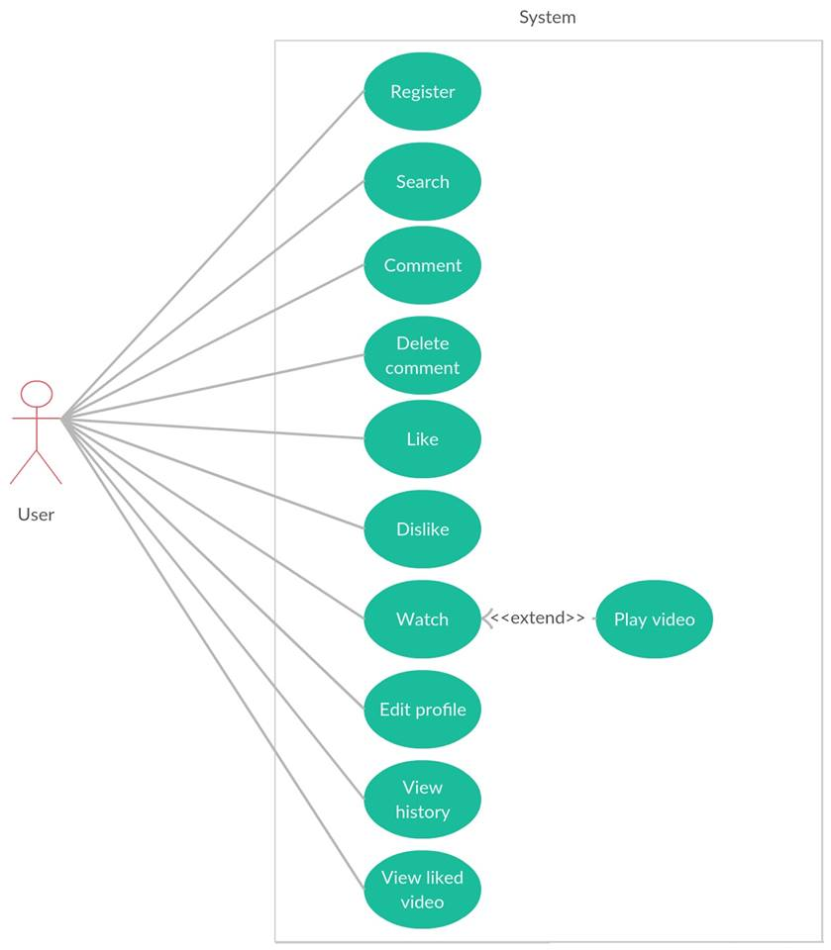
Use-case Diagram:

Slide 10
System Analysis and Design
Sample Use-cases:

Slide 11
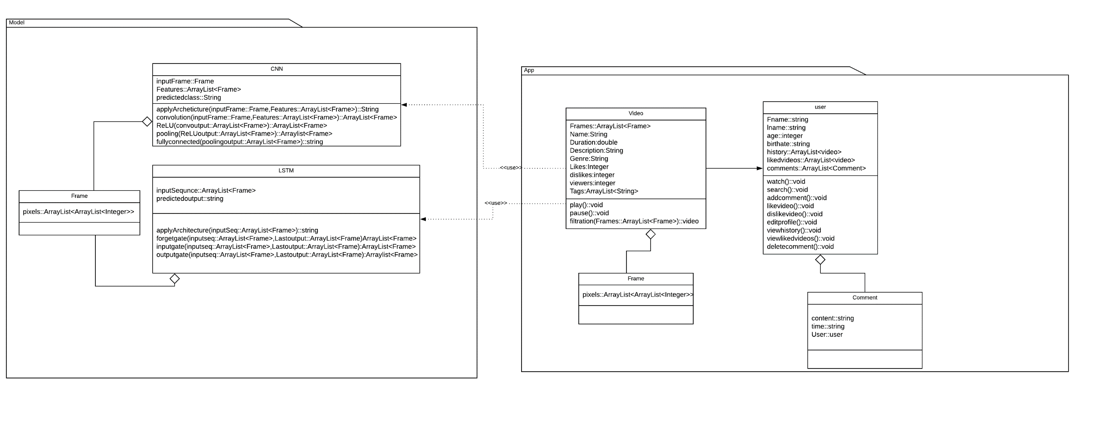
Class Diagram:

Slide 12
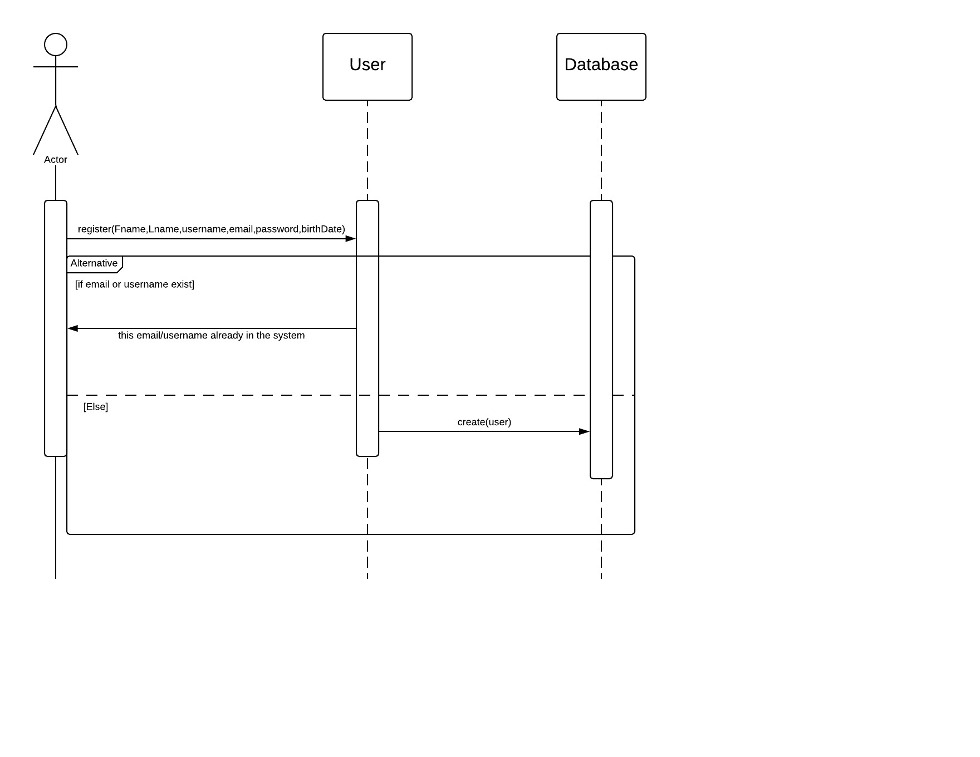
Register:

Slide 13
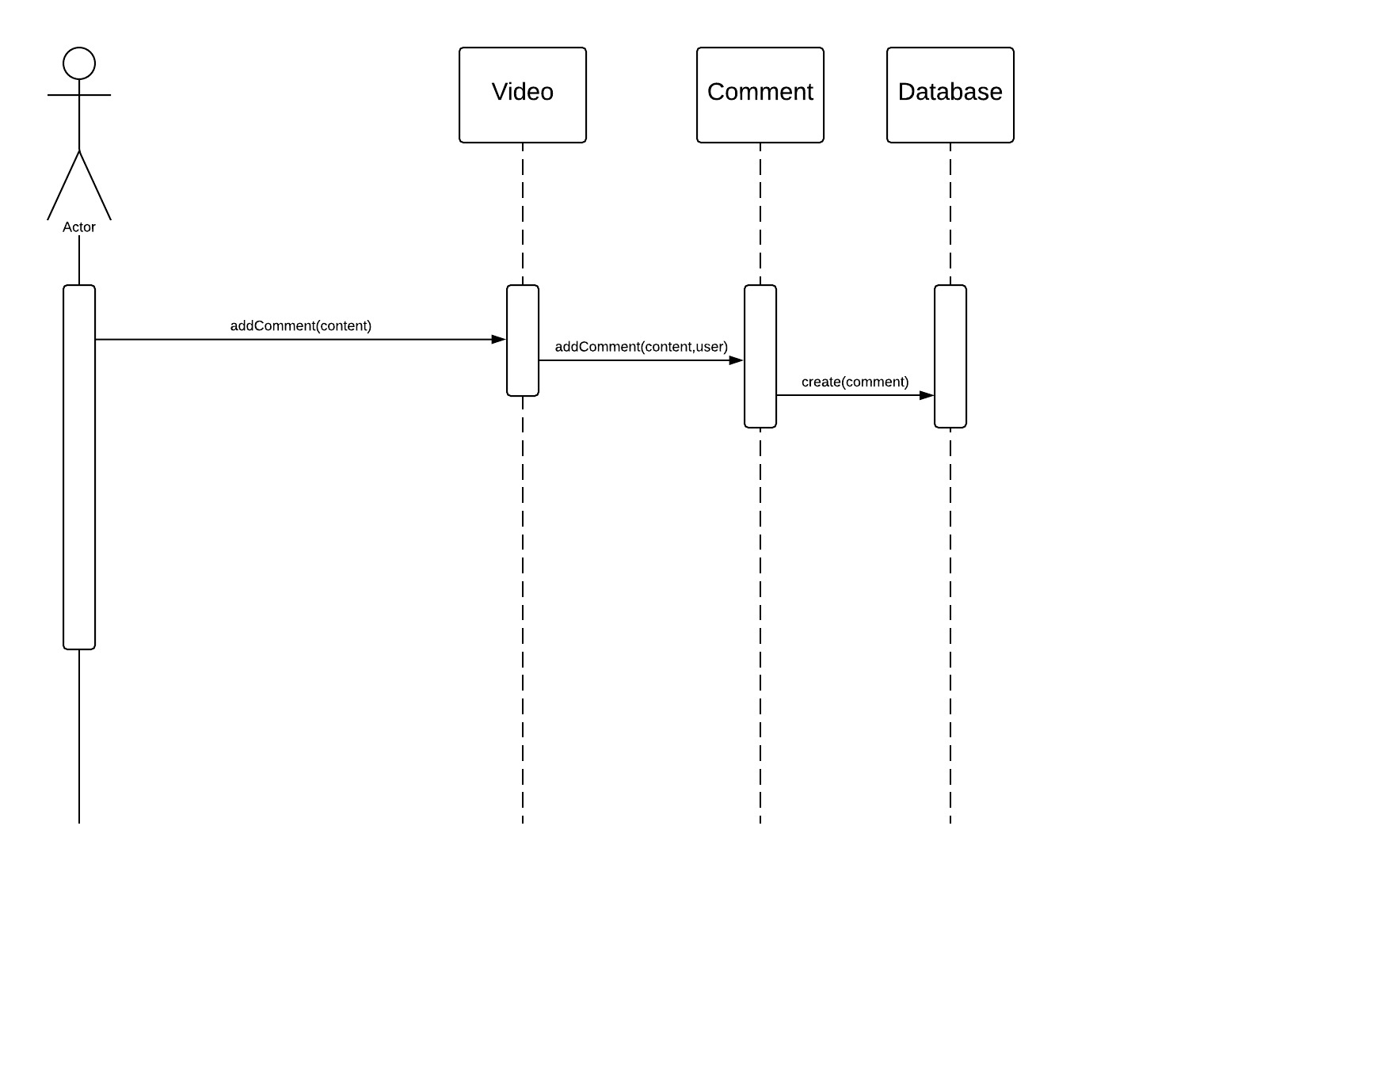
Add comment:

Slide 14
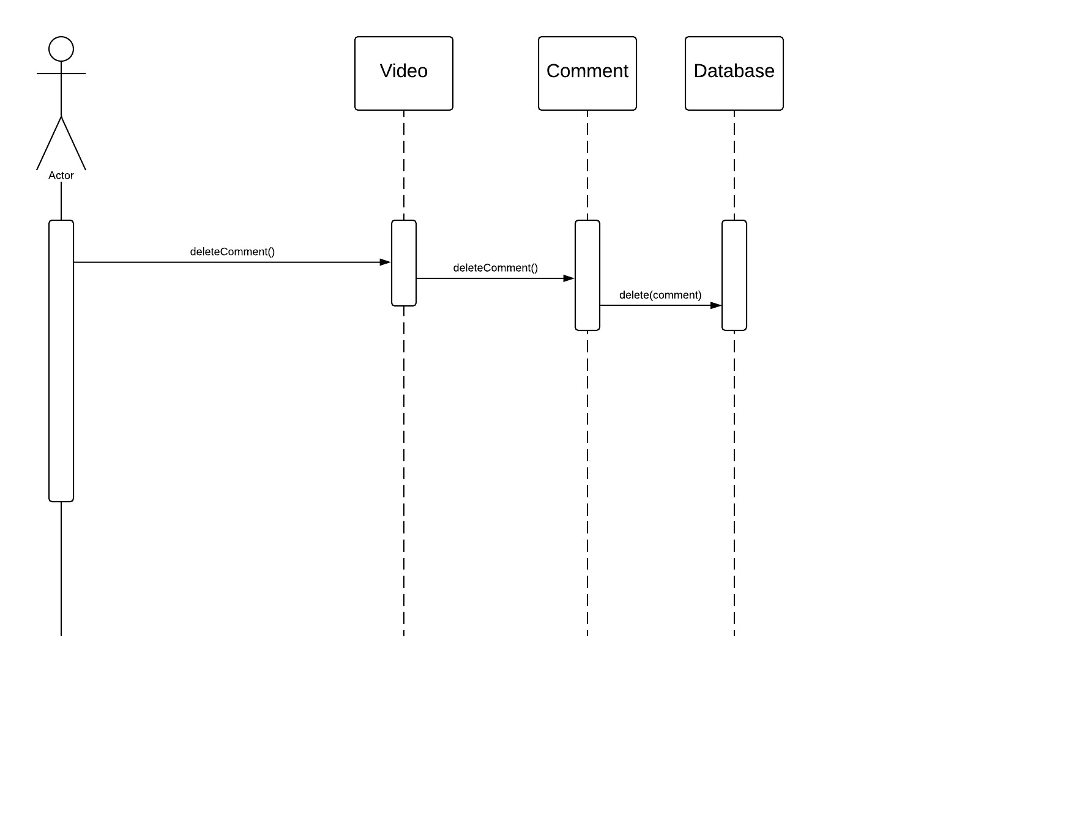
Delete Comment:

Slide 15
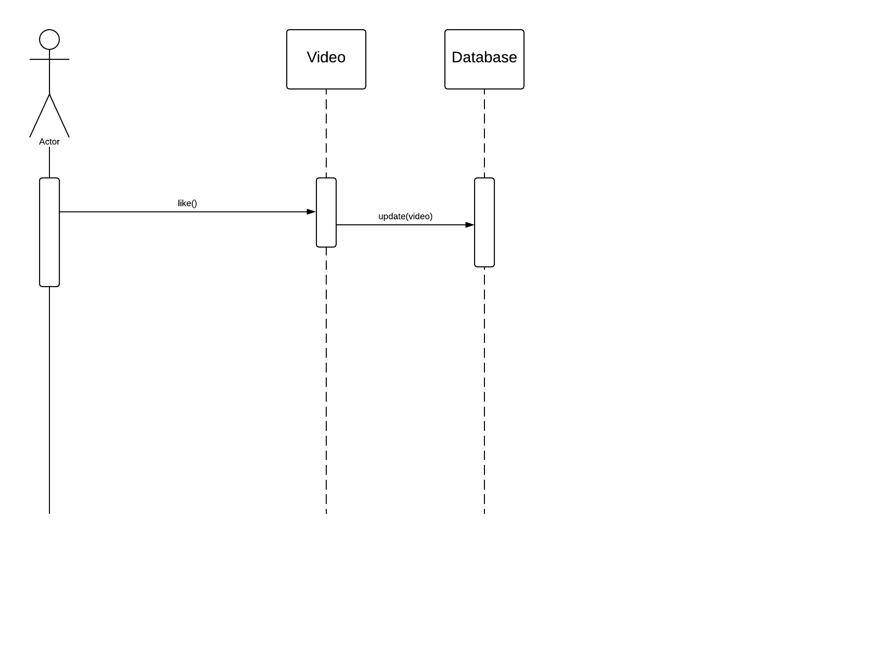
Like:

Slide 16

Dislike:

Slide 17
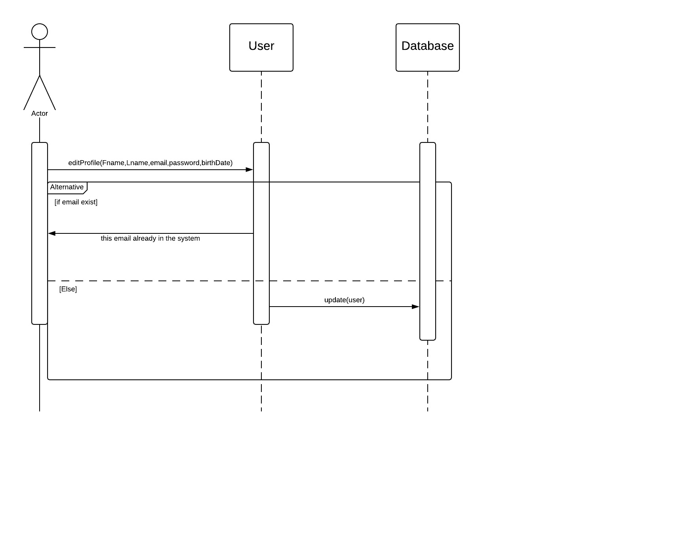
Edit Profile:

Slide 18
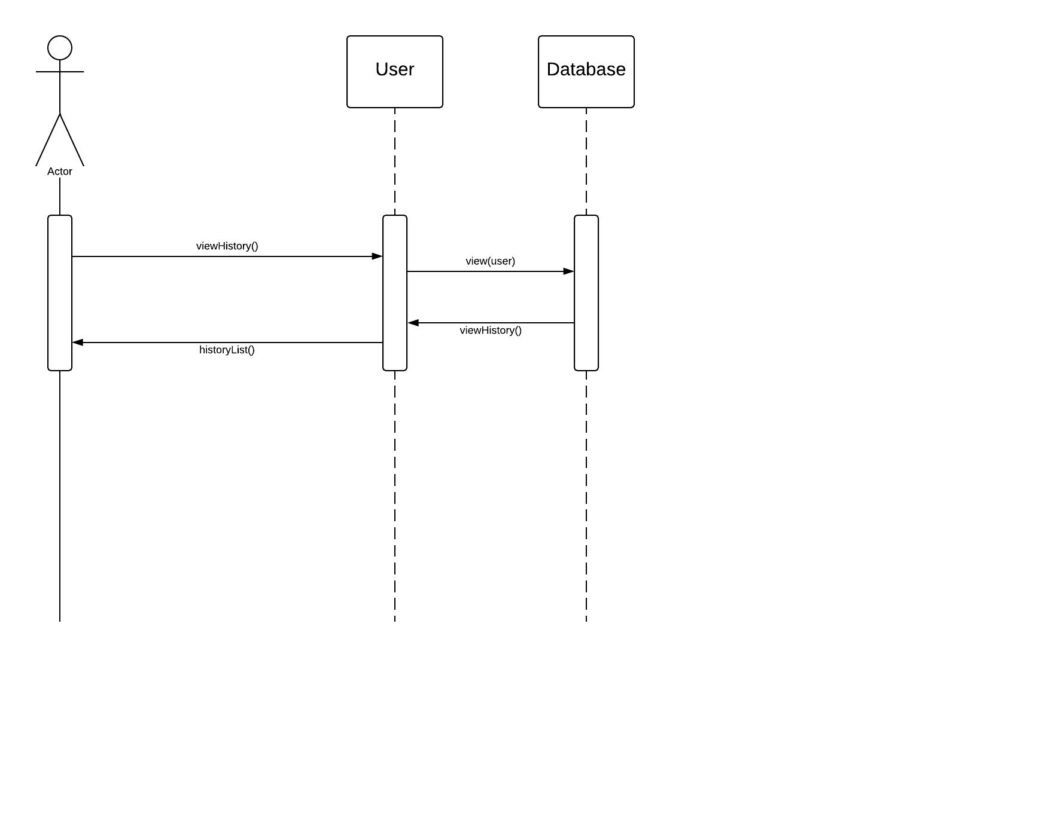
View History:

Slide 19
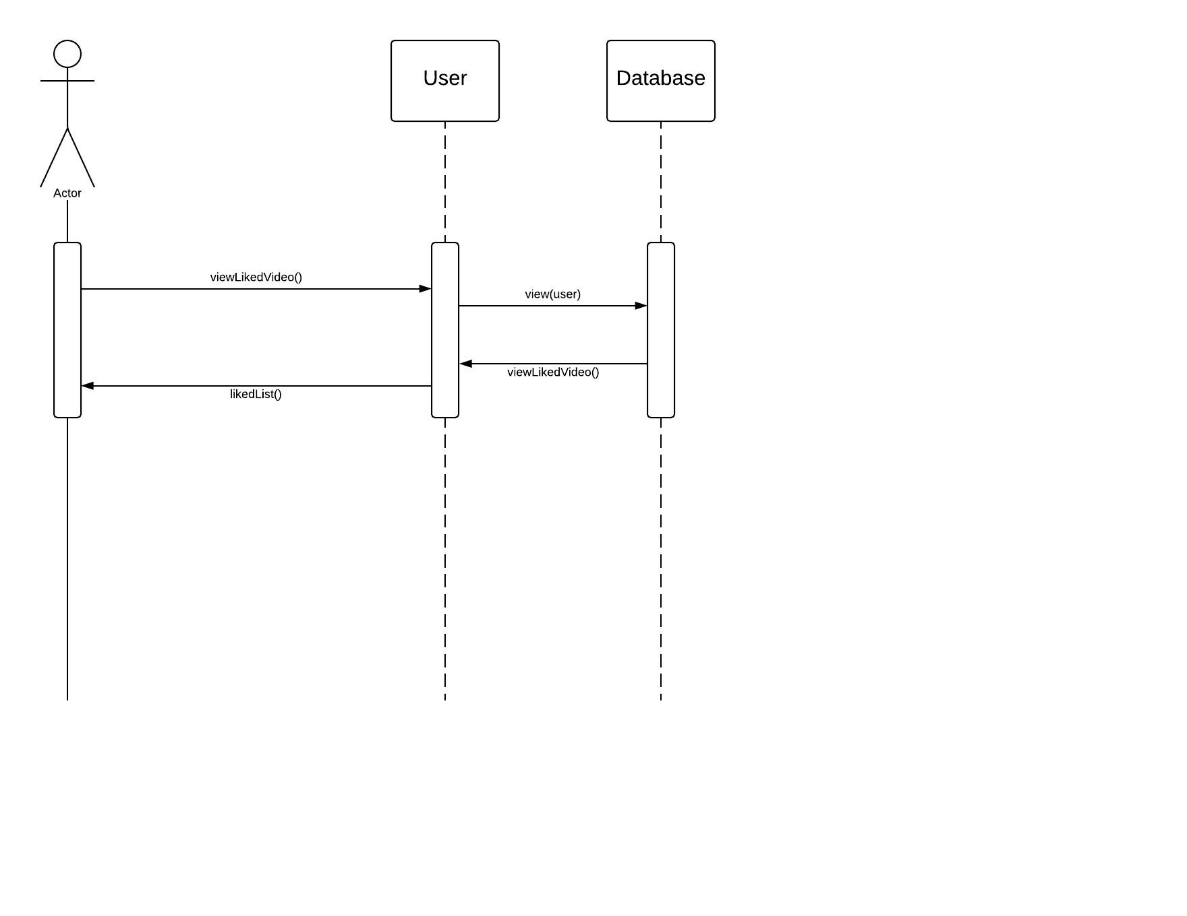
View Liked Video:

Slide 20
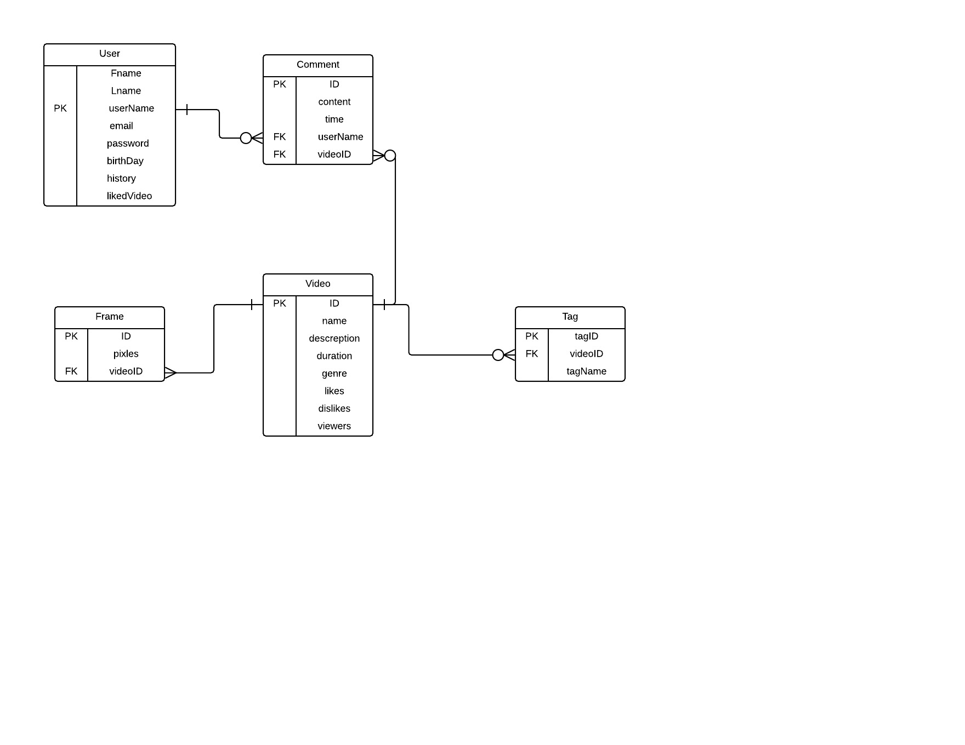
Entity Relationship Diagram (ERD):

Slide 21
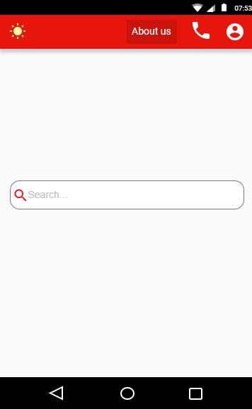

Slide 22
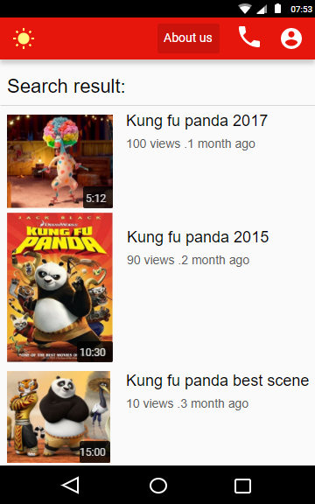

Slide 23
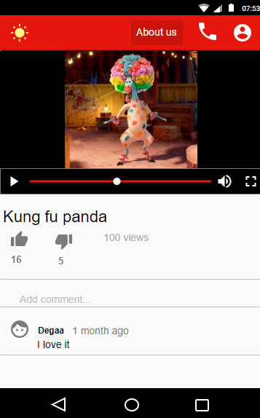

Slide 24
Time Plan
The tasks fulfilled in previous 4 months:
The tasks to be fulfilled in the next 4 Months:
Find Dataset.
Select the architecture to build up the model.
Study the Architectures.
Learning Keras API python code.
Find the Model to work on.
User interface.
System design (class diagram, use cases, Sequence diagram
Learning Keras API python code.
Filtration model.
Search model.
View video implementation.
Connect DB.
APP UI.

Slide 25
Conclusion

