Slide 1



Capstone Project

Slide 2

Problem Statement
When you are a beginner in programming and know the way to start and references are available, but in the middle of this way you need to share your passion with other people interested in the same field
Imagine that you are a beginner in the field of programming and do not know where to start or what are the good sources to return to, you need interested and knowledgeable people to benefit from them and benefit others
This is where it’s come the idea of my project Loop Chat

Slide 3
Brief about the project
It is an application that targets developers with different experiences, united by a love of programming and a passion for learning more from others is to give information to others

Slide 4
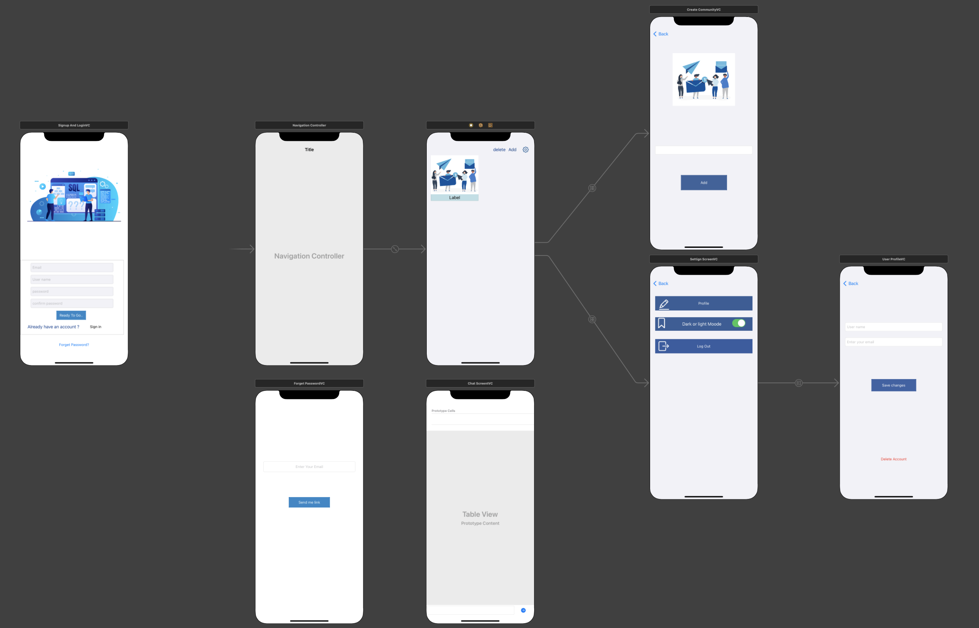
Wireframe

Slide 5
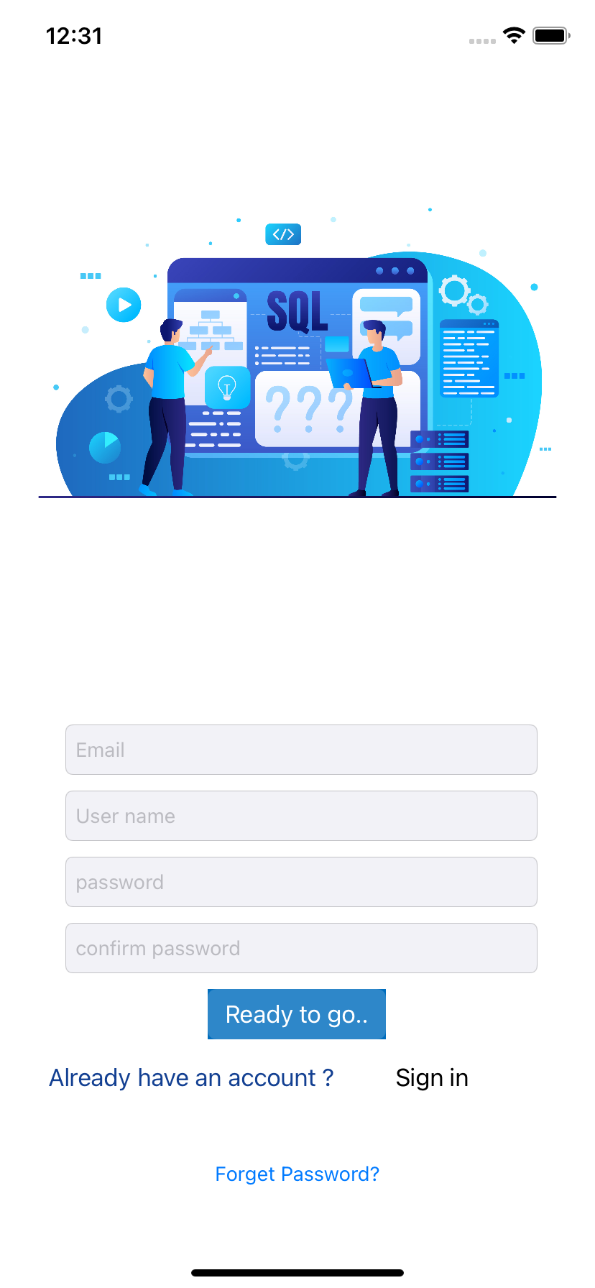

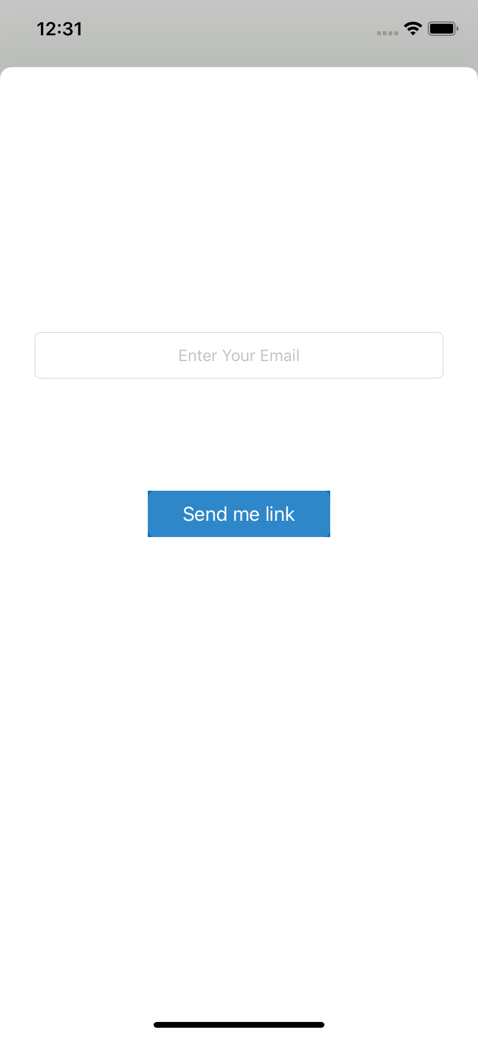
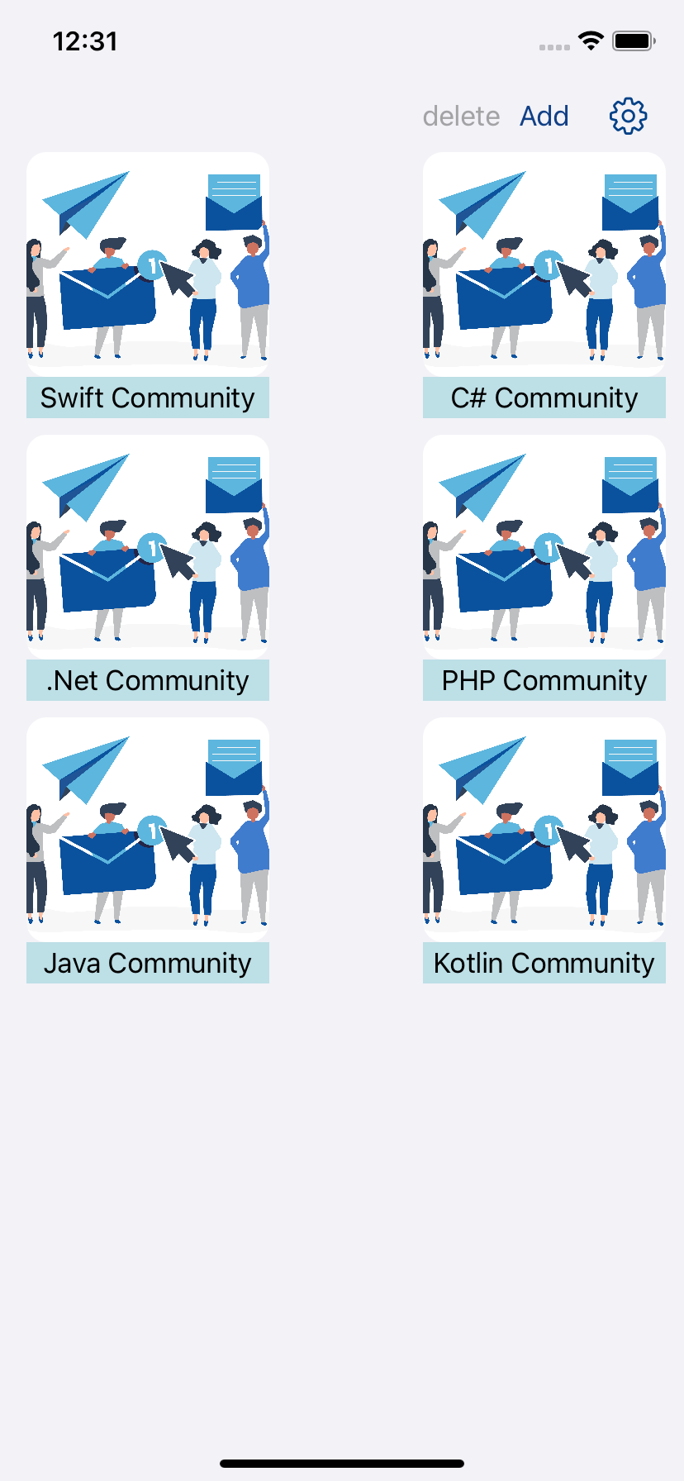
Demo of the project
Log in Screen
Sign up Screen
Forget password Screen
communities Screen

Slide 6
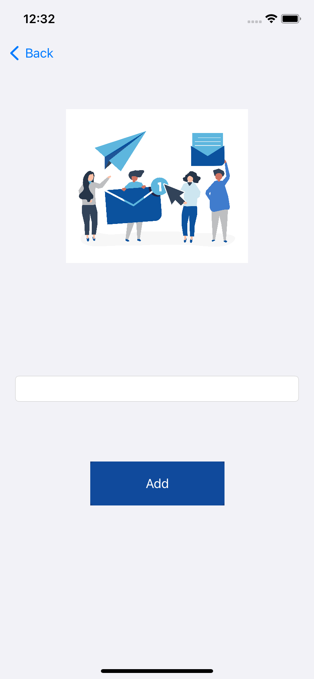
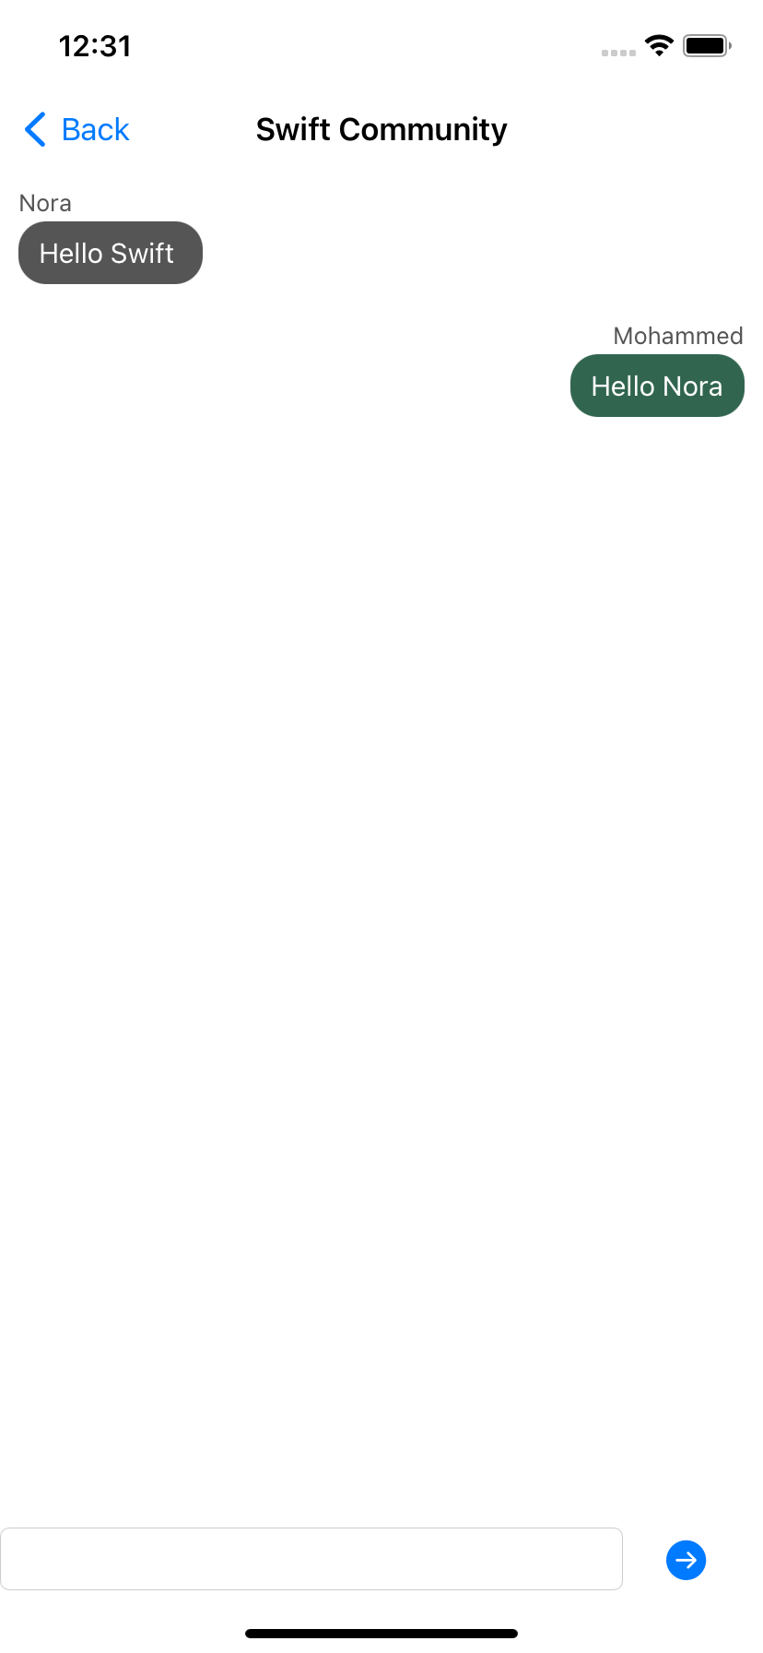
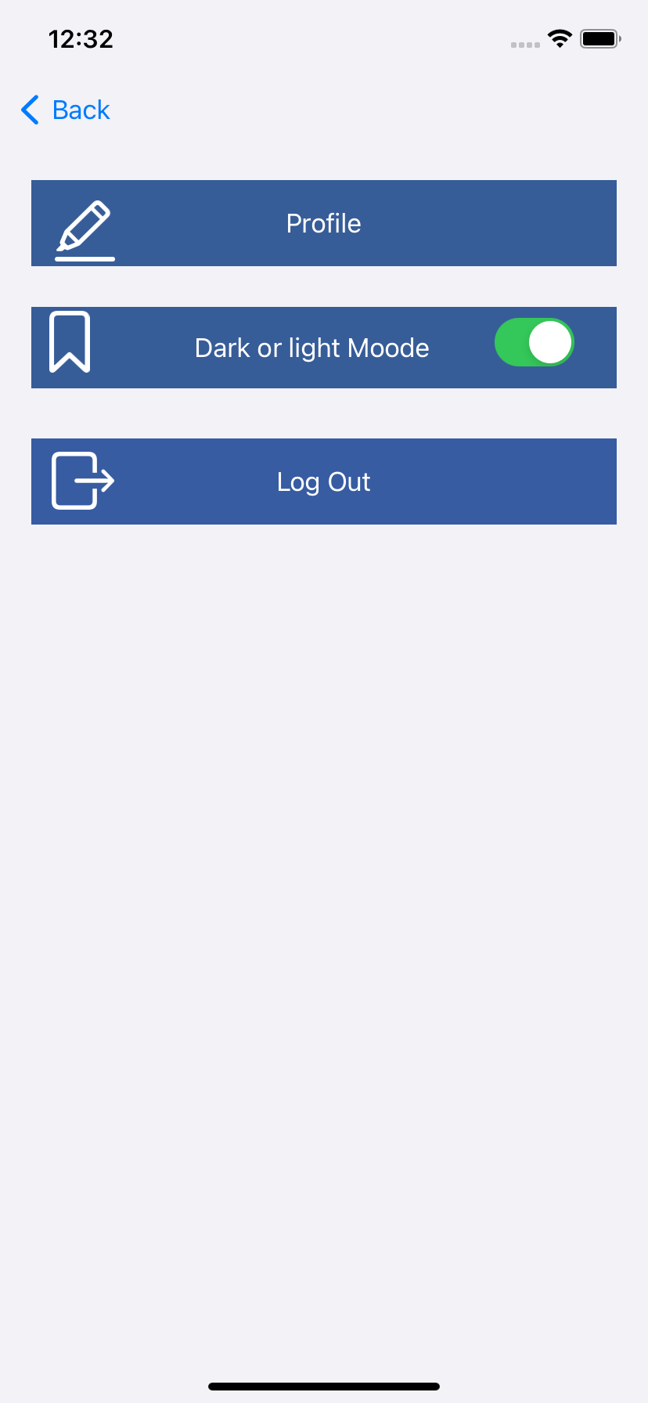
Demo of the project
Add Community Screen
Chat Screen
Setting Screen

Slide 7
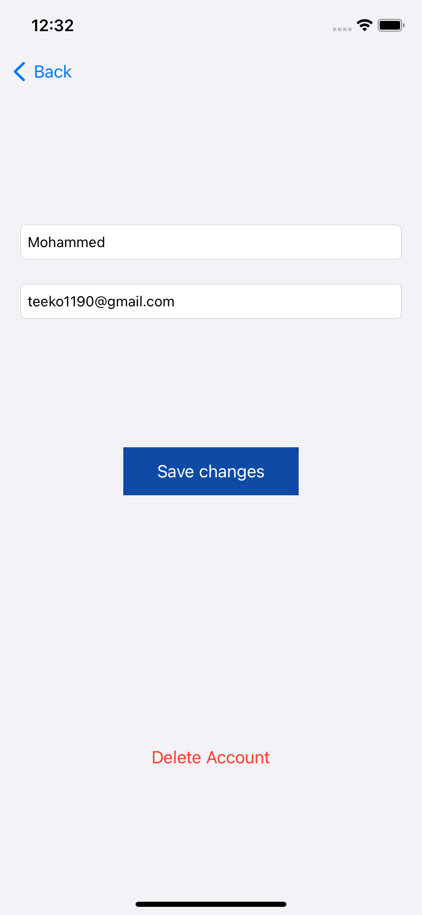
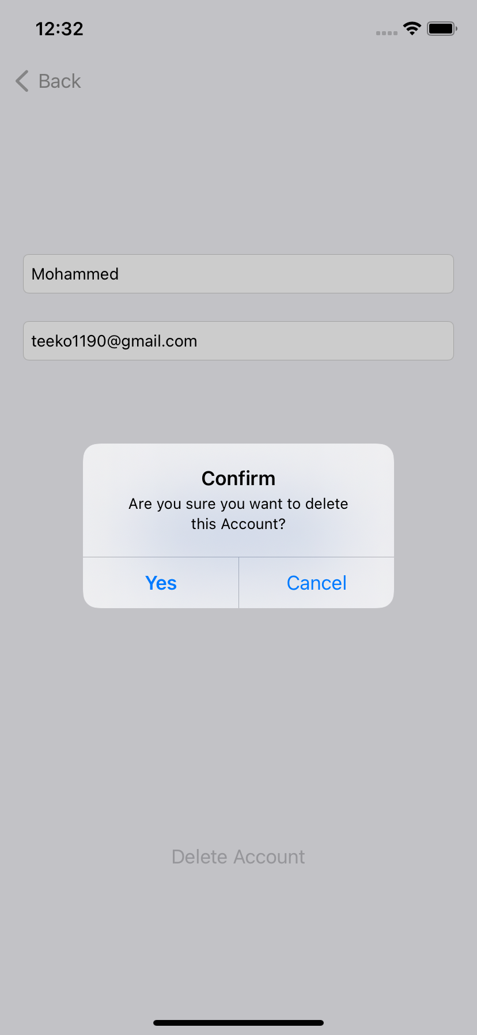
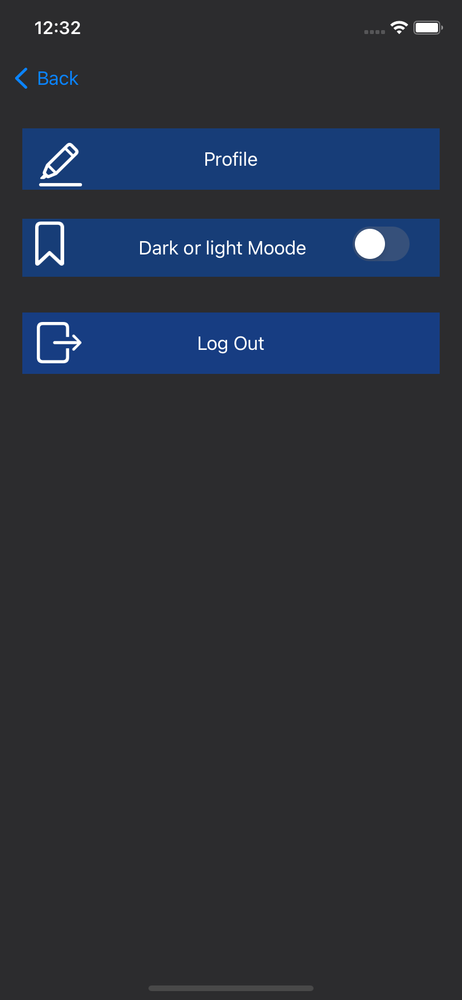
Demo of the project
User Profile Screen
Delete Account
Dark & Light Mood switch

Slide 8



Technologies used

Slide 9
Thank you

