Slide 1







TRENDING TECHNOLOGIES: STACK OVERFLOW DEVELOPER SURVEY (2019)
Norah Alturaiman
30 June 2024

Slide 2



OUTLINE
Executive summary
Introduction
Methodology
Results
Visualization – charts
Dashboard
Discussion
Findings & implications
Conclusion
Appendix

Slide 3

EXECUTIVE SUMMARY
Top programming languages in demand:
JavaScript,HTML/CSS, SQL, Bash/Shell/PowerShell, Python
Top database Skills in demand:
My SQL, Microsoft SQL Server, Postgre SQL, SQLLite, MongoDB
Popular Platforms:
Windows, Linux, Docker, AWS, Slack
Popular Web Frames:
jQuery, Angular/ Angular.js, React.js, Asp.NET, Express
Future Technology Trend:
Python takes the third row, followed by SQL and TypeScript
Redis and Elasticsearch also place in Top 5.
Android is in the Top 5 demanded platforms, the rest remains
React.js takes the first row and Vue.js is the latest addition as the last

Slide 4

INTRODUCTION
In the realm of programming and technology, several key trends have emerged in recent years.
These insights shed light on the evolving landscape of programming languages, web frameworks, and the demographics of professional developers.
Stack Overflow conducts an inclusive survey of individuals engaged in coding globally.
Covering a wide array of topics from preferred technologies to career aspirations, 2024 marks the 9th consecutive year of survey publication.
Let's explore some of the notable findings.

Slide 5

METHODOLOGY
Data is based on the survey conducted by Stack Overflow from January 23 to February 14 and involved 88,883 software developers from 179 countries.
• Familiarization with this dataset was achieved through completing IBM labs on Coursera, which encompassed topics such as Web Scraping, Dataset Exploration, Data Wrangling, Exploratory Data Analysis, and Data Visualization.
• Data analysis and visualization was conducted via IBM Cognos Analytics.

Slide 6
RESULTS
Python overtakes Java, becoming the 5th most preferred language with significant growth. It stands as the fastest-growing major programming language.
JavaScript remains the most used programming language.
jQuery is the most widely used among web frameworks, with React.js surpassing Angular in developer usage this year.
among students than professional developers in regions like the US, India, and the UK.

Slide 7
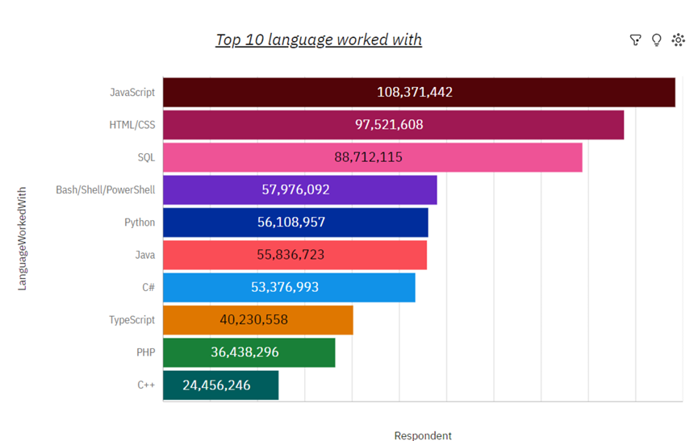
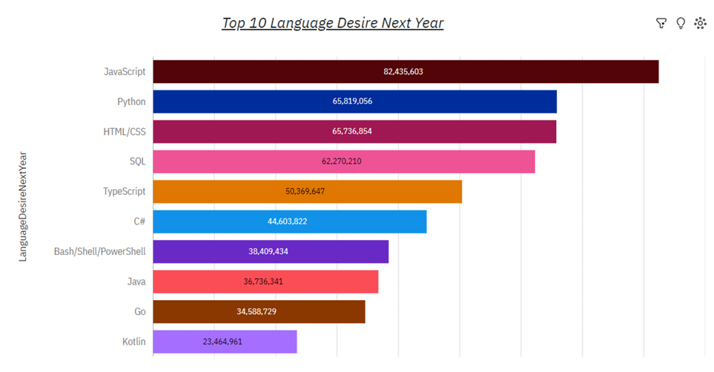
PROGRAMMING LANGUAGE TRENDS
2019
Next Year

Slide 8
PROGRAMMING LANGUAGE TRENDS
Findings
JavaScript and HTML/CSS emerge as the most used programming languages among all respondents
SQL also maintains a significant presence.
Python just edged out Java in overall ranking
Implications
The dominance of JavaScript and HTML/CSS underscores their indispensability in modern web development, highlighting the importance of mastering them for developers.
The high usage of SQL emphasizes the critical role of data management and querying in modern software applications, across both web and non-web environments.
The rise of Python might also reflect its versatility and ease of use, attracting developers across various domains from data science to software development.

Slide 9
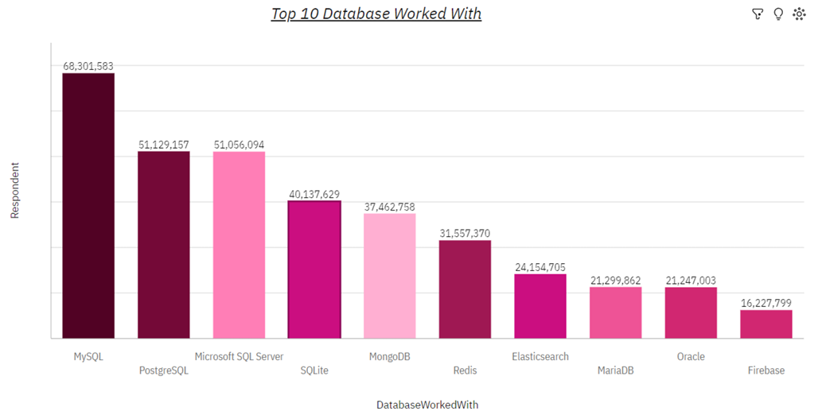
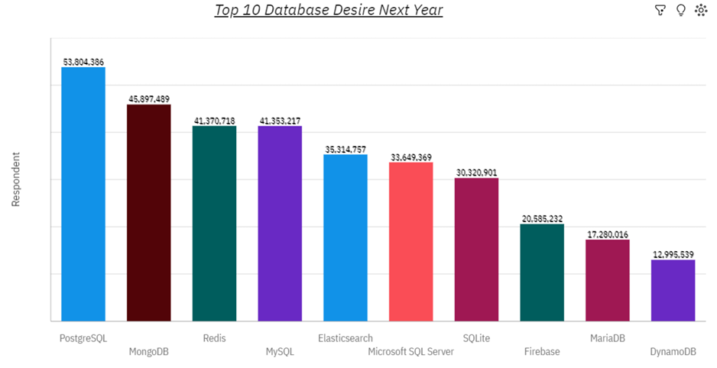
DATABASE TRENDS
2019
Next Year

Slide 10
DATABASE TRENDS
Findings
MySQL leads as the most used DBMS among all respondents.
PostgreSQL and Microsoft SQL Server follow closely behind MySQL.
MongoDB ranks as the top NoSQL database
Implications
The popularity of MySQL, PostgreSQL, and Microsoft SQL Server underscores the importance of relational databases in various applications.
The high usage of MongoDB reflects the growing trend towards NoSQL databases, driven by the need for flexible data models and scalability, particularly in modern web and mobile applications.
The diverse range of database systems utilized by developers indicates the importance of selecting the right tool for the job, considering factors such as data structure, scalability, and performance requirements

Slide 11

DASHBOARD
You can find the dashboard link below:
https://github.com/NouraAz/Final-capstone

Slide 12
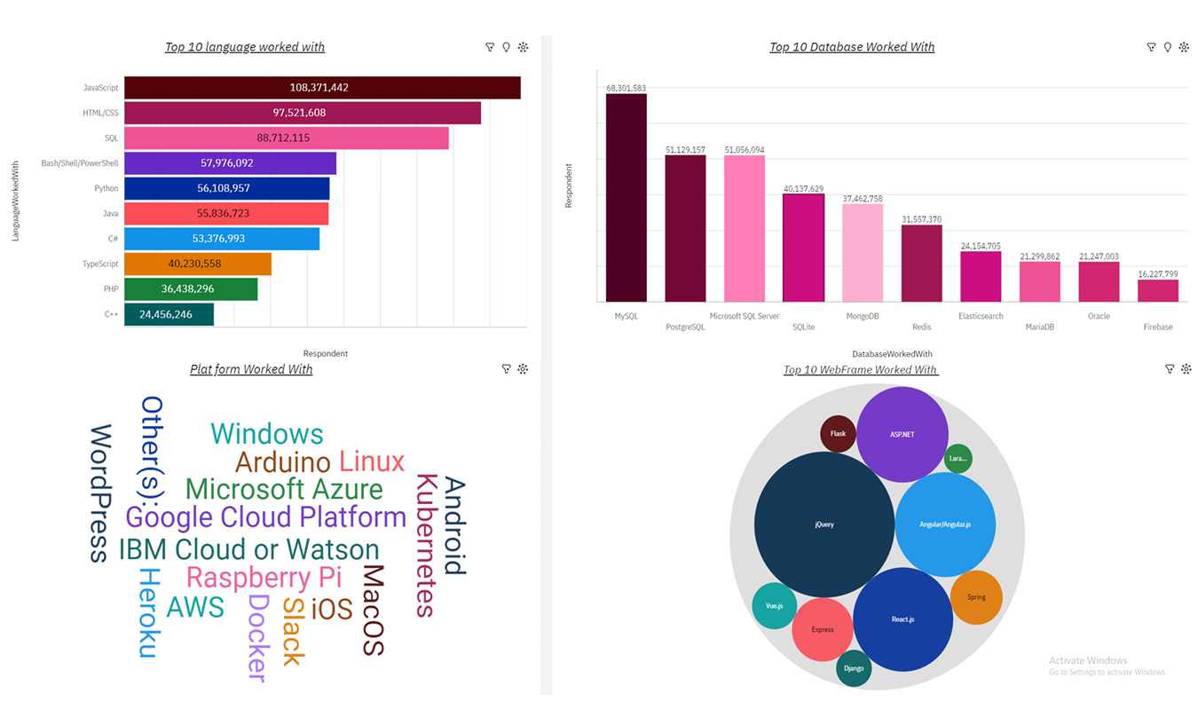
DASHBOARD TAB 1

Slide 13
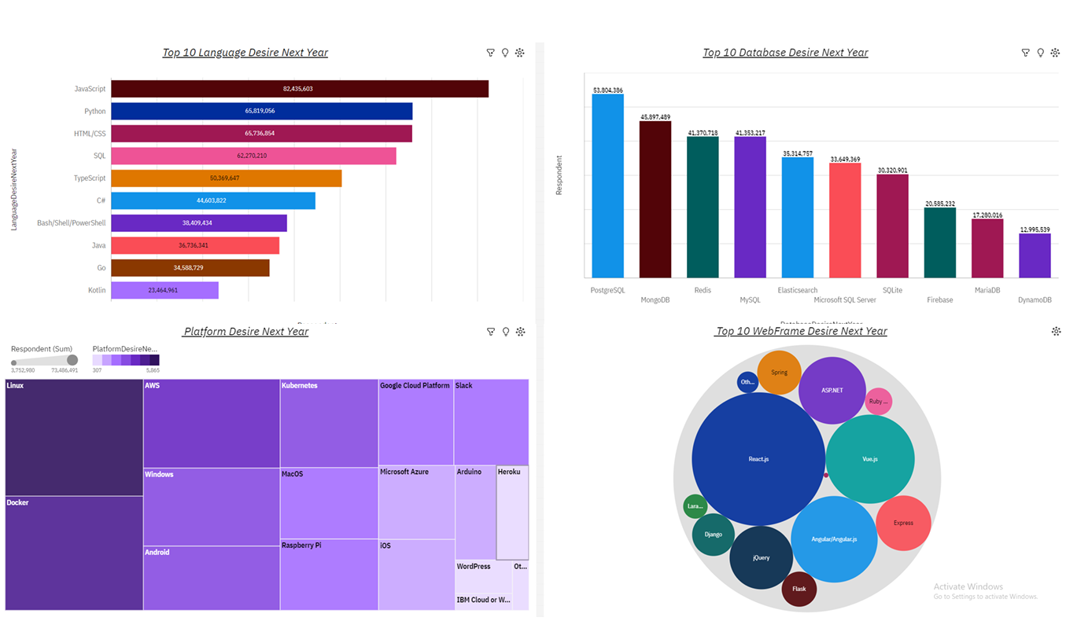
DASHBOARD TAB 2

Slide 14
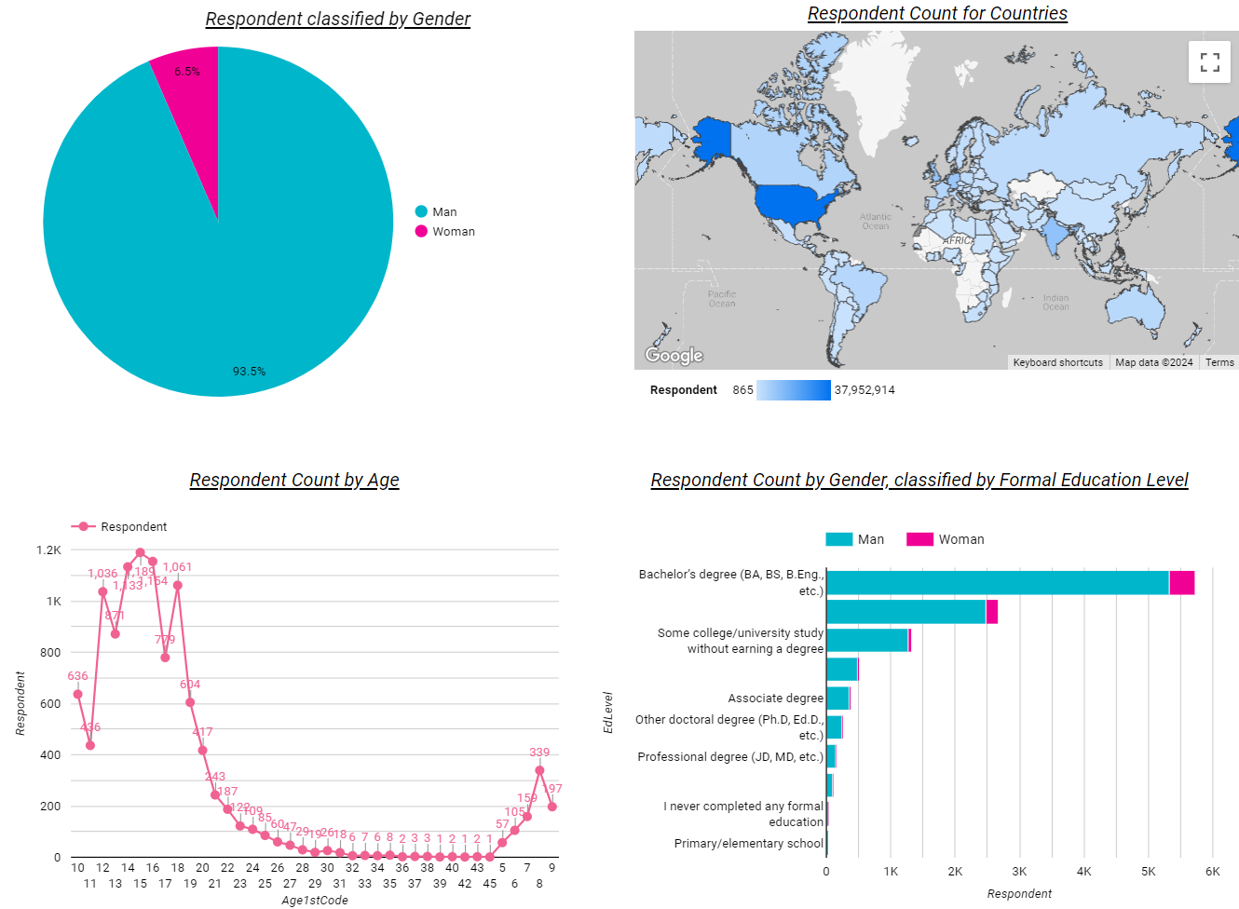
DASHBOARD TAB 3

Slide 15
DISCUSSION
The dominance of JavaScript and HTML/CSS and the adoption of MySQL as the leading database management system
Highlights the central role of web development in the programming landscape
Opens up discussions on the significance of client-side scripting and styling, trends in web development frameworks, and the evolving nature of web technologies

Slide 16
CONCLUDING REMARKS
Findings
Technology Trends: The dominance of JavaScript and HTML/CSS underscores the importance of staying updated with technology trends in web development.
Data Management: The prevalence of MySQL, PostgreSQL, and Microsoft SQL Server highlights the critical role of effective data management in software development.
Implications
Web Dominance: The widespread usage of JavaScript and HTML/CSS indicates the dominance of web development in the programming ecosystem, reflecting the growing importance of online platforms and digital experiences.
Database Diversity: The variety of database management systems used highlights the importance of flexibility and adaptability in data storage solutions. Organizations must consider factors such as data structure, scalability, and performance when selecting a database system.

Slide 17

CONCLUSION
The findings underscore the dynamic nature of the programming landscape and the critical role of technology in driving innovation across industries.
As developers navigate this ever-changing terrain,
a keen understanding of diverse programming languages.
database systems becomes essential to meet the demands of modern applications.
ensure optimal outcomes in software development projects.

Slide 18

APPENDIX
Compare Language Usage
Compare Platform Usage
POPULAR LANGUAGES
Top 5 databases that Respondents

Slide 19
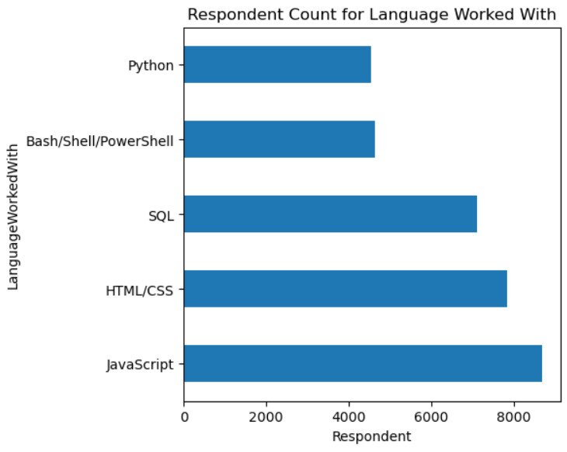
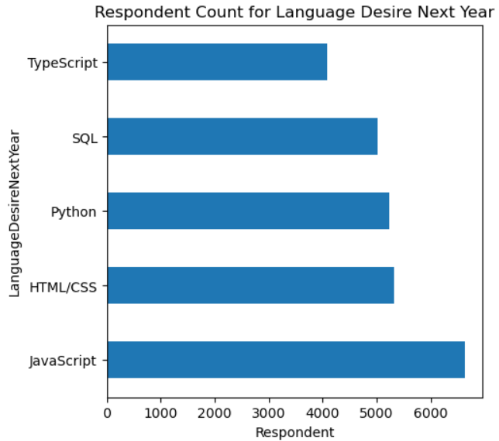
Compare Language Usage
Current Year -2019-
Next Year -2020-

Slide 20
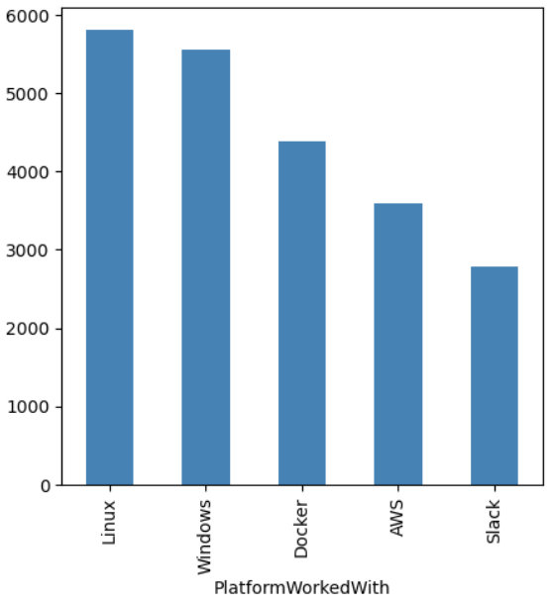
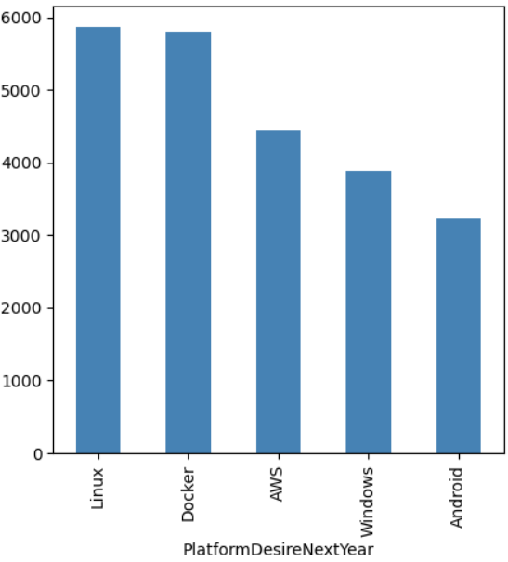
Compare Platform Usage
Current Year -2019-
Next Year -2020-

Slide 21
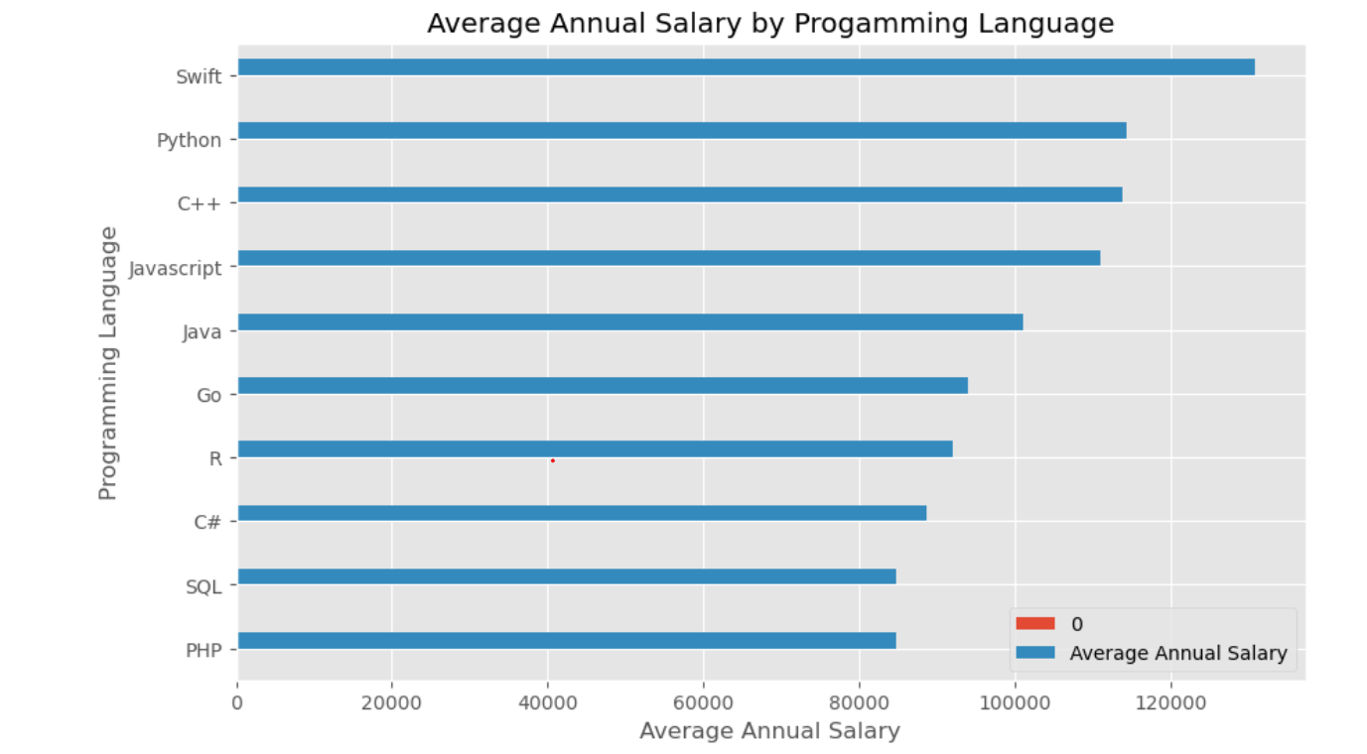
POPULAR LANGUAGES

Slide 22
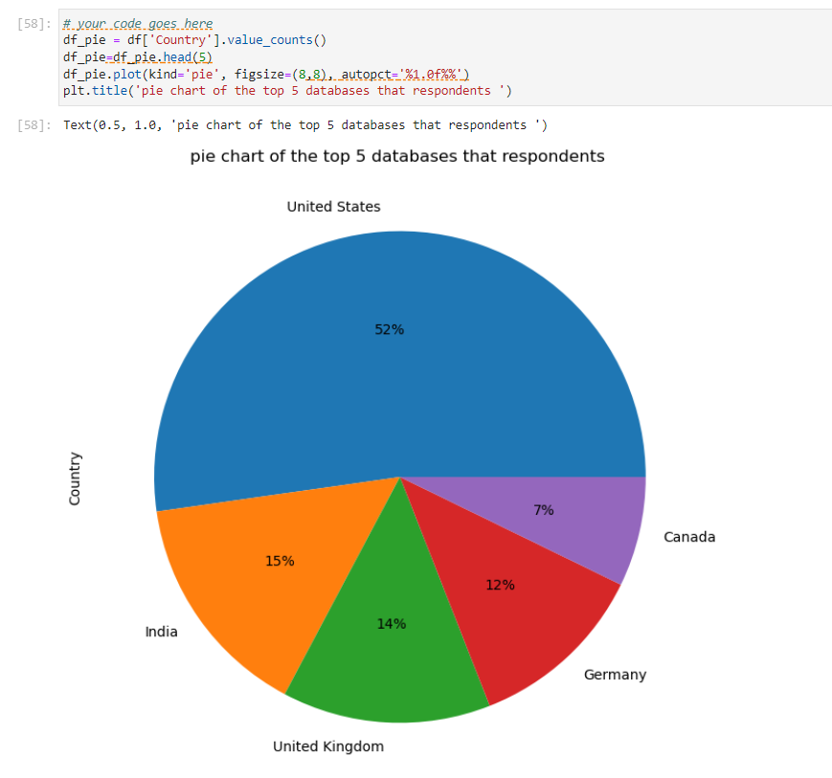
Top 5 databases that Respondents

