Slide 1
Lecture 1 + 2 Quiz

Slide 2
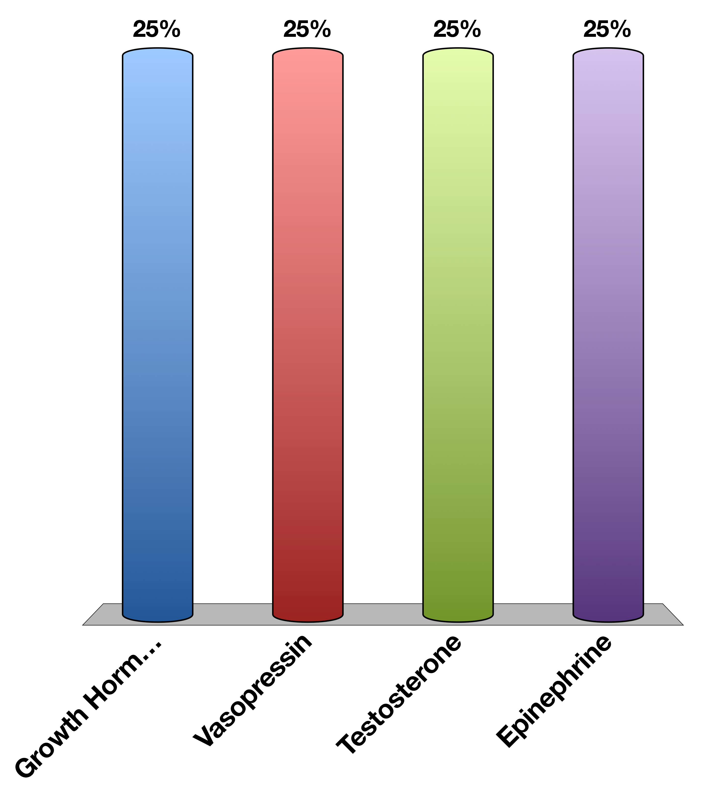
Which of the following is a peptide hormones
Growth Hormone
Vasopressin
Testosterone
Epinephrine
30

