Slide 2
Learning Objectives
Name three zones in the adrenal cortex and major regulator(s) of each zone.
Name three steroidogenesis pathways and their major products.
Explain briefly the physiological mechanism of adrenogenital syndrome.
Describe the physiological actions and roles of aldosterone.
Explain briefly the renin-angiotensin system.
Describe the negative feedback regulation of aldosterone and its relationship to blood volume/blood pressure homeostasis.
Describe hepatic and extrahepatic metabolic actions of glucocorticoids. Discuss their relationship.
State the major findings caused by adrenal hypersecretion of mineralocorticoids.
State the major findings caused by adrenal hypersecretion of glucocorticoids.
Name the major hormones secreted from the adrenal medulla. Discuss the differences of epinephrine (epi) and norepinephrine (NE) in cardiovascular actions (physiological levels).
List the major metabolic actions of catecholamines.
Contrast the thresholds for actions vs. plasma levels of epi and NE under common conditions, like exercise, and in the disease pheochromocytoma

Slide 3
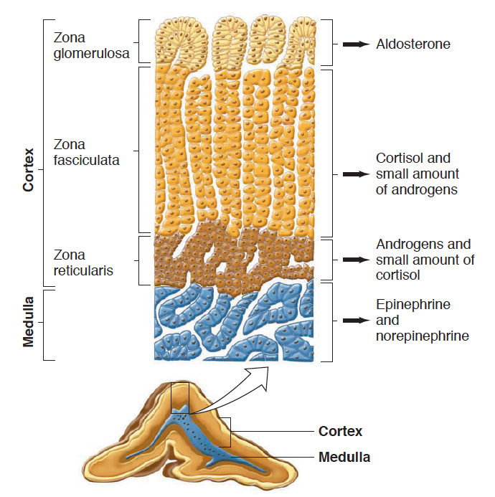
Adrenal Gland Anatomy

Slide 4
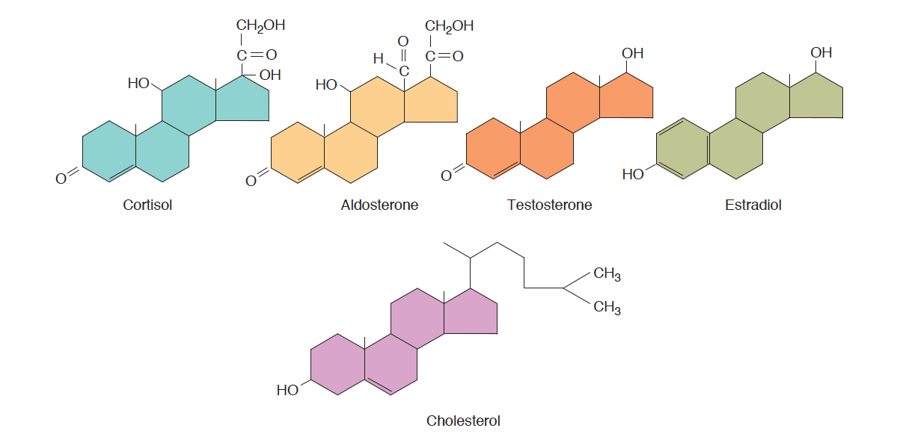
Steroid Hormones Released From Adrenal Medulla

Slide 5
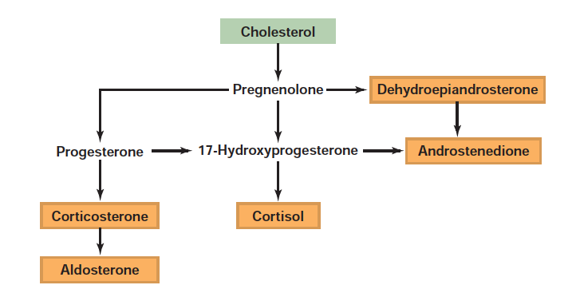
Steroid Hormone Synthesis

Slide 6
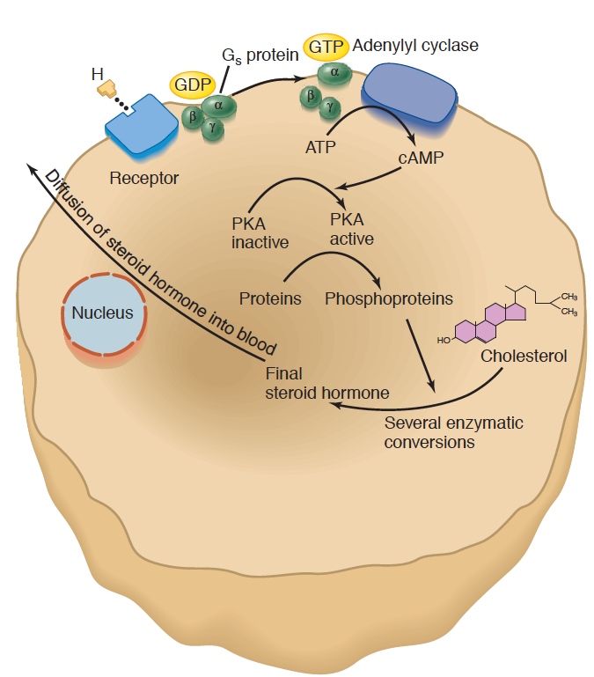
Steroid Hormone Synthesis Mechanisms
Signal | Receptor | Hormone
ACTH | MC2R (GPCR - Gs) | Cortisol
Angiotensin II | AGTR1 (GPCR – Gq) | Aldosterone

Slide 7
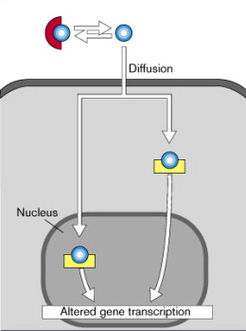
Both Aldosterone and Cortisol Function Through Nuclear Hormone Signaling

Slide 8
Aldosterone Regulates Mineral Balance

Slide 9
Aldosterone Summary
Where is it made? | Adrenal Cortex (Zona glomerulosa)
What causes its release? | Angiotensin II Signaling (GPCR –Gq) and to a lesser extent ACTH
What are its receptors? | Mineralcorticoid Receptor
What tissues does it affect? | Kidneys (Collecting Ducts and Distal Convoluted Tubule) | ENAc, Na/K Transporter/SGK
How does it get turned off? | Receptor desensitization, less ATII signaling, 11BHSD2

Slide 10
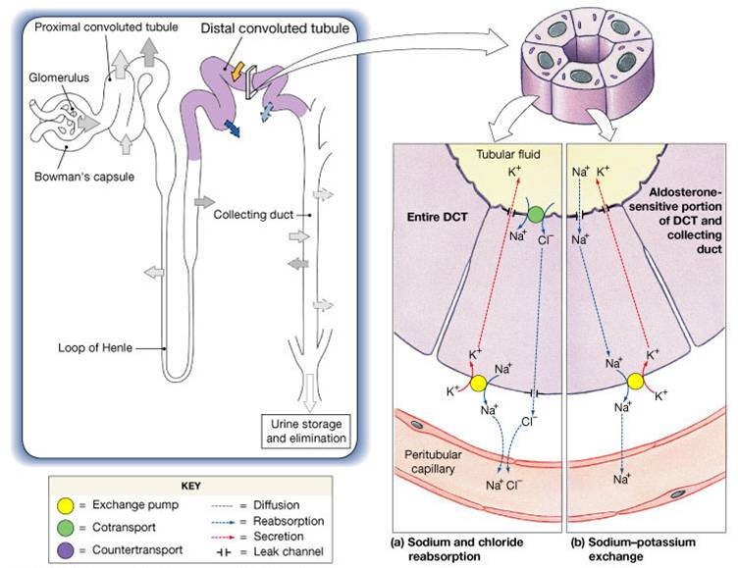
Key Aldosterone Effectors
ENac
Na/K

Slide 11
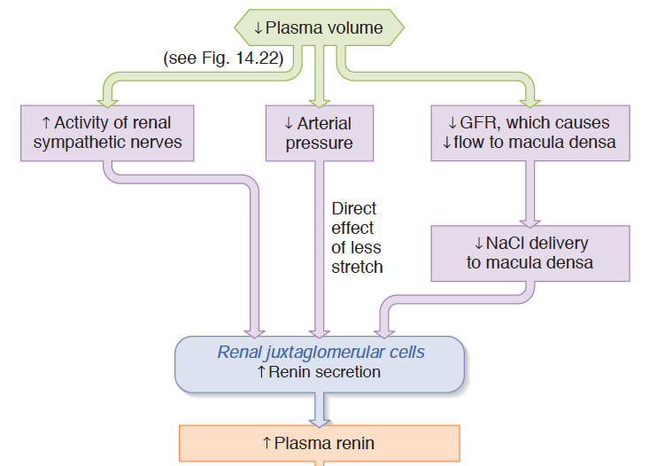
Renin as a Volume/Pressure Sensor

Slide 12
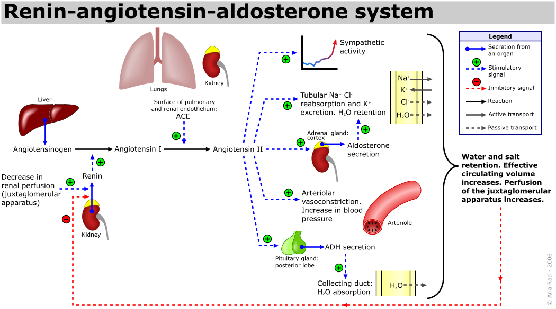
The Renin/Angiotensin System

Slide 13
Glucocorticoids Mediate Long Term Stress Responses

Slide 14
Cortisol Summary
Where is it made? | Adrenal Cortex (Zona fasciculata)
What causes its release? | ACTH (GPCR –Gs)
What are its receptors? | Glucocorticoid Receptor
What tissues does it affect? | Muscle | Protein Catabolism
 | Adipose | Increased Lipolysis, Adipogenesis
 | Liver | Increased Gluconeogenesis
 | Brain | Less Food Intake
 | Immune System | Reduced Th2 Activation
How does it get turned off? | Receptor desensitization, Negative Feedback to Pituitary, Negative Feedback to Hypothalamus, 11BHSD2

Slide 15
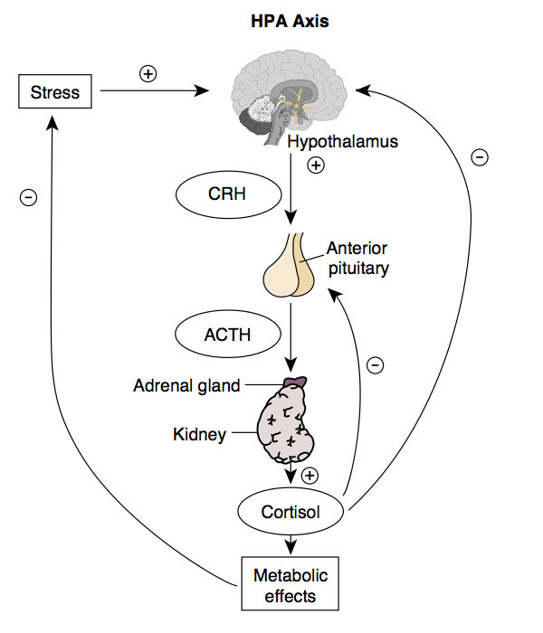
HPA Axis

Slide 16
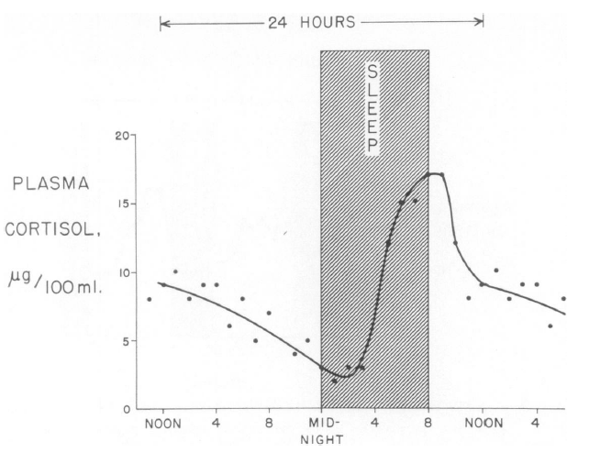
Daily Rhythms of Cortisol Release
Liddle GW (1966) An analysis of circadian rhythms in human adrenocortical secretory activity. Trans Am Clin Clim Assoc 77: 151–160.

Slide 17
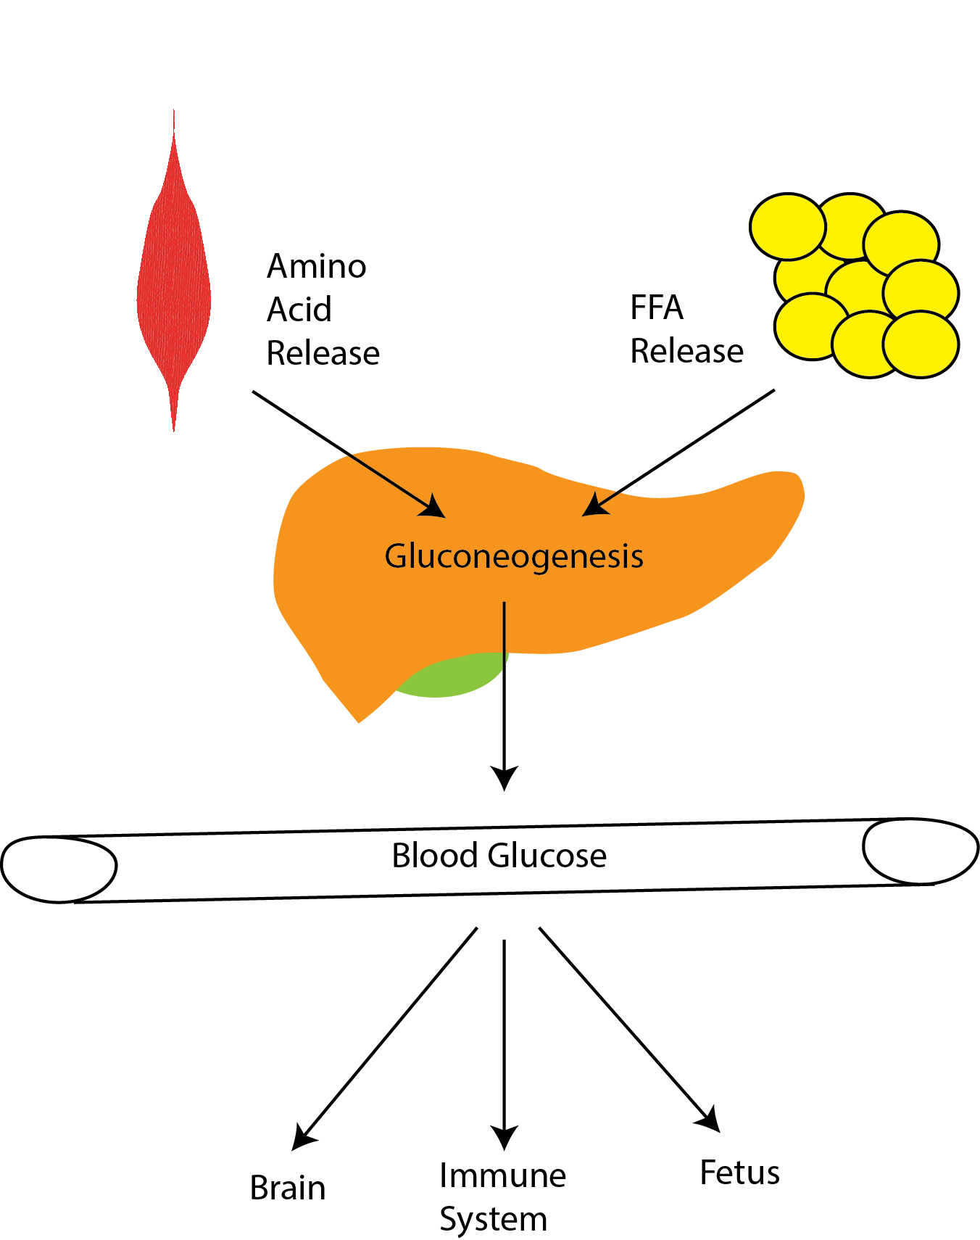
Cortisol Maintains Blood Glucose Levels
Notes:
Induces gluconeogenesis
Induces protein/triglyceride breakdown
Promotes insulin resistance

Slide 18
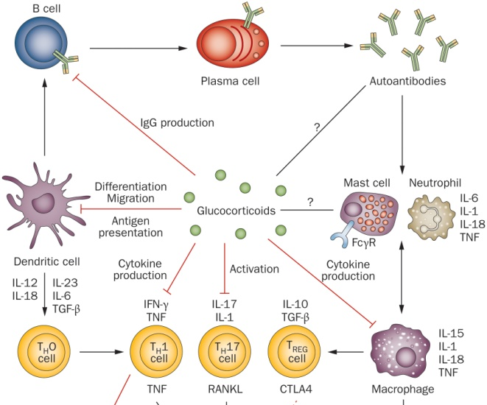
Effects of Cortisol on Immune Function

Slide 19
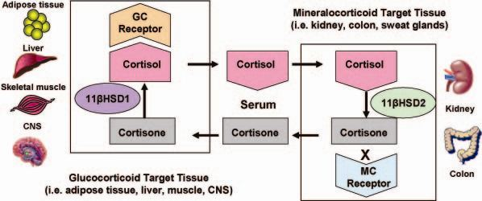
11β-HSD 2 and Local Concentrations of Glucocorticoids

Slide 20
Adrenal Steroid Hormone Disfunction

Slide 21
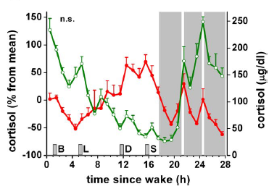
Night Time Workers
Normal
Sleep disrupted
Scheer F AJL, Hilton MF, Mantzoros CS, Shea S A (2009) Adverse metabolic and cardiovascular consequences of circadian misalignment. Proc Natl Acad Sci U S A 106: 4453–4458. doi:10.1073/pnas.0808180106.
Notes:
Fedex workers

Slide 22
Discuss
Congenital Adrenal Hyperplasia
Mutations in biosynthesis of cortisol/aldosterone
What would be the effects on
Sex hormone production
Salt balance
Adrenal size

Slide 23
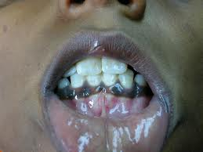
Addison’s Disease
Autoimmune destruction of adrenal gland
How would this anatomically differ from CAH?
Why would blood pressure be low?
Why would there be a risk of hypoglycemia?
Notes:
Hyperpigmentation is due to constant release of ACTH/MSH which are both part of POMC. This is because of reduced negative feedback of Cortisol onto the ACTH releasing cells/

Slide 24
Tumors Affecting Adrenal Function
Conn’s syndrome (adenoma of zona glomerulosa)
Cushing’s syndrome
pituitary adenoma (ACTH releasing) or
adenoma of zona fasciculata

Slide 25
Adrenaline Mediates Short-Term Stress Responses

