Slide 1
Lecture 1 + 2 Quiz

Slide 2
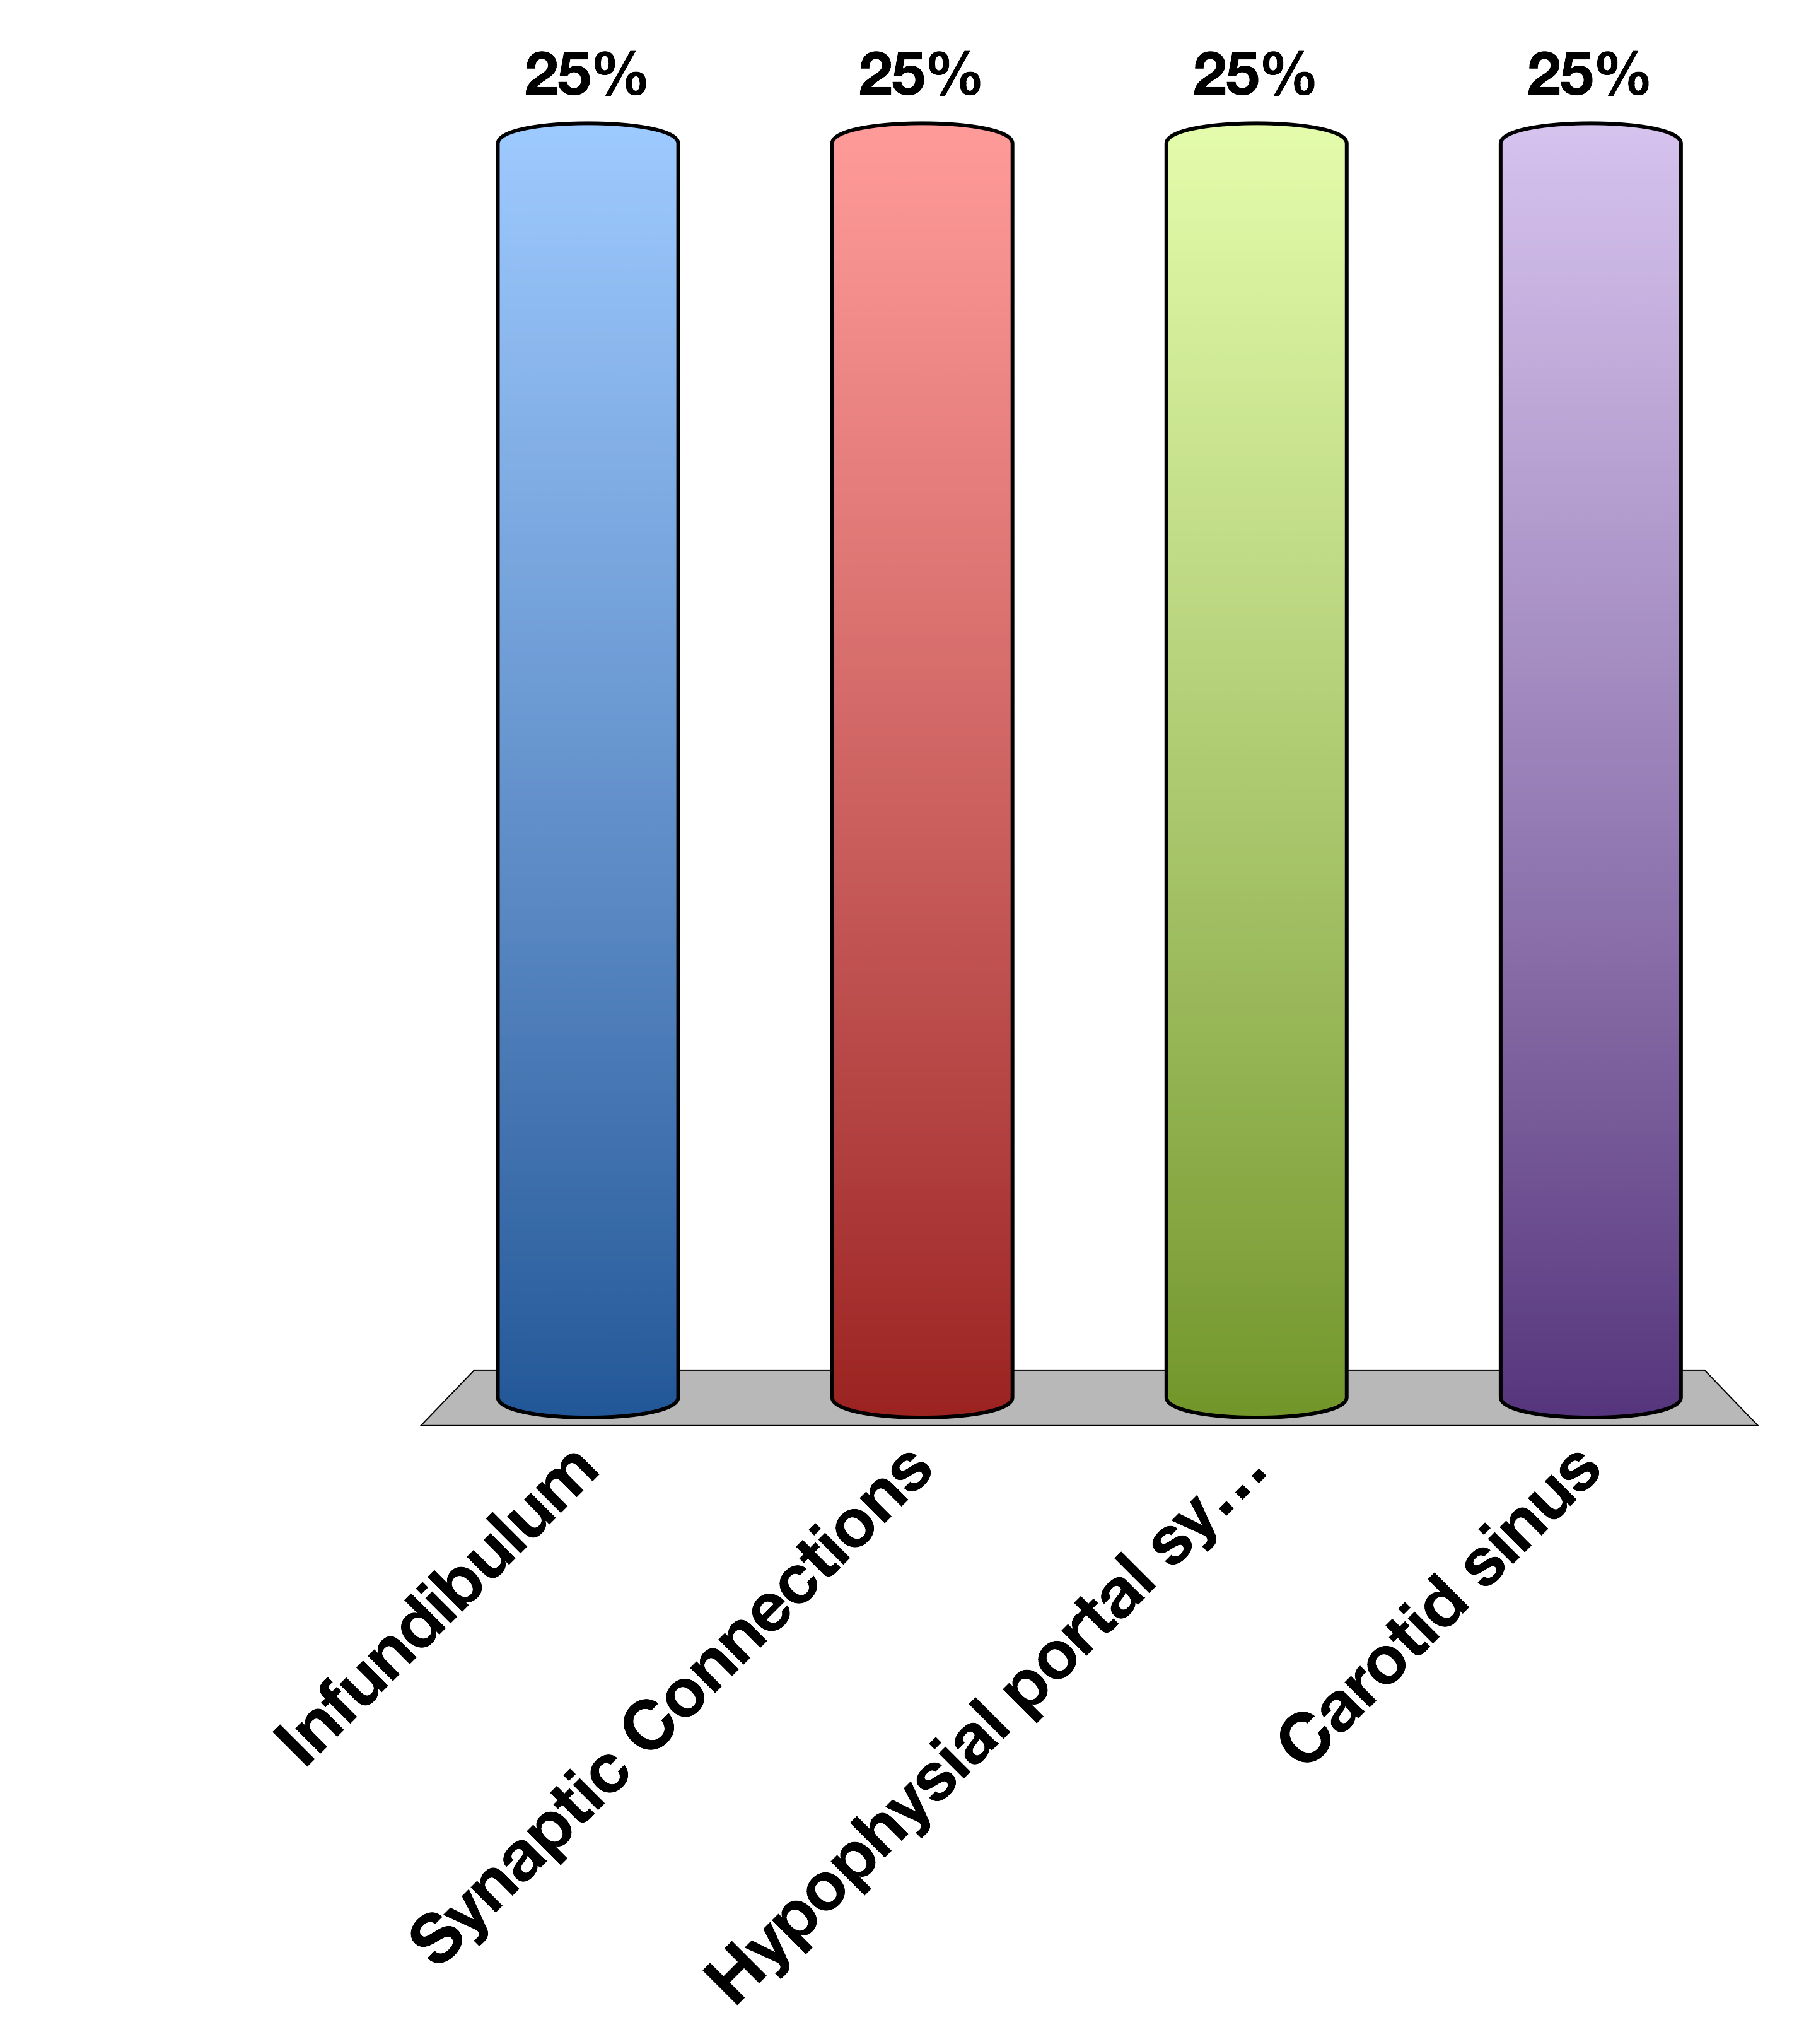
The Hypothalamus Connects to the Anterior Pituitary via the…
Infundibulum
Synaptic Connections
Hypophysial portal system
Carotid sinus
30

Slide 3
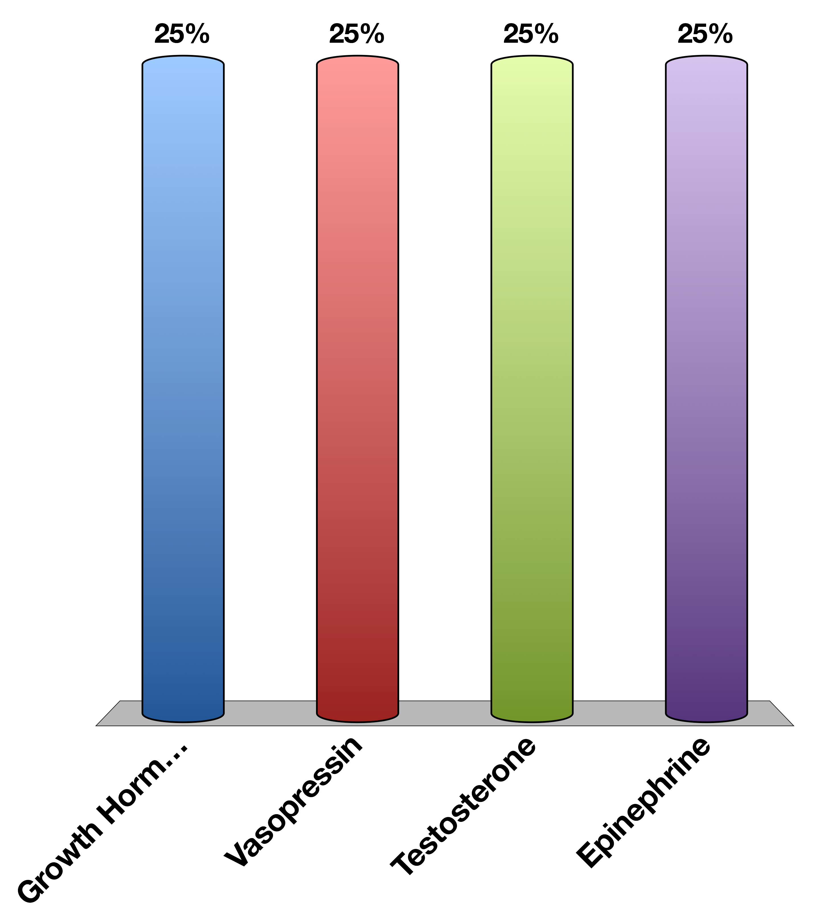
Which of the following is a peptide hormones
Growth Hormone
Vasopressin
Testosterone
Epinephrine
30

Slide 4
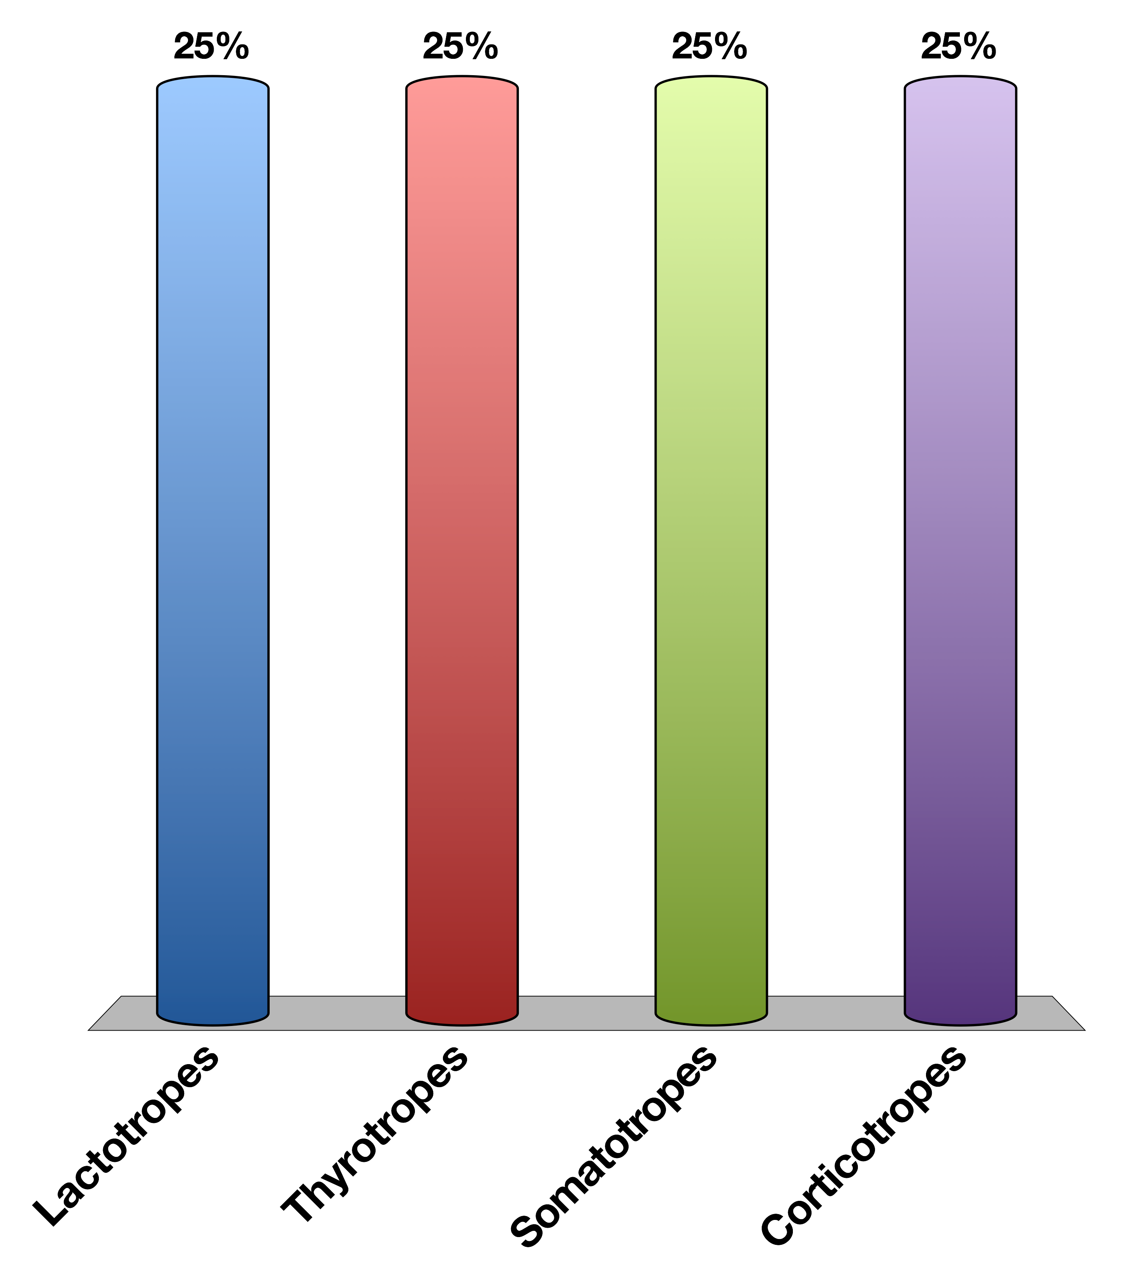
What Cell Type Secretes Growth Hormone
Lactotropes
Thyrotropes
Somatotropes
Corticotropes
30

Slide 5
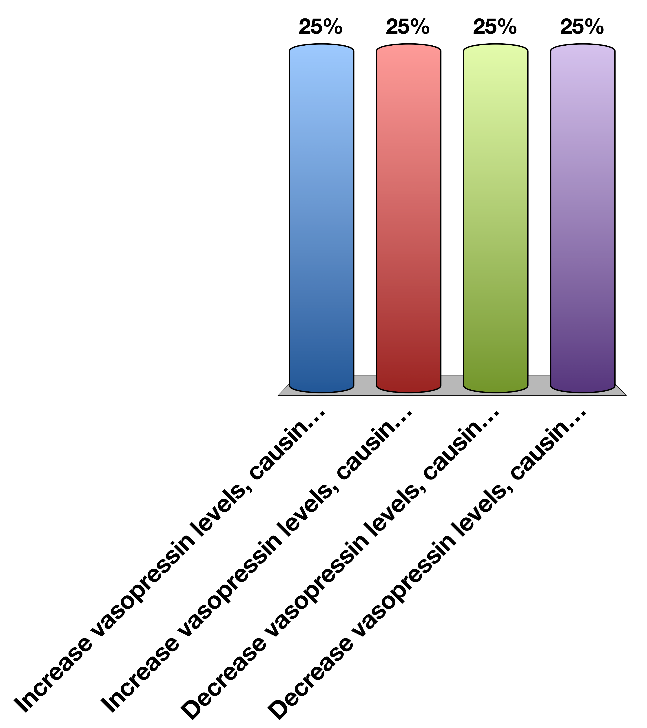
Drinking a lot of water will…
Increase vasopressin levels, causing water reuptake
Increase vasopressin levels, causing water excretion
Decrease vasopressin levels, causing water reuptake
Decrease vasopressin levels, causing water excretion
30

