Slide 1



RAMQA

Slide 2



Team Members
Nourah Alhazyim
Aljawhrah Alammar
Halima Alrashidi
Hamoud Alkharji

Slide 3
Table Of Contents
01
04
02
05
03
06
Introduction
Demo
Vision 2023
Future Works
Implementation
Conclusion

Slide 4
Introduction
What is the importance of technology in human life?
Technology is crucial in human life because it enhances efficiency, facilitates communication, expands access to information, improves healthcare, enables innovation, and enhances overall quality of life.
Can all segments of society use technology?
No, there is a segmentation of society that faces limitations in utilizing technology, exemplified by individuals with paralysis who lack hand mobility and rely solely on eye movement.
What is RAMQA?
The "Ramqa" project focuses on developing technology specifically tailored for individuals with paralysis, particularly those who can only move their eyes. It aims to improve their access to and interaction with technology.

Slide 5
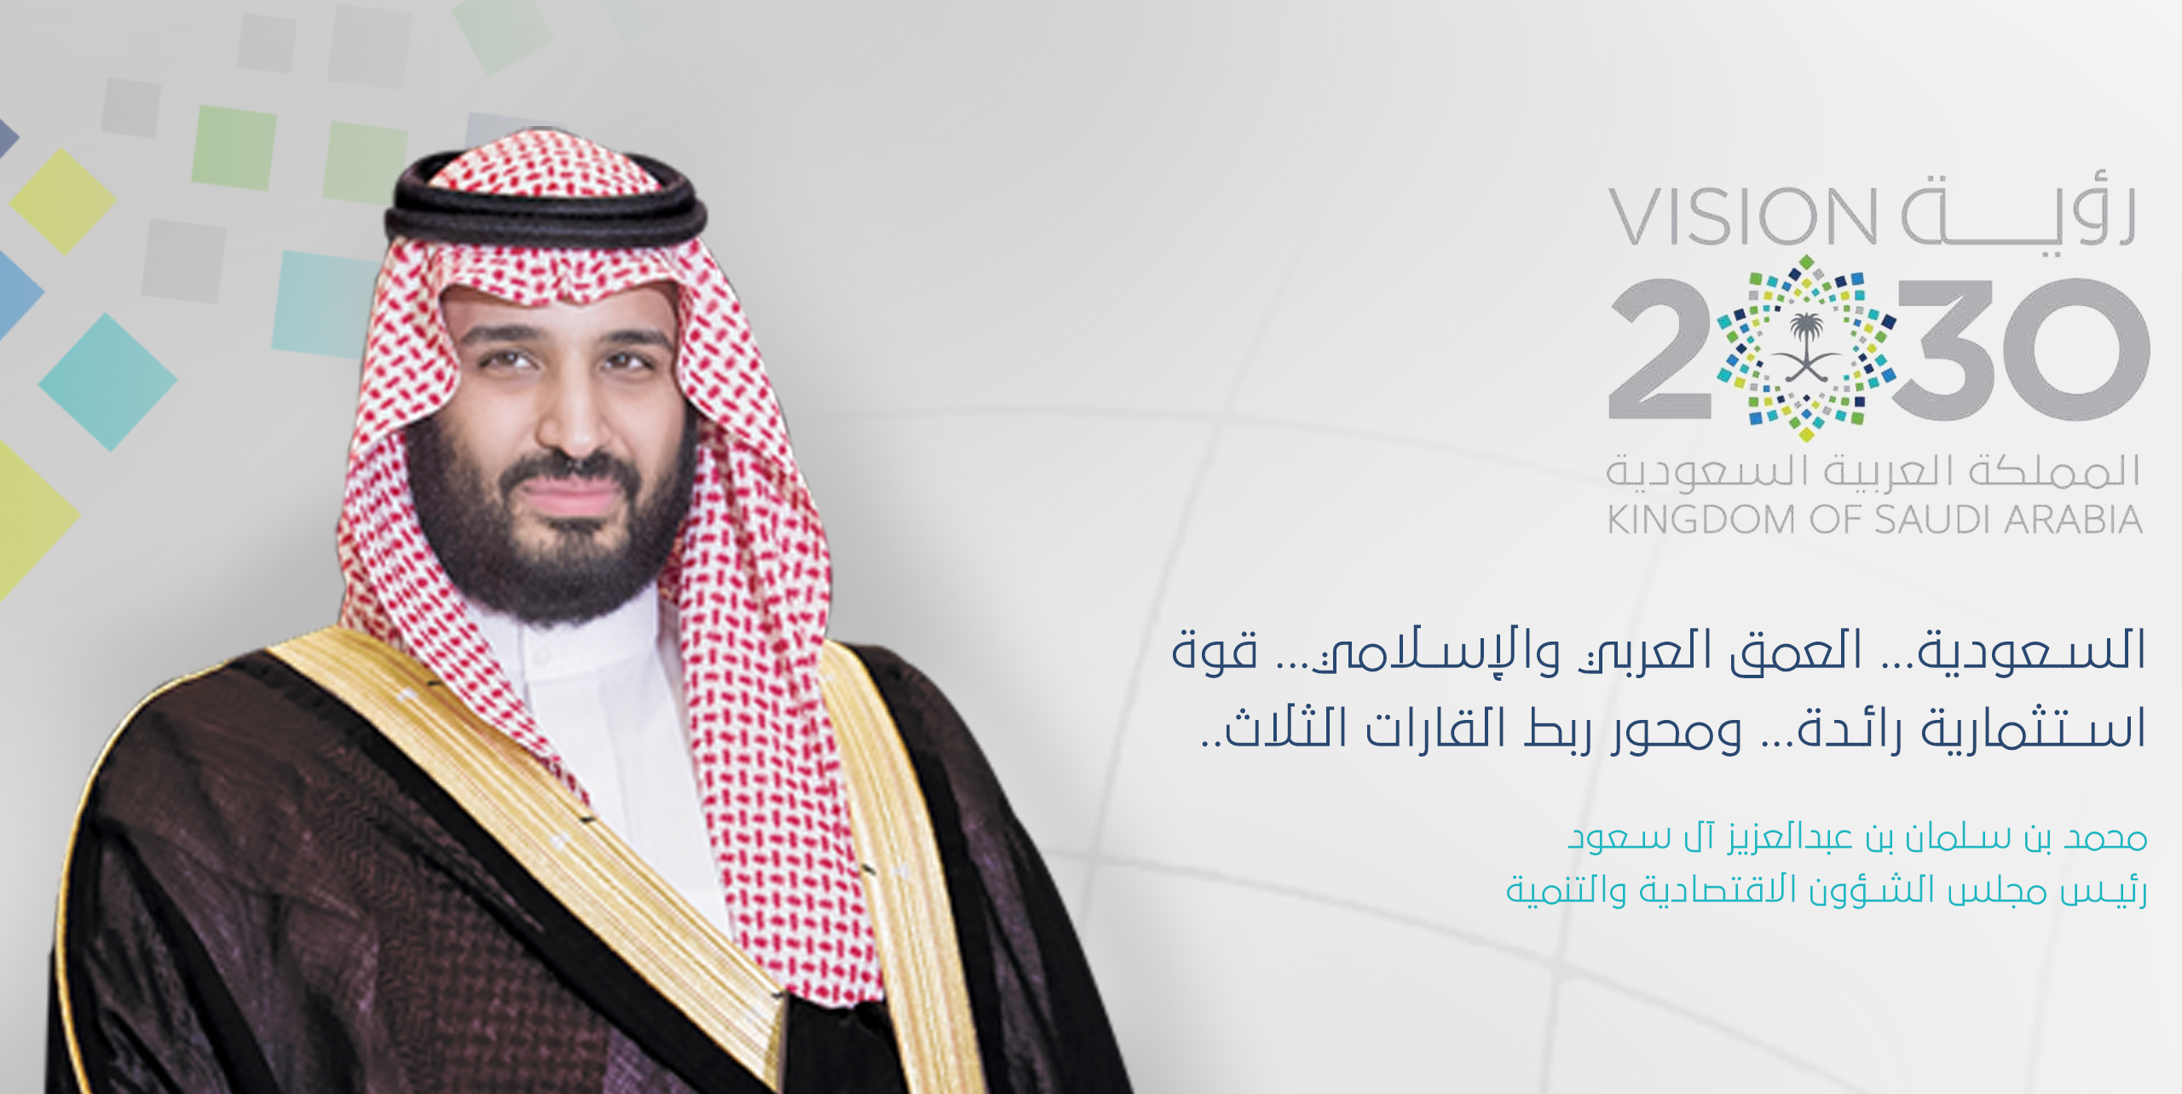
Vision 2030
How does the RAMQA project achieve Vision 2030?
The RAMQA project aligns with Vision 2030 by developing tailored technology solutions for individuals with disabilities, particularly paralysis. Its focus on innovations like eye-controlled technology fosters inclusivity and improves quality of life. By empowering disabled individuals to use technology effectively, Ramqa supports Vision 2030's goals of innovation, social inclusion, and building a knowledge-based economy.

Slide 6
Implementation
Several stages were involved in the implementation process
Search for eye-tracking
technology
Sourcing a dataset
Selecting a model
Real or Synthetic
Create dataset
Mediapipe
PyAutoGui

Slide 7
Model Results
Eye
1
3
2
Pupil
Direction
(Left Eye - Left Center Pupil ) + (Right Eye - Right Center Pupil ) /2

Slide 8








Tools
Library
Bbuilding Model
Website

Slide 9

Demo

Slide 10
Future Work
Enhanced Accuracy
Upgrading Features
Enhance Usability Accessibility

Slide 11
Conclusion
RAMQA project enhances the lives of individuals with severe mobility impairments by leveraging advanced eye-tracking technology. It empowers users to control digital interfaces through eye movements, increasing their independence and social integration while improving their overall quality of life.

Slide 12
Thank You For Listening !

