Slide 1

Acadia
Academic Productivity & Student Wellbeing Management System
17.05.2026
Öğr. Gör. Mustafa Sami CÜCEN

Slide 2

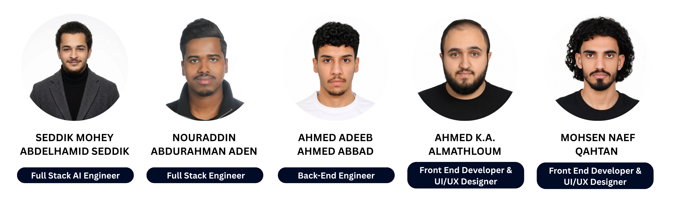
Advisor
Team Members

Slide 3
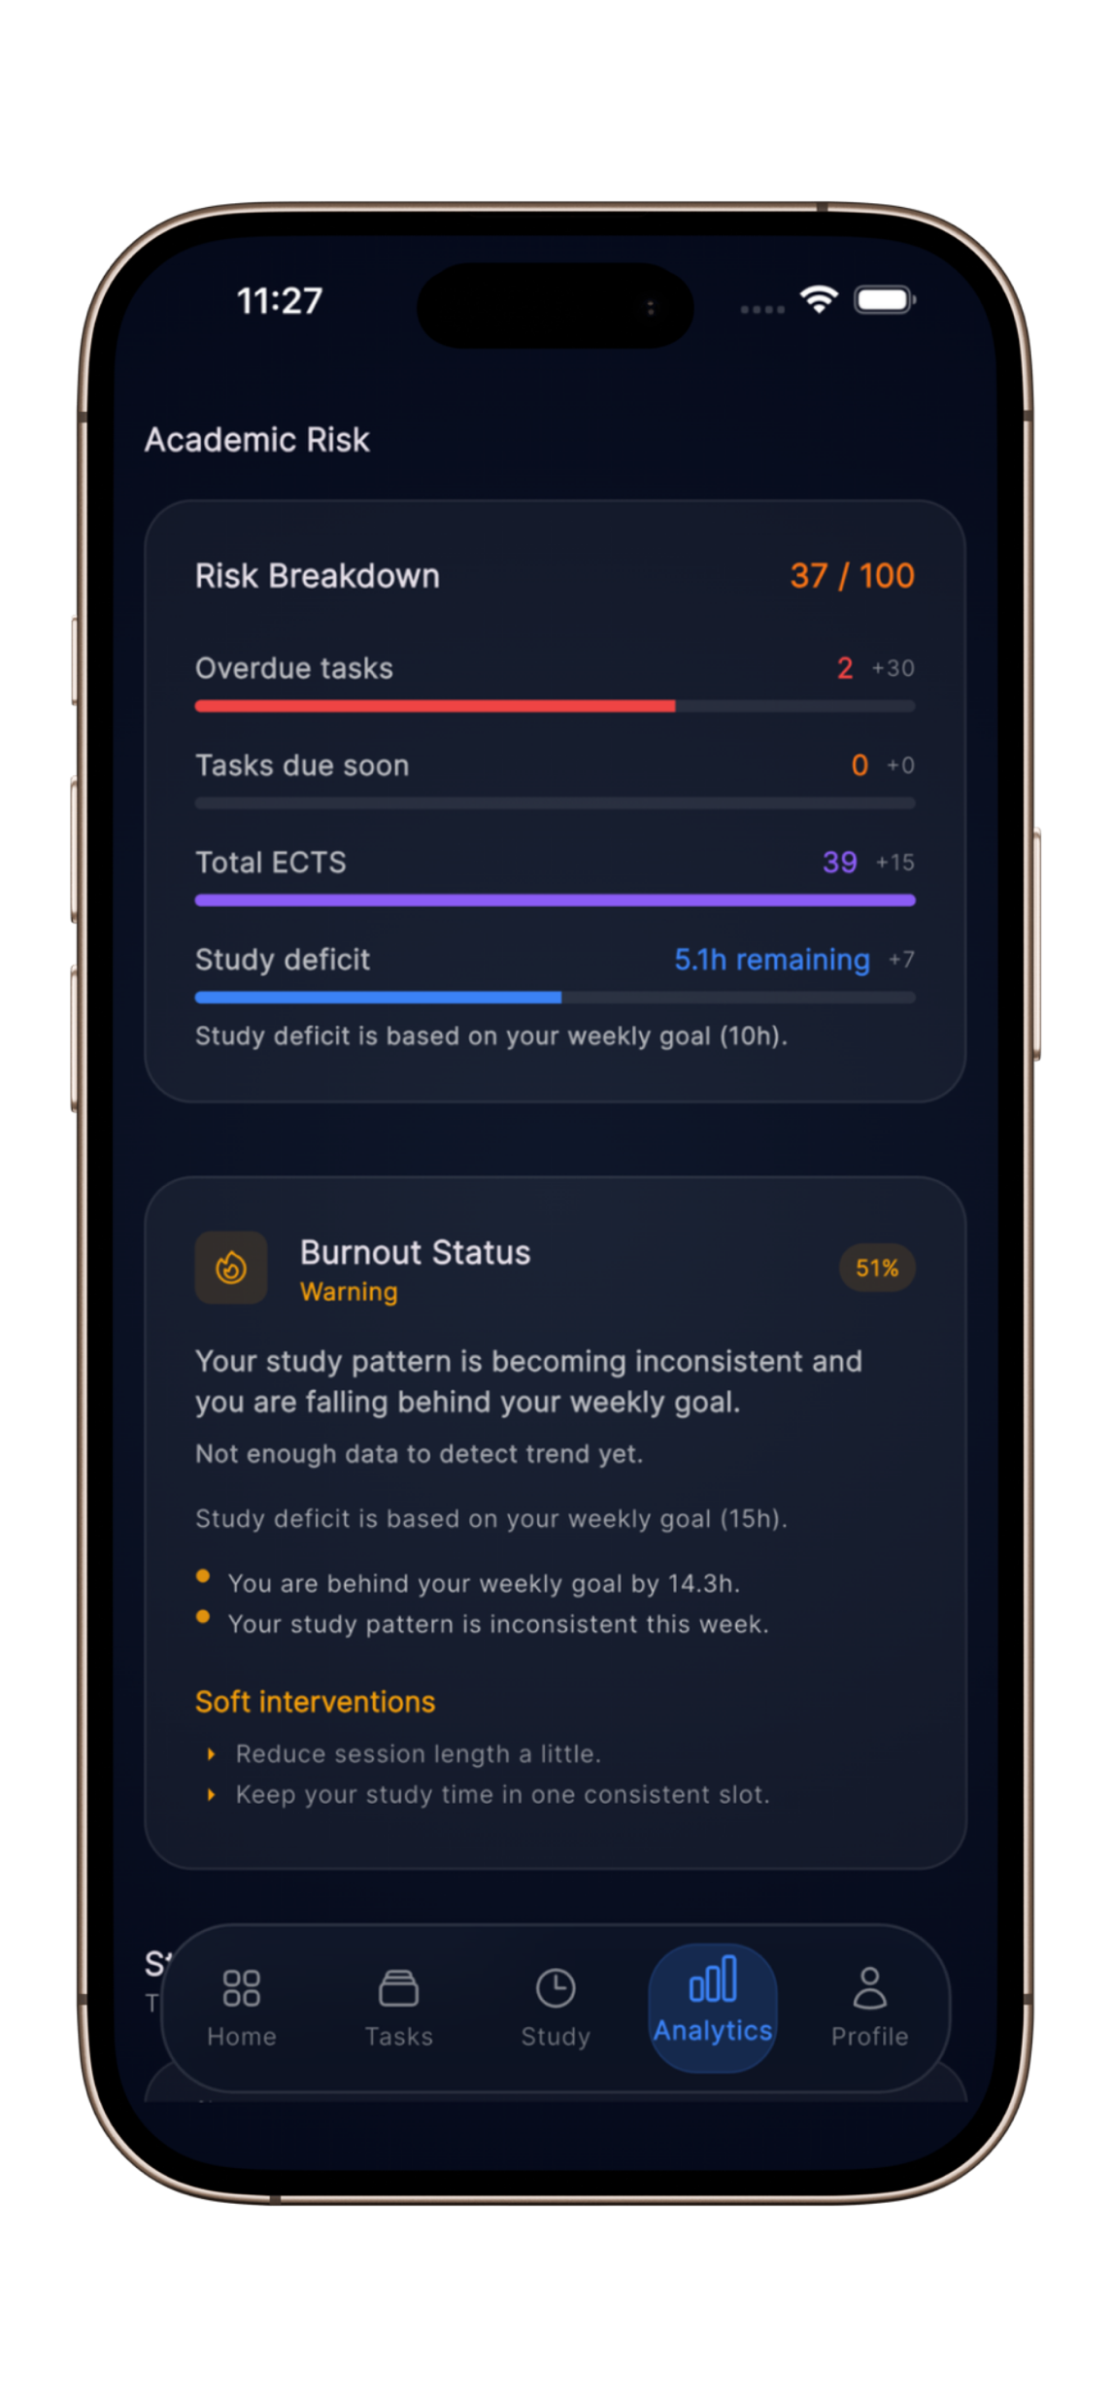
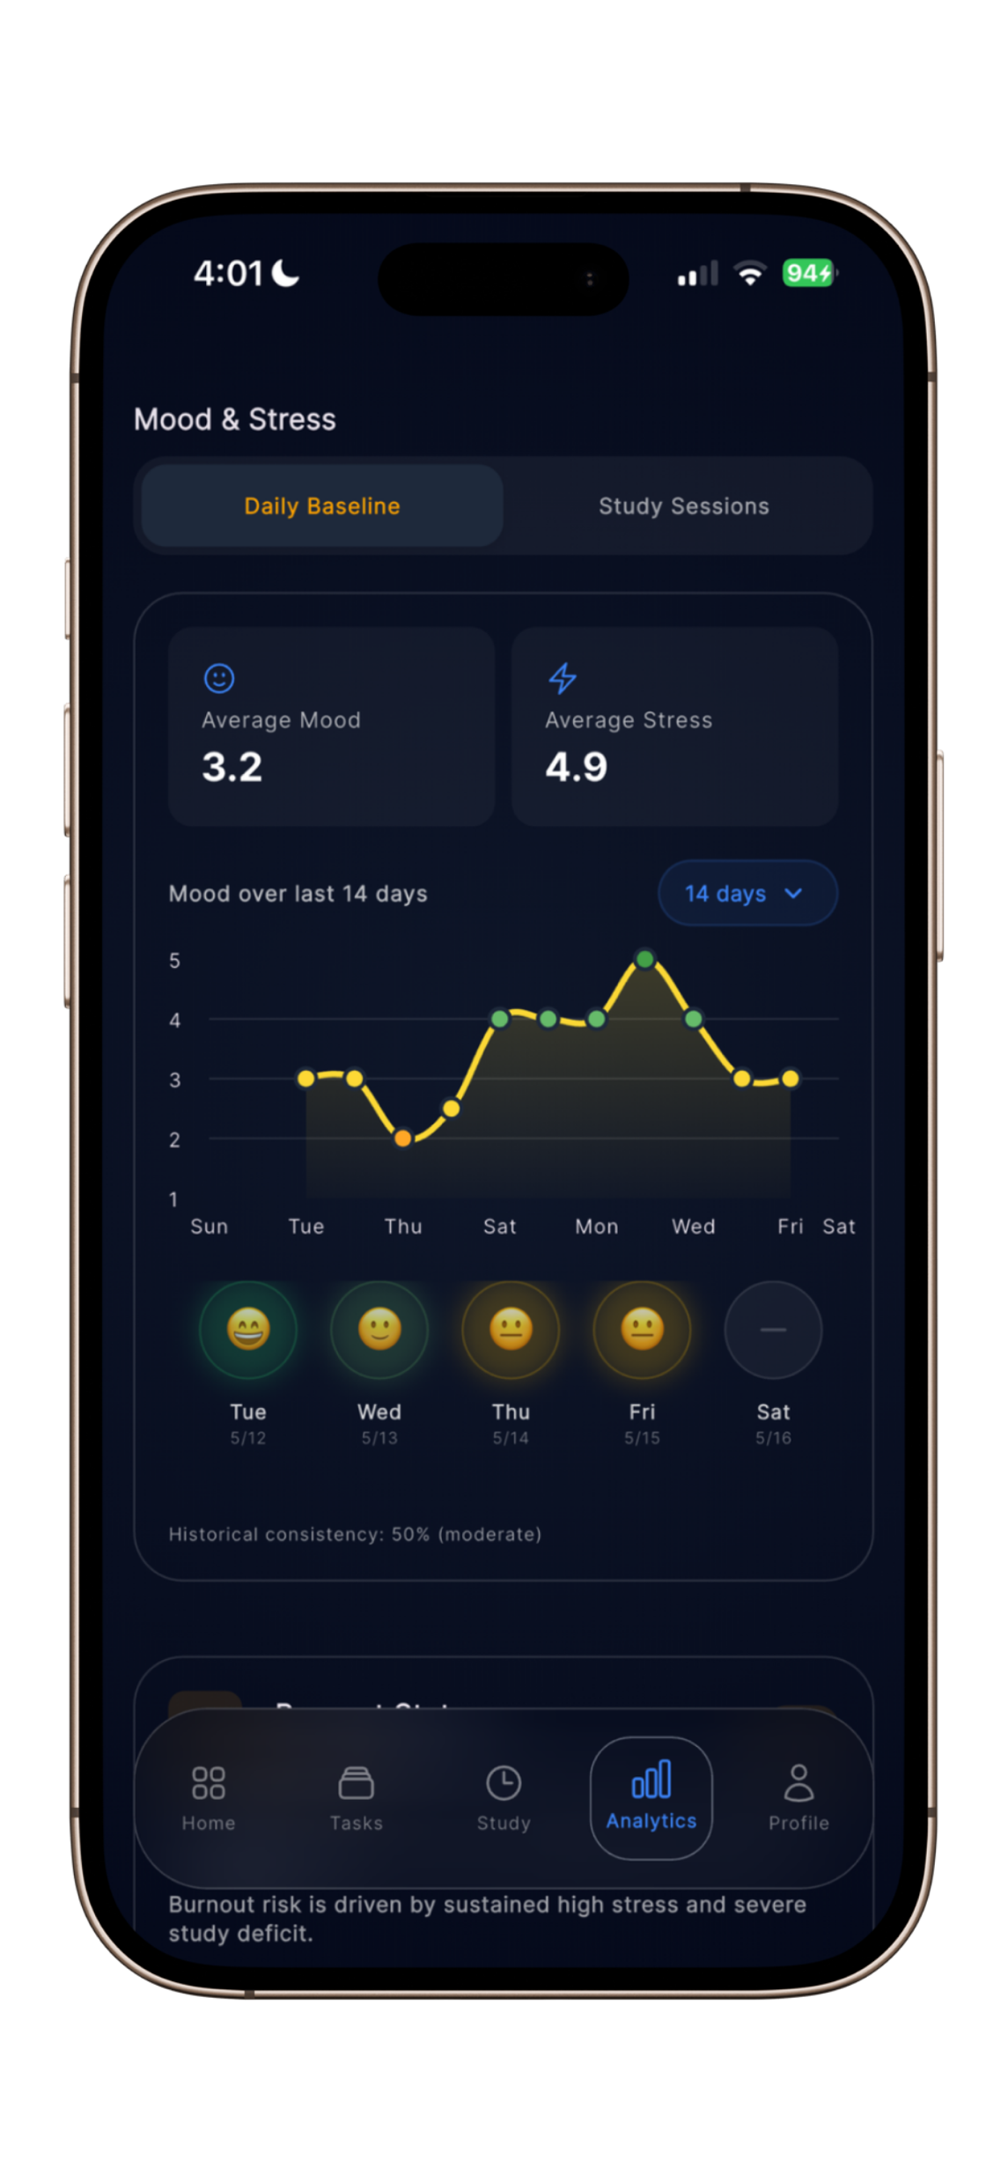
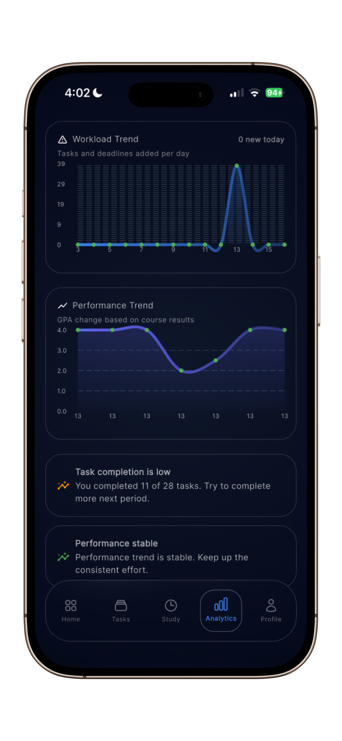
Why Acadia?
University students face increasing academic pressure every semester.
Students struggle with:
  Missed deadlines
  Poor study organization
  Inconsistent study habits
  Burnout and stress
  Difficulty prioritizing academic work
  Most productivity applications only manage tasks.
  They do not understand academic behavior.
  Acadia was designed to solve this problem.
Acadia combines:
  Academic management
  Analytics
  Realtime monitoring
  Intelligent recommendations
  AI assistance
  Wellbeing tracking
  Inside one unified system.

Slide 4
Problem Statement
Students often use multiple disconnected applications for:
  Tasks
  Calendars
  Reminders
  Notes
  Timers
  Analytics
This creates:
  Fragmented workflows
  Poor academic visibility
  Weak deadline management
  Inconsistent study tracking
Current systems fail to:
  Evaluate academic risk
  Monitor burnout
  Generate intelligent recommendations
  Provide realtime analytics
Acadia addresses these limitations through an integrated academic productivity ecosystem.

Slide 5
Project Objectives
The main objectives of Acadia are:
  Improve academic organization
  Monitor productivity
  Reduce academic stress
  Improve workload management
  Provide intelligent recommendations
  Support academic decision making
  Deliver realtime insights
Acadia also provides a scalable architecture for future AI-driven academic systems.

Slide 6
Proposed Solution
Acadia is a cross-platform academic productivity system developed using Flutter and Supabase.
Acadia provides:
  Semester management
  Course management
  Task tracking
  Deadline management
  Study sessions
  Pomodoro system
  Mood tracking
  Analytics dashboards
  Academic risk monitoring
  AI recommendations
  Intelligent notifications
  Realtime synchronization

Slide 7
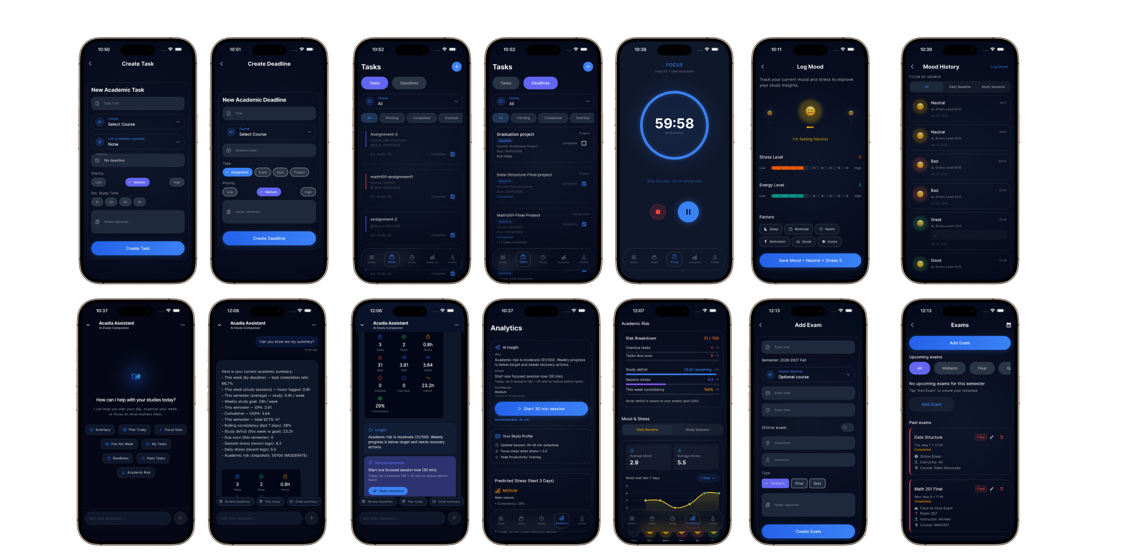
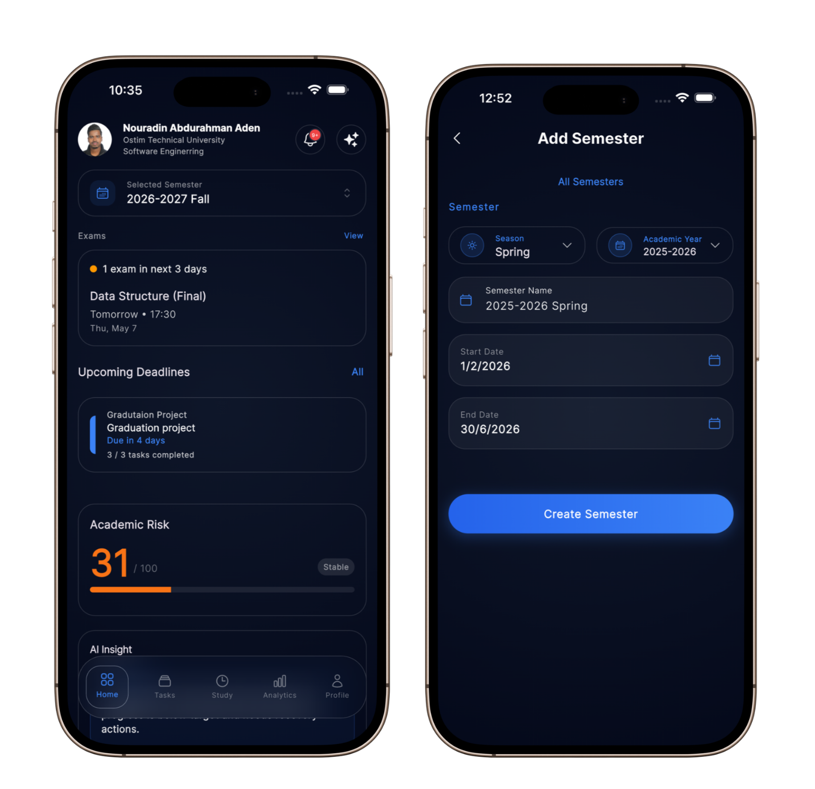
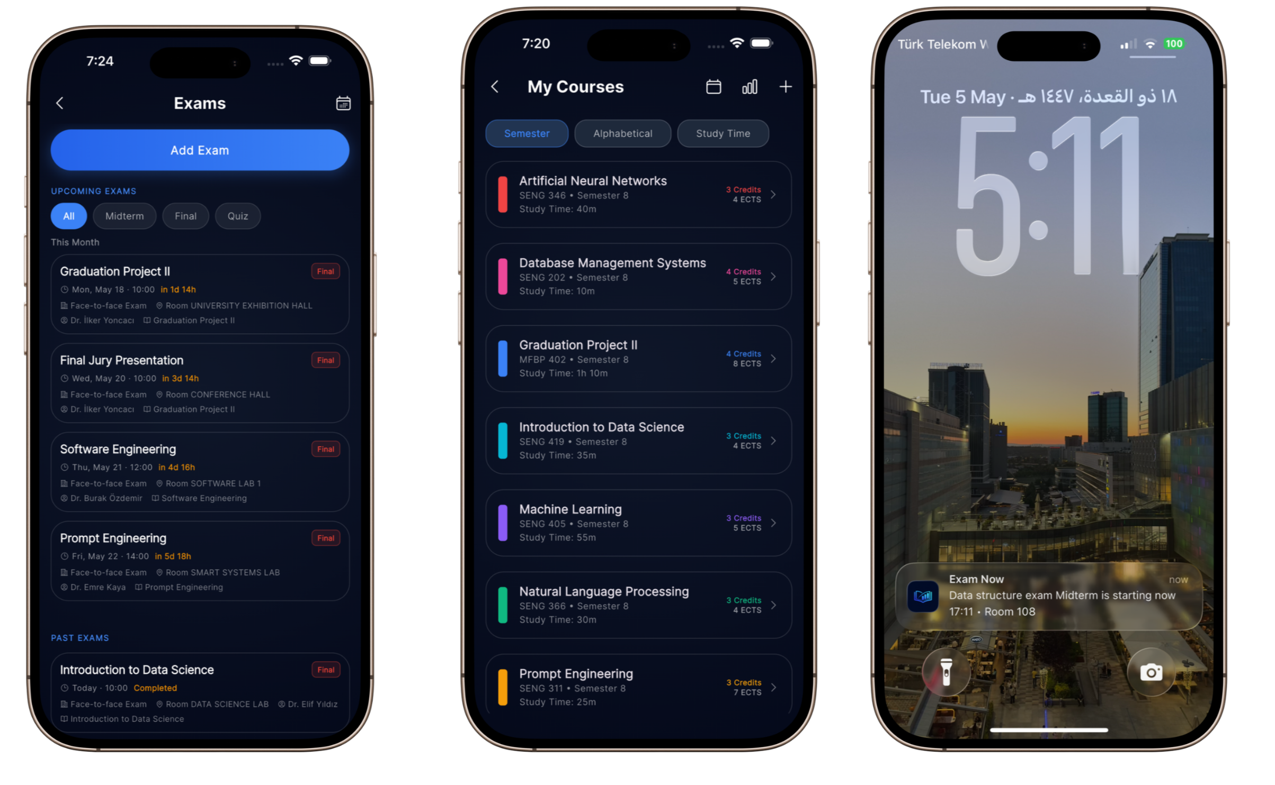
Proposed Solution

Slide 8
Technology Stack
Layer | Technologies
Frontend | Flutter, Dart
State Management | Riverpod
Backend | Supabase
Database | PostgreSQL
Notifications | Firebase Cloud Messaging
AI Integration | NVIDIA NIM, Llama 3.1
Local Storage | Hive
Navigation | GoRouter
Charts | fl_chart
Version Control | GitHub
Project Management | Notion Scrum Workspace

Slide 9
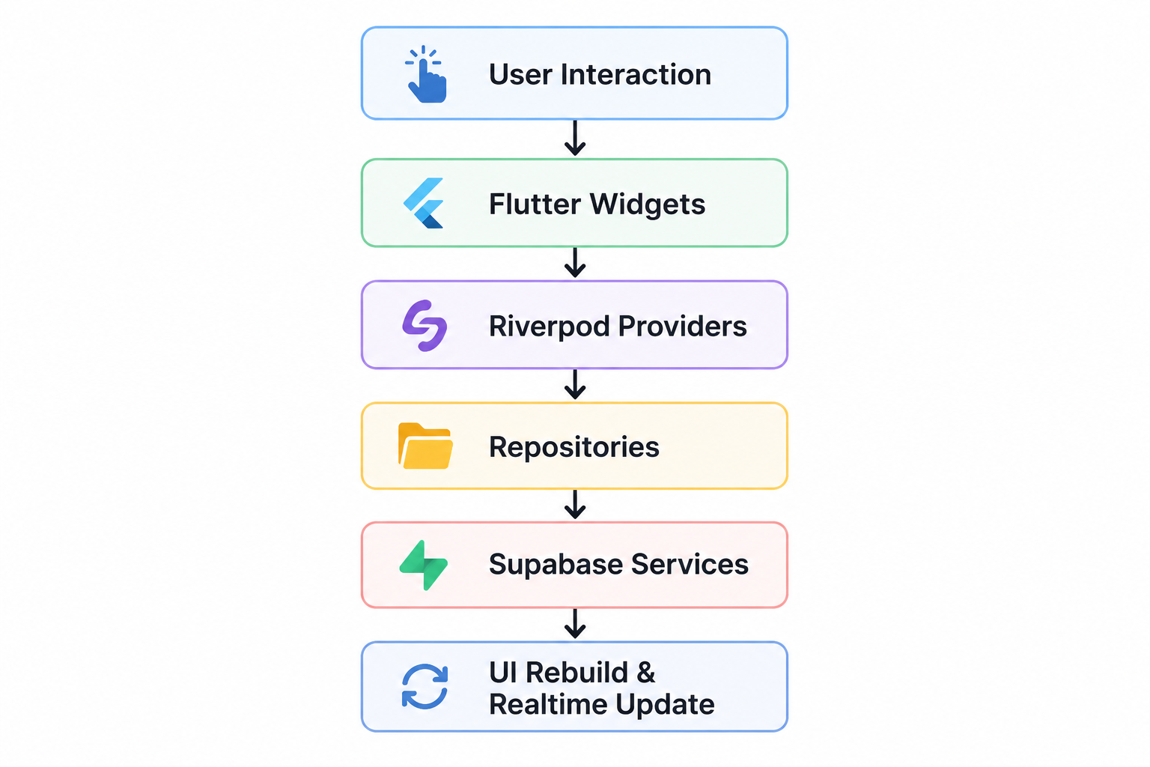
Frontend Architecture
Acadia’s frontend was developed using Flutter with a modular UI architecture and Riverpod state management.
The frontend system was divided into:
  Reusable widgets
  Feature-based screens
  Providers
  Controllers
  Responsive layouts
  Shared UI components
The application UI was designed to support:
Android
iOS
Tablets
Large screens
Responsive resizing

Slide 10
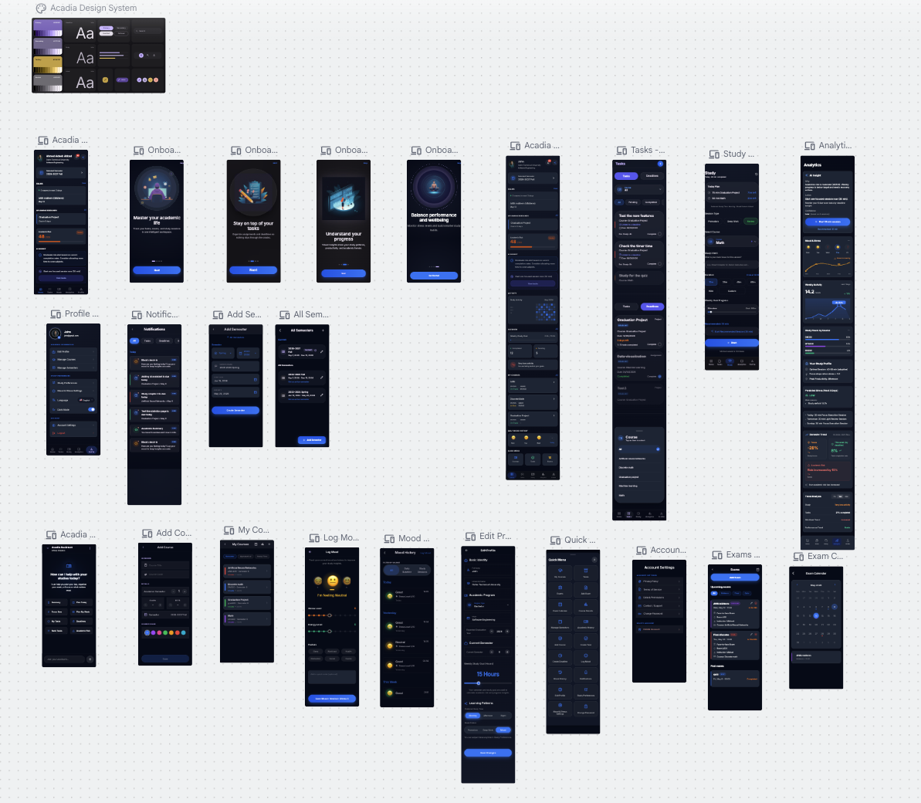
UI/UX Design & User Experience
The UI/UX system was designed to improve:
  Readability
  Simple navigation
  Academic organization
  Student focus
  Productivity tracking
The interface follows:
  Modern mobile design
  Glassmorphism UI
  Consistent spacing
  Clear visual hierarchy
  Responsive interactions
Design Goals
  Reduce cognitive overload
  Improve task visibility
  Simplify academic workflows
  Reduce navigation complexity
  Support long term usability
UI Features
  Animated onboarding
  Dashboard cards
  Analytics charts
  Progress indicators
  Bottom navigation
  Realtime updates
  Adaptive widgets
  Mood tracking
  Risk indicators
  Study timers

Slide 11
Software Development Process
Sprint | Main Focus
Sprint 1 | UI/UX Planning & System Design
Sprint 2 | Authentication & Core Setup
Sprint 3 | Semester & Course System
Sprint 4 | Tasks & Deadlines System
Sprint 5 | Study Timer System
Sprint 6 | Mood & Stress Tracking
Sprint 7 | Analytics Engine
Sprint 8 | Risk Engine & Decision Engine
Sprint 9 | Prediction System & AI Assistant
Sprint 10 | Smart Notification System
Sprint 11 | Realtime Optimization & Final Features
Sprint 12 | App Stabilization
Sprint 13 | Testing & Quality Assurance
Sprint 14 | Documentation, Poster & Presentation
Agile Scrum Development
The development process followed Agile Scrum methodology.
The project was divided into weekly sprints.
Scrum was used for:
  Sprint planning
  Backlog management
  Feature tracking
  Testing coordination
  Sprint reviews
  Retrospectives

Slide 12
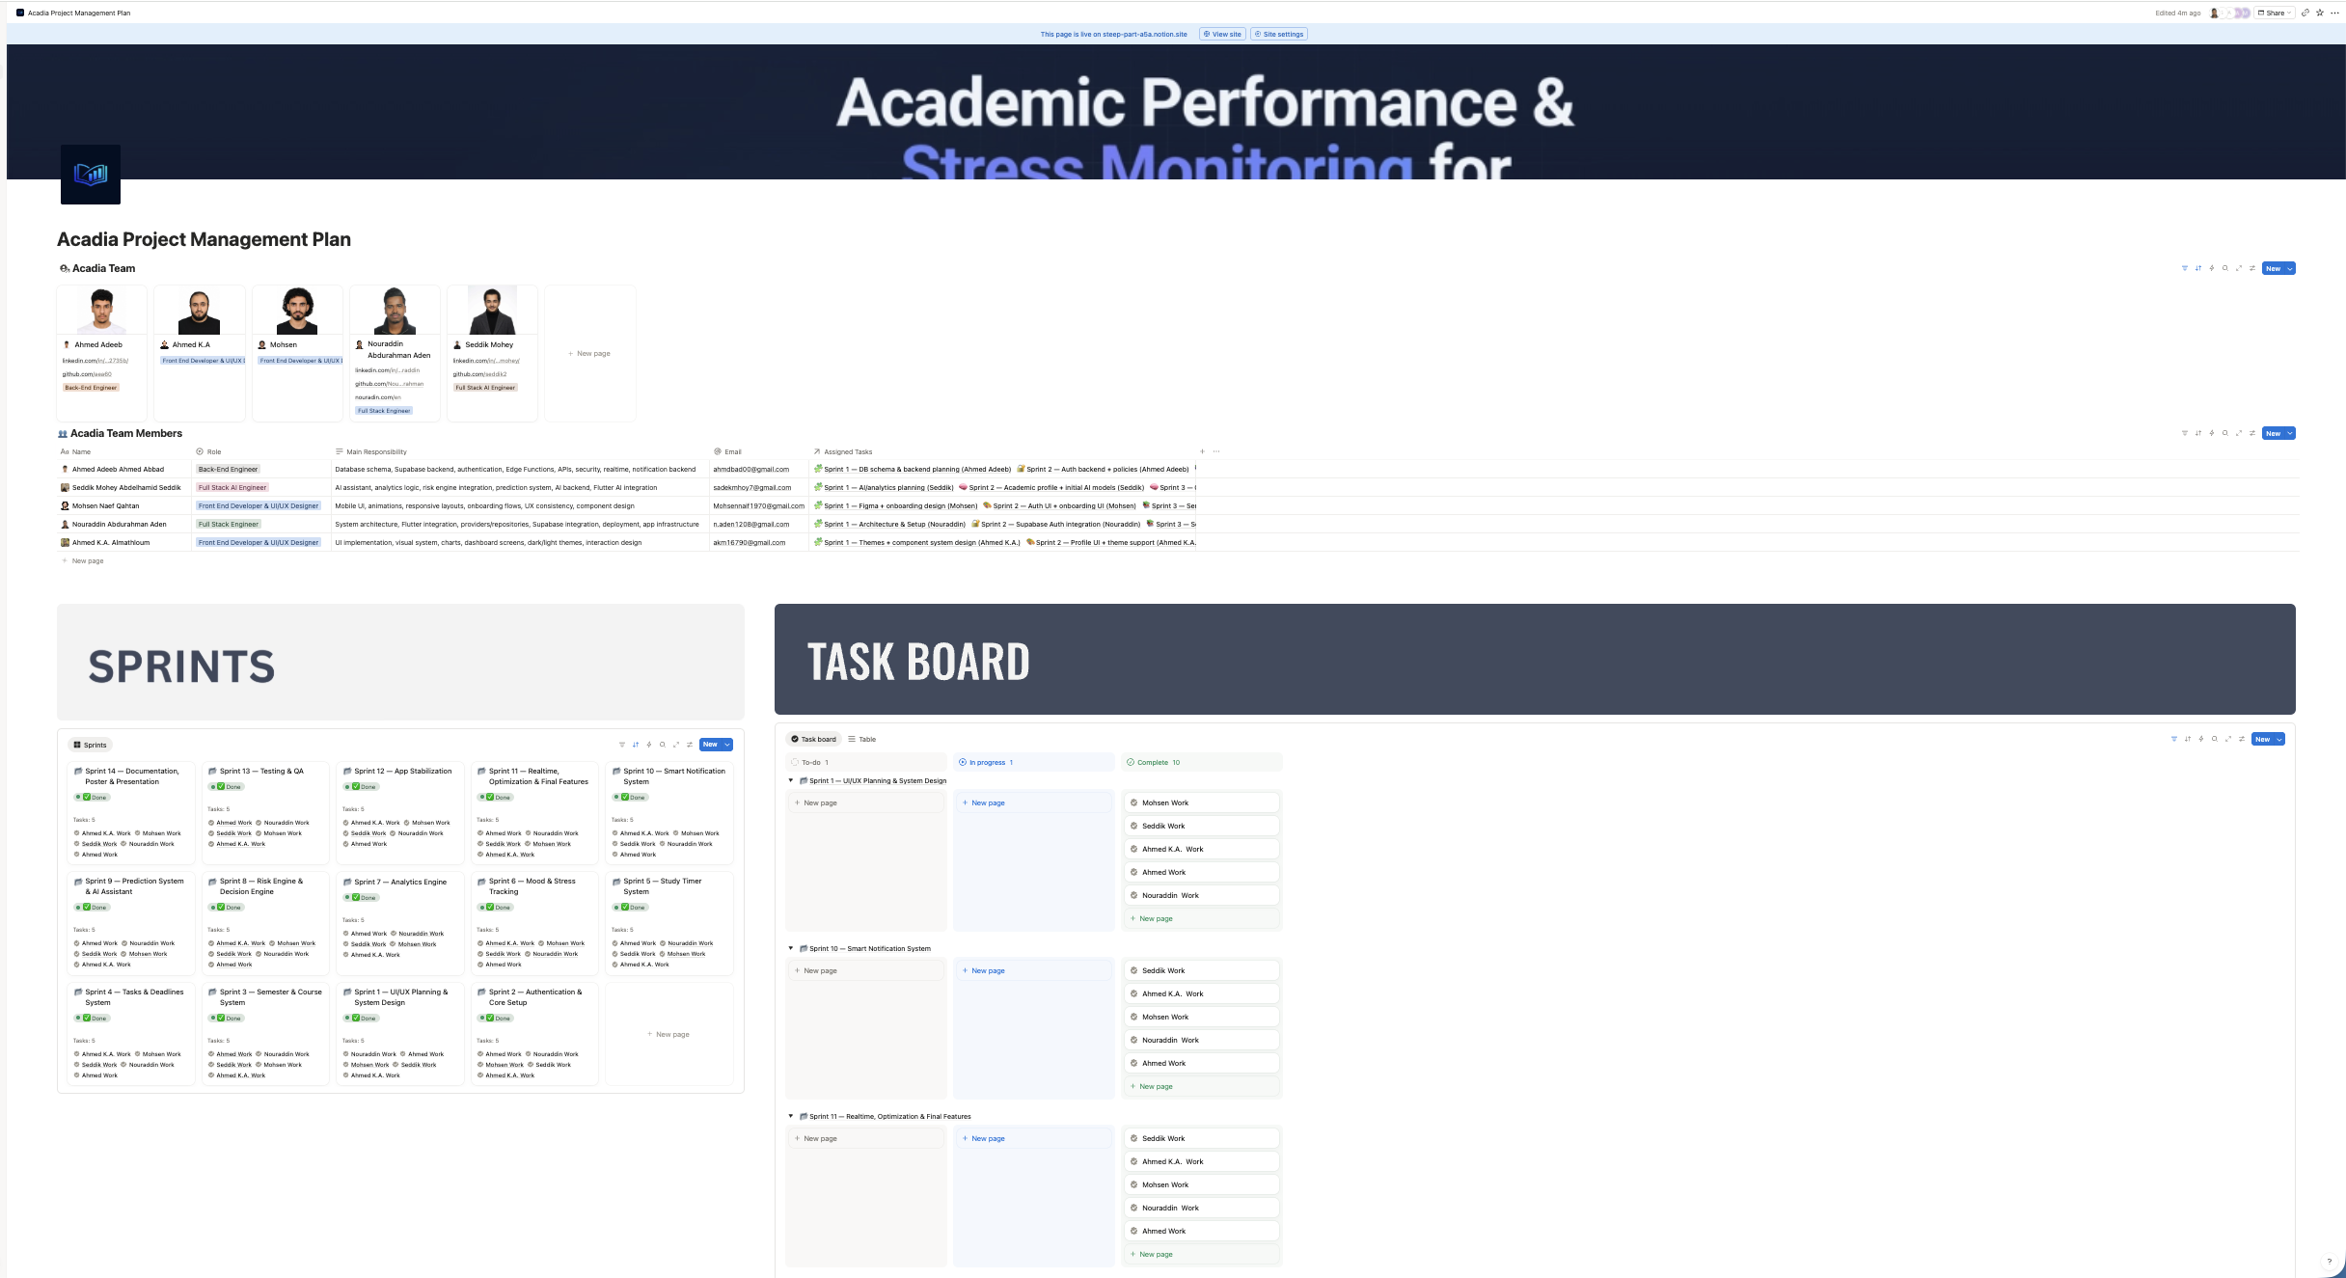
Software Development Process
Agile Scrum Development

Slide 13
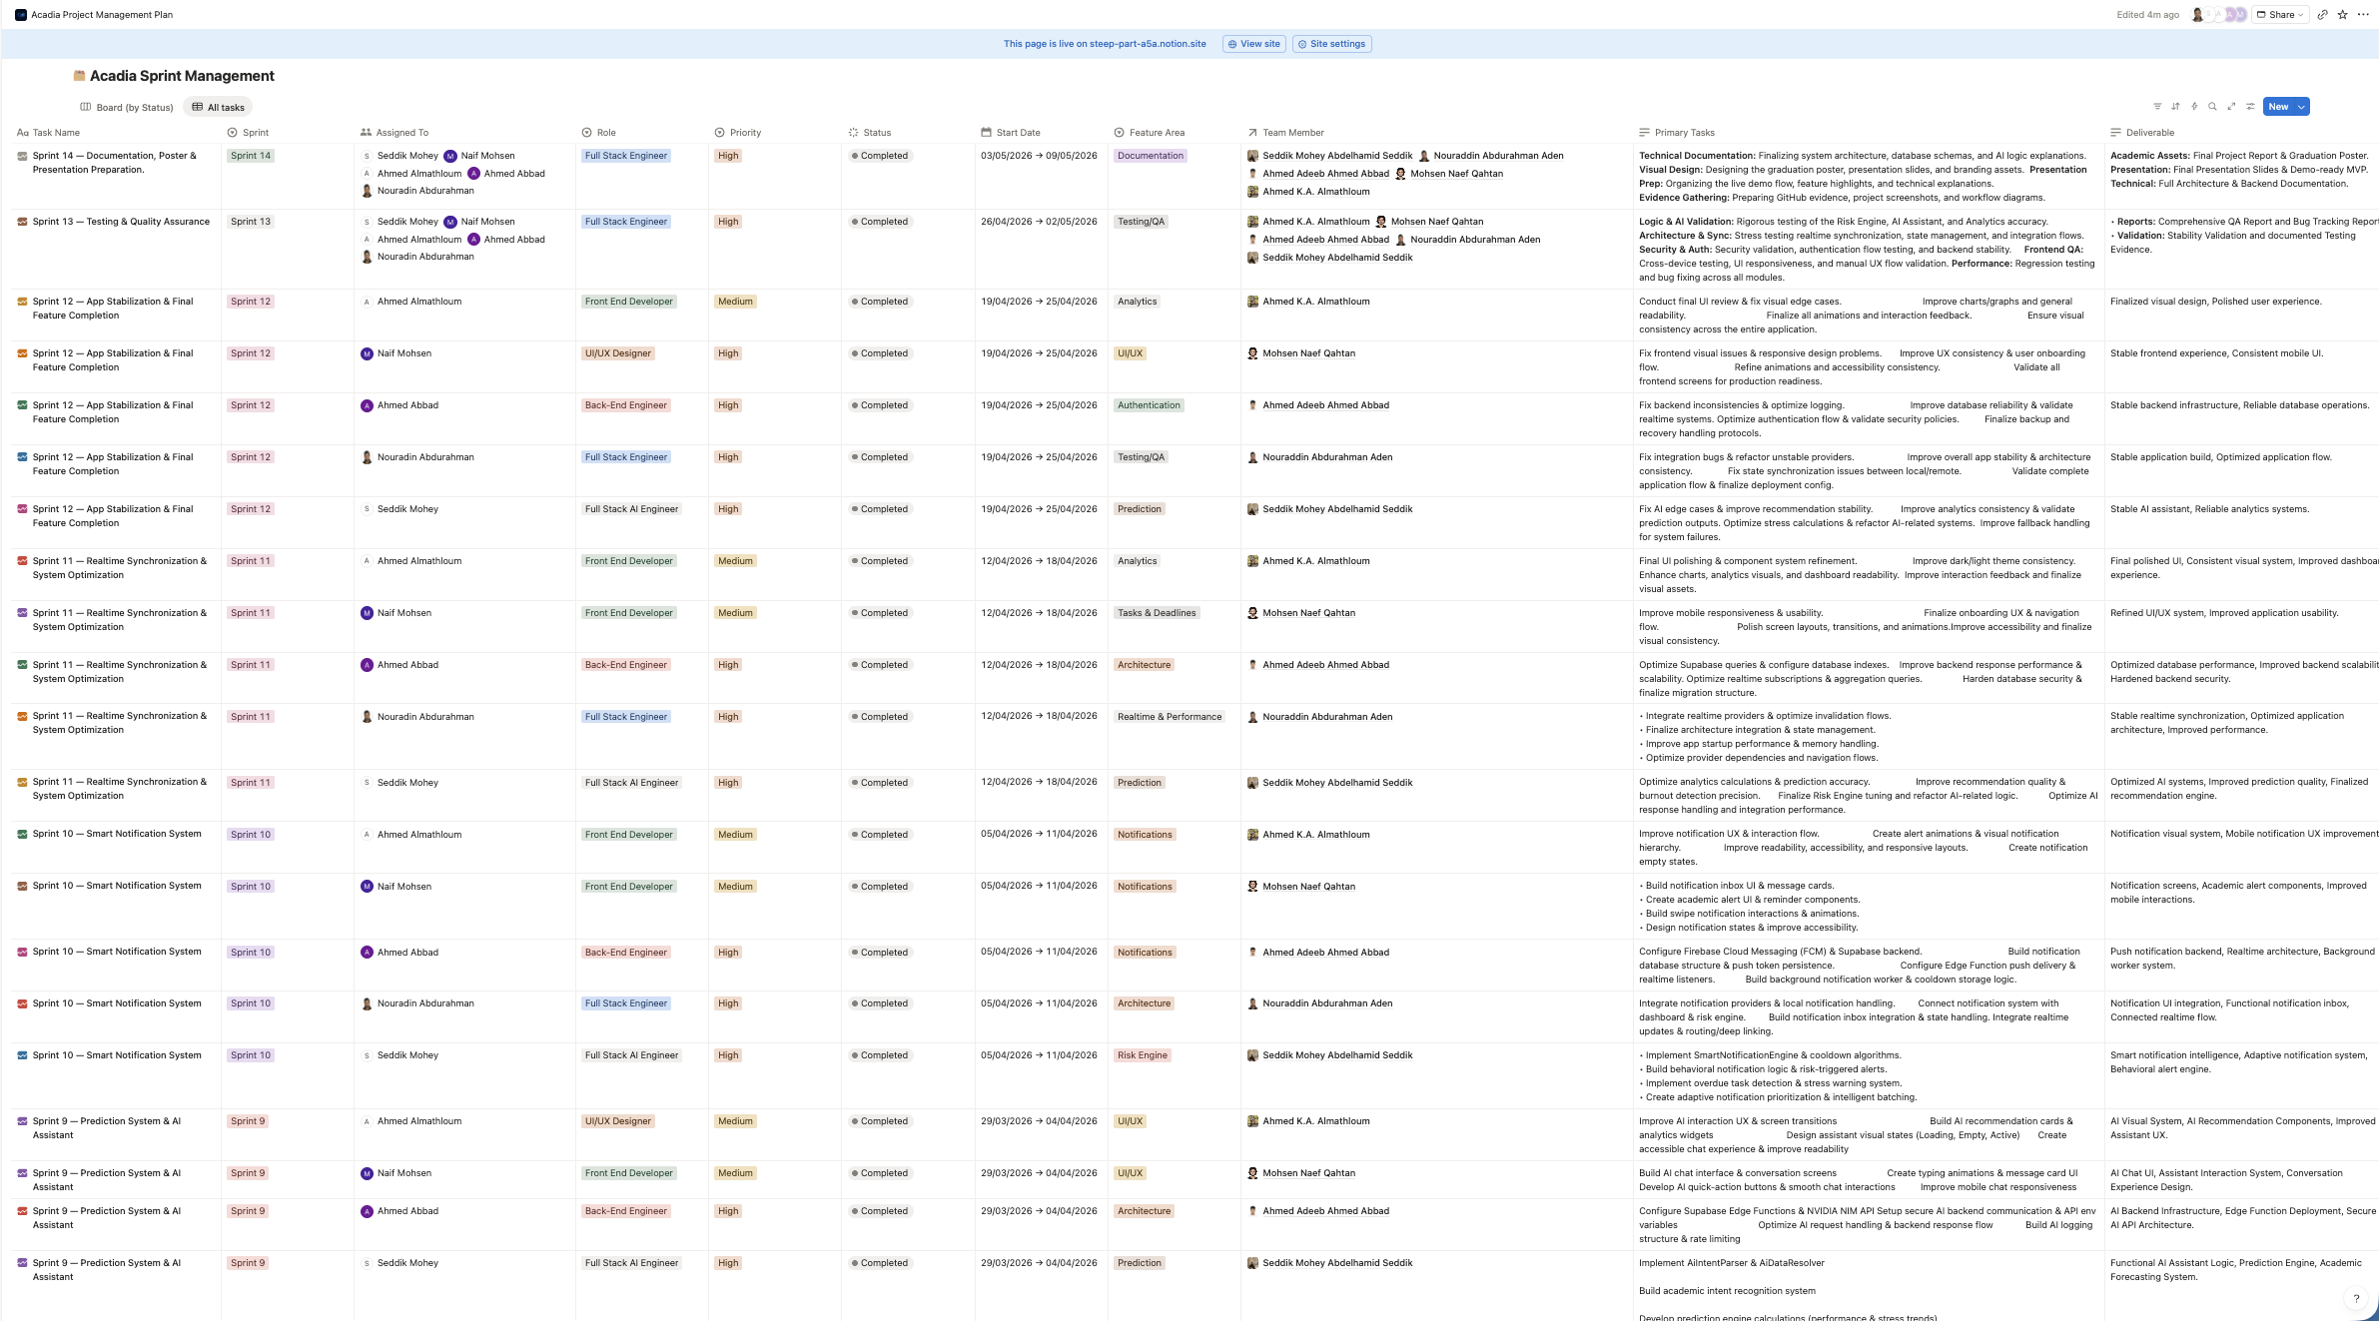
Software Development Process
Agile Scrum Development

Slide 14
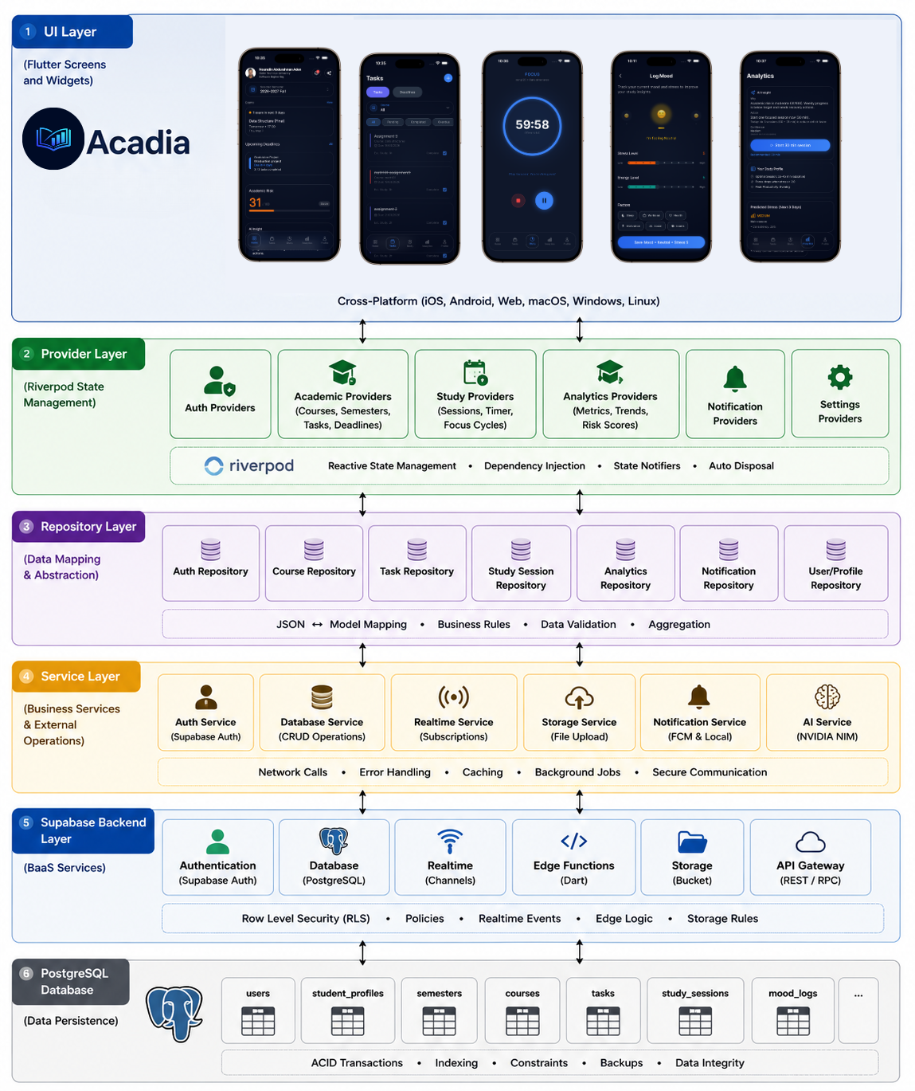
System Architecture
Acadia System Architecture
Acadia follows a layered architecture.
The architecture separates:
  Ui
  Providers
  Repositories
  Services
  Backend infrastructure
This improves:
  Scalability
  Maintainability
  Modularity
  Realtime synchronization

Slide 15
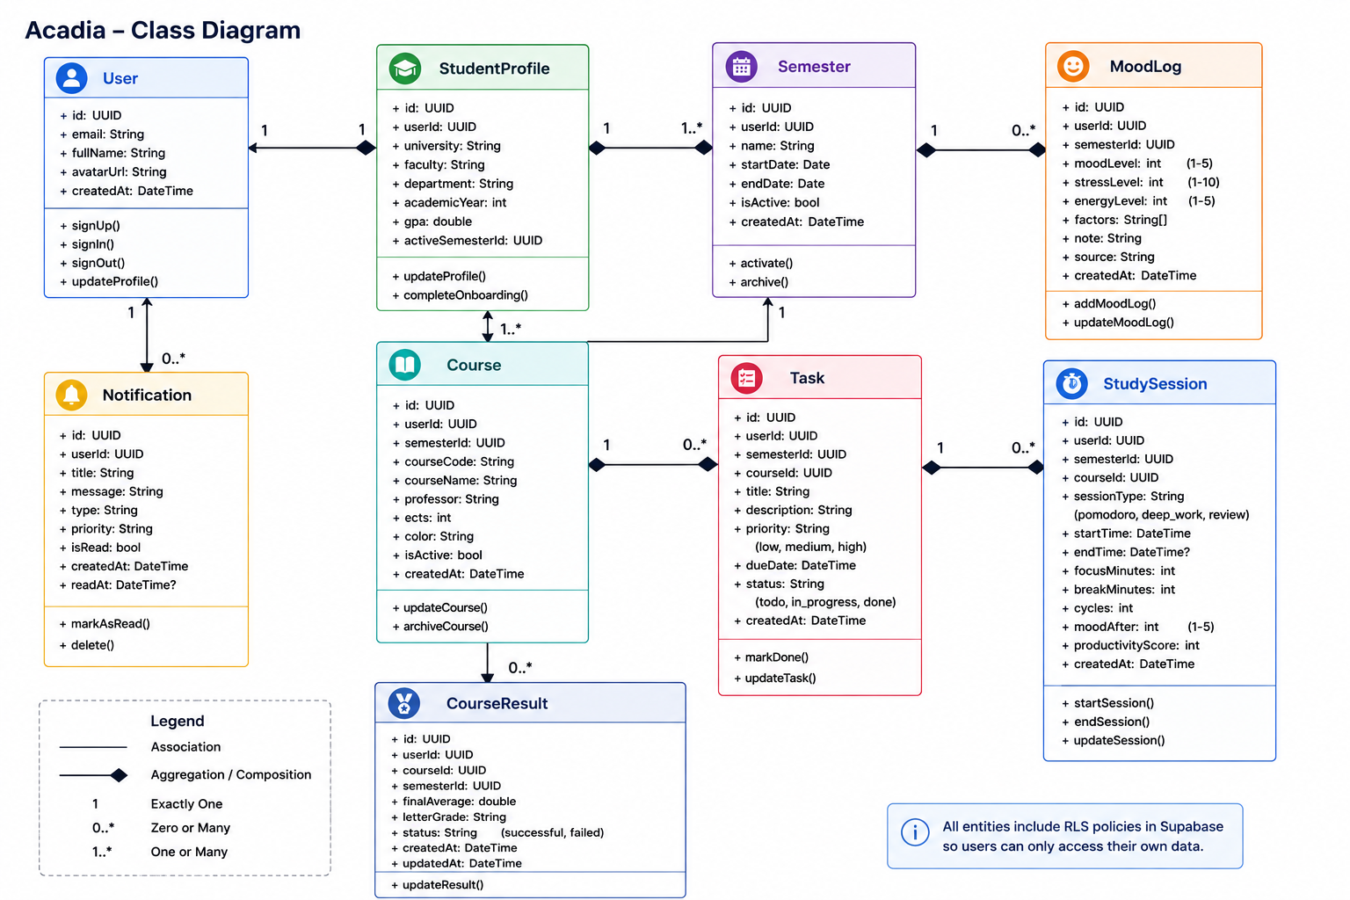
Database Design
Database Structure
Acadia uses PostgreSQL through Supabase.
The database stores:
  Semesters
  Courses
  Tasks
  Exams
  Study sessions
  Analytics
  Notifications
  Mood logs
Security is implemented using Row Level Security (RLS).

Slide 16
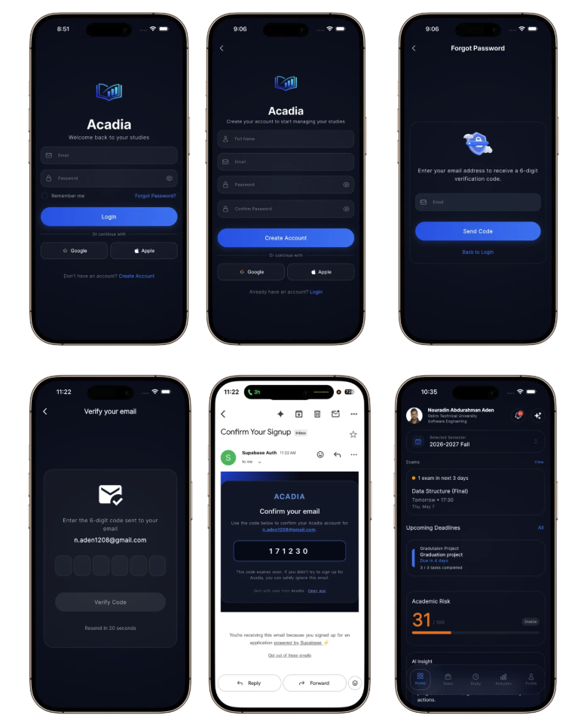
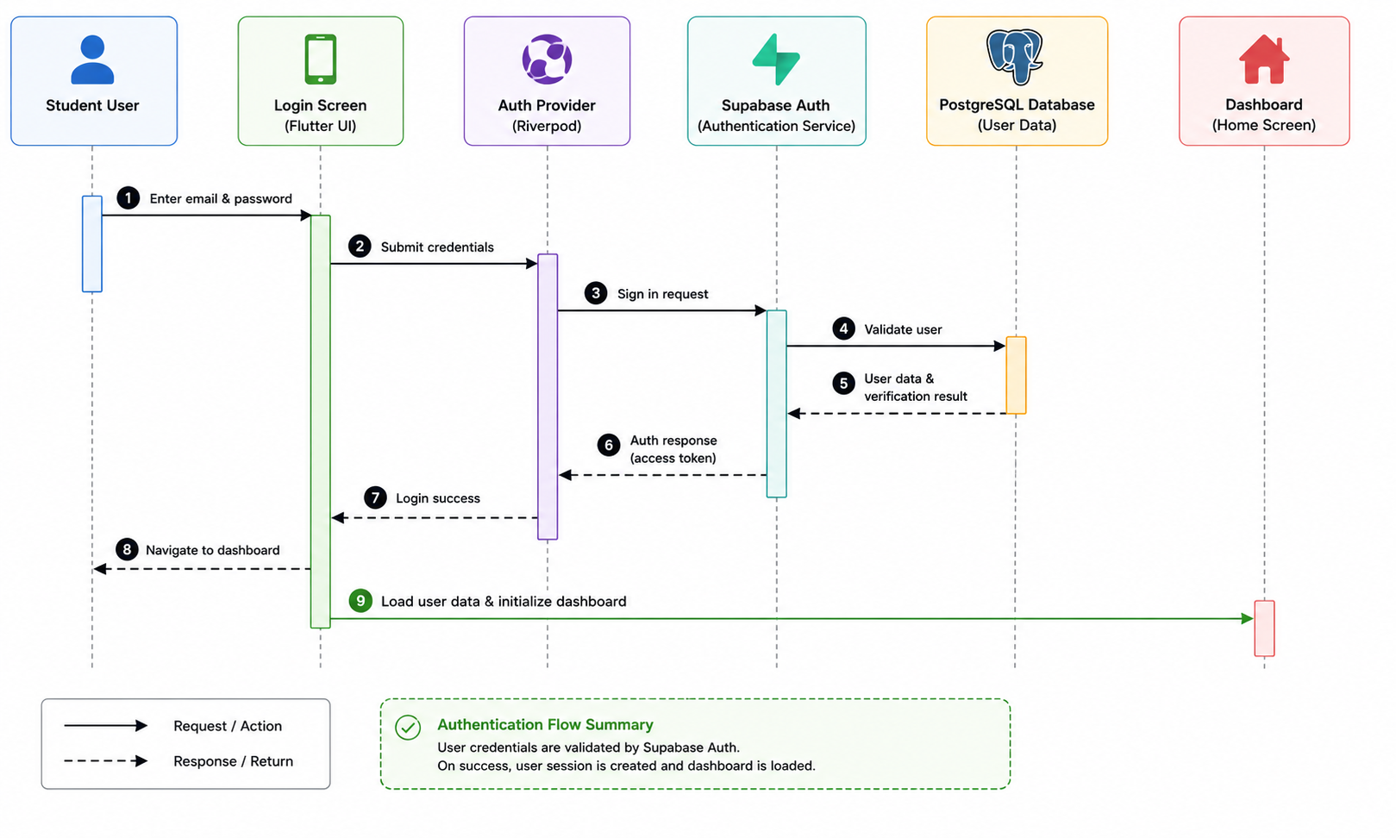
Authentication System
Acadia provides secure authentication using Supabase Auth.

Slide 17
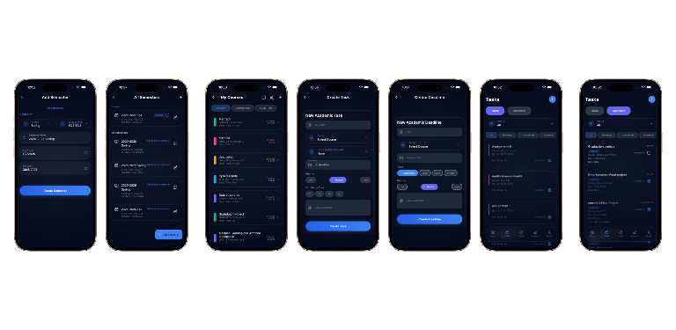
Academic Management System
Semester, Course & Task Management
Acadia allows students to organize academic life inside one centralized system.
Students can:
  Create semesters
  Add courses
  Manage assignments
  Manage deadlines
  Manage exams
  Track academic progress
The system supports realtime synchronization.

Slide 18
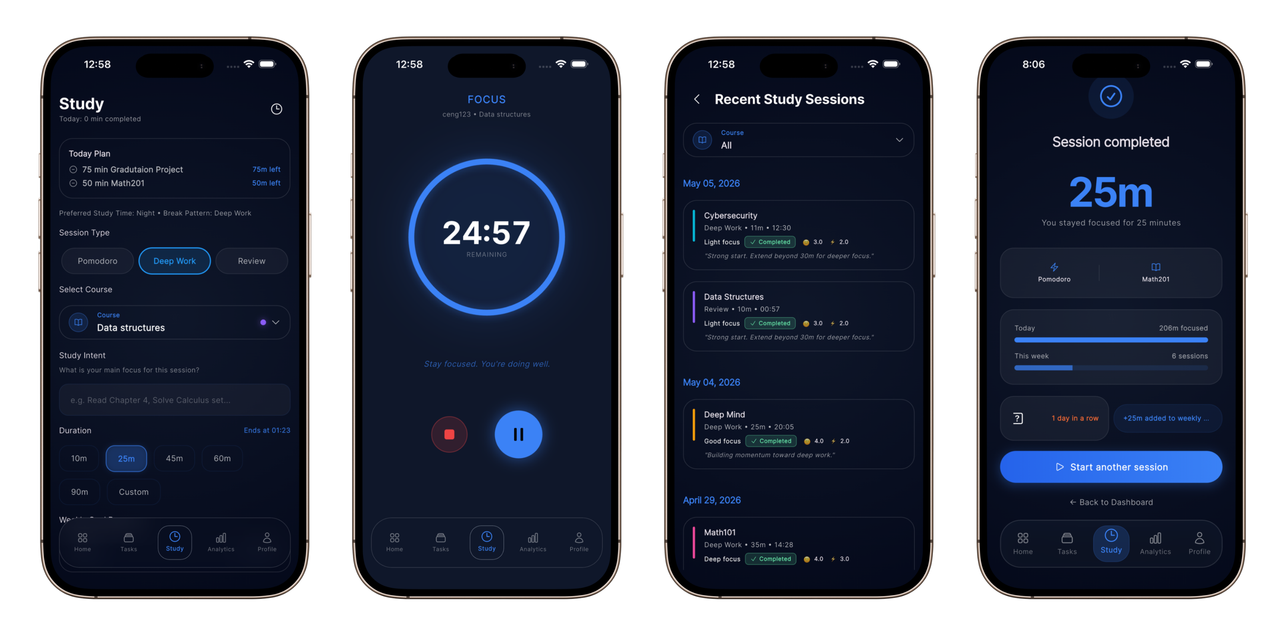
Study Session System
Pomodoro & Study Session System
Acadia includes advanced study session tracking.
Supported modes:
  Pomodoro sessions
  Deep-work sessions
  Review sessions
  Features:
  Focus/break cycles
  Timer persistence
  Session recovery
  Productivity tracking
  Realtime analytics updates

Slide 19
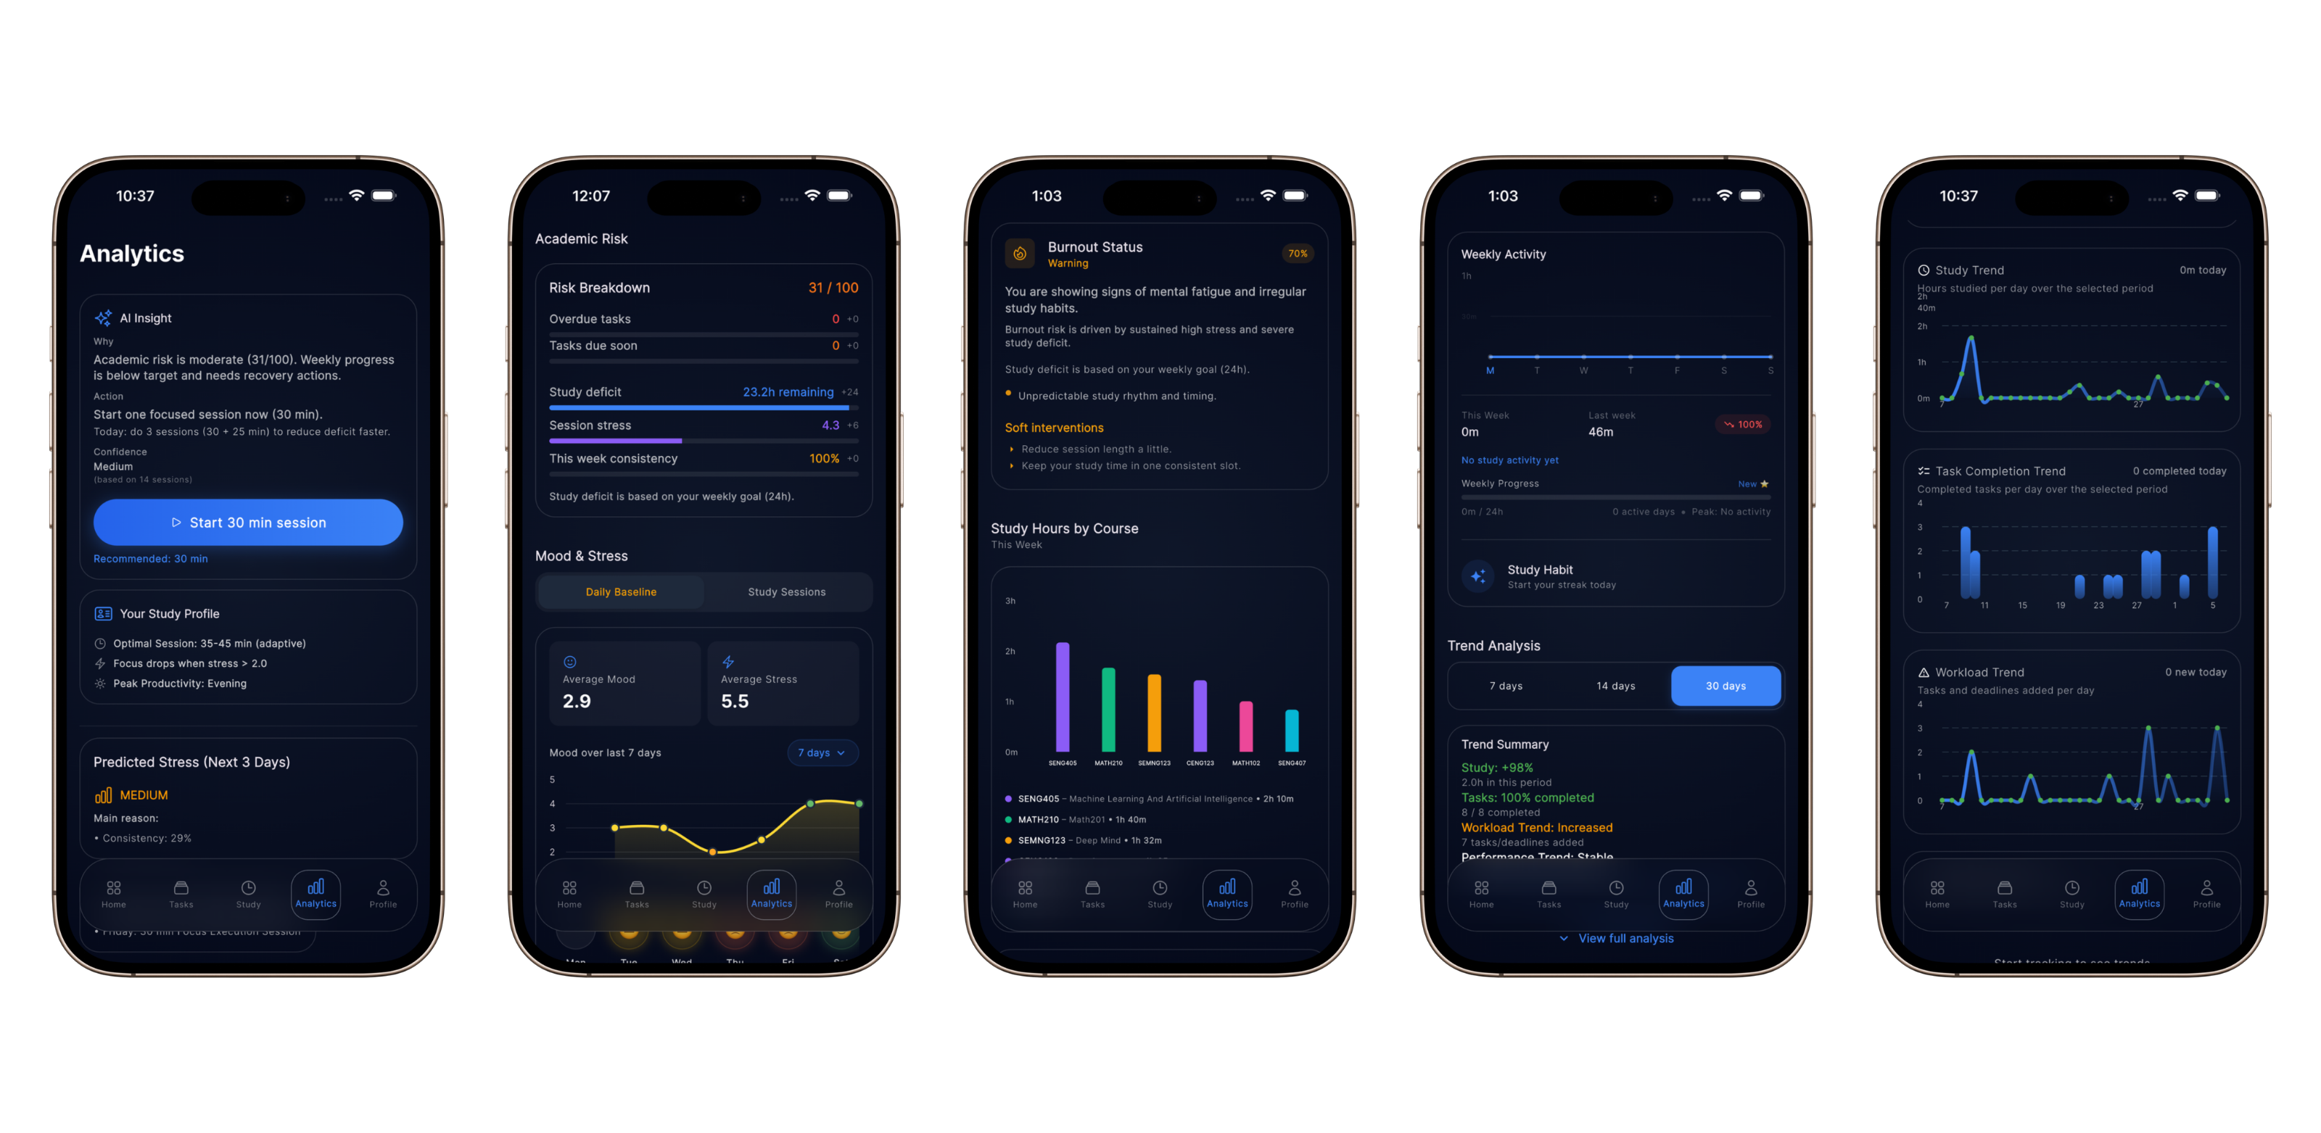
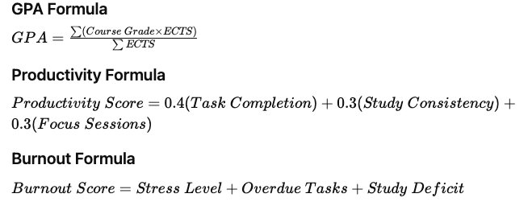
Academic Analytics Engine
Academic Analytics System
Acadia calculates academic metrics in realtime.
The analytics engine evaluates:
GPA trends
Workload pressure
Study consistency
Task completion rate
Stress trends
Burnout indicators

Slide 20
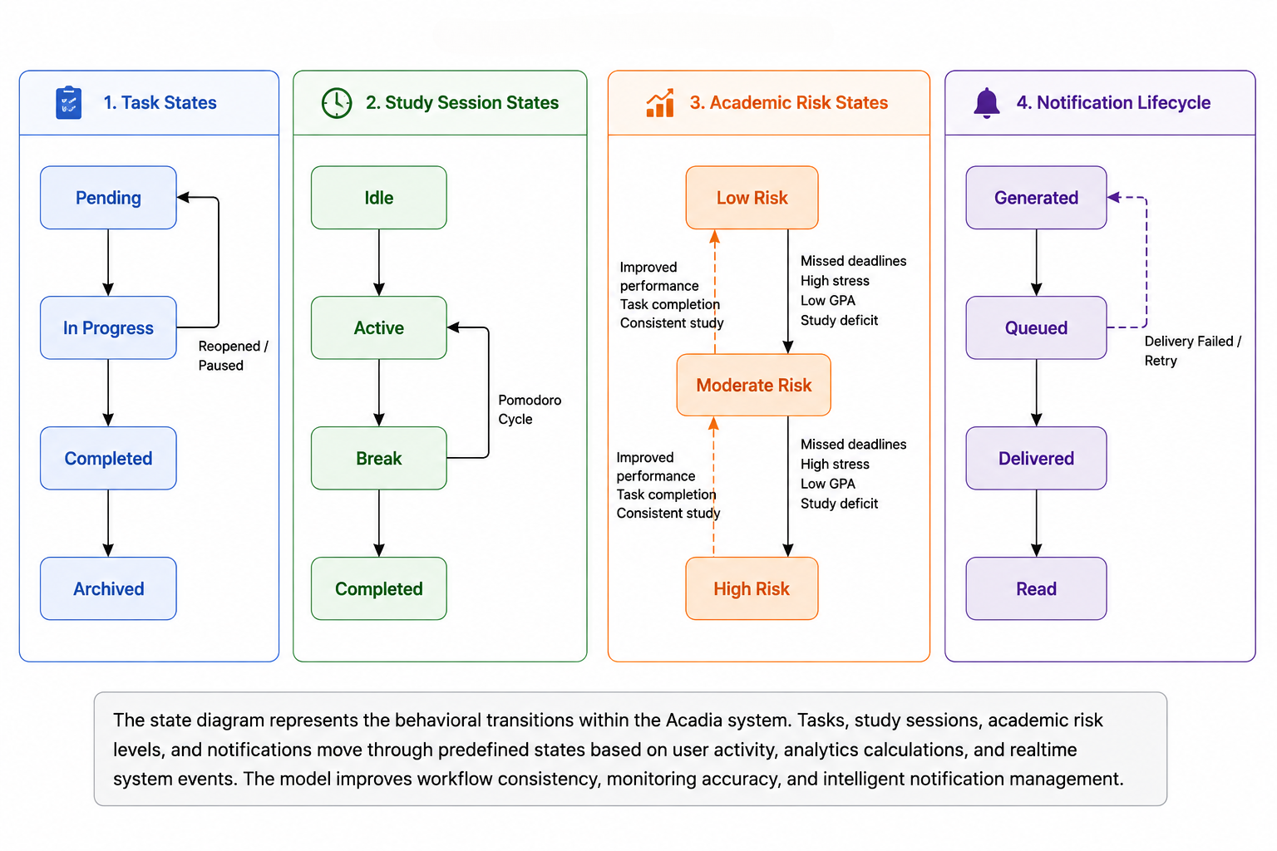
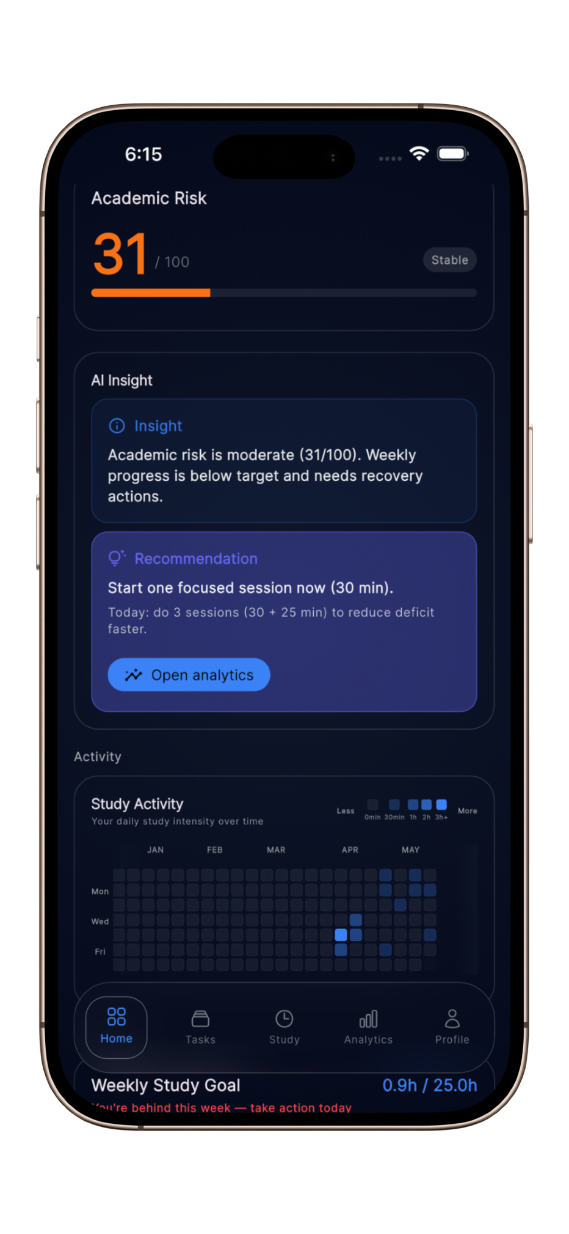
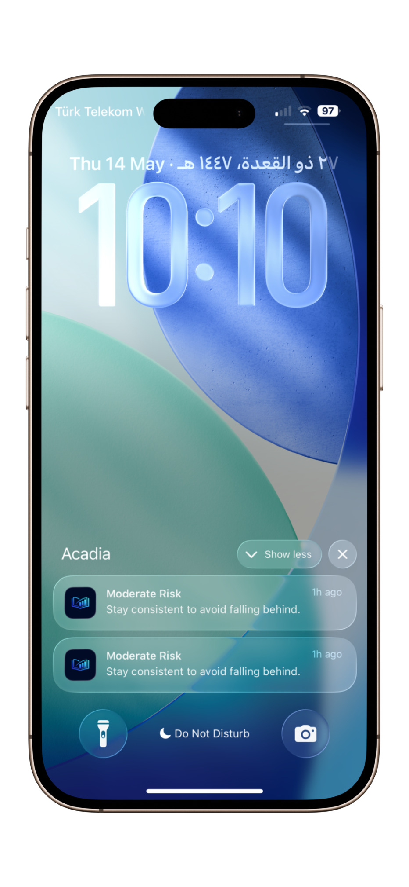


Academic Risk Engine
Academic Risk Detection System
Acadia evaluates academic risk levels using behavioral and productivity indicators.
The system analyzes:
Overdue tasks
GPA decline
Stress escalation
Workload pressure
Low study consistency
Missed deadlines
Score | Risk Level
0–30 | Low Risk
31–60 | Moderate Risk
61–100 | High Risk

Slide 21
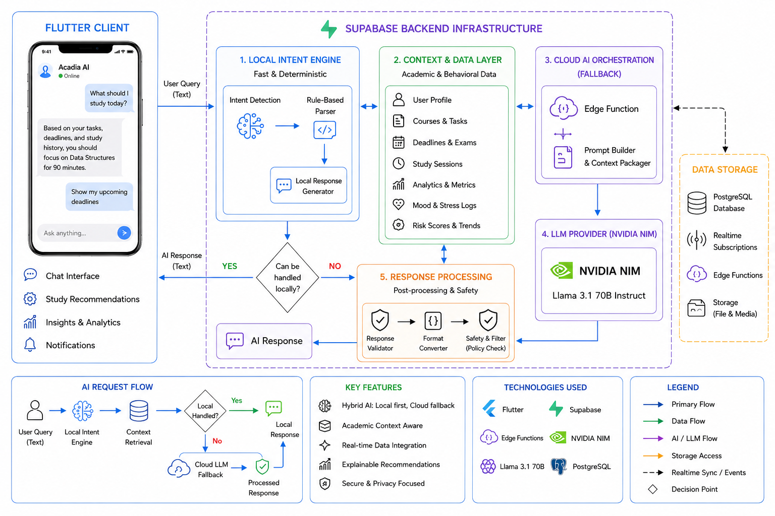
AI Assistant
AI Assistant & Recommendation System
Acadia integrates an AI assistant for academic support.
The AI system uses:
  Local intent parsing
  Recommendation logic
  Cloud AI fallback using NVIDIA NIM and llama 3.1
The assistant helps students:
  Prioritize courses
  Identify weak subjects
  Improve study planning
  Understand productivity trends
AI Workflow
User Query
→ Local Intent Engine
→ Analytics Evaluation
→ AI Recommendation Engine
→ Llama 3.1 Fallback
→ Response Generation

Slide 22
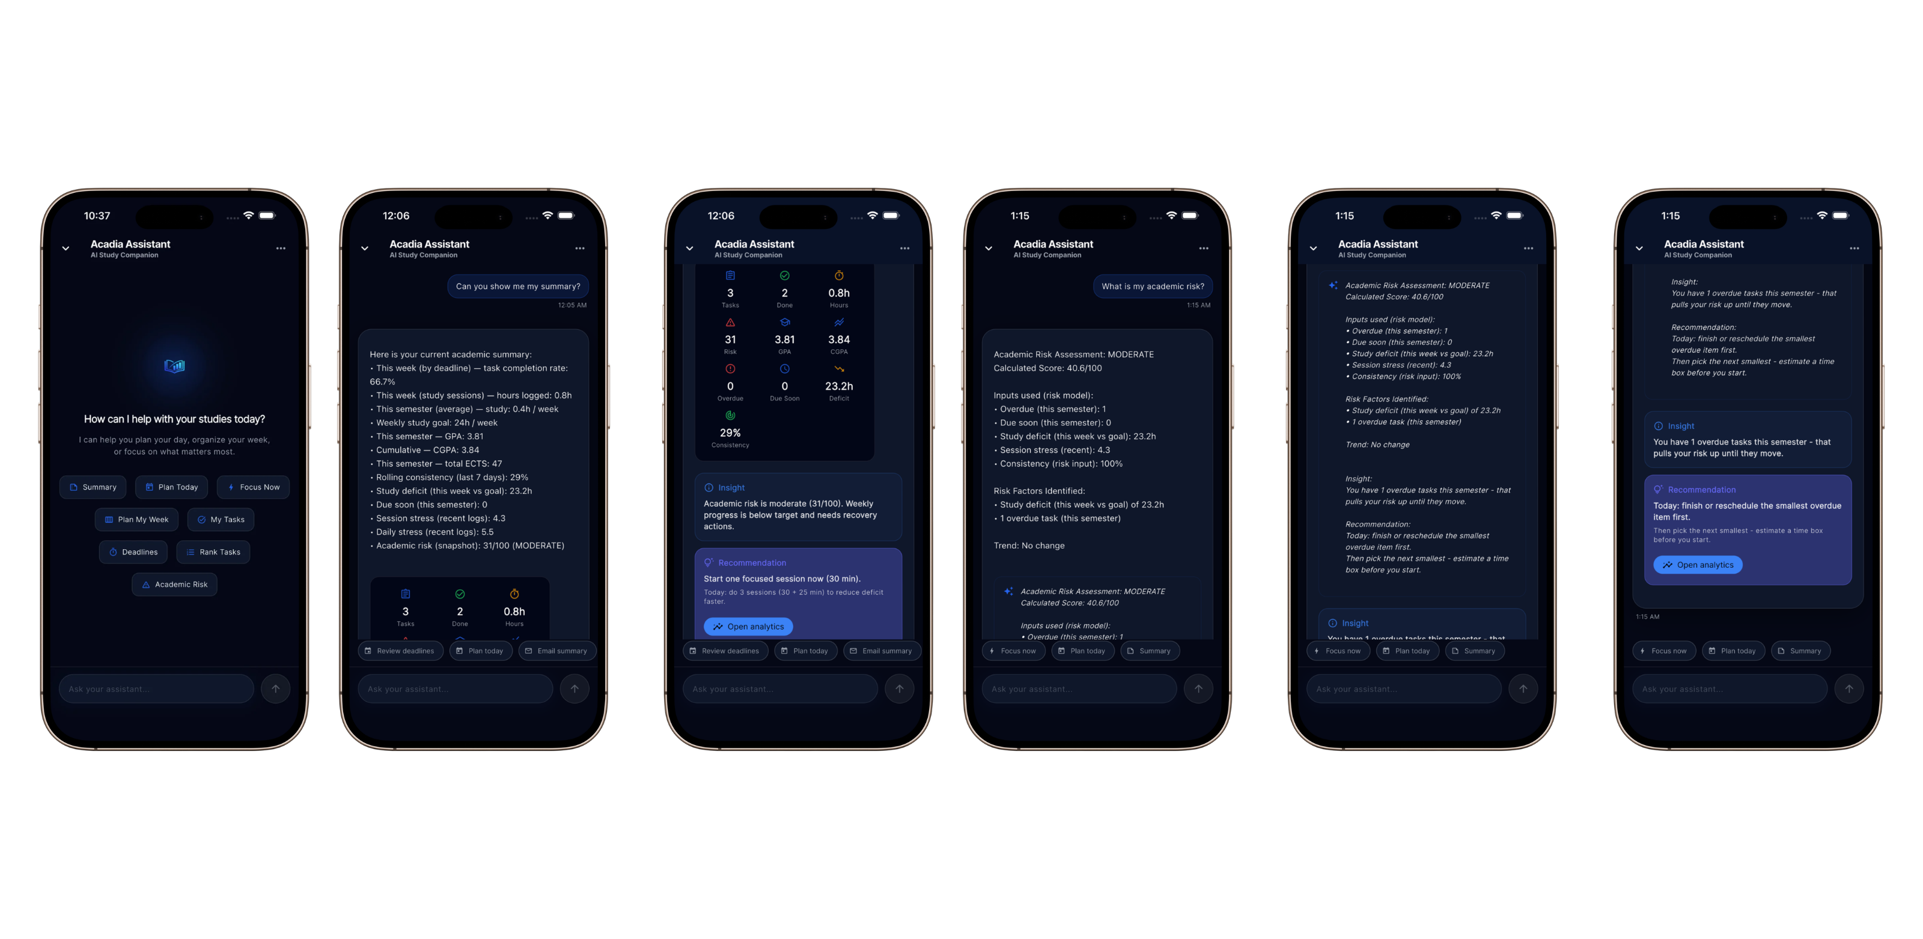
AI Assistant
AI Assistant & Recommendation System

Slide 23
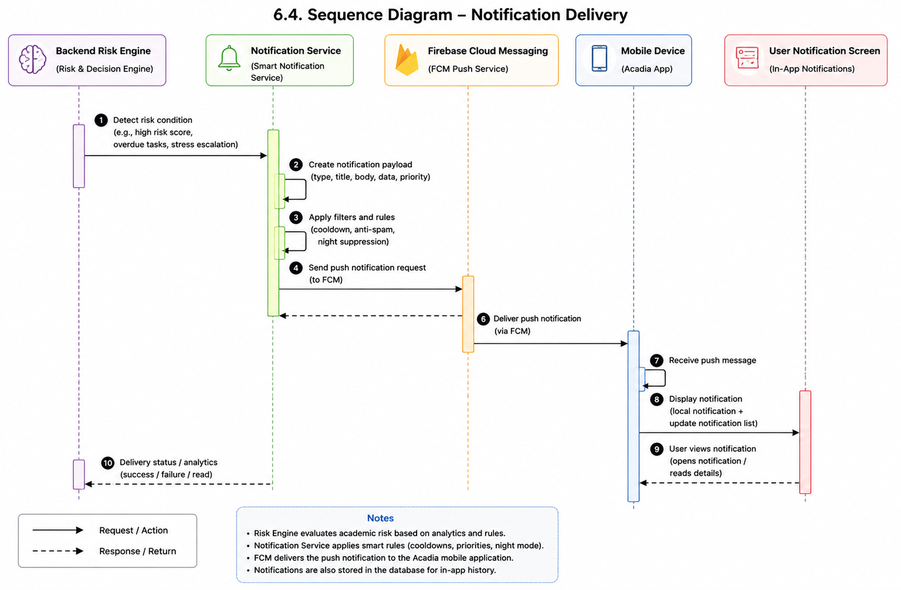
Realtime Notification System
Smart Notification System
Acadia includes intelligent realtime notifications.
Notifications are generated for:
  Overdue tasks
  Deadline reminders
  High stress levels
  Academic risk alerts
  Study recommendations
Firebase Cloud Messaging is used for push notifications.
Notification Flow
Risk Engine
→ Notification Service
→ Firebase Cloud Messaging
→ Mobile Device
→ User Notification

Slide 24
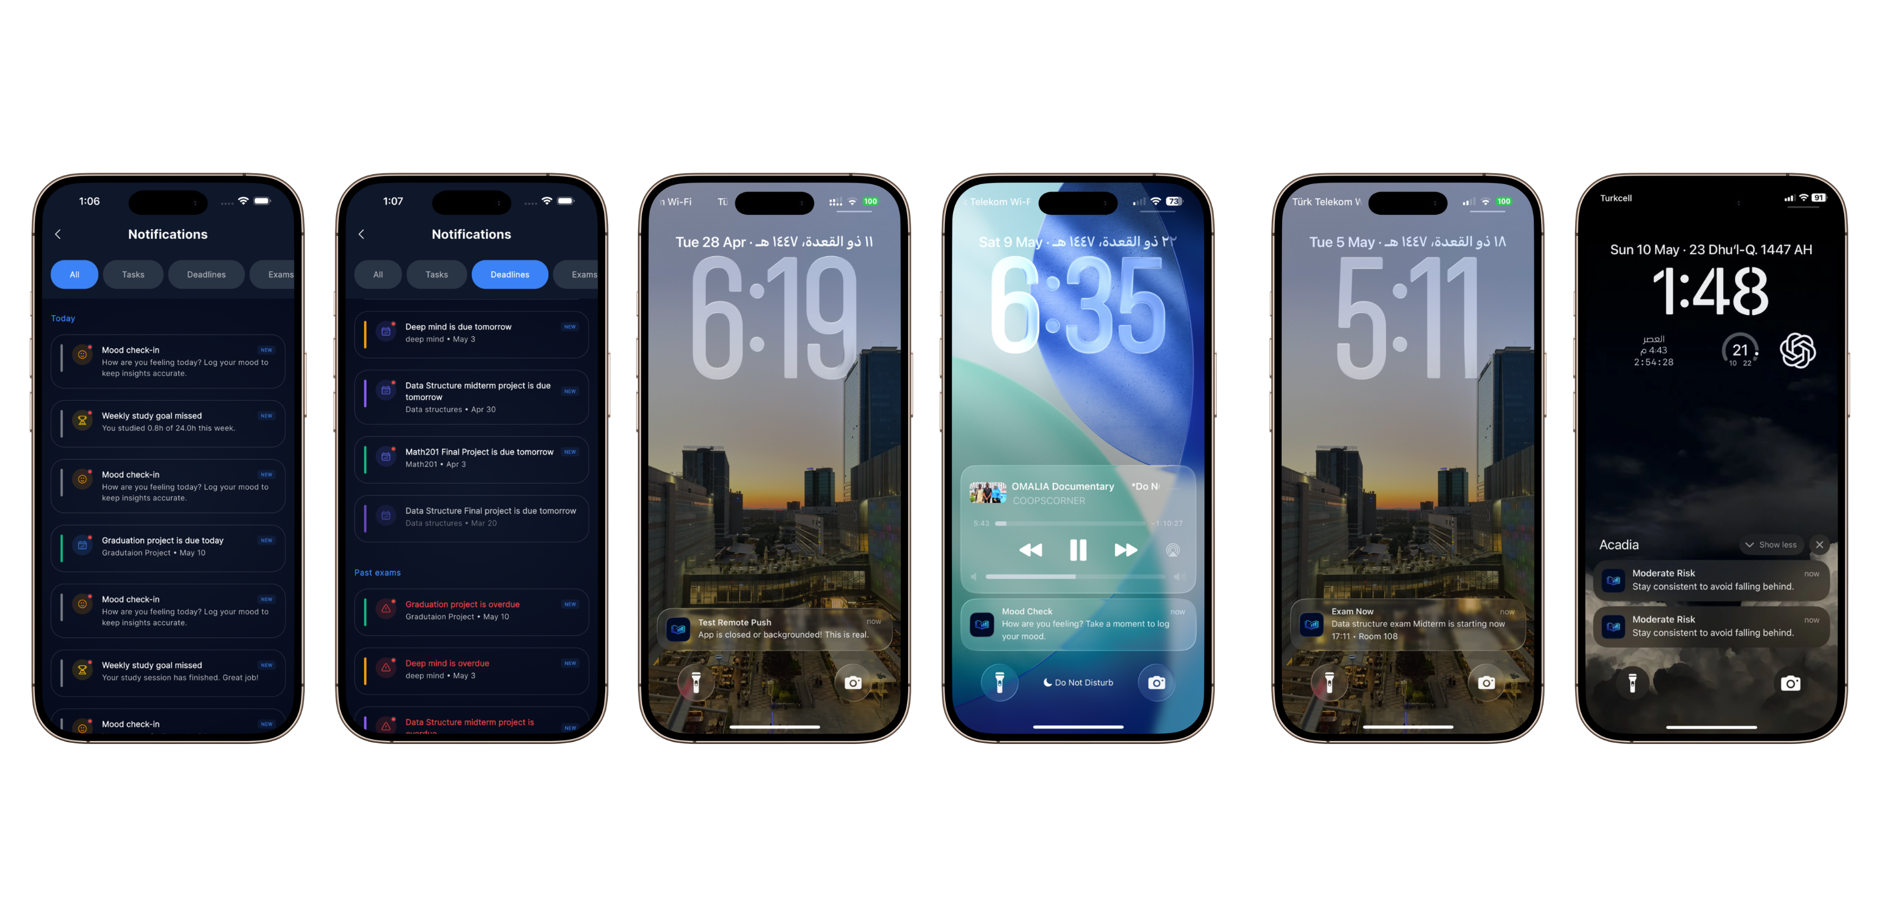
Realtime Notification System

Slide 25
Testing & Evaluation
The system was tested using:
  Unit testing
  Integration testing
  Realtime synchronization testing
  Usability testing
  Scenario-based testing
Test Scenario | Result
Authentication Flow | Passed
Realtime Synchronization | Passed
Study Session Recovery | Passed
Notification Delivery | Passed
Risk Engine Calculations | Passed
Analytics Dashboard | Passed
AI Assistant Responses | Passed

Slide 26
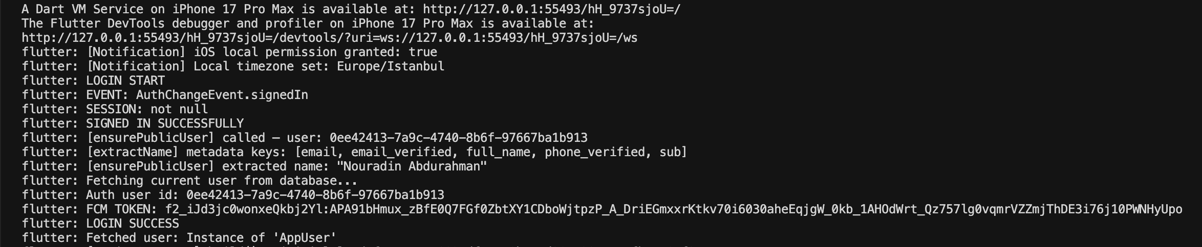
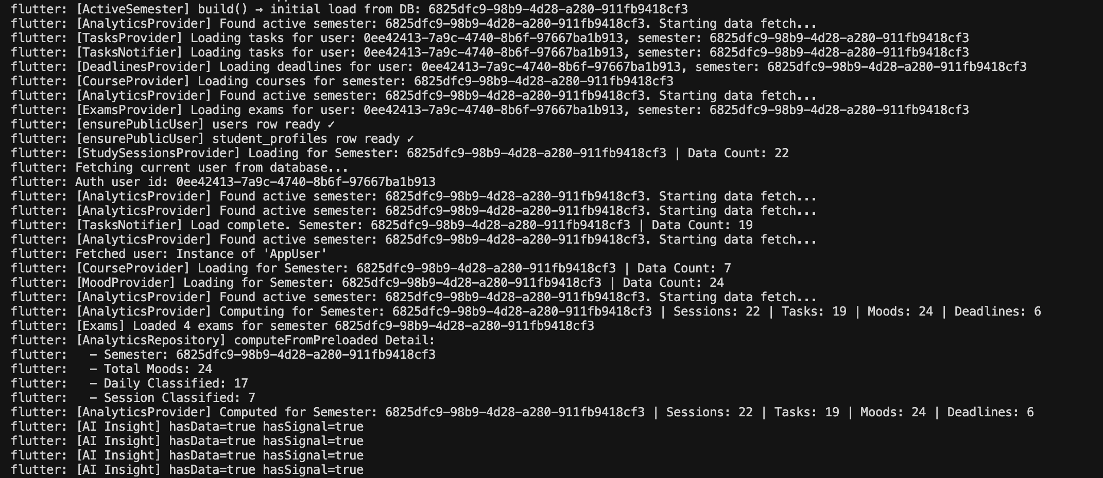
Testing & Evaluation
LOG IN PROCESS
USER DATA FETCHING

Slide 27
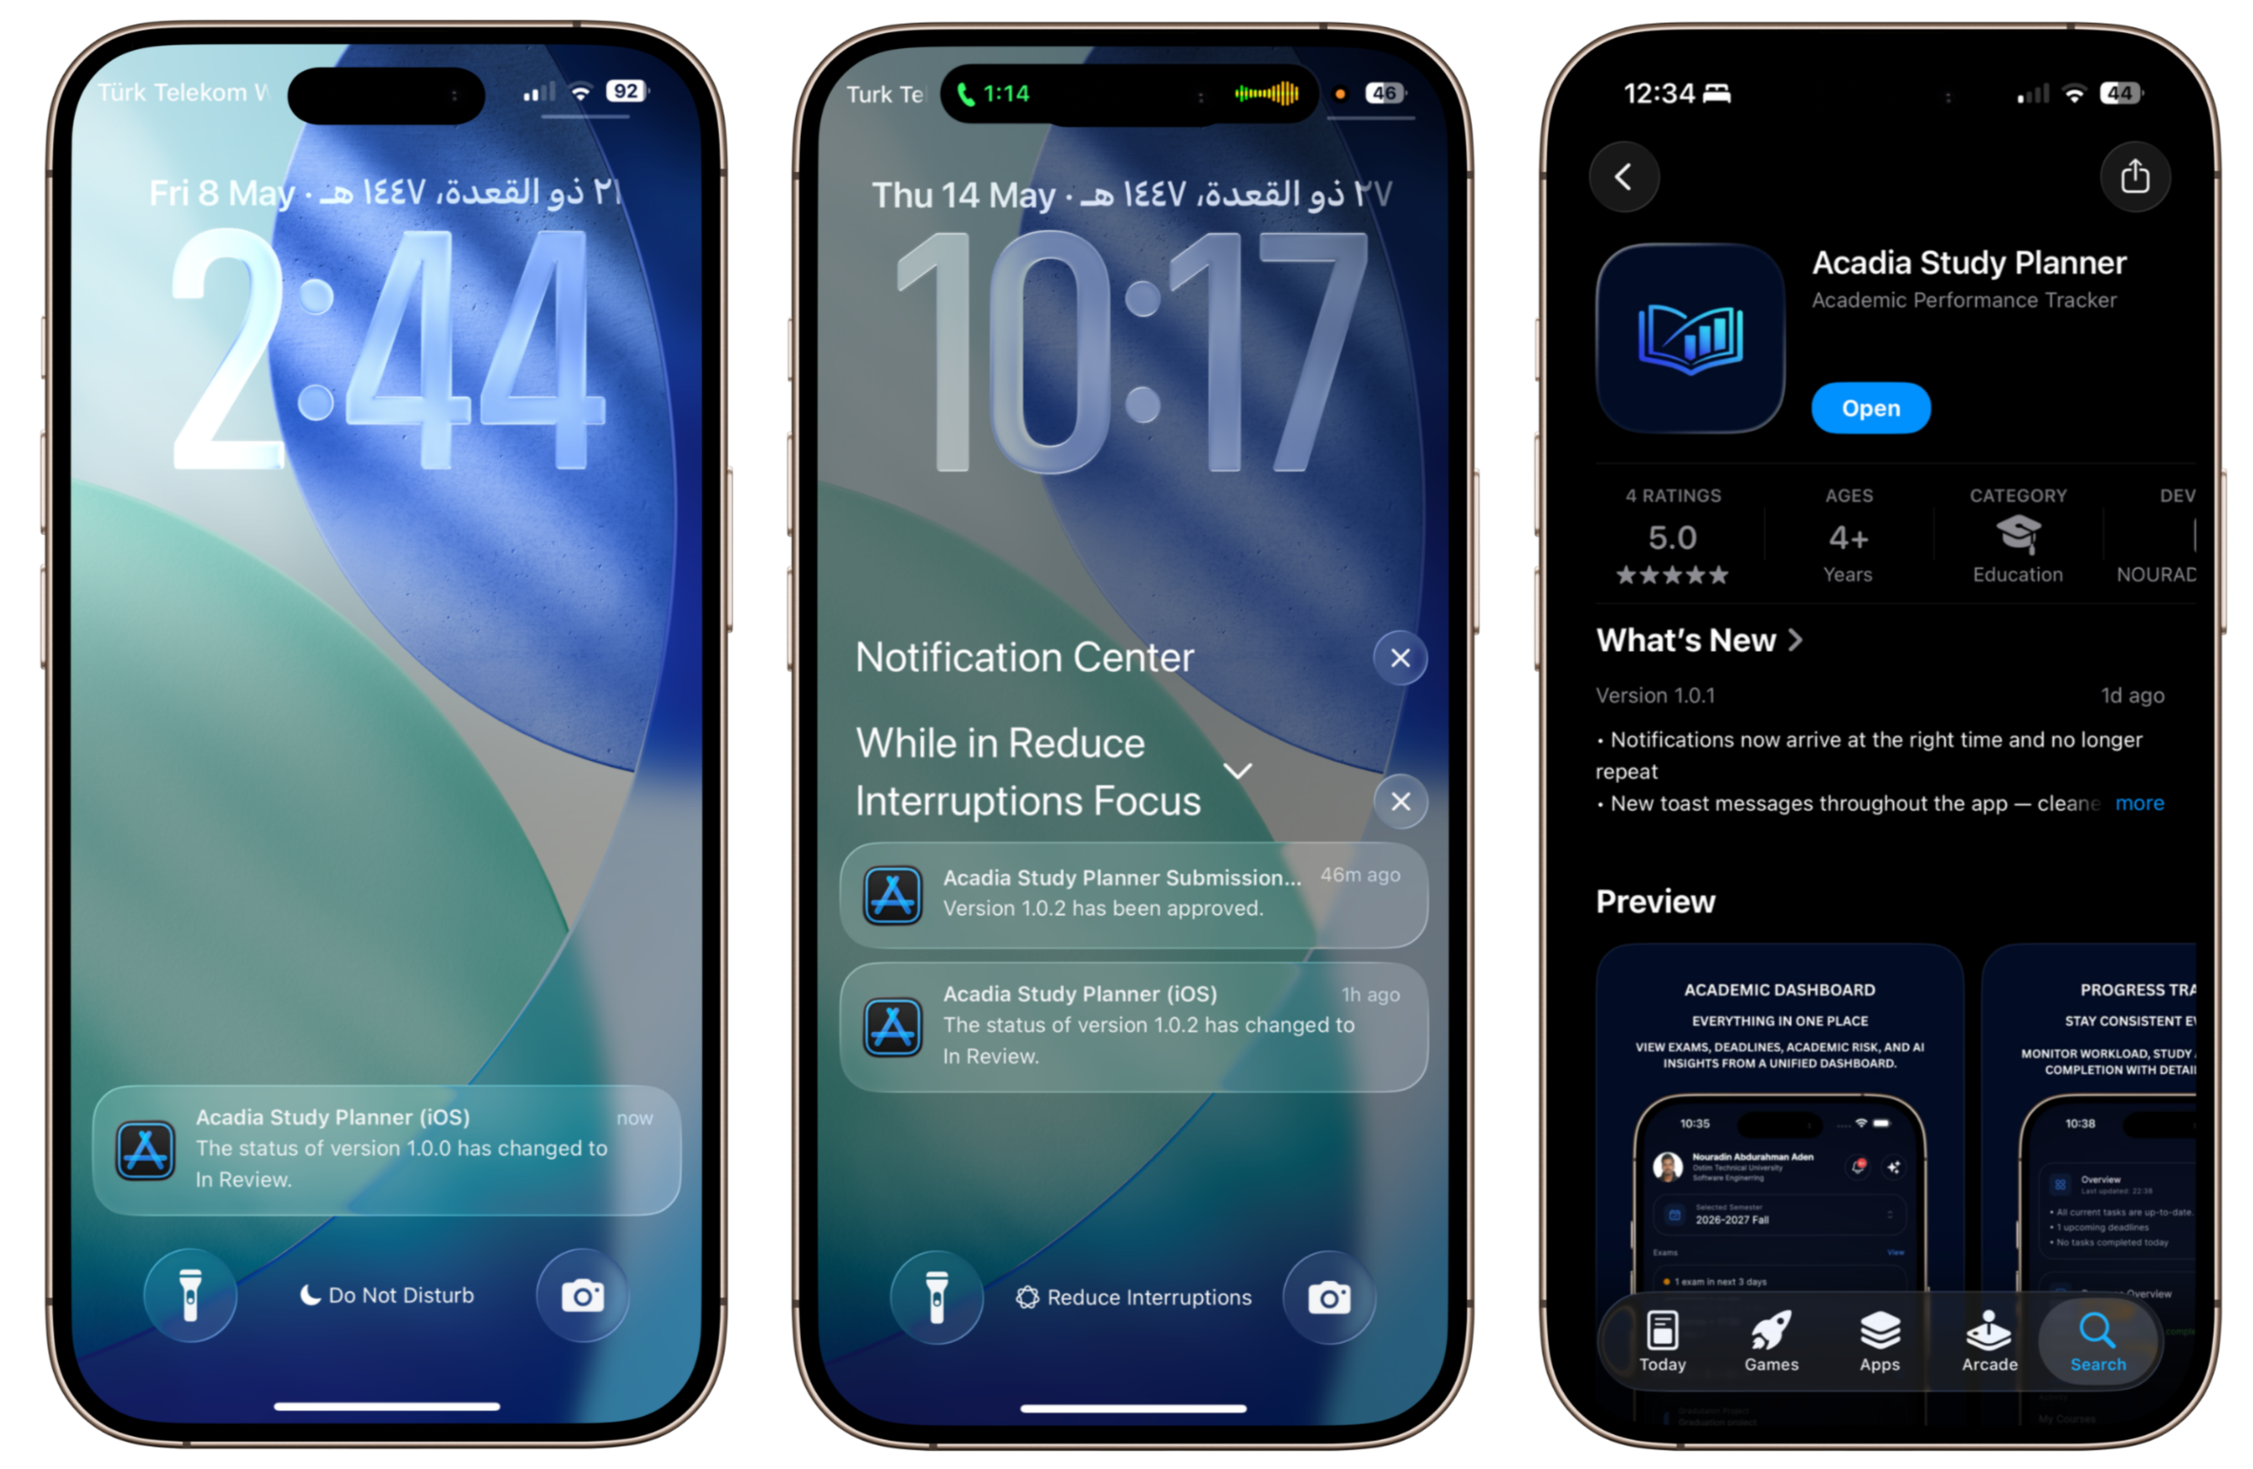
Deployment & Publishing
Acadia was deployed as a production-ready application.
The project includes:
  App store publishing
  Production supabase backend
  Realtime cloud infrastructure
  Mobile deployment pipeline
  Github repository
A dedicated jury testing account was created.

Slide 28

Deployment & Publishing
Jury Account
Email: jury@acadia.app
Password: Acadia2026

Slide 29
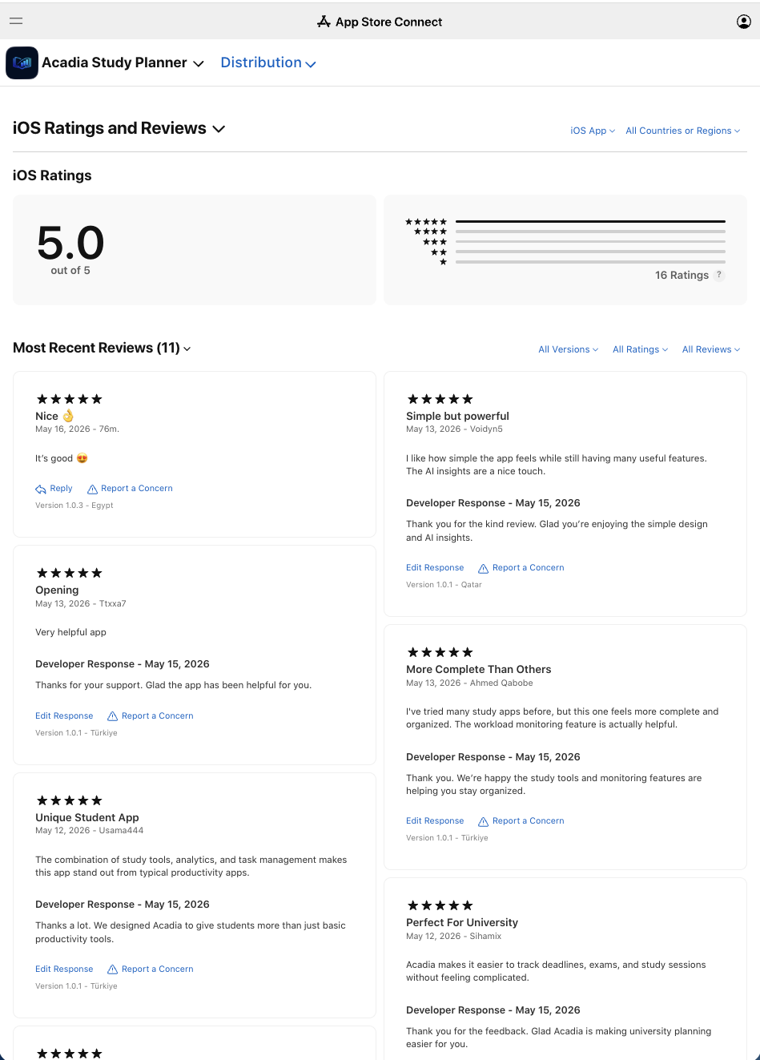
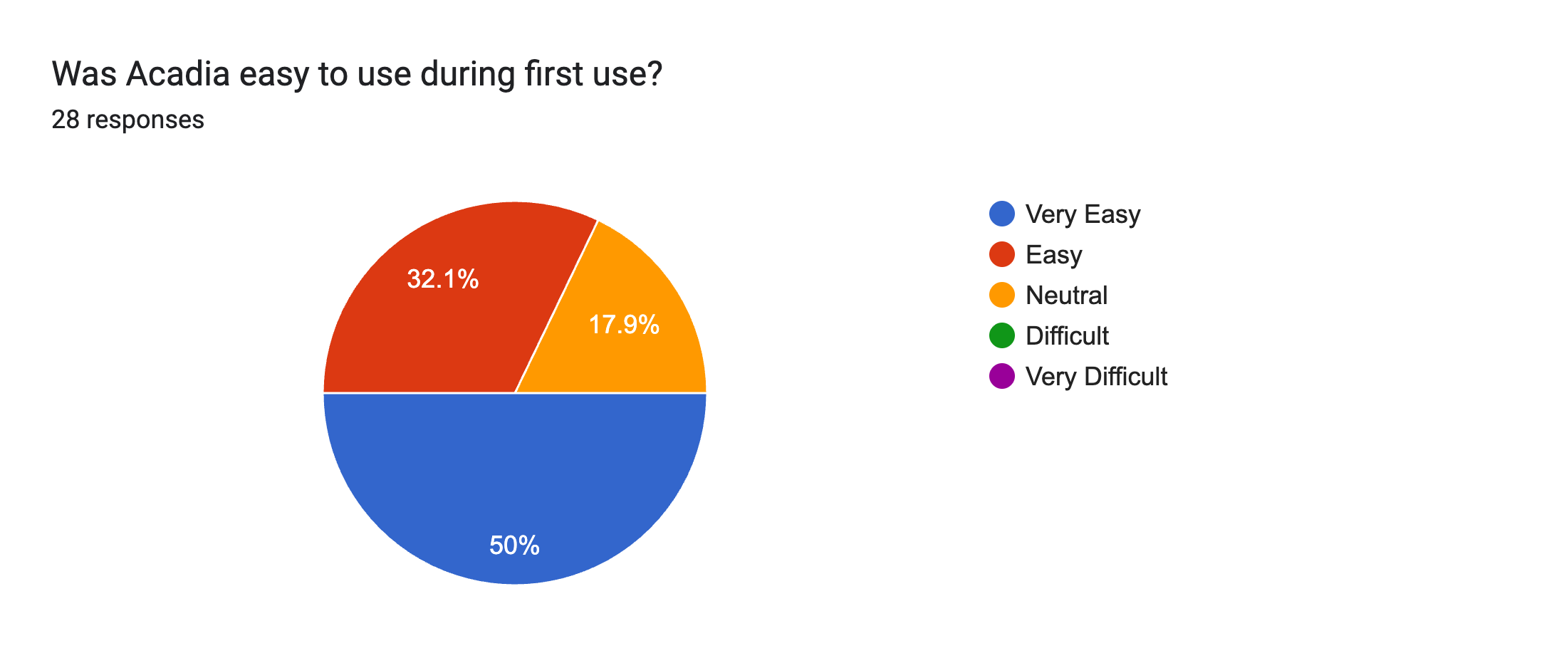
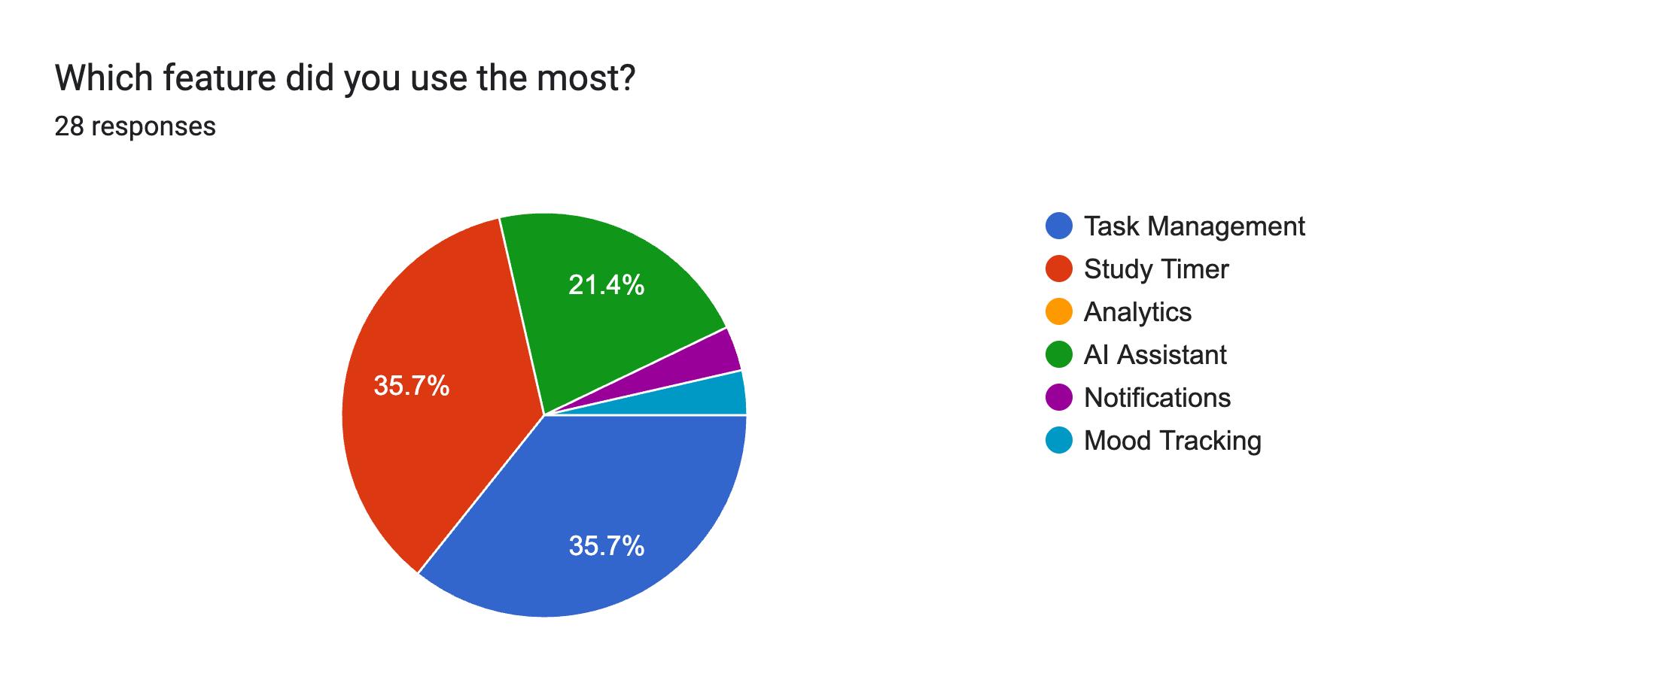
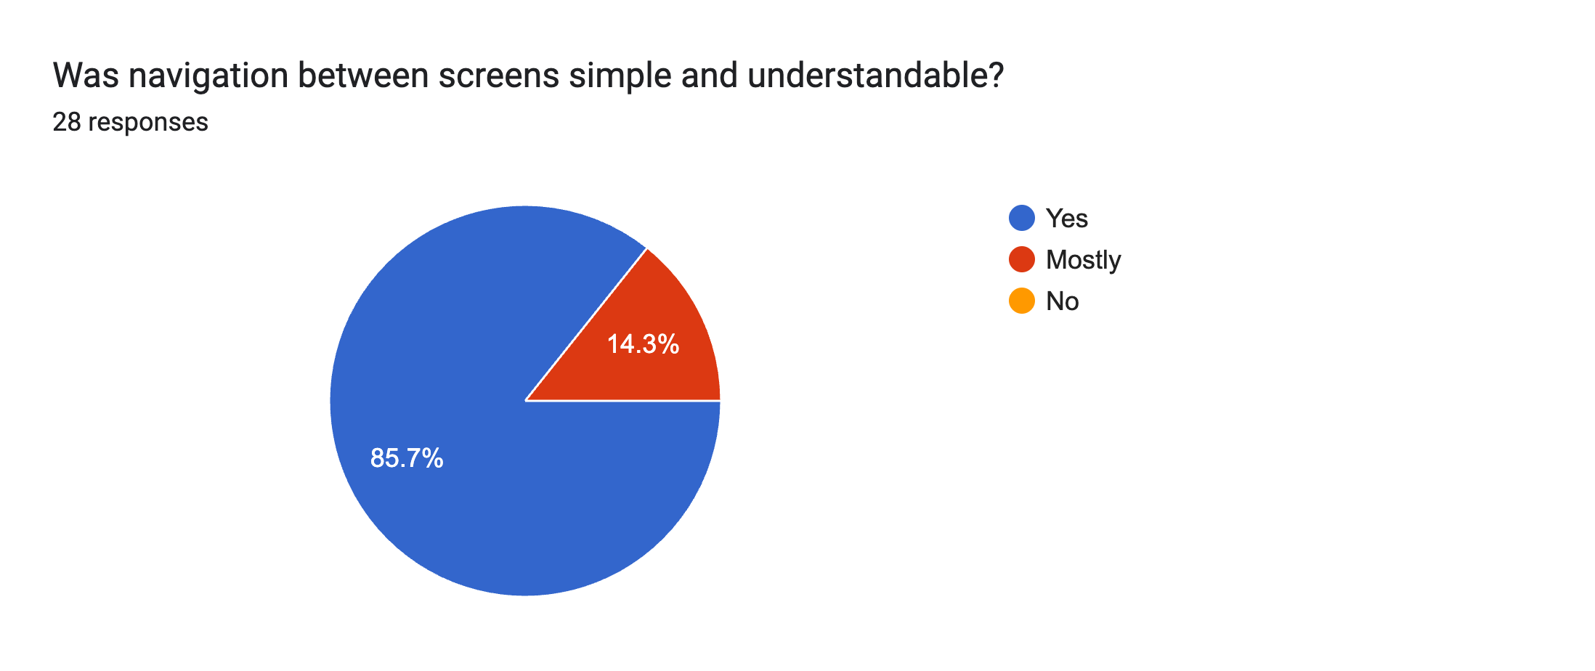
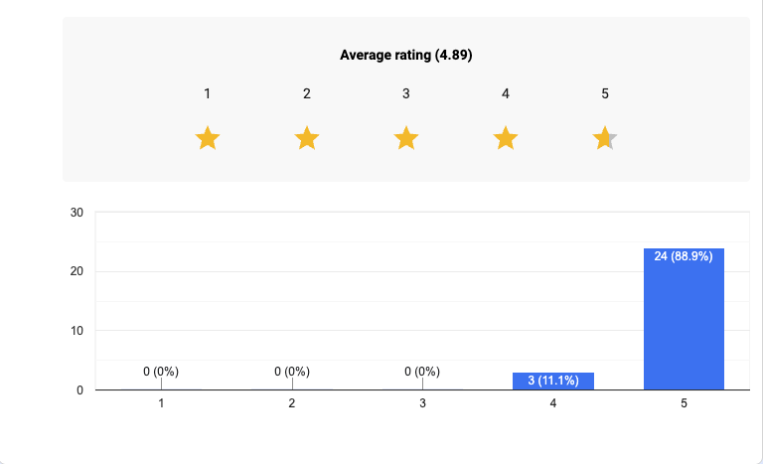
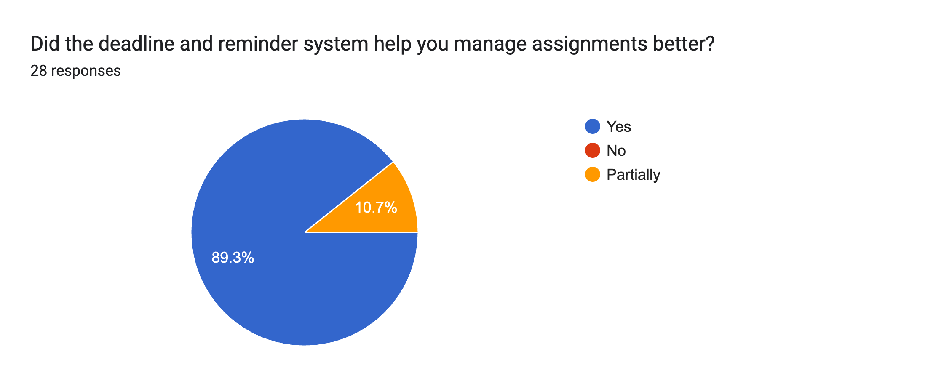
User Feedback & Survey
User Feedback and Evaluation
To evaluate Acadia in a real-world environment, the application was deployed on the Apple App Store and tested by university students.
A survey was conducted with 28 participants to measure usability, usefulness, UI/UX quality, feature effectiveness, AI recommendation quality, and system stability.

Slide 30
Challenges Faced
Challenges During Development
Main challenges included:
  Realtime synchronization complexity
  Provider state consistency
  Notification scheduling
  Timer persistence
  AI orchestration
  Supabase realtime handling
  Analytics optimization
  Cross-platform UI consistency
The team solved these challenges through iterative Scrum development and continuous testing.

Slide 31
Future Work
Future Improvements
Future development plans include:
  Predictive academic forecasting
  Advanced AI tutoring
  Calendar synchronization
  Wearable device integration
  Collaborative study groups
  Advanced machine learning models
  University system integration
  Web dashboard expansion

Slide 32
Conclusion
Acadia demonstrates how software engineering, AI, analytics, and realtime systems can be combined into one academic productivity ecosystem.
Acadia provides:
  Intelligent academic monitoring
  Productivity analytics
  Realtime academic insights
  Ai-assisted recommendations
  Stress and burnout awareness
The project achieved its objectives and produced a scalable production-ready MVP.

Slide 33

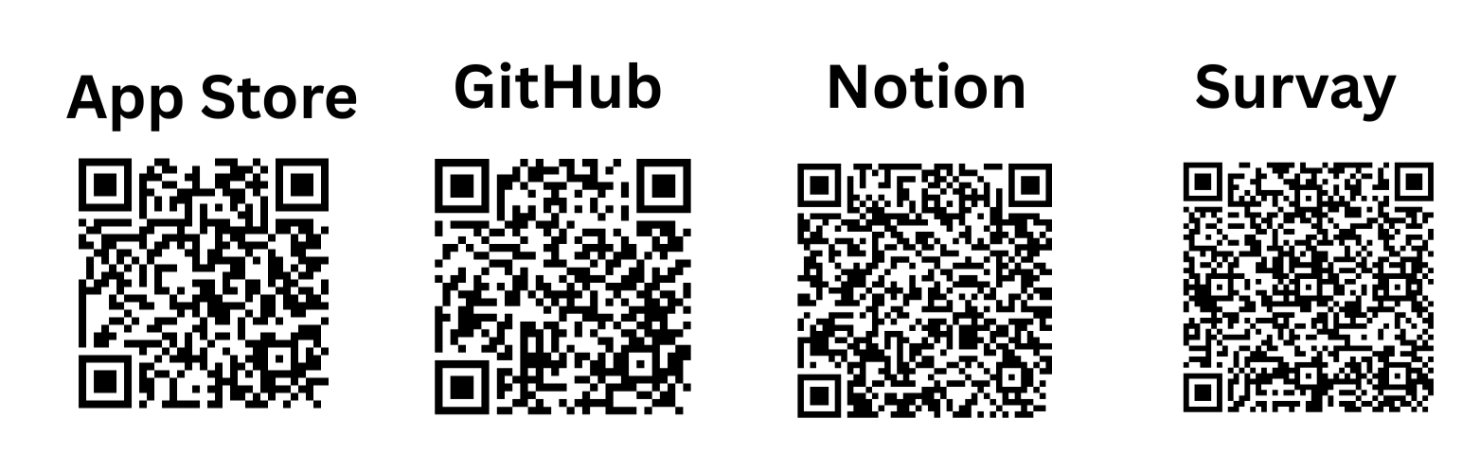

Slide 34
Thank You
17.05.2026
Öğr. Gör. Mustafa Sami CÜCEN

