Slide 1
Predicting the Saudi Stock Market Index - TASI
Nourah Almuhanna
18/11/2021
Data Science Bootcamps for SDAIA Academy.

Slide 2
Outline
Introduction
Data and Methodology
Results and Conclusions
Questions
References
18/11/2021
Data Science Bootcamps for SDAIA Academy.

Slide 3
Introduction
The project aims to predict the future values of the stock market index for the Saudi Stock Exchange (TASI) using machine learning
The project proposed approach involving Support Vector Regression (SVR).
18/11/2021
Data Science Bootcamps for SDAIA Academy.
Notes:
The project aims to predict the future values of the stock market index for the Saudi Stock Exchange (TASI) using machine learning. Experiments are performed in 1–10, 15 and 30 days in advance. The project proposed approach involving Support Vector Regression (SVR). The project is based on a paper by Patel et.al. (2015) where he used machine learning techniques to predict two stock market indices CNX Nifty and S&P Bombay stock exchange. The project aims to predict the future values of the stock market index for the Saudi Stock Exchange (TASI) using machine learning. Experiments are performed in 1–10, 15 and 30 days in advance. The project proposed approach involving Support Vector Regression (SVR). The project is based on a paper by Patel et.al. (2015) where he used machine learning techniques to predict two stock market indices CNX Nifty and S&P Bombay stock exchange.

Slide 4
Data and Methodology
The dataset retrieved from Bloomberg.
Simple 10 days moving average.
Weighted 10 days moving average.
Momentum Stochastic K%
Stochastic D%
Relative strength index (RSI)
Moving average convergence divergence (MACD)
A/D (Accumulation/Distribution) oscillator
CCI (commodity channel index).
Average True Range (ATR)
18/11/2021
Data Science Bootcamps for SDAIA Academy.
Notes:
Initially, the data will be daily from 2010 until 2021 of TASI index since the Saudi stock market has changed in structure in the past 10 years. Predictor variables are taken from Patel et.al (2015) which are the following:

Slide 5
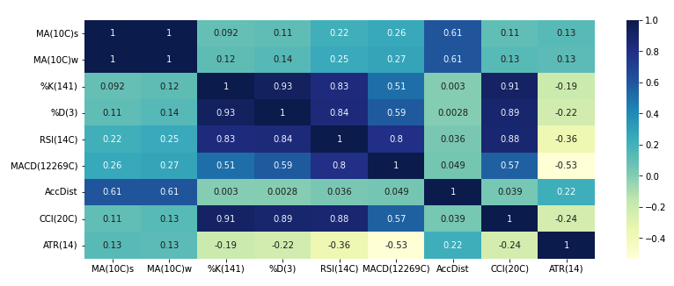
Data and Methodology
Correlations
Figure 1: correlation matrix for the first result
18/11/2021
Data Science Bootcamps for SDAIA Academy.
Notes:
First I choose the below variables to detriment the correlation, however, I found Ma(10C)s and MA(10C)W doing the same effect no new information
MA(10C)s
MA(10C)w
%K(141)
%D(3)
RSI(14C)
MACD(12269C)
AccDist
CCI(20C)
ATR(14)

Slide 6
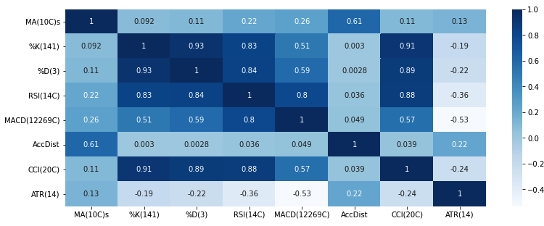
Data and Methodology
Figure 2: correlation matrix for the second result
18/11/2021
Data Science Bootcamps for SDAIA Academy.
Notes:
When I change in some of the variables the correlation disappear.

Slide 7
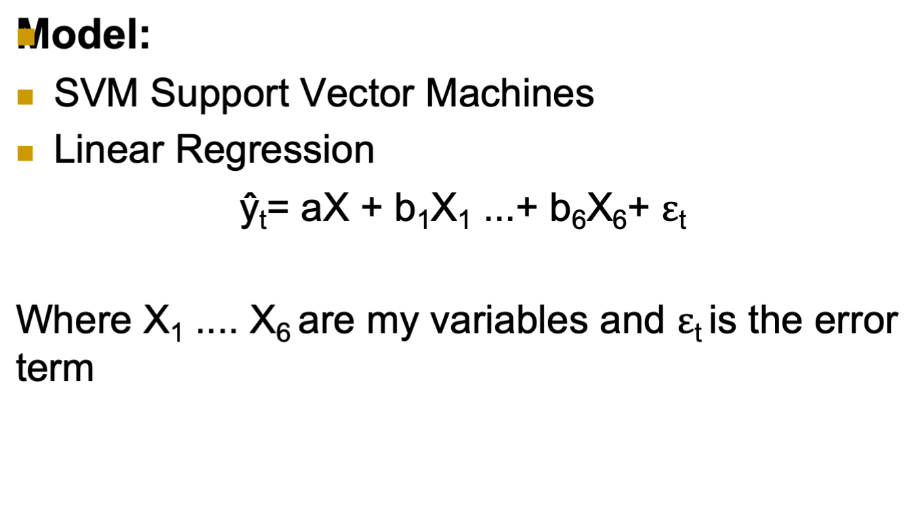
Data and Methodology
18/11/2021
Data Science Bootcamps for SDAIA Academy.

Slide 8
Data and Methodology
Tools:
numpy
pandas
Matplotlib
seaborn
datetime
sklearn.linear_model
18/11/2021
Data Science Bootcamps for SDAIA Academy.

Slide 9
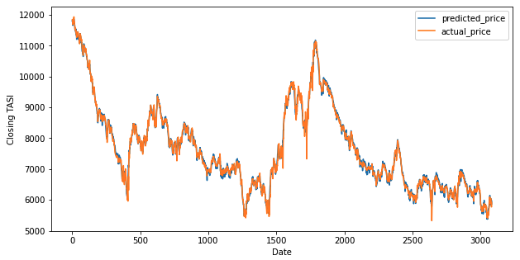
Results and Conclusions
R Square= %99.59
18/11/2021
Data Science Bootcamps for SDAIA Academy.

Slide 10
Results and Conclusions
Linear Regression return better result than SVM
SVM need to be done along stages with ANN and RF to get better result.
18/11/2021
Data Science Bootcamps for SDAIA Academy.

Slide 11
Questions
18/11/2021
Data Science Bootcamps for SDAIA Academy.

Slide 12
References
Patel, J., Shah, S.R., Thakkar, P., & Kotecha, K. (2015). Predicting stock market index using fusion of machine learning techniques. Expert Syst. Appl., 42, 2162-2172.
18/11/2021
Data Science Bootcamps for SDAIA Academy.

