Slide 1

BloomWatch for NASA SpaceApps 2025 Hackathon
Made by "Canada BloomWatchers"
Pardis Preeti Nouraldin Hassan
Notes:
AI-generated content may be incorrect. ---

Slide 2
TODO: - Rewrite all slides - Use proper images - Redo all animations - Add NASA and CSA Logos - Add Certified AI logo and what content uses AI

Slide 3
AI Usage Notice
API testing via Postman
HTML/CSS/JS Library Suggestions for displaying NASA map data content
Making this PowerPoint Presentation
Drafting `script.js`

Slide 4
Project Overview
Notes:
BloomWatch Introduction

Slide 5
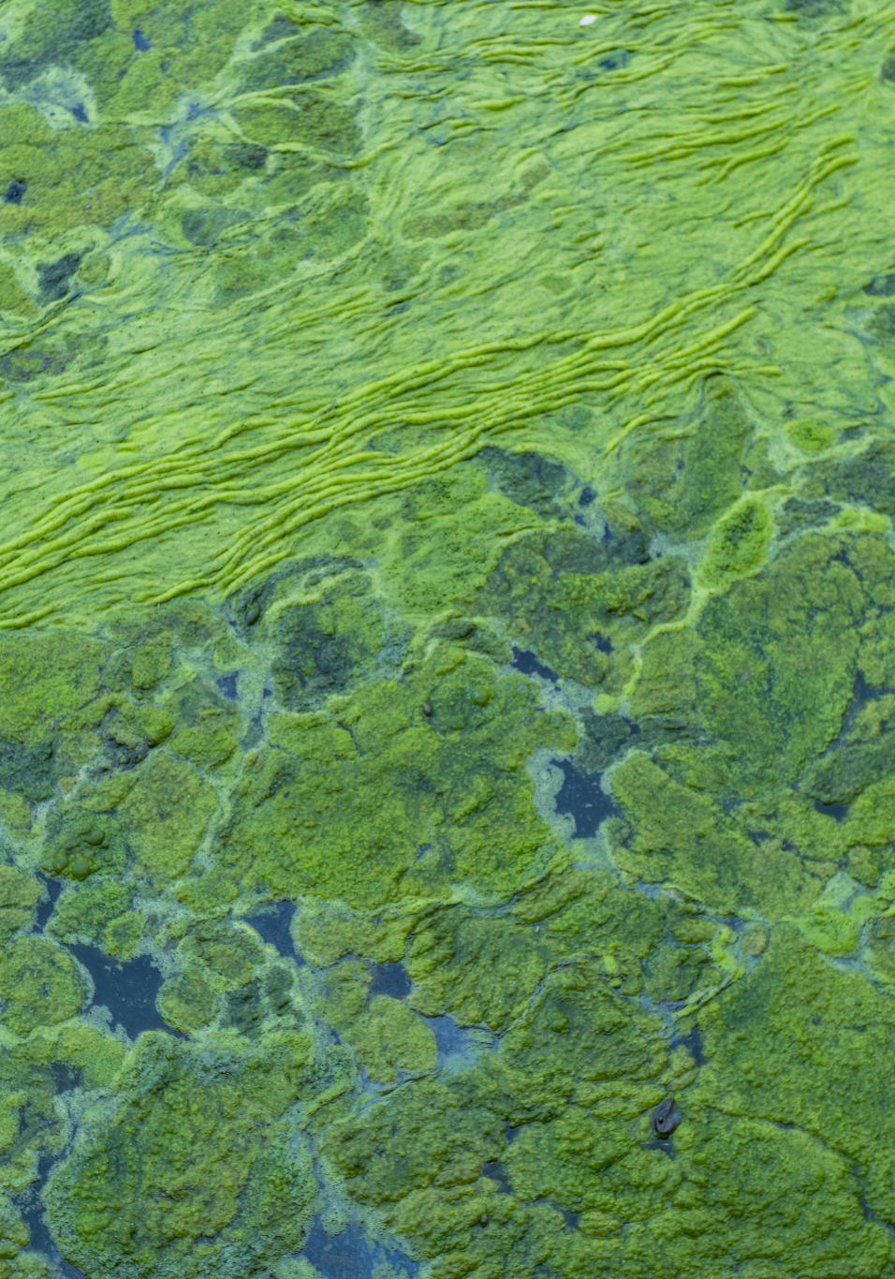
BloomWatch Introduction
Addressing Harmful Algal Blooms
BloomWatch targets the detection and management of harmful algal blooms threatening water quality and public health.
Satellite and Machine Learning Integration
The project uses satellite imagery combined with machine learning to analyze and predict algal bloom occurrences in real-time.
Supporting Environmental Decision-Making
BloomWatch provides actionable insights to agencies and communities for proactive environmental management.
Expert Team and Technological Innovation
Canada BloomWatchers combines expertise in data science and environmental science to develop a scalable user-friendly solution.
Notes:
TODO: Rewrite the slides and notes BloomWatch is an innovative environmental monitoring initiative developed for NASA SpaceApps 2025. The project is spearheaded by the team 'Canada BloomWatchers' and aims to address the growing concern of harmful algal blooms (HABs) in aquatic ecosystems. These blooms pose significant threats to water quality, marine life, and public health. BloomWatch leverages satellite imagery and machine learning algorithms to detect, analyze, and predict the occurrence of algal blooms in real-time. By integrating data from NASA’s Earth observation satellites, the system provides actionable insights for environmental agencies, researchers, and communities. The project not only enhances situational awareness but also supports proactive decision-making to mitigate the impact of HABs. The Canada BloomWatchers team combines expertise in data science, environmental science, and software engineering to deliver a scalable and user-friendly solution. Their participation in NASA SpaceApps 2025 reflects a commitment to leveraging space-based technologies for sustainable environmental stewardship.

Slide 6
Partner Organizations
Notes:
NASA and Canadian Space Agency Collaboration

Slide 7
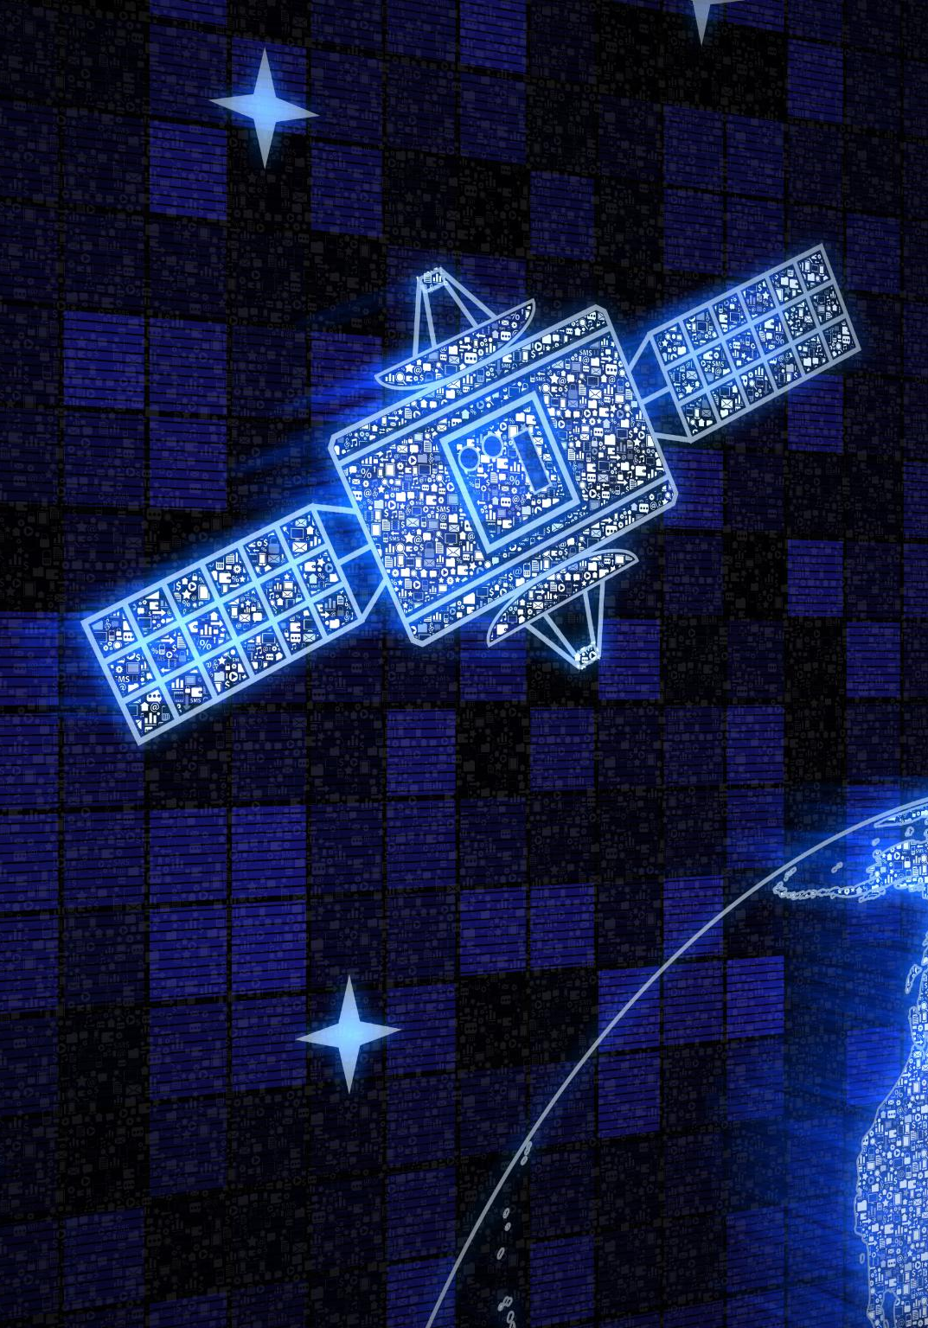
NASA and Canadian Space Agency Collaboration
NASA's Satellite Data
NASA provides high-resolution satellite data and remote sensing technology for effective environmental monitoring.
Canadian Space Agency Contributions
CSA supports Earth observation programs and fosters innovation in space science through collaborative frameworks.
International Collaboration
NASA and CSA collaboration exemplifies international efforts to address global environmental challenges through shared vision and resources.
Empowering Citizen Science
Their partnership empowers citizen scientists and developers to create impactful environmental monitoring solutions like BloomWatch.
Notes:
BloomWatch is supported by two prominent space organizations: NASA and the Canadian Space Agency (CSA). NASA provides access to high-resolution satellite data and remote sensing technologies essential for monitoring environmental changes. The Canadian Space Agency contributes through its Earth observation programs and collaborative frameworks that promote innovation in space science. The inclusion of both logos in the presentation symbolizes the international cooperation and shared vision for addressing global environmental challenges. NASA’s expertise in satellite operations and data analytics complements CSA’s regional focus and commitment to sustainable development. Together, these agencies empower citizen scientists and developers to create impactful solutions like BloomWatch. Their support underscores the importance of open data and cross-border collaboration in tackling ecological issues. The Canada BloomWatchers team acknowledges the invaluable resources and guidance provided by these agencies, which have been instrumental in shaping the project’s direction and capabilities.

Slide 8
AI Certification
Notes:
AI Contributions to BloomWatch

Slide 9
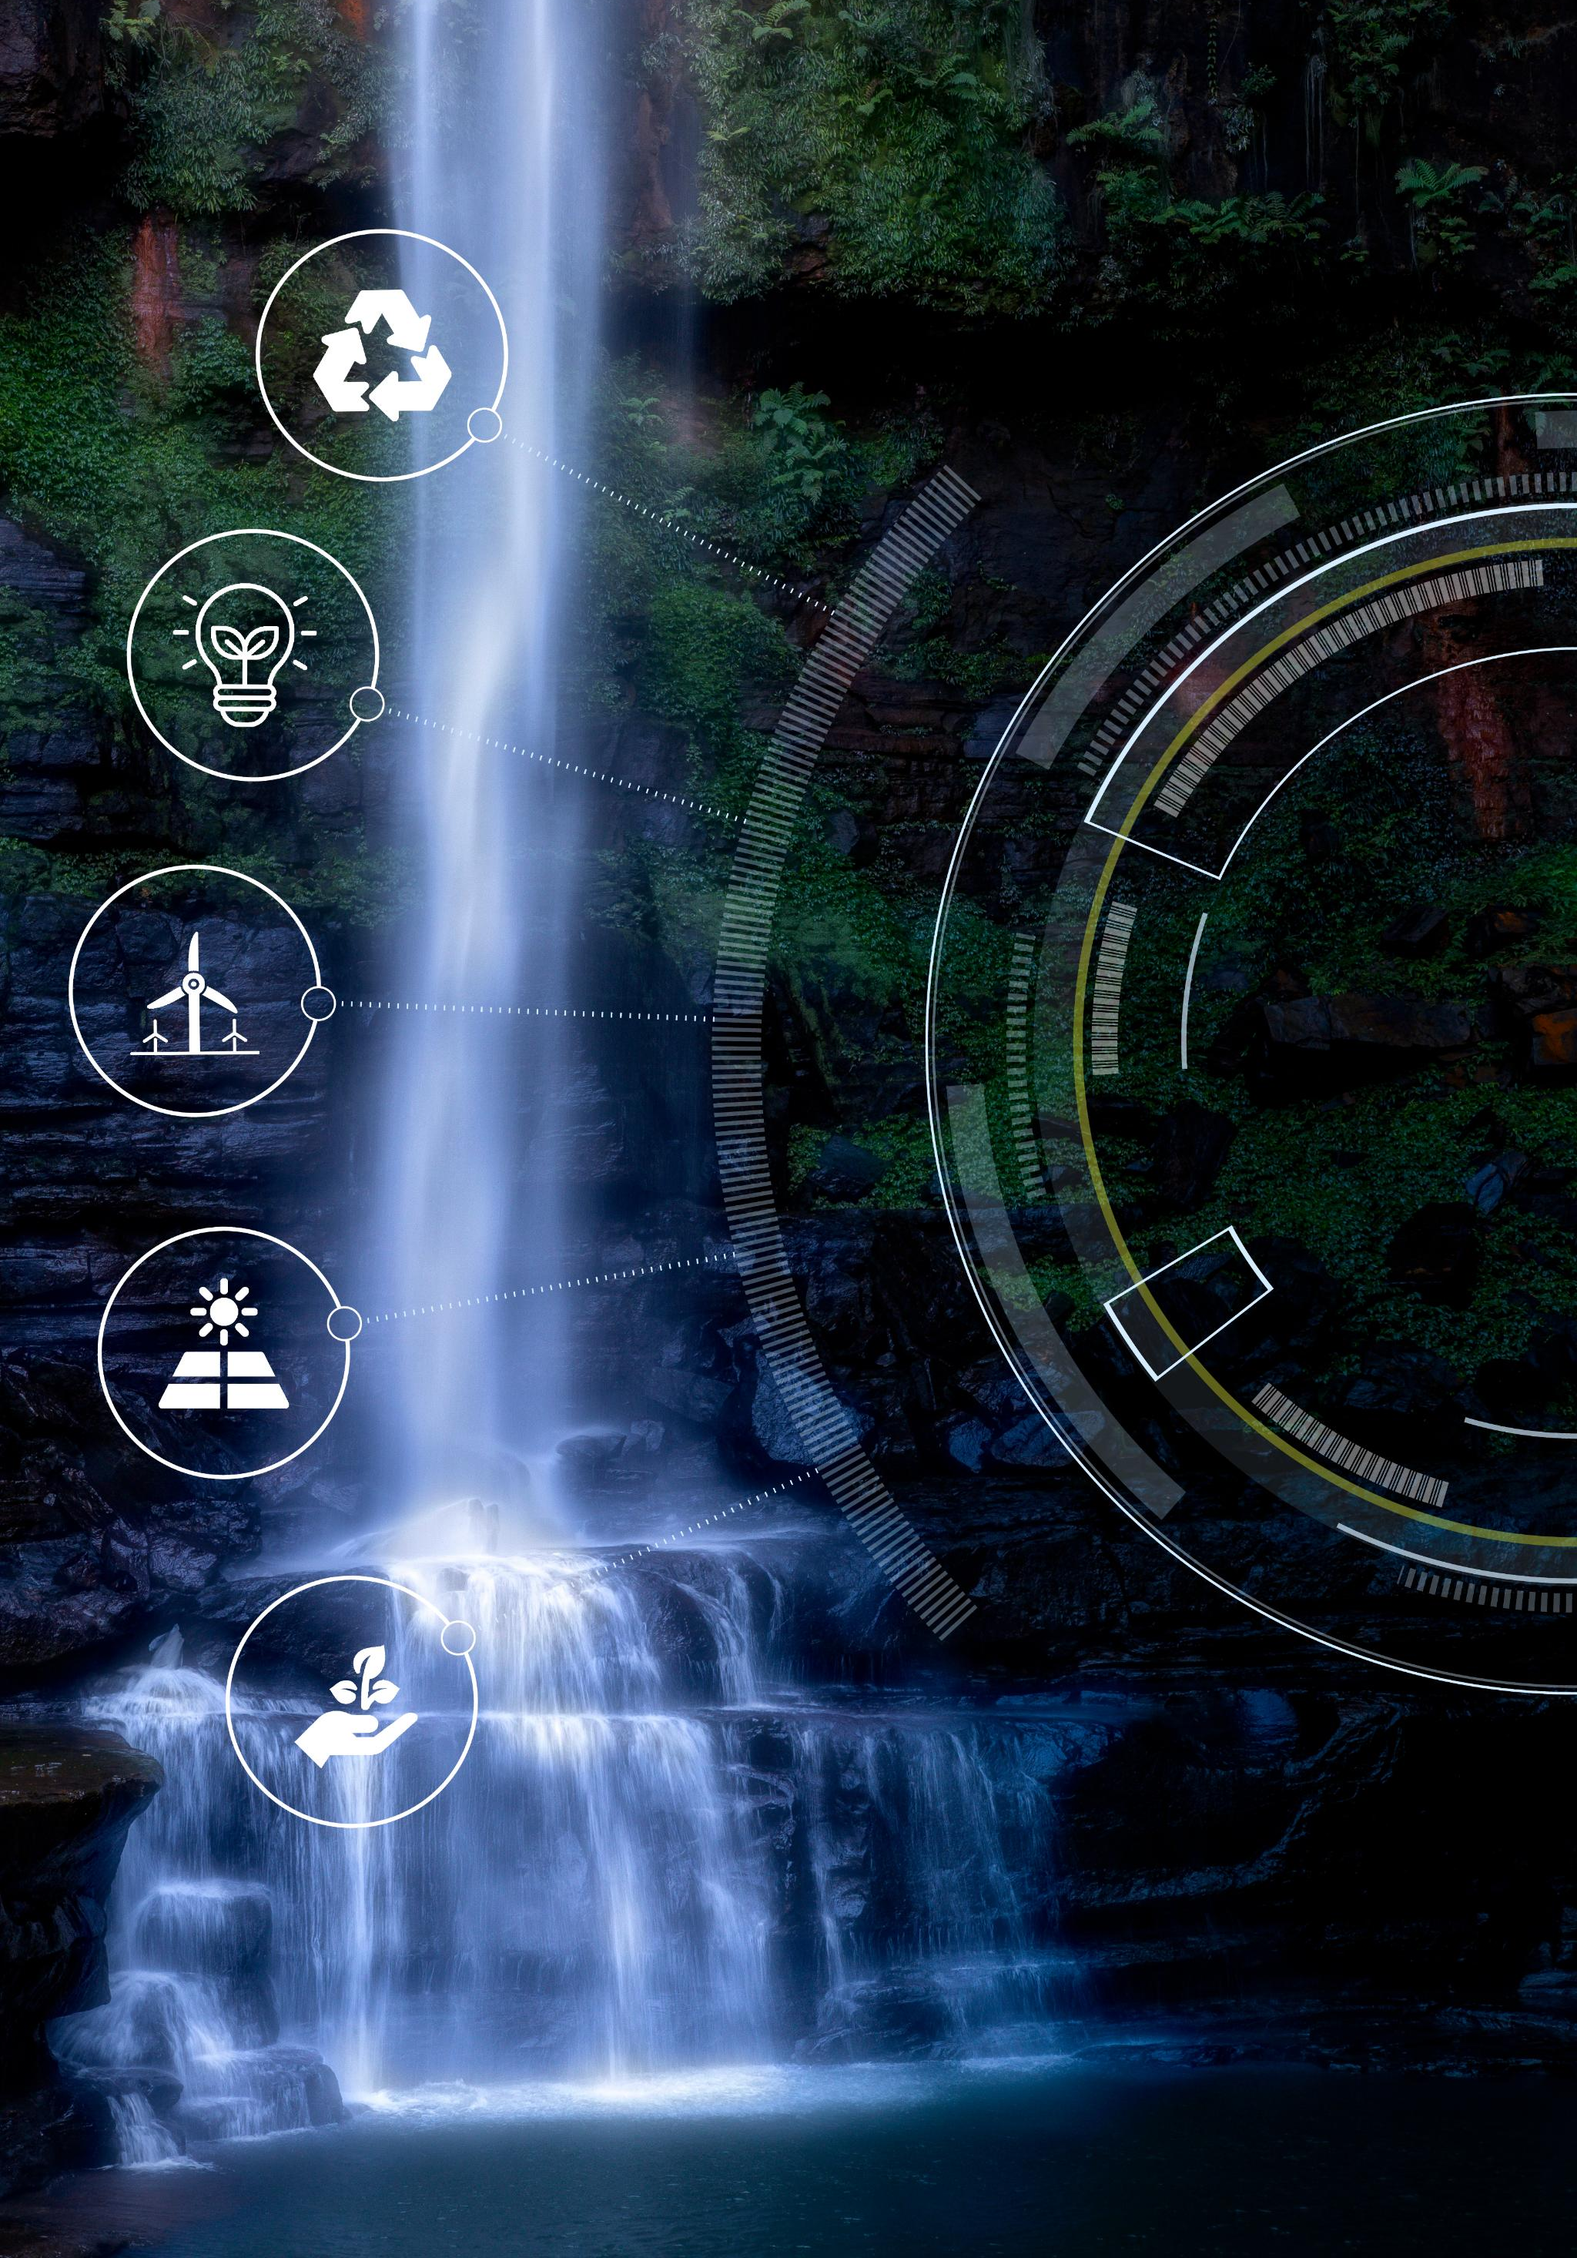
AI Contributions to BloomWatch
Satellite Data Analysis
AI analyzed satellite data to detect harmful algal bloom patterns using machine learning on spectral and environmental variables.
Image Processing and Visualization
AI enhanced environmental image processing and visualization for clearer interpretation and communication of bloom findings.
Presentation and Documentation
AI tools generated presentation layouts and content summaries, streamlining the documentation of BloomWatch findings.
Project Planning and Productivity
AI supported project planning by organizing tasks, suggesting workflows, and enhancing team productivity.
Notes:
Artificial Intelligence (AI) played a pivotal role in the development and execution of the BloomWatch project. A dedicated slide in the presentation features a round sticker labeled 'AI Certified', signifying the integration of AI technologies throughout the project lifecycle. AI was utilized in multiple facets: first, it analyzed satellite data to detect patterns indicative of harmful algal blooms. This involved training machine learning models to recognize bloom signatures based on spectral characteristics and environmental variables. Second, AI facilitated the processing and visualization of environmental images, enabling clearer interpretation and communication of findings. Third, AI tools assisted in generating presentation materials, including slide layouts and content summaries, thereby streamlining the documentation process. Lastly, AI supported project planning by organizing tasks, suggesting workflows, and enhancing team productivity. These contributions highlight the transformative potential of AI in environmental monitoring and project management. The Canada BloomWatchers team leveraged AI not only for technical tasks but also for creative and strategic functions, demonstrating its versatility and value in multidisciplinary initiatives.

