Slide 1



CACHE COHERENCE SIMULATION

Slide 2
TEAM MEMBERS:
BN: 24
BN: 35
BN: 41
BN: 65
BN: 67
DIAA ELDIN HASSAN
KAREEM MOHAMED
MARINA BEDEER
NOURAN ALAA
HALA ALAA ELDIN

Slide 3
MSI PROTOCOL
In this repository we are presenting the Cache Coherence MSI Protocol to analyze how would cache perform under various workloads.
We have studied about different snooping based Cache Coherence Protocols in class. Whenever a processor wants to read or write something, it tries to use its own cache to avoid having to go to the memory each time (as it’s very slow). But, when we have multiple processors, we need to synchronize the caches, so that all processors have a coherent view of memory. For this, one approach is to use a snooping cache, where each cache monitors the memory reads and writes done by other caches and takes some action based on those requests. MSI is one simple choice but there are other protocols too which offer different kinds of benefits under specific workloads - MESI, MOSI, MOESI, etc.
To simulate the output we are using SMPCache simulator which comes with a pre-configured memory traces and different protocols configurations to be used for the simulation.
.

Slide 4
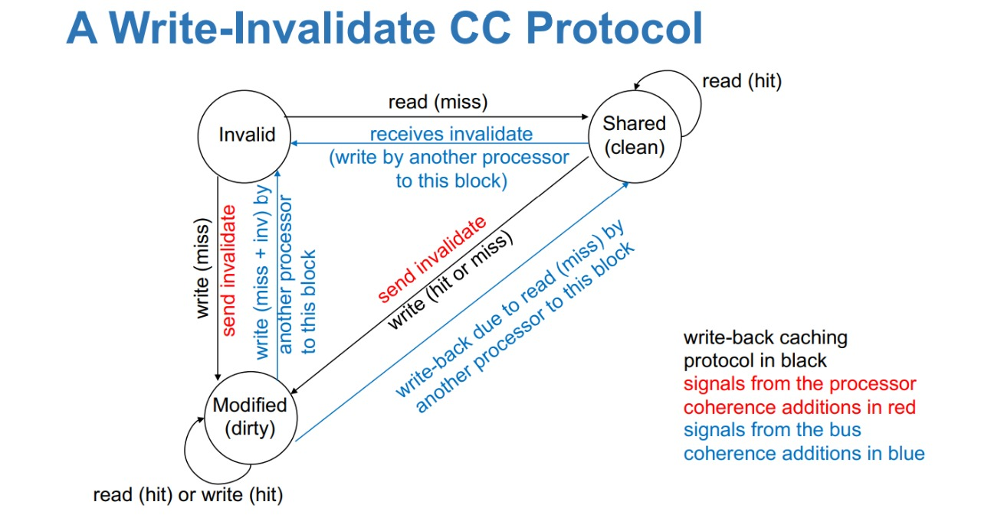
The following is the State Transition Diagram for MSI Protocol

Slide 5
SIMULATION RESULTS
ACCESS NUMBERS: 5&6
ACCESS NUMBER: 12&13
ACCESS NUMBER: 17&18

Slide 6
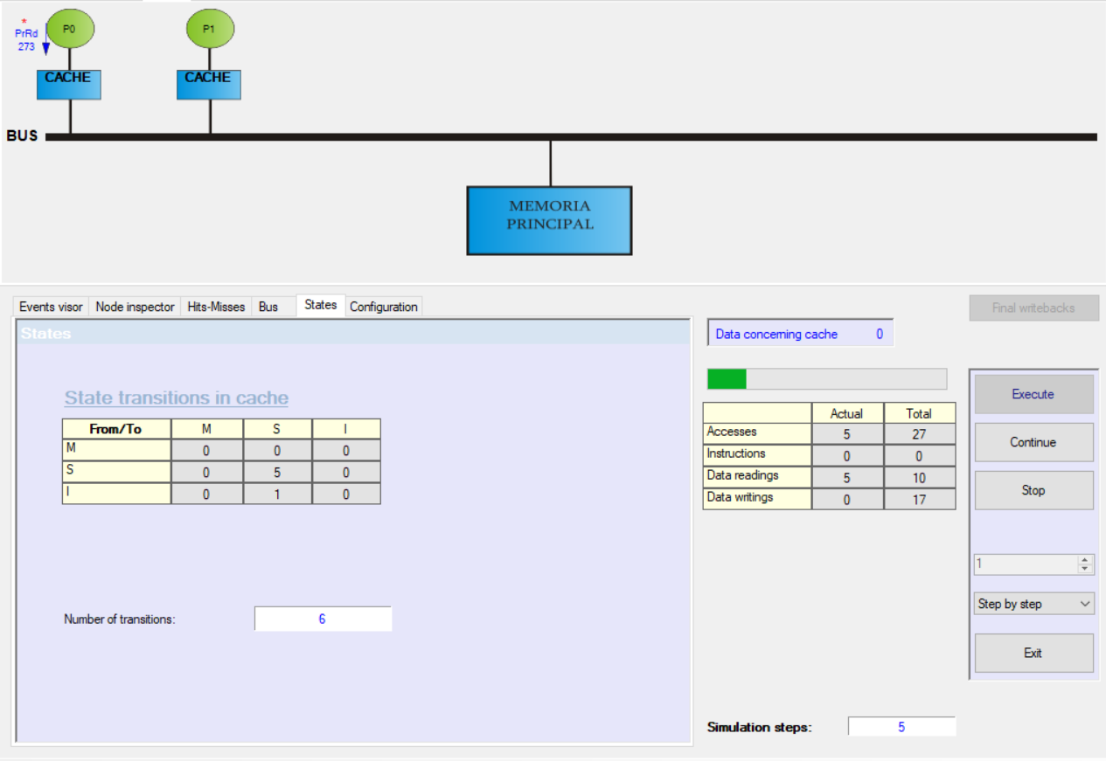
ACCESS NUMBER 5:
Node P[0] Seek block -> 273
1.- Reading request (PrRd) 2.- Hit in cache
STATE TRANSITION IN CACHE:
SHARED → SHARED

Slide 7
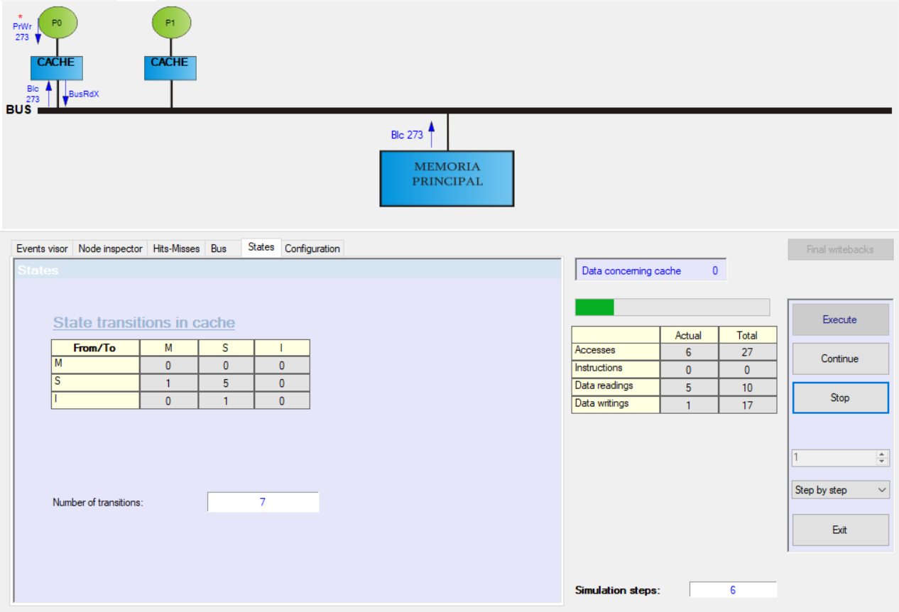
ACCESS NUMBER 6:
Node P[0] Seek block -> 273
1.- Writing request (PrWr)
2.- Hit in cache
3.- Bus exclusive reading request (BusRdX)
4.- The bus arbiter grants bus to node P0
5.- Transfer of block 273 from main memory
STATE TRANSITION IN CACHE:
SHARED → MODIFIED

Slide 8
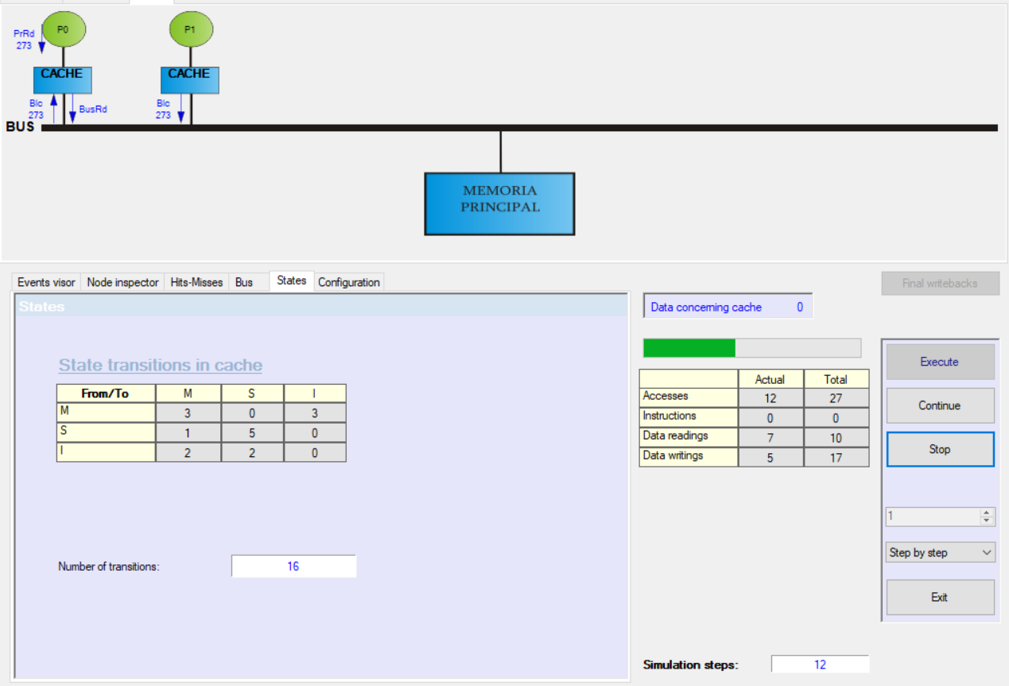
ACCESS NUMBER 12:
Node P[0] Seek block -> 273
1.- Reading request (PrRd)
2.- Miss in cache
3.- Bus reading request (BusRd)
4.- The bus arbiter grants bus to node P0
5.- Transfer of block 273 from node P1
6.- Writeback in node P1 block 273
6a.- Writeback request (BusWb)
6b.- Transfer of block 273 to main memory
STATE TRANSITION IN CACHE:
INVALID → SHARED

Slide 9
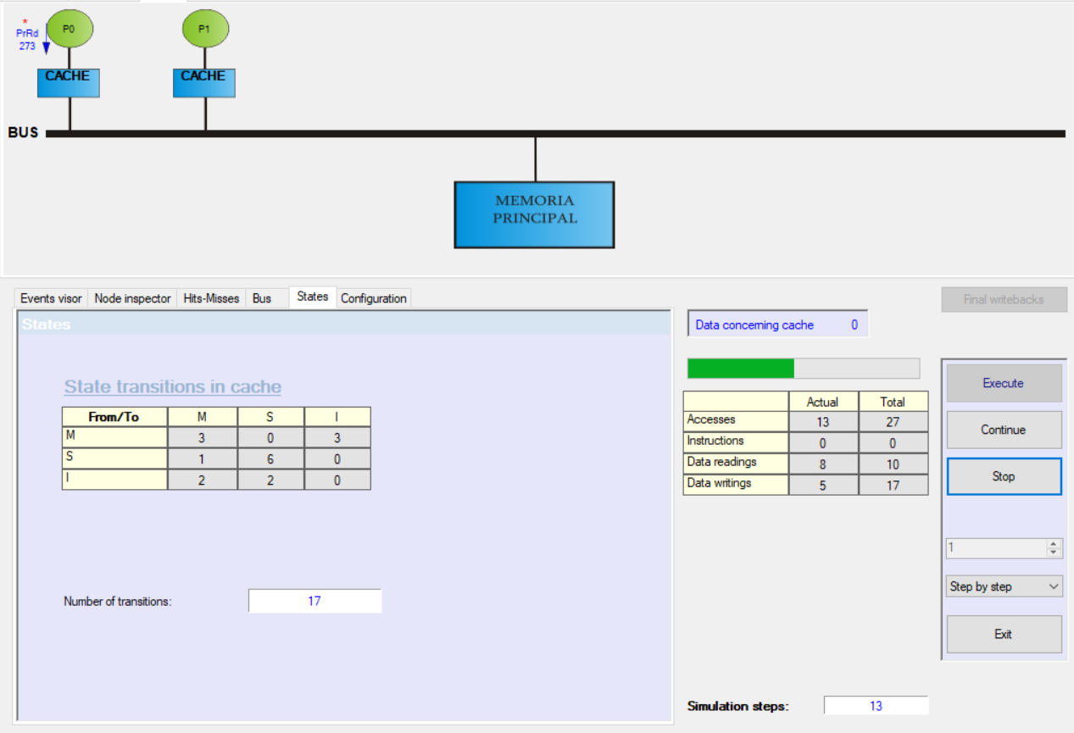
ACCESS NUMBER 13:
Node P[0] Seek block -> 273
1.- Reading request (PrRd)
2.- Hit in cache
STATE TRANSITION IN CACHE:
SHARED → SHARED

Slide 10
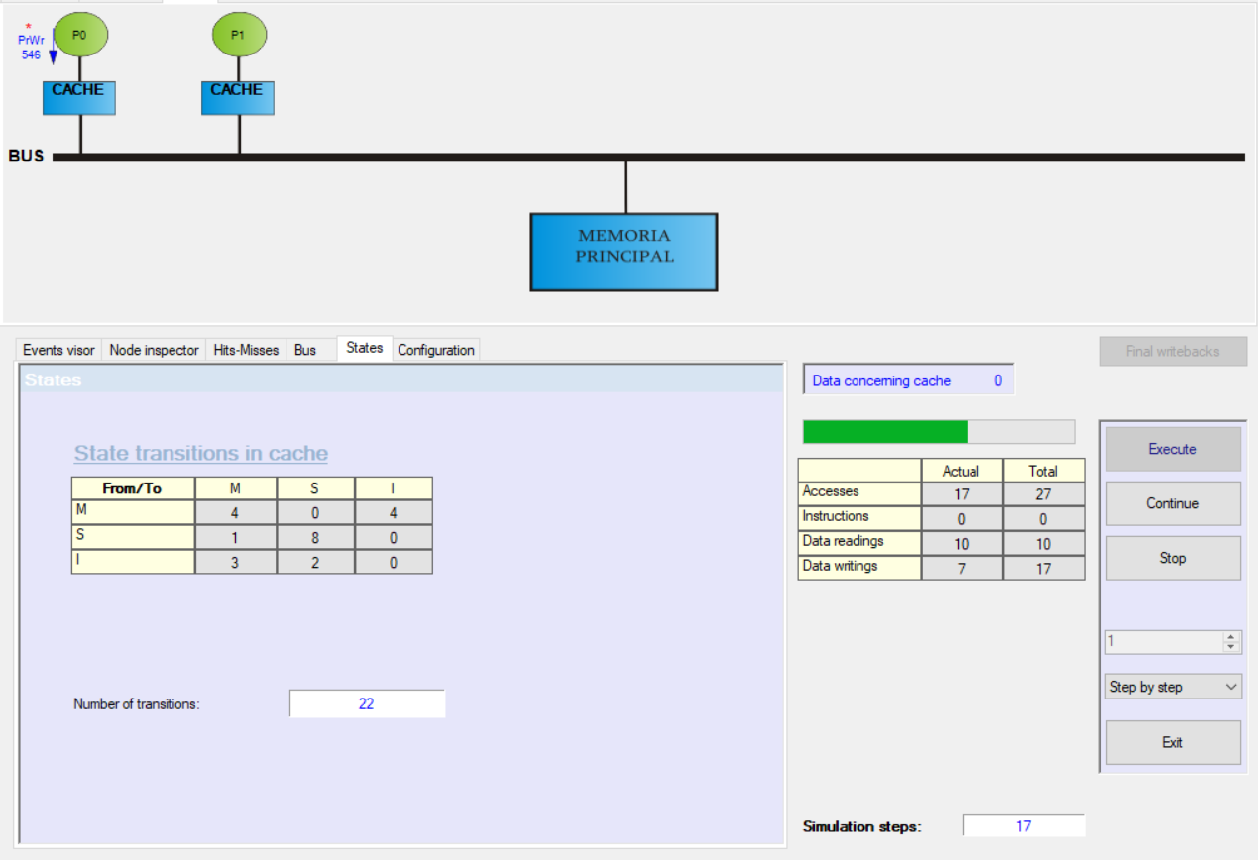
ACCESS NUMBER 17:
Node P[0] Seek block -> 546
1.- Writing request (PrWr)
2.- Hit in cache
STATE TRANSITION IN CACHE:
MODIFIED → MODIFIED
AFTER MODIFICATION OF P[1] ON B.546
MODIFIED → INVALID

Slide 11
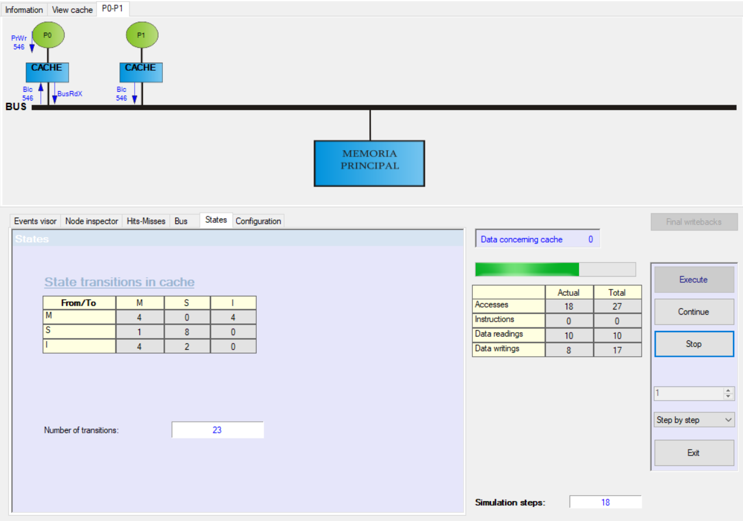
ACCESS NUMBER 18:
Node P[0] Seek block -> 546
1.- Writing request (PrWr)
2.- Miss in cache
3.- Bus exclusive reading request (BusRdX)
4.- The bus arbiter grants bus to node P0
5.- Transfer of block 546 from node P1
STATE TRANSITION IN CACHE:
INVALID → MODIFIED

Slide 12
THANK YOU
https://github.com/Nouran-Alaa/CacheCoherence_CA

