Slide 1

WELCOME TO OUR MEMORY TILE GAME
We will discuss the process of building our game
start matching !!

Slide 2
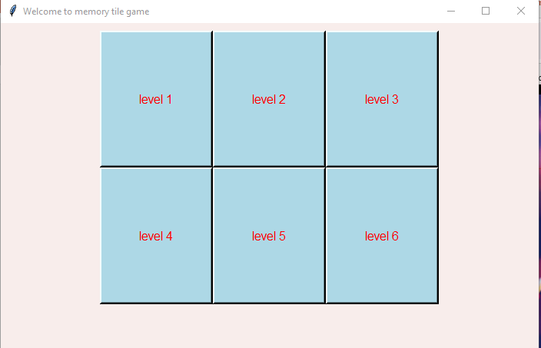
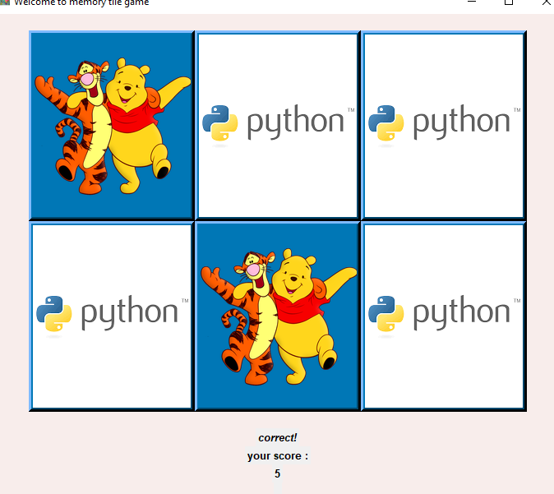
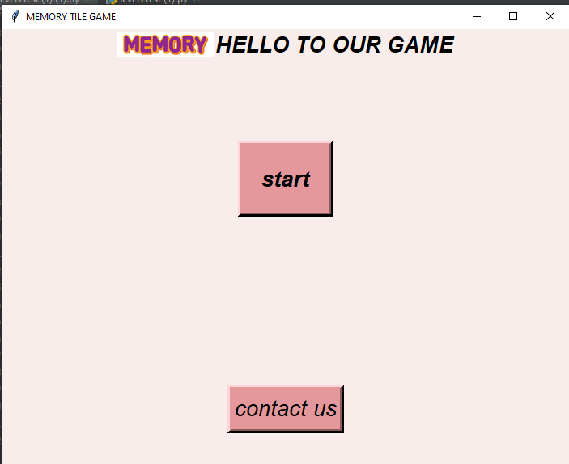

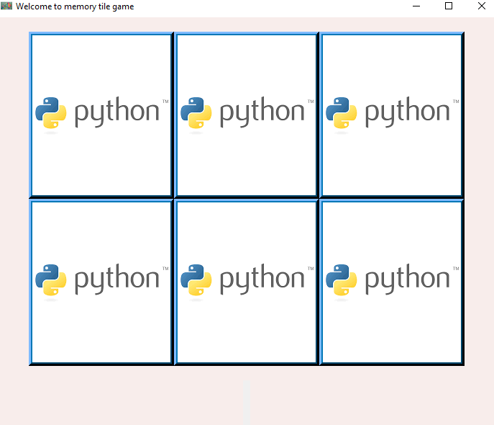
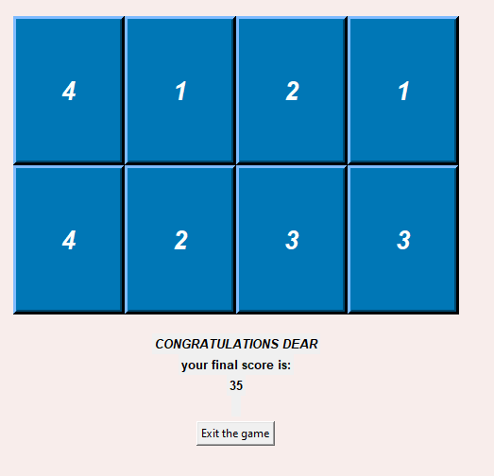



Slide 3

EACH MEMBER’S ROLE
NOURAN
Design buttons of the levels
Making sure the two selected buttons have the same answer.

Slide 4
EACH MEMBER’S ROLE
NOURAN
inserting images to be matched
Methods of flipping the buttons to show our matches

Slide 5
EACH MEMBER’S ROLE
DOAA
Matches:
Numbers list
Words list
Colors list
Active background

Slide 6
EACH MEMBER’S ROLE
MARWA
Making sure that there are only two selected buttons.

Slide 7
EACH MEMBER’S ROLE
NOURAN & MARWA
Transferring between levels
Designing the windows
Designing the COLORS

Slide 8
TRY OUR GAME AND SEND TO US YOUR FEEDBACK

