Slide 1
Deep Learning cse 485 PROJECT : FACE MASK DETECTION
Nouran Ahmed Abdelhameed 18p4496

Slide 2

agenda
Introduction
Problem Statement
Diagram
Applications
Implementation
MobileNetV2 Architecture
Transfer Learning
File mask_detect.py
Training
Results
Comparison between other architectures

Slide 3
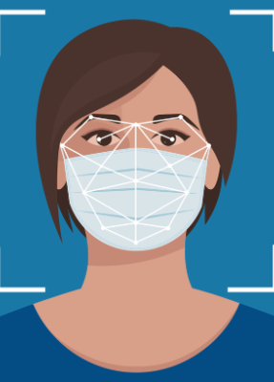
Introduction
In the face of the COVID-19 pandemic, public health measures such as wearing face masks have become paramount in preventing the spread of the virus.
Face mask detection systems have emerged as a powerful tool to monitor and enforce compliance with face mask regulations in various settings, including public spaces, workplaces, and transportation hubs.
The development and implementation of face mask detection systems have significant implications for public health and safety.

Slide 4
Problem statement
The goal is to create an automated system that can analyse video frames, identify faces, and accurately classify whether a person is wearing a mask or not wearing a mask at all.
To address this problem, we will utilize Python, Keras, and OpenCV, which are popular tools and libraries for computer vision and deep learning tasks.
By leveraging pre-trained deep learning models and image processing techniques, we can develop an efficient and effective face mask detection system that operates on real video streams and images.

Slide 5

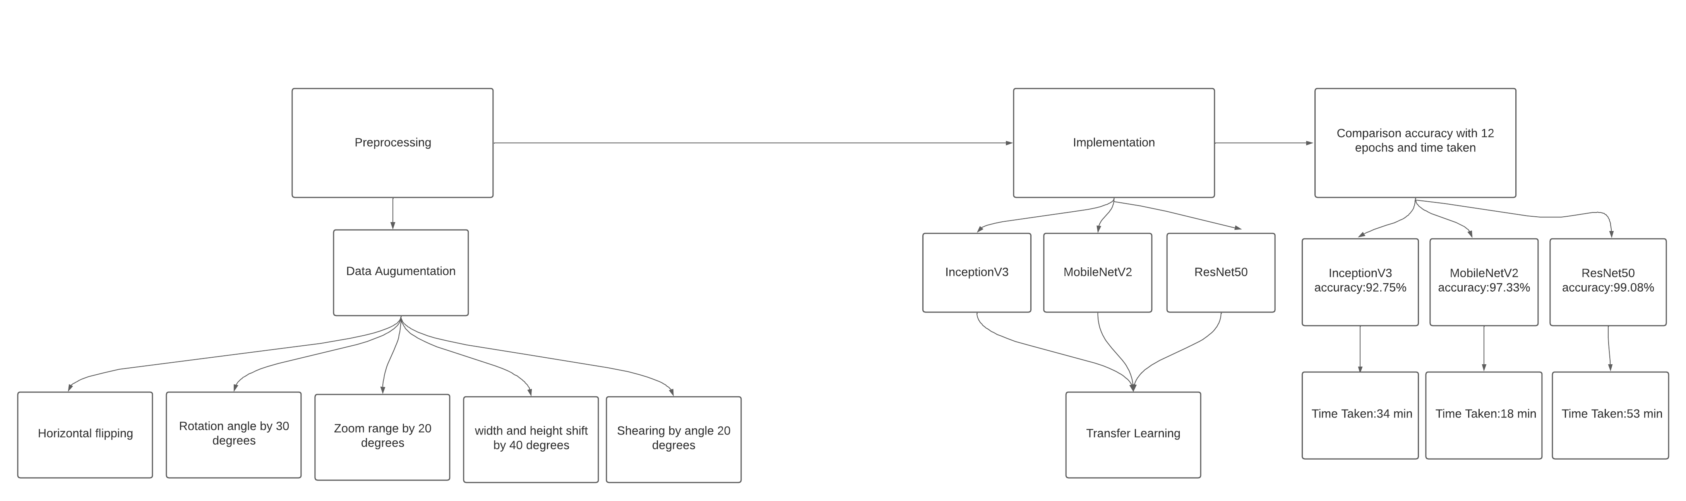
Diagram

Slide 6
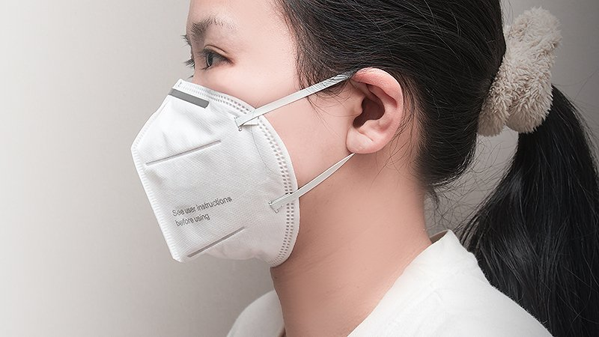

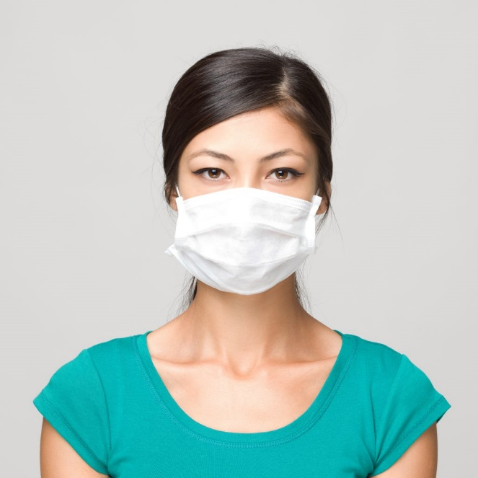

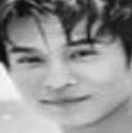
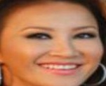
IMPLMENTATION
Dataset: From Kaggle website
With Mask:
Without Mask:

Slide 7
IMPLMENTATION
Pre-processing:
Pre-process the label so we performed one-hot encoding on the labels by the LabelBinarizer which is a SciKit Learn class that accepts Categorical data as input and returns a NumPy array.
Perform data augmentation on images to generate new images by ImageDataGenerator.
FaceNet: is a deep learning architecture for face recognition developed by researchers at Google. It uses a deep convolutional neural network (CNN) to extract high-level features from face images and then maps these features into a lower-dimensional space called an embedding and I used pre-trained Caffe models to Detect and classify faces with third-party DNNs which is res10_300x300_ssd_iter_140000. And a prototxt file which is model definition files that are required when you train a model.

Slide 8
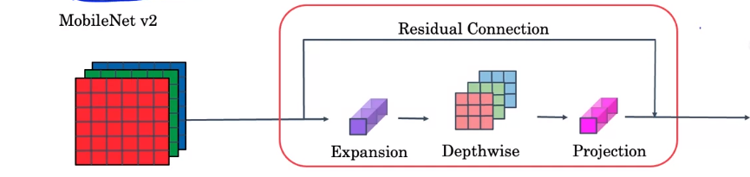
MOBILENET V2 ARCHITECTURE
MobileNetV2 employs a depth-wise convolution which is , it applies a separate filter to each input channel and produces a set of intermediate output channels followed by a point-wise linear projection to change the number of channels and It takes the intermediate output channels from the depth-wise convolution and performs a 1 × 1 convolution on them.
This structure reduces the number of parameters and computations compared to traditional residuals.
the concept of linear bottlenecks, which are used to increase the non-linearity of the network By applying a lightweight non-linearity, such as a ReLU after the depth-wise convolution, the network can capture more complex features while keeping the model size small.

Slide 9
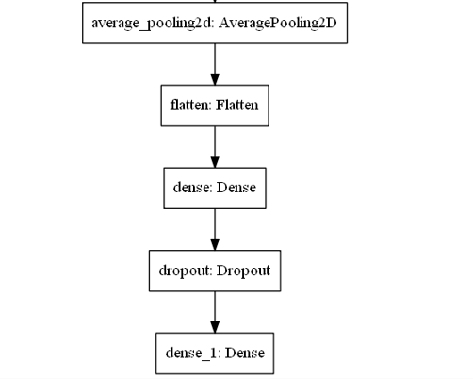
Transfer Learning
After Loading the base model as MobileNetV2, Resnet50 and InceptionV3, we freeze the output layer to adjust it with our goal, so we add an average2Dpool with 7*7 kernel size then 2 dense layer (fully connected) with 128 units and the last one 2 units to predict which is a person wearing a mask or not.

Slide 10
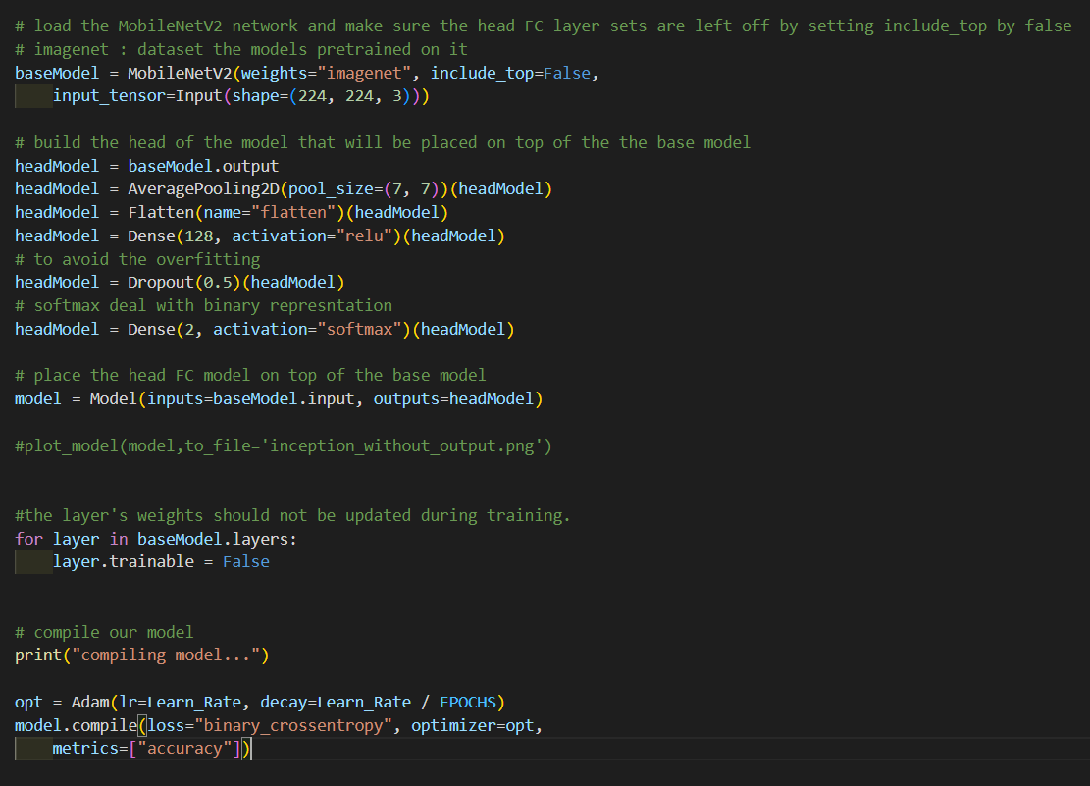
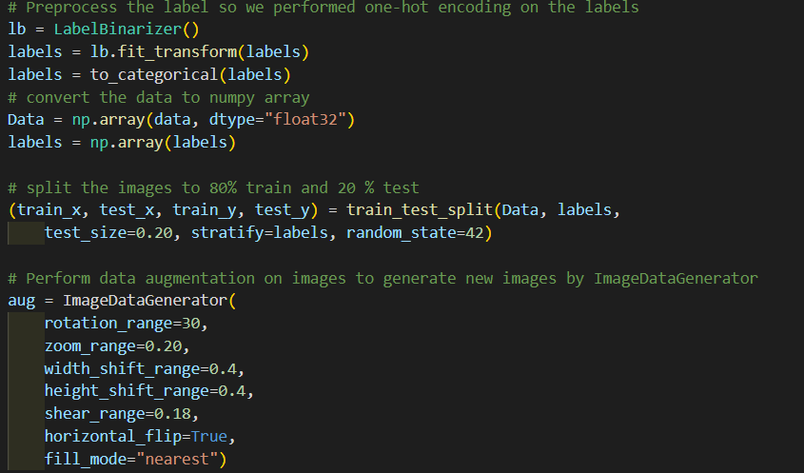
File mask_detect.py

Slide 11
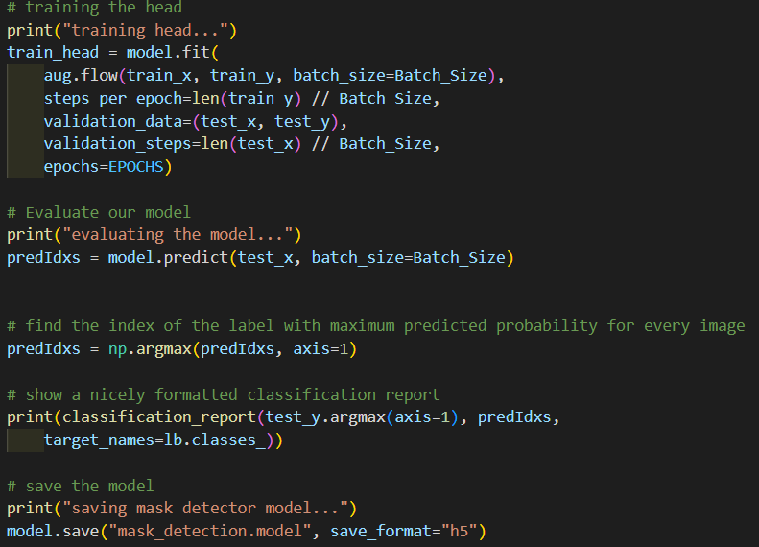
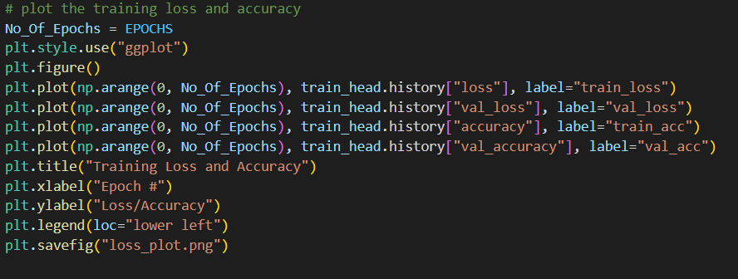
File mask_detect.py

Slide 12
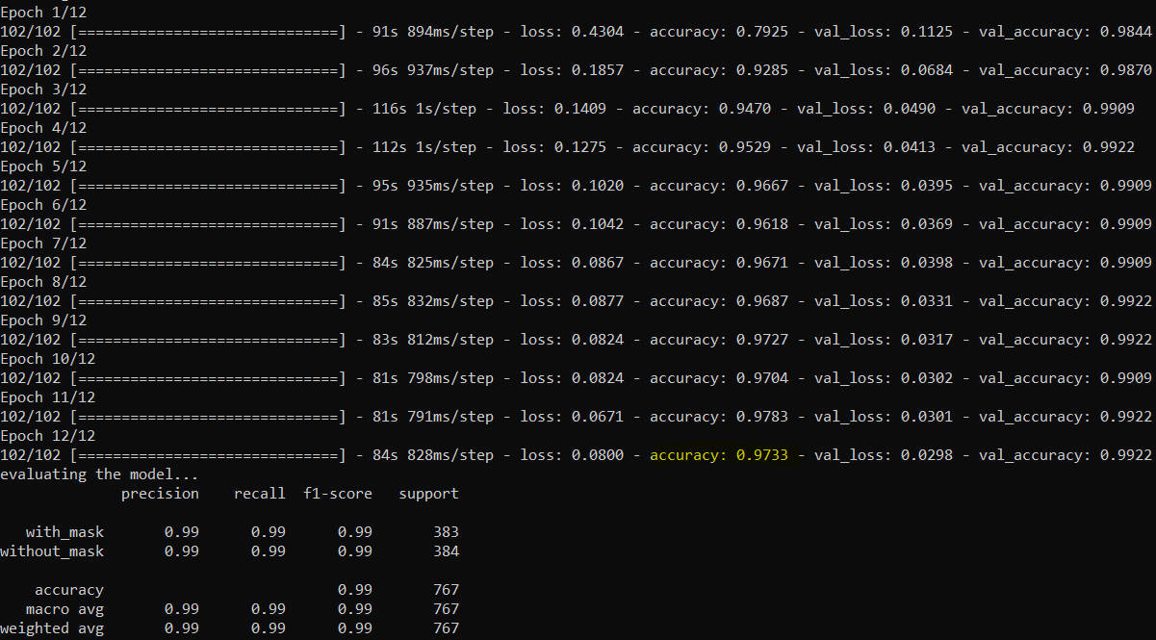
Training
I trained my model by 12 epochs and here is the result of every epoch in the training process and the last epoch with accuracy 97.33%
Then we can see the classification report which is says that the model is very good

Slide 13
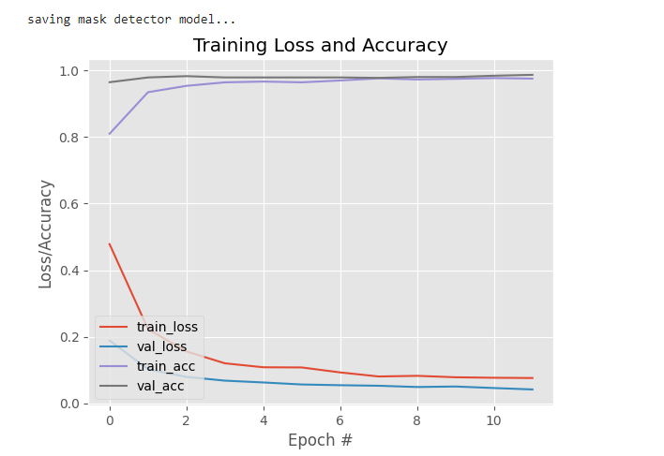
Training
MobileNetV2
We can also see that at the graph of loss and accuracy throughout the 12 epochs and it seems the loss is decreasing, and the accuracy is increasing which is a very good model.

Slide 14
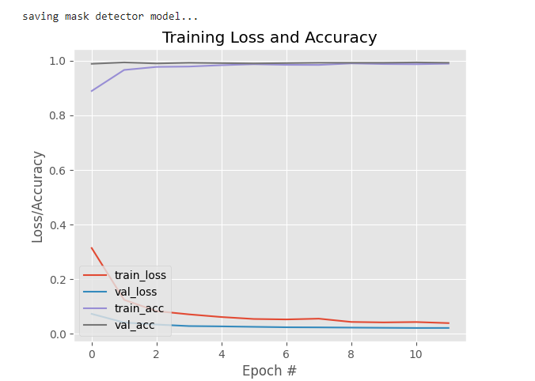
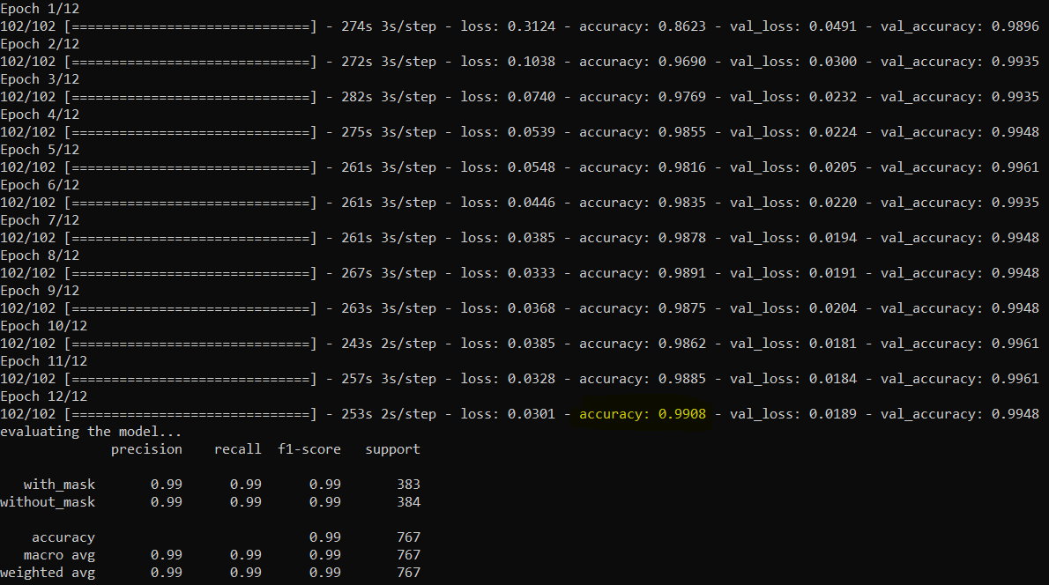
Training
ResNet50
We can also see that at the graph of loss and accuracy throughout the 12 epochs and it seems the loss is decreasing, and the accuracy is increasing which is a very good model.
I trained my model by 12 epochs and here is the result of every epoch in the training process and the last epoch with accuracy 99.08%

Slide 15
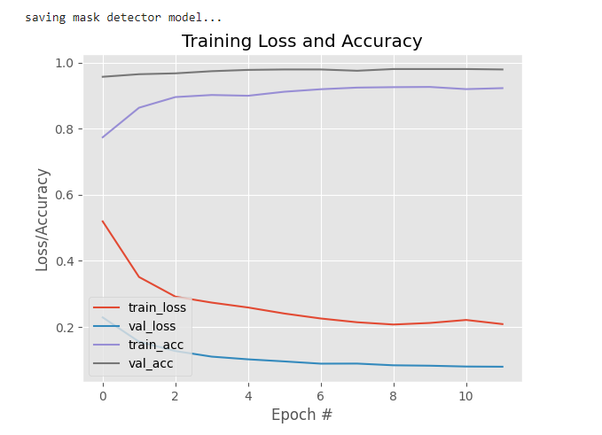
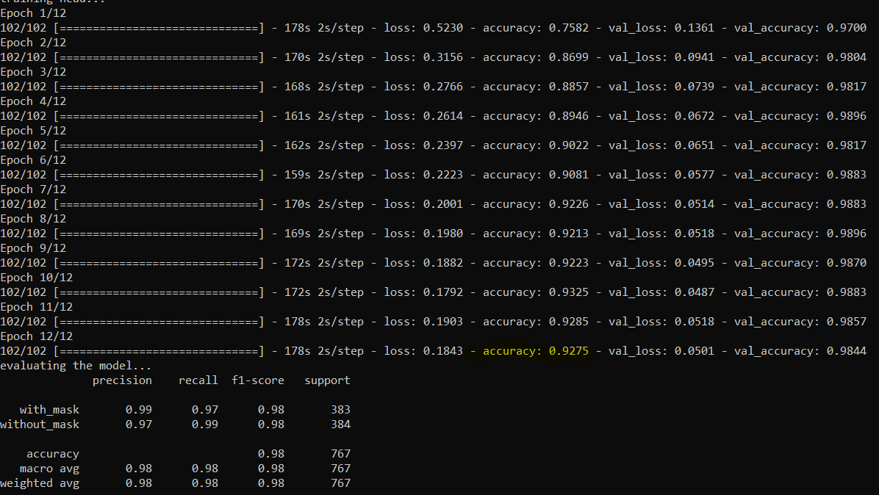
Training
InceptionV3
We can also see that at the graph of loss and accuracy throughout the 12 epochs and it seems the loss is decreasing, and the accuracy is increasing which is a very good model.
I trained my model by 12 epochs and here is the result of every epoch in the training process and the last epoch with accuracy 92.75%

Slide 16
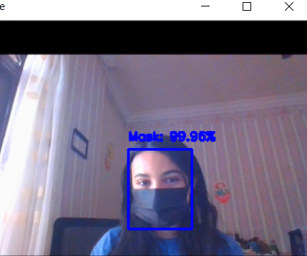
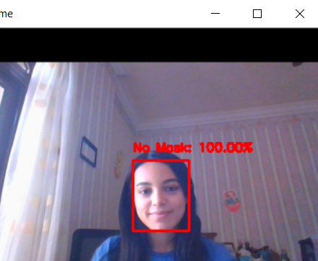
Results
On real time video streams with mask and no mask.
MobileNetV2
We can see that it detected that there is a person wearing mask or not with very high accuracy.

Slide 17
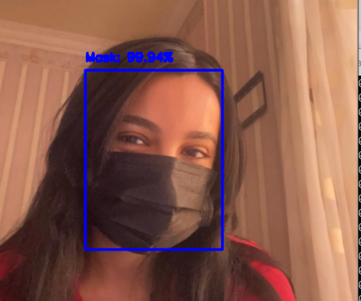
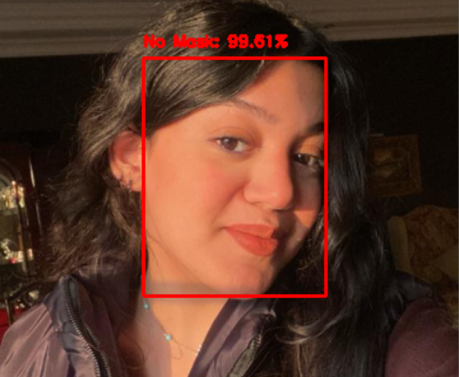
Results
On images with mask and no mask.
MobileNetV2
We can see that it detected that there is a person wearing mask or not with very high accuracy.

Slide 18
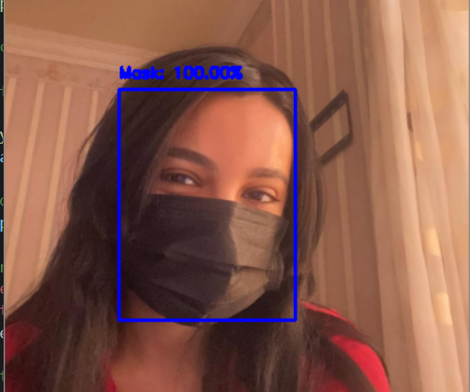
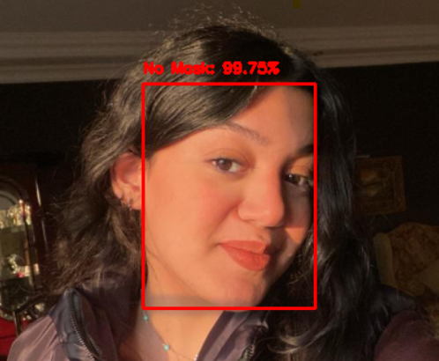
Results
On images with mask and no mask.
ResNet50
We can see that it detected that there is a person wearing mask or not with the highest accuracy.

Slide 19
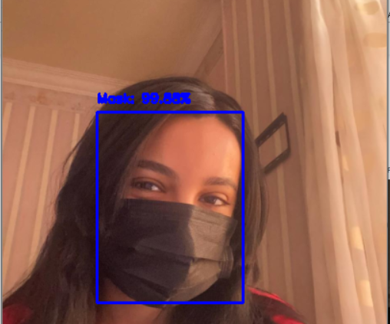
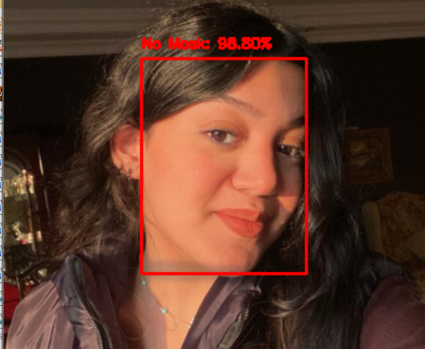
Results
On images with mask and no mask.
InceptionV3
We can see that it detected that there is a person wearing mask or not with the lowest accuracy.

Slide 20
Comparison between other architectures
MobileNetV2 :
We can see that it’s accurate model with accuracy 97.33% and when we tested it on images it worked well with a good prediction value but still resNet50 better than it.
The model takes to finish the 12 epochs 18 minutes and it the shortest time between all the models.
ResNet :
We can see that it’s the most accurate model with accuracy 99.08% and when we tested it on images it worked so well with the highest prediction values among the remaining models.
The model takes to finish the 12 epochs 53 minutes and it the longest time between all the models.
InceptionV3 :
We can see that it’s the most accurate model with accuracy 92.75 % and when we tested it on images it worked so well with the lowest prediction values among the other models.
The model takes to finish the 12 epochs 34 minutes and it is an average time between the other models.

Slide 21
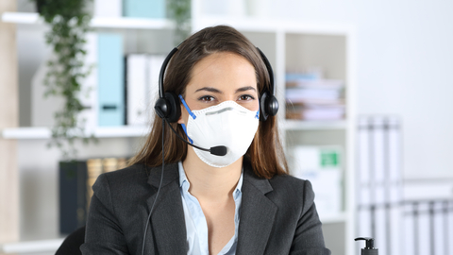

Applications
Healthcare Facilities: can be utilized in hospitals, clinics, and other healthcare settings to reinforce infection control measures. By identifying individuals who are not wearing masks , healthcare providers can take immediate action to prevent the spread of infections.
Public Spaces and Transportation: can be deployed in public spaces such as shopping malls, airports, train stations, and bus terminals. These systems help ensuring a safer environment for both staff and visitors.
Educational Institutions: Schools, colleges, and universities can benefit from face mask detection systems to ensure the safety of students, teachers, and staff.
Workplaces and Offices: can be implemented in office buildings, factories, and other work environments to ensure that employees adhere to mask-wearing protocols. By automating the monitoring process, these systems help maintain a healthy and productive workplace.

Slide 22

THANK YOU !

