Slide 1
Deep Learning cse 485 PROJECT : FACE MASK DETECTION
Nouran Ahmed Abdelhameed 18p4496

Slide 2
agenda
Introduction
Problem Statement
Applications
Implementation
MobileNetV2 Architecture
Testing
Results
Comparison between other architectures

Slide 3

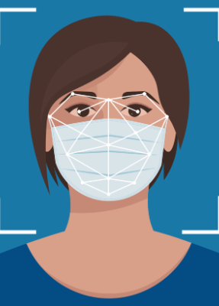
Introduction
In the face of the COVID-19 pandemic, public health measures such as wearing face masks have become paramount in preventing the spread of the virus.
Face mask detection systems have emerged as a powerful tool to monitor and enforce compliance with face mask regulations in various settings, including public spaces, workplaces, and transportation hubs.
The development and implementation of face mask detection systems have significant implications for public health and safety. By automating the process of monitoring mask-wearing, these systems can help reduce the burden on human resources and enhance the efficiency of mask compliance enforcement.

Slide 4
Problem statement
The goal is to create an automated system that can analyse video frames, identify faces, and accurately classify whether a person is wearing a mask, wearing it incorrectly, or not wearing a mask at all.
The system should provide real-time feedback to ensure timely intervention and enforcement of mask-wearing protocols.
To address this problem, we will utilize Python, Keras, and OpenCV, which are popular tools and libraries for computer vision and deep learning tasks.
By leveraging pre-trained deep learning models and image processing techniques, we can develop an efficient and effective face mask detection system that operates on real video streams.

Slide 5
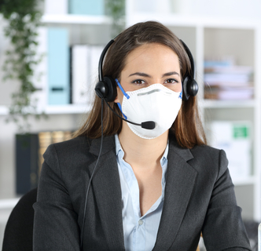
Applications
Healthcare Facilities: Face mask detection can be utilized in hospitals, clinics, and other healthcare settings to reinforce infection control measures. By identifying individuals who are not wearing masks , healthcare providers can take immediate action to prevent the spread of infections.
Public Spaces and Transportation: Face mask detection systems can be deployed in public spaces such as shopping malls, airports, train stations, and bus terminals. These systems help ensuring a safer environment for both staff and visitors.
Educational Institutions: Schools, colleges, and universities can benefit from face mask detection systems to ensure the safety of students, teachers, and staff.
Workplaces and Offices: Face mask detection can be implemented in office buildings, factories, and other work environments to ensure that employees adhere to mask-wearing protocols. By automating the monitoring process, these systems help maintain a healthy and productive workplace.

Slide 6
IMPLMENTATION
Dataset: From Kaggle website
Pre-processing:
Pre-process the label so we performed one-hot encoding on the labels by the LabelBinarizer which is a SciKit Learn class that accepts Categorical data as input and returns a NumPy array.
Perform data augmentation on images to generate new images by ImageDataGenerator.
MobileNetV2 : is a popular convolutional neural network (CNN) architecture designed for efficient image classification and other computer vision tasks on mobile and embedded devices. While it is not specifically designed for the detection of masks, it can be adapted and trained for such a task using transfer learning.
FaceNet: is a deep learning architecture for face recognition developed by researchers at Google. It uses a deep convolutional neural network (CNN) to extract high-level features from face images and then maps these features into a lower-dimensional space called an embedding.

Slide 7
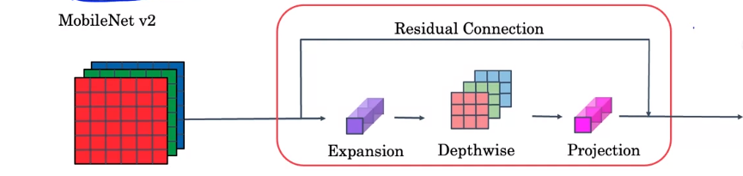
MOBILENET V2 ARCHITECTURE
The inverted residual structure is introduced as an alternative to the traditional residual connections. Instead of adding the input feature maps to the output,
MobileNetV2 employs a depth-wise convolution which is , it applies a separate filter to each input channel and produces a set of intermediate output channels followed by a point-wise linear projection to change the number of channels and It takes the intermediate output channels from the depth-wise convolution and performs a 1 × 1 convolution on them.
This structure reduces the number of parameters and computations compared to traditional residuals.
the concept of linear bottlenecks, which are used to increase the non-linearity of the network By applying a lightweight non-linearity, such as a ReLU after the depth-wise convolution, the network can capture more complex features while keeping the model size small.

Slide 8
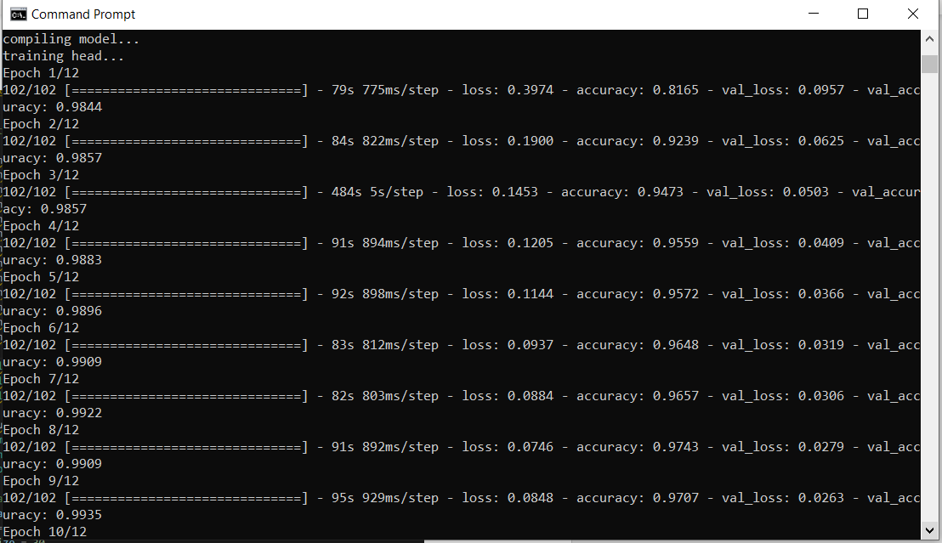
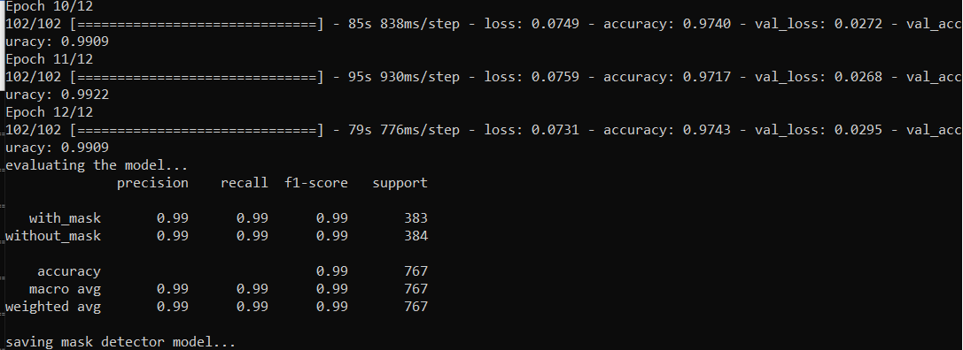
TESTING
I trained my model by 12 epochs and here is the result of every epoch in the training process.
We can see the classification report with the precision, recall, f1-score, and support with says that our model is very good.

Slide 9
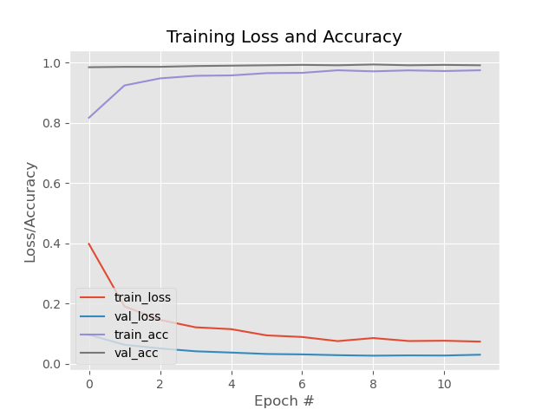
TESTING
We can also see that at the graph of loss and accuracy throughout the 12 epochs and it seems the loss is decreasing, and the accuracy is increasing which is a very good model.

Slide 10
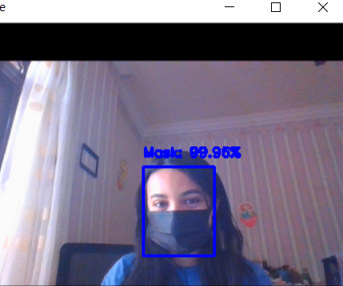
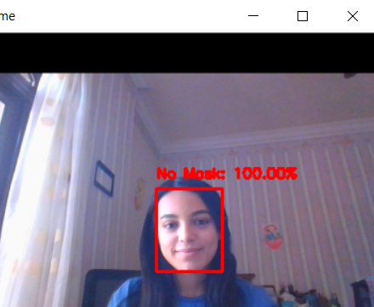
Results
On real time video streams with mask and no mask.
We can see that it detected that there is a person wearing mask or not with very high accuracy.

Slide 11
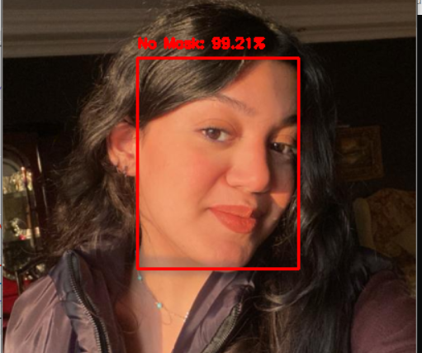
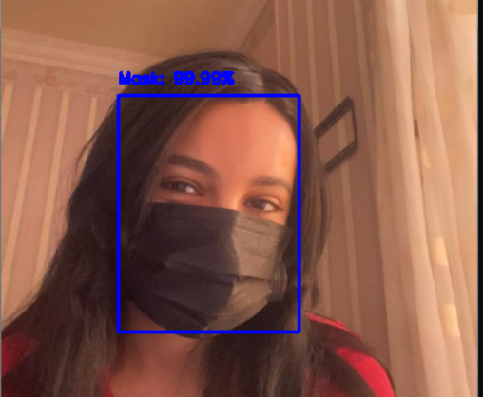
Results
On images with mask and no mask.
We can see that it detected that there is a person wearing mask or not with very high accuracy.

Slide 12
Comparison between other architectures
MobileNetV2 :
Pros: MobileNetV2 is lightweight and efficient, making it suitable for deployment on resource-constrained devices. It offers a good balance between model size, speed, and accuracy.
Cons: Due to its reduced complexity, MobileNetV2 may have limitations in capturing intricate details and handling complex patterns compared to deeper architectures.
ResNet :
Pros: ResNet's residual connections enable effective training of very deep networks and help capture intricate features. It has achieved state-of-the-art performance on various computer vision tasks.
Cons: Deeper ResNet architectures may be computationally expensive and require a larger amount of training data to prevent overfitting.
DenseNet :
Pros: DenseNet's dense connectivity promotes feature reuse and enhances gradient flow throughout the network. It allows for efficient parameter usage and has shown strong performance with limited training data.
Cons: DenseNet architectures may have higher memory requirements compared to other models due to the dense connections.
Inception :
Pros: Inception models capture information at multiple spatial resolutions, allowing them to extract both local and global features effectively. They have demonstrated strong performance in various computer vision tasks.
Cons: Inception architectures can be computationally expensive and may require more resources during training and inference compared to simpler models.

Slide 13

THANK YOU !

