Slide 1
KUBERNETES

Slide 2
Why do we need Kubernetes?
Kubernetes is a container orchestration platform designed to manage containerized applications in a clustered environment.
Kubernetes automates the deployment, management, and scaling of containerized applications.
Kubernetes allows you to scale applications dynamically. It can automatically scale up or down the number of containers based on the resource usage and demand, ensuring efficient use of computing resources.
Kubernetes provides built-in mechanisms for self-healing and high availability. It can automatically replace failed containers, restart them if they crash, and reschedule them on different nodes if necessary.
Originally developed by Google and now maintained by the Cloud Native Computing Foundation (CNCF).

Slide 3
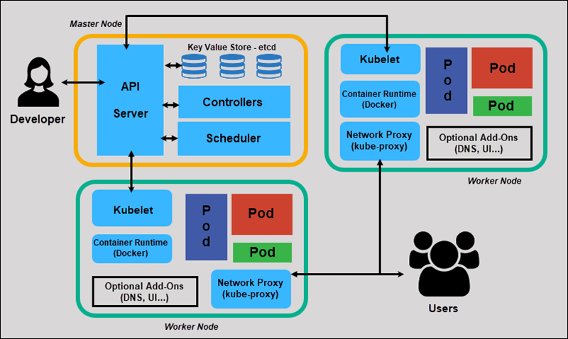
Kubernetes architecture

Slide 4
Key components of master node (control plane components)
ETCD - is a distributed key-value store that is crucial for the operation of Kubernetes. It provides a reliable way to store configuration data and state information about the cluster.
Kube scheduler - is a critical component responsible for assigning newly created Pods to nodes in a cluster based on available resources and constraints. Its role is pivotal in ensuring efficient resource utilization, load balancing, and adherence to various scheduling policies.
Controller manager - is a daemon that embeds several controllers into a single process. Each controller is responsible for a specific aspect of the cluster, such as managing nodes, endpoints, and replication. The Controller Manager operates by watching the Kubernetes API server for changes and taking actions to enforce the desired state of the system.
Kubeapiserver -is a core component of the Kubernetes control plane responsible for exposing the Kubernetes API. It serves as the central hub for all communication within the Kubernetes cluster, handling requests from users, other control plane components, and external systems.

Slide 5
Key components of worker nodes
Pod -is the smallest and simplest unit in the Kubernetes object model that you can create or deploy. A Pod represents a single instance of a running process in your cluster. Pods are used to host containers, and they encapsulate one or more application containers, storage resources, a unique network IP, and options that govern how the container(s) should run.
Kubelet - is a critical component of Kubernetes that runs on each node in a cluster. It acts as an agent responsible for managing and ensuring the health of Pods running on its node. The Kubelet interacts with the container runtime to start and stop containers, monitors their status, and communicates with the Kubernetes control plane.
Kube proxy - is a core networking component of Kubernetes that manages network rules on each node to facilitate communication between Pods and services. It maintains network rules to allow network traffic to reach the appropriate Pods across different nodes in the cluster, effectively implementing service discovery and load balancing.
Container runtime - is the software responsible for running containers on a host system.

Slide 6
Basic commands
minikube start (to start Kubernetes enginer and create a cluster)
Minikube status ( to see all processes taking place in the cluster)
kubectl create deployment pod_name --image=name_of_image ( to create a pod)
kubectl get pods (to list pods), kubectl get deployments ( to list deployments), kubectl get nodes (list nodes), kubectl get services (list services in the current namespace)
kubectl delete deployments pod_name (to delete a deployment)
kubectl describe pod pod_name (displays detailed info about the pod)
kubectl cluster-info ( to get information about cluster)
Kubectl run name_of_node ( to deploy)

Slide 7
THANK YOU

