Slide 1
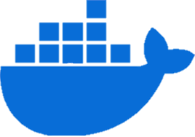
DOCKER

Slide 2
Basic terminologies
Docker: Is a platform that enables developers and system administrators to build, ship, and run applications in lightweight containers.
Container: A lightweight, standalone, and executable package that includes everything needed to run a piece of software, including the code, runtime, libraries, and dependencies.
Images: Docker images are a lightweight, standalone, executable package of software that includes everything needed to run an application: code, runtime, system tools, system libraries and settings.
Dockerfile: A text file that contains a series of instructions on how to build a docker image. it describes the steps needed to set up the environment for a specific application.

Slide 3
Port: They act as communication endpoints for applications. in networking, ports allow different services running on the same machine to be accessed separately.
Volume: A docker volume is a data storage mechanism used to persist data in docker containers, making it possible to share and manage data beyond the container's lifecycle.
Network: Enables communication between docker containers.
Docker compose: A tool for defining and running multi-container docker applications using a yaml file.

Slide 4
Dockerfile commands
From – specifies the base image to use
run – executes a command in the container at build time and commits the result. Used for installing packages or running other setup tasks.
WORKDIR – sets the working directory for subsequent commands like run, cmd, copy and add
Copy – copies files or directories from the host system into the container.
Add – similar to copy, but can also extract files and download URLs.
Env – sets environment variables in the container.

Slide 5
Extra Dockerfile commands
Label – adds metadata to the image, such as version, description, or maintainer information.
EXPOSE – informs docker that the container listens on the specified network ports at runtime. this does not actually publish the ports.
CMD – specifies the default command to run when the container starts. this command can be overridden when the container is run.
Entrypoint – sets the command that will always run when the container starts.

Slide 6
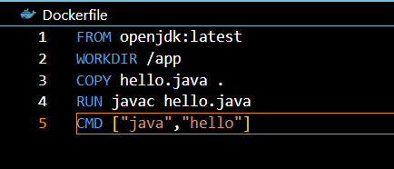

Slide 7
Docker commands
docker images (list all images), docker images –q ( list all image ids)
docker pull <image> (download image from docker hub)
docker push <image> (upload image to docker hub)
docker tag <image> <repositiory:tag>
docker ps ( shows all running containers)
docker ps –a (shows all containers including stopped containers)
docker run image (runs a container, also pulls it if not available in the machine)
docker build –t ImageName . (builds the image)

Slide 8
docker rm <container> ( removes a container)
docker rmi <image> (removes a image)
docker history <image> (show history of an image)
docker stop <container> ( stop running a container)
docker start <container> ( start running a container)
docker restart <container> (restart a container)
docker search <image> (searches for a image in docker hub)
docker login –u <username> ( login to docker)
docker exec –it <container_name> sh ( to open a shell inside a running container)

Slide 9
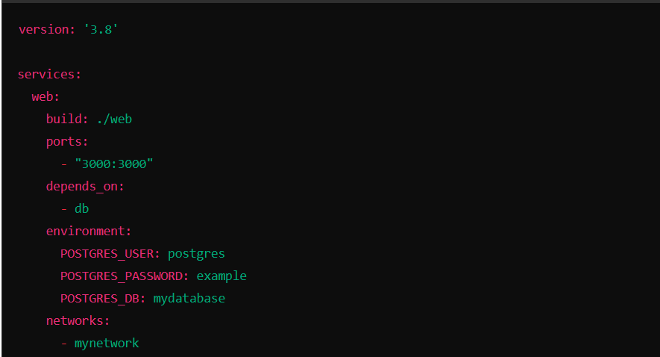
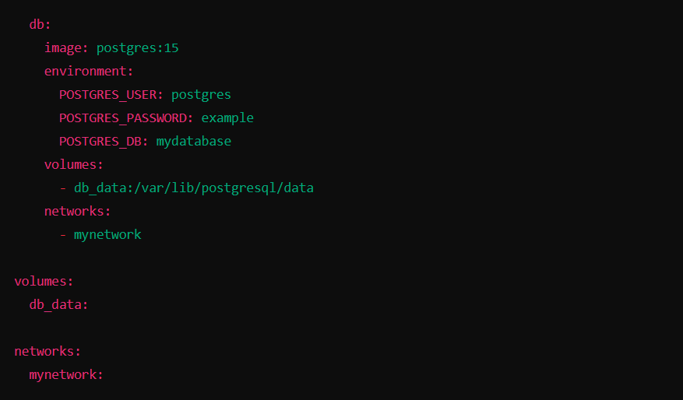
Docker compose
Docker compose is a tool for defining and managing multi-container docker applications. it uses a yaml file to configure the application’s services, networks, and volumes, enabling developers to build, run, and manage complex applications with ease.

Slide 10
Docker compose commands
docker-compose up (build, (re)create, start, and attach to containers for a service)
docker-compose down (stop and remove containers, networks, images, and volumes)
docker-compose build (build or rebuild services)
docker-compose start (build or rebuild services)
docker-compose stop (stops running containers without removing them)
docker-compose restart (restarts all services)
docker-compose logs (fetches and displays the logs of running services)

Slide 11
docker-compose ps (displays the status of all services)
docker-compose config (validates the configuration and displays the final configuration)
docker-compose pull (pulls the latest images for all services)
docker-compose push (pushes service images to a registry)

Slide 12
Volume commands
Docker volume ls (lists al volumes)
Docker volume create volume_name (creates a volume)
Docker volume inspect volume_name (inspect details of the volume)
Docker volume rm volume_name (to remove a volume)
Docker volume prune (remove all unused volume)
[note- Use a volume when multiple containers need access to the same data]

Slide 13
Networks
Default networks in docker
bridge: The default network for containers. Containers launched without specifying a network are connected to this network.
none: Containers connected to this network have no network interface. it’s useful for isolating containers from any network.
host: Containers use the host's network stack directly, which can improve performance but comes with security and configuration trade-offs.

Slide 14
Network commands
docker network ls (list all network commands)
docker network create network_name ( to create a new network)
docker network inspect network_name (inspect a specific network)
docker network connect network_name container ( to connect a network to a container)
docker network disconnect network_name container ( to disconnect a network to a container)
docker network rm network_name ( to remove a network)
docker network prune ( to remove all unused networks)
docker network run --network network_name ( to run a container on a specific network)

Slide 15
Thank you

