Slide 1
Single-View 3D Reconstruction of Household Objects
Milestone 2 — Experiments, Results & Improvement
DMET 901 — Computer Vision · German University in Cairo
Instructor: Dr. Mohamed Karam · TA: Eng. Rawan Darwish
Team 9 (home-omni3d) · Presented by Noureldin S. Abdelrahman
Notes:
Milestone 2 asks four things: run the model chosen in Milestone 1 on our dataset, show the setup, present and discuss the results, and propose an improvement. Each member presents the models on their own branch; my part is AtlasNet-SVR, Point-E and TripoSR.

Slide 2
Agenda
01
Problem & dataset
06
Results & discussion
02
From MS1 to MS2
07
Proposed improvement
03
Models we explored
08
Pix2Vox, COLMAP, neural fields
04
Evaluation protocol
09
Who does what & summary
05
Setup: AtlasNet · Point-E · TripoSR
Single-view 3D reconstruction · MS2 · Team 9
2
Notes:
Nine parts, following the four Milestone 2 requirements: setup, results, discussion, improvement.

Slide 3
Problem statement
One photo in, full 3D shape out
Input
One RGB view, 224² crop
1 RGB view
224² crop
Output
32³ voxel grid (or points / mesh)
Network + shape prior
learned from data
Success
Matches the scan, incl. the hidden back
32³ voxels / points / mesh
front, back, inside
Why: AR, interior staging. One photo instead of CAD or multi-view scanning.
Single-view 3D reconstruction · MS2 · Team 9
3
Notes:
The input is one RGB render of an object (view 00 of its 24 turntable views); source renders are 1024x1024 RGBA and the encoders resize to 224x224. The output is the complete 3D shape, either as a 32-cubed voxel occupancy grid (Pix2Vox family) or as a surface point cloud or mesh (AtlasNet, Point-E, TripoSR). Success means the prediction overlaps and lies close to the scanned ground truth, including the unseen back and on rare categories, not just the common ones. Today a person would model the object by hand in CAD/Blender or scan it from many views; we want one photo to be enough.

Slide 4
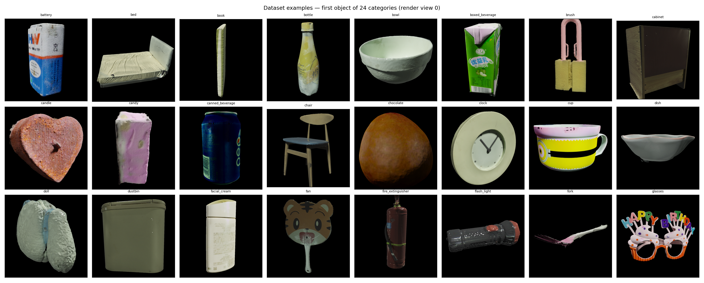
Dataset at a glance
OmniObject3D — house-themed subset of real scanned objects
76
1,694
24
260
categories
objects
views per object
test objects
Ground truth: 4,096-pt cloud
Renders: 1024² RGBA + poses
Voxels: 32³, from the clouds
Split: 70/15/15, seeded
Licence: CC BY 4.0
Renders, view 0
Single-view 3D reconstruction · MS2 · Team 9
4
Notes:
We use the house-themed subset of OmniObject3D from OpenDataLab: 18 bedroom plus 58 extra house categories, auto-discovered by prepare_model_data.py. Each object has 24 posed Blender renders (1024x1024 RGBA plus transforms.json) and a 4,096-point ground-truth cloud; voxels are derived from the clouds at 32-cubed. The shared split is a deterministic 70/15/15 per category: 1,177 / 257 / 260 objects, frozen with SHA-256 checksums in ashry's benchmark manifest. One object (laptop_002, 9 of 24 views) is dropped at prep time. OmniObject3D is released under CC BY 4.0, so we may use and redistribute derived results with attribution.

Slide 5
Long tail, hard views, imperfect proxy
Objects per category, from the benchmark manifest
Imbalance: top 10 classes = 31%
Rare: 35/76 have <3 test objects
Occlusion: back & inside hidden
Thin parts: forks, chair legs
Domain gap: clean renders
doll: 84 median ≈ 20
bed, plug: 2
Good proxy: real scans. Not: in-the-wild photos.
Single-view 3D reconstruction · MS2 · Team 9
5
Notes:
Counts come straight from ashry/benchmark/results/benchmark_v1.json on the ashry branch (1bf8436). The largest class, doll, has 84 objects; bed, canned_beverage and plug have only 2; the median is about 20. 35 of 76 categories have fewer than 3 test objects, so their per-class scores are noise and we flag them rather than draw conclusions. A single view hides the back and the inside of an object, and the renders are clean turntable images on black, which is easier than real cluttered photos: that is where the dataset is not a perfect proxy.

Slide 6
From MS1 to MS2
What we explored, what we kept, and why
MS1 — explored
MS2 — committed scope
Subset grown 50 → 69 → 76 classes
Pix2Vox + AtlasNet baselines
NeRF multi-view oracle
Screened 7 more candidates
Trained: Pix2Vox/++, AtlasNet-SVR
Frozen priors: Point-E, TripoSR, LGM
References: COLMAP, 3DGS, NeRF, NeuS
Dropped: Pixel2Mesh, DeepSDF, additive‑subtractive
Why: MS1 AtlasNet scored the same on a blank image (F 0.0032 vs 0.0029) → add pretrained priors.
Single-view 3D reconstruction · MS2 · Team 9
6
Notes:
At MS1 (tag milestone-1, f33b704, 26 Sep 2026) we grew the house subset from 50 to 69 to 76 categories, trained Pix2Vox and AtlasNet-SVR baselines, ran a multi-view NeRF oracle, and ran the Tatarchenko input-usage test. That test is the key justification: AtlasNet scored about the same with a blank image (F 0.0032) as with the real one (F 0.0029); this was Noureldin S.'s MS1 AtlasNet run, recorded on main, so the early models were leaning on category priors. That is why MS2 adds pretrained encoders, frozen generative priors (Point-E, TripoSR) and multi-view references. Pixel2Mesh and DeepSDF, listed for ashry at MS1, were replaced by 3DGS, NeRF and NeuS; TripoSR moved from hamdy to nesegemaa, and hamdy now runs LGM. Additive-subtractive modelling, named on the bones branch, has no implementation and is dropped. The 7 screened candidates were Pixel2Mesh, DeepSDF, 3DGS, NeRF, TripoSR, Point-E and COLMAP. From here on, each member's plan is exactly what is on their branch.

Slide 7
Single-view models we explored
Summary: specialists we train, priors we use frozen
Model | Output | How | Type | Owner
Pix2Vox | 32³ voxels | ResNet → 3D deconv | trained | Mohamed Ayman
Pix2Vox++ | 32³ voxels | View fusion + 3D U-Net | trained | Mohamed Ayman
AtlasNet-SVR | surface | 25 patch MLPs | trained | Noureldin S.
Point-E | 4,096 pts | CLIP → point diffusion | frozen | Noureldin S.
TripoSR | mesh | Image → triplane → mesh | frozen | Noureldin S.
LGM | 3D Gaussians | ImageDream → Gaussians | frozen | Hamdy
Question: do pretrained priors beat specialists trained on 1,177 objects?
Single-view 3D reconstruction · MS2 · Team 9
7
Notes:
Pix2Vox encodes the image with a ResNet and decodes a 32-cubed occupancy grid; the MS1 baseline on main is now continued as one track on mohamed-ayman. Pix2Vox++ on mohamed-ayman adds context-aware multi-view fusion and a 3D U-Net refiner, trained with BCE plus Dice. AtlasNet-SVR deforms 25 learned 2D patches into a surface with a Chamfer loss. Each model has one owner: Pix2Vox and Pix2Vox++ are Mohamed's; AtlasNet, Point-E and TripoSR are Noureldin S.'s; LGM is Hamdy's. Point-E (CLIP-conditioned point diffusion) and TripoSR (image to triplane to mesh) are used frozen to test whether large pretrained priors beat models trained only on our 1,177 training objects. LGM, also frozen, turns the photo into 4 views with ImageDream and then regresses 3D Gaussians from them.

Slide 8
Evaluation protocol
One metric family per output type
Voxels
Surfaces
Views (multi-view only)
IoU @ 0.2 / 0.3 / 0.4 / 0.5
Chamfer + F-score@τ
PSNR + SSIM
4 thresholds catch over- and under-sized shapes
F catches blobs that Chamfer hides
Held-out views 020–023
Micro + macro: rare classes count equally; n < 3 flagged
Protocol: each track states split, scale and units
Chamfer with F-score and micro with macro are always reported — never one alone.
Single-view 3D reconstruction · MS2 · Team 9
8
Notes:
Voxels are scored with IoU at four thresholds, because a model can look good at a low threshold by predicting oversized shapes or at a high one by predicting small ones. Surfaces are scored with Chamfer distance (average mismatch) together with F-score at a tolerance tau, which combines precision and recall and exposes blob-like predictions Chamfer hides. Every table reports both micro (all objects) and macro (per-category) means; categories with fewer than 3 test objects are flagged noisy. Each track keeps its own protocol, so every number carries its split, views, normalisation and units. PSNR/SSIM on held-out views apply only to the multi-view references and are never mixed with geometry scores.

Slide 9
Setup — AtlasNet-SVR, Point-E, TripoSR
Noureldin S. · one protocol for all three
Model | Input / preprocessing | Key settings | Runs
AtlasNet-SVR | View 00 · ImageNet ResNet-18 | 25 patches · Chamfer · lr 1e-3 · batch 8 · 50 ep | 24
Point-E | View 00 · masked | base40M + upsampler · guidance 3 · 4,096 pts | 12
TripoSR | View 00 · masked | Marching cubes 128 · 4,096 pts | 3
Evaluation
Split: 1,177 train · 257 val · 260 test (70/15/15, seeded)
Metrics: UnitBall scale · squared Chamfer · F@τ=0.001 · micro + macro
Rule: best-epoch weights only; GT clouds used for scoring only.
Single-view 3D reconstruction · MS2 · Team 9
9
Notes:
AtlasNet-SVR is trained here: ImageNet ResNet-18 encoder, a 1024-d shape code, 25 patch decoders, Chamfer loss, learning rate 1e-3, batch 8, 50 epochs, 2,500 points; we always deploy the best-epoch weights. 24 runs varied views and pooling, patch count and template, bottleneck, learning rate, batch, augmentation, a frozen encoder and an edge regulariser. Point-E (base40M-imagevec plus the upsampler, guidance 3, 4,096 points) and TripoSR (marching cubes at 128, 4,096 sampled points) are used frozen. Preprocessing: input view 00; masked background for Point-E and TripoSR. Evaluation: the 260-object test split, UnitBall normalisation, squared Chamfer, F-score at tau = 0.001, micro and macro means. Ground-truth clouds are used for scoring only.

Slide 10
Results — AtlasNet-SVR, 24 runs
Full 260-object test split, micro Chamfer (lower is better)
0.0332
0.161
Chamfer (was 0.0467)
F-score (was 0.083)
SPHERE template: −29% Chamfer. Seed 7 agrees (0.0343).
Caveat: SPHERE outputs 64k points. At matched 2,500 pts: 0.0409 (−12%); F no longer higher.
Single-view 3D reconstruction · MS2 · Team 9
10
Notes:
Every run is scored on the full test split. The faithful baseline (ImageNet encoder, SQUARE patches) reaches 0.0467 Chamfer and F 0.083. The SPHERE template is the largest single gain: 0.0332 and F 0.161 for seed 123, with seed 7 agreeing. A frozen encoder (0.0389) and 3 attention-pooled views (0.0414) also help; flips, a lower learning rate and 10 patches hurt. Caveat: the SPHERE template always outputs 64,050 points versus 2,500, and Chamfer/F are density-sensitive; at matched 2,500 points the winner scores 0.0409, still about 12% better than the baseline in Chamfer, but its F-score drops below the baseline. Final-epoch weights explode up to 71,000x, so best-epoch snapshots are essential.

Slide 11
Results — AtlasNet vs frozen priors
Same 260 test objects, same protocol, 4,096 points each
Model | Type | Chamfer ↓ | F@0.001 ↑ | Macro Ch / F
AtlasNet-SVR (SPHERE) | trained | 0.0384 | 0.090 | 0.0348 / 0.165 (64k pts)
TripoSR (masked) | frozen | 0.129 | 0.089 | 0.124 / 0.090
Point-E (default) | frozen | 0.186 | 0.082 | 0.186 / 0.080
Specialist vs priors: 3–5× lower Chamfer; F-scores close (0.082–0.090)
TripoSR: masked 0.129 < raw 0.132 < crop 0.137
Point-E: guidance, seeds, denoising move scores ≤ 0.01
Caveat: AtlasNet saw these categories in training; the priors are zero-shot.
Single-view 3D reconstruction · MS2 · Team 9
11
Notes:
All three of my models on the same 260 test objects and the same protocol. For a fair density, AtlasNet is shown at 4,096 points: Chamfer 0.0384, F 0.090. TripoSR (masked input) gets 0.129 / 0.089 and Point-E 0.186 / 0.082. The trained specialist has 3 to 5 times lower Chamfer; F-scores are close. Caveat: AtlasNet was trained on these categories (different objects), while Point-E and TripoSR are zero-shot. Preprocessing matters for TripoSR: masked 0.129 beats raw 0.132 and crop 0.137; for Point-E, guidance, seeds and denoising move scores by at most about 0.01, so its output is dominated by its own prior.

Slide 12
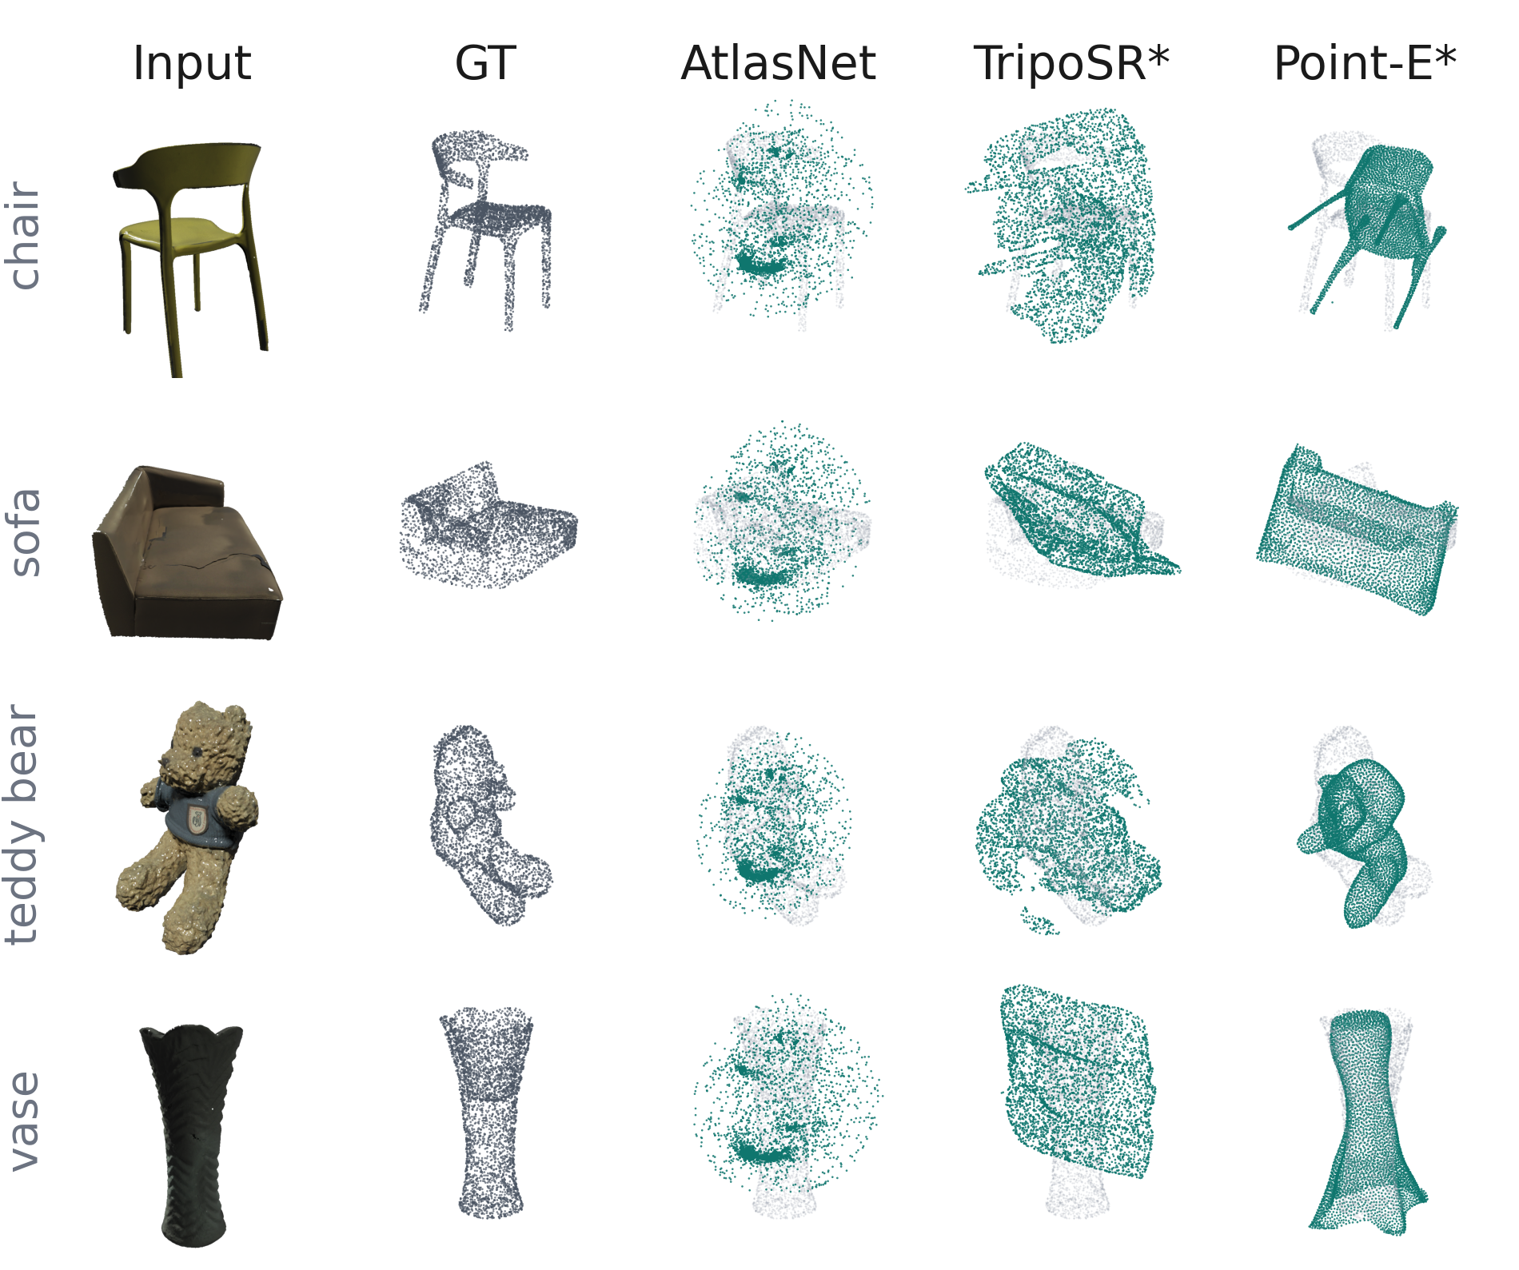
Qualitative — prediction vs ground truth
Noureldin S. · test objects, median AtlasNet score per class
What it shows
AtlasNet: one diffuse cloud that covers every object
TripoSR, Point-E: real shapes, wrong pose and scale
Thin parts: chair legs lost by all three
Lesson: low Chamfer can reward coverage, not shape — always look at outputs.
* ICP-aligned for display only
Single-view 3D reconstruction · MS2 · Team 9
12
Notes:
One test object per class, chosen as the median by AtlasNet's score, not the best. Grey is the ground truth, teal the prediction, drawn the way the team viewer draws them. TripoSR and Point-E work in their own canonical pose, so their clouds are ICP-aligned to the ground truth for display only; their scores are not aligned. The picture explains the numbers: AtlasNet's low Chamfer comes from a diffuse cloud that covers every object in a similar way. Across 40 test objects its outputs are 3 to 4 times more alike than TripoSR's or Point-E's (0.064 vs 0.20 and 0.28 mean nearest-neighbour distance between outputs of different objects). TripoSR and Point-E produce recognisable shapes, but in the wrong pose and scale, which Chamfer punishes heavily.

Slide 13
Discussion — what the results show
AtlasNet, Point-E, TripoSR
Topology > capacity
SPHERE −29%; 10 patches, smaller bottleneck hurt
Frozen > finetuned encoder
0.0389 vs 0.0467: too few objects for 11M params
Views need attention
3 views + attention 0.0414; max pooling worse
Best epoch is the model
final epochs explode, up to 71,000×
Weak image use
real vs blank −17%; outputs look alike (next slide)
Single-view 3D reconstruction · MS2 · Team 9
13
Notes:
Five lessons. Topology beats capacity: the SPHERE template gives the biggest gain, while 10 patches or a 512 bottleneck hurt. On 1,177 training objects a frozen ImageNet encoder beats finetuning (0.0389 vs 0.0467): the 11M encoder parameters overfit. Extra views only help with attention pooling; max pooling is worse and 8 attention views are unstable. Best-epoch weights are essential because final epochs explode. The winner does read its image: the real input beats a constant grey image by about 17% Chamfer (0.0332 vs 0.0400), but a shuffled image scores almost the same as constant, so a large category prior remains. The frozen priors are dominated by what they already know; TripoSR's attached 'fin' artifacts cannot be removed by post-hoc cleanup. The qualitative slide that follows shows the consequence: AtlasNet's outputs for different objects are 3 to 4 times more alike than TripoSR's or Point-E's, so its low Chamfer is largely coverage.

Slide 14
Proposed improvement
One tested, three to test next
Tested
Proposed next
SPHERE template
1
SPHERE + frozen encoder
two independent wins, never combined
0.0467 → 0.0332
2
Class-balanced sampling
35/76 classes have <3 test objects
Chamfer, 260 test objects, −29%. Shapes still diffuse (slide 12).
3
Stricter evaluation
fixed 4,096 pts, F@1%, and a visual check
Single-view 3D reconstruction · MS2 · Team 9
14
Notes:
Tested: replacing AtlasNet's square patches with a sphere template cut full-split Chamfer from 0.0467 to 0.0332, agreed by two seeds; a low-learning-rate finetune adds only about 2%, so this configuration is near its ceiling. Proposed next, in order: combine the two independent wins, the SPHERE template and the frozen encoder, which have never been run together; add class-balanced sampling, since 35 of 76 classes have fewer than 3 test objects and the macro means wobble; and make evaluation stricter: fix every evaluation at 4,096 points, add a tight F-score threshold, and always inspect outputs, because the qualitative slide shows that a diffuse cloud can win on Chamfer.

Slide 15
Setup & results — Pix2Vox, Pix2Vox++
Mohamed Ayman · 3 input views, own seed-42 split (263 test objects)
Setting | Value
Encoder · output | ResNet-18 · 32³ voxels + refiner
Loss | BCE + 0.5 · Dice
Optimiser | lr 1e-4 enc / 1e-3 dec · wd 1e-4
Batch · epochs | 16 · 15 / 30
Input | 3 views · 224² · AMP, grad clip 1.0
0.333
0.327
Pix2Vox IoU@0.4
Pix2Vox++ IoU@0.4
CD-L1: 0.105 / 0.099
F@0.02: 0.236 / 0.256
Best val IoU: 0.408 / 0.418
Improvement: [TEAM TO CONFIRM — Mohamed]
Single-view 3D reconstruction · MS2 · Team 9
15
Notes:
Mohamed Ayman's track. Setup from configs/config.yaml: ResNet-18 encoder, 32-cubed voxels, refiner on, loss BCE plus 0.5 Dice, batch 16, learning rates 1e-4 for the encoder and 1e-3 for the decoder, weight decay 1e-4, mixed precision, gradient clip 1.0, 224-pixel inputs, 3 views. Training logs show 15 epochs for Pix2Vox and 30 for Pix2Vox++, with best validation IoU 0.408 and 0.418. Test results on 263 objects (micro): IoU@0.4 0.333 and 0.327, Chamfer-L1 0.105 and 0.099, F@0.02 0.236 and 0.256. This uses a different split and 3 views, so it is not comparable with the single-view numbers. Improvement: Mohamed to present.

Slide 16
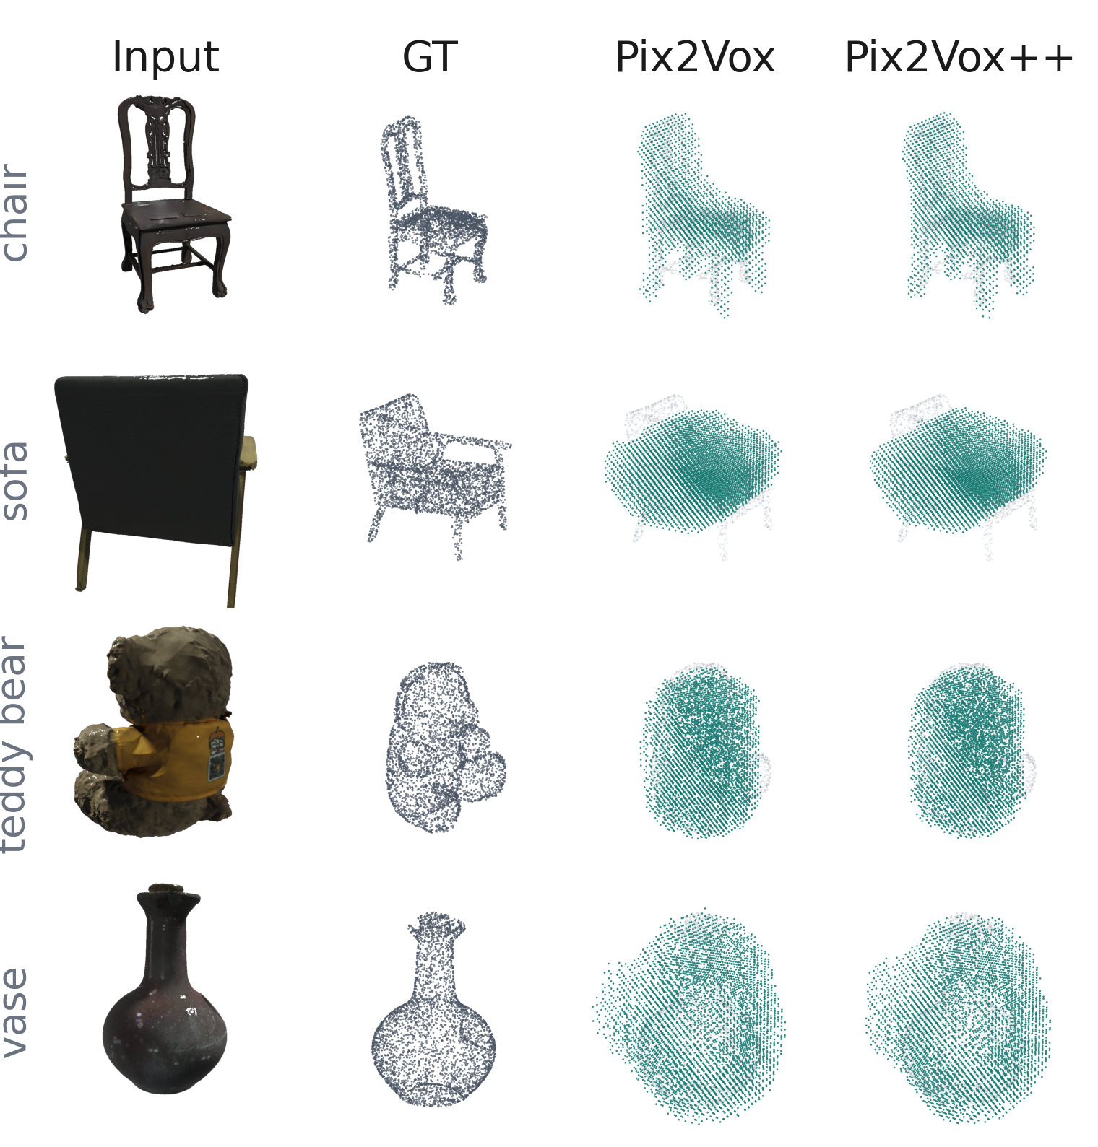
Qualitative — Pix2Vox, Pix2Vox++
Mohamed Ayman · test objects, median Pix2Vox++ score per class
What it shows
Silhouette: overall shape and size roughly right
Thin parts: legs, open frames, necks filled in at 32³
Pix2Vox++ ≈ Pix2Vox: matches IoU 0.327 vs 0.333
Limit: 32³ resolution caps detail — blobs, not parts.
Single-view 3D reconstruction · MS2 · Team 9
16
Notes:
Mohamed's own viewer export: 32-cubed voxel predictions turned into points, against the ground truth in grey. One test object per class, median by Pix2Vox++ score. Both models get the overall silhouette and size roughly right, but the 32-cubed grid fills in thin parts: chair legs and the sofa's open frame become solid, and the vase neck is lost. Pix2Vox++ looks very close to Pix2Vox, matching their close IoU (0.327 vs 0.333).

Slide 17
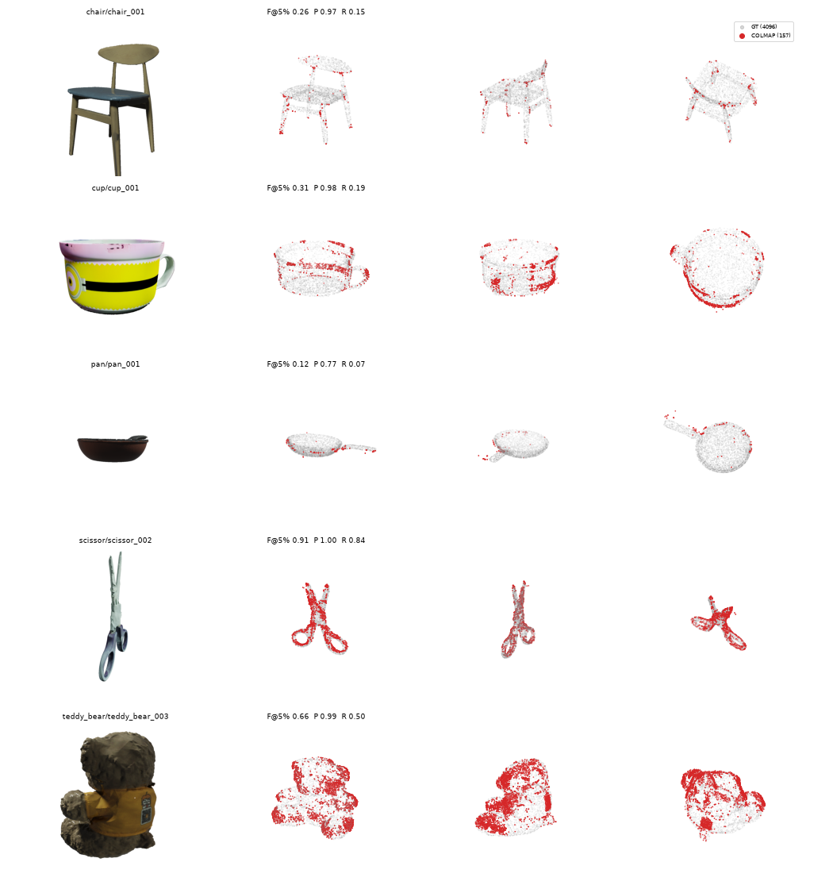
Setup & results — multi-view references
COLMAP (Noureldeen A.) · 3DGS, NeRF, NeuS (Ashry)
COLMAP · Noureldeen A. · 294 objects, 286 scored
0.134
0.539
0.370
CD-L1 · known poses
F@5% · known poses
CD-L1 · blind SfM
Setup: masked SIFT, exhaustive matching, 4 objects/class
Member | Track | Status
Ashry | 3DGS · NeRF · NeuS | Scores [TEAM TO CONFIRM]
Ashry | NeRF oracle | 19.11 dB PSNR · 0.80 SSIM
COLMAP known poses (red) vs GT (grey)
Multi-view: not comparable to single-view.
Single-view 3D reconstruction · MS2 · Team 9
17
Notes:
Noureldeen A. ran COLMAP with pycolmap: masked SIFT features and exhaustive matching, either triangulating with the known cameras or running blind incremental SfM, on 4 random objects per category (294; 286 scored after a ground-truth alignment filter that drops fits with under 90% of points inside the silhouettes). Known poses: Chamfer-L1 0.134, F@5% 0.539; blind SfM registers about 14 of 24 views and gets 0.370 / 0.378. Ashry trains 3DGS, NeRF and NeuS per object on views 000-019 and holds out 020-023; screening runs use 6,000 3DGS iterations and 1,024 rays per step. The NeRF oracle averages 19.11 dB PSNR / SSIM 0.80 on 24 objects. 3DGS/NeuS scores are still to be committed.

Slide 18
Who does what
Each member owns the models on their branch
Phase 1
Data pipeline
done
Phase 2
Run models
done
Phase 3
Evaluate
in progress
Phase 4
Improve
next
Member | Branch | Models | Status
Mohamed Ayman | mohamed-ayman | Pix2Vox, Pix2Vox++ | Trained + evaluated
Noureldin S. | nesegemaa | AtlasNet-SVR, Point-E, TripoSR | Evaluated, 260 test objs
Noureldeen A. | bones | COLMAP (known poses, SfM) | Scored, 286 objects
Ashry | ashry | 3DGS, NeRF, NeuS | Trained; scores pending
Hamdy | hamdy | LGM | Code in; to run
Single-view 3D reconstruction · MS2 · Team 9
18
Notes:
Scope rule: each member's work is exactly what is on their branch, nothing more. Phase 1 is done: download, preparation, the 70/15/15 split and integrity checks are on main. Phase 2 is where every branch is now: finishing the models already in each owner's folder. Phase 3 evaluates each track with the evaluator already on its branch and records the protocol. Phase 4, for MS3, puts every track's results side by side in the team viewer and the branch apps, with protocols stated and no cross-track ranking. Hamdy's LGM pipeline code is in; it is next to be run and evaluated. Workflow: main is the shared base and docs, code lives only in each owner's folder, small results are committed per run, predictions go to the team viewer.

Slide 19
Summary
1
Task: one photo → full 3D shape
Key results
2
Data: 76 classes, long tail
AtlasNet: 0.0467 → 0.0332
Priors: 3–5× higher Chamfer
Pix2Vox/++: IoU 0.333 / 0.327
COLMAP: F@5% 0.539
3
Tracks: all run; mine evaluated on 260 test objs
4
Next: test the proposed improvements
Single-view 3D reconstruction · MS2 · Team 9
19
Notes:
Four takeaways: the task is fixed; the data is long-tailed, so we report micro and macro; every model was run, and mine were evaluated on all 260 test objects; next we test the proposed improvements. Key numbers: the SPHERE template took AtlasNet from 0.0467 to 0.0332 Chamfer; the frozen priors sit 3-5x higher; Pix2Vox and Pix2Vox++ reach IoU@0.4 of 0.333 and 0.327 on 3 views; COLMAP with known poses reaches F@5% 0.539.

Slide 20
Thank you — Questions?
Team 9 · home-omni3d
github.com/NoureldinAbdelrahman/home-omni3d
Notes:
Invite questions. Any team member can answer for their own track: Mohamed Ayman (Pix2Vox/++), Noureldin S. (AtlasNet, Point-E, TripoSR), Noureldeen A. (COLMAP), Ashry (3DGS, NeRF, NeuS), Hamdy (LGM). The repository and every branch referenced in the deck are on GitHub.

