Slide 1

Numerical Bilinear Interpolation for Image Rescaling
MATH 307: Numerical Analysis
Mostafa Hisham (ID: 202201998)
Nour-Eldin Mohamed Saber (ID: 202201310)
Zewail City for Science and Technology

Slide 2

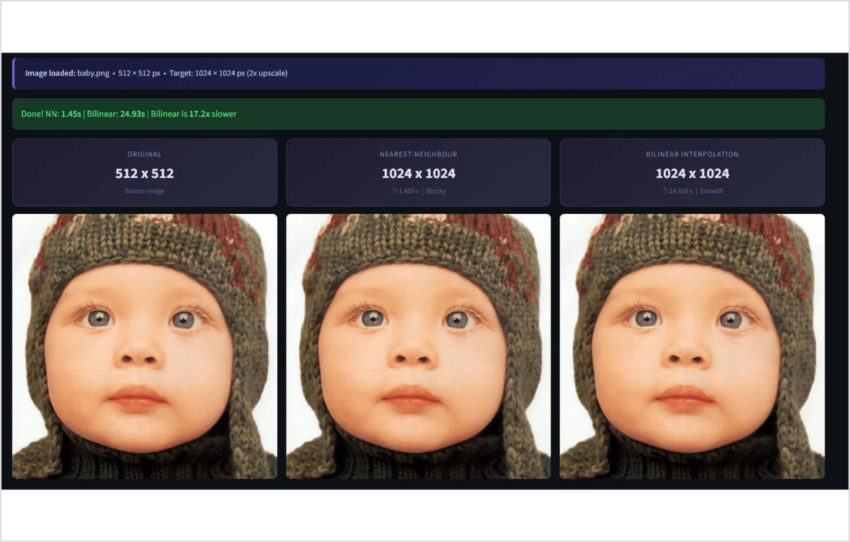
Introduction & Goal
Digital images are inherently discrete grids. When we perform geometric operations like rescaling, we often map to non-integer coordinates.
The Problem: Standard grids cannot resolve sub-pixel locations without interpolation.
The Goal: Implement and compare numerical methods (Nearest-Neighbor vs. Bilinear) for smooth upscaling.
The Solution: A production-grade microservices architecture featuring a FastAPI backend and Streamlit frontend.

Slide 3

Mathematical Formulation
Bilinear interpolation extends 1D linear splines into two dimensions. The process estimates the intensity f(x, y) by weighting the four nearest integer-grid neighbors.
f(x, y) ≈ (1-dx)(1-dy)f(x₁, y₁) + dx(1-dy)f(x₂, y₁) + (1-dx)dyf(x₁, y₂) + dx dy f(x₂, y₂)
1. Inverse Mapping: Calculate fractional source coordinates x = u / sₓ and y = v / sᵧ.
2. Distance Weights: Define dx = x - floor(x) and dy = y - floor(y) as the offsets within the pixel cell.
3. Sequential Interpolation: The formula is equivalent to performing 1D Lagrange interpolation twice along the x-axis, then once along the y-axis.

Slide 4

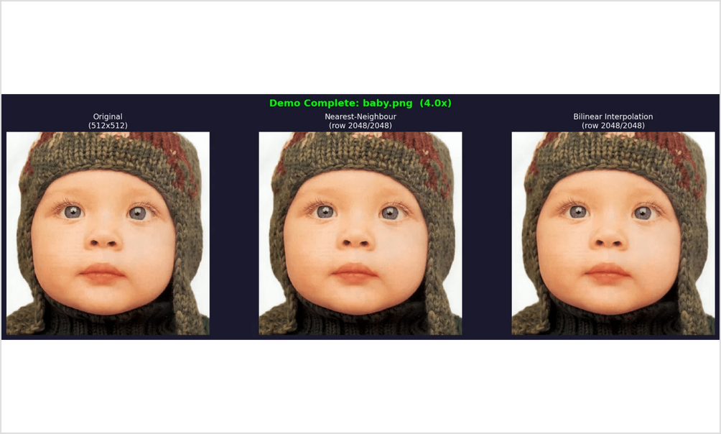
Methodology & Tools
The project employs a decoupled microservices architecture to separate numerical computation from the user interface.
Technology
Role in System
Backend engine for vectorized numerical processing.
FastAPI & NumPy
Interactive frontend for real-time visualization.
Streamlit
Figure 2: The Streamlit interactive interface deployed on Hugging Face.
Containerization for reproducible deployment.
Docker
Cloud hosting for the public live demo.
Hugging Face

Slide 5

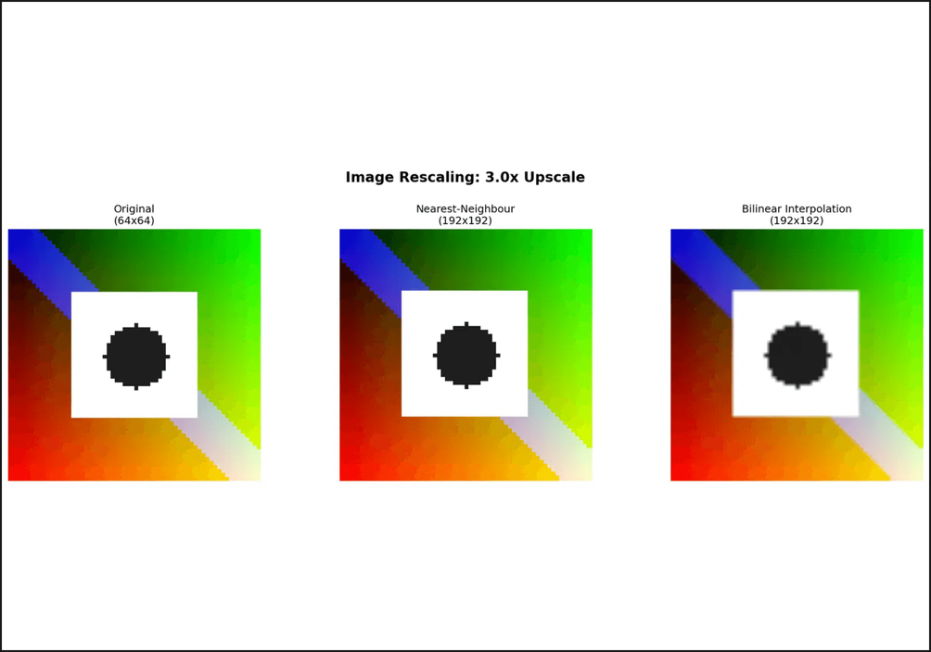
Nearest-Neighbor vs. Bilinear
Nearest-Neighbor (Baseline)
Assigns the value of the single closest pixel. While computationally efficient, it leads to significant aliasing and "blocky" artifacts, especially visible in diagonal lines and curves.
Bilinear Interpolation
Computes a weighted average of the four surrounding pixels. This creates a continuous surface, resulting in smooth gradients and a much higher perceived visual quality for upscaled images.
Figure 2: Visual comparison showing blocky artifacts in Nearest-Neighbor vs. smooth gradients in Bilinear Interpolation.

Slide 6
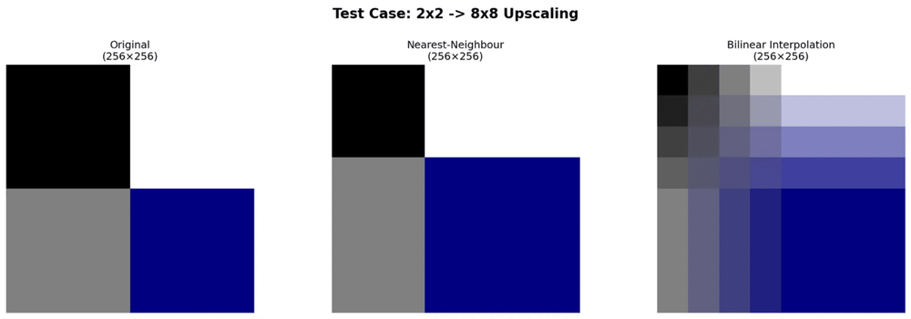
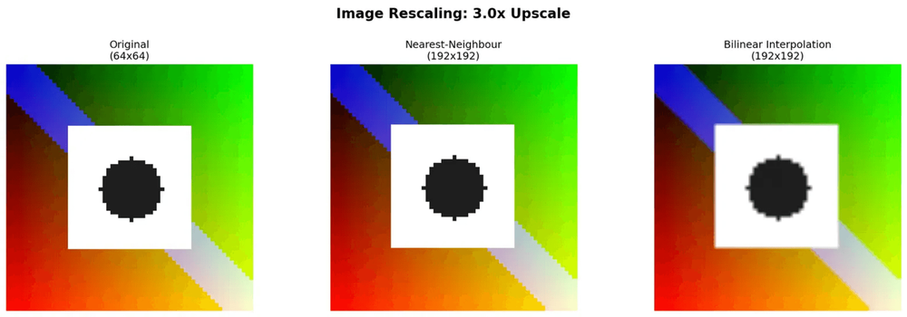
Experimental Results
Test Case 1: Synthetic Validation
Test Case 2: Real-World Upscaling
A controlled 2×2 → 8×8 upscaling test was performed to verify mathematical correctness. The bilinear method produced perfect color blending across the grid.
Upscaling a 512×512 photograph to 2048×2048. Bilinear interpolation demonstrably outperforms nearest-neighbor by eliminating blocky artifacts.
Figure 1: Mathematical validation on a synthetic color grid.
Figure 2: Side-by-side comparison of NN vs. Bilinear interpolation.

Slide 7

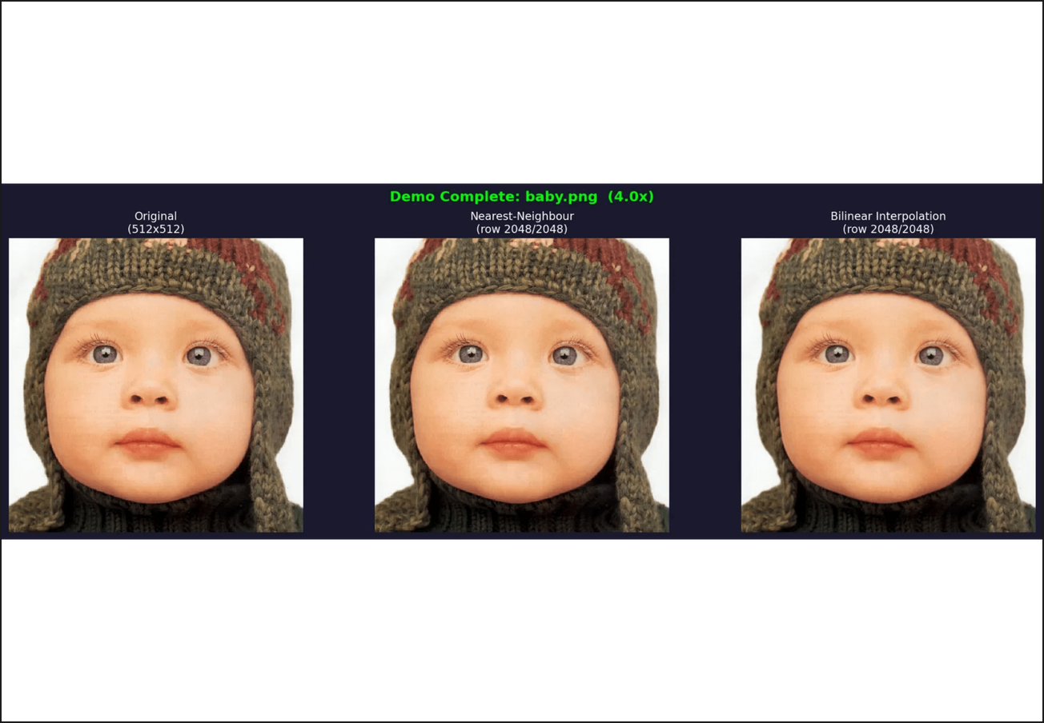
Live Demo & UI Features
The system is deployed as a fully interactive web application, allowing for real-time validation of the numerical algorithms.
Interactive Zoom Inspector
Compare raw pixels side-by-side with interpolated
results using a detail-view tool.
Real-time Comparison
Toggle between Nearest-Neighbor and Bilinear
methods to see immediate visual differences.
Performance Metrics
The UI reports backend processing time and
numerical error metrics (MSE, PSNR).
Publicly hosted on Hugging Face Spaces via Docker containerization.

Slide 8

Work Division & Conclusion
Team Responsibilities
Final Takeaways
Member
Key Contributions
Classical numerical methods like Lagrange interpolation remain foundational to modern digital image processing.
Backend Engine (FastAPI), Numerical Implementation (NumPy), Mathematical Derivation, Cloud Deployment.
Bilinear interpolation provides a superior balance between computational speed and visual reconstruction quality.
Mostafa Hisham
Frontend UI (Streamlit), Dockerization, DevOps, Cloud Deployment,Numerical Implementation (NumPy), Mathematical Derivation.
The microservices approach demonstrates how mathematical algorithms can be delivered as scalable web solutions.
Nour-Eldin Mohamed
Thank you for your attention.

