Slide 1
Using the Hadoop Ecosystem to Drive Healthcare Innovation
Aly Sivji
April 25, 2017

Slide 2
About Me
Aly Sivji
Twitter: @CaiusSivjus
Blog: http://alysivji.github.io
Senior Analyst @ IBM Watson Health
Value-Based Care: Planning Solutions
Grad Student @ Northwestern University
Medical Informatics
Interests:
Technology 🐍
Data 📈
Star Trek 🖖🏾
Notes:
Before we get to what we’re talking about. I’ll talk about me.

Slide 3
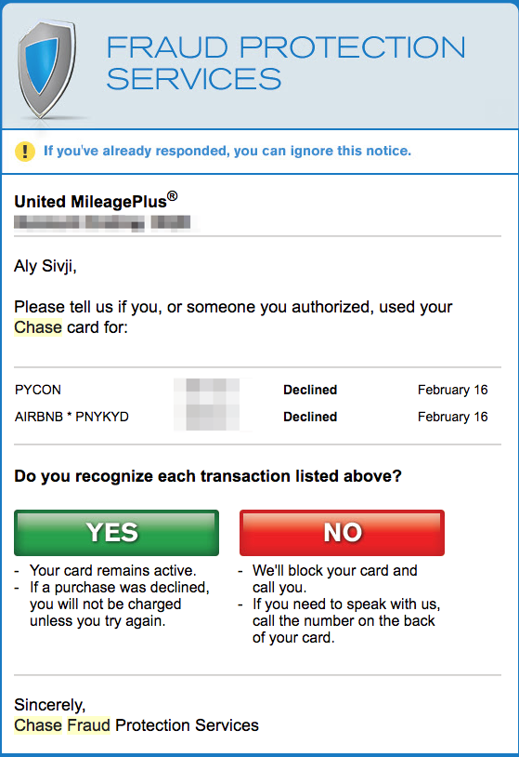
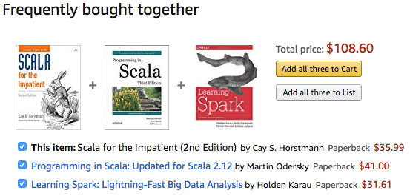
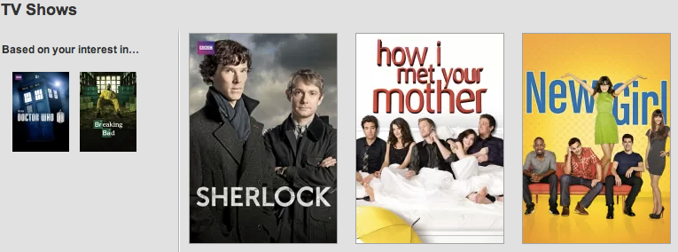
Overview
Big Data drives most industries
Notes:
Data has been making a huge difference in other industries
Chase uses machine learning algorithms to flag purchases that could be fraudulent. Last time this happened, I booked my flight using my American Airlines card and booked my hotel and conference on my United card. Chase didn’t know about the flight so it asked for my confirmation. Saves them money for having to pay for fraudulent purchases.
Amazon uses data mining to find products purchased together and makes suggestions to increase revenue. Spark was created in Scala and most people who learn Scala do so in order to use Spark in its native language. Amazon doesn’t know this, but it can use data to figure this out.
Netflix’s recommendation system finds users who are similar to you and uses their ratings to make predictions for media for you to watch

Slide 4
Overview
What about Healthcare?
Machine Learning
Fraud detection ($65+ billion lost every year)
Wired Article
dataiku - Detecting Medicare Fraud
Preventing unnecessary procedures
Data Mining
Identifying medication prescribed together
Recommender Systems
Finding similar patients
Notes:
Medical fraud dedection could be more robust or similar algorithms can find unnecessary procedures (purchases that do not match my profile)
Data mining to suggest medication that is always prescribed together if an order is missing it
Recommendation system to find similar patients. Group them by the treatment prescribed, rate their outcomes and use that information to suggest optimal course of action
Why is this not widespread in healthcare?

Slide 5
Overview
Healthcare is Different.
People who work in healthcare
Additional Reading
John Halamka (The Health Care Blog)
Health Catalyst
Notes:
People who work in healthcare know, healthcare is different.
We won’t really go into too many details why, but you can find out more at the links provided.
I will spend some time discussing how healthcare has changed and made it easier to facilitate a data revolution

Slide 6

Overview
Data Analytics / Data Science
Retrospective versus Predictive
Machine Learning
Types of Algorithms
Healthcare Analytics
Notes:
What do we mean by data revolution?
Data is ubiquitous... We’ll explore data science in some depth to understand the basic principles of the field and get a grasp on how we can make our information actionable
Bee is Buzzword Bee! I’ll try to include him every time I use a buzzword

Slide 7
Overview
Apache Hadoop Ecosystem
Big Data framework
Distributed computation on commodity hardware
Demo!
Notes:
Next we’ll talk about we can use the Hadoop ecosystem to analyze healthcare data

Slide 8
Road to Electronic Health Records
1920s – Modern record keeping begins
1960s – Dr. Larry Weed introduces problem-oriented medical records
1972 – Regenstrief Institute develops first EMR System
1980s-90s – Siloed adoption by departments & admin
1996 – HIPAA establishes national standards for electronic health records
2004 – President Bush calls for Computerized Health Records
Notes:
Is paved with good intentions ;)
1920s [1]
Healthcare professionals realized that documenting patient care benefited both providers and patients. Patient records established the details, complications and outcomes of patient care.
Once healthcare providers realized that they were better able to treat patients with complete and accurate medical history, documentation became wildly popular.
Health records were soon recognized as being critical to the safety and quality of the patient experience.
1960s [2]
Charting how we currently know it. First, a patient database is collected. Then use that information to start the diagnosis process. Database is very thorough contains:
Family history
Prior encounter information
Lab results
Current health status
1972 [1, 2]
There are quite a few cases of electronic record system pilots (thru universities and large healthcare facilities), this is the first major system that was developed. Did not attract many physicians
1980s-90s [1, 2]
Computers made their way into hospitals, like they did in every other professional environment, but systems did not speak to each other
1996
HIPAA was passed and national standards for electronic health records was established
2004 [1, 3]
In his 2004 State of the Union, President George W Bush calls for computerized health records. Established the Office of the National Coordinator for Health Information Technology. It coordinates nationwide efforts to implement HealthIT and electronic exchange of health information.
References
[1] http://www.rasmussen.edu/degrees/health-sciences/blog/health-information-management-history/
[2] http://www.nethealth.com/a-history-of-electronic-medical-records-infographic/
[3] https://en.wikipedia.org/wiki/Office_of_the_National_Coordinator_for_Health_Information_Technology

Slide 9
2009: EHRs Go Mainstream
HITECH Act passed by President Obama
$25.9 billion to expand Health IT (HIT) adoption
Meaningful Use (MU) program
Incentive payments for using HIT to
Improve quality, safety, efficiency of care
Engage patients
Increase care co-ordination
Goal: MU compliance => better outcomes
Notes:
Meaningful Use provided incentive payments to healthcare providers who could demonstrate they used health information technology in a ‘meaningful way’ to improve quality, engage patients, increase care coordination.
Goal is that MU compliance will result in:
Better clinical outcomes
Improved population health outcomes
Increased transparency and efficiency
Empowered individuals
https://en.wikipedia.org/wiki/Health_Information_Technology_for_Economic_and_Clinical_Health_Act
https://www.healthit.gov/providers-professionals/meaningful-use-definition-objectives

Slide 10
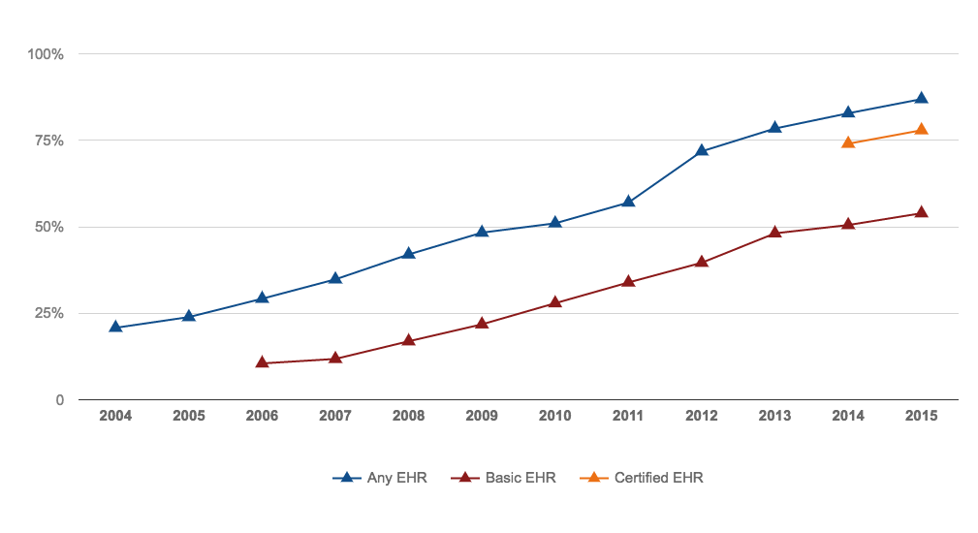
EHR Adoption: Doubled Since 2008
Office-based Physician Electronic Health Record Adoption (2005-2015)
Source: Office of the National Coordinator for Health Information Technology. 'Office-based Physician Electronic Health Record Adoption,' Health IT Quick-Stat #50. dashboard.healthit.gov/quickstats/pages/physician-ehr-adoption-trends.php. Dec 2016.
Notes:
Did it work? Well… it did increase EHR adoption

Slide 11
Health Data Today
Electronic Health Records
Genomic Data ($1000 genome)
Medical Internet of Things (mIoT)
Wearable devices
Bottom Line: Data is growing
Big Data = 'Bigger Data' in Healthcare (article)
Notes:
* EHR systems have a wealth of data and are collecting more each day
* Genomic sequencing costs less than $1000 dollar, I’ve heard about a race to $100 as well
* Medical sensors are collecting information at a dizzying pace. One big application is patient sensors in post-acute care environments where patients are hooked up to machines collecting real-time data
* People are more concerned about their health than ever before and the consumer wearable industry is growing.

Slide 12
Data Analytics
Businesses collect lots of data
IBM: 90% of world’s data created in last 2 years
How can we find hidden patterns in the data and make information actionable?
Data Science!
Notes:
But we’re getting ahead of ourselves. I need to introduce the topic of data analytics
References
[1] https://datascience.berkeley.edu/about/what-is-data-science/

Slide 13
Types of Analytics
Retrospective Analytics
Summarizing historical activity / performance
Limited scope for making future plans
Better than nothing
Notes:
References
[1] http://blog.datagravity.com/the-transition-to-predictive-analytics/

Slide 14
Types of Analytics
Predictive Analytics
Finding patterns (correlations) between historical environment and results
Apply to current environment to make predictions
Notes:
References
[1] http://blog.datagravity.com/the-transition-to-predictive-analytics/

Slide 15
Predictive Analytics
"Once you have enough data, you start to see patterns. You can then build a model of how these data work. Once you build a model, you can predict.”
Michael Wu
Chief Scientist, Lithium Technologies
Notes:
References
[1] http://www.informationweek.com/big-data/big-data-analytics/big-data-analytics-descriptive-vs-predictive-vs-prescriptive/d/d-id/1113279

Slide 16
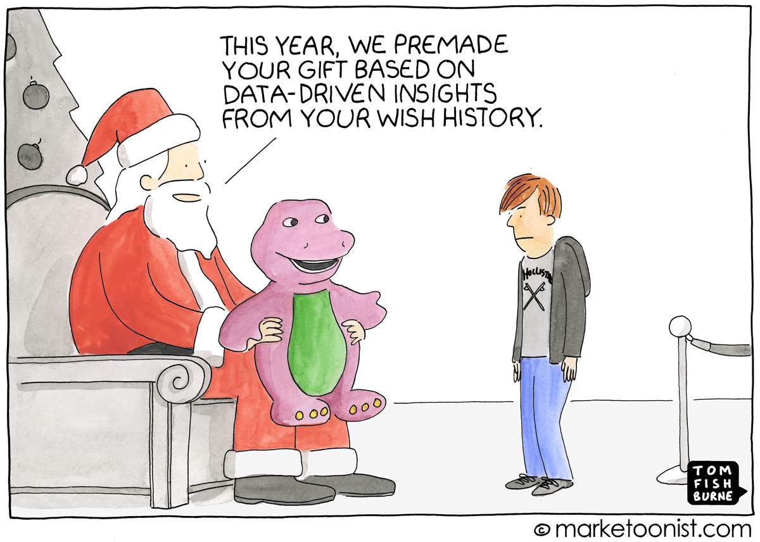
Predictive Analytics
Notes:
References
[1] https://marketoonist.com/2016/12/predictive-analytics.html

Slide 17
Machine Learning (ML)
“Field of study that gives computers the ability to learn without being explicitly programmed”
Arthur Samuel
Artificial Intelligence Pioneer
Notes:
This leads nicely into the topic of Machine Learning
References
http://www.ibmbigdatahub.com/blog/how-does-machine-learning-work?cm_mmc=OSocial_Twitter-_-IBM+Analytics_Inbound+Marketing-_-WW_WW-_-B+Yelland+3-20-2017&cm_mmca1=000000VQ&cm_mmca2=10000779&

Slide 18
Machine Learning Algorithms
A probabilistic framework to create models used for predictions
Predictive models are developed iteratively
Models are refined until they converge
i.e. output gets close to a specific value

Slide 19
Types of ML Algorithms
Unsupervised Learning
Group objects by similar characteristics
Given inputs (X), find label for each observation
Supervised Learning
Given inputs (X) and output (Y)
Find function f that maps X to Y
Given new inputs (X_{new}), predict value/label (Y_{new})
Notes:
References
[1] http://machinelearningmastery.com/supervised-and-unsupervised-machine-learning-algorithms/
[2] http://www.ibmbigdatahub.com/blog/how-does-machine-learning-work

Slide 20
Types of Supervised Learning
Regression
Try to predict a value (continuous variable)
Classification
Try to predict a label (discrete variable)

Slide 21
Analytics in Healthcare
“Advanced analytics can be used to improve medical outcomes, increase financial performance, deepen relationships with customers and patients, and drive new medical innovations”
Jason Burke
Author of Health Analytics
Notes:
Why is this relevant to us in healthcare?

Slide 22
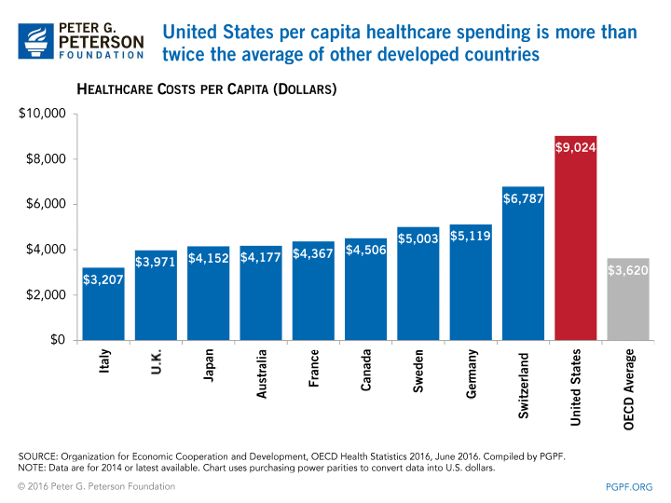
Healthcare Challenges
US Healthcare spending = $3.4 trillion / year
Notes:
Analytics is suited to the specific challenges in healthcare
References
[1] http://www.pbs.org/newshour/rundown/new-peak-us-health-care-spending-10345-per-person/
[2] http://www.pgpf.org/chart-archive/0006_health-care-oecd

Slide 23
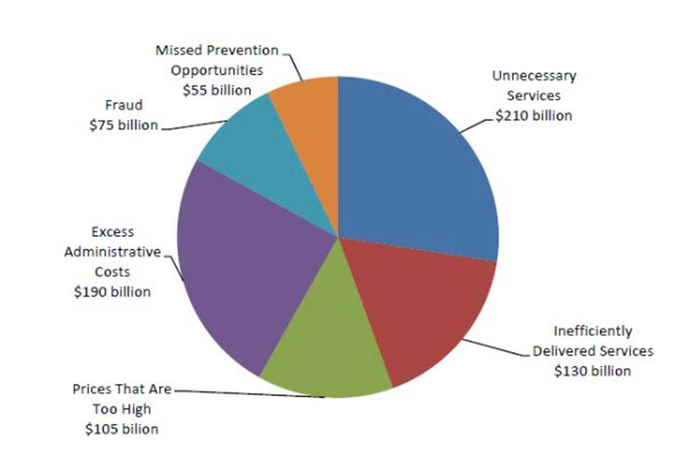
Healthcare Challenges
US system wastes $750 billion annually
Source: Washington Post (Sept 2012). Retrieved from https://www.washingtonpost.com/news/wonk/wp/2012/09/07/we-spend-750-billion-on-unnecessary-health-care-two-charts-explain-why/

Slide 24
Healthcare Challenges
Low quality
To Err is Human Report:
44,000 - 98,000 deaths to preventable medical errors
Rates poorly when compared to other countries
Last in 2014 Commonwealth Fund survey on:
Quality of care
Access to doctors
Equity
Notes:
References
[1] https://en.wikipedia.org/wiki/To_Err_is_Human_(report)
[2] http://time.com/2888403/u-s-health-care-ranked-worst-in-the-developed-world/

Slide 25
Solution: Big Data!
Use data analytics and machine learning to improve outcomes & lower costs

Slide 26
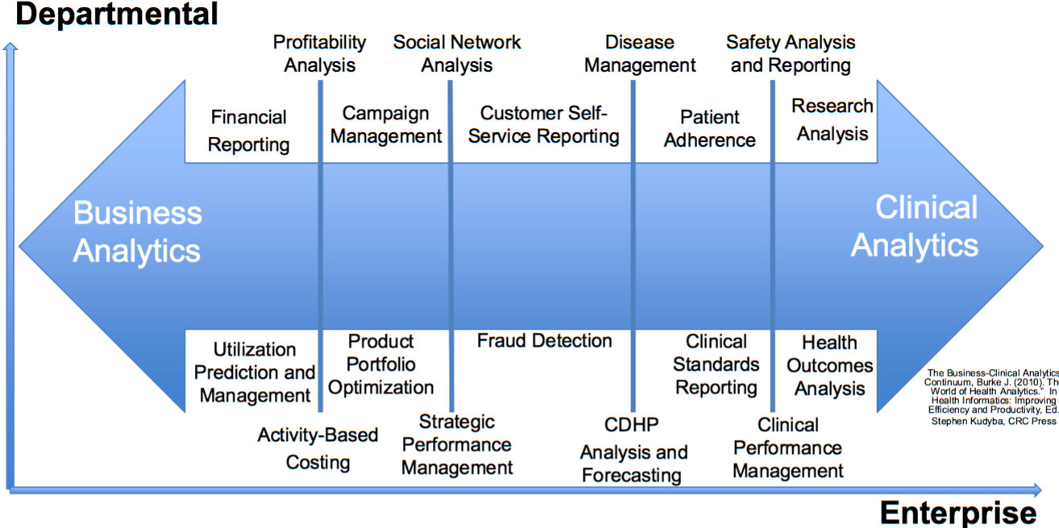
Types of Healthcare Analytics
Notes:
Healthcare analytics is broad as we can see from this diagram. Lots of areas where a little bit of deliberate data science and machine learning to make a difference

Slide 27
Good News
Most of the analytical and software capabilities needed to drive systemic changes in healthcare are already available as:
Commercial software
Open Source solutions 🎉
Hadoop ecosystem
Notes:
Worth noting that most of the analytical capabilities needed to drive systemic changes in healthcare are already available in commercial software

Slide 28
Big Data
Characteristics (4 V’s of Big Data)
Volume
Scale of data
Variety
Diversity of data (many sources)
Velocity
Speed of data
Veracity
Certainty of data
5th V: Value?
Notes:
So let’s start talking about Big Data. What is big data?
In healthcare, there is a lot of data… each genome is around 200GB of raw data.
Lots of different information… clinical, notes, lab information, demographic result data, patient generated data
Velocity data... Real time sensors monitoring patients
Veracity... How sure are we that the data we get is correct?
References
[1] http://www.ibmbigdatahub.com/infographic/extracting-business-value-4-vs-big-data

Slide 29
Types of Data
Structured
Highly organized information that fits neatly into a relational database (columns and rows)
Unstructured
Has internal structure, but does not fit into a traditional database (or spreadsheet)
Most data is unstructured (>80%)
Can use Extract-Transform-Load (ETL) Processing to turn unstructured data into structured data
Notes:
References
[1] https://www.trifacta.com/blog/structured-unstructured-data/
[2] http://sherpasoftware.com/blog/structured-and-unstructured-data-what-is-it/

Slide 30

Apache Hadoop
Set of open source software technology components that form a scalable system we can use to analyze Big Data
Main features:
Distributed storage and processing
Data is too big for a single computer
Runs on commodity hardware
Fault tolerant
Hardware failures are common and handle automatically
Runs in Java Virtual Machine (JVM) environment
Notes:
How can we deal with all this data? Hadoop Ecosystem!

Slide 31
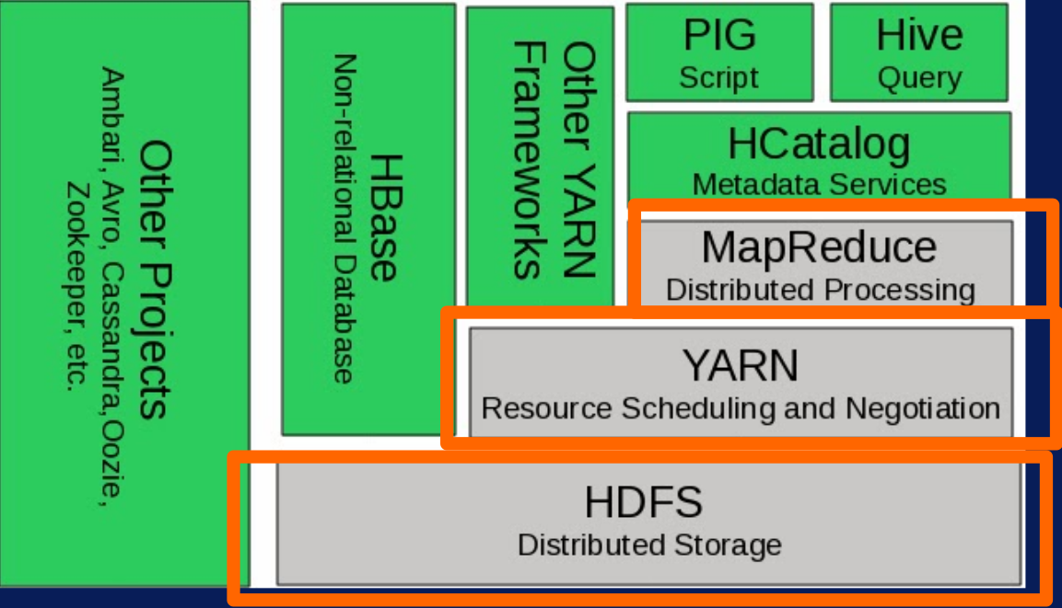
Sample Hadoop Stack
Source: Soong, K. (Feb 2016). Big Data Specialization. Retrieved from http://ksoong.org/big-data

Slide 32
Core Hadoop Components
Yet Another Resource Negotiator (YARN)
“Operating System” for Hadoop
Controls how resources are allocated to different applications and execution engines across cluster
Notes:
References
[1] http://www.littlebeelibrary.com/pdfs/Apache_Hadoop.pdf

Slide 33
Core Hadoop Components
Hadoop Distributed File System (HDFS)
Highly scalable storage system
Data File

Slide 34
Core Hadoop Components
Hadoop Distributed File System (HDFS)
Too big to fit on single machine => Partition
A | B
C | D

Slide 35
Core Hadoop Components
Hadoop Distributed File System (HDFS)
Split across multiple machines
Data is protected against hardware failure
Server 1
Server 2
Server 3
Server 4
A | B
C
A
 | D
A
C | D
 | B
C | D

Slide 36
Core Hadoop Components
Hadoop Distributed File System (HDFS)
Server goes down, we can still reconstruct data
Server 1
Server 2
Server 3
Server 4
🔥
A | B
C
A
 | D
A
C | D
 | B
C | D

Slide 37
Core Hadoop Components
Execution Engine
Used when running analytic applications
Distributed data allows us to perform parallel computations
MapReduce execution engine comes bundled with the Hadoop core distribution
Can plug-in different components
Tez, Storm, Spark, etc
Notes:
Execution engine is used to perform calculations on the underlying data

Slide 38
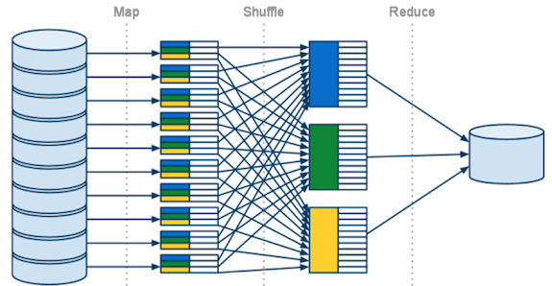
MapReduce Overview
HDFS
HDFS
Source: Eckroth, J. (n.d.). MapReduce. Retrieved from http://cinf401.artifice.cc/notes/mapreduce.html
Notes:
The MapReduce engine runs the map step on all nodes in the cluster to produce a set of intermediate output files. It then sorts these intermediate les and then runs a reduce step to take the sorted intermediate les and aggregate the data to get a final result.
This process is scalable but relatively slow because of the need to write lots of intermediate les to disk and then read them again.

Slide 39
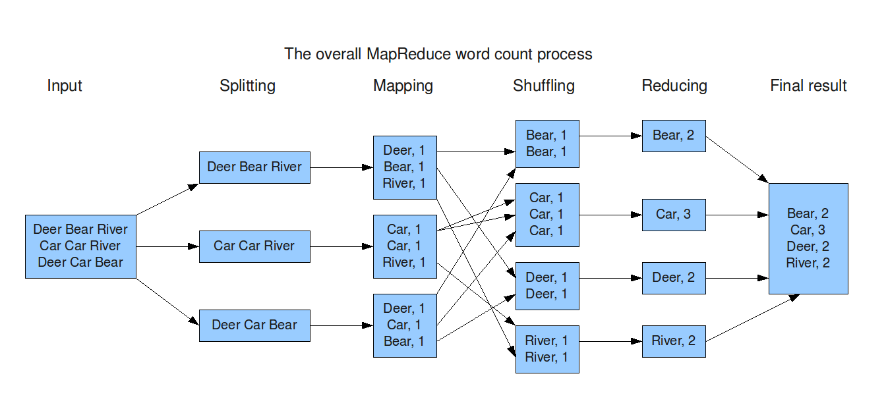
MapReduce Example
Source: Zhang, X. (Jul 2013). A Simple Example to Demonstrate how does the MapReduce work. Retrieved from http://xiaochongzhang.me/blog/?p=338

Slide 40
MapReduce Limitations
Lot of read/writes
I/O becomes bottleneck when performing analysis
Machine Learning algorithms are iterative
Many reads and writes cycles before convergence
Slow runtime
There must be a better way!

Slide 41
Apache Tez
Optimizes workflow to limit number of writes
Less I/O => faster execution

Slide 42
Apache Storm
Execution engine for real-time streaming applications
Data is analyzed as it is generated BEFORE it is stored

Slide 43
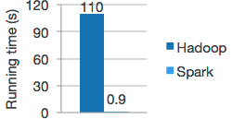
Apache Spark
In-memory computational engine
Read in data once, subsequent calculations are done in-memory
Logistic Regression Runtime
Notes:
The key takeaway from this presentation: Use Spark to do all calculations

Slide 44
Other Apache Projects
Apache Hive
SQL interface to data stored in HDFS
Analysts with SQL experience can use Hadoop

Slide 45
Other Apache Projects
Databases
Apache HBase
Apache Cassandra

Slide 46
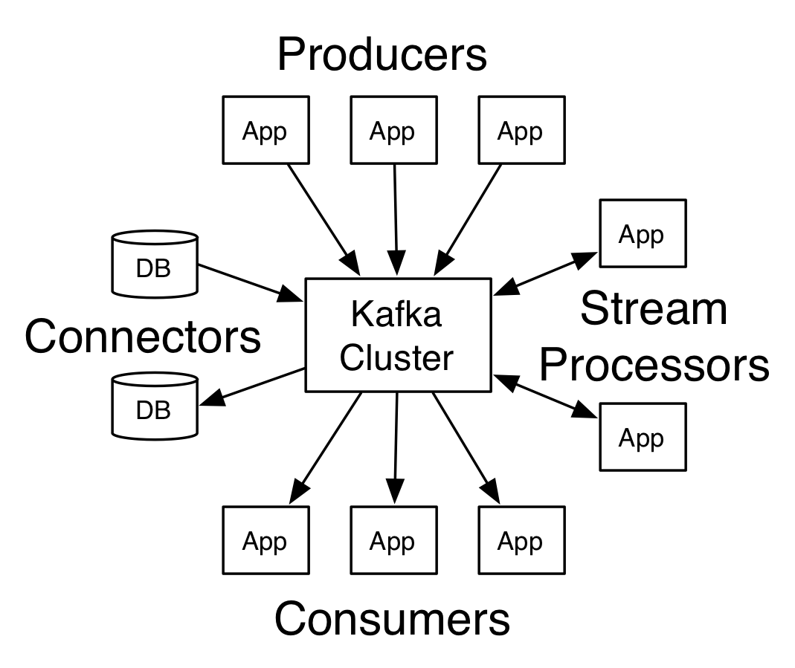
Other Apache Projects
Apache Kafka
Messaging system for streaming data

Slide 47
Optimal Hadoop Workflow
Depends on what you are trying to do
Data Lake (HDFS)
Storage repository that holds data in raw format
Read into Spark to perform analysis
Use Data Science and Machine Learning algorithms
Demo will walkthrough this workflow

Slide 48
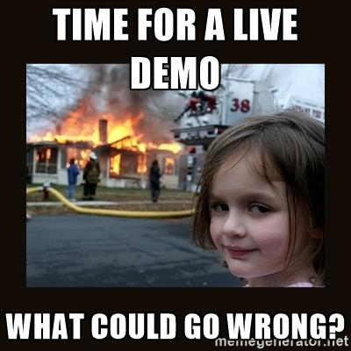

Slide 49
Dataset
Texas Department of State Health Services
Released State Inpatient / Outpatient data (link)
Inpatient (IP) - 1999 to 2010
Outpatient (OP) – Q42009 to 2010
Data is de-identified and made available for free
Tab-delimited text files (for each quarter)
IP data – 450MB base table, 500MB charges
OP data – 750MB base table, 700MB charges

Slide 50
Spark Background
Java, Scala, Python, and R APIs (docs)
Built around the concept of Resilient Distributed Datasets (RDDs)
Can perform MapReduce on RDD
OR
Use the Spark DataFrame abstraction
*Recommended*

Slide 51
Spark DataFrame
Distributed collection of rows and named columns
Think relational database or spreadsheet
Akin to pandas DataFrame or R data.frame
# Displays the content of the DataFrame
df.show()
#
# +----+-------+
# | age| name|
# +----+-------+
# |null|Michael|
# | 30| Andy|
# | 19| Justin|
# +----+-------+

Slide 52
Questions?
Slides and code available at
https://github.com/alysivji/talks

