Slide 1
FRAUD DETECTION UNDER
EXTREME CLASS IMBALANCE
A systematic comparison of six classifiers on one million bank account applications
Machine Learning Classification Project — Phase 2
Dataset: Bank Account Fraud (BAF), NeurIPS 2022
1,000,000 applications · 1.10% fraud · 90:1 imbalance

Slide 2
PROBLEM & DATASET
Rare fraud, asymmetric costs
The task. Given attributes captured at the moment of an online bank account application, predict whether it is fraudulent.
Why it’s hard. Fraud is < 2% of applications, and the two errors cost very differently: a missed fraud is expensive, while too many false alarms flood manual review and hurt real customers.
The trap. A “always legitimate” model scores 98.9% accuracy — so accuracy is meaningless here.
1,000,000
11,029
applications
fraud cases (1.10%)
90 : 1
31 + 1
class imbalance ratio
features + target
Fraudulent Bank Account Detection · Phase 2
2

Slide 3
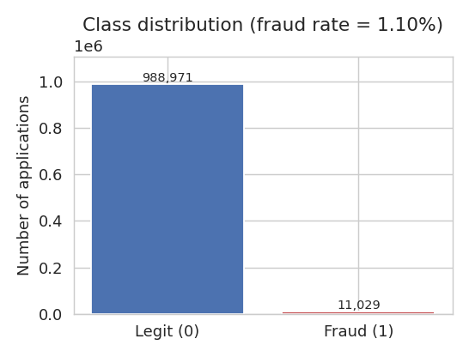
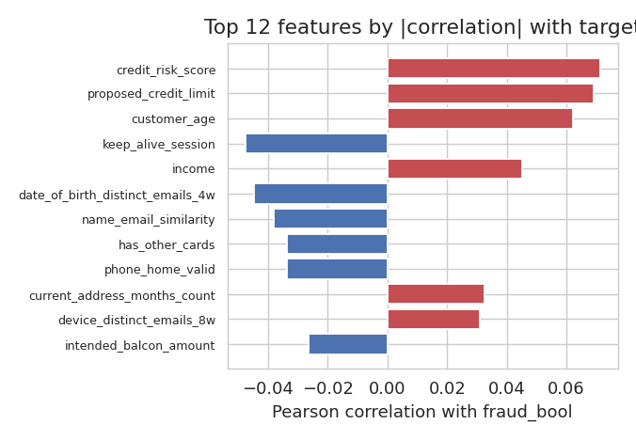
EXPLORATORY ANALYSIS
Many weak signals, no silver bullet
Every feature’s correlation with fraud is |r| < 0.1 → favors additive models that combine many weak cues.
Fraudulent Bank Account Detection · Phase 2
3

Slide 4
METHODOLOGY
A leakage-safe, reproducible pipeline
1
Preprocess
−1 → NaN + missing flags · median impute · one-hot · standardize — fit on TRAIN only
2
Train
6 classifiers + stacking ensemble · class weighting for imbalance · seed 42
3
Ablate
Grid search + stratified k-fold CV · scored by PR-AUC · ≥3 configs each
4
Evaluate
One shared held-out test set · common metric suite · touched once
Imbalance treatment: class weighting where supported (LogReg, Tree, SVM, RF, GB); SMOTE for k-NN — kept deliberately to expose its consequences.
Fraudulent Bank Account Detection · Phase 2
4

Slide 5
RESULTS — OVERVIEW
Three models tie at the top
What the numbers say
Logistic Regression, Gradient Boosting and Stacking lead (PR-AUC ≈ 0.135).
Stacking has the best ranking (ROC-AUC 0.913).
At a 5% false-positive budget, LogReg catches 54% of all fraud.
The single tree and k-NN trail badly.
Fraudulent Bank Account Detection · Phase 2
5

Slide 6
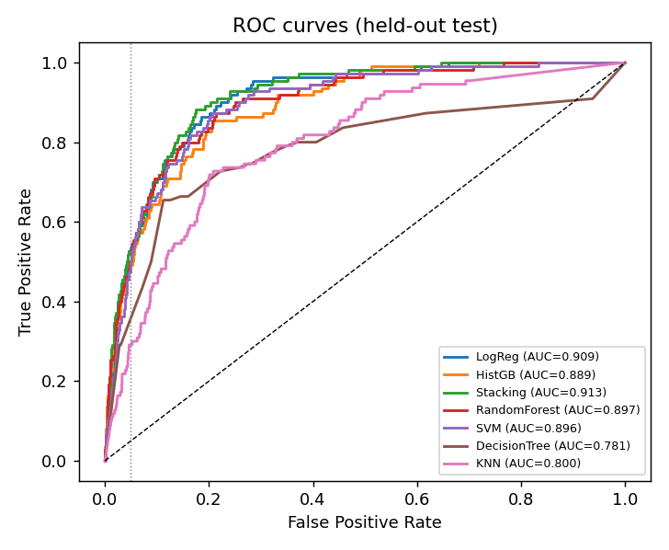
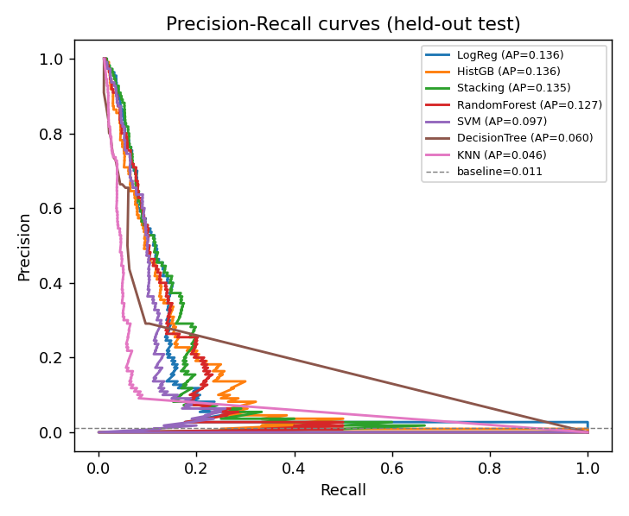
RESULTS — CURVES
Honest performance at any threshold
Fraudulent Bank Account Detection · Phase 2
6

Slide 7
THE CASE STUDY
k-NN and the SMOTE validation-leakage trap
0.988
0.046
→
Cross-validation PR-AUC
(looked spectacular)
Real held-out PR-AUC
(worst of all models)
Why? SMOTE ran on the whole training pool BEFORE cross-validation, so synthetic minority points leaked into validation folds — the model was scored on near-copies of its own data.
Lesson: resampling must live INSIDE the cross-validation loop.

Slide 8
INTERPRETATION
Why simple models win here
Pre-engineered features
STRONGEST FRAUD SIGNAL
1
Anonymized, binned inputs already encode the non-linear structure a tree would otherwise discover.
Missing previous
address
Weak interactions
2
+1.33
All target correlations < 0.1 — a problem of many weak independent cues suits additive log-odds.
standardized logistic-regression weight
Tiny minority
3
Encoding missingness explicitly turned a data gap into the single best predictor.
Only 441 fraud cases in training starve high-capacity models (deep trees, RBF SVM) of signal.
Fraudulent Bank Account Detection · Phase 2
8

Slide 9
CONCLUSION
Findings, limitations, next steps
Key findings
Limitations
A weighted Logistic Regression matches boosted trees & stacking (ROC-AUC ≈ 0.91).
Explicit missing-value flags carry strong, interpretable signal.
SMOTE outside CV produces a dramatic leakage artifact.
Evaluate imbalance by PR-AUC & budgeted recall — never accuracy.
50k stratified subsample (441 fraud) caps achievable PR-AUC.
Single train/test split; SVM tuned on subsamples.
No threshold calibration or fairness audit yet.
Future work
Scale to full 1M rows; put SMOTE inside CV.
Time-based split on the “month” field for drift.
Calibrate to an explicit cost matrix; audit fairness.
Fraudulent Bank Account Detection · Phase 2
9

