Slide 1


DIGITAL EGYPT PIONEERS INITIATIVE · DATA ANALYSIS TRACK
EXOPLANET
HABITABILITY ZONE ANALYSIS
"Where Data Meets Discovery"
Nourhan Khalifa · Hannah Hany · Reham Osama
Mohamed Essam · Youssef Abdullah · Youssef Amir
Supervisor: Eng. Mohamed Alemam
EXOPLANET HABITABILITY ZONE
01
Notes:
[0:00–0:15] "Where data meets discovery." Welcome — this is Exoplanet Habitability Zone Analysis, our graduation project for the Digital Egypt Pioneers Initiative, Data Analysis Track. In the next five minutes, we'll show you how we turned raw NASA data into a tool that helps answer one of humanity's biggest questions: are we alone?

Slide 2









PROJECT CONCEPT
Turning NASA's Raw Numbers Into a
Habitability Story
A graduation project built entirely on real, continuously-updated observational data from NASA’s Exoplanet Archive — identifying which confirmed exoplanets fall inside their star’s habitable “Goldilocks Zone,” and ranking how Earth-like each one is.
Data Engineering
Feature Engineering
Clean ~6,100 real exoplanets across a Bronze → Silver → Gold pipeline
Derive luminosity, flux, equilibrium temperature & Earth Similarity Index
Dashboard
Predictive Modeling
A 7-page interactive Power BI habitability story
ML models that judge a planet’s habitability live
EXOPLANET HABITABILITY ZONE
02
Notes:
[0:15–0:40] Our mission: explore distant worlds through data. We took real, continuously-updated exoplanet measurements from NASA and built a full pipeline — data engineering, scientific feature engineering, dimensional modeling, an interactive dashboard, and predictive machine learning — to identify which planets could plausibly support life, and rank how Earth-like each one is.

Slide 3
DATA & ENGINEERING PIPELINE
From a Live NASA Archive to a Clean,
Analysis-Ready Dataset
6,128
19
Bronze
Planets in the raw snapshot
Raw columns selected
Raw ingestion — NASA extract + parallax file, structure & null inspection
~43%
5,394
Silver
Cells missing or placeholder zeros
Rows after physics-based cleaning
All imputation logic — physics-based fills, dedup, distance merge
Source: NASA Exoplanet Archive (Caltech / IPAC) — Planetary Systems table, updated daily.
Gold
Missing values were recovered with real astrophysics — Kepler’s Third Law, the stellar Radius–Mass relation, and Mass–Radius regimes — before any row was dropped.
Star-schema dimensional model — 1 fact + 4 dimension tables
+ Enrichment: ESI, escape velocity & habitability flags layered on top of Gold
EXOPLANET HABITABILITY ZONE
03
Notes:
[0:40–1:10] We started with NASA's Exoplanet Archive — 6,128 planets, 19 raw columns, and about 43% missing or placeholder data. Rather than dropping incomplete rows, we recovered missing values using real physics — Kepler's Third Law, stellar mass-radius relationships — wherever possible. The result: a clean 5,394-row dataset, processed through a Bronze-Silver-Gold medallion pipeline into a star-schema data model ready for analysis.

Slide 4
FEATURE ENGINEERING
Scoring Every Planet Against Earth
GOLD LAYER — STAR SCHEMA
Properties NASA doesn’t measure directly — stellar luminosity, received flux, equilibrium temperature, escape velocity — were derived from physics, then combined into the Earth Similarity Index (ESI): a 0–1 score where 1.0 means identical to Earth.
Dim_Star
Dim_Planet
ESI weighting by property
Radius
0.57
Fact_
Exoplanets
Density
1.07
Escape Velocity
0.7
Temperature (dominant)
5.58
Dim_Discovery
GJ 1002 b scores highest — ESI = 0.9935, Earth’s closest known physical twin among confirmed exoplanets in this dataset.
Dim_Date
EXOPLANET HABITABILITY ZONE
04
Notes:
[1:10–1:40] On top of that clean data, we engineered the science that makes habitability analysis possible — stellar luminosity, received flux, equilibrium temperature, escape velocity — and combined them into the Earth Similarity Index, weighted heavily toward temperature. The result: GJ 1002 b scores 0.9935 — essentially Earth's closest known twin among all confirmed exoplanets.

Slide 5
PREDICTIVE MODELING
Two Models, One Question: Could This
Planet Support Life?
Habitability Classifier
Earth Similarity Regressor
Random Forest + SMOTE
XGBoost, sample-weighted
Predicts Habitable / Not Habitable from radius, mass, flux, temperature, semi-major axis & eccentricity.
Scores how Earth-like a planet is on a 0–100 scale, weighting rare high-ESI planets 20× more heavily.
99.06%
0.60
87.0%
2.31 pts
Test Accuracy
Recall (habitable class)
R² Score
MAE
Both models are deployed live — through a Streamlit demo app and directly inside the dashboard’s AI Model page.
EXOPLANET HABITABILITY ZONE
05
Notes:
[1:40–2:10] We didn't stop at descriptive analysis — we built two machine learning models. A Random Forest classifier predicts Habitable or Not Habitable with over 99% test accuracy. An XGBoost regressor scores Earth similarity on a 0-to-100 scale with an R-squared of 87%. Both run live — through a Streamlit app and directly inside our dashboard.

Slide 6
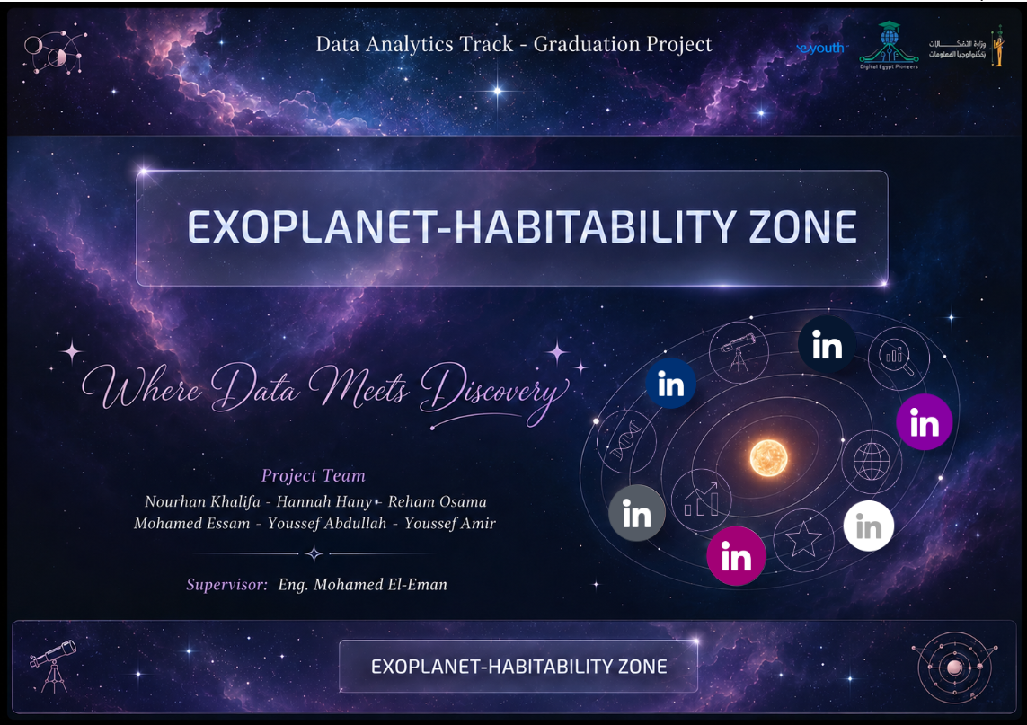
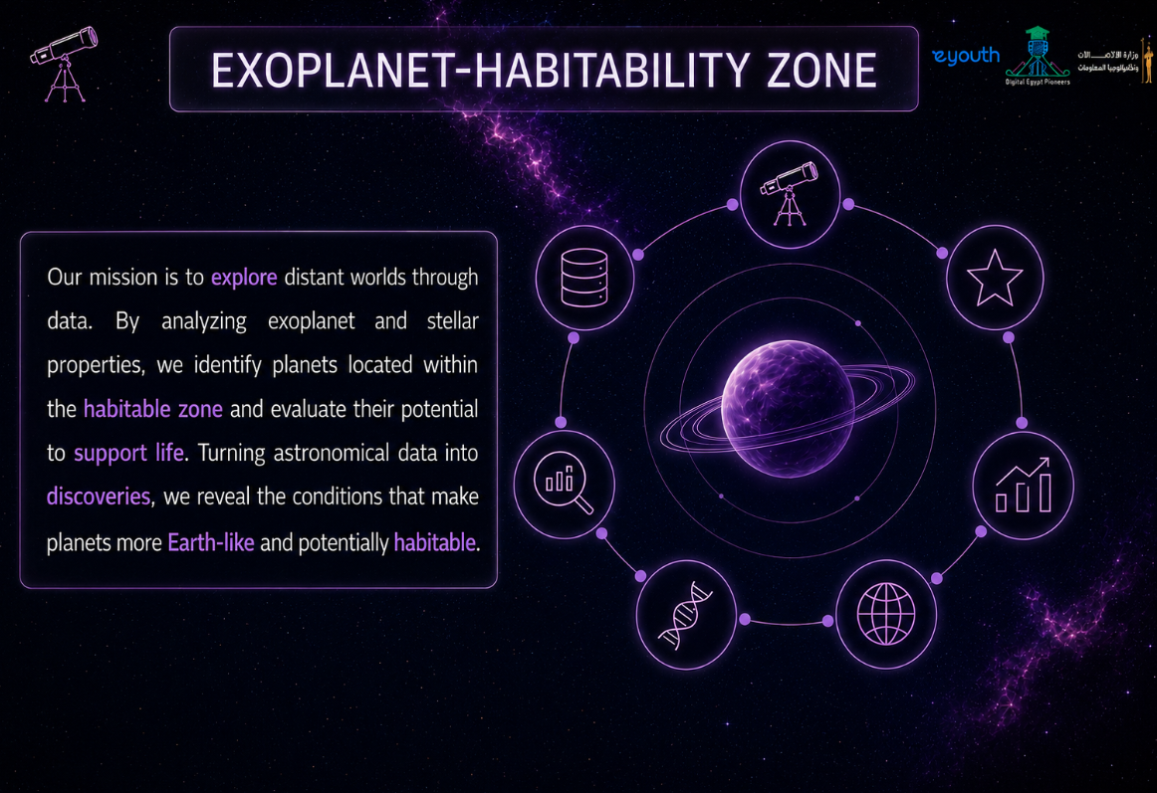
DASHBOARD WALKTHROUGH
A Seven-Page Data Storytelling Journey
Designed first in Figma — a cosmic, nebula-themed identity carried consistently across every page of the Power BI report.
EXOPLANET HABITABILITY ZONE
06
Notes:
[2:10–2:25] Now let's walk through the dashboard itself — a seven-page data story, designed first in Figma with a consistent cosmic identity, from the branded cover page through the mission statement.

Slide 7
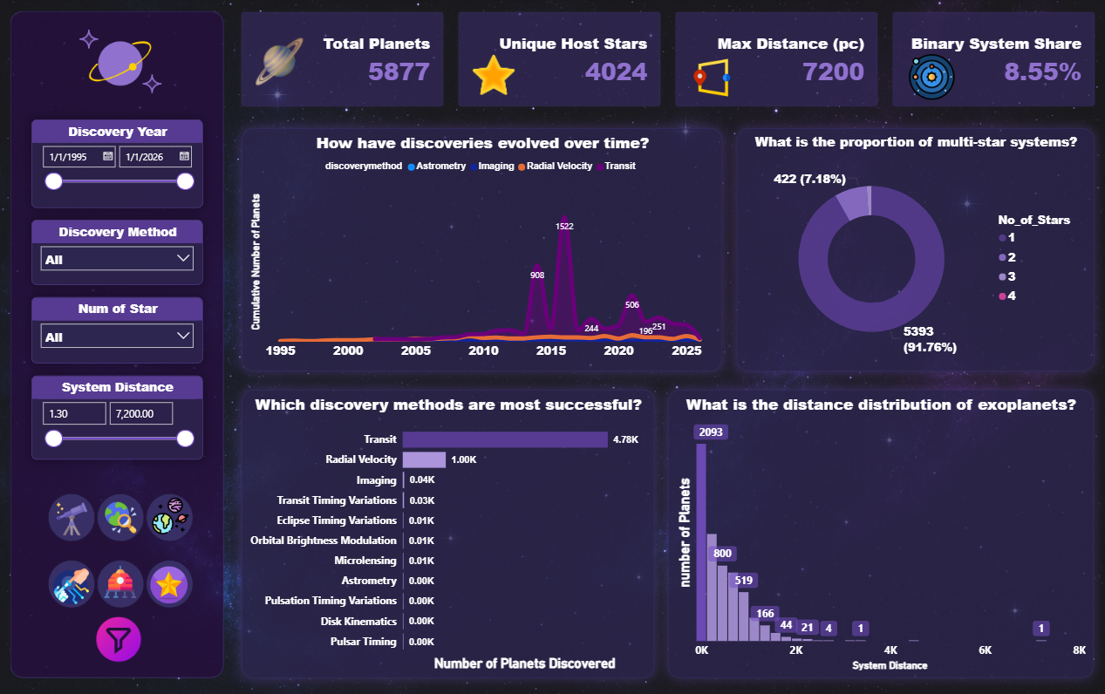
DASHBOARD · PAGE 2
Overview — Discovery History & System Structure
5,877
Total Planets
4,024
Unique Host Stars
7,200 pc
Max Distance
8.55%
Binary Systems
Transit dominates discoveries (~4.78K planets); discovery pace peaked in 2016 with 1,522 new confirmations.
EXOPLANET HABITABILITY ZONE
07
Notes:
[2:25–2:50] The Overview page sets the scene: 5,877 confirmed planets, 4,024 unique host stars, spanning distances up to 7,200 parsecs. We can see discovery history over time — the Transit method dominates — and how single-star versus multi-star systems break down.

Slide 8
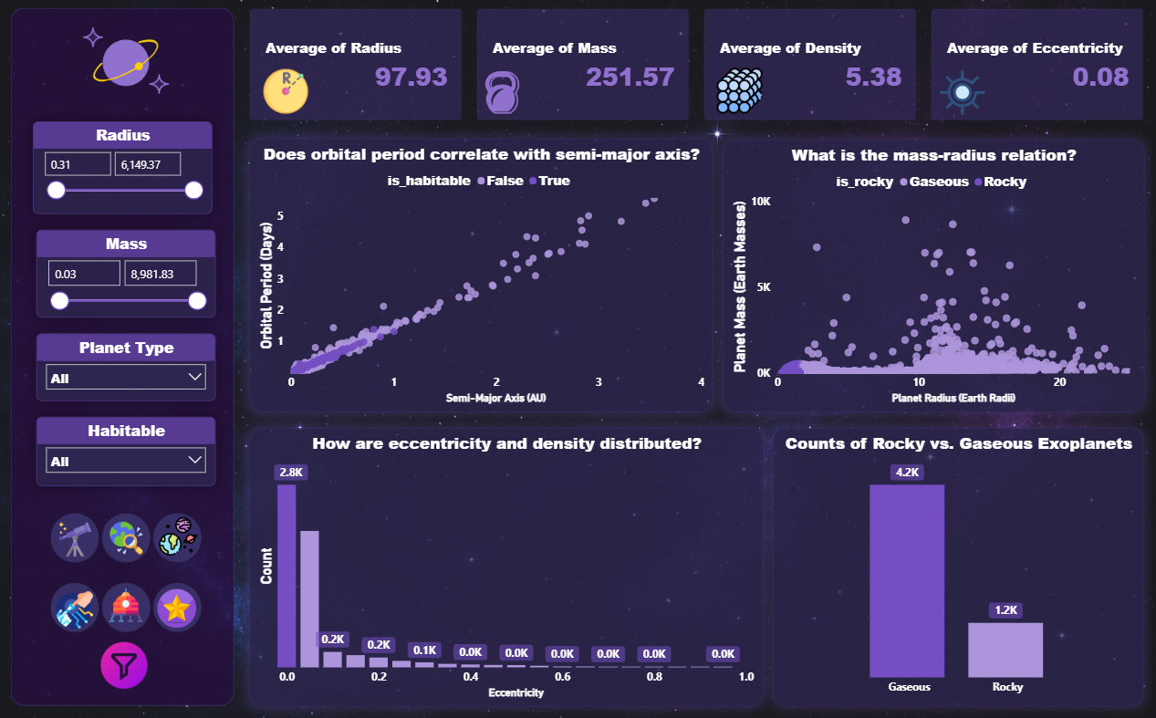
DASHBOARD · PAGE 3
Habitability — Physical & Orbital Characteristics
97.93 R⊕
Avg. Radius
251.57 M⊕
Avg. Mass
5.38 Earth’s Density
Avg. Density
0.08
Avg. Eccentricity
Kepler’s Third Law visually confirmed: orbital period rises cleanly with semi-major axis. 4.2K planets Gaseous vs 1.2K Rocky.
EXOPLANET HABITABILITY ZONE
08
Notes:
[2:50–3:15] The Habitability page dives into planet physics — size, mass, density, and orbital shape. Our Kepler's Third Law scatter plot visually confirms the physics we used to clean the data, and we can clearly separate rocky planets from gas giants.

Slide 9
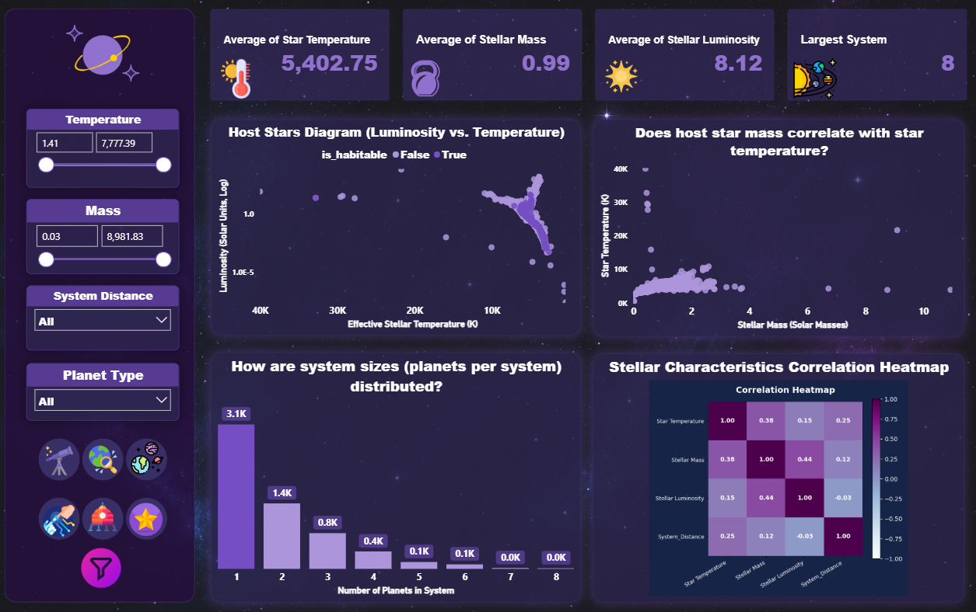
DASHBOARD · PAGE 4
Star Systems — Host Star Properties
5,402.75 K
Avg. Star Temperature
0.99 M☉
Avg. Stellar Mass
8.12 L☉
Avg. Stellar Luminosity
8 planets
Largest System
A correlation heatmap (Python visual) shows Stellar Mass and Luminosity as the strongest related pair (0.44).
EXOPLANET HABITABILITY ZONE
09
Notes:
[3:15–3:40] The Star Systems page turns to the host stars themselves — average temperature close to our own Sun, and a correlation heatmap showing how stellar mass and luminosity move together.

Slide 10
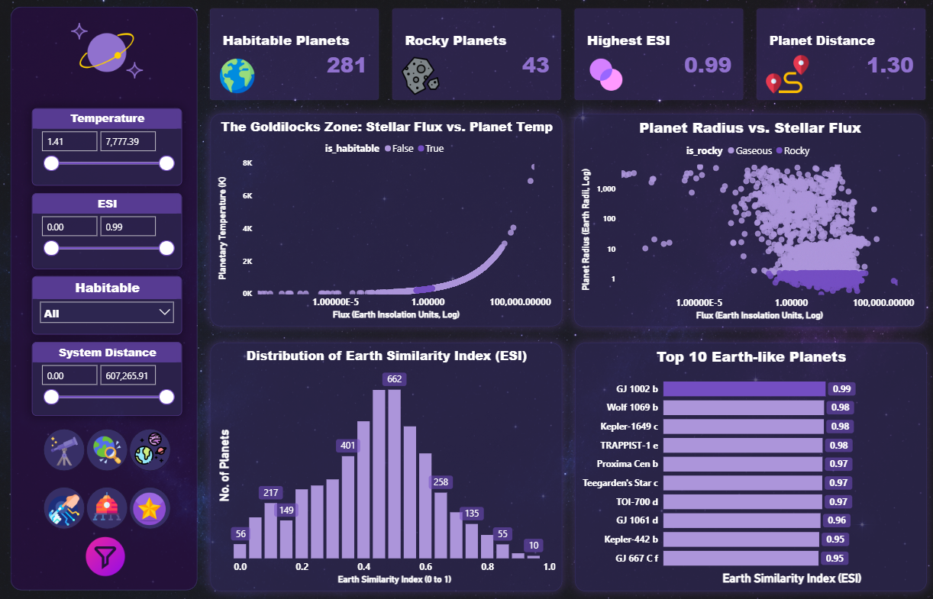
DASHBOARD · PAGE 5
Planet Explorer — Habitability & the Goldilocks Zone
281
Habitable Planets
43
Habitable & Rocky
0.99
Highest ESI
≈ 1.3 pc
Closest Habitable Planet
This is the analytical centerpiece — the page that isolates and ranks the planets most likely to support life.
EXOPLANET HABITABILITY ZONE
10
Notes:
[3:40–4:10] This is the heart of the project — Planet Explorer. Here we isolate the 281 planets that fall inside the habitable zone, cross-reference size against stellar flux, and rank the top 10 most Earth-like candidates by ESI score.

Slide 11
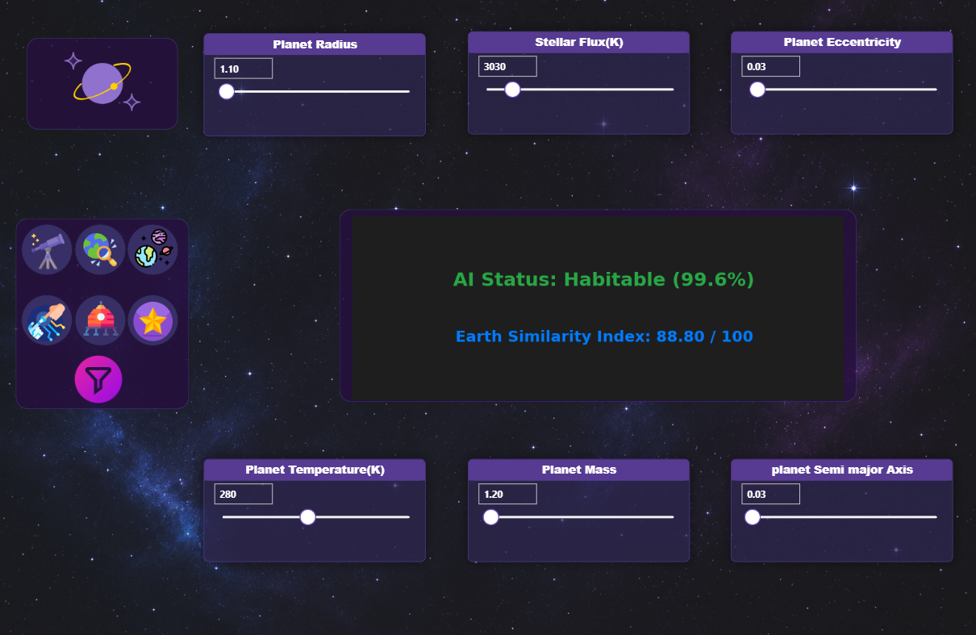
DASHBOARD · PAGE 6
AI Model — Live Habitability Prediction
Six live slicers feed a Python visual that runs the trained classifier and regressor in real time — mirroring the standalone Streamlit app exactly.
Planet Radius
Planet Mass
Stellar Flux
Temperature
Semi-Major Axis
Eccentricity
Output: AI Status (Habitable/Not) with confidence %, plus an Earth Similarity Index out of 100.
EXOPLANET HABITABILITY ZONE
11
Notes:
[4:10–4:30] And finally, the AI Model page brings our machine learning to life inside the dashboard — six live sliders let anyone test a hypothetical planet and instantly see whether it's predicted habitable, with a confidence score and Earth Similarity Index.

Slide 12
PROJECT IMPACT
What the Data Revealed
5,877
281
Confirmed exoplanets analyzed
Planets inside the habitable zone
45
0.9935
Habitable AND rocky candidates
Highest ESI — GJ 1002 b, Earth’s closest twin
EXOPLANET HABITABILITY ZONE
12
Notes:
[4:30–4:50] To sum up the impact: from 5,877 confirmed exoplanets, we found 281 inside the habitable zone, 45 that are both habitable and rocky, and one standout — GJ 1002 b — Earth's closest known twin.

Slide 13
Thank You
"Where Data Meets Discovery"
Digital Egypt Pioneers Initiative — Data Analysis Track | Graduation Project 2025/2026
Nourhan Khalifa · Hannah Hany · Reham Osama · Mohamed Essam · Youssef Abdullah · Youssef Amir
EXOPLANET HABITABILITY ZONE
13
Notes:
[4:50–5:00] Thank you for watching. This project was built by Nourhan Khalifa, Hannah Hany, Reham Osama, Mohamed Essam, Youssef Abdullah, and Youssef Amir, under the supervision of Eng. Mohamed El-Eman. Where data meets discovery.

