Slide 1


DEPI IBM Data Science
Employee Attrition Prediction & Analysis Project
Final Presentation — Model, Deployment & Business Impact
Course Instructor: Dr. Ahmed Mostafa | Date: 11/7/2026
Team: • Rezk Youssef • Moaz Abdelfattah • Felopateer Michael •Nourhan Noureldin • Fareda Hossam • Sally Marqos

Slide 2
Agenda
01
Business Problem & Objectives
02
Dataset & Exploratory Analysis
03
Statistical Validation & Feature Selection
04
Model Development & Optimization
05
Deployment Architecture & Live Demo
06
Business Impact & Next Steps
Employee Attrition Prediction & Analysis — DEPI IBM Data Science
2

Slide 3
The Business Problem
Employee attrition carries direct and hidden costs — recruitment, onboarding, lost productivity, and knowledge drain. Identifying at-risk employees early lets HR intervene before it's too late.
Why it matters
16.1%
Our Objectives
of employees in our data left the company
Identify the strongest drivers of attrition using statistics and feature importance
Benchmark multiple ML models for the best accuracy / recall trade-off
Deploy the model as a live, usable tool — not just a notebook
Add monitoring so prediction quality can be tracked over time
~ EGP 1,000s
avg. income gap between leavers and stayers
Top signal
Overtime is the #1 recurring driver across every test
Employee Attrition Prediction & Analysis — DEPI IBM Data Science
3

Slide 4
Dataset Overview
IBM HR Analytics Employee Attrition & Performance dataset
1,470
35
0
83.9% / 16.1%
Employee records
Features (numeric + categorical)
Missing values or duplicates
Stayed vs. Left (imbalanced)
Because the data had no missing values or duplicates, preprocessing focused on encoding categorical variables, engineering new features (SalaryExperienceRatio, TenureGroup), and correcting class imbalance with SMOTE — rather than data cleaning.
Employee Attrition Prediction & Analysis — DEPI IBM Data Science
4

Slide 5
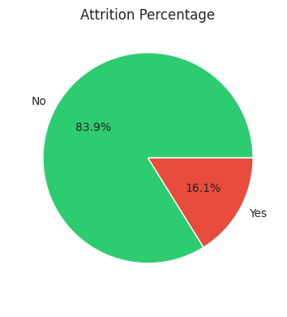
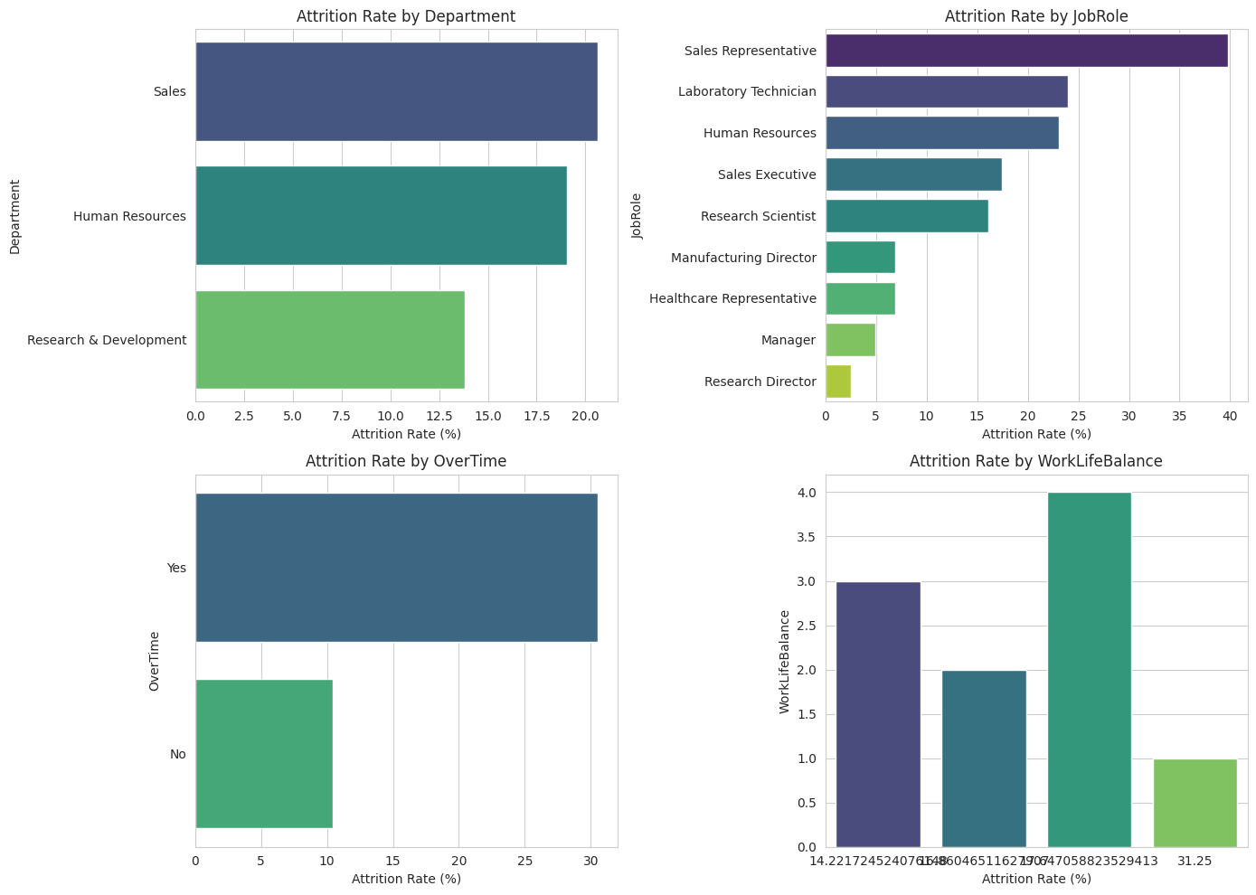
Dataset Overview
IBM HR Analytics Employee Attrition & Performance dataset
Employee Attrition Prediction & Analysis — DEPI IBM Data Science
4

Slide 6
Key EDA Insights
Most employees are 30–40 years old; Monthly Income is right-skewed
Employees who work overtime leave at a much higher rate
Attrition varies meaningfully by department and job role
Most employees rate work-life balance as 3 (“Better”) on a 1–4 scale
Outliers concentrated in Monthly Income & Total Working Years
Correlation Highlights
YearsAtCompany, YearsInCurrentRole & YearsWithCurrManager are strongly correlated
MonthlyIncome correlates with JobLevel and TotalWorkingYears
Tenure and role stability move together — employees who stay longer keep the same role and manager
Employee Attrition Prediction & Analysis — DEPI IBM Data Science
5

Slide 7
Statistical Validation
Hypothesis tests confirm which features truly drive attrition
Test | Comparison | Result | Conclusion
t-test | Monthly Income: Left vs Stayed | t=-7.48, p<0.001 | Leavers earn significantly less
Chi-squared | Job Role vs Attrition | χ²=86.19, p<0.001 | Attrition differs by job role
Chi-squared | OverTime vs Attrition | χ²=87.56, p<0.001 | Overtime strongly linked to leaving
ANOVA | Income across Job Roles | F=810.21, p<0.001 | Income differs sharply by role
ANOVA | Income across Work-Life Balance | F=0.61, p=0.607 | Not significant
Bottom line: Salary, overtime, and job role are statistically validated drivers of attrition — directly shaping our feature selection and HR recommendations.
Employee Attrition Prediction & Analysis — DEPI IBM Data Science
6

Slide 8
Feature Engineering & Selection
Engineered Features
Consistently Top-Ranked
SalaryExperienceRatio — balances pay against work experience
TenureGroup — bins YearsAtCompany into New / Junior / Mid / Senior career stages
MonthlyIncome
OverTime
Selection Techniques
SalaryExperienceRatio
RFE (Logistic Regression): 10 features selected, incl. SalaryExperienceRatio
Random Forest importance: MonthlyIncome, Age, OverTime lead the ranking
Final set = union of both techniques → Employee_Attrition_Selected_Features.csv
Age
TotalWorkingYears
Employee Attrition Prediction & Analysis — DEPI IBM Data Science
7

Slide 9
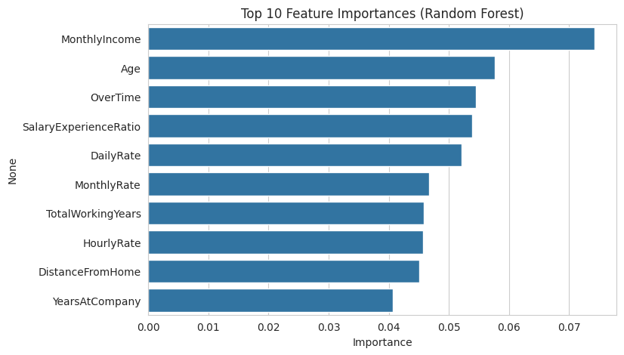
graphs
Employee Attrition Prediction & Analysis — DEPI IBM Data Science
7

Slide 10
Model Development
4 classifiers, SMOTE-balanced training data, 5-fold stratified CV
Why Accuracy Isn't Enough
Random Forest & XGBoost score highest on accuracy...
...but Logistic Regression catches far more real leavers (77% recall)
For attrition, missing a true leaver is costlier than a false alarm
Employee Attrition Prediction & Analysis — DEPI IBM Data Science
8

Slide 11
Optimizing the Final Model
GridSearchCV Tuning (XGBoost)
Final Tuned Model — Test Set
Parameter | Best Value
learning_rate | 0.01
max_depth | 4
n_estimators | 400
Best CV F1 | 0.8831
82.99%
Test Accuracy
0.79
27 combinations × 5-fold CV = 135 fits tested
ROC-AUC
Decision Threshold Tuning
Default 0.5 cutoff under-catches leavers. Testing 0.20–0.50 found the best F1 (0.50) at a threshold of 0.25 — adopted for production.
0.45 / 0.30
Precision / Recall (Attrition = Yes)
Employee Attrition Prediction & Analysis — DEPI IBM Data Science
9

Slide 12
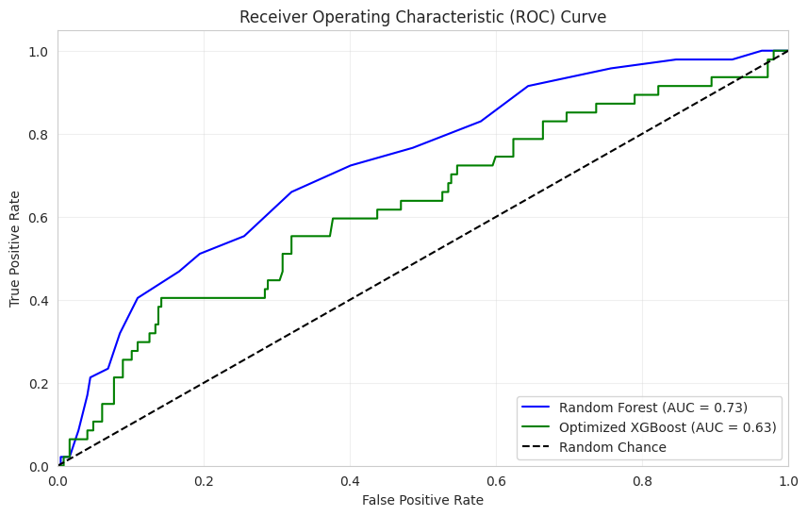
graphs
Employee Attrition Prediction & Analysis — DEPI IBM Data Science
7

Slide 13
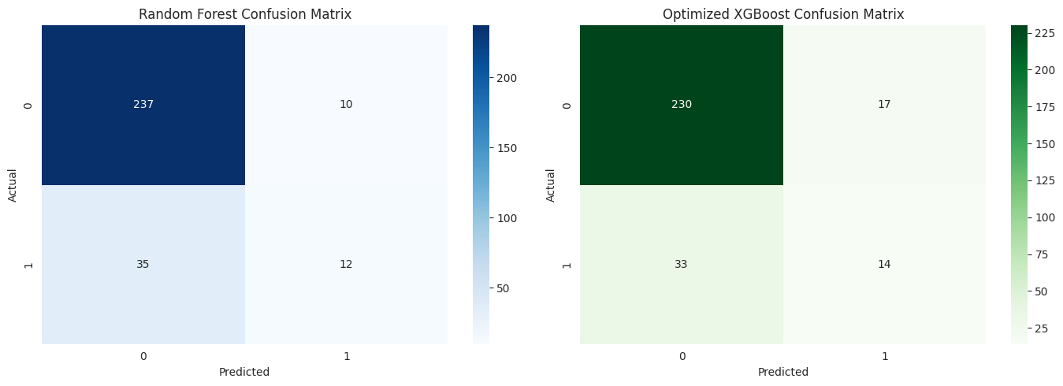
graphs
Employee Attrition Prediction & Analysis — DEPI IBM Data Science
7

Slide 14
Deployment Architecture
Trained Model
FastAPI Backend
Streamlit Dashboard
XGBoost + scaler +
feature artifacts (.pkl)
/predict endpoint
hosted on Railway
HR-facing UI
Streamlit Community Cloud
Railway resolved earlier module-path & scikit-learn version-pinning issues from initial setup
An initial Vercel deployment was abandoned due to serverless package size limits
Every prediction is logged (input, prediction, probability, timestamp) for monitoring
Employee Attrition Prediction & Analysis — DEPI IBM Data Science
10

Slide 15
Live Demo
HR Attrition Risk Dashboard — Streamlit
🔗
[https://employee-attrition-prediction-and-analysis-project.streamlit.app/]
Enter an employee's Age, Monthly Income, OverTime status, Total Working Years, and Job Satisfaction to get an instant attrition risk score.
Employee Attrition Prediction & Analysis — DEPI IBM Data Science
11

Slide 16
Business Impact & HR Recommendations
Review overtime policy — the strongest, most consistent driver of attrition
Address pay gaps in high-turnover roles — leavers earn significantly less on average
Watch tenure milestones — role & manager stability compound over time
Use the dashboard proactively — score teams before resignations happen, not after
Recall over raw accuracy — threshold tuned to catch more true leavers
Employee Attrition Prediction & Analysis — DEPI IBM Data Science
12

Slide 17
Future Improvements
1
2
3
Richer Features
New Algorithms
Automated Retraining
Add engagement & satisfaction survey scores
Try neural networks, LightGBM, CatBoost
Use monitoring logs to trigger drift-based refreshes
4
5
Scalable Deployment
Explainability
Containerize with Docker; expand dashboard inputs
Add SHAP values so HR sees *why* an employee is flagged
Employee Attrition Prediction & Analysis — DEPI IBM Data Science
13

Slide 18
Thank You
Questions & Discussion
Employee Attrition Prediction & Analysis — DEPI IBM Data Science

