Slide 1
Advanced Computing Facility
(ACF)
Robert (Bobby) Whitten
Group Leader
User Assistance, Education, Outreach, and Training

Slide 2
What is the ACF?
The Advanced Computing Facility (ACF) is a partnership between the Joint Institute of Computational Sciences (JICS), the University of Tennessee Knoxville (UTK), the University of Tennessee Health Science Center, and other partners. This partnership represents an investment into research computing by the partner sites to provide a balanced set of resources including compute nodes with a high-performance interconnect, a multi-petabyte high performance parallel file system, high-performance data transfer nodes, and 100 gigabit bandwidth network connectivity.
The ACF provides researchers with a computing ecosystem optimized to support their scientific goals. The initial ACF will combine the existing Beacon cluster and Lustre file system from JICS along with the storage, Sigma, Rho, and Monster nodes of the Newton program from UTK. Investments from institutions or individual researchers into the ACF will give priority access to the entire ACF ecosystem. Effective support is a key feature of the ACF. Operation, technical, and scientific support are available for users of the ACF. The support encompasses technical, domain, and system assistance. Researchers wishing to include the ACF in their proposals have access to domain expertise that can provide grant writing assistance.

Slide 3
ACF Schematic
UT campus investments afford the use of all resources within ACF.
ACF
State Agency Funded Resources
UTC Funded Resources
UTMC Funded Resources
UTHSC Funded Resources
UTK Funded Resources

Slide 4

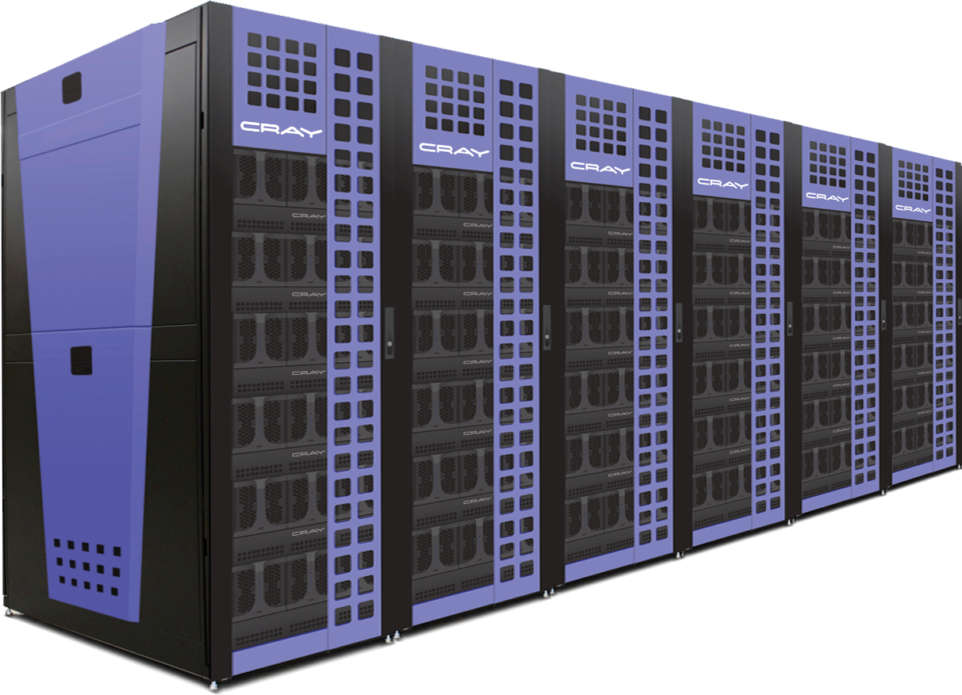
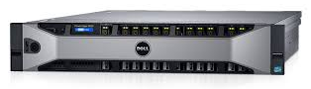
Current Hardware Resources
Beacon Cray Xtreme-X Supercomputer Peak Performance: 210.1 TFLOP/s
Compute Nodes | 48
CPU model | Intel Xeon E5-2670
CPUs per node | 2 8-core, 2.6GHz
RAM per node | 256 GB
SSD per node | 2 x 480 GB (RAID 0)
Intel® Xeon Phi Coprocessors per node | 4 x 5110P 60-core, 1.053GHz 8 GB GDDR5 RAM
Interconnect | FDR InfiniBand Fat Tree
#1 on November 2012 Green500 List
ACAI
login.nics.utk.edu
General purpose server
Home directories only

Slide 5
Beacon Logical Organization
Login
Compute 2
Compute 5
Compute 6
Compute 3
I/O
Compute 1
Compute 4
Compute 7

Slide 6
Connecting
Activate your account
go to https://portal.nics.tennessee.edu/class/70/student
Set up your SecurID token
ssh stdXXXX@login.nics.utk.edu
Enter 6-digit code from SecurID
Create new PIN
Can now connect to
login.nics.utk.edu
beacon.nics.utk.edu
Compute node reservation on Beacon
qsub -I -lwalltime=1:00:00,nodes=1:shrdacc

Slide 7

Questions?
Getting Help:
help@nics.utk.edu
www.nics.utk.edu

