Slide 1
Recipe-Recommendation-System
Nour Shosharah

Slide 2
Agenda
Trainee Bio
Problem Definition
Technical Explanation
Dataset
Pre-processing techniques
Building Recommender sys
Develop web app
Conclusion

Slide 3
A Brief about Trainee
Have A bachelor’s Degree in Computer Engineering from Damascus university
Natural language processing engineer with 1+ of experience
For contact :
nour--chocharah linkedin profile

Slide 4
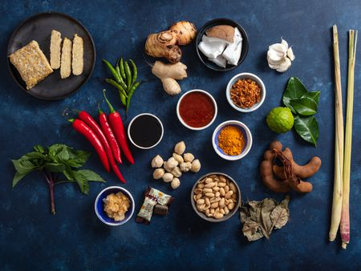
Problem Definition
You don’t know many recipes to cook !!
You have ingredients in your home and want to know what’s cooking
Here my recommendation sys may help you

Slide 5
Flow chart for stages
Recipes Dataset
Data Cleaning &parsing
Feature Extraction (TF-idf)
Similrity Function
Data Cleaning &parsing
User input (ingredients)
API
Top N recommendation recipe

Slide 6
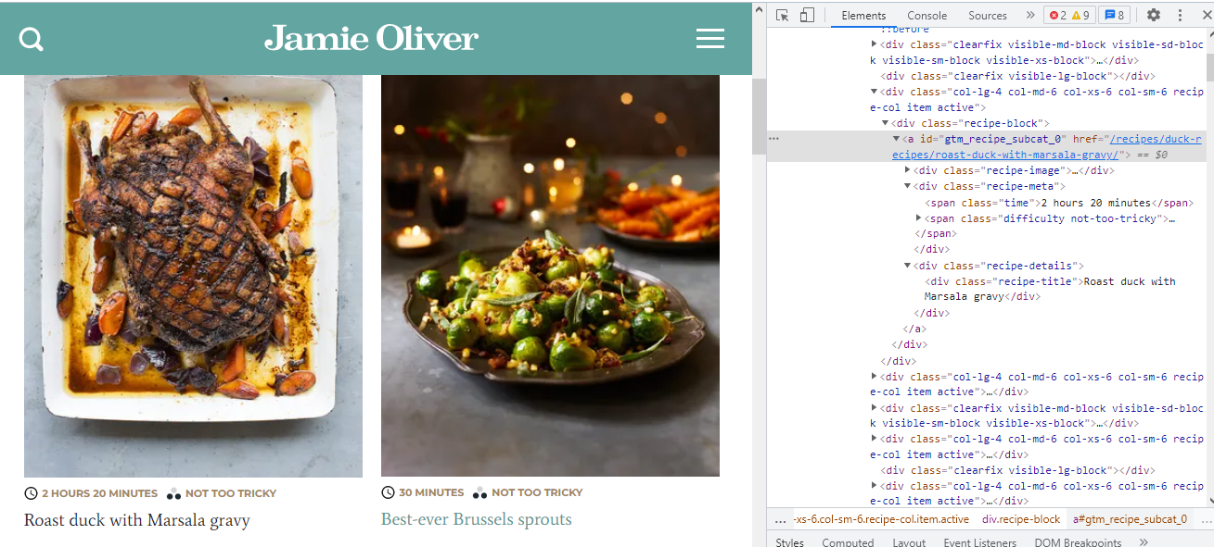
Dataset: There isn’t dataset ,
so I Scrap Data from Jamie Oliver’s cooking website ,First : scrap url of all recipes main course :

Slide 7
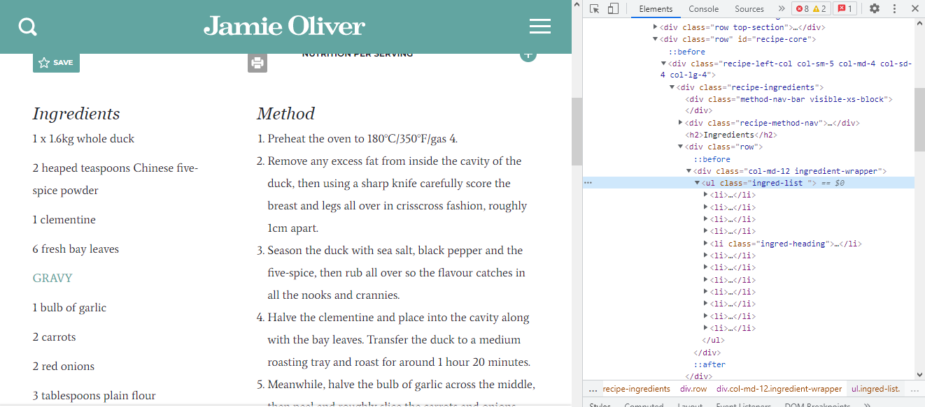
Dataset: There isn’t dataset ,
Second : scrap ingredients for each recipe that I Previously scraped by url

Slide 8
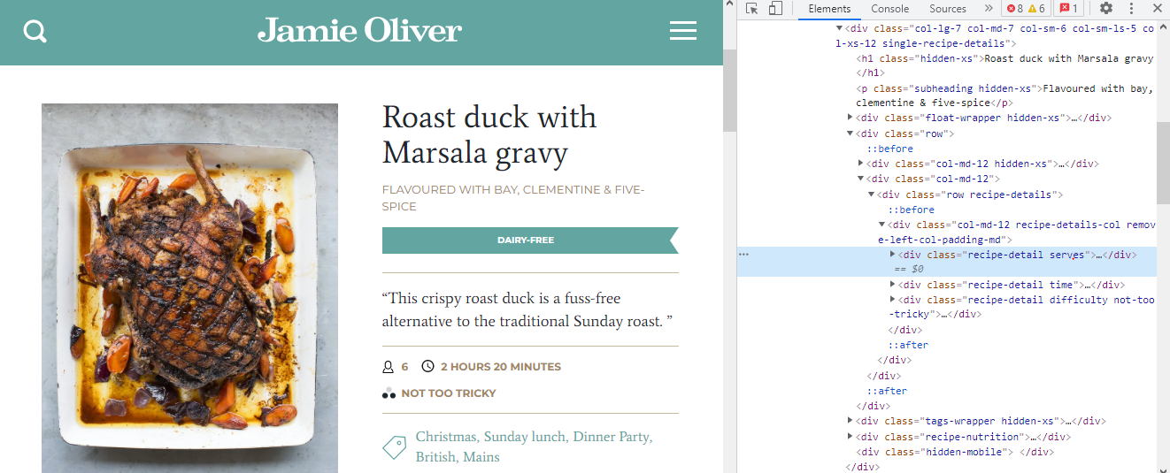
Dataset: There isn’t dataset ,
Third : for each recipe you can scrap serves , difficulty and time to cook

Slide 9
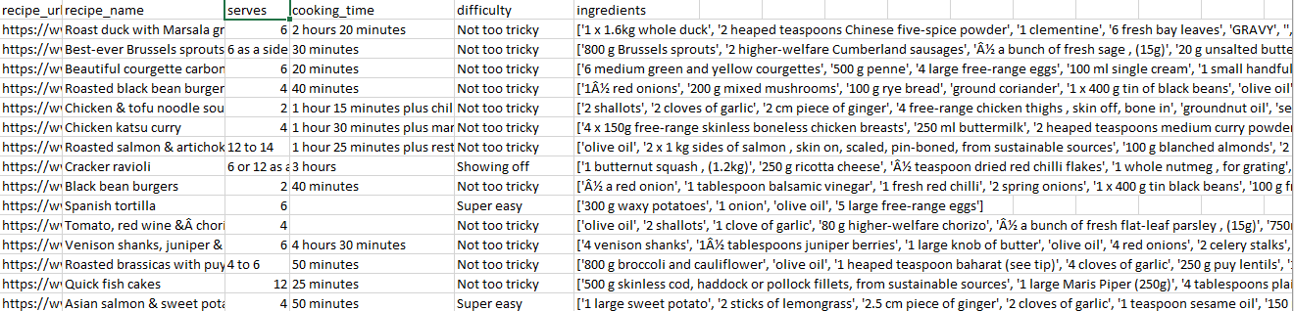
Final Data set

Slide 10
Pre-processing techniques
Remove measures (kg, teaspoon..etc..)
Remove very high frequency (that doesn’t like important features between recipes (oil, pepper ..etc.)
Remove unnecessary (punctuation, digits )
Make all word in lemmatize &Lower

Slide 11
Pre-processing techniques
['duck', 'chinese five spice powder', 'clementine', 'fresh bay leaf', 'gravy', 'garlic',
'carrot', 'red onion', 'plain flour', 'marsala', 'organic chicken stock']
['1 x 1.6kg whole duck', '2 heaped teaspoons Chinese five-spice powder', '1 clementine',
'6 fresh bay leaves', 'GRAVY', '', '1 bulb of garlic', '2 carrots', '2 red onions',
'3 tablespoons plain flour', '100 ml Marsala', '1 litre organic chicken stock']'
Cleaning function

Slide 12
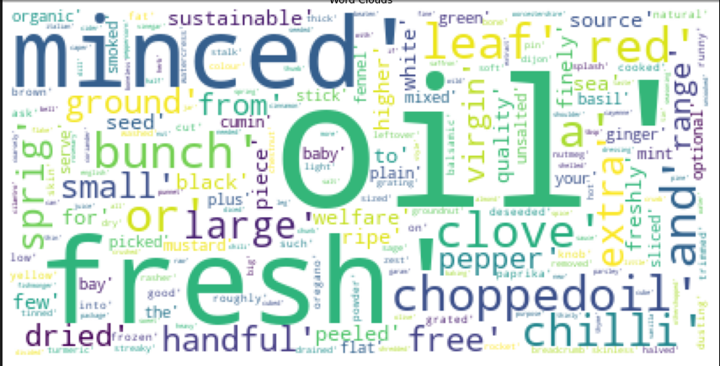
Pre-processing techniques
Wordcloud for words appear in high frequency that make this them common to all recipes and not a specific feature of a particular recipe

Slide 13
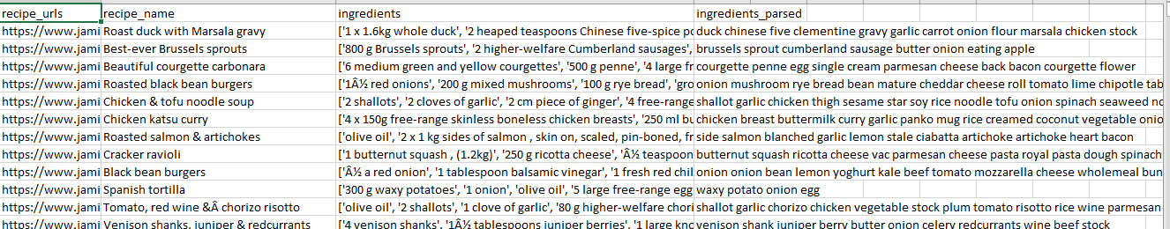
Data set after cleaning

Slide 14
Extracting Features
Encode each document (recipe ingredients)
TF-IDF (term frequencies-inverse document frequency) performed well .

Slide 15
Building Recommender sys
We use content-based filtering which enables us to recommend recipes to people based on the attributes (ingredients) the user provides
Measure the similarity using cosine similarity:
Between ingredients the user provides and the ingredients we have in our dataset
Recommended 5 high score based on similarity

Slide 16
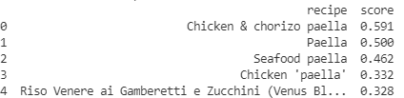
Example for recommended 5 best scores
test_ingredients = "onion, chorizo, chicken thighs, paella rice, frozen peas, prawns"

Slide 17
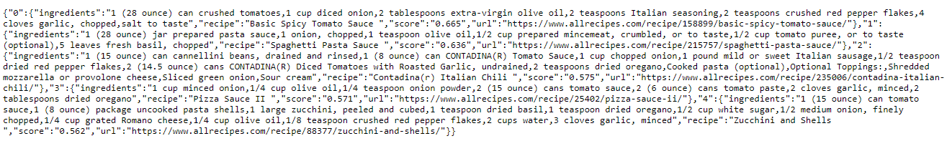
Develop web app
First deployment using FLASK to practice API:
run in http://127.0.0.1:5000/recipe?ingredients=%20pasta%20tomato%20onion

Slide 18

Develop web app using streamlit
deployment using FLASK it’s ok , but still need improvement that’s we moved to use best tool for data science project tool for deployment Streamlit
Streamlit is a free and open-source framework to rapidly build and share beautiful machine learning and data science web apps
Why should data scientists use Streamlit?
No front-end (html, js, css) experience or knowledge is required.
You don’t need to spend days or months to create a web app, you can create a really beautiful machine learning or data science app in only a few hours or even minutes.
It is compatible with the majority of Python libraries (e.g. pandas, matplotlib, seaborn, plotly, Keras, PyTorch, SymPy(latex)).
Less code is needed to create amazing web apps.

Slide 19
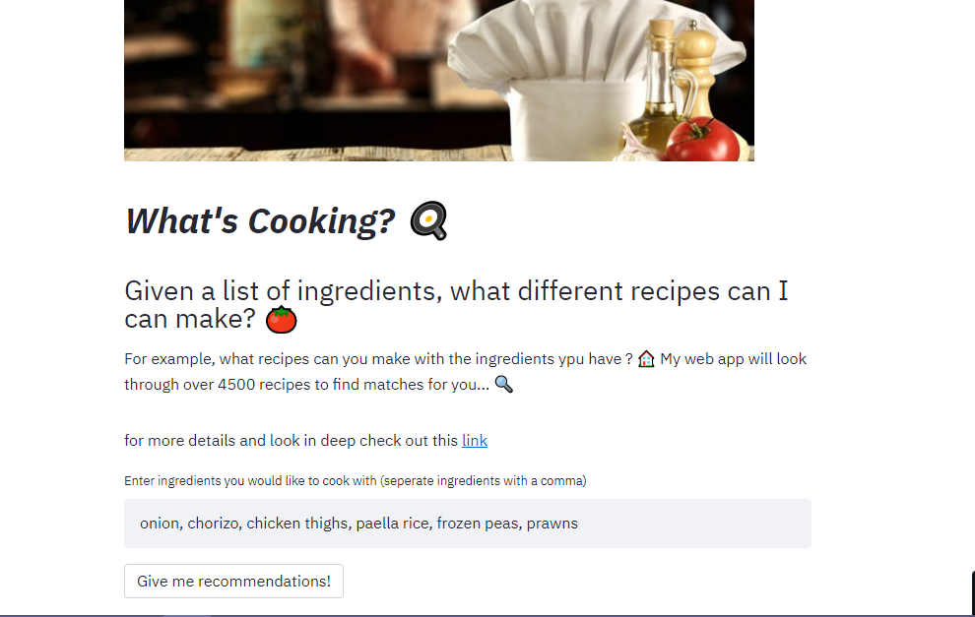
Develop web app using streamlit:
Run locally :
http://localhost:8501

Slide 20
Live Demo
You can try by yourself:
chef_recommendation_sys

Slide 21

Conclusion
We start with scraping data then parsed the HTML using BeautifulSoup, then for each recipe webpage we looped through the soup object to extract the relevant information.
Then we cleaning ingredients
Build content based recommendation sys
Finally develop web app with friendly interface to use fron final user
Improvements :
Use another Embedding method such as word2vec
Try another distance measure
Happy

Slide 22
Resources :
https://jackmleitch.medium.com/using-beautifulsoup-to-help-make-beautiful-soups-d2670a1d1d52
https://towardsdatascience.com/building-a-recipe-recommendation-api-using-scikit-learn-nltk-docker-flask-and-heroku-bfc6c4bdd2d4
https://towardsdatascience.com/building-a-recipe-recommendation-system-297c229dda7b
https://www.datacamp.com/community/tutorials/streamlit
https://stevenkyle2013.medium.com/quick-intro-into-web-scraping-with-python-using-beautifulsoup-5ad319846168

Slide 23


