Slide 1
Hardware Software Platforms Project Presentation
Servomotor (Write)
DUVIVIER.HUGO@student.umons.ac.be
DETRAIT.ROMAIN@student.umons.ac.be
WALID.KAMECHE@student.umons.ac.be.

Slide 2
Content
Aim of the project
Tools
Programming language
Servo protocol: context
Create driver [H]
Create testbench [H]
Simulation [H]
Program the FPGA [S]
Program the Processor HPS PS ARM [S]
Execution
Servo (Write) - Duvivier Hugo

Slide 3
Aim of the project/tools
Create a tutorial based on a known development environment and target platform
We use:
Altera Quartus (version 18.1 lite) EDA tool
Intel Altera SoC Qsys Platform designer
DE1/DE0 nano SoC development kits
to interact with the peripheral (servo) through a hardware driver.
Servo (Write) - Duvivier Hugo

Slide 4
Tools
Intel Altera SoC Qsys Development Environment allows the creation of hardware/software development → Combination of a processor (software) and a reconfigurable circuit (templates/examples: https://moodle.umons.ac.be/mod/resource/view.php?id=189534)
https://www.intel.ca/content/www/ca/en/software/programmable/quartus-prime/download.html (download Intel Quartus 18.1 Lite) When you install Quartus, you must select the device Cyclone V
Servo (Write) - Duvivier Hugo

Slide 5
Tools
ModelSim is needed for simulations. It is available when Quartus is installed
Monitor is also needed to develop software for the processor. We will use the Linux OS which is installed on the SD card
https://www.intel.com/content/www/us/en/software-kit/665987/intel-quartus-prime-standard-edition-design-software-version-18-1-for-windows.html (software tools to compile C program)
Servo (Write) - Duvivier Hugo

Slide 6
Programming language
VHDL is a hardware description language to represent the behaviour and architecture of a digital electronic system. Its full name is VHSIC Hardware Description Language.
The hardware driver is in VHDL.
Servo (Write) - Duvivier Hugo

Slide 7
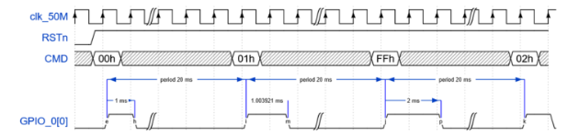
Servo protocol: context
Clock 50MHz RSTn reset low
CMD command duration range 0 to 255 (0 to 1ms) 8-bit data input register
GPIO output pin
Servo (Write) - Duvivier Hugo

Slide 8
[H]Create Driver
Create a new VHDL file (Driver)
Create the entity, architecture and ports.
We need two 7-bit I/O ports (to connect to the HPS PIO external connection registers of the processor), a clock and reset signals
We will drive the GPIOs of the board
Servo (Write) - Duvivier Hugo

Slide 9
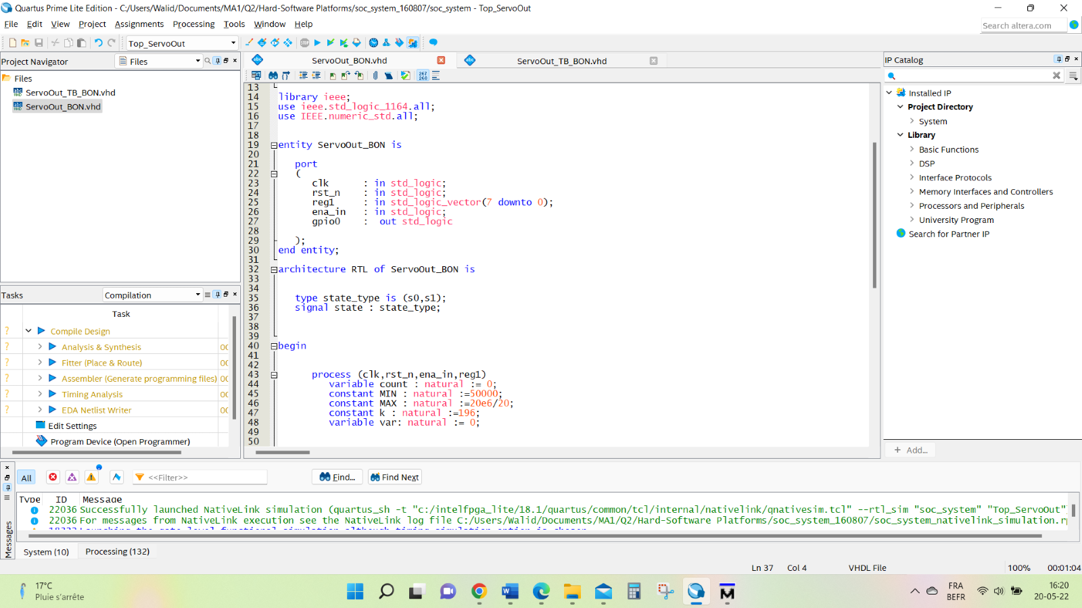
Driver (code)
Servo (Write) - Duvivier Hugo

Slide 10
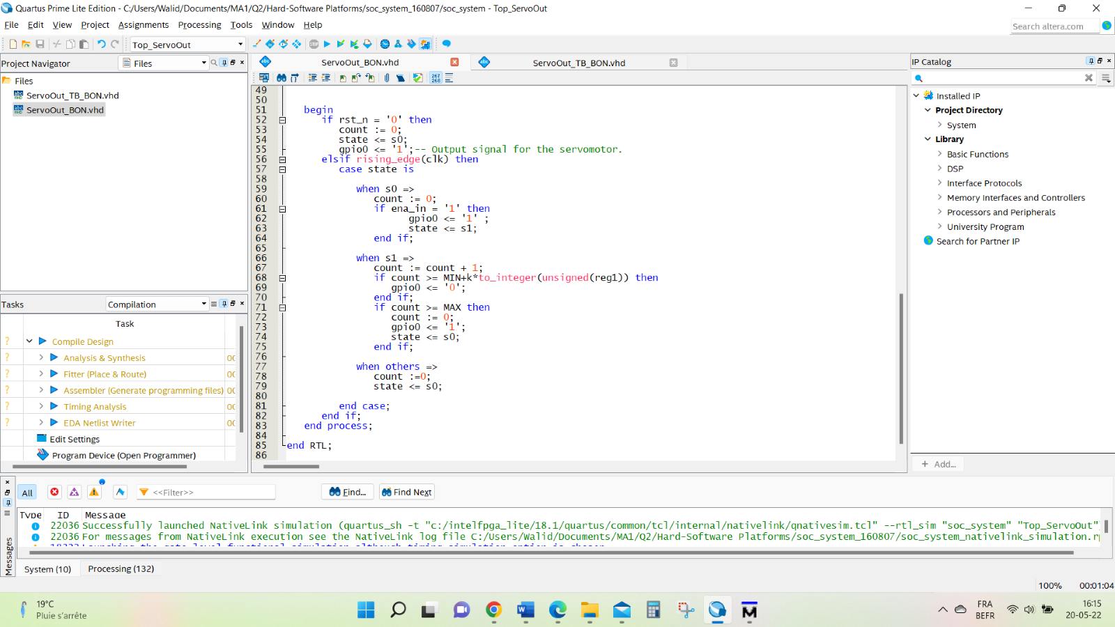
Driver (code)
Servo (Write) - Duvivier Hugo

Slide 11
Create Testbench
The testbench is used to check that our VHDL code is correct and does what we want
Create new VHDL file (Driver_TB)
To be considered as a Testbench, just change the property: right click on the Project Navigator > Drive_TB>Properties> VHDL Test bench
Create the input signals with a default value, the clock and reset signals
000000001 for 1 and 11111111 for 255
Servo (Write) - Duvivier Hugo

Slide 12
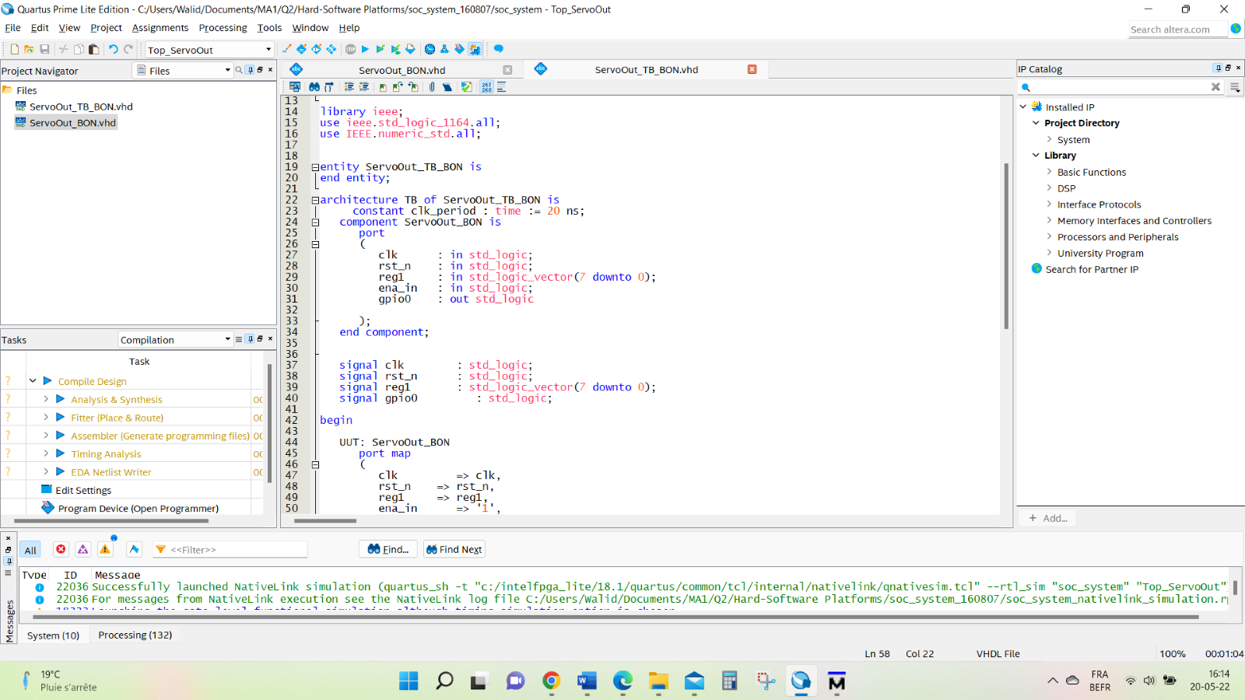
Create testbench
Servo (Write) - Duvivier Hugo

Slide 13
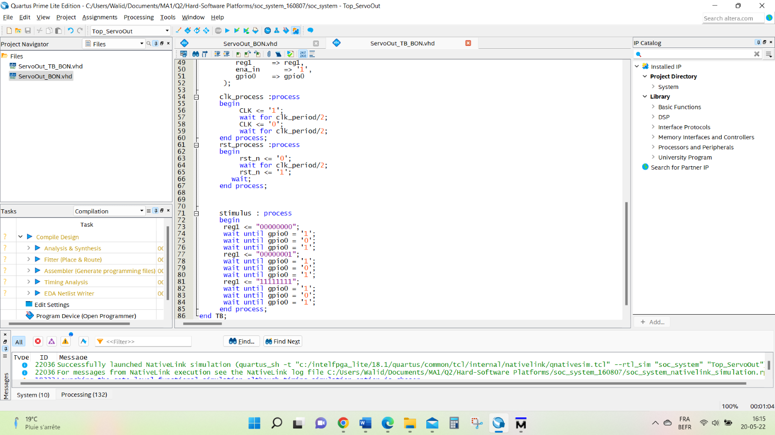
Create testbench
Servo (Write) - Duvivier Hugo

Slide 14
Simulation
Now, you can test the Driver using the Testbench → Assignments> Settings
and add the test bench you created as the file to be used for simulation
Servo (Write) - Duvivier Hugo

Slide 15
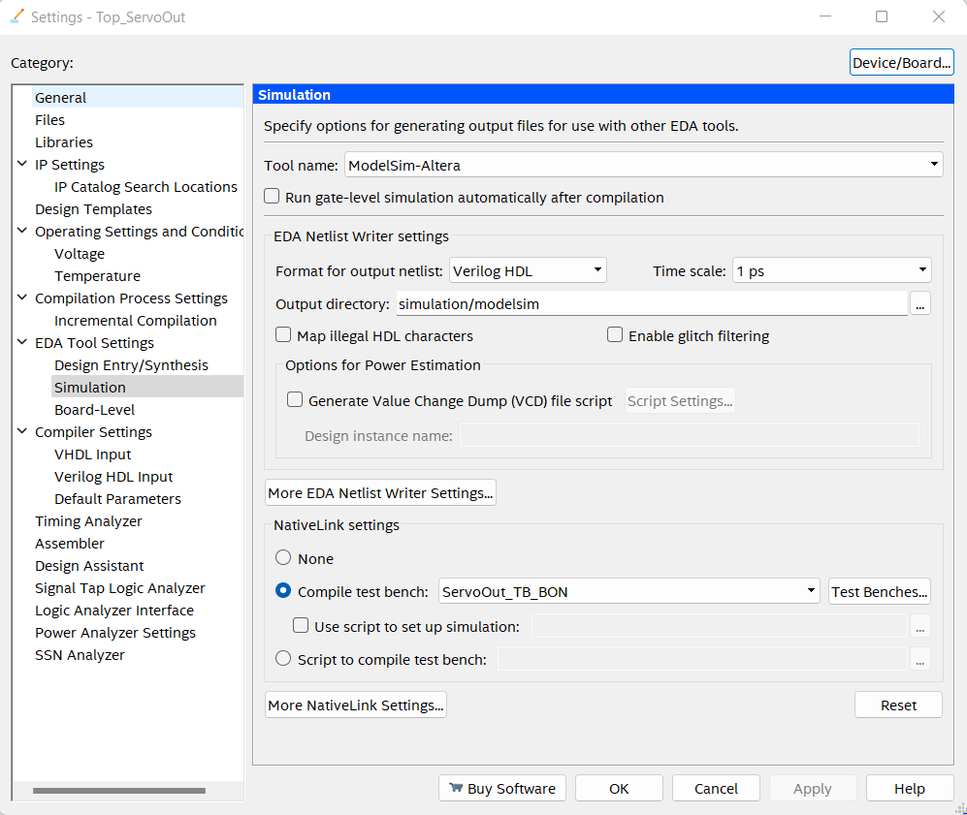
Simulation
Servo (Write) - Duvivier Hugo

Slide 16
Simulation
Run the simulation to see if your module is working correctly
With ModelSim, you could see the expected results (1ms for the first (0), 2ms for the last (255) and finally the 20ms period for the clock)
We go from 1 to 2 ms because it is the limit given in the datasheet of the servomotor (we may use the cursors)
Servo (Write) - Duvivier Hugo

Slide 17
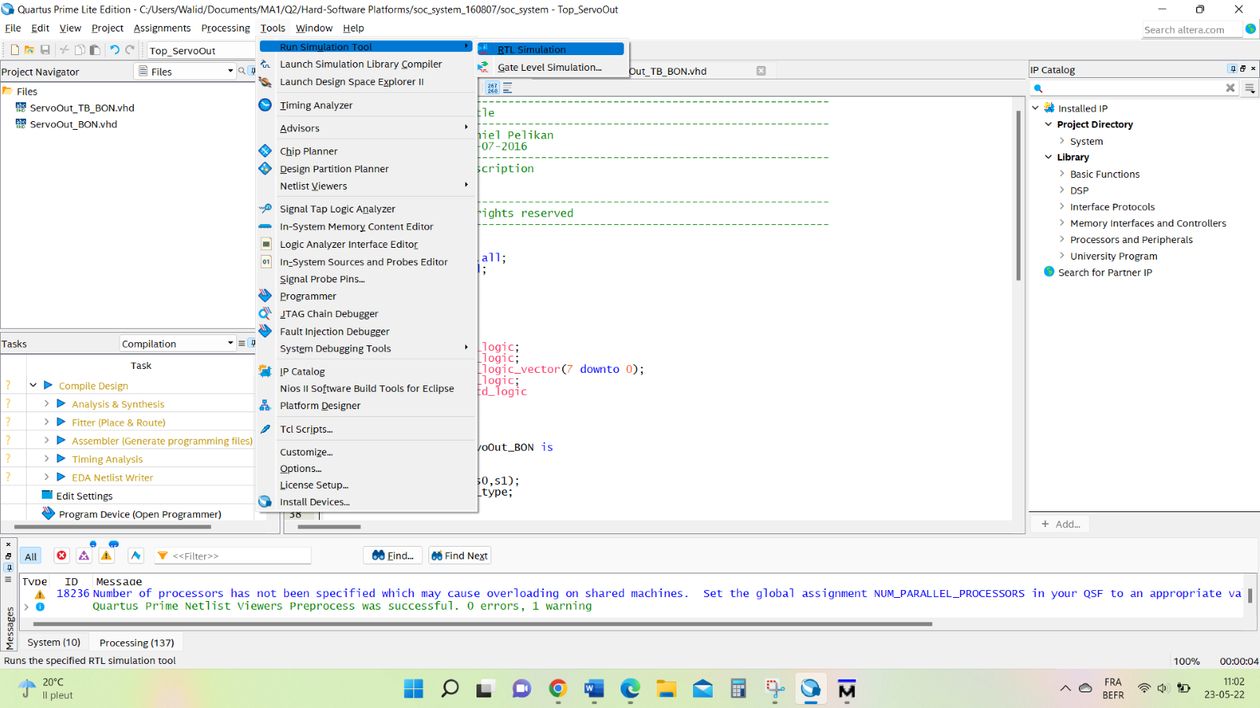
Simulation
Servo (Write) - Duvivier Hugo

Slide 18
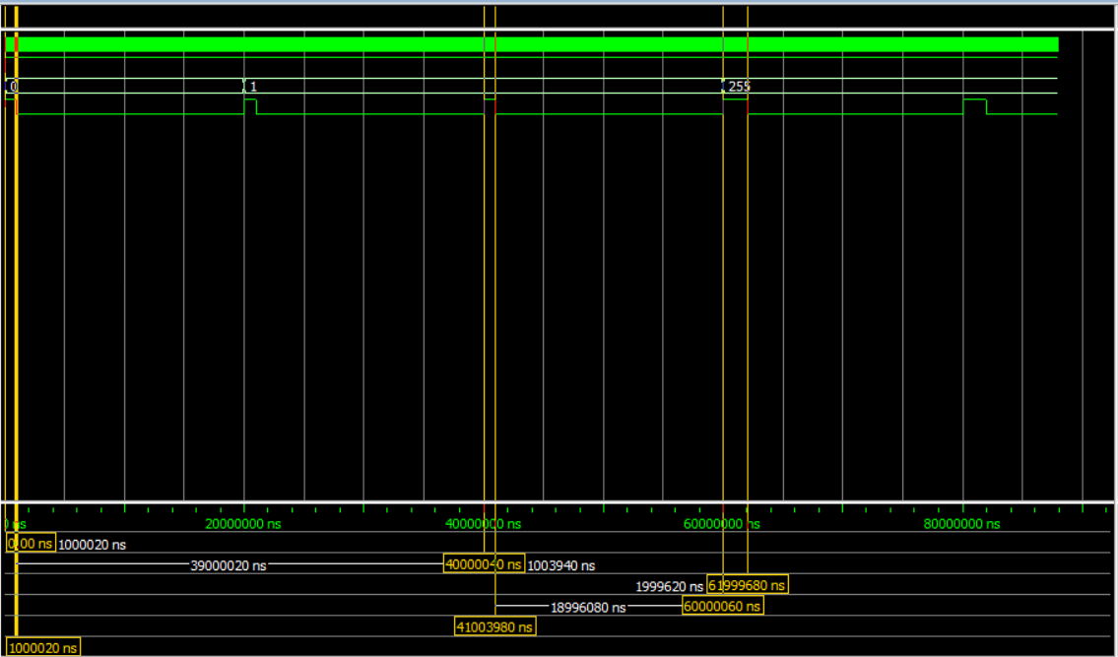
Simulation
Servo (Write) - Duvivier Hugo

Slide 19
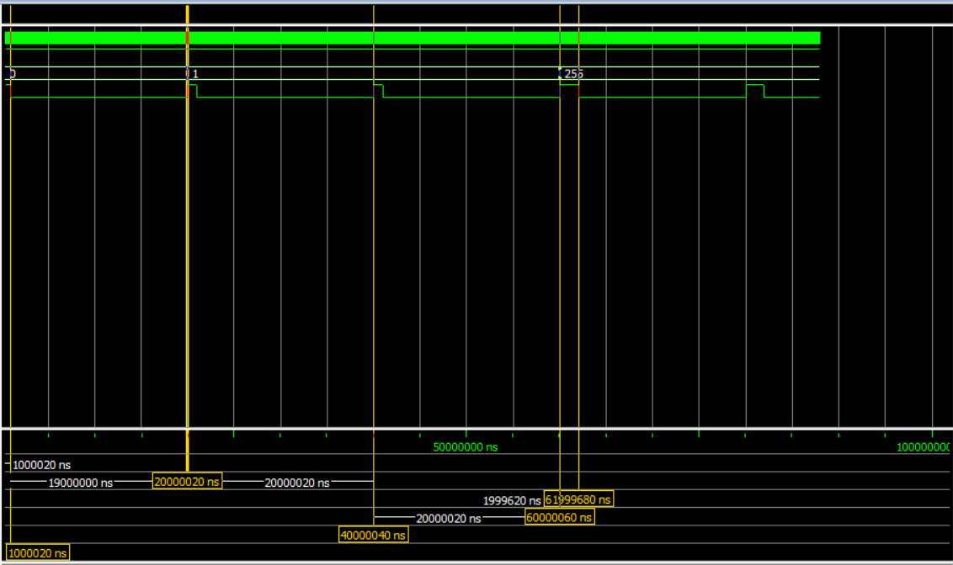
Simulation
Servo (Write) - Duvivier Hugo

Slide 20
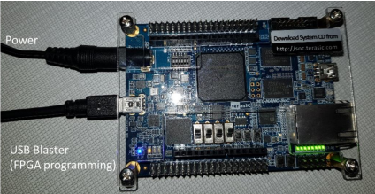
[S]Program the FPGA
First you need to connect your FPGA to the alimentation and the USB blaster (for FPGA programming) to the USB port of your PC:
Servo (Write) - Duvivier Hugo

Slide 21
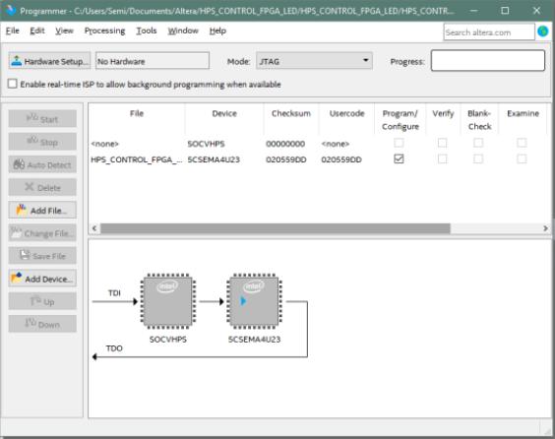
Program the FPGA
To program the FPGA just click on Tools/Programmer, when the project is open in Quartus. This will open the tool to program the FPGA:
Servo (Write) - Duvivier Hugo

Slide 22
Program the FPGA
If you don’t see the FPGA (Hardware setup), click on Hardware Setup and you should be able to see it and add it.
To program the FPGA you need to open the programming file soc_system.sof. (click on Add File and select the file)
To program the FPGA, now just click the Start button. If the programming is correct, you will see the message 100% successful.
Servo (Write) - Duvivier Hugo

Slide 23
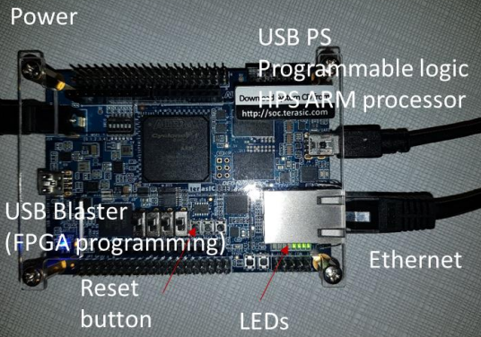
Program the Processor HPS PS ARM
To program the processor you need to transfer your application program to your home directory in Linux. To login, you can do it using a USB port connected to your PC (Serial Terminal using Putty) or the Ethernet cable (SSH Terminal using Putty). You also need the IP address. For that, just connect another USB port (at the opposite site of your board) to your PC.
Servo (Write) - Duvivier Hugo

Slide 24
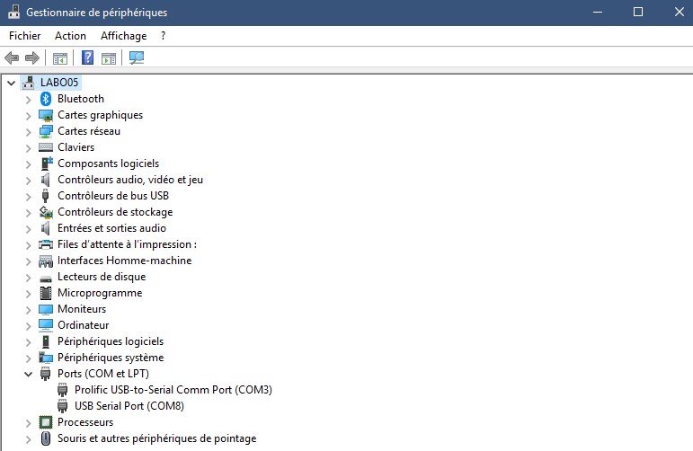
Program the Processor HPS PS ARM
To see the port just start Gestionaire de Peripheriques (on windows) and see the ports (see the port name available COMXXX)
Servo (Write) - Duvivier Hugo

Slide 25
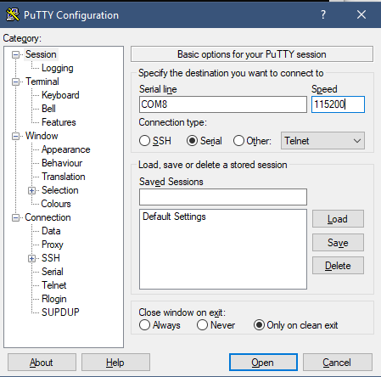
Program the Processor HPS PS ARM
Then you can start Putty, Serial, Port name COMXXX, and baudrate 115200, and click Open.
Servo (Write) - Duvivier Hugo

Slide 26
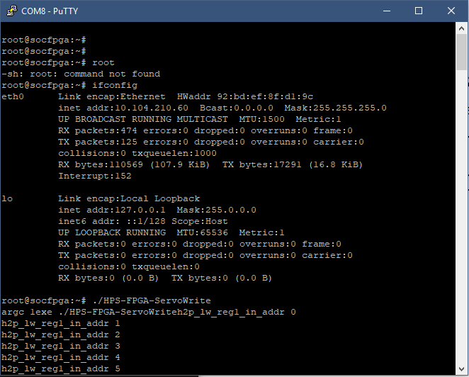
Putty
Type ENTER several times on the terminal to see the login. If the login doesn’t appear, then press the reset button on the board and you will see the Linux reset then the login. In our case, we will login as root (password terasic, but it is not needed in Serial mode).
Servo (Write) - Duvivier Hugo

Slide 27
Putty
As you have the Ethernet cable connected to the board, you can now get the IP address by typing ifconfig. With that IP address, you can create an SSH connection login to transfer your application program to that address.
Servo (Write) - Duvivier Hugo

Slide 28
If your application program is not available (check the files using ls), we will need to copy the executable using ssh copy. For that we will use the SoC EDS shell. Just start EDS:
Access the directory where the code is.
Type make to see if you need to compile the program (sometimes the source code was modified and the executable must be updated). If the program is already updated, make will show the message "Nothing to be done". Otherwise, the make will execute and compile the application program for the ARM processor.
Servo (Write) - Duvivier Hugo

Slide 29
When it is done, the executable will be ready to be sent to the board. The generated program is named HPS-FPGA-ServoWrite, (you can see the name by typing cat Makefile and checking the target executable).
Now that you know the IP address of your Linux and you have the executable, just copy the executable to your account on the board by using the command scp ‘nom_d_executable’ root@’adresse_ip’:/home/root. In our case, scp HPS-FPGA-ServoWrite root@10.104.210.60:/home/root.
Servo (Write) - Duvivier Hugo

Slide 30
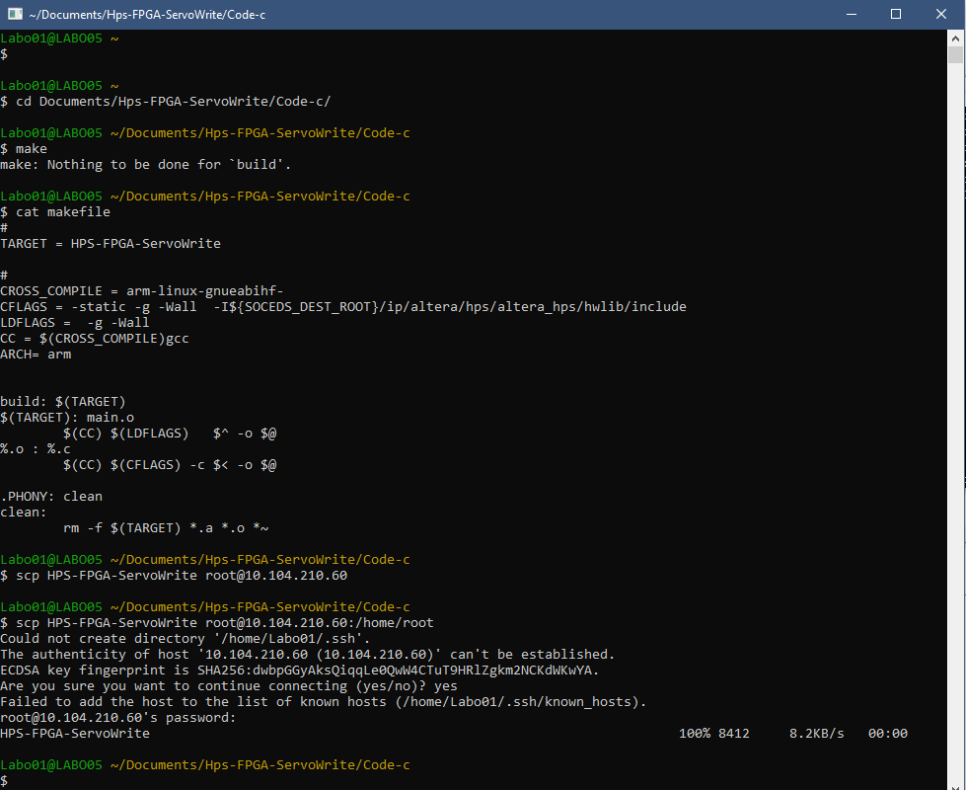
Servo (Write) - Duvivier Hugo

Slide 31
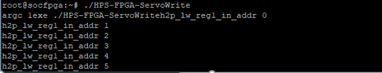
Execution
Once transferred, you can execute the application program. Just type the name of the application program in Putty.
Our application works, the servomotor moves from 0 to 90° according to its datasheet to avoid a breakage.
Servo (Write) - Duvivier Hugo

Slide 32
More informations
You can see more informations in our gitHub: https://github.com/Nouuu13/Servo-protocol-Write
There are all the used codes, explanations and videos to understand and illustrate our project.
Servo (Write) - Duvivier Hugo

Slide 33
Thanks for your attention!
DUVIVIER Hugo
DETRAIT Romain
KAMECHE Walid
Servo (Write) - Duvivier Hugo

